Slide 1
ns-3 Training

Slide 2
Introduction and logistics
CTTC facilities
Meals and coffee
Wi-Fi
Wiki page:
  https://www.nsnam.org/wiki/AnnualTraining2015
Meet your instructors

Slide 3
Monday agenda
Monday
  ns-3 survey and overview tutorial, starting from first principles and walking through the running of simulations, configuration management, architecture of the software core, network emulation, and development practices using ns-3.
  Methodology and workflow for developing new models in ns-3, using a case study.
  Several tools used to extract and visualize data from ns-3 simulations, including the flow monitor,network animator NetAnim, Python-based visualizer, and the ns-3 tracing system.

Slide 4
Tuesday agenda
Tuesday
  (09:00-10:30) Large-scale, distributed simulations with ns-3 (instructor: Peter Barnes)
  (11:00-12:30)An introduction to the Direct Code Execution (DCE) environment, enabling users to use real application and Linux networking code in ns-3 (instructor: Hajime Tazaki)
  Lunch break
  (14:00-16:00) A survey of the LTE models, including model architecture, propagation models, LTE Radio Protocol Stack and EPC model. (instructor: Nicola Baldo)
  16:30-18:00) A tutorial on vehicular communication simulations, including mobility, WiFi and WAVE models, and propagation. (instructor: Konstantinos Katsaros)

Slide 5
Later in the week
WNS3 Wednesday and Thursday morning
ns-3 Consortium Annual Meeting (16h00 Thursday)
Developer meetings Friday

Slide 6
ns-3 training goals
Learn about the project scope, and where to get additional help
Understand the architecture and design goals of the software
Introduce how to write new code for the simulator
Learn about selected topics in more detail
Answer your questions

Slide 7
Motivations for ns-3 project
Develop an extensible simulation environment for networking research
  1) a tool aligned with the experimentation needs of modern networking research
  2) a tool that elevates the technical rigor of network simulation practice
  3) an open-source project that encourages community contribution, peer review, and long-term maintenance and validation of the software

Slide 8
Network performance evaluation options
ns-3 enables researchers to more easily move between simulations, test beds, and experiments
Direct Code
Execution
Emulation
modes
ns-3 core
Test and evaluation options
Pure
simulation
Simulation
cradles
Virtual/Physical
test beds
Field
experiments
Live
networks
Increasing realism
Increasing complexity

Slide 9
ns history
1990
2000
2010
1988: REAL (Keshav)
1990s: ns-1
regular
releases
1996: ns-2
1997-2000: DARPA VINT
2001-04: DARPA SAMAN, NSF CONSER
2006: NSF CISE CRI Awards
Inputs: yans,
GTNetS, ns-2
ns-3 core development (2006-08)
June 2008: ns-3.1
May 2015: ns-3.23

Slide 10
Relationship to ns-2
ns-3 is a new simulator, without backward compatibility
Similarities to ns-2:
C++ software core
GNU GPLv2 licensing
ported ns-2 models: random variables, error models, OLSR, Calendar Queue scheduler
Differences:
Python scripting (or C++ programs) replaces OTcl
most of the core rewritten
new animators, configuration tools, etc. are in work
ns-2 is no longer actively maintained/supported

Slide 11
How the project operates
Project provides three annual software releases
Users interact on mailing lists and using Bugzilla bug tracker
Code may be proposed for merge
  Code reviews occur on a Google site
Maintainers (one for each module) fix or delegate bugs, participate in reviews
Project has been conducting annual workshop and developer meeting around SIMUTools through 2013
  Some additional meetings on ad hoc basis
Google Summer of Code (March-August) six of the past seven summers

Slide 12
Sustainment
The NS-3 Consortium is a collection of organizations cooperating to support and develop the ns-3 software.
It operates in support of the open source project
  by providing a point of contact between industrial members and ns-3 developers,
  by sponsoring events in support of ns-3 such as users' days and workshops,
  by guaranteeing maintenance support for ns-3's core, and
  by supporting administrative activities necessary to conduct a large open source project.

Slide 13
Publications using ns-3
A common question is "How many ns-3 papers are there?
Small survey of 139 paper results from 2013-14 search of IEEE library (top relevant results)
Some papers matched multiple categories
Hot topics:
  LTE/cellular networks (15)
  Wireless routing protocols (14)
  Sensor networks (13)
  Wireless MAC and PHY protocols (11)

Slide 14
Paper counts by topic

Slide 15










Acknowledgment of support

Slide 16
Software overview

Slide 17
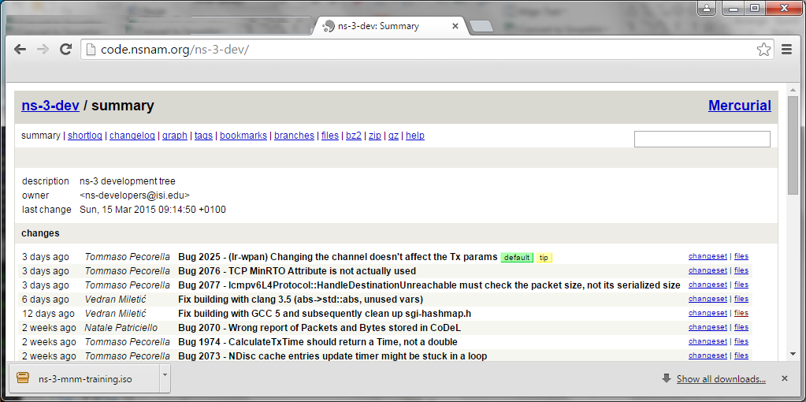
Options for working along
1) Download the required packages onto your (Linux, OS X, or BSD) system
2) Download or copy the ISO image (Live DVD)
3) Browse the code online: https://code.nsnam.org

Slide 18
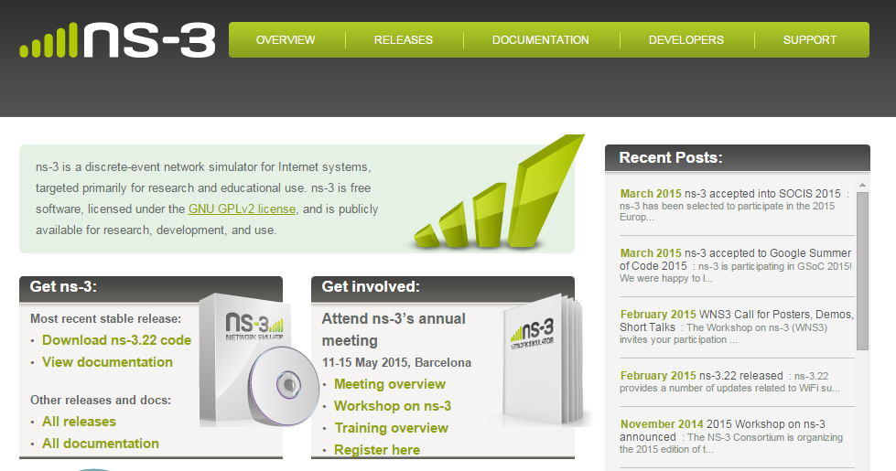
ns-3 main website
Project home: https://www.nsnam.org

Slide 19
Software overview
ns-3 is written in C++, with bindings available for Python
  simulation programs are C++ executables or Python programs
  ~350,000 lines of C++ (estimate based on cloc source code analysis)
ns-3 is a GNU GPLv2-licensed project
ns-3 is mainly supported for Linux, OS X, and FreeBSD
  Windows Visual Studio port available
ns-3 is not backwards-compatible with ns-2

Slide 20
Discrete-event simulation basics
Simulation time moves in discrete jumps from event to event
C++ functions schedule events to occur at specific simulation times
A simulation scheduler orders the event execution
Simulation::Run() executes a single-threaded event list
Simulation stops at specific time or when events end

Slide 21
The basic ns-3 architecture
Application
Application
Application
Application
Sockets-like
API
Protocol
stack
Protocol
stack
Packet(s)‏
Node
Node
NetDevice
NetDevice
NetDevice
Channel
NetDevice
Channel

Slide 22
Software orientation
Key differences from other network simulators:
1) Command-line, Unix orientation
  vs. Integrated Development Environment (IDE)
2) Simulations and models written directly in C++ and Python
  vs. a domain-specific simulation language

Slide 23
Software organization
Two levels of ns-3 software and libraries
1) Several supporting libraries, not system-installed, can be in parallel to ns-3
Netanim
pybindgen
Click routing
ns-3
2) ns-3 modules exist
within the ns-3 directory
module
module
module
module
module
module

Slide 24
Current models
utilities
devices
protocols
visualizer
bridge
mesh
config-
store
applications
aodv
Node class
NetDevice ABC
Address types
(Ipv4, MAC, etc.)
Queues
Socket ABC
Ipv4 ABCs
Packet sockets
csma
spectrum
internet
(IPv4/v6)
dsdv
flow-monitor
energy
emu
Packets
Packet Tags
Packet Headers
Pcap/ascii file writing
tap-bridge
olsr
netanim
mpi
point-to-
point
uan
click
stats
Smart pointers
Dynamic types
Attributes
Callbacks
Tracing
Logging
Random Variables
mobility
virtual-
net-device
network
nix-vector-
routing
topology-
read
lte
Events
Scheduler
Time arithmetic
propagation
lr-wpan
wifi
core
openflow
BRITE
wimax
24

Slide 25
Module organization
models/
examples/
tests/
bindings/
doc/
wscript

Slide 26
ns-3 programs
ns-3 programs are C++ executables that link the needed shared libraries
  or Python programs that import the needed modules
The ns-3 build tool, called 'waf', can be used to run programs
waf will place headers, object files, libraries, and executables in a 'build' directory

Slide 27
Python bindings
ns-3 uses a program called PyBindGen to generate Python bindings for all libraries
v
v
v
v
C++
header
Intermediate
Python
program
C++
bindings
code
Python
module
(py)gccxml
PyBindGen
C++ compiler

Slide 28
Integrating other tools and libraries

Slide 29
Other libraries
more sophisticated scenarios and models typically leverage other libraries
ns-3 main distribution uses optional libraries (libxml2, gsl, mysql) but care is taken to avoid strict build dependencies
the 'bake' tool (described later) helps to manage library dependencies
users are free to write their own Makefiles or wscripts to do something special

Slide 30
Gnuplot
src/tools/gnuplot.{cc,h}
C++ wrapper around gnuplot
classes:
  Gnuplot
  GnuplotDataset
    Gnuplot2dDataset, Gnuplot2dFunction
    Gnuplot3dDataset, Gnuplot3dFunction

Slide 31
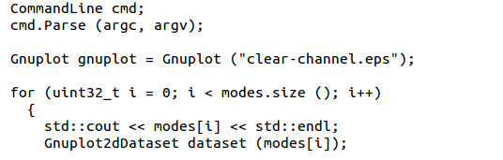

Enabling gnuplot for your code
examples/wireless/wifi-clear-channel-cmu.cc
produce a plot file that
will generate an EPS figure
one dataset per mode
Add data to dataset
Add dataset to plot

Slide 32
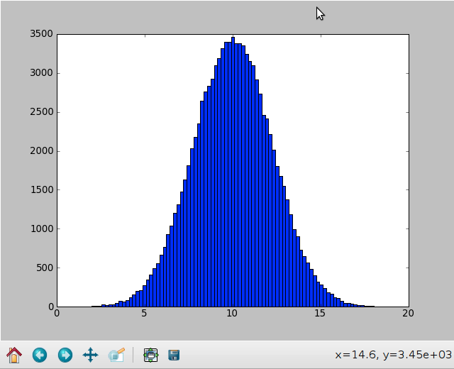
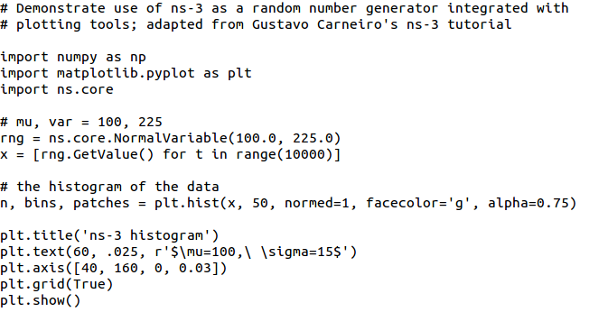
Matplotlib
src/core/examples/sample-rng-plot.py

Slide 33
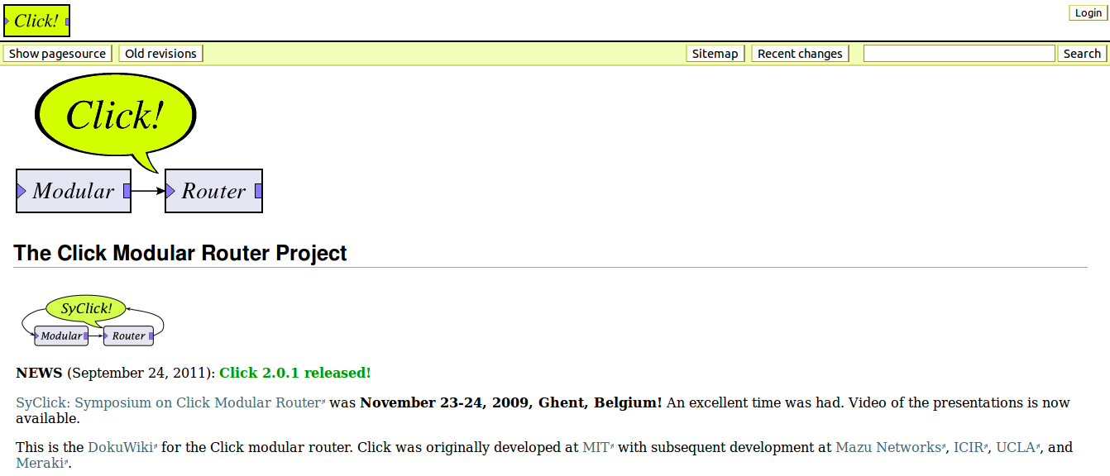
Click Modular Router

Slide 34
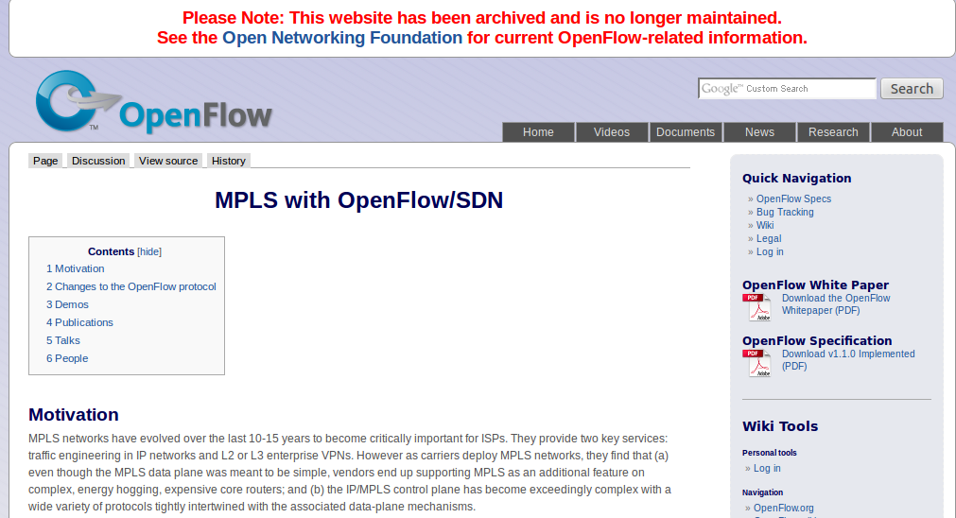
OpenFlow Switch

Slide 35
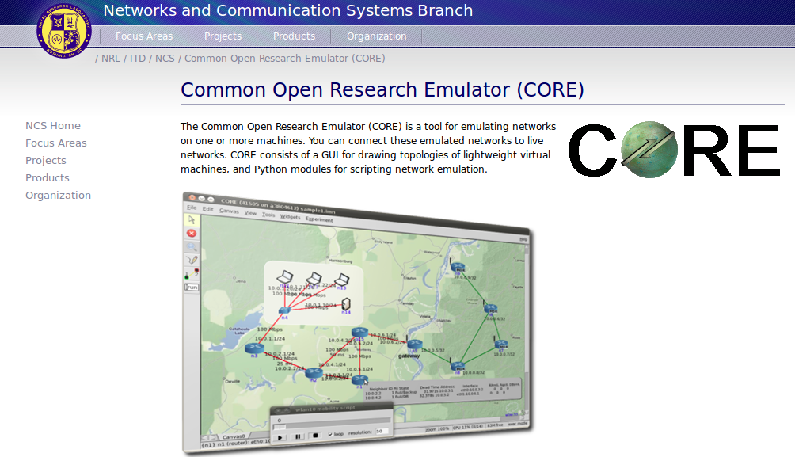
CORE emulator

Slide 36
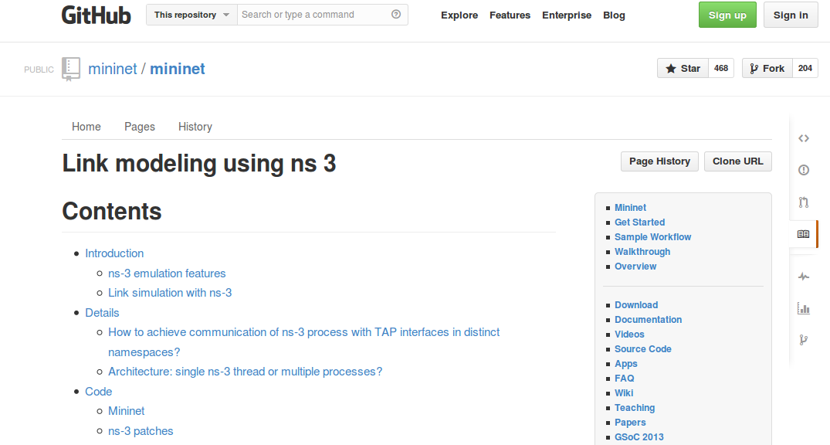
mininet emulator

Slide 37
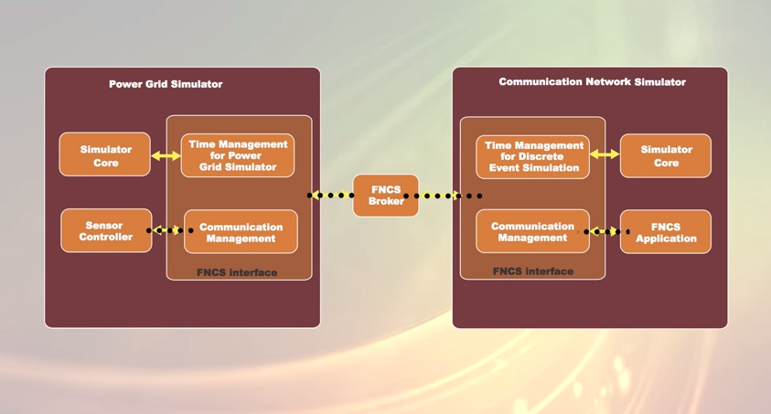
Co-simulation frameworks have emerged
PNNL's FNCS framework integrates ns-3 with transmission and distribution simulators
Image source: PNNLgov YouTube video:
Introducing FNCS: Framework for Network Co-Simulation

Slide 38
FAQs
Does ns-3 have a Windows version?
  Yes, for Visual Studio 2012
  http://www.nsnam.org/wiki/Ns-3_on_Visual_Studio_2012
Does ns-3 support Eclipse or other IDEs?
  Instructions have been contributed by users
  http://www.nsnam.org/wiki/HOWTO_configure_Eclipse_with_ns-3
Is ns-3 provided in Linux or OS X package systems (e.g. Debian packages)?
  Ubuntu/Debian packages for ns-3.17 release
Does ns-3 support NRL protolib applications?
  Not yet

Slide 39
Summarizing
ns-3 models are written in C++ and compiled into libraries
  Python bindings are optionally created
ns-3 programs are C++ executables or Python programs that call the ns-3 public API and can call other libraries
ns-3 is oriented towards the command-line
ns-3 uses no domain specific language
ns-3 is not compatible with ns-2

Slide 40
Finding documentation and code

Slide 41
Resources
Web site:
  http://www.nsnam.org
Mailing lists:
  https://groups.google.com/forum/#!forum/ns-3-users
  http://mailman.isi.edu/mailman/listinfo/ns-developers
Wiki:
  http://www.nsnam.org/wiki/
Tutorial:
  http://www.nsnam.org/docs/tutorial/tutorial.html
IRC: #ns-3 at freenode.net

Slide 42
Suggested steps
Work through the ns-3 tutorial
Browse the source code and other project documentation
  manual, model library, Doxygen, wiki
  ns-3 Consortium tutorials (May 2014)
    https://www.nsnam.org/consortium/activities/training/
Ask on ns-3-users mailing list if you still have questions
  We try to answer most questions

Slide 43
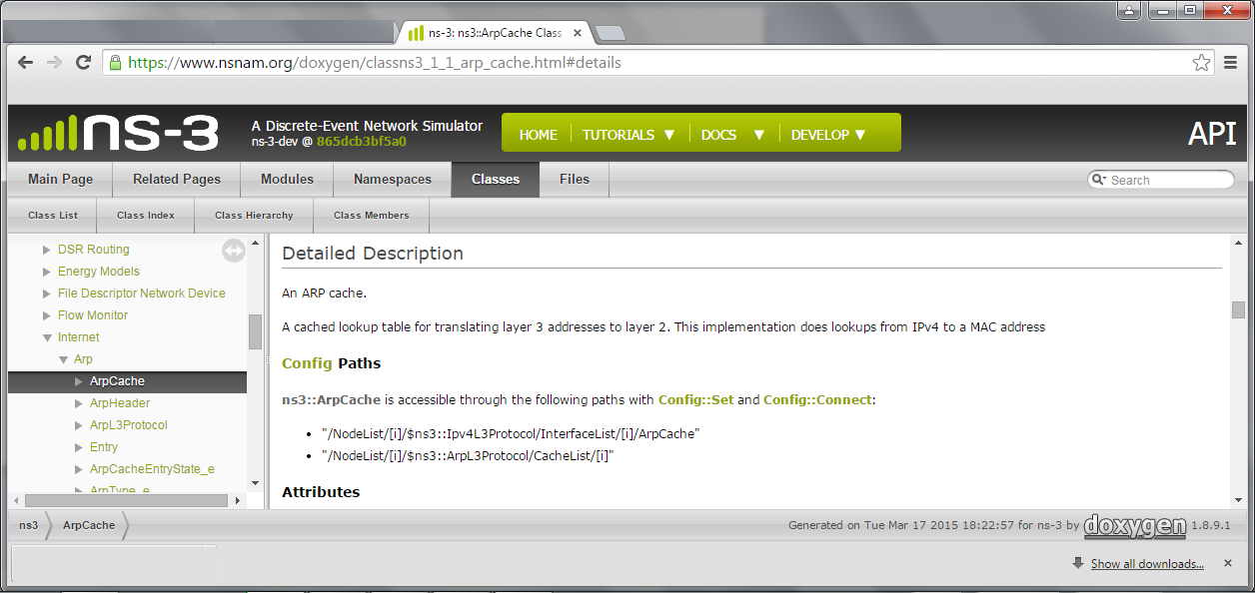
APIs
Most of the ns-3 API is documented with Doxygen
  https://www.nsnam.org/doxygen

Slide 44
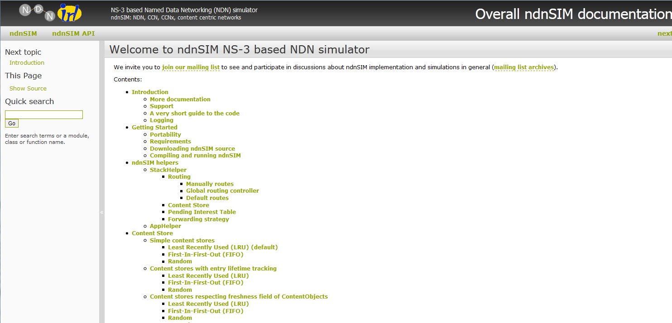
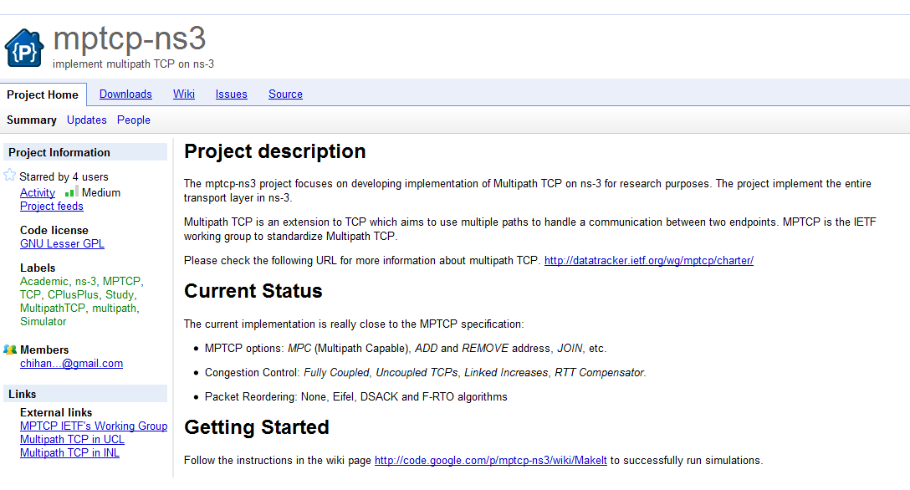
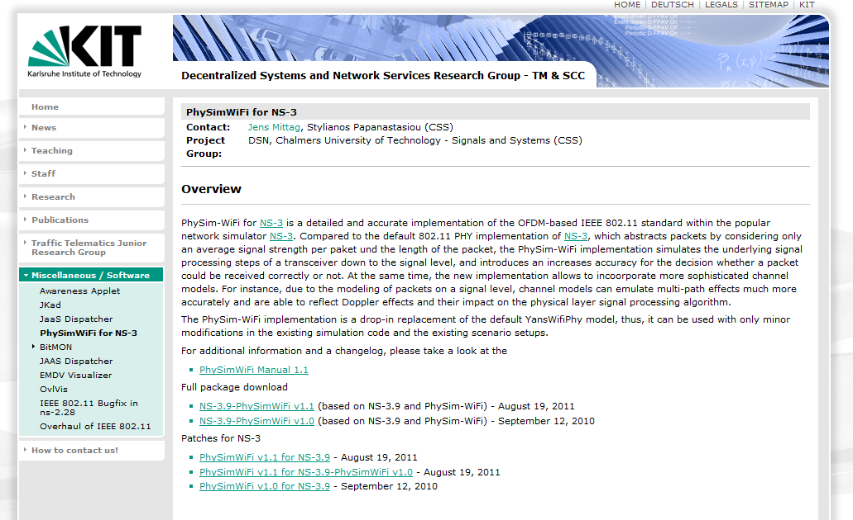
Contributed code and associated projects

Slide 45
Reading existing code
Much insight can be gained from reading ns-3 examples and tests, and running them yourselves
Many core features of ns-3 are only demonstrated in the core test suite (src/core/test)
Stepping through code with a debugger is informative
  callbacks and templates make it more challenging than usual

Slide 46
ns-3 build systems

Slide 47
Software introduction
Download the latest release
  wget http://www.nsnam.org/releases/ns-allinone-3.19.tar.bz2
  tar xjf ns-allinone-3.19.tar.bz2
Clone the latest development code
  hg clone http://code.nsnam.org/ns-3-allinone
Q. What is "hg clone"?
A. Mercurial (http://www.selenic.com) is our source code control tool.

Slide 48
Software building
Two levels of ns-3 build
1) bake (a Python-based build system to control an ordered build of
ns-3 and its libraries)
Network
Simulation
Cradle
pybindgen
click routing
ns-3
2) waf, a build system written in Python
module
module
module
module
module
module
3) build.py (a custom Python build script to control an ordered build of
ns-3 and its libraries) <--- may eventually be deprecated

Slide 49
ns-3 uses the 'waf' build system
Waf is a Python-based framework for configuring, compiling and installing applications.
  It is a replacement for other tools such as Autotools, Scons, CMake or Ant
  http://code.google.com/p/waf/
For those familiar with autotools:
configure ./waf configure
make ./waf build

Slide 50
waf configuration
Key waf configuration examples
  ./waf configure
    --enable-examples
    --enable-tests
    --disable-python
    --enable-modules
Whenever build scripts change, need to reconfigure
Demo: ./waf --help
./waf configure --enable-examples --enable-tests --enable-modules='core'
Look at: build/c4che/_cache.py

Slide 51
wscript example
## -*- Mode: python; py-indent-offset: 4; indent-tabs-mode: nil; coding: utf-8; -*-
def build(bld):
obj = bld.create_ns3_module('csma', ['network', 'applications'])
obj.source = [
'model/backoff.cc',
'model/csma-net-device.cc',
'model/csma-channel.cc',
'helper/csma-helper.cc',
]
headers = bld.new_task_gen(features=['ns3header'])
headers.module = 'csma'
headers.source = [
'model/backoff.h',
'model/csma-net-device.h',
'model/csma-channel.h',
'helper/csma-helper.h',
]
if bld.env['ENABLE_EXAMPLES']:
bld.add_subdirs('examples')
bld.ns3_python_bindings()

Slide 52
waf build
Once project is configured, can build via ./waf build or ./waf
waf will build in parallel on multiple cores
waf displays modules built at end of build
Demo: ./waf build
Look at: build/ libraries and executables

Slide 53
Running programs
./waf shell provides a special shell for running programs
  Sets key environment variables
  ./waf --run sample-simulator
  ./waf --pyrun src/core/examples/sample-simulator.py

Slide 54
Build variations
Configuring a build type is done at waf configuration time
debug build (default): all asserts and debugging code enabled
  ./waf -d debug configure
optimized
  ./waf -d optimized configure
static libraries
  ./waf --enable-static configure

Slide 55
Controlling the modular build
One way to disable modules:
  ./waf configure --enable-modules='a','b','c'
The .ns3rc file (found in utils/ directory) can be used to control the modules built
Precedence in controlling build
  1) command line arguments
  2) .ns3rc in ns-3 top level directory
  3) .ns3rc in user's home directory
Demo how .ns3rc works

Slide 56
Building without wscript
The scratch/ directory can be used to build programs without wscripts
Demo how programs can be built without wscripts

Slide 57
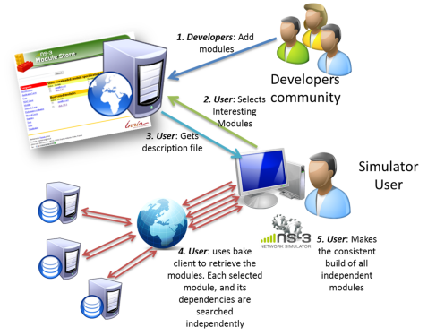
bake overview
Open source project maintains a (more stable) core
Models migrate to a more federated development process
"bake" tool (Lacage and Camara)
Components:
build client
"module store" server
module metadata
Figure source: Daniel Camara

Slide 58
bake basics
bake can be used to build the Python bindings toolchain, Direct Code Execution, Network Simulation Cradle, etc.
Manual available at https://www.nsnam.org/docs/bake/tutorial/html/index.html
./bake.py configure -e <module>
./bake.py show
./bake.py download
./bake.py build

Slide 59
Placeholder slide for demoing bake
Demo: ./waf build
Look at: build/ libraries and executables

Slide 60
Visualization

Slide 61
PyViz overview
Developed by Gustavo Carneiro
Live simulation visualizer (no trace files)
Useful for debugging
  mobility model behavior
  where are packets being dropped?
Built-in interactive Python console to debug the state of running objects
Works with Python and C++ programs

Slide 62
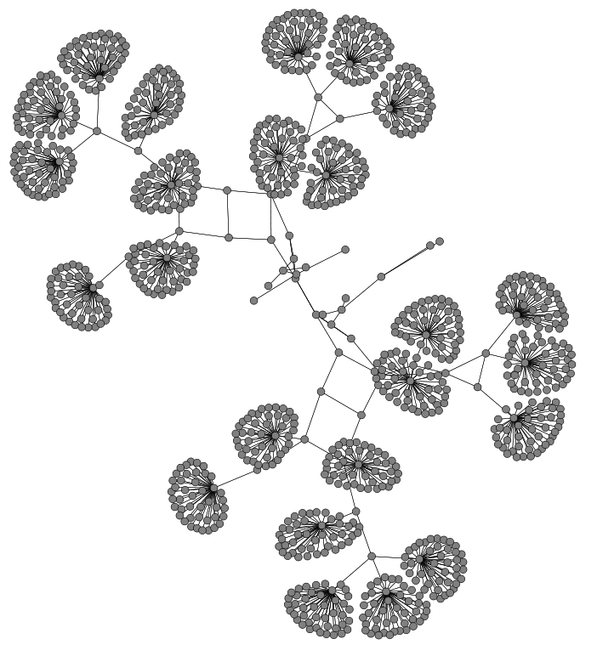
Pyviz screenshot (Graphviz layout)

Slide 63
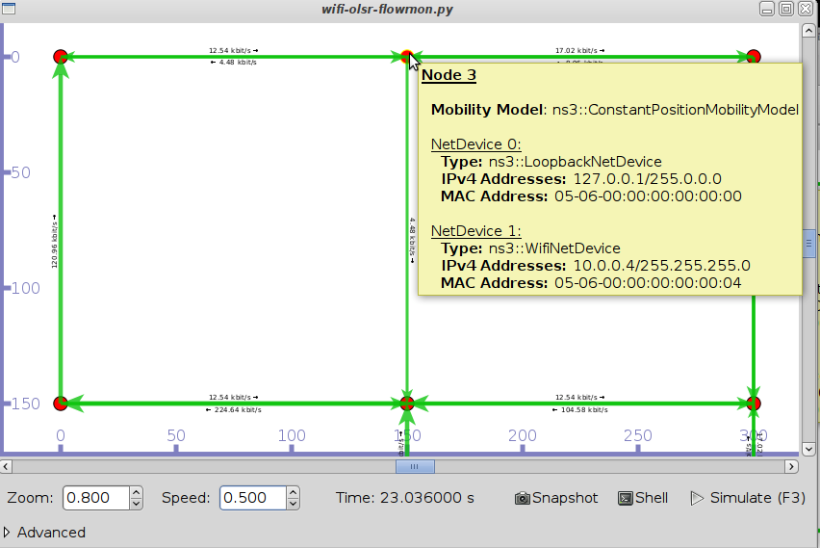
Pyviz and FlowMonitor
src/flow-monitor/examples/wifi-olsr-flowmon.py

Slide 64

Enabling PyViz in your simulations
Make sure PyViz is enabled in the build
If program supports CommandLine parsing, pass the option
  --SimulatorImplementationType=
  ns3::VisualSimulatorImpl
Alternatively, pass the "--vis" option

Slide 65
FlowMonitor
Network monitoring framework found in src/flow-monitor/
Goals:
  detect all flows passing through network
  stores metrics for analysis such as bitrates, duration, delays, packet sizes, packet loss ratios
G. Carneiro, P. Fortuna, M. Ricardo, "FlowMonitor-- a network monitoring framework
for the Network Simulator ns-3," Proceedings of NSTools 2009.

Slide 66
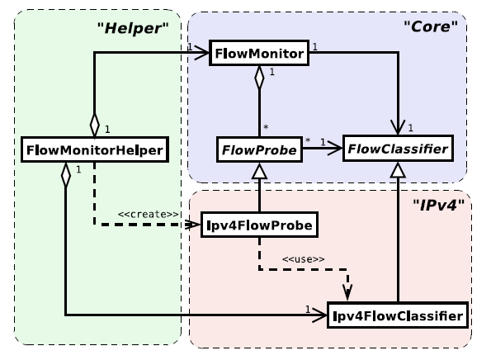
FlowMonitor architecture
Basic classes
  FlowMonitor
  FlowProbe
  FlowClassifier
  FlowMonitorHelper
IPv6 coming in
ns-3.20 release
Figure credit: G. Carneiro, P. Fortuna, M. Ricardo, "FlowMonitor-- a network monitoring
framework for the Network Simulator ns-3," Proceedings of NSTools 2009.

Slide 67
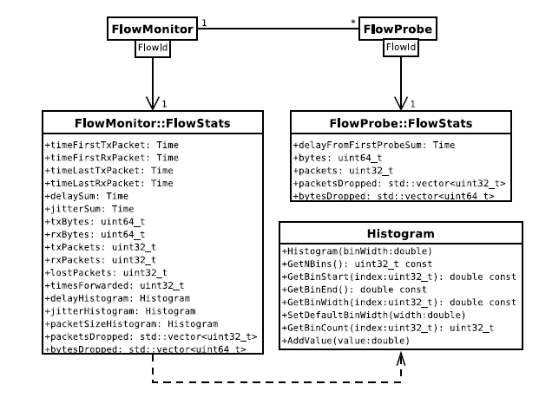
FlowMonitor statistics
Statistics gathered

Slide 68
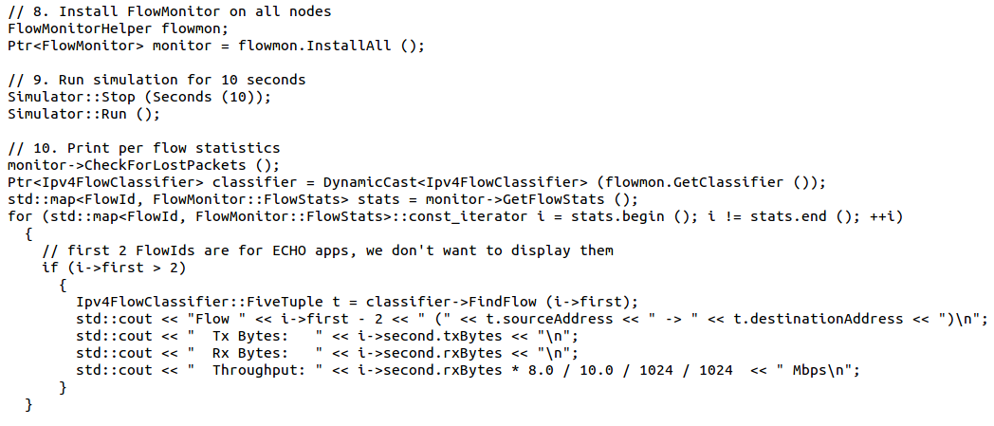
FlowMonitor configuration
example/wireless/wifi-hidden-terminal.cc

Slide 69
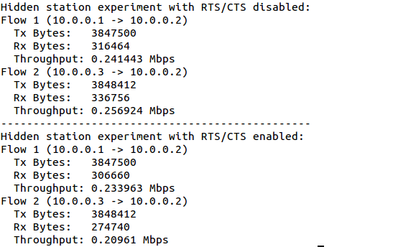
FlowMonitor output
This program exports statistics to stdout
Other examples integrate with PyViz

Slide 70
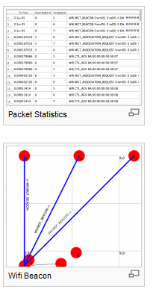
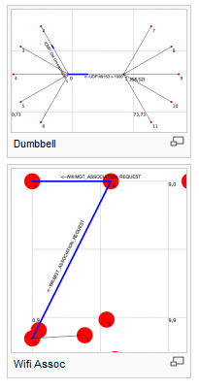
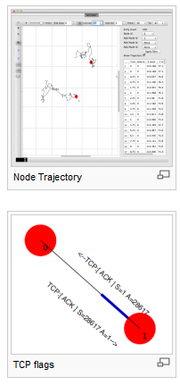
NetAnim
"NetAnim" by George Riley and John Abraham
pyviz

Slide 71
NetAnim key features
Animate packets over wired-links and wireless-links
  limited support for LTE traces
Packet timeline with regex filter on packet meta-data.
Node position statistics with node trajectory plotting (path of a mobile node).
Print brief packet-meta data on packets

Slide 72
Placeholder for netanim videos

