Slide 1
ns-3 Training

Slide 2
Simulator core

Slide 3
Simulator core
Simulation time
Events
Simulator and Scheduler
Command line arguments
Random variables

Slide 4
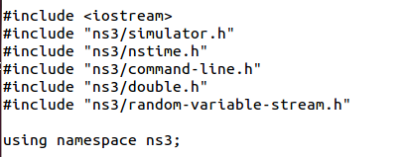
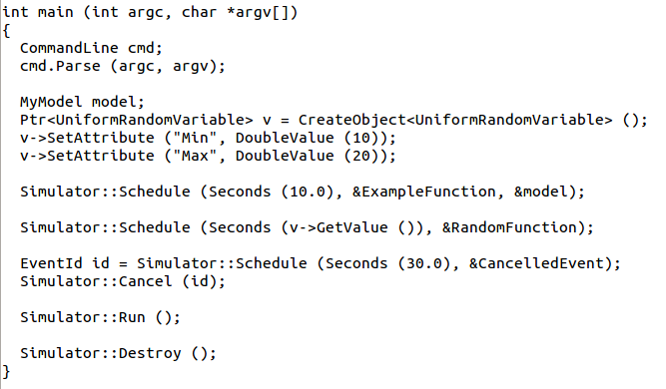
Simulator example

Slide 5

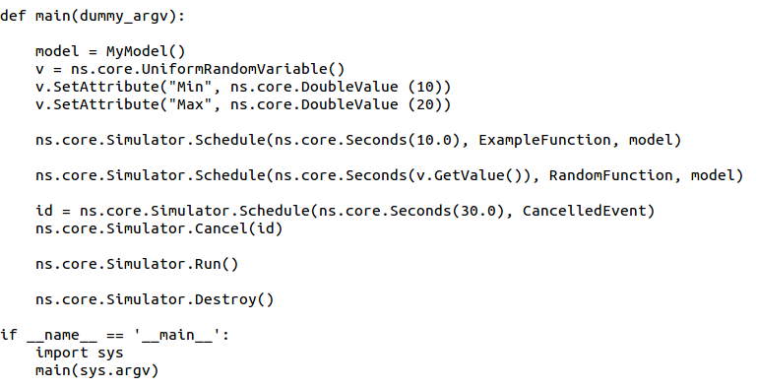
Simulator example (in Python)

Slide 6
Simulation program flow
Handle program inputs
Configure topology
Run simulation
Process outputs

Slide 7

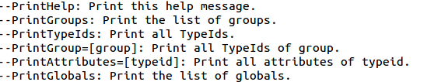
Command-line arguments
Add CommandLine to your program if you want command-line argument parsing
Passing --PrintHelp to programs will display command line options, if CommandLine is enabled
./waf --run "sample-simulator --PrintHelp"

Slide 8
Time in ns-3
Time is stored as a large integer in ns-3
  Minimize floating point discrepancies across platforms
Special Time classes are provided to manipulate time (such as standard operators)
Default time resolution is nanoseconds, but can be set to other resolutions
Time objects can be set by floating-point values and can export floating-point values
  double timeDouble = t.GetSeconds();

Slide 9
Events in ns-3
Events are just function calls that execute at a simulated time
  i.e. callbacks
  another difference compared to other simulators, which often use special "event handlers" in each model
Events have IDs to allow them to be cancelled or to test their status

Slide 10
Simulator and Schedulers
The Simulator class holds a scheduler, and provides the API to schedule events, start, stop, and cleanup memory
Several scheduler data structures (calendar, heap, list, map) are possible
"RealTime" simulation implementation aligns the simulation time to wall-clock time
  two policies (hard and soft limit) available when the simulation and real time diverge

Slide 11
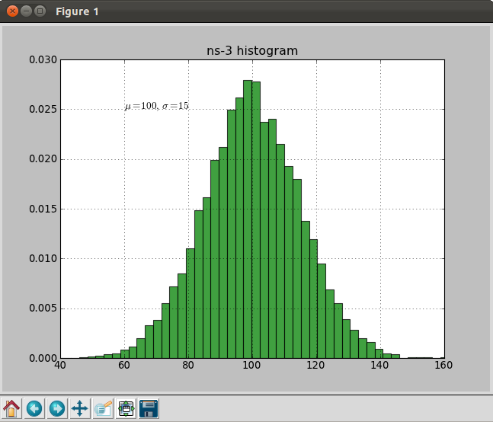
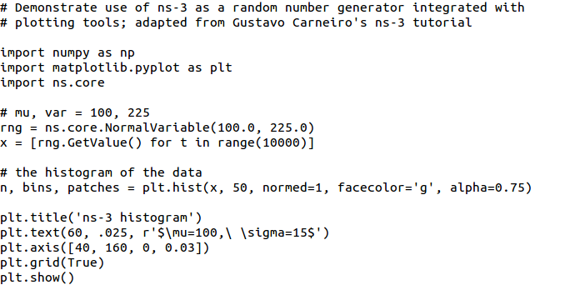
Random Variables
from src/core/examples/sample-rng-plot.py
Currently implemented distributions
  Uniform: values uniformly distributed in an interval
  Constant: value is always the same (not really random)
  Sequential: return a sequential list of predefined values
  Exponential: exponential distribution (poisson process)
  Normal (gaussian), Log-Normal, Pareto, Weibull, triangular

Slide 12
Random variables and independent replications
Many simulation uses involve running a number of independent replications of the same scenario
In ns-3, this is typically performed by incrementing the simulation run number
  not by changing seeds

Slide 13
ns-3 random number generator
Uses the MRG32k3a generator from Pierre L'Ecuyer
  http://www.iro.umontreal.ca/~lecuyer/myftp/papers/streams00.pdf
  Period of PRNG is 3.1x10^57
Partitions a pseudo-random number generator into uncorrelated streams and substreams
  Each RandomVariableStream gets its own stream
  This stream partitioned into substreams

Slide 14
Run number vs. seed
If you increment the seed of the PRNG, the streams of random variable objects across different runs are not guaranteed to be uncorrelated
If you fix the seed, but increment the run number, you will get an uncorrelated substream

Slide 15
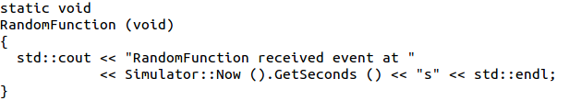
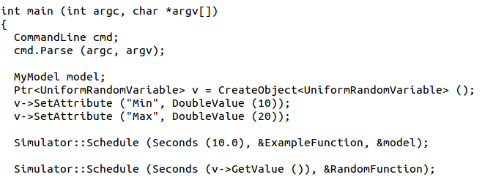
Putting it together
Example of scheduled event
Demo real-time, command-line, random variables...

Slide 16
Nodes and Devices

Slide 17
Example walkthrough
This section progressively builds up a simple ns-3 example, explaining concepts along the way
Files for these programs are available on the ns-3 wiki

Slide 18
Example program
wns3-version1.cc
  Link found on wiki page
  Place program in scratch/ folder

Slide 19
Fundamentals
Key objects in the simulator are Nodes, Packets, and Channels
Nodes contain Applications, “stacks”, and NetDevices

Slide 20
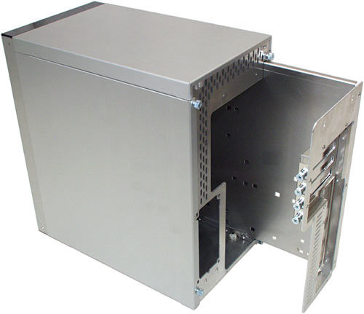


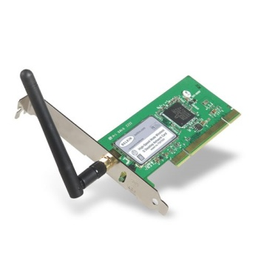
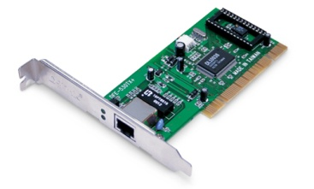
Node basics
A Node is a shell of a computer to which applications, stacks, and NICs are added
Application
Application
Application
“DTN”

Slide 21
NetDevices and Channels
NetDevices are strongly bound to Channels of a matching type
ns-3 Spectrum models relax this assumption
Nodes are architected for multiple interfaces
WifiChannel
WifiNetDevice

Slide 22
Internet Stack
Internet Stack
  Provides IPv4 and some IPv6 models currently
No non-IP stacks ns-3 until 802.15.4 was introduced in ns-3.20
  but no dependency on IP in the devices, Node, Packet, etc. (partly due to the object aggregation system)

Slide 23
Other basic models in ns-3
Devices
  WiFi, WiMAX, CSMA, Point-to-point, Bridge
Error models and queues
Applications
  echo servers, traffic generator
Mobility models
Packet routing
  OLSR, AODV, DSR, DSDV, Static, Nix-Vector, Global (link state)

Slide 24
Structure of an ns-3 program
int main (int argc, char *argv[])
{
// Set default attribute values
// Parse command-line arguments
// Configure the topology; nodes, channels, devices, mobility
// Add (Internet) stack to nodes
// Configure IP addressing and routing
// Add and configure applications
// Configure tracing
// Run simulation
}

Slide 25
Helper API
The ns-3 “helper API” provides a set of classes and methods that make common operations easier than using the low-level API
Consists of:
  container objects
  helper classes
The helper API is implemented using the low-level API
Users are encouraged to contribute or propose improvements to the ns-3 helper API

Slide 26
Containers
Containers are part of the ns-3 “helper API”
Containers group similar objects, for convenience
  They are often implemented using C++ std containers
Container objects also are intended to provide more basic (typical) API

Slide 27
The Helper API (vs. low-level API)
Is not generic
Does not try to allow code reuse
Provides simple 'syntactical sugar' to make simulation scripts look nicer and easier to read for network researchers
Each function applies a single operation on a ''set of same objects”
A typical operation is "Install()"

Slide 28
Helper Objects
NodeContainer: vector of Ptr<Node>
NetDeviceContainer: vector of Ptr<NetDevice>
InternetStackHelper
WifiHelper
MobilityHelper
OlsrHelper
... Each model provides a helper class

Slide 29
Installation onto containers
Installing models into containers, and handling containers, is a key API theme
NodeContainer c;
c.Create (numNodes);
...
mobility.Install (c);
...
internet.Install (c);
...

Slide 30
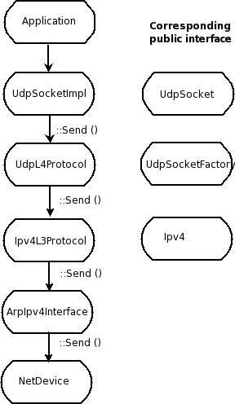
Internet stack
The public interface of
the Internet stack is
defined (abstract base
classes) in
src/network/model
directory
The intent is to support
multiple implementations
The default ns-3 Internet
stack is implemented in
src/internet-stack

Slide 31
Example program iterations
Walk through four additional revisions of the example program
  wns3-version2.cc
  wns3-version3.cc
  wns3-version4.cc

Slide 32
Visualization

Slide 33
PyViz overview
Developed by Gustavo Carneiro
Live simulation visualizer (no trace files)
Useful for debugging
  mobility model behavior
  where are packets being dropped?
Built-in interactive Python console to debug the state of running objects
Works with Python and C++ programs

Slide 34
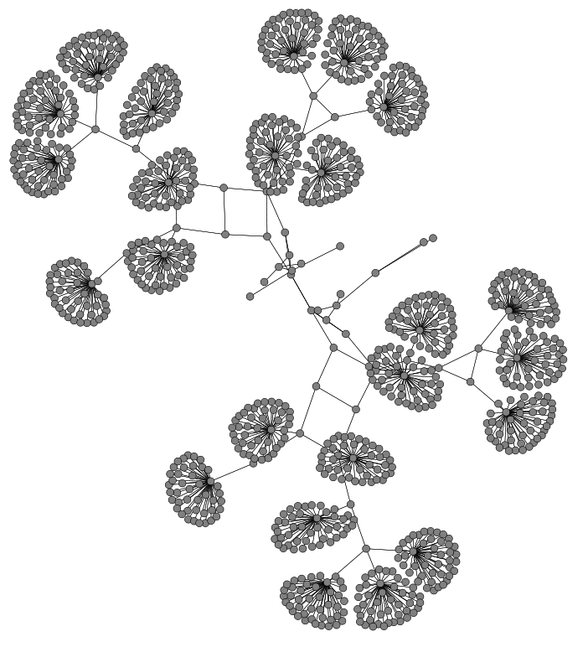
Pyviz screenshot (Graphviz layout)

Slide 35
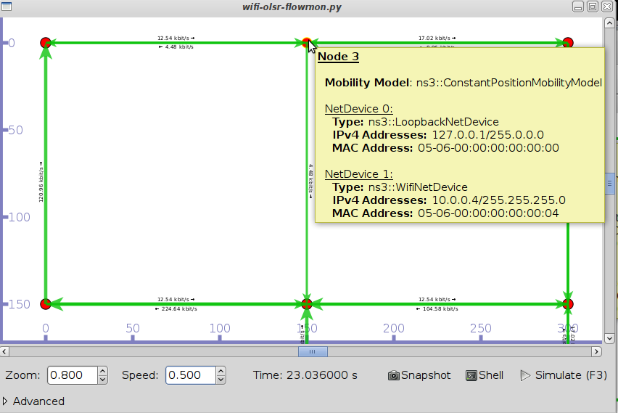
Pyviz and FlowMonitor
src/flow-monitor/examples/wifi-olsr-flowmon.py

Slide 36

Enabling PyViz in your simulations
Make sure PyViz is enabled in the build
If program supports CommandLine parsing, pass the option
  --SimulatorImplementationType=
  ns3::VisualSimulatorImpl
Alternatively, pass the "--vis" option

Slide 37
FlowMonitor
Network monitoring framework found in src/flow-monitor/
Goals:
  detect all flows passing through network
  stores metrics for analysis such as bitrates, duration, delays, packet sizes, packet loss ratios
G. Carneiro, P. Fortuna, M. Ricardo, "FlowMonitor-- a network monitoring framework
for the Network Simulator ns-3," Proceedings of NSTools 2009.

Slide 38
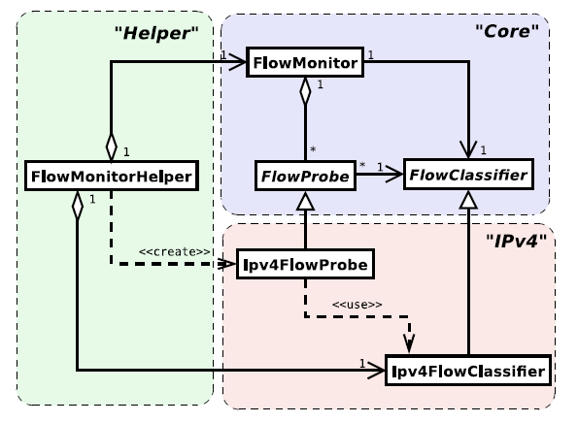
FlowMonitor architecture
Basic classes
  FlowMonitor
  FlowProbe
  FlowClassifier
  FlowMonitorHelper
IPv6 coming in
ns-3.20 release
Figure credit: G. Carneiro, P. Fortuna, M. Ricardo, "FlowMonitor-- a network monitoring
framework for the Network Simulator ns-3," Proceedings of NSTools 2009.

Slide 39
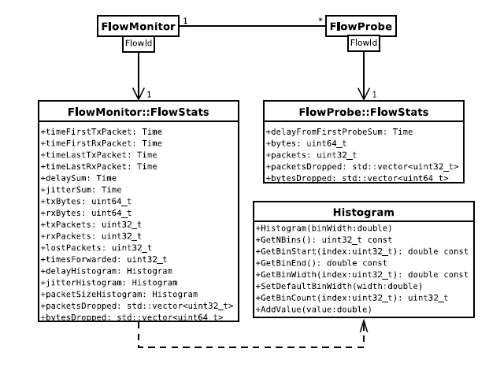
FlowMonitor statistics
Statistics gathered

Slide 40
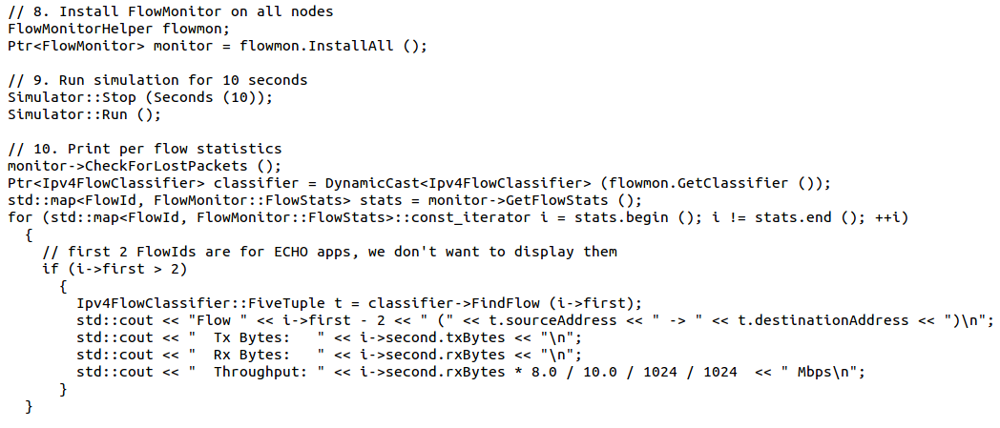
FlowMonitor configuration
example/wireless/wifi-hidden-terminal.cc

Slide 41
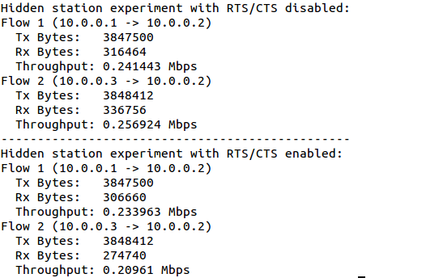
FlowMonitor output
This program exports statistics to stdout
Other examples integrate with PyViz

Slide 42
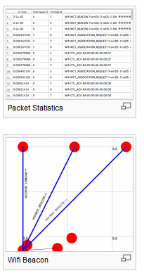
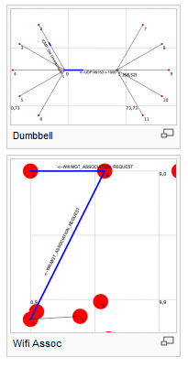
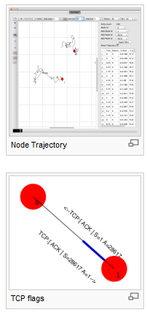
NetAnim
"NetAnim" by George Riley and John Abraham
pyviz

Slide 43
NetAnim key features
Animate packets over wired-links and wireless-links
  limited support for LTE traces
Packet timeline with regex filter on packet meta-data.
Node position statistics with node trajectory plotting (path of a mobile node).
Print brief packet-meta data on packets

Slide 44
Placeholder for netanim videos

Slide 45
ns-3 Objects

Slide 46
Object metadata system
ns-3 is, at heart, a C++ object system
ns-3 objects that inherit from base class ns3::Object get several additional features
  smart-pointer memory management (Class Ptr)
  dynamic run-time object aggregation
  an attribute system

Slide 47
Smart pointers
Smart pointers in ns-3 use reference counting to improve memory management
The class ns3::Ptr is semantically similar to a traditional pointer, but the object pointed to will be deleted when all references to the pointer are gone
ns-3 heap-allocated objects should use the templated Create<>() or CreateObject<> () methods

Slide 48
Examples
Ptr<WifiNetDevice> dev =
CreateObject<WifiNetDevice> ();
Ptr<Packet> pkt = Create<Packet> ();
(instead of Packet* = new Packet;)
why Create<> vs CreateObject<>?
two different base classes; generally use CreateObject<>(), but Create<> for Packet

Slide 49
Dynamic run-time object aggregation
This feature is similar to "Component Object Model (COM)"-- allows interfaces (objects) to be aggregated at run-time instead of at compile time
Useful for binding dissimilar objects together without adding pointers to each other in the classes

Slide 50
Usage
ns-3 Node protocol stacks are added via aggregation
  The IP stack can be found from a Node pointer without class Node knowing about it
Energy models are typically aggregated to nodes
To find interfaces, use GetObject<>(); e.g.
Ptr<Ipv4> ipv4 = m_node->GetObject<Ipv4> ();

Slide 51
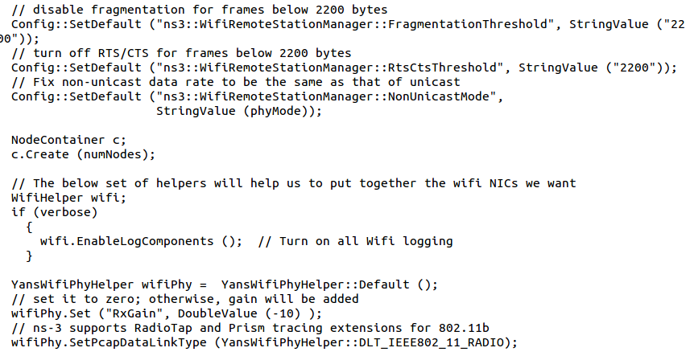
Attributes and default values

Slide 52
ns-3 attribute system
Problem: Researchers want to identify all of the values affecting the results of their simulations
  and configure them easily
ns-3 solution: Each ns-3 object has a set of attributes:
  A name, help text
  A type
  An initial value
Control all simulation parameters for static objects
Dump and read them all in configuration files
Visualize them in a GUI
Makes it easy to verify the parameters of a simulation

Slide 53
Short digression: Object metadata system
ns-3 is, at heart, a C++ object system
ns-3 objects that inherit from base class ns3::Object get several additional features
  dynamic run-time object aggregation
  an attribute system
  smart-pointer memory management (Class Ptr)
We focus here on the attribute system

Slide 54
Use cases for attributes
An Attribute represents a value in our system
An Attribute can be connected to an underlying variable or function
  e.g. TcpSocket::m_cwnd;
  or a trace source

Slide 55
Use cases for attributes (cont.)‏
What would users like to do?
  Know what are all the attributes that affect the simulation at run time
  Set a default initial value for a variable
  Set or get the current value of a variable
  Initialize the value of a variable when a constructor is called
The attribute system is a unified way of handling these functions

Slide 56
How to handle attributes
The traditional C++ way:
  export attributes as part of a class's public API
  walk pointer chains (and iterators, when needed) to find what you need
  use static variables for defaults
The attribute system provides a more convenient API to the user to do these things

Slide 57
Navigating the attributes
Attributes are exported into a string-based namespace, with filesystem-like paths
  namespace supports regular expressions
Attributes also can be used without the paths
  e.g. “ns3::WifiPhy::TxGain”
A Config class allows users to manipulate the attributes

Slide 58
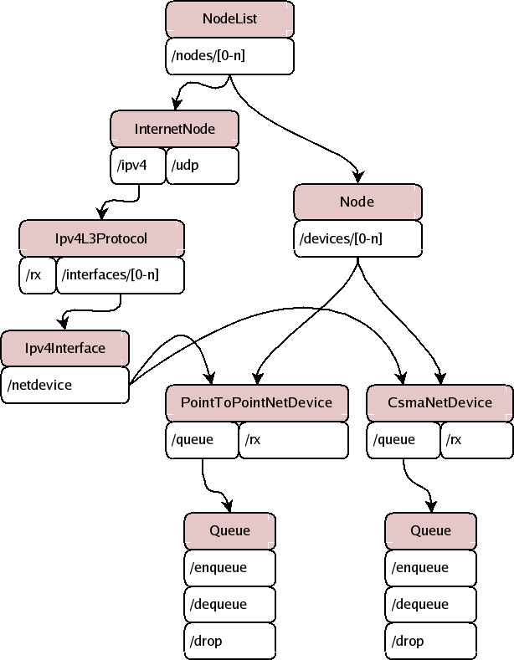
Attribute namespace
strings are used to describe paths through the namespace
Config::Set ("/NodeList/1/$ns3::Ns3NscStack<linux2.6.26>/net.ipv4.tcp_sack", StringValue ("0"));

Slide 59
Navigating the attributes using paths
Examples:
  Nodes with NodeIds 1, 3, 4, 5, 8, 9, 10, 11:
    “/NodeList/[3-5]|[8-11]|1”
  UdpL4Protocol object instance aggregated to matching nodes:
    “/$ns3::UdpL4Protocol”

Slide 60
What users will do
e.g.: Set a default initial value for a variable
  Config::Set (“ns3::YansWifiPhy::TxGain”, DoubleValue (1.0));
Syntax also supports string values:
  Config::Set (“YansWifiPhy::TxGain”, StringValue (“1.0”));
Attribute
Value

Slide 61
Fine-grained attribute handling
Set or get the current value of a variable
  Here, one needs the path in the namespace to the right instance of the object
  Config::SetAttribute(“/NodeList/5/DeviceList/3/$ns3::WifiNetDevice/Phy/$ns3::YansWifiPhy/TxGain”, DoubleValue(1.0));
  DoubleValue d; nodePtr->GetAttribute ( “/NodeList/5/NetDevice/3/$ns3::WifiNetDevice/Phy/$ns3::YansWifiPhy/TxGain”, d);
Users can get Ptrs to instances also, and Ptrs to trace sources, in the same way

Slide 62
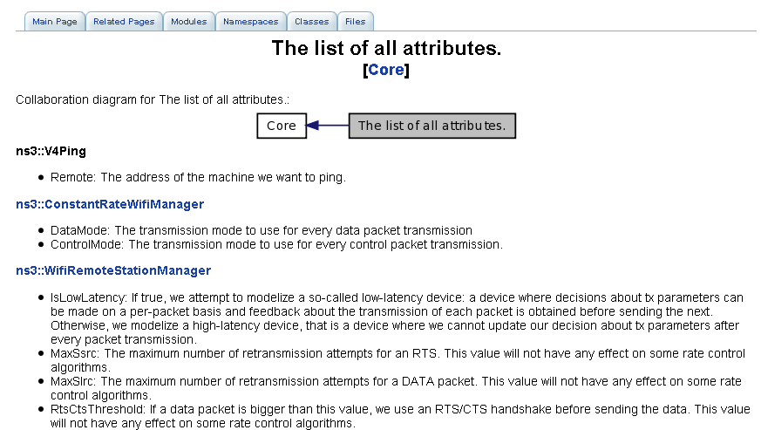
Attribute documentation

Slide 63
Options to manipulate attributes
Individual object attributes often derive from default values
  Setting the default value will affect all subsequently created objects
  Ability to configure attributes on a per-object basis
Set the default value of an attribute from the command-line:
  CommandLine cmd;
  cmd.Parse (argc, argv);
Set the default value of an attribute with NS_ATTRIBUTE_DEFAULT
Set the default value of an attribute in C++:
  Config::SetDefault ("ns3::Ipv4L3Protocol::CalcChecksum",
  BooleanValue (true));
Set an attribute directly on a specic object:
  Ptr<CsmaChannel> csmaChannel = ...;
  csmaChannel->SetAttribute ("DataRate",
  StringValue ("5Mbps"));

Slide 64
Summary on ns-3 objects
ns-3 objects that inherit from base class ns3::Object get several additional features
  smart-pointer memory management (Class Ptr)
  dynamic run-time object aggregation
  an attribute system
These types of objects are allocated on the heap, not on the stack

Slide 65
Packets

Slide 66
ns-3 Packet
Packet is an advanced data structure with the following capabilities
  Supports fragmentation and reassembly
  Supports real or virtual application data
  Extensible
  Serializable (for emulation)
  Supports pretty-printing
  Efficient (copy-on-write semantics)

Slide 67
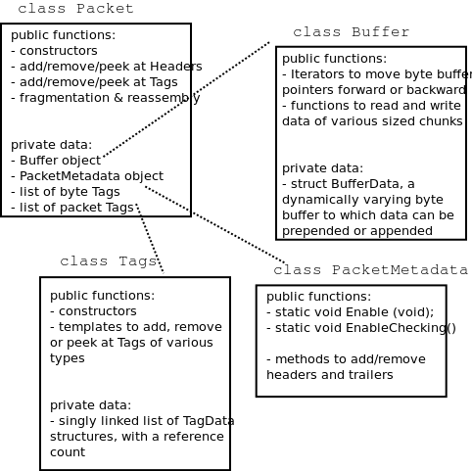
ns-3 Packet structure
Analogous to an mbuf/skbuff

Slide 68
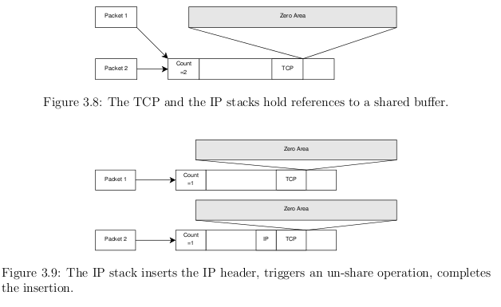
Copy-on-write
Copy data bytes only as needed
Figure source: Mathieu Lacage's Ph.D. thesis

Slide 69
Headers and trailers
Most operations on packet involve adding and removing an ns3::Header
class ns3::Header must implement four methods:
Serialize()
Deserialize()
GetSerializedSize()
Print()

Slide 70
Headers and trailers (cont.)
Headers are serialized into the packet byte buffer with Packet::AddHeader() and removed with Packet::RemoveHeader()
Headers can also be 'Peeked' without removal
Ptr<Packet> pkt = Create<Packet> ();
UdpHeader hdr; // Note: not heap allocated
pkt->AddHeader (hdr);
Ipv4Header iphdr;
pkt->AddHeader (iphdr);

Slide 71
Packet tags
Packet tag objects allow packets to carry around simulator-specific metadata
  Such as a "unique ID" for packets or
Tags may associate with byte ranges of data, or with the whole packet
  Distinction is important when packets are fragmented and reassembled

Slide 72
Tracing and statistics
Tracing is a structured form of simulation output
Example (from ns-2):
+ 1.84375 0 2 cbr 210 ------- 0 0.0 3.1 225 610
- 1.84375 0 2 cbr 210 ------- 0 0.0 3.1 225 610
r 1.84471 2 1 cbr 210 ------- 1 3.0 1.0 195 600
r 1.84566 2 0 ack 40 ------- 2 3.2 0.1 82 602
+ 1.84566 0 2 tcp 1000 ------- 2 0.1 3.2 102 611
Problem: Tracing needs vary widely
  would like to change tracing output without editing the core
  would like to support multiple outputs

Slide 73
Tracing overview
Simulator provides a set of pre-configured trace sources
  Users may edit the core to add their own
Users provide trace sinks and attach to the trace source
  Simulator core provides a few examples for common cases
Multiple trace sources can connect to a trace sink

Slide 74
Tracing in ns-3
ns-3 configures multiple 'TraceSource' objects (TracedValue, TracedCallback)
Multiple types of 'TraceSink' objects can be hooked to these sources
A special configuration namespace helps to manage access to trace sources
TracedValue
Config::Connect ("/path/to/traced/value", callback1);
TraceSource
Config::Connect ("/path/to/trace/source", callback2);
TraceSource
unattached

Slide 75
NetDevice trace hooks
Example: CsmaNetDevice
NetDevice::
ReceiveCallback
CsmaNetDevice::Send ()
MacTx
MacRx
MacDrop
queue
Sniffer
PromiscSniffer
MacTxBackoff
PhyTxBegin
PhyRxEnd
PhyRxDrop
PhyTxDrop
PhyTxEnd
CsmaNetDevice::
TransmitStart()
CsmaNetDevice::
Receive()
CsmaChannel

Slide 76
Writing and debugging your own examples

Slide 77
Writing and debugging new programs
Choosing between Python and C++
Reading existing code
Understanding and controlling logging code
Error conditions
Running programs through a debugger

Slide 78
Python bindings
ns-3 uses the 'pybindgen' tool to generate Python bindings for the underlying C++ libraries
Existing bindings are typically found in the bindings/ directory of a module
Some methods are not provided in Python (e.g. hooking trace sources)
Generating new bindings requires a toolchain documented on the ns-3 web site

Slide 79
Debugging support
Assertions: NS_ASSERT (expression);
  Aborts the program if expression evaluates to false
  Includes source file name and line number
Unconditional Breakpoints: NS_BREAKPOINT ();
  Forces an unconditional breakpoint, compiled in
Debug Logging (not to be confused with tracing!)
  Purpose
    Used to trace code execution logic
    For debugging, not to extract results!
  Properties
    NS_LOG* macros work with C++ IO streams
    E.g.: NS_LOG_UNCOND (”I have received ” << p->GetSize () << ” bytes”);
    NS_LOG macros evaluate to nothing in optimized builds
    When debugging is done, logging does not get in the way of execution performance

Slide 80
Debugging support (cont.)
Logging levels:
  NS_LOG_ERROR (...): serious error messages only
  NS_LOG_WARN (...): warning messages
  NS_LOG_DEBUG (...): rare ad-hoc debug messages
  NS_LOG_INFO (...): informational messages (eg. banners)
  NS_LOG_FUNCTION (...):function tracing
  NS_LOG_PARAM (...): parameters to functions
  NS_LOG_LOGIC (...): control flow tracing within functions
Logging ”components”
  Logging messages organized by components
  Usually one component is one .cc source file
  NS_LOG_COMPONENT_DEFINE ("OlsrAgent");
Displaying log messages. Two ways:
  Programatically:
    LogComponentEnable("OlsrAgent", LOG_LEVEL_ALL);
  From the environment:
    NS_LOG="OlsrAgent" ./my-program

Slide 81
Running C++ programs through gdb
The gdb debugger can be used directly on binaries in the build directory
An easier way is to use a waf shortcut
  ./waf --command-template="gdb %s" --run <program-name>

Slide 82
Running C++ programs through valgrind
valgrind memcheck can be used directly on binaries in the build directory
An easier way is to use a waf shortcut
  ./waf --command-template="valgrind %s" --run <program-name>
Note: disable GTK at configure time when running valgrind (to suppress spurious reports)
  ./waf configure --disable-gtk --enable-tests ...

Slide 83
Testing
Can you trust ns-3 simulations?
  Can you trust any simulation?
    Onus is on the simulation project to validate and document results
    Onus is also on the researcher to verify results
ns-3 strategies:
  regression tests
    Aim for event-based rather than trace-based
  unit tests for verification
  validation of models on testbeds where possible
  reuse of code

Slide 84
Test framework
ns-3-dev is checked nightly on multiple platforms
  Linux gcc-4.x, i386 and x86_64, OS X, FreeBSD clang, and Cygwin (occasionally)
./test.py will run regression tests
Walk through test code, test terminology (suite, case), and examples of how tests are run

Slide 85
Improving performance
Debug vs optimized builds
  ./waf -d debug configure
  ./waf -d debug optimized
Build ns-3 with static libraries
  ./waf --enable-static
Use different compilers (icc)
  has been done in past, not regularly tested

