Slide 1
Distributed (Parallel) Simulation with ns-3
WNS3 2016 Tutorial, University of Washington
https://www.nsnam.org/wiki/AnnualTraining2016
June 14, 2016
Peter D. Barnes, Jr (LLNL)
Ken Renard (ARL)

Slide 2
Why should you care about distributed (parallel) simulation?
Motivation
Faster execution
  Measure ~10⁴ packet receives/wall clock second/core
Large models, too big for one compute node
Heavy-weight nodes
  DCE applications
  Virtual machines
  Core routers with large forwarding tables

Slide 3
Motivation for High Performance, Scalable Network Simulation
Motivation
Reduce simulation run-time for large, complex network simulations
  Complex models require more CPU cycles and memory
    MANETs, robust radio devices
    More realistic application-layer models and traffic loading
    Load balancing among CPUs
  Potential to enable real-time performance for NS-3 emulation
Enable larger simulated networks
  Distribute memory footprint to reduce swap usage
  Potential to reduce impact of N² problems such as global routing
Allows network researchers to run multiple simulations and collect significant data

Slide 4
ns-3 Execution Scaling
Motivation
10^{~4} packets/core/sec
  Independent of model size
  100 cores is ~100x
  faster than 1 core
Nikolaev, et al, SIMUTools 2013
CONSTANT SOLUTION TIME

Slide 5

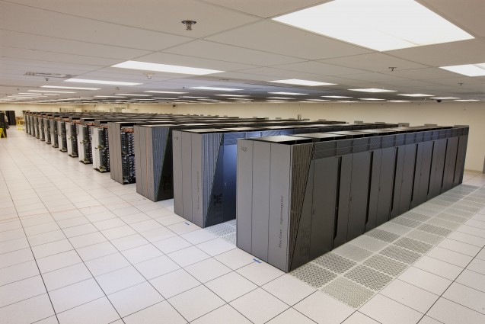
How many hardware threads do you have?
Motivation
This laptop
MacBook Pro, mid 2015
Intel Core i7:
8 hardware threads
My other computer
BlueGene/Q
  Currently TOP500 #3
  8M hardware threads

Slide 6
Outline
Motivation
Intro to MPI
Parallel Discrete Event Simulation (PDES)
PDES in ns-3
Constructing models
Example
Error Conditions
Performance
Future Capabilities
Motivation
Big topics. Focus on the concepts and terms needed to understand //ns-3
MPI
PDES
ns-3
Models
Example
Errors
Performance
Future

Slide 7
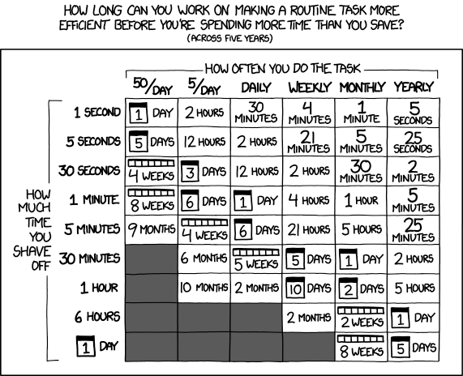
Parallelizing ns-3 Models Is Straightforward
Motivation
, But…
https://xkcd.com/1205

Slide 8
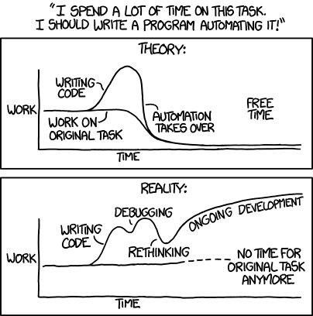
And the Reality…
Motivation
https://xkcd.com/1319

Slide 9
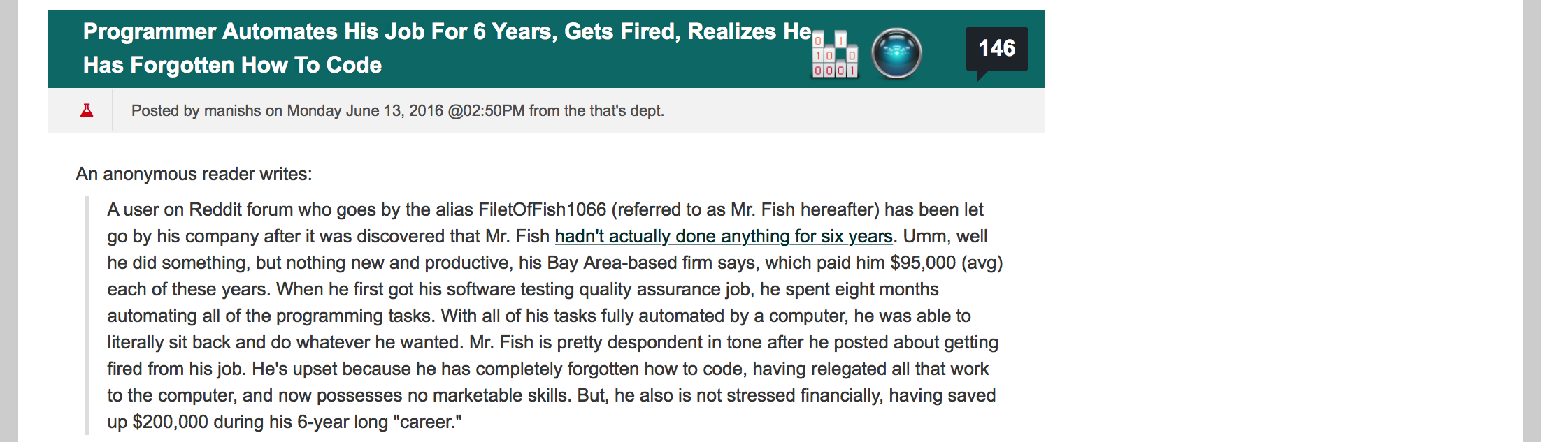
Unless You’re This Guy
Motivation

Slide 10
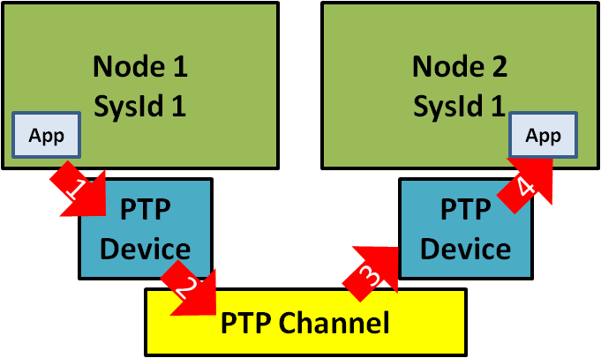
But Seriously
Motivation
Today:
Getting one model to run in parallel
Not discussing how to run one model many times (in parallel)
0

Slide 11
MPI Topics
MPI
Core features
API specification
Ranks and communicators
Point-to-point messages
Collectives
Getting and using MPI
Examples
  Hello World
  Simple messaging
  Ghost cell pattern

Slide 12
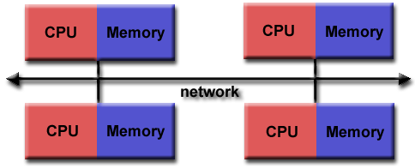
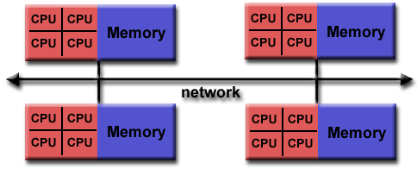
Message Passing Interface (MPI)
Features 1
MPI
De facto standard programming model for parallel scientific codes (but see Charm++ for an alternative)
Basic functionality is sending messages (data) between processes, which are called ranks
Core features
  API specification
    ~Language independent (FORTRAN, C, C++, Python, Java,…)
    Supports (doesn’t preclude) high performance and scalability
  Point-to-point (src,dst) messaging, as well as collectives
    Broadcast, reduction (compute min value), …
  Works equally well on distributed and shared memory
https://computing.llnl.gov/tutorials/mpi/

Slide 13
MPI Features 2
MPI
API specification, implementation up to “vendor”
  Vary in performance, runtime launch, …
  Architecture-specific libraries can target specialized hardware
    High-speed interconnects: Infiniband, PAMI, …
    Specialized network topologies: Fat-tree, Dragonfly, 5-d torus
    Specialized network interfaces: low-latency, high-throughput
    Multi-path routing
  Multiple implementations can coexist (but not interoperate)
    OpenMPI, MPICH, IBM, …
    Language-specific: mpi4py, mpiJava, …

Slide 14
MPI Concepts
Ranks and Communicators
MPI
Processes are called ranks
Communicator
  Group of ranks, numbered [0,R) within the group
  Enables separating messages by purpose
  Initial default communicator is MPI_COMM_WORLD
  Several functions for creating communicators, to support specific topologies
ns-3 Communicator
ns-3 Rank 0
ns-3 Rank 1
Service Communicator
Service Rank 0
Service Rank 1
Service Rank M
ns-3 Rank N

Slide 15
MPI Concepts
Point-to-Point Messages
MPI
Send a message to a specific rank in a communicator
  MPI_Send(data, data_length, data_type,
  destination, tag, communicator)
    data/data_length Message contents
    data_type MPI-defined data types
    Or a custom data type (i.e, a struct)
    destination Rank Number
    tag Application tag to distinguish types
    communicator
  Matching MPI_Recv()
  Blocking and non-blocking versions
  Various optimized calls, for managing memory
  Wait for a message, test for new messages

Slide 16
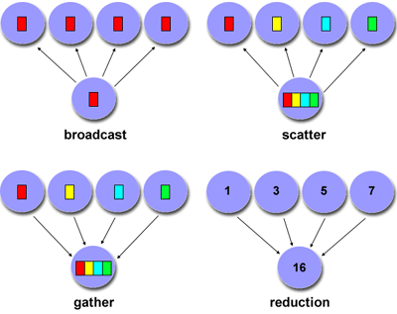
MPI Concepts 3
Collective Communications
MPI
Higher level patterns involving more than 2 ranks
Synchronization
  MPI_Barrier
Data movement
  MPI_Bcast
  MPI_Scatter
  MPI_Gather
  MPI_Allgather
Reductions
  MPI_Reduce
  MPI_Allreduce
Combinations
  MPI_Reduce_scatter
  MPI_Alltoall
  MPI_Scan

Slide 17
MPI Full API
MPI
Environment Management
MPI_Abort | MPI_Errorhandler_create | MPI_Errorhandler_free | MPI_Errorhandler_get | MPI_Errorhandler_set | MPI_Error_class
MPI_Error_string | MPI_Finalize | MPI_Get_processor_name | MPI_Get_version | MPI_Init | MPI_Initialized
MPI_Wtick | MPI_Wtime
Point-to-Point Communication
MPI_Bsend | MPI_Bsend_init | MPI_Buffer_attach | MPI_Buffer_detach | MPI_Cancel | MPI_Get_count
MPI_Get_elements | MPI_Isend | MPI_Iprobe | MPI_Irecv | MPI_Irsend | MPI_Isend
MPI_Issend | MPI_Probe | MPI_Recv | MPI_Recv_init | MPI_Request_free | MPI_Rsend
MPI_Rsend_init | MPI_Ssend | MPI_Ssend_init | MPI_Start | MPI_Startall | MPI_Test
MPI_Test_cancelled | MPI_Testall | MPI_Testany | MPI_Testsome | MPI_Wait | MPI_Waitall
MPI_Waitany | MPI_Waitsome
Collective Communication
MPI_Allgather | MPI_Allgatherv | MPI_Allreduce | MPI_Alltoall | MPI_Alltoallv | MPI_Barrier
MPI_Bcast | MPI_Gather | MPI_Gatherv | MPI_Op_create | MPI_Op_free | MPI_Reduce
MPI_Reduce_scatter | MPI_Scan | MPI_Scatter | MPI_Scatterv
Process Group
MPI_Group_compare | MPI_Group_difference | MPI_Group_excl | MPI_Group_free | MPI_Group_incl | MPI_Group_intersection
MPI_Group_range_excl | MPI_Group_range_incl | MPI_Group_rank | MPI_Group_size | MPI_Group_translate_ran | MPI_Group_union
Communicators
MPI_Comm_compare | MPI_Comm_create | MPI_Comm_dup | MPI_Comm_free | MPI_Comm_group | MPI_Comm_rank
MPI_Comm_remote_group | MPI_Comm_remote_size | MPI_Comm_size | MPI_Comm_split | MPI_Comm_test_inter | MPI_Intercomm_create
MPI_Intercomm_merge
Derived Types
MPI_Type_commit | MPI_Type_contiguous | MPI_Type_extent | MPI_Type_free | MPI_Type_hindexed | MPI_Type_hvector
MPI_Type_indexed | MPI_Type_lb | MPI_Type_size | MPI_Type_struct | MPI_Type_ub | MPI_Type_vector
Virtual Topology
MPI_Cart_coords | MPI_Cart_create | MPI_Cart_get | MPI_Cart_map | MPI_Cart_rank | MPI_Cart_shift
MPI_Cart_sub | MPI_Cartdim_get | MPI_Dims_create | MPI_Graph_create | MPI_Graph_get | MPI_Graph_map
MPI_Graph_neighbors | MPI_Graph_neighbors_count | MPI_Graphdims_get | MPI_Topo_test
Miscellaneous
MPI_Address | MPI_Attr_delete | MPI_Attr_get | MPI_Attr_put | MPI_Keyval_create | MPI_Keyval_free
MPI_Pack | MPI_Pack_size | MPI_Pcontrol | MPI_Unpack

Slide 18
Getting and Using MPI
MPI
Check your package manager
Only the API defined
  Tool names and configuration vary
  OpenMPI commands used here for illustration
Building your code
  Typically a compiler wrapper script, to ensure correct includes and libraries: $ mpicc …
  Often hidden inside your build system (Makefile, wscript)
Multiple executables
  Possible to run different executables on different ranks
  But job launch commands depend on package, so not portable
  Typically build everything into one executable, select functions based on rank id at runtime

Slide 19
Getting and Using MPI
MPI
Where to run ranks?
  Single computer: typically defaults to all hardware threads
  Ad hoc cluster: --hostfile
  node names and max number of ranks
  HPC cluster: typically via a batch job system, which selects physical nodes and launches jobs as a shell script
  “Overcommitment”: running more ranks than cores or hardware threads
Launching
  $ mpirun –n <nranks> <executable>
  Need to launch on each host
Example OpenMPI Hosts File
# This is an example hostfile. Comments begin with # # # The following node is a single processor machine: foo.example.com # The following node is a dual-processor machine: bar.example.com slots=2 # The following node is a quad-processor machine, # over-subscribing disallowed yow.example.com slots=4 max-slots=4
Example OpenMPI Build and Run
$ mpicxx -o hello hello.cc $ mpirun -np 4 ./hello Hello World from rank 3 of 4 (35986) Hello World from rank 0 of 4 (35983) Hello World from rank 1 of 4 (35984) Hello World from rank 2 of 4 (35985)

Slide 20
Parallel Hello World
MPI
hello.cc
#include <mpi.h> int main (int argc, char **argv) { int size, rank, rc; rc = MPI_Init (&argc, &argv); if (rc != MPI_SUCCESS) MPI_Abort(MPI_COMM_WORLD, rc); MPI_Comm_size (MPI_COMM_WORLD, &size); MPI_Comm_rank (MPI_COMM_WORLD, &rank); printf ("Hello World from rank %d of %d (%d)\n", rank, size, getpid ()); MPI_Finalize(); }
Typical Structure
  Include header
  Initialize MPI with command-line args
  Get world size, my rank index
  Parallel code
    Send messages, synchronize…
  Clean shutdown
6. Build and Launch
1
2
3
4
5
Example OpenMPI Build and Run
$ mpicxx -o hello hello.cc $ mpirun -n 4 ./hello Hello World from rank 3 of 4 (35986) Hello World from rank 0 of 4 (35983) Hello World from rank 1 of 4 (35984) Hello World from rank 2 of 4 (35985)
6

Slide 21
Simple Messaging Example
MPI
Parallel Body of send1.cc
if (size < 2) { printf ("Need two ranks\n"); MPI_Abort(MPI_COMM_WORLD, 0); } char *msg = (char *)"Hello"; int msg_len = strlen(msg); char in_msg[msg_len + 1]; // leave space to add null if (rank == 0) { int dest = 1; rc = MPI_Send (msg, msg_len, MPI_CHAR, dest, 0, MPI_COMM_WORLD); } if (rank == 1) { int count = 0; MPI_Status stat; rc = MPI_Recv (&in_msg, msg_len, MPI_CHAR, MPI_ANY_SOURCE, 0, MPI_COMM_WORLD, &stat); in_msg[msg_len] = (char) 0; MPI_Get_count (&stat, MPI_CHAR, &count); printf("Rank %d received message \"%s\" (%d) “ “from rank %d tag %d.\n", rank, in_msg, count, stat.MPI_SOURCE, stat.MPI_TAG); }
Rank0 --“Hello”--> Rank1
Typical Structure
  Check #ranks
  Message data buffers
  Each rank runs different code
  Sends paired with Recv
  Send and Recv data lengths, types match
1
2
3
4
5
Example OpenMPI Build and Run
$ mpicxx -o hello hello.cc $ mpirun -np 4 ./hello Hello World from rank 3 of 4 (35986) Hello World from rank 0 of 4 (35983) Hello World from rank 1 of 4 (35984) Hello World from rank 2 of 4 (35985)
Example OpenMPI Build and Run
$ mpicxx -o send1 send1.cc $ mpirun -np 4 ./send1 Rank 1 received message "Hello" (5) from rank 0 tag 0.

Slide 22
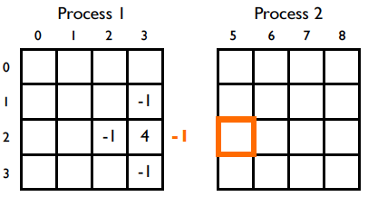
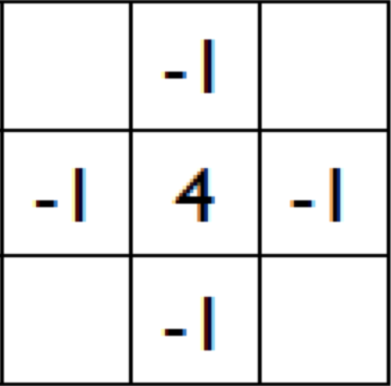
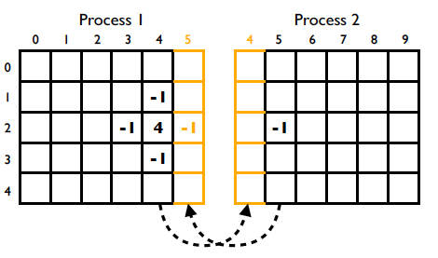
Ghost Cell Design Pattern
MPI
Decomposition
  Need neighbors’ data: stencil
  Some neighbors are remote
Solution:
  Ghosts replicate data
  Two-phase execution
    Exchange neighbor data Communication
    Compute local update Computation
Stencil | Partitioning
Partitioning with Ghosts
http://people.csail.mit.edu/fred/ghost_cell.pdf
Maximize computation/communication. Overlap computation and communication.

Slide 23
PDES Topics
PDES
Discrete Event Simulation
  Mathematical paradigm and time control
  State and time evolution
  Event scheduling
  Time consuming processes
Parallel DES
  Logical processors
  Causality
  Granted-time synchronization
  Lookahead
  Null-message synchronization

Slide 24
Classification of Simulation Techniques
PDES
Mathematical Paradigm
Static vs. dynamic time control
Parallelism?
Synchronization Style
Load Distribution

Slide 25
Mathematical Paradigm
PDES
Aspect
Form of model | Discrete systems Automata, agents, particle systems, stochastic processes, etc. | Ordinary or partial differential equations
Time, space, state | Continuous or discrete | All continuous
State changes | Discontinuous in time Constant between state changes | Continuous in time Occasional discontinuities Piecewise differentiable
Mathematical tools | Probability and statistics | Numerical analysis
Discrete simulation is natural when there are no underlying physical equations

Slide 26
Time Control
PDES
Aspect
Event times | Dynamically computed | Statically chosen
Time resolution | (Ideally) Floating point time Zero lower limit on resolution: inherently multi-scale | (Usually) Integer time Nonzero lower limit on resolution
Event distribution in space and time | Sparse and irregular | Dense and regular
Appropriate for | Irregular, asynchronous and/or multi-scale models | Spatially and temporally regular models
Event-driven execution imposes no timescale
  Supports simulation with wide dynamic range in natural time scales and/or long quiescent periods

Slide 27
DES State and Time Evolution
PDES
State values change discontinuously in simulation time
  Constant between state changes
  Time interval between state changes is not fixed
Computation (real world time) required to compute new state value
  Computation occurs at a fixed value of simulation time
Rate of model evolution not fixed
  Faster or slower than real time
  (Best effort) real time, to interoperate with external real systems

Slide 28
DES Event Scheduling
PDES
Objects communicate by sending messages = schedule events
  Event is a function call, to be executed Δt in the future–no backwards arrows
  Typically an event schedules one or more future events
All event types allowed
  Event to self
  Event sends multiple messages
  Event sends no messages
  Events can tie
  Non-FIFO scheduling

Slide 29
Sequential DES Main Event Loop
PDES
createInitialObjects();
eventList.insert(initialEvents); // Priority queue on event time
while ( !(terminationCondition() || eventList.empty()) ) do
{
event e = eventList.removeMinSimTime(); // Choose next event
simTime = e.getEventTime(); // Set virtual time and unpack event
object = e.getEventObject();
method = e.getMethod();
args = e.getArgs();
object.method(args); // Invoke the event method
// May change state of object
// May schedule future events
// May create or destroy objects
// May cancel (delete) future events
}
finalize();
Clean separation between Simulator and Application Model.

Slide 30
Modeling Time-Consuming Process
PDES
Model state values change at an instant in simulation time
  So how to model time-consuming processes?
Finite state machine
  Model state is the FSM state
  Events cause FSM transitions, schedule future transitions

Slide 31
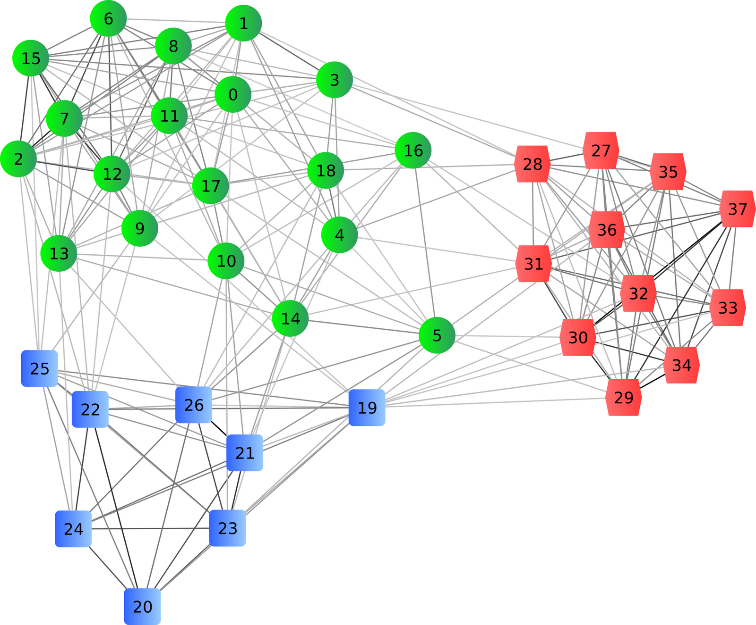
Parallel Discrete Event Simulation
PDES
Decompose model into Logical Processes
  Separate objects and event queues
  Execute independently
  Events for other LPs become messages
  ~ MPI Ranks
LP 1
LP 3
LP 2
http://www.enggprojects.in/2011/07/adaptive-de-clustering-of-data.html
Parallel execution must produce exact same results as sequential!
Notes:
Development of PDES predates MPI by a decade, so it has it’s own terms.

Slide 32
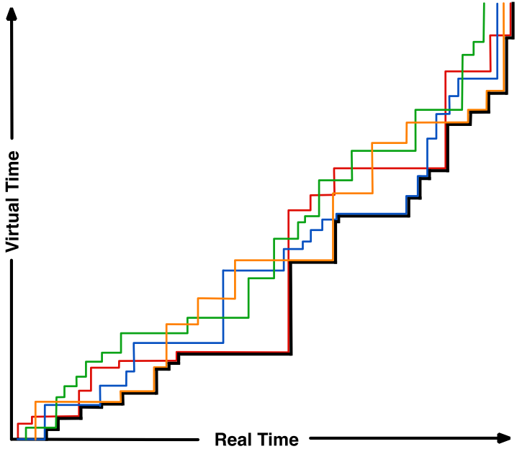
PDES Execution: LPs Advance Independently
PDES
Sometimes ahead in virtual time, sometimes behind
More or less real time per event
Never backwards!
  Hallmark of conservative execution
  (Ask me about optimistic execution ☺)

Slide 33
Need for Synchronization of LPs:
Prevent Causality Violations
PDES
Sequential event sequence
LP 2’s perspective:
Arrival of LP1 event
Need to guarantee no messages arrive in the past (for conservative PDES).

Slide 34
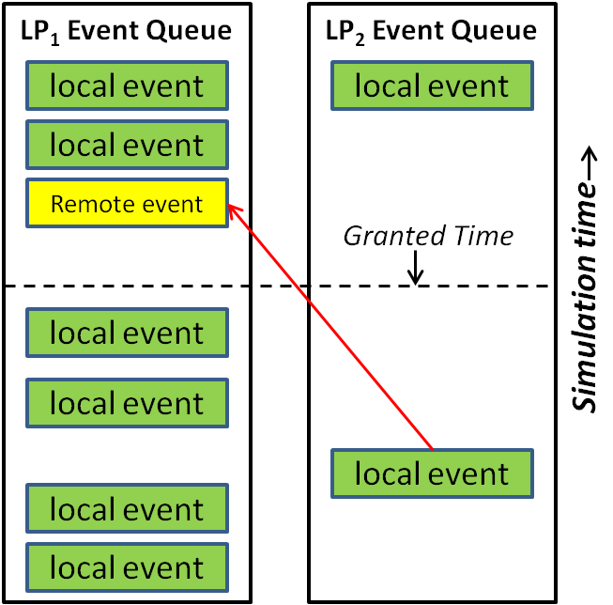
Granted Time Window Synchronization
PDES
If we could guarantee no remote events will arrive before GrantedTime
  All events before GrantedTime are safe
  At GrantedTime need to resynchronize:
    Receive and schedule events from other LPs
    Compute new GrantedTime
Performance
  Even workload distribution limits cpu idle time
  Maximize GrantedTime to execute more events in parallel between synchronization rounds

Slide 35
Lookahead and LBTS Provide the Granted Time Guarantee
PDES
Model must provide Lookahead
  Minimum delay for remote events
    Example: network channel link latency
    + transmission time for smallest packet
Lower Bound Time Stamp (LBTS)
  Min next event time across all LPs
GrantedTime = LBTS + Lookahead
Synchronization across LPs is expensive
  Typically barrier (to wait for slowest LP)
  Plus (at least one) all gather or reduction
  Each of these is log(N_{LP}) in time
Finding large Lookahead in your model is key to performance

Slide 36
Null-Message Alternative for Static and Sparse LP Graphs
PDES
GrantedTime assumes all LPs can message all other LPs
But my LP graph is sparse. Why synchronize with everyone?
  Every message sent could communicate my virtual time
  Guarantee at least one message every Lookahead
  Send Null-message when necessary
http://www.enggprojects.in/2011/07/adaptive-de-clustering-of-data.html

Slide 37
To Learn More…
PDES
Much of this material from a short course presented spring 2014
  David Jefferson, LLNL, co-inventor of Optimistic PDES
  15 sessions
  Slides and videos publicly available:
  http://pdes-course-2014.ucllnl.org
Sequential DES
Ties, LBTS, Lookahead
Chandy, Misra, Bryant: YAWNS
Deadlock
Null Messages
Dynamic Object Creation
Critical Path
Speedup
Optimistic DES, TimeWarp
Global Virtual Time
Commitment
Checkpointing
Rollback and Reverse Computation
Dynamic Load Balancing
Mixed Discrete and Continuous

Slide 38
Parallel ns-3
ns-3
History
PDES in ns-3
Mechanics
  Enabling
  Running
PDES Simulators
  GrantedTime
  NullMessage
Parallel Models 1
  The easy way
Lookahead
Under the covers:
  PointToPointRemoteChannel
  PointToPointNetDevice
Parallel Models 2
  The hard way
  Limitations

Slide 39
Parallel ns-3 History
ns-3
Initial release in ns-3.8
  J. Pelkey and G. Riley, “Distributed Simulation with MPI in ns-3,” WNS3 2011, Barcelona, Spain.
  Roots from:
    Parallel/Distributed ns (pdns)
    Georgia Tech Network Simulator (GTNetS)
Publications
  K. Renard, et al, “A Performance and Scalability Evaluation of the ns-3 Distributed Scheduler,” SimuTools 2012
  S. Nikolaev, et al, “Performance of Distributed ns-3 Network Simulator,” SimuTools 2013
  WNS3 2015

Slide 40
PDES in ns-3
ns-3
Sequential ns-3
LP is implicit
  ns3::Simulator
Event messages
  Explicit future function calls
    Schedule (delay, &fn,…)
Virtual time discipline
  DefaultSimulatorImpl
  RealtimeSimulatorImpl
  VisualSimulatorImpl
Parallel ns-3
Each rank is an LP
Event messages
  Local to LP: explicit future function calls
  Remote: implicit message send
Synchronization
  DistributedSimulatorImpl
  NullMessageSimulatorImpl
Lookahead (later)

Slide 41
Enabling Parallel ns-3
ns-3
Configure with --enable-mpi
  Tries to run mpic++
    Recognizes OpenMPI and MPICH libraries
  Defines NS3_MPI and
  either NS3_OPENMPI or NS3_MPICH
Followed by usual build
Configuring ns-3 With MPI
$ ./waf configure --enable-mpi Setting top to : ... ... ---- Summary of optional NS-3 features: Build profile : debug ... MPI Support : enabled ... 'configure' finished successfully (1.295s) $ ./waf build ...

Slide 42
Running Parallel ns-3 Scripts
ns-3
Waf can’t distinguish sequential and parallel
  Need to specify mpirun and number of ranks explicitly
Running Parallel Scripts with waf and mpirun
$ ./waf --run simple-distributed Waf: Entering directory `build/debug' Waf: Leaving directory `build/debug' 'build' finished successfully (2.118s) This simulation requires 2 and only 2 logical processors. Command [‘build/debug/src/mpi/examples/ns3-dev-simple-distributed-debug'] exited with code 1 # Multiple ranks on a single computer: $ ./waf --run simple-distributed --command-template="mpirun -np 2 %s" Waf: Entering directory `build/debug' Waf: Leaving directory `build/debug' 'build' finished successfully (2.104s) At time 1.02264s packet sink received 512 bytes from 10.1.1.1 port 49153 total Rx 512 bytes At time 1.0235s packet sink received 512 bytes from 10.1.2.1 port 49153 total Rx 512 bytes At time 1.02437s packet sink received 512 bytes from 10.1.3.1 port 49153 total Rx 512 bytes At time 1.02524s packet sink received 512 bytes from 10.1.4.1 port 49153 total Rx 512 bytes # Multiple computers: $ mpirun –np 2 ./waf –run simple-distributed

Slide 43
Switching Between GrantedTime and NullMessage Simulators
ns-3
Use environment variable
  $ NS_GLOBAL_VALUE=\
  “SimulatorImplementationType=ns3::NullMessageSimulatorImpl” \
  ./waf --run ...
Use command line:
Selecting the Parallel Simulator from the Command Line
bool nullmsg = false; CommandLine cmd; cmd.AddValue ("nullmsg", "Enable the use of null-message synchronization", nullmsg); cmd.Parse (argc,argv); ... if(nullmsg) { GlobalValue::Bind ("SimulatorImplementationType", StringValue ("ns3::NullMessageSimulatorImpl")); } else { GlobalValue::Bind ("SimulatorImplementationType", StringValue ("ns3::DistributedSimulatorImpl")); } MpiInterface::Enable (&argc, &argv);
Notes:
Won’t say anything more about these simulator implementations. Straightforward implementation of the algorithms we just discussed.

Slide 44
Constructing Distributed Models
The Easy Way
ns-3
All ranks construct the full topology
  All Nodes, NetDevices and Channels
    Label Nodes with rank: Node::Node (uint32_t systemId)
  All Internet stacks and addresses
  Good
    Single code for model construction, runs sequential and parallel
    Event execution happens in parallel
    Enables GOD and NIx-vector routing to function with no extra work
  Bad
    Memory is used for nodes/stacks/devices that “belong” to other ranks
    (But ask me about memory scaling presented in WNS3 2015 ☺)
Install local applications only
  Non-local nodes (not on my rank) should not have applications

Slide 45
Where to Get Lookahead?
ns-3
Primarily from link latency
What about shared channels like CSMA or wireless?
  Latency can be zero
  Multiple NetDevices
  Can’t span ranks!
Only PointToPoint links can cross ranks
  Global Lookahead is smallest cross-rank latency

Slide 46
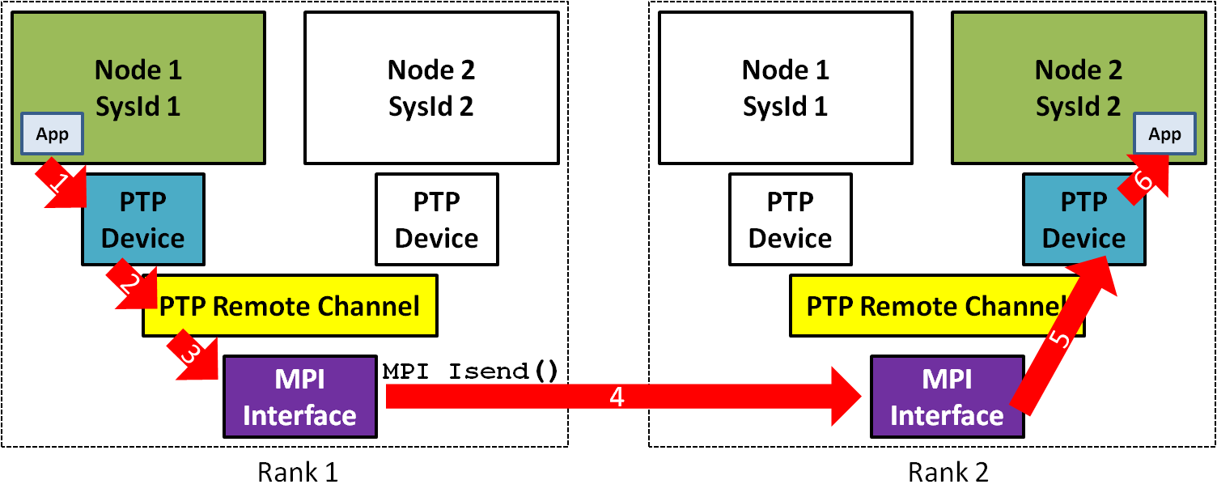
Under the Covers: PointToPointHelper::Install
ns-3
src/point-to-point/helper/point-to-point-helper.cc
bool useNormalChannel = true; Ptr<PointToPointChannel> channel = 0; if (MpiInterface::IsEnabled ()) { uint32_t currSystemId = MpiInterface::GetSystemId (); if (a->GetSystemId () != currSystemId || b->GetSystemId () != currSystemId) { useNormalChannel = false; } } if (useNormalChannel) { channel = m_channelFactory.Create<PointToPointChannel> (); } else { channel = m_remoteChannelFactory.Create<PointToPointRemoteChannel> (); Ptr<MpiReceiver> mpiRecA = CreateObject<MpiReceiver> (); mpiRecA->SetReceiveCallback (MakeCallback (&PointToPointNetDevice::Receive, devA)); devA->AggregateObject (mpiRecA); // Same for b }
Sequential
Distributed
Distributed

Slide 47
Under the Covers: Sending a Packet from PointToPointNetDevice
ns-3
MpiInterface::SendPacket()
    Packet data
    Receive time – Local Now() + Latency + Packet Tx duration
    Remote SystemId (rank)
    Remote NodeId
    Remote InterfaceId
  Serialize packet and destination data
  Send to remote rank with non-blocking MPI_Isend()
PointToPointNetDevice Call Chain
PointToPointNetDevice::Send() { TransmitStart() { PointToPointRemoteChannel::TransmitStart() { MpiInterface::SendPacket();

Slide 48
Under the Covers: Getting a Remote Packet to the PointToPointNetDevice
ns-3
At end of GrantedTime, DistributedSimulatorImpl calls GrantedTimeWindowMpiInterface::ReceiveMessages()
Reads all pending MPI messages
  Deserialize target Receive time, NodeId and InterfaceId
  Deserialize packet data
  Find Node by NodeId
  Find NetDevice on Node with correct InterfaceId
  Get MpiReceiver object aggregated to the NetDevice
    MpiReceiver merely holds the correct NetDevice Callback
  Schedule MpiReceiver::Receive event at Receive time

Slide 49
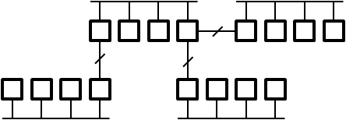
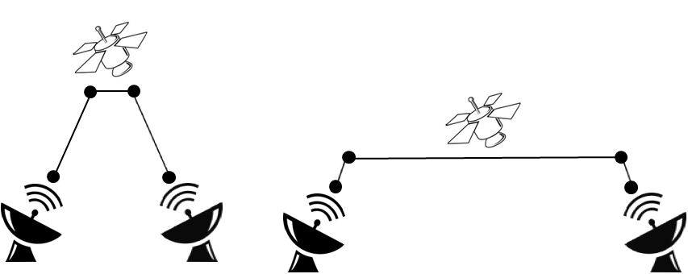
Building a Distributed ns-3 Simulation
Models
Choose partitioning strategy
  Label contiguous regions which
  can’t be partitioned
    CSMA and wireless
  Select regions which will share a rank
    Find large point-to-point latencies for good Lookahead
    Minimize communication between ranks
Build topology as normal, assigning Nodes to ranks CreateObject<Node> (rankId)
Rewrite topology to improve
partitioning
  CSMA with only 2 nodes
  Move latency

Slide 50
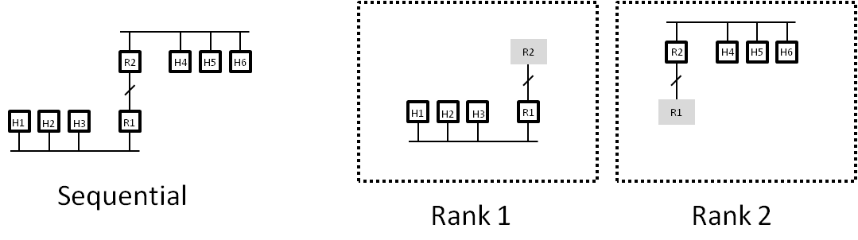
Constructing Distributed Models
The Hard Way
Models
Use the ghost cell design pattern to save memory
  Only create local Nodes, Applications, Internet stacks, NetDevices and Channels
  Plus “ghost” nodes: remote endpoint of PointToPointRemoteChannel
Requires manual intervention
  Global and NIX routing do not see entire topology
    Add static, default routes manually. Hint: IPv6 allows for more “aggregatable” routes
  Ghost nodes will likely have incorrect remote NodeId, InterfaceId
  Must align interface identifiers by hand in same fashion

Slide 51
Limitations of Distributed NS3
Models
Partitioning is a manual process
Partitioning is restricted to Point-To-Point links only
  Partitioning within a wireless network is not supported
    Lookahead is very small and dynamic
Need full topology in all LPs
  Exception with careful node ordering, interface numbering, and manual routing

Slide 52
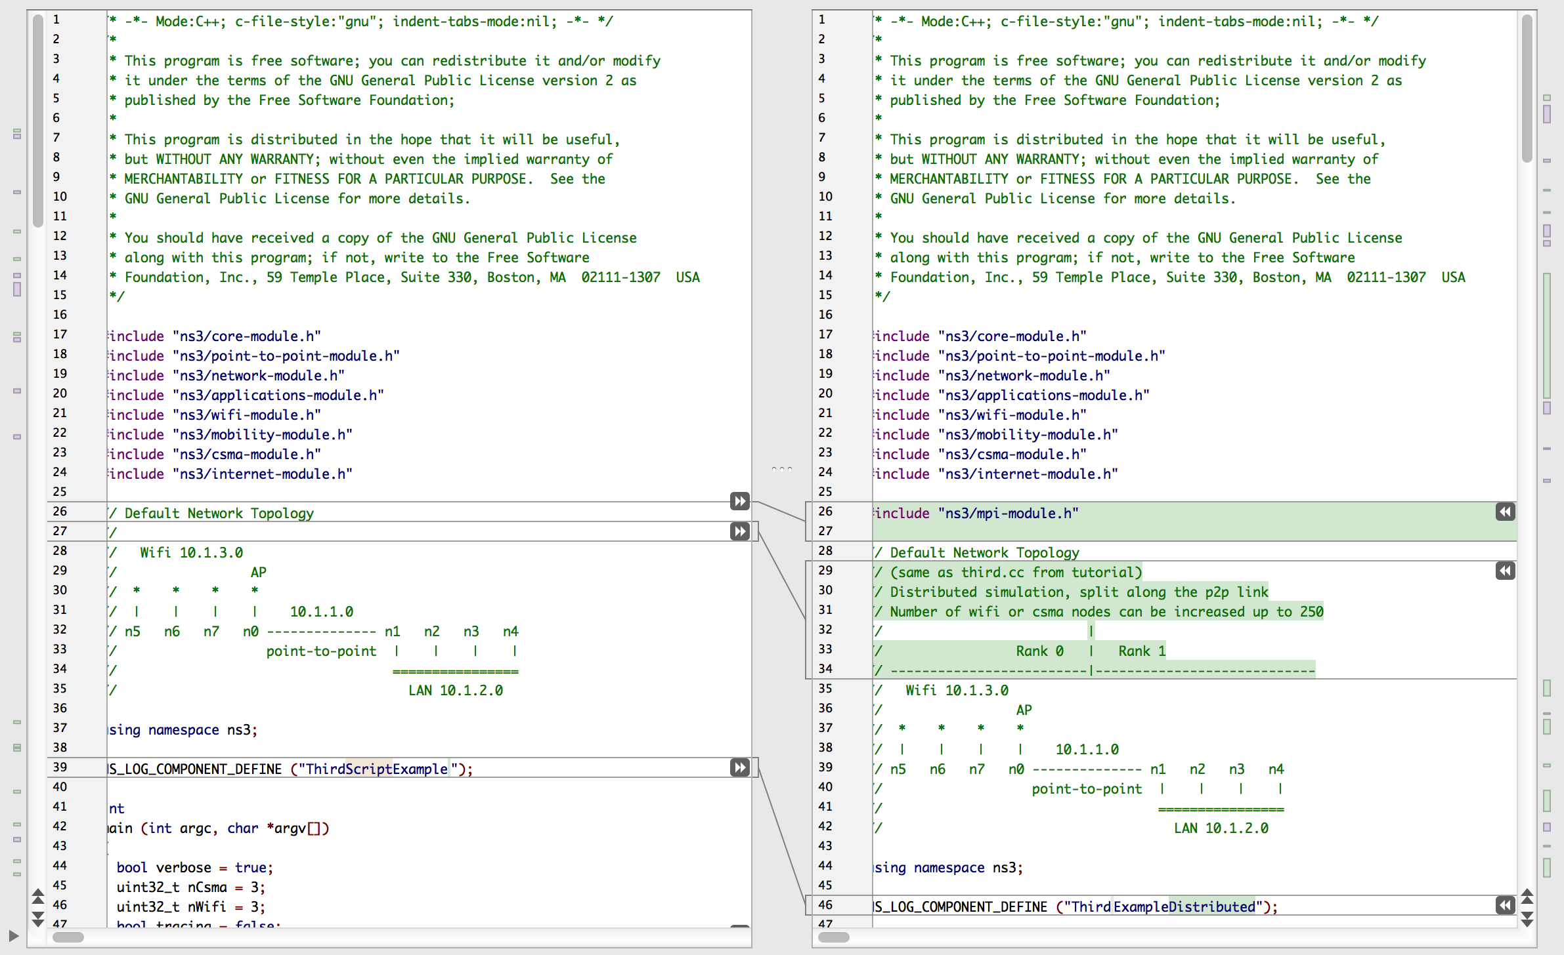
examples/tutorial/third.cc src/mpi/examples/third-distributed.cc
Example
Include mpi-module.h
Same topology, split across Point-to-point link
1
2

Slide 53
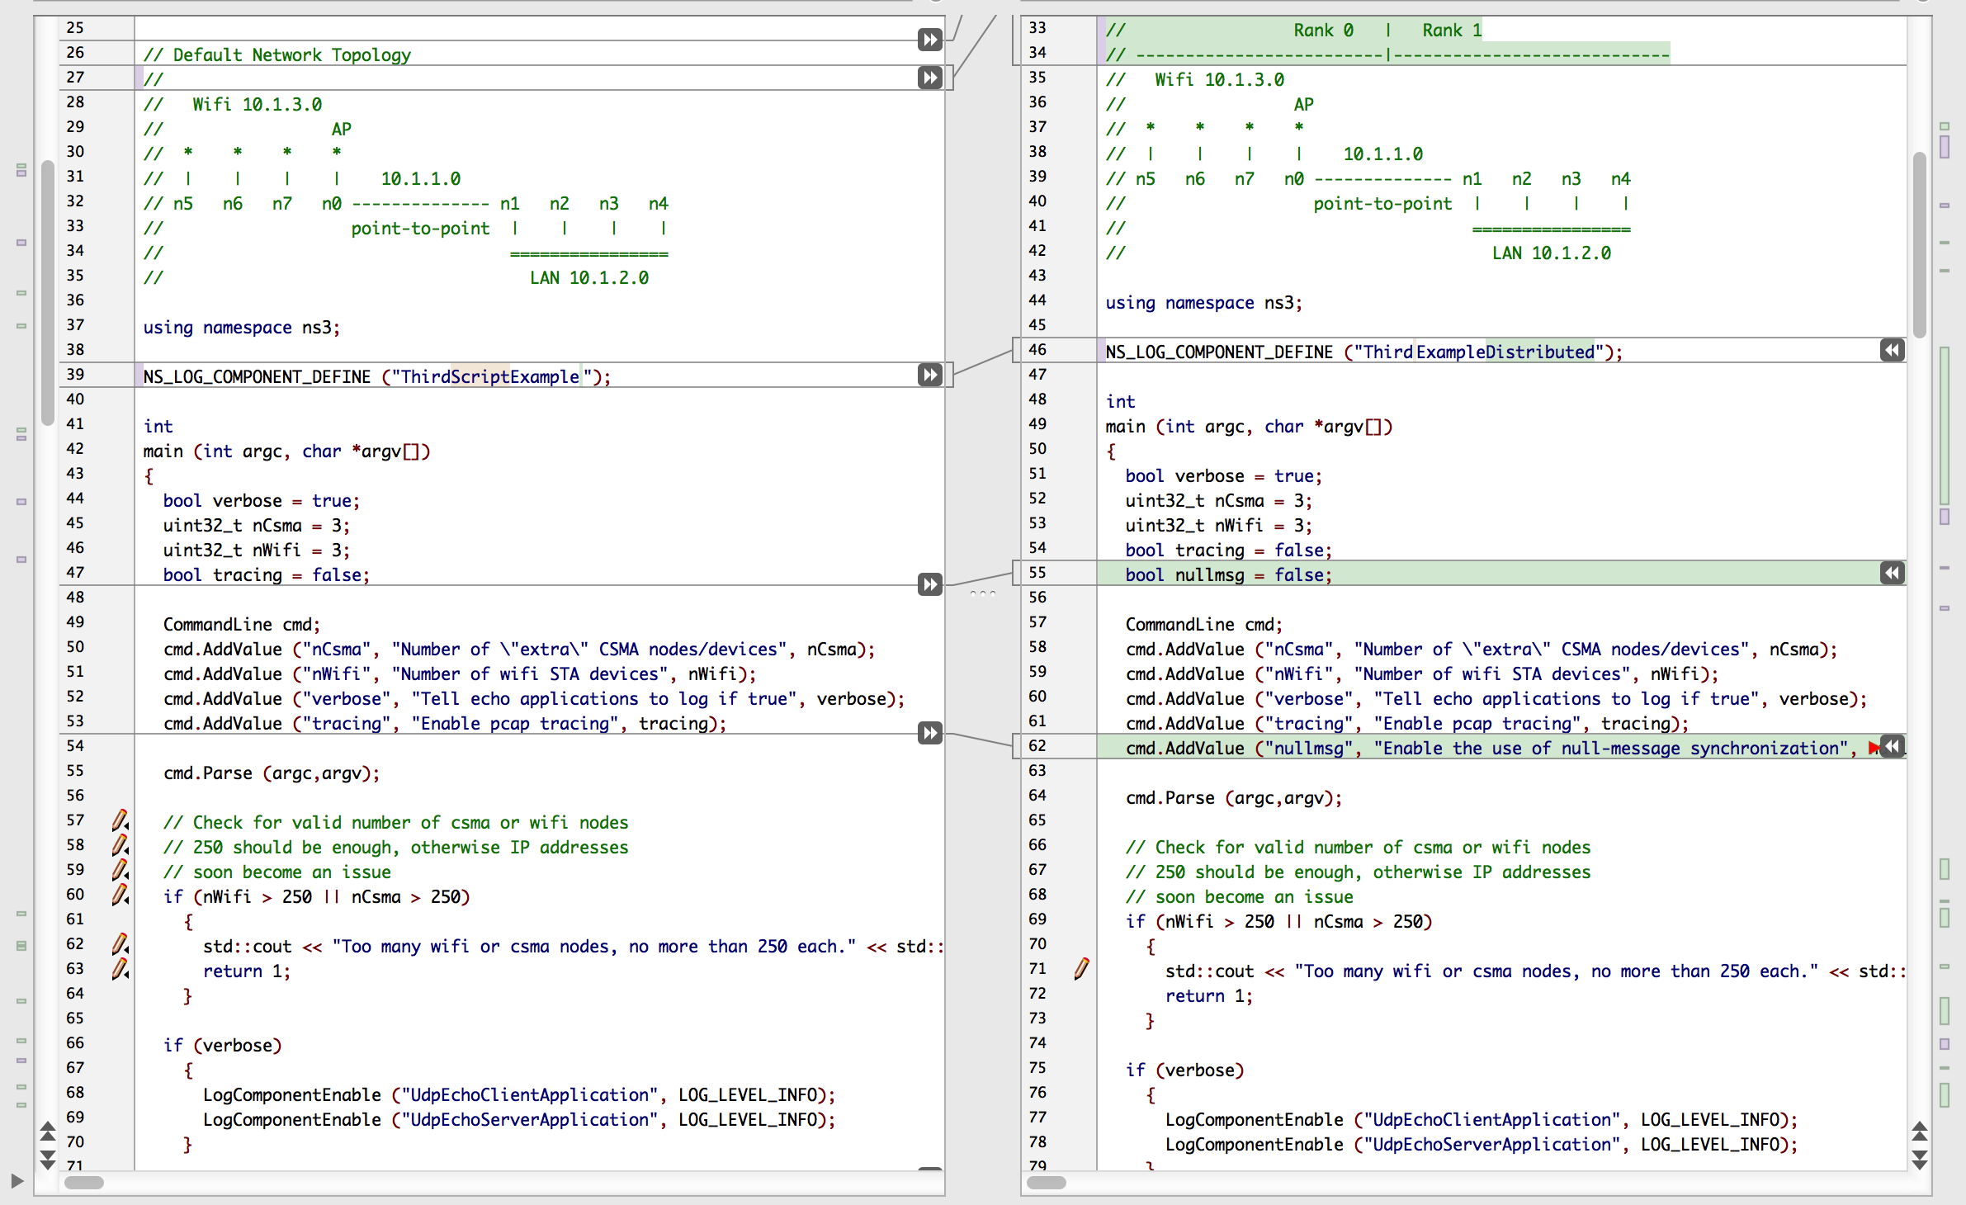
examples/tutorial/third.cc src/mpi/examples/third-distributed.cc
Example
Different log component name
Command line argument to select Null message
1
2

Slide 54
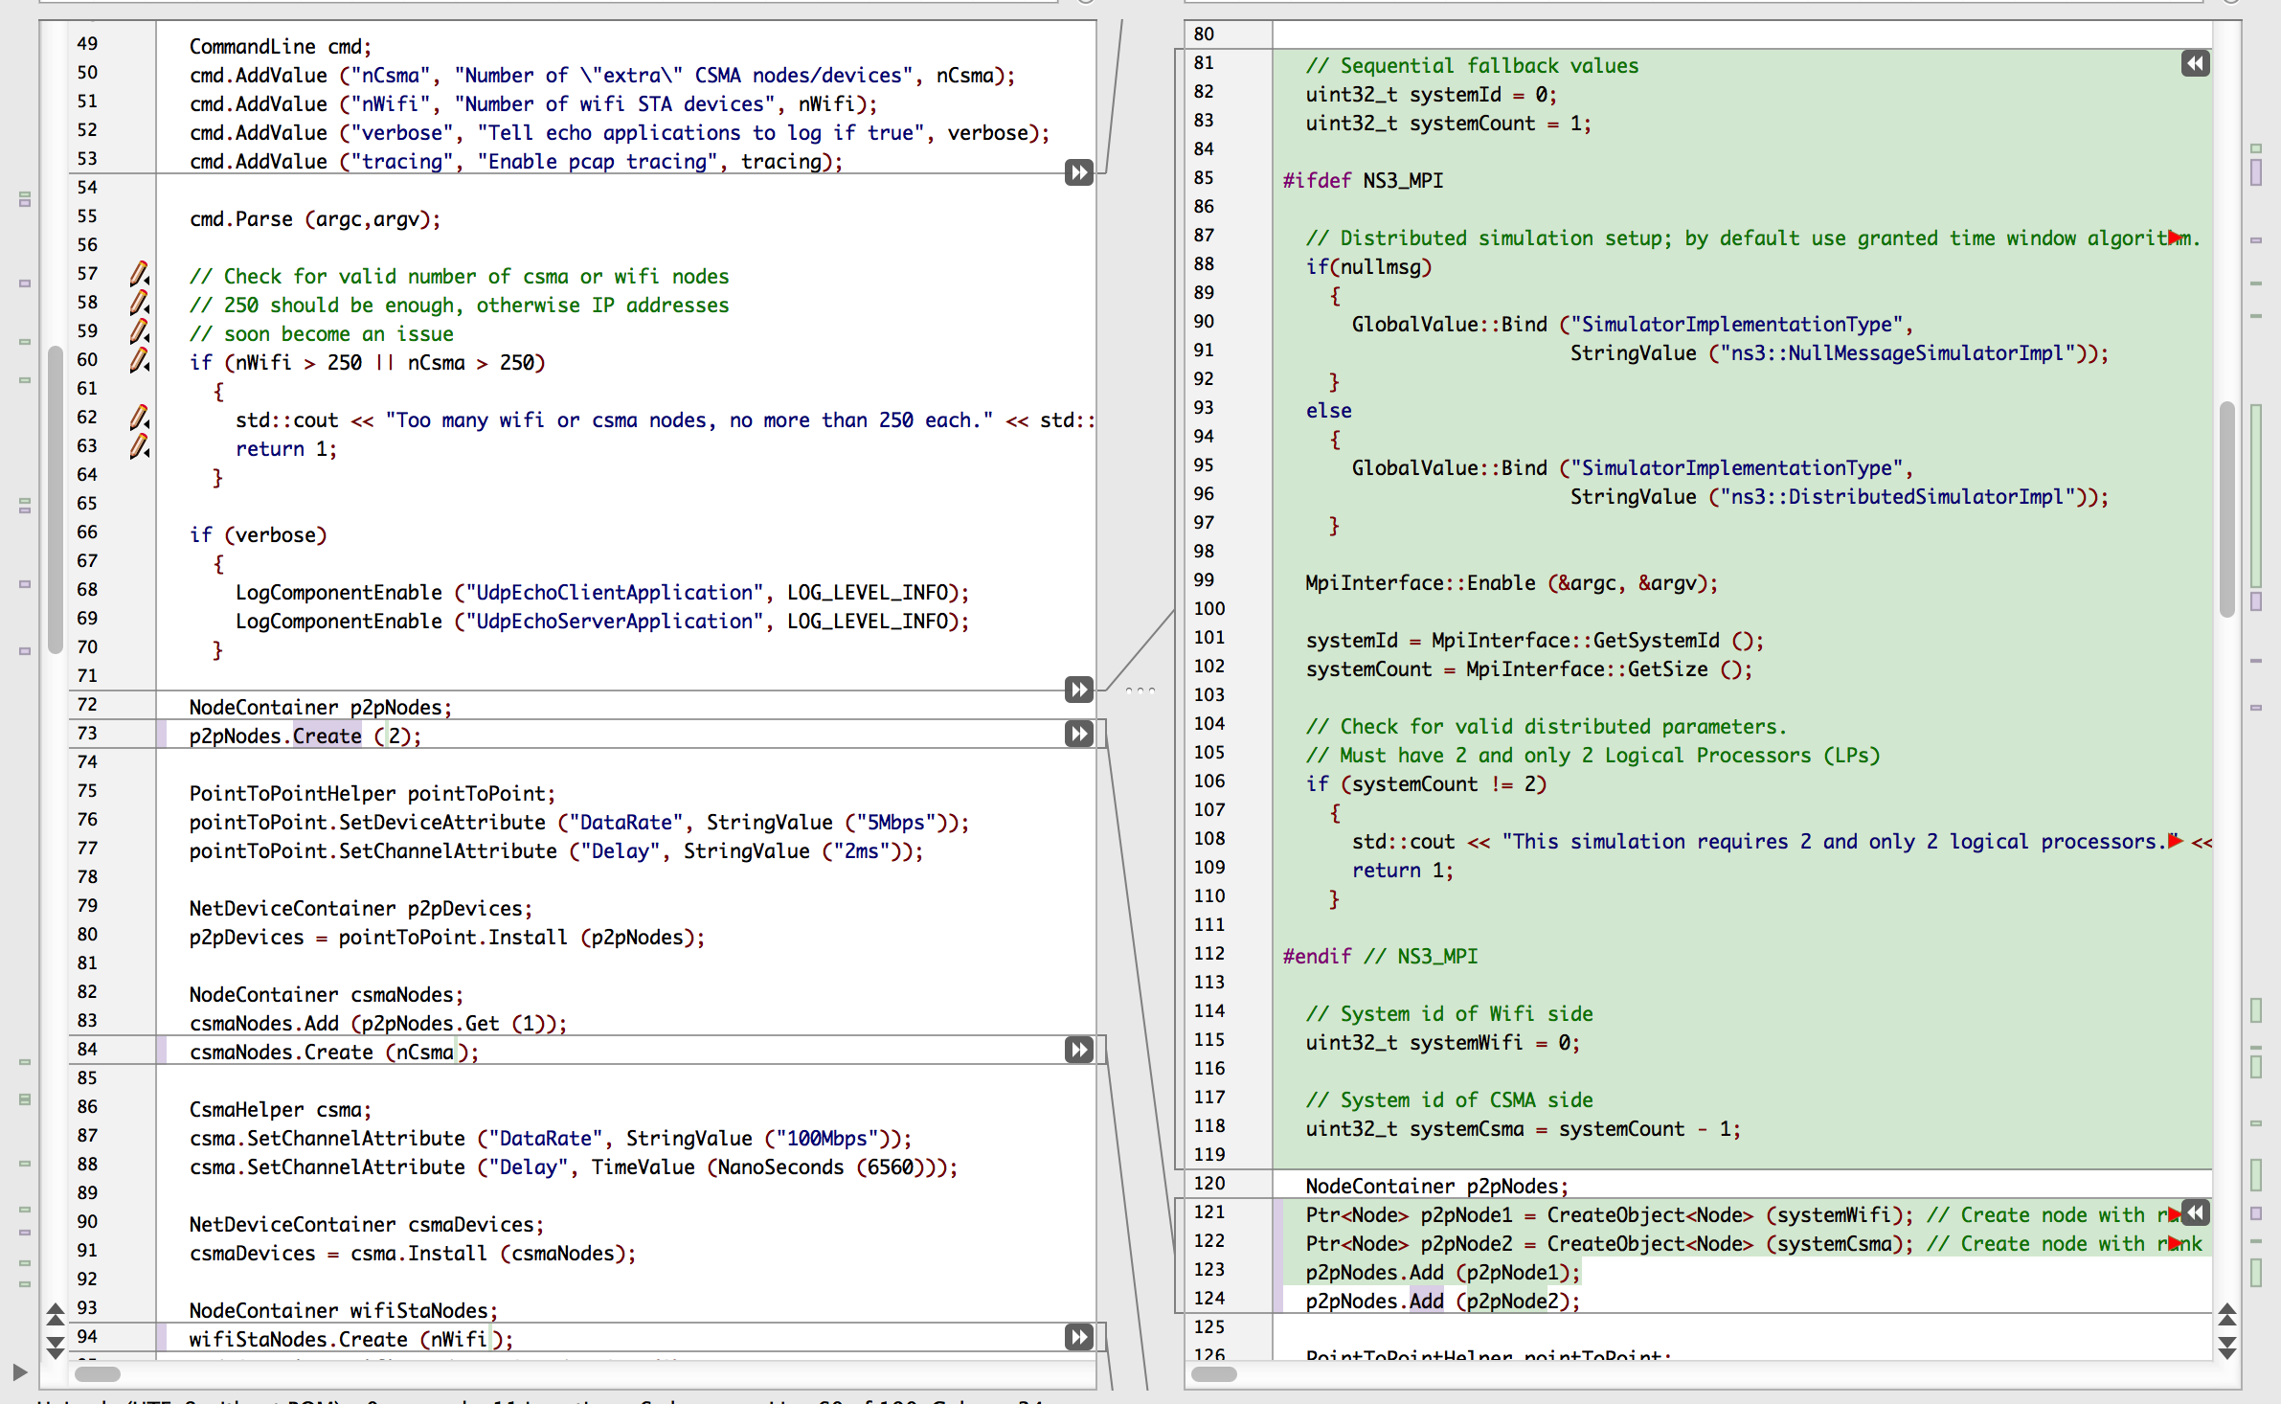
examples/tutorial/third.cc src/mpi/examples/third-distributed.cc
Example
Condition on NS3_MPI
Null message selector
Initialize MPI
Get rank #, number of ranks
Check number of ranks
Use symbolic names for each rank
Create point-to-point nodes
1
2
3
4
5
6
7

Slide 55
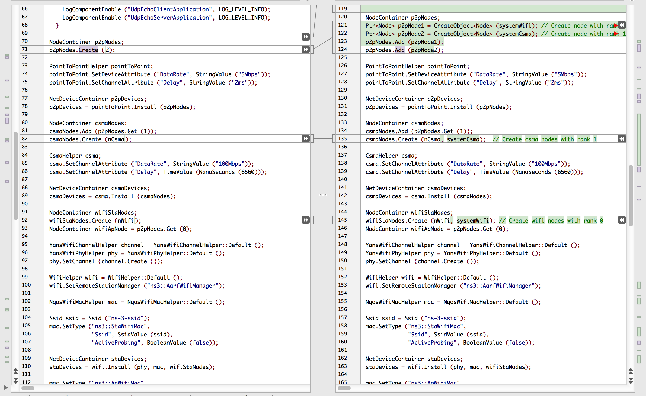
examples/tutorial/third.cc src/mpi/examples/third-distributed.cc
Example
Create CSMA nodes on one rank
Create Wifi nodes on another rank
1
2

Slide 56
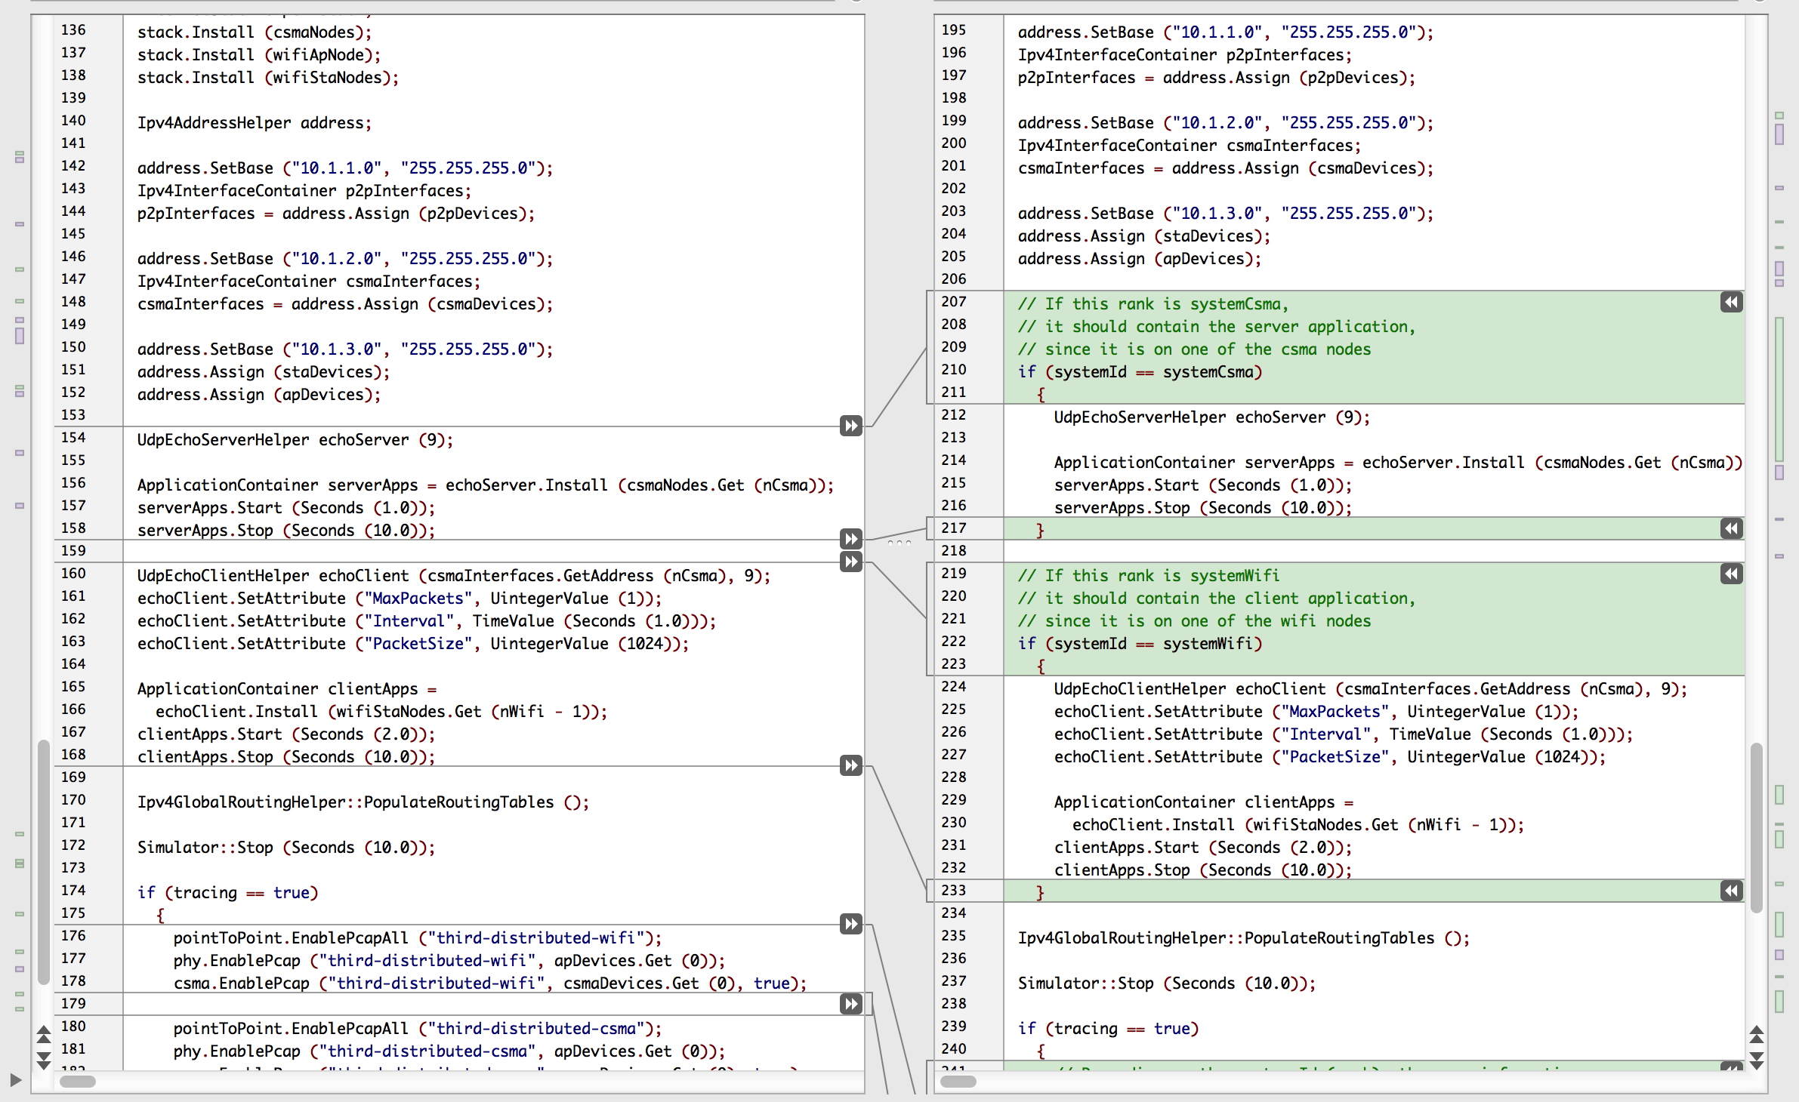
examples/tutorial/third.cc src/mpi/examples/third-distributed.cc
Example
Install devices, addresses and Internet stack everywhere
Install applications only on rank-local nodes
1
2
2

Slide 57
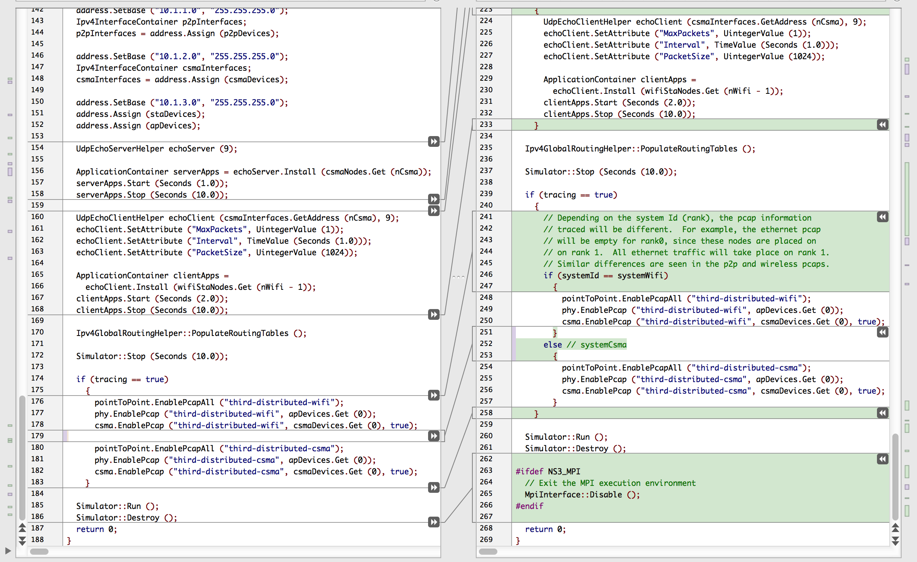
examples/tutorial/third.cc src/mpi/examples/third-distributed.cc
Example
Enable PCAP tracing on local nodes?
Close MPI cleanly
1
2

Slide 58
Script Output–Identical
Example
$ ./waf –run third
Waf: Entering directory `build/debug' Waf: Leaving directory `build/debug' 'build' finished successfully (2.152s) At time 2s client sent 1024 bytes to 10.1.2.4 port 9 At time 2.01796s server received 1024 bytes from 10.1.3.3 port 49153 At time 2.01796s server sent 1024 bytes to 10.1.3.3 port 49153 At time 2.03364s client received 1024 bytes from 10.1.2.4 port 9
$ ./waf --run third-distributed \ --command-template="mpirun -n 2 %s --tracing"
Waf: Entering directory `build/debug' Waf: Leaving directory `build/debug' 'build' finished successfully (2.050s) At time 2s client sent 1024 bytes to 10.1.2.4 port 9 At time 2.01796s server received 1024 bytes from 10.1.3.3 port 49153 At time 2.01796s server sent 1024 bytes to 10.1.3.3 port 49153 At time 2.03364s client received 1024 bytes from 10.1.2.4 port 9

Slide 59
Cryptic Error Conditions
Errors
Can't use distributed simulator without MPI compiled in
  Not finding or building with MPI libraries
  Reconfigure NS-3 and rebuild
assert failed. cond="pNode && pMpiRec", file=../src/mpi/model/mpi-interface.cc, line=413
  Mis-aligned node or interface IDs

Slide 60
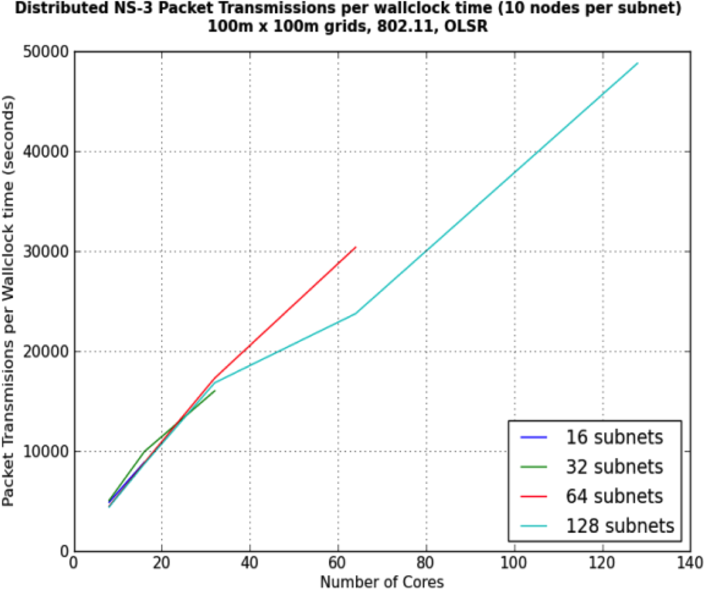
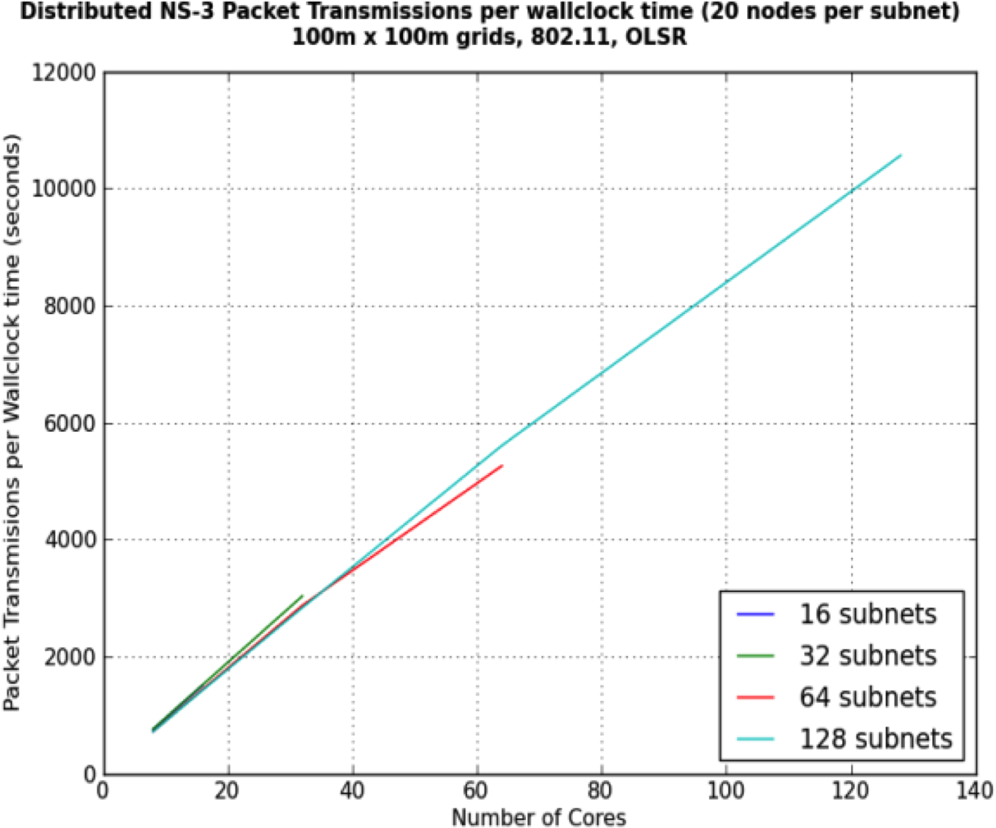
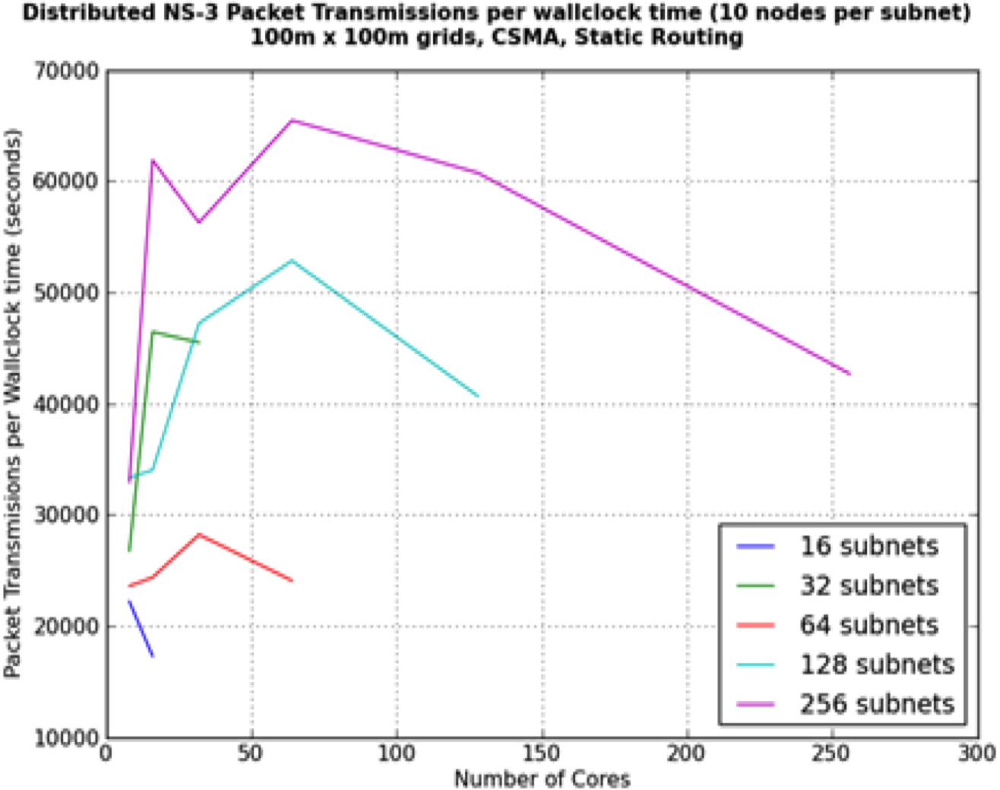
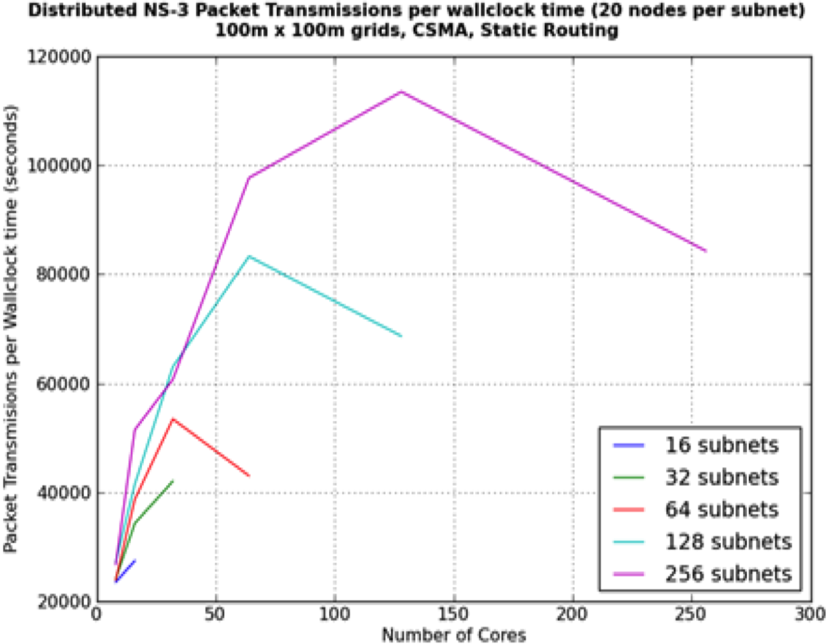
Performance Optimizations
Performance
Larger Lookahead
Synchronization cost grows exponentially with LP count
  More work per LP is better
  Speed gains up to 10²⁻³ ranks, depending on model
Appropriate performance metric
  Events/sec can be misleading with varying event cost
  Packet transmissions (or receives) per wall-clock time

Slide 61
Parallel Performance with Large Computation Load: 802.11+OLSR
Performance
Linear scaling out to 128 ranks

Slide 62
Parallel Performance with Small Computation Load: CSMA+Static
Performance
Performance drops at modest number of ranks

Slide 63
Work in Progress
Future
Automatic memory scaling
  Automatic ghost nodes, globally unique node IDs
  (See WNS3 2015 paper ☺)
Automatic partitioning, ghost alignment
Distributed Real Time
  Versus simultaneous real-time emulations:
    LP-to-LP messaging gives greater Lookahead than independent ns-3 instances connected by emulated network devices
Scalable default routing
  AS-like routing between LPs
  Scalable replacement for GOD or Nix-vector routing with ghost nodes

Slide 64
(Mostly) Parallel Partitioning Tools
Future

