Slide 1
ns-3 Training

Slide 2
Outline
Wi-Fi in detail
  Support of standard features
  Architecture
  Configuration via helpers
Advanced use case: LAA-Wifi-Coexistence
  SpectrumWifiPhy
  Adding a LBT Access Manager
  Scenario support
  Output data processing

Slide 3
Wi-Fi Overview
WiFi module features
  DCF implementation (Basic + RTS/CTS)
  802.11 a/b/g/n/ac (2.4 & 5 GHz) PHY
  MSDU/MPDU aggregation
  QoS support (EDCA)
  Infrastructure and ad-hoc modes
  Many rate adaptation algorithms
  AWGN-based error models
Unsupported features
  MIMO
  11ac advanced features (Tx beamforming, Mu-MIMO)
Related modules
  Mesh (802.11s) and WAVE (802.11p/vehicular)

Slide 4
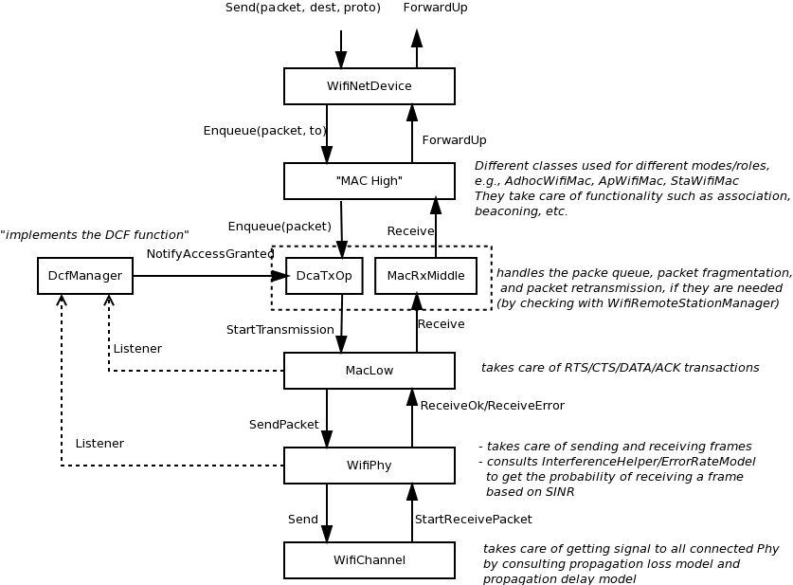
Wi-Fi Architecture

Slide 5
MAC High
Presently, three MAC high models
  AdhocWifiMac: simplest one
  ApWifiMac: beacon, associations by STAs
  StaWifiMac: association based on beacons
All inherit from RegularWifiMac, which handles QoS and non-QoS support

Slide 6
Rate controls
The following rate control algorithms can be used by the MAC low layer:
Algorithms found in real devices:
  ArfWifiManager (default for WifiHelper), OnoeWifiManager, ConstantRateWifiManager, MinstrelWifiManager, MinstrelHtWifiManager
Algorithms in literature:
  IdealWifiManager, AarfWifiManager, AmrrWifiManager, CaraWifiManager, RraaWifiManager, AarfcdWifiManager, ParfWifiManager, AparfWifiManager
Example use of constant rate
std::string phyMode ("OfdmRate54Mbps");
wifi.SetRemoteStationManager ("ns3::ConstantRateWifiManager",
"DataMode",StringValue (phyMode),
"ControlMode",StringValue (phyMode));

Slide 7
MAC Middle/Low
Three components:
MacLow
  RTS/CTS/DATA/ACK transactions
  Aggregation, Block acks
DcfManager
  implements the DCF
DcaTxop and EdcaTxopN:
  One for NQoS, the other for QoS
  Packet queue
  Fragmentation/Retransmissions

Slide 8
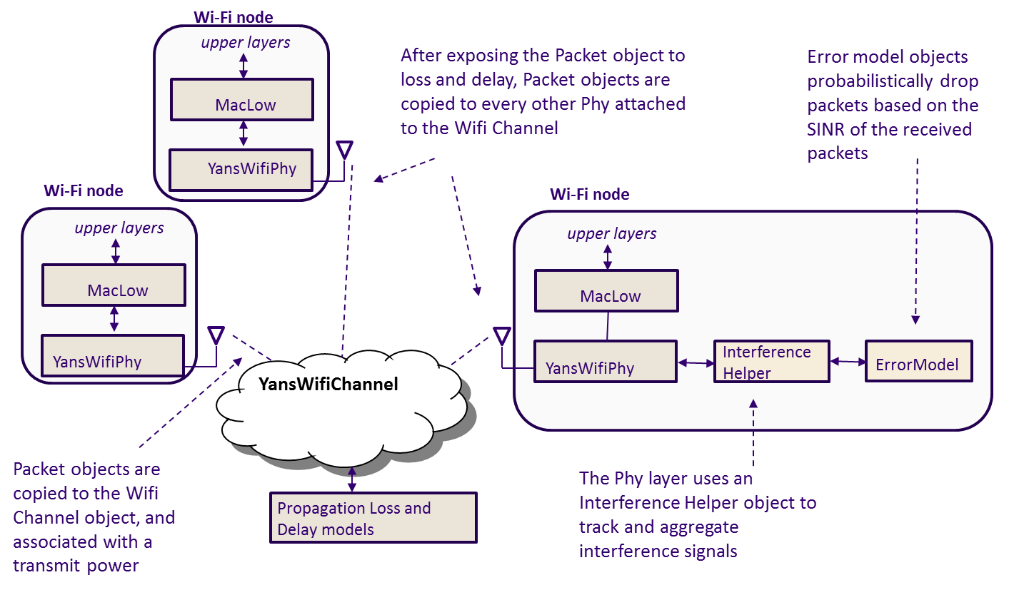
Current Wi-Fi PHY abstraction

Slide 9
Physical layer
No AGC model
Sync on first RX with energy > detection threshold
Collision: the error model will likely cause a drop of the packet
No capture effect: won’t re-sync on a stronger packet

Slide 10
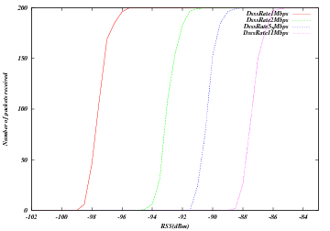
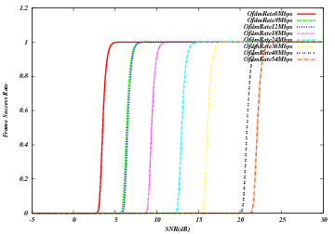
Error models
Based on analytical models with error bounds
Three implementations with different bounds: YansErrorRateModel, NistErrorRateModel, DssErrorRateModel
DsssErrorRateModel
NistErrorRateModel (OFDM)

Slide 11
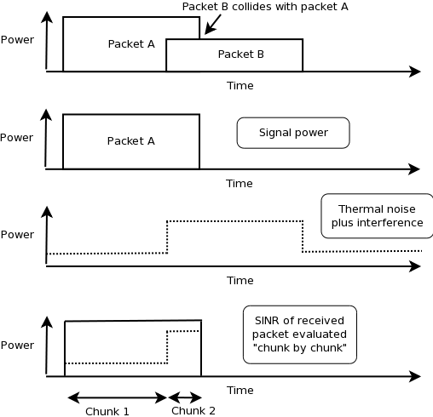
Interference helper
SINR evaluated on chunk-by-chunk basis

Slide 12
Configuring 802.11n/ac
Example programs include
  examples/wireless/ht-wifi-network.cc
  examples/wireless/vht-wifi-network.cc
  examples/wireless/wifi-aggregation.cc
Setting the WifiPhyStandard will set most defaults reasonably
  WifiHelper wifi;
  wifi.SetStandard (WIFI_PHY_STANDARD_80211ac);
  WifiMacHelper mac;
802.11ac uses 80 MHz channel by default; 802.11n uses 20 MHz

Slide 13
802.11n/ac rate controls
Possible options are IdealWifiManager, MinstrelHtWifiManager, and ConstantRateWifiManager
examples:
  src/wifi/examples/ideal-wifi-manager-example.cc
  src/wifi/examples/minstrel-ht-wifi-manager-example.cc

Slide 14
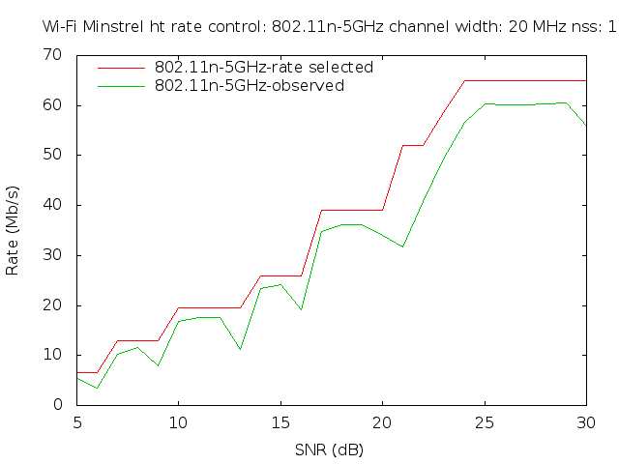
Example output for MinstrelHt
$ ./waf --run "minstrel-ht-wifi-manager-example --standard=802.11n-5GHz"
$ gnuplot minstrel-ht-802.11n-5GHz-20MHz-LGI-1SS.plt

Slide 15
Typical configuration
std::string phyMode ("DsssRate1Mbps");
NodeContainer ap;
ap.Create (1);
NodeContainer sta;
sta.Create (2);
WifiHelper wifi;
wifi.SetStandard (WIFI_PHY_STANDARD_80211b);
YansWifiPhyHelper wifiPhy = YansWifiPhyHelper::Default ();
// ns-3 supports RadioTap and Prism tracing extensions for 802.11
wifiPhy.SetPcapDataLinkType (YansWifiPhyHelper::DLT_IEEE802_11_RADIO);
YansWifiChannelHelper wifiChannel;
// reference loss must be changed since 802.11b is operating at 2.4GHz
wifiChannel.SetPropagationDelay ("ns3::ConstantSpeedPropagationDelayModel");
wifiChannel.AddPropagationLoss ("ns3::LogDistancePropagationLossModel",
"Exponent", DoubleValue (3.0),
"ReferenceLoss", DoubleValue (40.0459));
wifiPhy.SetChannel (wifiChannel.Create ());

Slide 16
Typical configuration (cont.)
// Add a non-QoS upper mac, and disable rate control
WifiMacHelper wifiMac;
wifi.SetRemoteStationManager ("ns3::ConstantRateWifiManager",
"DataMode",StringValue (phyMode),
"ControlMode",StringValue (phyMode));
// Setup the rest of the upper mac
Ssid ssid = Ssid ("wifi-default");
// setup ap.
wifiMac.SetType ("ns3::ApWifiMac",
"Ssid", SsidValue (ssid));
NetDeviceContainer apDevice = wifi.Install (wifiPhy, wifiMac, ap);
NetDeviceContainer devices = apDevice;
// setup sta.
wifiMac.SetType ("ns3::StaWifiMac",
"Ssid", SsidValue (ssid),
"ActiveProbing", BooleanValue (false));
NetDeviceContainer staDevice = wifi.Install (wifiPhy, wifiMac, sta);
devices.Add (staDevice);

Slide 17
Typical configuration (cont.)
// Configure mobility
MobilityHelper mobility;
Ptr<ListPositionAllocator> positionAlloc = CreateObject<ListPositionAllocator> ();
positionAlloc->Add (Vector (0.0, 0.0, 0.0));
positionAlloc->Add (Vector (5.0, 0.0, 0.0));
positionAlloc->Add (Vector (0.0, 5.0, 0.0));
mobility.SetPositionAllocator (positionAlloc);
mobility.SetMobilityModel ("ns3::ConstantPositionMobilityModel");
mobility.Install (ap);
mobility.Install (sta);
// other set up (e.g. InternetStack, Application)

Slide 18
Athstats helper
Hooks Wi-Fi traces to provide debugging similar to Madwifi drivers
Example athstats output from example ./waf --run wifi-ap
m_txCount m_rxCount unused short long exceeded rxError
0 0 0 0 0 0 0 0 0 0 0M
0 60 0 0 0 0 0 0 0 0 0M
0 123 0 0 0 0 0 0 0 0 0M
0 122 0 0 0 0 0 0 0 0 0M
0 122 0 0 0 0 0 0 0 0 0M
0 122 0 0 0 0 0 0 0 0 0M
0 122 0 0 0 0 2 0 0 0 0M
0 122 0 0 0 0 23 0 0 0 0M
0 122 0 0 0 0 14 0 0 0 0M
0 122 0 0 0 0 14 0 0 0 0M
0 122 0 0 0 0 26 0 0 0 0M
0 122 0 0 0 0 12 0 0 0 0M

Slide 19
LTE/Wi-Fi Coexistence

Slide 20
Use case: LAA Wi-Fi Coexistence
ns-3 has been extended to support scenarios for LTE LAA/Wi-Fi Coexistence
Methodology defined in 3GPP Technical Report TR36.889
Enhancements needed:
  Wireless models (LBT access manager, SpectrumWifiPhy, propagation/fading models)
  Scenario support (traffic models)
  Output data processing

Slide 21
Indoor 3GPP scenario

Slide 22
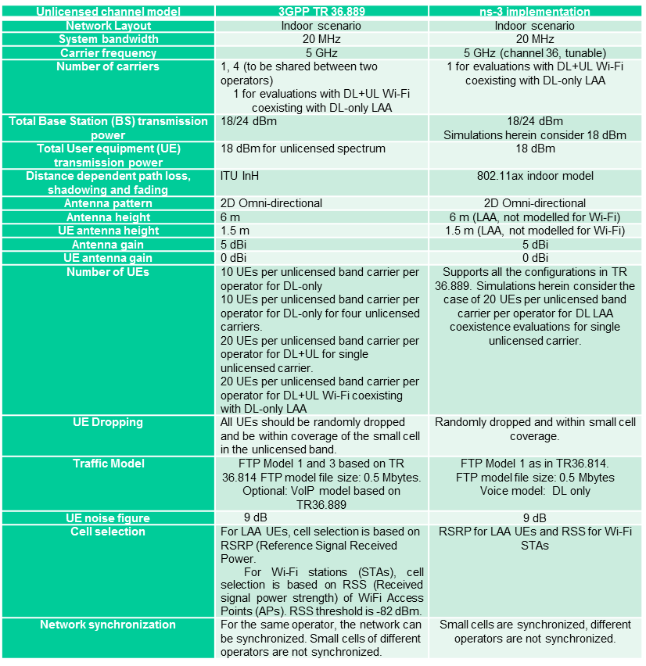
Indoor scenario details

Slide 23
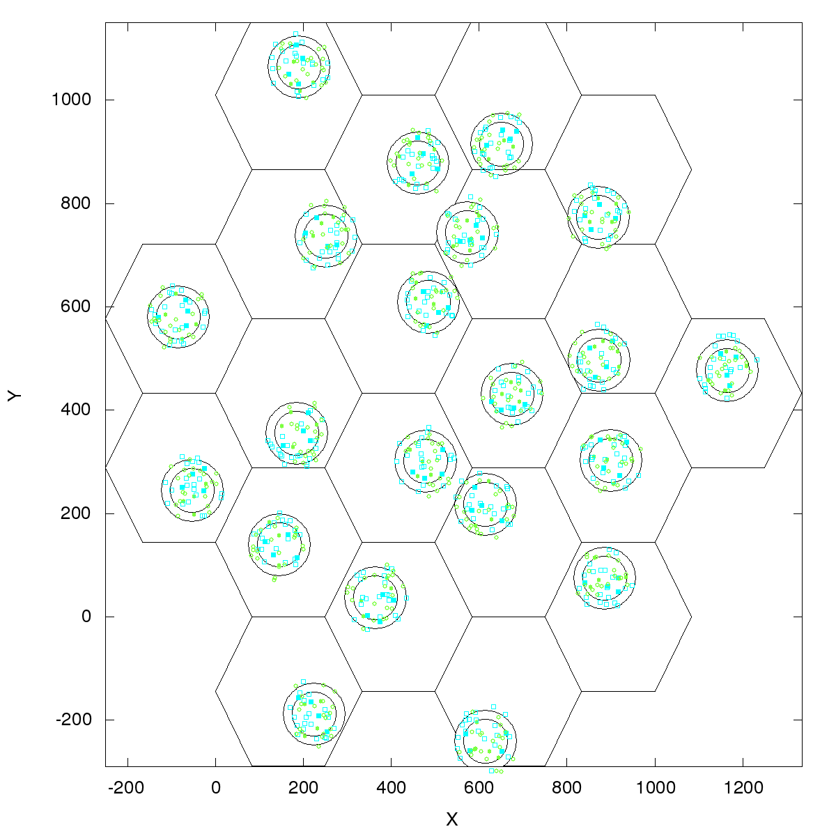
Outdoor 3GPP scenario
Outdoor layout: hexagonal macrocell layout. 7 macro sites and 3 cells per site. 1 Cluster per cell. 4 small cells per operator per cluster, uniformly dropped. ITU UMi channel model.
Figure source: 3GPP TR 36.889 V13.0.0 (2015-05)

Slide 24
References
ns-3 Wiki page:
  https://www.nsnam.org/wiki/LAA-WiFi-Coexistence
    module documentation
    references to various publications
    documentation on reproducing results
Code:
  http://code.nsnam.org/laa/ns-3-lbt

Slide 25
Sample results

Slide 26
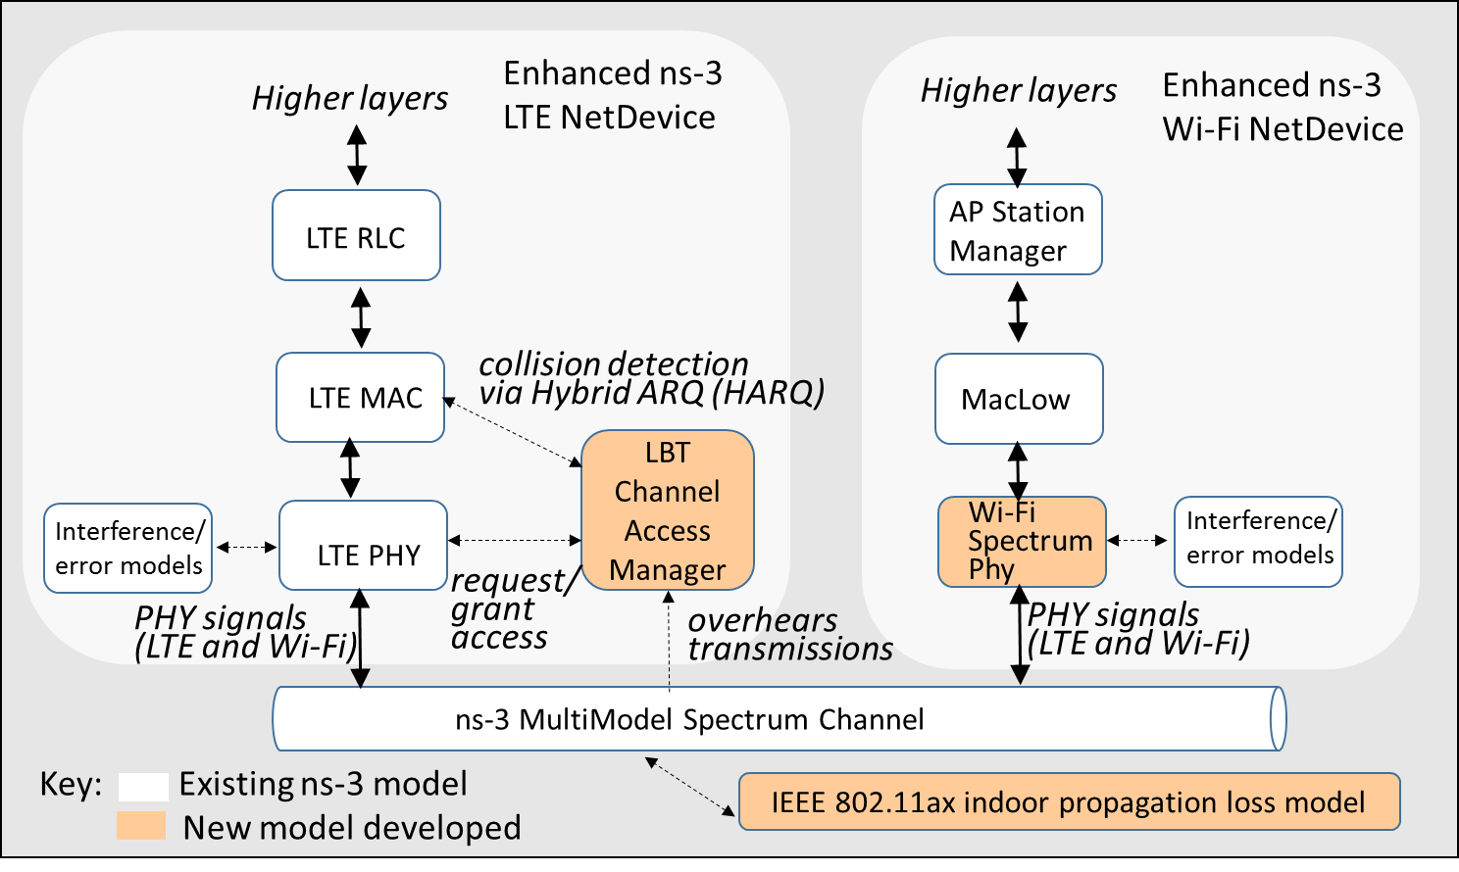
Wi-Fi enhancements

Slide 27
Model enhancements: Wi-Fi
Spectrum Wi-Fi Phy implementation
Wi-Fi preamble detection based on AWGN and TGn Channel Model D
Wi-Fi RSS-based AP selection and roaming
Wi-Fi MIMO approximations to support 2x2 DL, 1x2 DL on AWGN and TGn Model D

Slide 28
Model enhancements: LTE
LTE interference model relies on the simplifying assumption that all interfering signals are LTE and are synchronized at the subframe level.
LTE inteference model has been enhanced to handle inteference by signals of any type.
This relies on the ns-3 Spectrum framework.
The reception of LTE signals is evaluated by chunks, where each chunk is identified by a constant power spectral density.

Slide 29
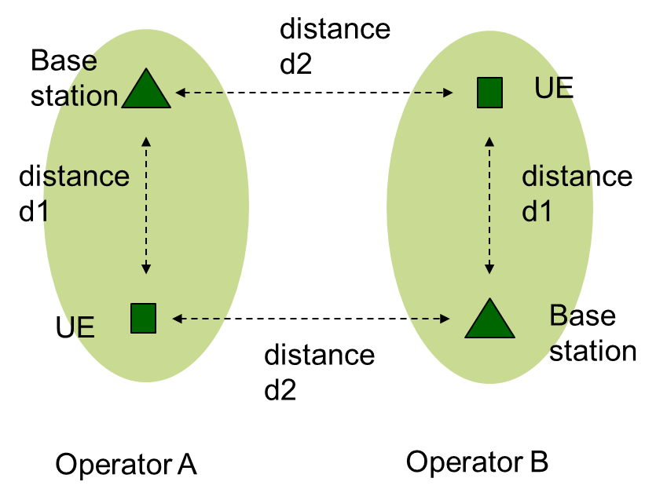
Scenario
An initial test scenario, useful for testing basic model operation in a small scale setting, grew into TR36.889-like indoor and outdoor scenarios
D1 and d2 can vary and operator A and B can be both LTE or Wi-Fi

Slide 30
Output experiment scripts
Shell scripts and gnuplot helpers to manage configuration and data output
(demonstrate)

Slide 31
Status
Portions are being migrated into ns-3-dev
  SpectrumWifiPhy in ns-3.26
  LTE components, propagation model likely in ns-3.27
  Scenario helper may be rewritten
Trying to decompose into pieces easy to merge
For more information:
  https://www.nsnam.org/wiki/LAA-WiFi-Coexistence

