Slide 1
ns-3 Direct Code Execution
ns-3 Annual Meeting
June 2016

Slide 2
Credits
DCE originated with Mathieu Lacage (INRIA), was substantially developed by Emilio Mancini and Frederic Urbani (INRIA), and finished off by Hajime Tazaki
DCE leverages the bake build system substantially developed by Daniel Camara (INRIA)
DCE is presently maintained by Hajime Tazaki and Matthieu Coudron.

Slide 3
Outline
High-level overview of DCE
Bake build system
  Example: ns-allinone-3.25 via Bake
DCE examples:
  iperf
  thttpd
  Quagga ospfd
Q&A

Slide 4
Goals
Lightweight virtualization of kernel and application processes, interconnected by simulated networks
Benefits:
  Implementation realism in controlled topologies or wireless environments
  Model availability
  Debugging a whole network within a single process
Limitations:
  Not as scalable as pure simulation
  Tracing more limited
  Configuration different
  C or C++ applications only

Slide 5
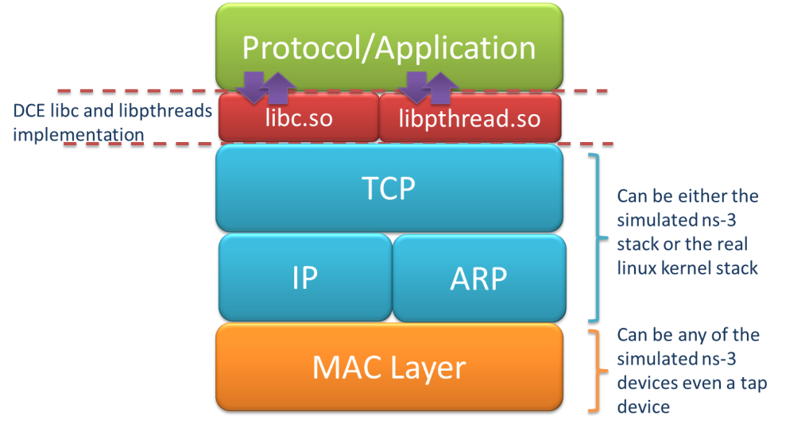
Direct Code Execution
DCE/ns-3 framework requires the virtualization of a series of services
  Multiple isolated instances of the same protocol on the same machine
System calls are captured and treated by DCE
Network stack protocols calls are captured and redirected
To perform its work, DCE
re-implements the Linux
program loader and parts
of libc and libpthread

Slide 6
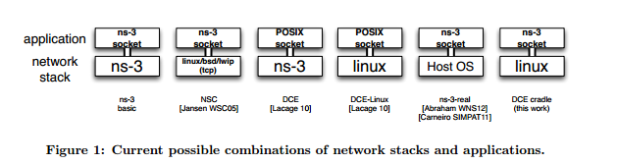
DCE modes
DCE modes in context of possible approaches
Figure source: DCE Cradle: Simulate Network Protocols with Real Stacks for Better Realism, Tazaki et al, WNS3 2013.

Slide 7
References
Direct Code Execution: Revisiting Library OS Architecture for Reproducible Network Experiments
  Tazaki et al, CONEXT 2013
  http://hal.archives-ouvertes.fr/docs/00/88/08/70/PDF/con013-hal.pdf
DCE Cradle: Simulate Network Protocols with Real Stacks for Better Realism
  Tazaki et al, WNS3 2013
  http://hal.archives-ouvertes.fr/docs/00/78/15/91/PDF/wns3-2013.pdf
NetDev 1.1 talk (Feb. 2016): "LibOS as a regression test framework for Linux networking"
  https://www.youtube.com/watch?v=FNGkMFmboEc

Slide 8
Practical issues
All software must be re-compiled with –fpic and linked with –pie to generate the code as Position Independent Code (PIC)
Executables need to be installed to a place where DCE can find it
Applications may require system dependencies
Requires coverage of selected POSIX calls
Execution must be managed (e.g. start/stop time)
Programs may require:
  configuration files
  environment variables
  input files
How much stack size to allocate to programs?
Programs generate output (stdout, stderr, files)

Slide 9
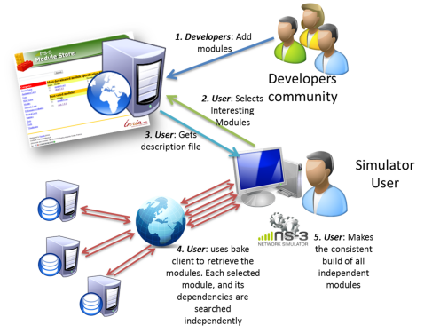
bake overview
Open source project maintains a (more stable) core
Models migrate to a more federated development process
"bake" tool (Lacage and Camara)
Components:
build client
"module store" server
module metadata
Figure source: Daniel Camara

Slide 10
bake basics
bake can be used to build the Python bindings toolchain, Direct Code Execution, Network Simulation Cradle, etc.
Manual available at https://www.nsnam.org/docs/bake/tutorial/html/index.html
./bake.py configure -e <module>
./bake.py check
./bake.py show
./bake.py download
./bake.py build

Slide 11
Placeholder slide for demoing bake
Demo: bake.py configure -e ns-allinone-3.25
Look at: build/ libraries and executables

Slide 12
bakeconf example
<module name="ns-allinone-3.25">
<source type="none"/>
<depends_on name="netanim-3.107" optional="True"/>
<depends_on name="nsc-0.5.3" optional="True"/>
<depends_on name="pybindgen-0.17.0.post49+ng0e4e3bc" optional="True"/>
<depends_on name="pyviz-prerequisites" optional="True"/>
<depends_on name="click-ns-3.25" optional="True"/>
<depends_on name="openflow-ns-3.25" optional="True"/>
<depends_on name="pygccxml-1.0.0" optional="True"/>
<depends_on name="gccxml-ns3" optional="True"/>
<depends_on name="BRITE" optional="True"/>
<depends_on name="ns-3.25" optional="False"/>
<build type="none"/>
</module>

Slide 13
Goals
Lightweight virtualization of kernel and application processes, interconnected by simulated networks
Benefits:
  Implementation realism in controlled topologies or wireless environments
  Model availability
  Debugging a whole network within a single process
Limitations:
  Not as scalable as pure simulation
  Tracing more limited
  Configuration different

Slide 14
DCE example walkthrough
cd ns-allinone-3.25
export BAKE_HOME=`pwd`/bake
export PATH=$PATH:$BAKE_HOME
export PYTHONPATH=$PYTHONPATH:$BAKE_HOME
cd bake
bake.py configure -e dce-ns3-1.8
bake.py check
bake.py show
bake.py download
bake.py build
cd source/ns-3-dce
./waf --run dce-iperf

Slide 15

The shared scenario
Node 0
Node 1
Node 2
iperf/HTTPD
iperf/wget
10.1.1.1
10.1.1.2
10.1.2.1
10.1.2.2
5 Mbps, 1 ms
5 Mbps, 1 ms
The shared scenario is a simple two node network

Slide 16

Step by step example
- What we need to do!
Create the nodes
Create stack
Create devices
Set addresses
Connect devices
Create DCE
Configuration the applications to run
Set start time for server and client
Set simulation time
Start simulation

Slide 17
Step by step example
- What we need to do!
Standard ns-3 procedures
DCE specific
Create the nodes
Create stack
Create devices
Set addresses
Connect devices
Create DCE
Configuration the applications to run
Set start time for server and client
Set simulation time
Start simulation

Slide 18
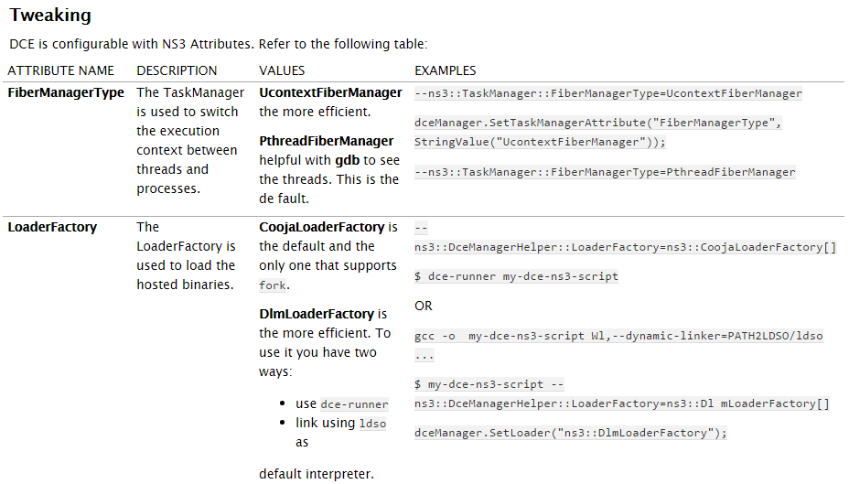
Tuning DCE

Slide 19
Adding system calls
What can go wrong (example: strfry not defined)
% ./waf --run dce-udp-perf
'build' finished successfully (0.704s)
/home/tazaki/hgworks/dce-dev/source/ns-3-dce/build/bin/dce-udp-perf: **relocation error: elf-cache/0/udp-perf: symbol strfry**, version GLIBC_2.2.5 not defined in file 0002.so.6 with link time reference
Command ['/home/tazaki/hgworks/dce-dev/source/ns-3-dce/build/bin/dce-udp-perf'] exited with code 127
Manual describes how to deal with this

Slide 20
Troubleshooting DCE
Simulation process may exceed system limit of open files per process
  check 'ulimit -n' and edit limits on your system
Maximum number of processes may exceed system limit
  check 'ulimit -u' and edit limits on your system
DCE stack size default of 8192 may need to be increased (stack overflow exceptions)
  DceApplicationHelper dce;
  dce.SetStackSize (1<<20);

Slide 21
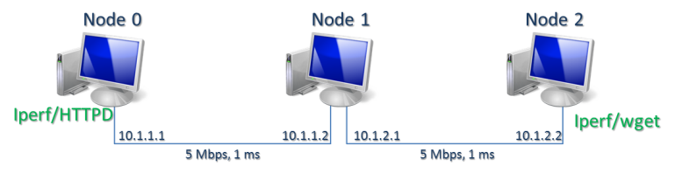
Step by step example
- iperf with ns-3 stack (I)
int main (int argc, char *argv[])
{
// Node Container creation
NodeContainer nodes;
nodes.Create (3);
// Linux stack creation
InternetStackHelper stack;
stack.Install (nodes);
// For real time
// GlobalValue::Bind ("SimulatorImplementationType", StringValue ("ns3::RealtimeSimulatorImpl"));
// GlobalValue::Bind ("ChecksumEnabled", BooleanValue (true));
// Device and channel creation
PointToPointHelper p2p;
p2p.SetDeviceAttribute ("DataRate", StringValue ("5Mbps“));
p2p.SetChannelAttribute ("Delay", StringValue ("1ms"));

Slide 22
Step by step example
- iperf with ns-3 stack (II)
// Node0-Node1 setup
Ipv4AddressHelper address;
address.SetBase ("10.1.1.0", "255.255.255.252"); // Node0-Node1 addresses
NetDeviceContainer devices;
devices = p2p.Install (nodes.Get (0), nodes.Get (1)); // connecting nodes
Ipv4InterfaceContainer interfaces = address.Assign (devices); // assign addresses
// Node1-Node2 setup
devices = p2p.Install (nodes.Get (1), nodes.Get (2)); // connecting nodes
address.SetBase ("10.1.2.0", "255.255.255.252"); // Node1-Node2 addresses
interfaces = address.Assign (devices); // assign addresses
// setup ip routes
Ipv4GlobalRoutingHelper::PopulateRoutingTables ();

Slide 23
Step by step example
- iperf with ns-3 stack (III)
DceManagerHelper dceManager;
dceManager.Install (nodes);
DceApplicationHelper dce;
ApplicationContainer apps;
dce.SetStackSize (1 << 20); // 1MB stack
dce.SetBinary ("iperf"); // Launch iperf client on node 0
dce.ResetArguments (); // clean arguments
dce.ResetEnvironment (); // clean environnent
dce.AddArgument ("-c"); // client
dce.AddArgument ("10.1.2.2"); //target machine address
dce.AddArgument ("-i"); // interval
dce.AddArgument ("1");
dce.AddArgument ("--time"); // how long
dce.AddArgument ("10");
apps = dce.Install (nodes.Get (0)); //install application
apps.Start (Seconds (0.7)); //start at 0.7 simulation time
apps.Stop (Seconds (20)); //stop at 20s simulation time
dce.SetBinary ("iperf"); // Launch iperf server on node 2
dce.ResetArguments (); // clean arguments
dce.ResetEnvironment (); // clean environnent
dce.AddArgument ("-s"); // server
dce.AddArgument ("-P"); // number of paralell servers
dce.AddArgument ("1");
apps = dce.Install (nodes.Get (2));
apps = dce.Install (nodes.Get (2));
apps.Start (Seconds (0.6));
DCE Setup

Slide 24
Step by step example
- iperf with ns-3 stack (IV)
// Simulation stop time
Simulator::Stop (Seconds (40.0));
// Run
Simulator::Run ();
// Stop
Simulator::Destroy ();
return 0;
}

Slide 25
Step by step example – iperf, ns-3
Generated
  elf-cache – program files
  exitprocs – execution process information
  files-0 files-2 – execution filesystem
files-x
  files-x corresponds to “/” of the machine x
  files-x/var/log/<pid>/
    cmdline – command executed
    status – execution information
    stderr – standard error output
    stdout – standard output
    syslog – syslog output

Slide 26
Step by step example
- HTTP with ns-3 stack (I)
int main (int argc, char *argv[])
{
// Node Container creation
NodeContainer nodes;
nodes.Create (3);
// Linux stack creation
InternetStackHelper stack;
stack.Install (nodes);
// For real time
// GlobalValue::Bind ("SimulatorImplementationType", StringValue ("ns3::RealtimeSimulatorImpl"));
// GlobalValue::Bind ("ChecksumEnabled", BooleanValue (true));
// Device and channel creation
PointToPointHelper p2p;
p2p.SetDeviceAttribute ("DataRate", StringValue ("5Mbps“));
p2p.SetChannelAttribute ("Delay", StringValue ("1ms"));

Slide 27
Step by step example
- HTTP with ns-3 stack (II)
// Node0-Node1 setup
Ipv4AddressHelper address;
address.SetBase ("10.1.1.0", "255.255.255.252"); // Node0-Node1 addresses
NetDeviceContainer devices;
devices = p2p.Install (nodes.Get (0), nodes.Get (1)); // connecting nodes
Ipv4InterfaceContainer interfaces = address.Assign (devices); // assign addresses
// Node1-Node2 setup
devices = p2p.Install (nodes.Get (1), nodes.Get (2)); // connecting nodes
address.SetBase ("10.1.2.0", "255.255.255.252"); // Node1-Node2 addresses
interfaces = address.Assign (devices); // assign addresses
// setup ip routes
Ipv4GlobalRoutingHelper::PopulateRoutingTables ();

Slide 28
Step by step example
- HTTP with ns-3 stack (III)
// Launch the server HTTP
dce.SetBinary ("thttpd");
dce.ResetArguments (); // clean arguments
dce.ResetEnvironment (); // clean environnent
dce.SetUid (1); // Set httpd for super user execution
dce.SetEuid (1);
apps = dce.Install (nodes.Get (0)); // install http daemon
apps.Start (Seconds (1)); // start time
// Launch the client WGET
dce.SetBinary ("wget");
dce.ResetArguments (); // clean arguments
dce.ResetEnvironment (); // clean environnent
dce.AddArgument ("-r"); // recursive wget
dce.AddArgument ("http://10.1.1.1/index.html");
apps = dce.Install (nodes.Get (2));
apps.Start (Seconds (2)); // start time
DCE Setup

Slide 29
Step by step example
- HTTP with ns-3 stack (IV)
// Simulation stop time
Simulator::Stop (Seconds (40.0));
// Run
Simulator::Run ();
// Stop
Simulator::Destroy ();
return 0;
}

Slide 30
With/without linux kernel
with ns-3 stack
  ./waf --run "dce-httpd --kernel=0"
with Linux stack
  ./waf --run "dce-httpd --kernel=1"

Slide 31
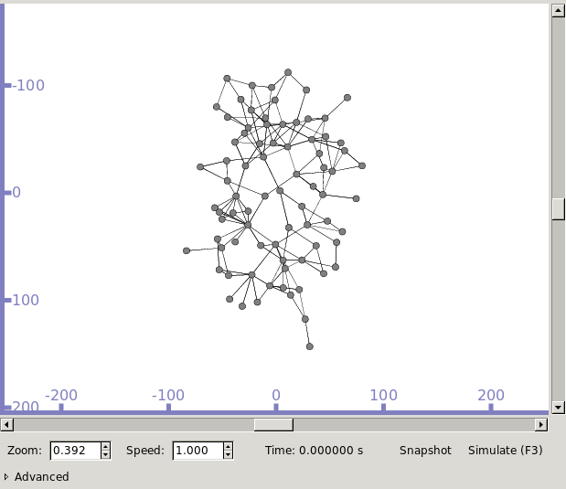
DCE example 3: quagga ospfd
Topology: from rocketfuel tool
Routing: ospfd (IPv4), all in area 0
Traffic: ns-3's v4Ping application across topology

Slide 32
Bugs in ns-3.25 version:
1) small typo in myscripts/ns-3-dce-quagga/wscript
diff -r 088f43fecbd0 wscript
--- a/wscript Tue Dec 01 11:26:23 2015 +0900
+++ b/wscript Tue Jun 14 09:42:43 2016 -0700
@@ -46,7 +46,7 @@
target='bin/dce-zebra-simple',
source=['example/dce-zebra-simple.cc'])
- module.add_example(needed = ['core', 'internet', 'dce-quagga', 'point-to-point', 'internet-apps,' 'applications', 'topology-read'],
+ module.add_example(needed = ['core', 'internet', 'dce-quagga', 'point-to-point', 'internet-apps', 'applications', 'topology-read'],
target='bin/dce-quagga-ospfd-rocketfuel',
source=['example/dce-quagga-ospfd-rocketfuel.cc'])
2) --vis option for DCE requires some symlinks in the bake/build/lib64/python2.7/site-packages directory

Slide 33
DCE example 3 walkthrough
cd ns-allinone-3.25
export BAKE_HOME=`pwd`/bake
export PATH=$PATH:$BAKE_HOME
export PYTHONPATH=$PYTHONPATH:$BAKE_HOME
cd bake
bake.py configure -e dce-ns3-1.8 dce-quagga-1.8
bake.py check
bake.py show
bake.py download
bake.py build
cd source/ns-3-dce
./waf --run dce-quagga-ospfd-rocketfuel (--vis)

