Slide 1
ns-3 Training
ns-3 Annual Meeting
June 2017

Slide 2
ns-3 training goals
Make attendees more productive with ns-3
  Learn about the project scope, and where to get additional help
  Understand the architecture and design goals of the software
  Introduce how to write new code for the simulator
  Learn about selected topics in more detail
  Answer your questions

Slide 3
Agenda and Instructors
Software and usage overview (T. Henderson)
How to write new models (T. Pecorella)
Wi-Fi and wireless models (T. Henderson)
TCP and AQM models (M. Tahiliani)
Traffic control (S. Avallone)
Please ask questions!
Please ask questions along the way!

Slide 4
Additional training archives
LTE (Lorenza Giupponi and Biljana Bojovic), June 2016
Parallel, Distributed Simulations (Peter Barnes), June 2016
Direct Code Execution (Tom Henderson), June 2016
Tracing (Walid Younes), June 2014
Please ask questions!
http://www.nsnam.org/wiki/Training2017

Slide 5
Your feedback on requested topics
1) what is your past level of experience with ns-3?
  various (from starting the tutorial to having written new models)
2) what technical topics in the simulator interest you the most?
  Wi-Fi, LTE, TCP
  routing 6LoWPAN, IoT, IPv6, BGP, and the core
3) past level of experience with any other network simulation tools?
  MATLAB/Simulink, plus ns-2, OPNET, OMNeT++, Totem

Slide 6
Your feedback on requested topics
4) what do you most want to get out of the training sessions
  refresh, get ideas for lab assignments, understand real-time simulations, inject real traffic, global tips and tricks about ns-3, learn LTE, implement new models

Slide 7
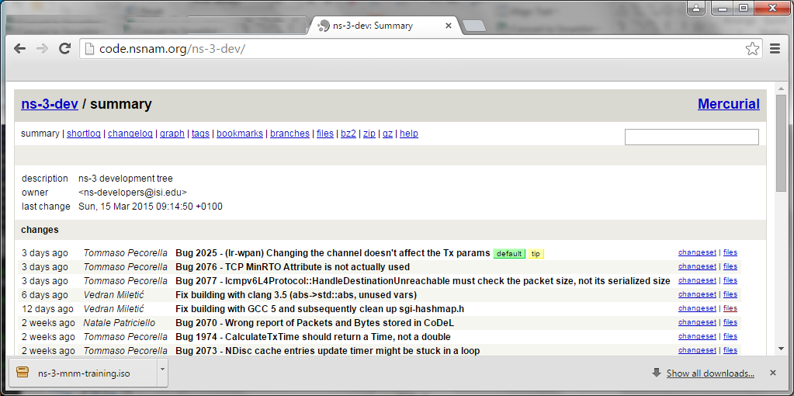
Options for working along
1) Download the required packages onto your (Linux, OS X, or BSD) system
2) Download the ISO image (Live DVD)
3) Browse the code online: https://code.nsnam.org

Slide 8
Project overview

Slide 9
Motivations for ns-3 project
Develop an extensible simulation environment for networking research
  1) a tool aligned with the experimentation needs of modern networking research
  2) a tool that elevates the technical rigor of network simulation practice
  3) an open-source project that encourages community contribution, peer review, and long-term maintenance and validation of the software
Community-maintained, scientific computing software
by following best current practices for open source

Slide 10


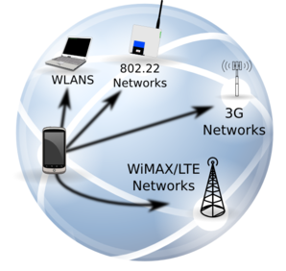




ns-3: An Open Source Network Simulator
ns-3 is a discrete-event network simulator targeted for research and educational use
model developers
Research
ns-3 software
NS-3 Consortium
ns-3 maintainers
Education

Slide 11
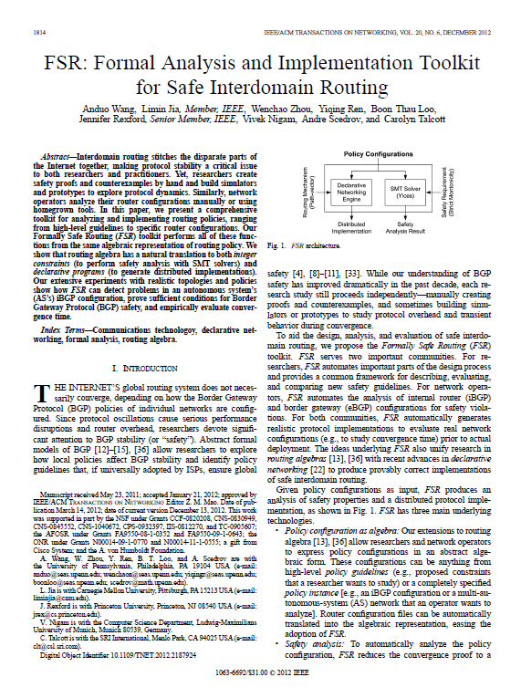
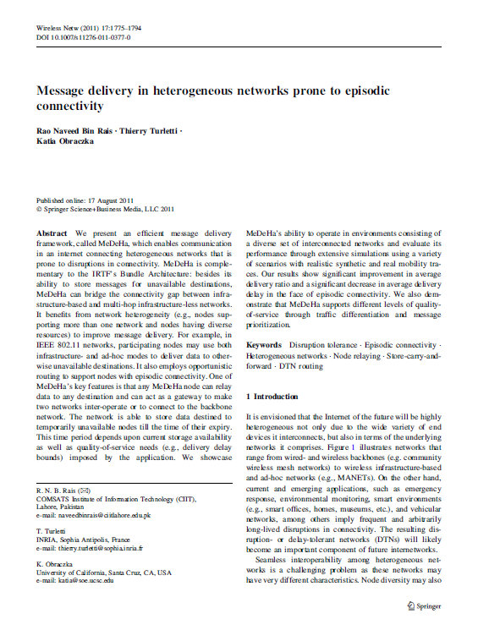
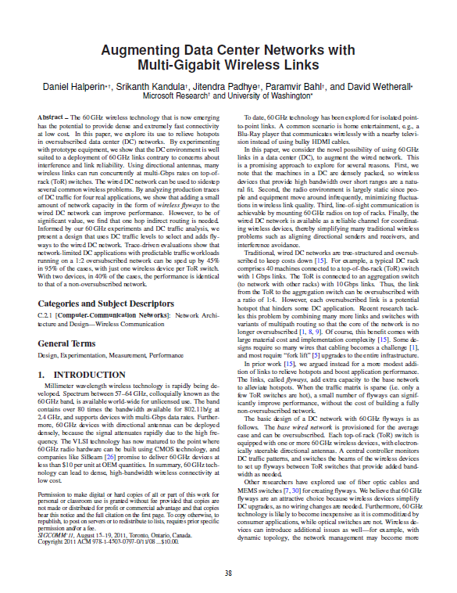
What have people done with ns-3?
thousands of publications to date
  search of 'ns-3 simulator' on IEEE and ACM digital libraries, or Google Scholar

Slide 12
ns-3 overview
ns-3 is a leading open source, packet-level network simulator oriented towards network research, featuring a high-performance core enabling parallelization across a cluster (for large scenarios), ability to run real code, and interaction with testbeds

Slide 13
Network performance evaluation options
ns-3 enables researchers to more easily move between simulations, test beds, and experiments
Direct Code
Execution
Emulation
modes
ns-3 core
Test and evaluation options
Pure
simulation
Simulation
cradles
Virtual/Physical
test beds
Field
experiments
Live
networks
Increasing realism
Increasing complexity

Slide 14
The open-source project

Slide 15
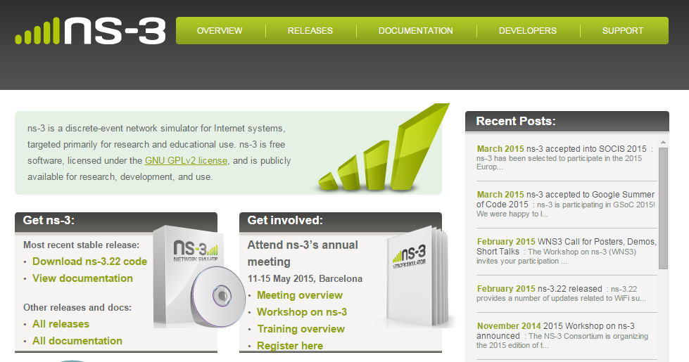
ns-3 main website
Project home: https://www.nsnam.org

Slide 16
How the project operates
Project provides three annual software releases
Users interact on mailing lists and using Bugzilla bug tracker
Code may be proposed for merge
  Code reviews occur on a Google site
Maintainers (one for each module) fix or delegate bugs, participate in reviews
Project has been conducting annual workshop and developer meeting around SIMUTools through 2013
  Some additional meetings on ad hoc basis
Summer projects (Google Summer of Code, ESA Summer of Code in Space, others...)

Slide 17
Maintainers, Authors, Users
~10-15 maintainers at any given time
191 authors credited in AUTHORS file
Over 6000 subscribers to ns-3-users Google Groups forum
Over 1500 subscribers to ns-developers mailing list
Various project forks exist (on Github and elsewhere)

Slide 18
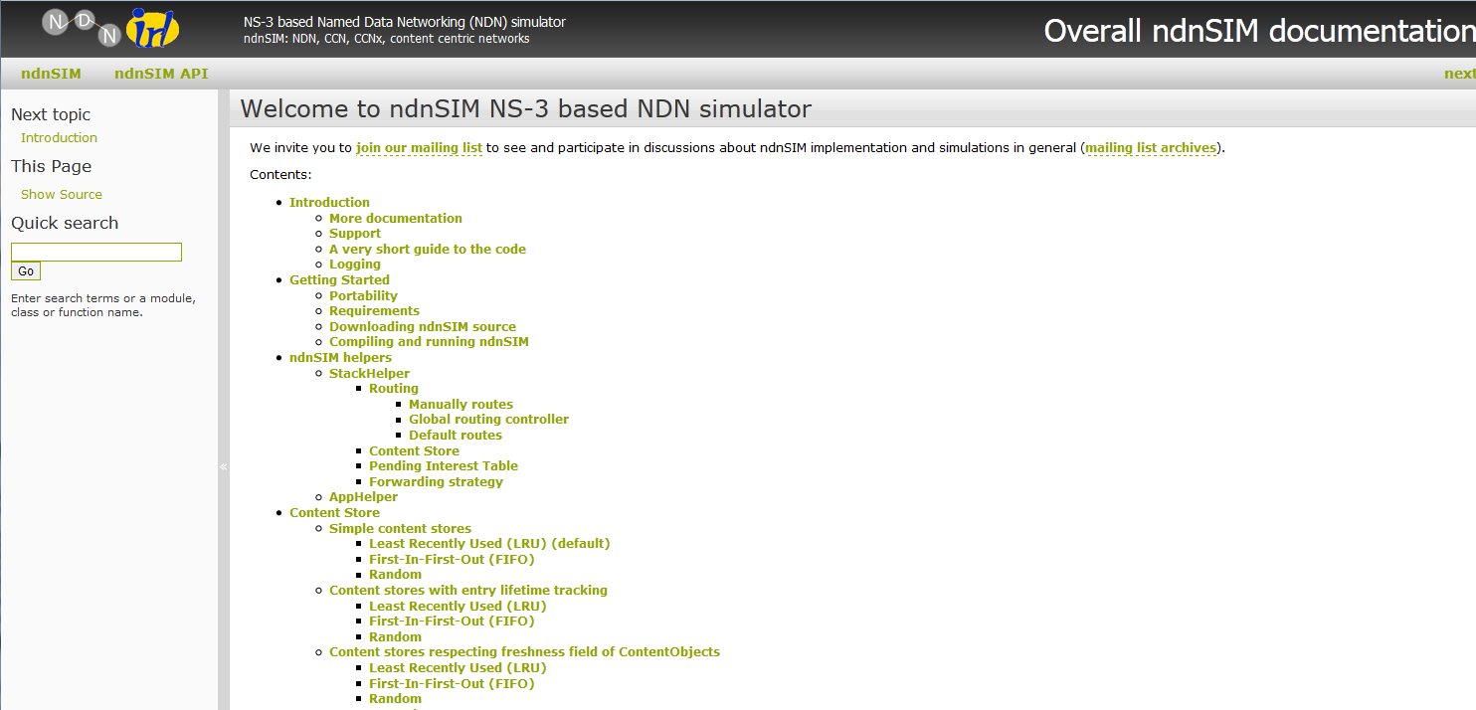
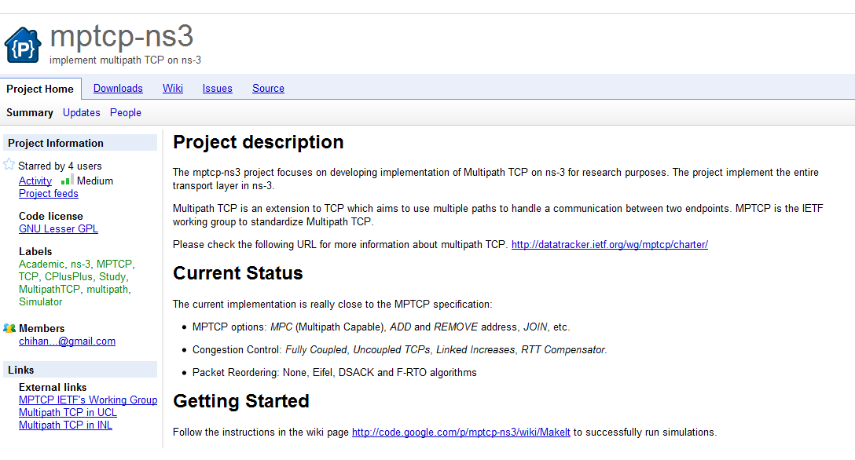
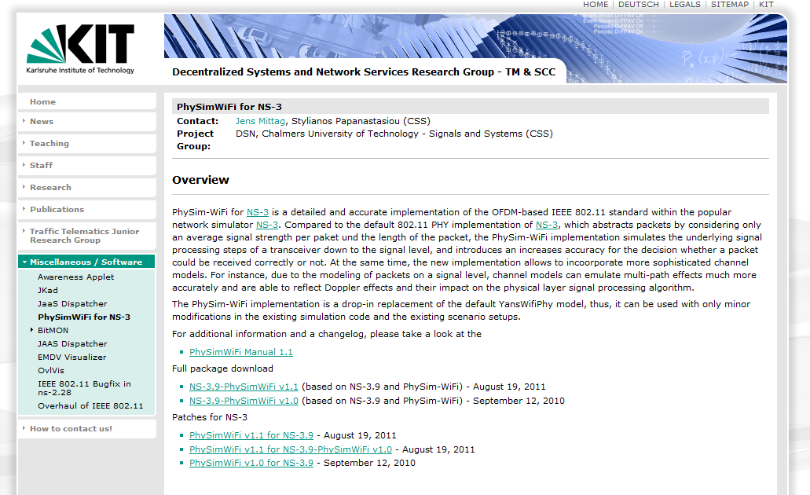
Contributed code and associated projects

Slide 19
Sustainment
The NS-3 Consortium is a collection of organizations cooperating to support and develop the ns-3 software.
It operates in support of the open source project
  by providing a point of contact between industrial members and ns-3 developers,
  by sponsoring events in support of ns-3 such as users' days and workshops,
  by guaranteeing maintenance support for ns-3's core, and
  by supporting administrative activities necessary to conduct a large open source project.

Slide 20
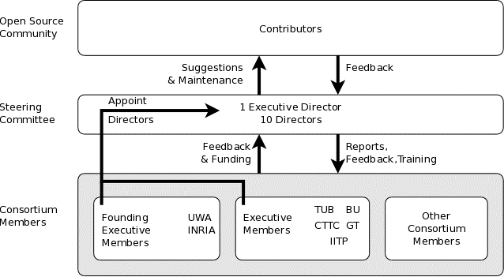
ns-3 Consortium governance
INESC

Slide 21











Acknowledgment of support

Slide 22
Software overview

Slide 23
Software overview
ns-3 is written in C++, with bindings available for Python
  simulation programs are C++ executables or Python programs
  ~350,000 lines of C++ (cloc estimate)
  almost exclusively C++98, beginning to use C++11
ns-3 is a GNU GPLv2-licensed project
ns-3 is mainly supported for Linux, OS X, and FreeBSD
  Windows Visual Studio port available
ns-3 is not backwards-compatible with ns-2

Slide 24
Discrete-event simulation basics
Simulation time moves in discrete jumps from event to event
C++ functions schedule events to occur at specific simulation times
A simulation scheduler orders the event execution
Simulation::Run() executes a single-threaded event list
Simulation stops at specific time or when events end
Execute a function
(may generate additional events)
Virtual time
Advance the virtual time
to the next event (function)

Slide 25
The basic ns-3 architecture
Application
Application
Application
Application
Sockets-like
API
Protocol
stack
Protocol
stack
Packet(s)‏
Node
Node
NetDevice
NetDevice
NetDevice
Channel
NetDevice
Channel

Slide 26
Software orientation
Key differences from other network simulators:
1) Command-line, Unix orientation
  vs. Integrated Development Environment (IDE)
2) Simulations and models written directly in C++ and Python
  vs. a domain-specific simulation language

Slide 27
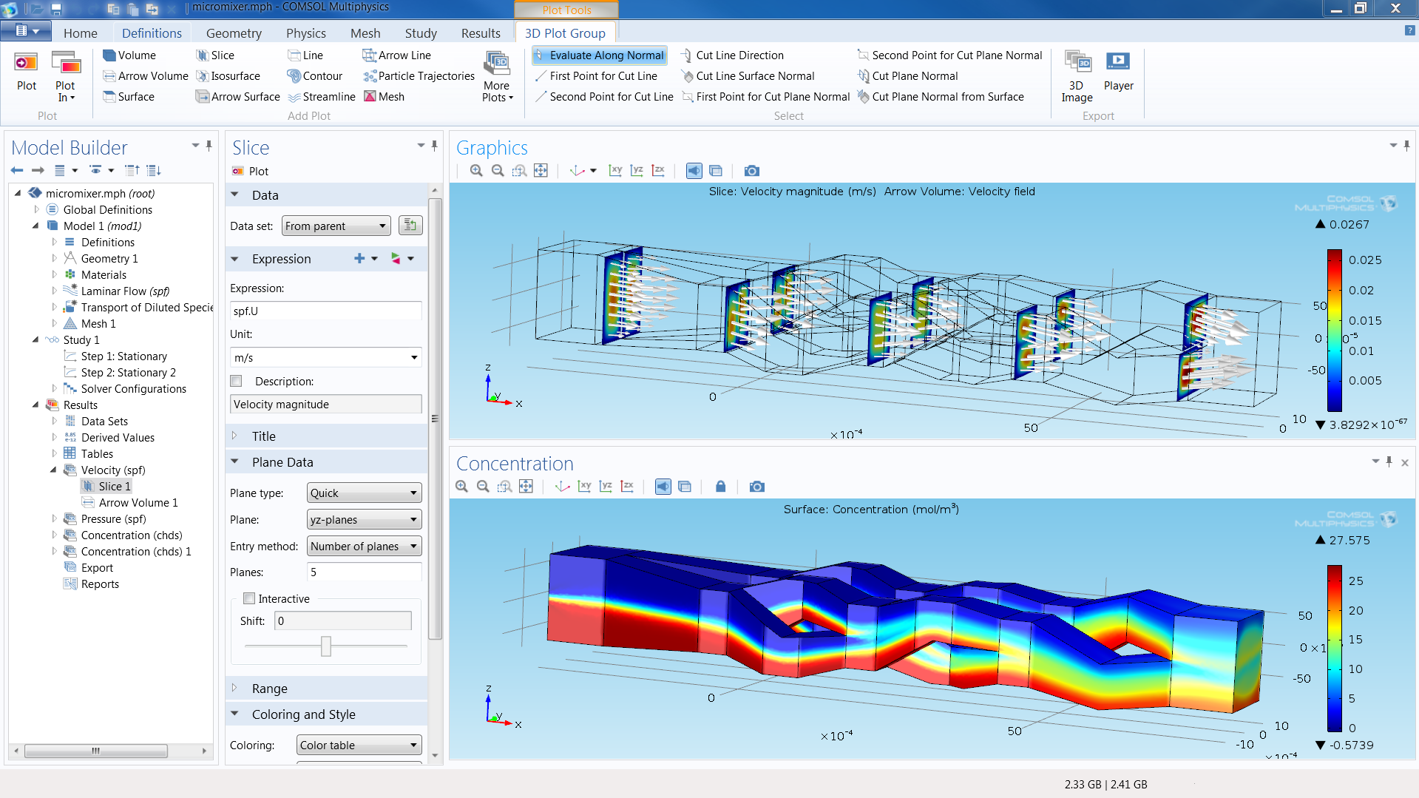
ns-3 does not have a graphical IDE
Figure source: https://www.comsol.com/comsol-multiphysics

Slide 28
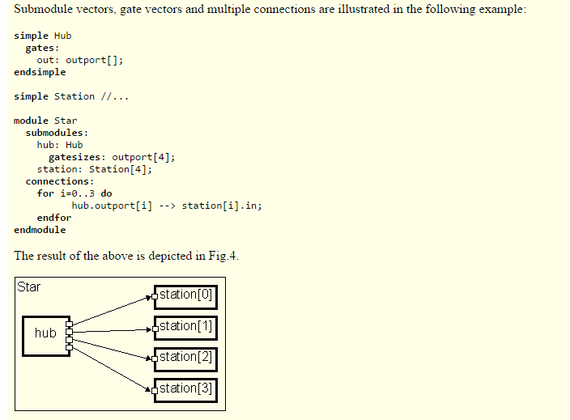
ns-3 not written in a high-level language
Example of OMNeT++ Network Description (NED) language
Figure excerpted from http://www.ewh.ieee.org/soc/es/Nov1999/18/ned.htm

Slide 29
Software organization
Two levels of ns-3 software and libraries
1) Several supporting libraries, not system-installed, can be in parallel to ns-3
Netanim
pybindgen
Click routing
ns-3
2) ns-3 modules exist
within the ns-3 directory
module
module
module
module
module
module

Slide 30
Current models
utilities
devices
protocols
visualizer
bridge
mesh
config-
store
applications
internet-apps
aodv
Node class
NetDevice ABC
Address types
(Ipv4, MAC, etc.)
Queues
Socket ABC
Ipv4 ABCs
Packet sockets
csma
spectrum
internet
(IPv4/v6)
dsdv
flow-monitor
energy
emu
Packets
Packet Tags
Packet Headers
Pcap/ascii file writing
tap-bridge
traffic-control
olsr
netanim
mpi
point-to-
point
uan
click
stats
Smart pointers
Dynamic types
Attributes
Callbacks
Tracing
Logging
Random Variables
mobility
virtual-
net-device
network
nix-vector-
routing
topology-
read
lte
Events
Scheduler
Time arithmetic
propagation
lr-wpan
wifi
core
openflow
BRITE
wimax
30

Slide 31
Module organization
models/
examples/
tests/
bindings/
doc/
wscript

Slide 32
ns-3 programs
ns-3 programs are C++ executables that link the needed shared libraries
  or Python programs that import the needed modules
The ns-3 build tool, called 'waf', can be used to run programs
waf will place headers, object files, libraries, and executables in a 'build' directory

Slide 33
Python bindings
ns-3 uses a program called PyBindGen to generate Python bindings for all libraries
v
v
v
v
C++
header
Intermediate
Python
program
C++
bindings
code
Python
module
(py)gccxml
PyBindGen
C++ compiler

Slide 34
Integrating other tools and libraries

Slide 35
Other libraries
more sophisticated scenarios and models typically leverage other libraries
ns-3 main distribution uses optional libraries (libxml2, gsl, mysql) but care is taken to avoid strict build dependencies
the 'bake' tool (described later) helps to manage library dependencies
users are free to write their own Makefiles or wscripts to do something special

Slide 36
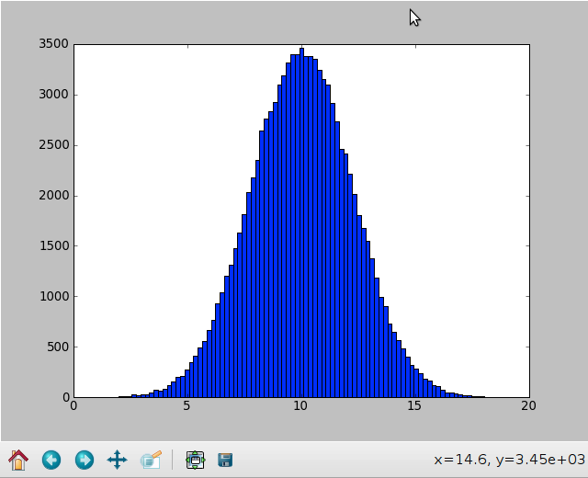
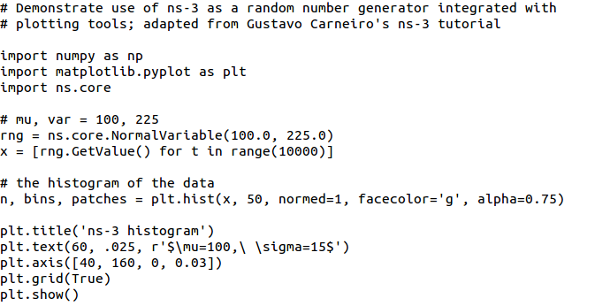
Matplotlib
src/core/examples/sample-rng-plot.py

Slide 37
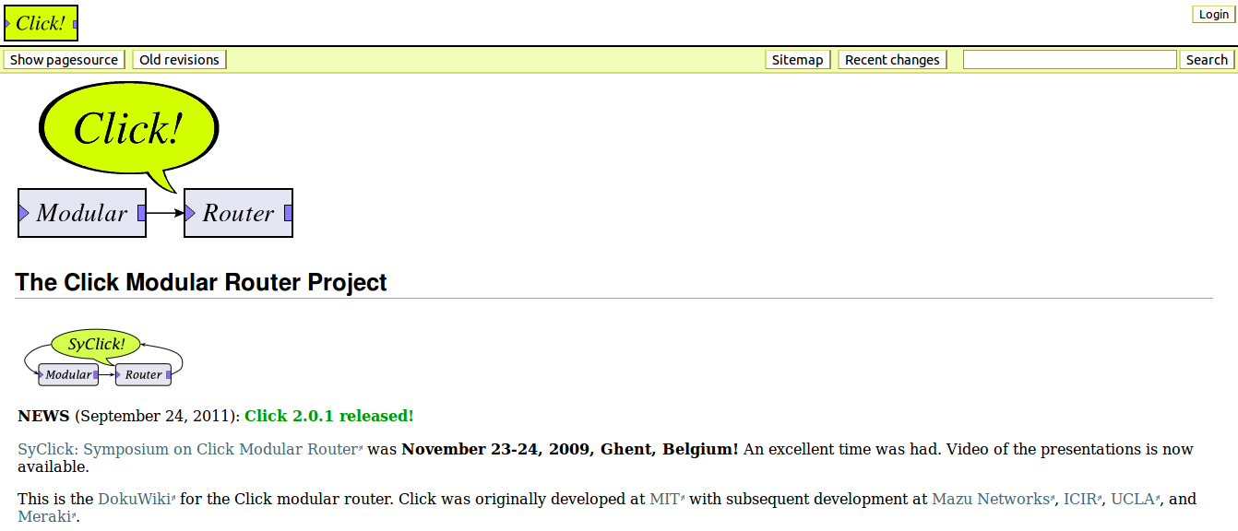
Click Modular Router

Slide 38
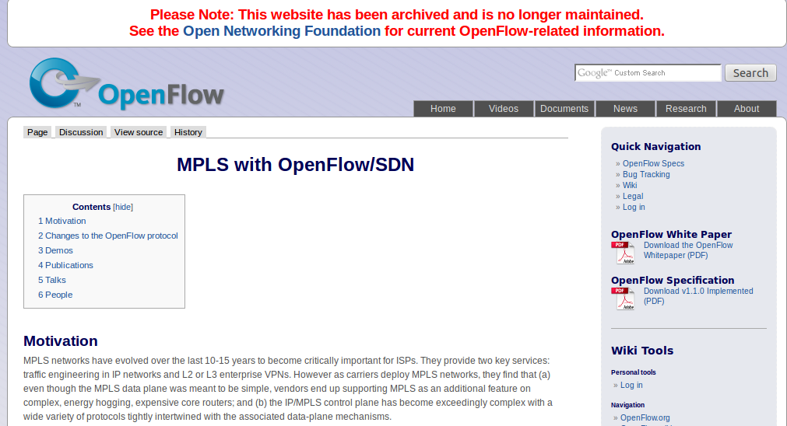
OpenFlow Switch

Slide 39
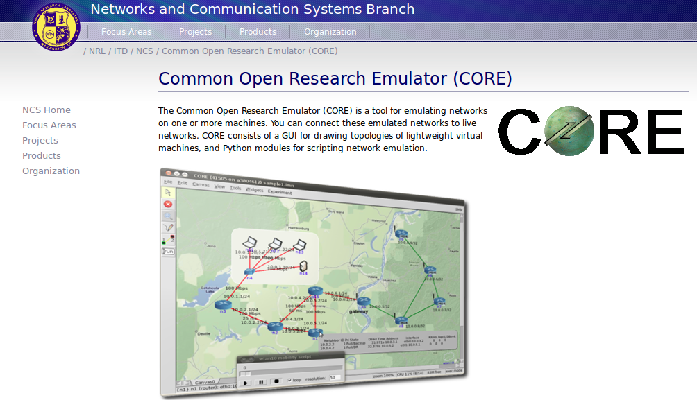
CORE emulator

Slide 40
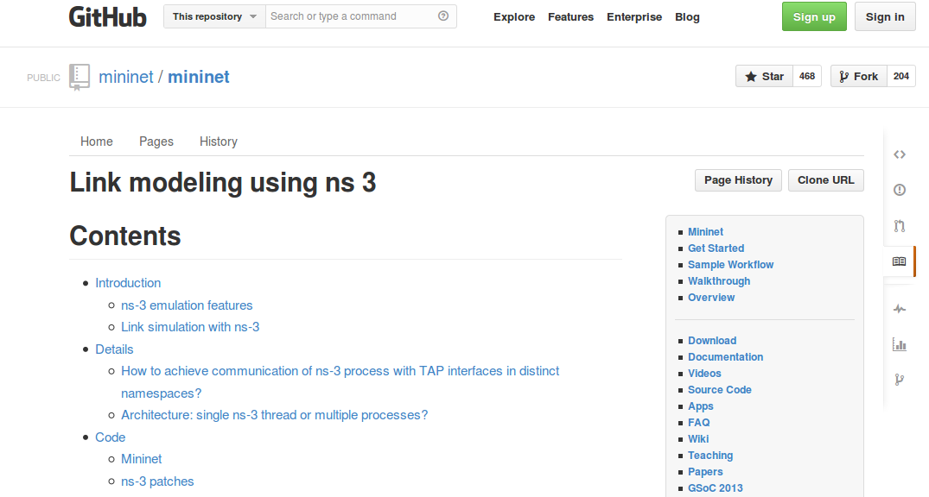
mininet emulator

Slide 41
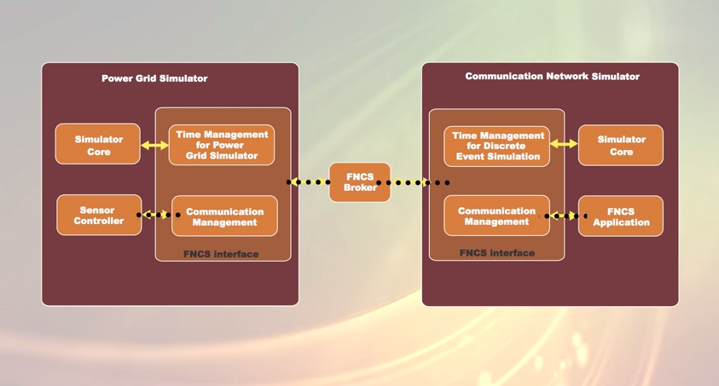
Co-simulation frameworks have emerged
PNNL's FNCS framework integrates ns-3 with transmission and distribution simulators
Image source: PNNLgov YouTube video:
Introducing FNCS: Framework for Network Co-Simulation

Slide 42
FAQs
Does ns-3 have a Windows version?
  Yes, for Visual Studio 2012
  http://www.nsnam.org/wiki/Ns-3_on_Visual_Studio_2012
Does ns-3 support Eclipse or other IDEs?
  Instructions have been contributed by users
  http://www.nsnam.org/wiki/HOWTO_configure_Eclipse_with_ns-3
Is ns-3 provided in Linux or OS X package systems (e.g. Debian packages)?
  Not officially, but some package maintainers exist
Does ns-3 support NRL protolib applications?
  Not yet

Slide 43
Summarizing
ns-3 models are written in C++ and compiled into libraries
  Python bindings are optionally created
ns-3 programs are C++ executables or Python programs that call the ns-3 public API and can call other libraries
ns-3 is oriented towards the command-line
ns-3 uses no domain specific language
ns-3 is not compatible with ns-2

