Slide 1
ns-3 Waf build system
ns-3 Annual Meeting
June 2017

Slide 2
Software introduction
Download the latest release
wget http://www.nsnam.org/releases/ns-allinone-3.26.tar.bz2
tar xjf ns-allinone-3.26.tar.bz2
Clone the latest development code
hg clone http://code.nsnam.org/ns-3-allinone
Q. What is "hg clone"?
A. Mercurial (http://www.selenic.com) is our source code control tool.

Slide 3
Software building
Two levels of ns-3 build
1) bake (a Python-based build system to control an ordered build of
ns-3 and its libraries)
Network
Simulation
Cradle
pybindgen
click routing
ns-3
2) waf, a build system written in Python
module
module
module
module
module
module
3) build.py (a custom Python build script to control an ordered build of
ns-3 and its libraries) <--- may eventually be deprecated

Slide 4
ns-3 uses the 'waf' build system
Waf is a Python-based framework for configuring, compiling and installing applications.
It is a replacement for other tools such as Autotools, Scons, CMake or Ant
http://code.google.com/p/waf/
For those familiar with autotools:
configure ./waf configure
make ./waf build

Slide 5
waf configuration
Key waf configuration examples
./waf configure
--enable-examples
--enable-tests
--disable-python
--enable-modules
Whenever build scripts change, need to reconfigure
Demo: ./waf --help
./waf configure --enable-examples --enable-tests --enable-modules='core'
Look at: build/c4che/_cache.py

Slide 6
wscript example
## -*- Mode: python; py-indent-offset: 4; indent-tabs-mode: nil; coding: utf-8; -*-
def build(bld):
obj = bld.create_ns3_module('csma', ['network', 'applications'])
obj.source = [
'model/backoff.cc',
'model/csma-net-device.cc',
'model/csma-channel.cc',
'helper/csma-helper.cc',
]
headers = bld.new_task_gen(features=['ns3header'])
headers.module = 'csma'
headers.source = [
'model/backoff.h',
'model/csma-net-device.h',
'model/csma-channel.h',
'helper/csma-helper.h',
]
if bld.env['ENABLE_EXAMPLES']:
bld.add_subdirs('examples')
bld.ns3_python_bindings()

Slide 7
waf build
Once project is configured, can build via ./waf build or ./waf
waf will build in parallel on multiple cores
waf displays modules built at end of build
Demo: ./waf build
Look at: build/ libraries and executables

Slide 8
Running programs
./waf shell provides a special shell for running programs
Sets key environment variables
./waf --run sample-simulator
./waf --pyrun src/core/examples/sample-simulator.py

Slide 9
Build variations
Configuring a build type is done at waf configuration time
debug build (default): all asserts and debugging code enabled
./waf -d debug configure
optimized
./waf -d optimized configure
static libraries
./waf --enable-static configure

Slide 10
Controlling the modular build
One way to disable modules:
./waf configure --enable-modules='a','b','c'
The .ns3rc file (found in utils/ directory) can be used to control the modules built
Precedence in controlling build
1) command line arguments
2) .ns3rc in ns-3 top level directory
3) .ns3rc in user's home directory
Demo how .ns3rc works

Slide 11
Building without wscript
The scratch/ directory can be used to build programs without wscripts
Demo how programs can be built without wscripts

Slide 12
ns-3 Training

Slide 13
Simulator core
Simulation time
Events
Simulator and Scheduler
Command line arguments
Random variables
Execute a function
(may generate additional events)
Virtual time
Advance the virtual time
to the next event (function)

Slide 14
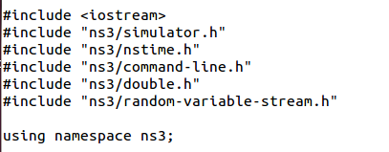
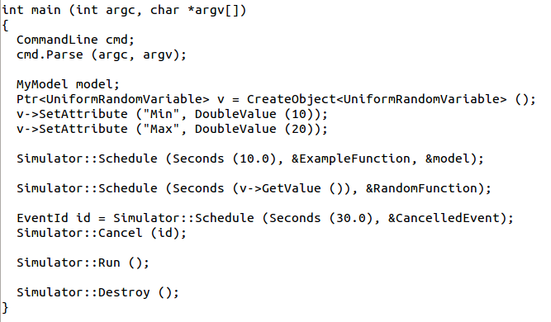
Simulator example

Slide 15
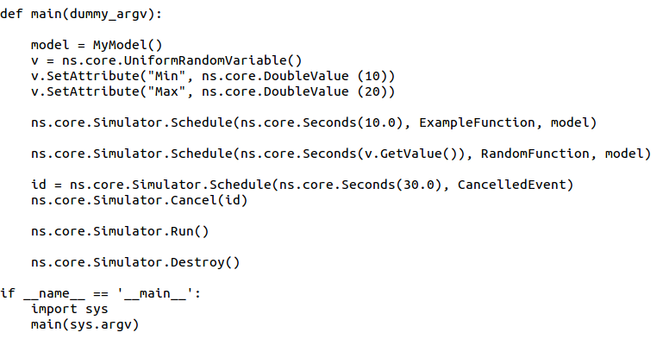
Simulator example (in Python)

Slide 16
Simulation program flow
Handle program inputs
Configure topology
Run simulation
Process outputs

Slide 17
Command-line arguments
Add CommandLine to your program if you want command-line argument parsing
Passing --PrintHelp to programs will display command line options, if CommandLine is enabled
./waf --run "sample-simulator --PrintHelp"

Slide 18
Time in ns-3
Time is stored as a large integer in ns-3
Minimize floating point discrepancies across platforms
Special Time classes are provided to manipulate time (such as standard operators)
Default time resolution is nanoseconds, but can be set to other resolutions
Note: Changing resolution is not well used/tested
Time objects can be set by floating-point values and can export floating-point values
double timeDouble = t.GetSeconds();
Best practice is to avoid floating point conversions where possible

Slide 19
Events in ns-3
Events are just function calls that execute at a simulated time
i.e. callbacks
this is another difference compared to other simulators, which often use special "event handlers" in each model
Events have IDs to allow them to be cancelled or to test their status

Slide 20
Simulator and Schedulers
The Simulator class holds a scheduler, and provides the API to schedule events, start, stop, and cleanup memory
Several scheduler data structures (calendar, heap, list, map) are possible
"RealTime" simulation implementation aligns the simulation time to wall-clock time
two policies (hard and soft limit) available when the simulation and real time diverge

Slide 21
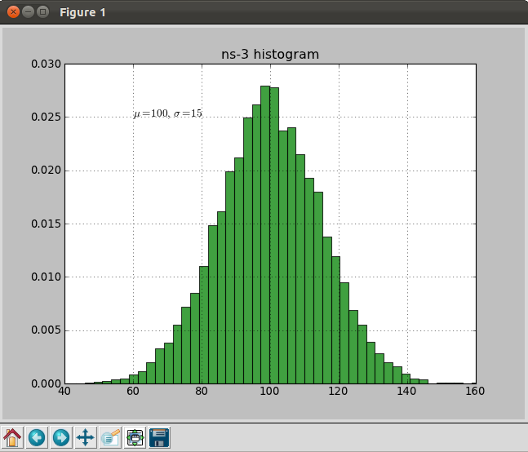
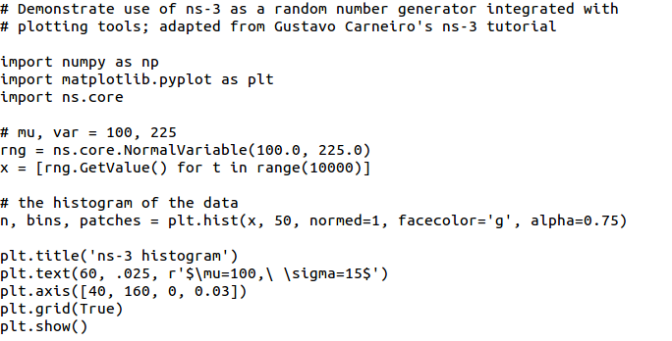
Random Variables
from src/core/examples/sample-rng-plot.py
Currently implemented distributions
Uniform: values uniformly distributed in an interval
Constant: value is always the same (not really random)
Sequential: return a sequential list of predefined values
Exponential: exponential distribution (poisson process)
Normal (gaussian), Log-Normal, Pareto, Weibull, triangular

Slide 22
Random variables and independent replications
Many simulation uses involve running a number of independent replications of the same scenario
In ns-3, this is typically performed by incrementing the simulation run number
not by changing seeds

