Slide 1
ns-3 Training

Slide 2
Simulator core
Simulation time
Events
Simulator and Scheduler
Command line arguments
Random variables
Execute a function
(may generate additional events)
Virtual time
Advance the virtual time
to the next event (function)

Slide 3
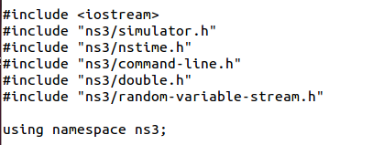
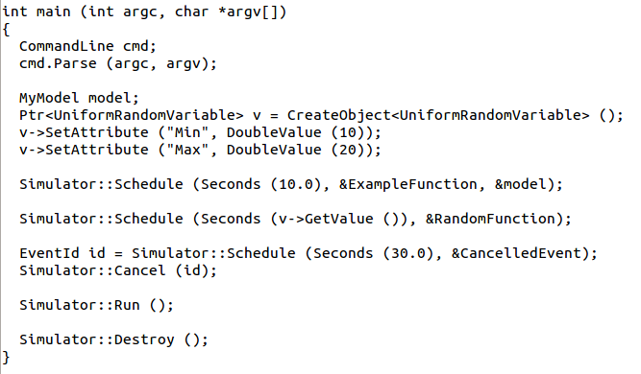
Simulator example

Slide 4

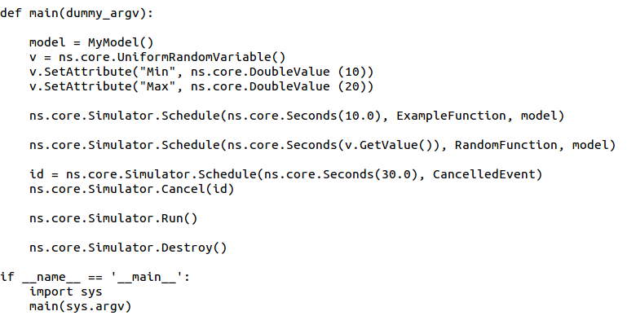
Simulator example (in Python)

Slide 5
Simulation program flow
Handle program inputs
Configure topology
Run simulation
Process outputs

Slide 6

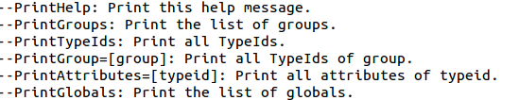
Command-line arguments
Add CommandLine to your program if you want command-line argument parsing
Passing --PrintHelp to programs will display command line options, if CommandLine is enabled
./waf --run "sample-simulator --PrintHelp"

Slide 7
Time in ns-3
Time is stored as a large integer in ns-3
  Minimize floating point discrepancies across platforms
Special Time classes are provided to manipulate time (such as standard operators)
Default time resolution is nanoseconds, but can be set to other resolutions
  Note: Changing resolution is not well used/tested
Time objects can be set by floating-point values and can export floating-point values
  double timeDouble = t.GetSeconds();
  Best practice is to avoid floating point conversions where possible

Slide 8
Events in ns-3
Events are just function calls that execute at a simulated time
  i.e. callbacks
  this is another difference compared to other simulators, which often use special "event handlers" in each model
Events have IDs to allow them to be cancelled or to test their status

Slide 9
Simulator and Schedulers
The Simulator class holds a scheduler, and provides the API to schedule events, start, stop, and cleanup memory
Several scheduler data structures (calendar, heap, list, map) are possible
"RealTime" simulation implementation aligns the simulation time to wall-clock time
  two policies (hard and soft limit) available when the simulation and real time diverge

Slide 10
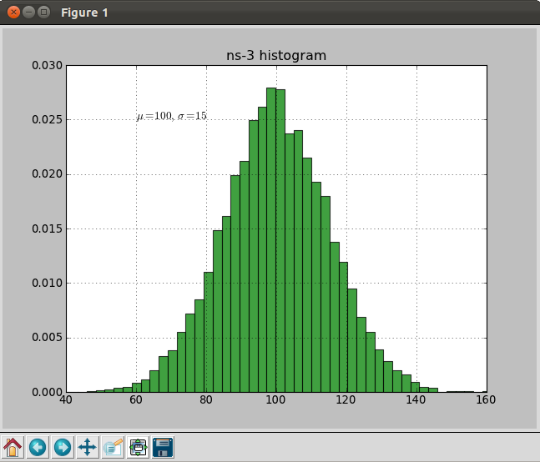
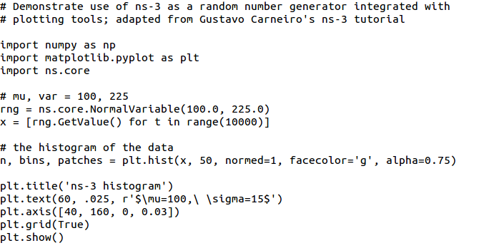
Random Variables
from src/core/examples/sample-rng-plot.py
Currently implemented distributions
  Uniform: values uniformly distributed in an interval
  Constant: value is always the same (not really random)
  Sequential: return a sequential list of predefined values
  Exponential: exponential distribution (poisson process)
  Normal (gaussian), Log-Normal, Pareto, Weibull, triangular

Slide 11
Random variables and independent replications
Many simulation uses involve running a number of independent replications of the same scenario
In ns-3, this is typically performed by incrementing the simulation run number
  not by changing seeds

Slide 12
ns-3 random number generator
Uses the MRG32k3a generator from Pierre L'Ecuyer
  http://www.iro.umontreal.ca/~lecuyer/myftp/papers/streams00.pdf
  Period of PRNG is 3.1x10^57
Partitions a pseudo-random number generator into uncorrelated streams and substreams
  Each RandomVariableStream gets its own stream
  This stream partitioned into substreams

Slide 13
Key Terminology
Seed: A set of values that generates an entirely new PRNG sequence
Stream: The PRNG sequence is divided into non-overlapping intervals called streams
Run Number (substream): Each stream is further divided to substreams, indexed by a variable called the run number.

Slide 14
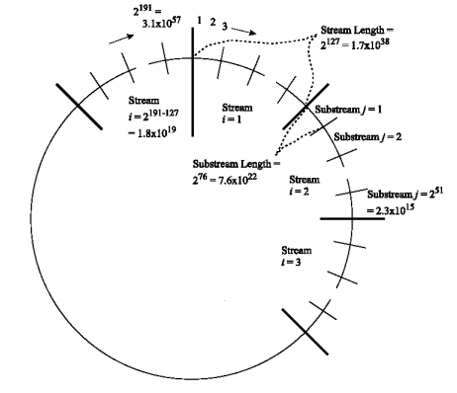
Streams and Substreams
Incrementing the
Run Number will move
all streams to a new
substream
Each ns-3
RandomVariableStream
object is assigned to a
stream (by default,
randomly)
Figure source: Pierre L’Ecuyer, Richard Simard, E. Jack Chen, and W. David Kelton.
An object-oriented random number package with many long streams and substreams. Operations Research, 2001.

Slide 15
Run number vs. seed
If you increment the seed of the PRNG, the streams of random variable objects across different runs are not guaranteed to be uncorrelated
If you fix the seed, but increment the run number, you will get uncorrelated streams

Slide 16

Setting the stream number
The ns-3 implementation provides access to 2^64 streams
2^63 are placed in a pool for automatic assignment, and 2^63 are reserved for fixed assignment
Users may optionally assign a stream number index to a random variable using the SetStream () method.
  This allows better control over selected random variables
  Many helpers have AssignStreams () methods to do this across many such random variables

Slide 17
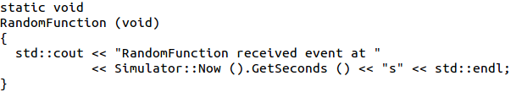
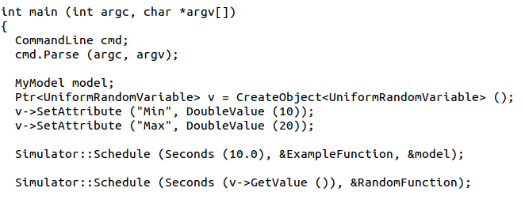
Putting it together
Example of scheduled event
Demo real-time, command-line, random variables...

Slide 18
ns-3 Training

Slide 19
Example walkthrough
This section progressively builds up a simple ns-3 example, explaining concepts along the way
Files for these programs are available on the ns-3 wiki

Slide 20
Example program
wns3-version1.cc
  Link found on wiki page
  Place program in scratch/ folder

Slide 21
Fundamentals
Key objects in the simulator are Nodes, Packets, and Channels
Nodes contain Applications, “stacks”, and NetDevices

Slide 22
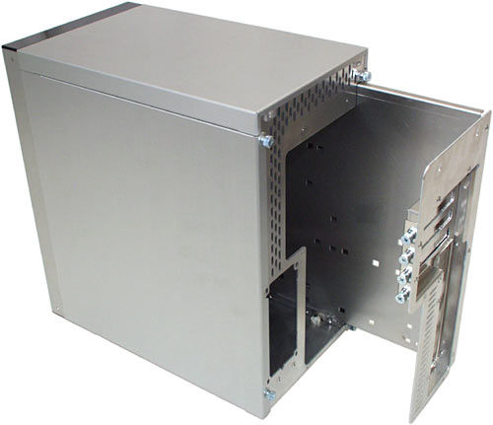


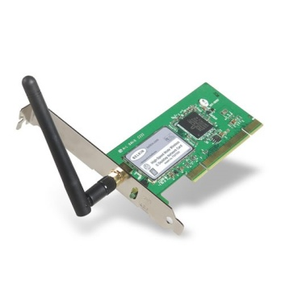
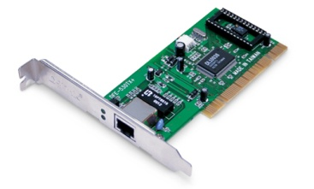
Node basics
A Node is a shell of a computer to which applications, stacks, and NICs are added
Application
Application
Application
“DTN”

Slide 23
NetDevices and Channels
(Originally) NetDevices were strongly bound to Channels of a matching type
ns-3 Spectrum models relax this assumption
Nodes are architected for multiple interfaces
YansWifiChannel
YansWifiNetDevice

Slide 24
Internet Stack
Internet Stack
  Provides IPv4 and some IPv6 models currently
No non-IP stacks ns-3 existed until 802.15.4 was introduced in ns-3.20
  but no dependency on IP in the devices, Node object, Packet object, etc. (partly due to the object aggregation system)

Slide 25
Other basic models in ns-3
Devices
  WiFi, WiMAX, CSMA, Point-to-point, ...
Error models and queues
Applications
  echo servers, traffic generator
Mobility models
Packet routing
  OLSR, AODV, DSR, DSDV, Static, Nix-Vector, Global (link state)

Slide 26
Structure of an ns-3 program
int main (int argc, char *argv[])
{
// Set default attribute values
// Parse command-line arguments
// Configure the topology; nodes, channels, devices, mobility
// Add (Internet) stack to nodes
// Configure IP addressing and routing
// Add and configure applications
// Configure tracing
// Run simulation
// Handle any post-simulation data processing
}

Slide 27
Helper API
The ns-3 “helper API” provides a set of classes and methods that make common operations easier than using the low-level API
Consists of:
  container objects
  helper classes
The helper API is implemented using the low-level API
Users are encouraged to contribute or propose improvements to the ns-3 helper API

Slide 28
Containers
Containers are part of the ns-3 “helper API”
Containers group similar objects, for convenience
  They are often implemented using C++ std containers
Container objects also are intended to provide more basic (typical) API

Slide 29
The Helper API (vs. low-level API)
Is not generic
Does not try to allow code reuse
Provides simple 'syntactical sugar' to make simulation scripts look nicer and easier to read for network researchers
Each function applies a single operation on a ''set of same objects”
A typical operation is "Install()"

Slide 30
Helper Objects
NodeContainer: vector of Ptr<Node>
NetDeviceContainer: vector of Ptr<NetDevice>
InternetStackHelper
WifiHelper
MobilityHelper
OlsrHelper
... Each model provides a helper class

Slide 31
Installation onto containers
Installing models into containers, and handling containers, is a key API theme
NodeContainer c;
c.Create (numNodes);
...
mobility.Install (c);
...
internet.Install (c);
...

Slide 32
Native IP models
IPv4 stack with ARP, ICMP, UDP, and TCP
IPv6 with ND, ICMPv6, IPv6 extension headers, TCP, UDP
IPv4 routing: RIPv2, static, global, NixVector, OLSR, AODV, DSR, DSDV
IPv6 routing: RIPng, static

Slide 33
IP address configuration
An Ipv4 (or Ipv6) address helper can assign addresses to devices in a NetDevice container
Ipv4AddressHelper ipv4;
ipv4.SetBase ("10.1.1.0", "255.255.255.0");
csmaInterfaces = ipv4.Assign (csmaDevices);
...
ipv4.NewNetwork (); // bumps network to 10.1.2.0
otherCsmaInterfaces = ipv4.Assign (otherCsmaDevices);

Slide 34
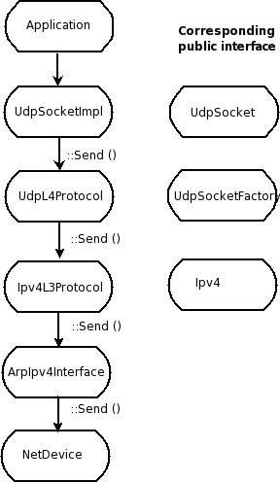
Internet stack
The public interface of
the Internet stack is
defined (abstract base
classes) in
src/network/model
directory
The intent is to support
multiple implementations
The default ns-3 Internet
stack is implemented in
src/internet-stack

Slide 35
Review of sample program (cont.)
ApplicationContainer apps;
OnOffHelper onoff ("ns3::UdpSocketFactory",
InetSocketAddress ("10.1.2.2", 1025));
onoff.SetAttribute ("OnTime", StringValue ("Constant:1.0"));
onoff.SetAttribute ("OffTime", StringValue ("Constant:0.0"));
apps = onoff.Install (csmaNodes.Get (0));
apps.Start (Seconds (1.0));
apps.Stop (Seconds (4.0));
PacketSinkHelper sink ("ns3::UdpSocketFactory",
InetSocketAddress ("10.1.2.2", 1025));
apps = sink.Install (wifiNodes.Get (1));
apps.Start (Seconds (0.0));
apps.Stop (Seconds (4.0));
Traffic generator
Traffic receiver

Slide 36
Applications and sockets
In general, applications in ns-3 derive from the ns3::Application base class
  A list of applications is stored in the ns3::Node
  Applications are like processes
Applications make use of a sockets-like API
  Application::Start () may call ns3::Socket::SendMsg() at a lower layer

Slide 37
Sockets API
Plain C sockets
int sk;
sk = socket(PF_INET, SOCK_DGRAM, 0);
struct sockaddr_in src;
inet_pton(AF_INET,”0.0.0.0”,&src.sin_addr);
src.sin_port = htons(80);
bind(sk, (struct sockaddr *) &src, sizeof(src));
struct sockaddr_in dest;
inet_pton(AF_INET,”10.0.0.1”,&dest.sin_addr);
dest.sin_port = htons(80);
sendto(sk, ”hello”, 6, 0, (struct sockaddr *) &dest, sizeof(dest));
char buf[6];
recv(sk, buf, 6, 0);
}
ns-3 sockets
Ptr<Socket> sk =
udpFactory->CreateSocket ();
sk->Bind (InetSocketAddress (80));
sk->SendTo (InetSocketAddress (Ipv4Address (”10.0.0.1”), 80), Create<Packet> (”hello”, 6));
sk->SetReceiveCallback (MakeCallback (MySocketReceive));
[…] (Simulator::Run ())
void MySocketReceive (Ptr<Socket> sk, Ptr<Packet> packet)
{
...
}

Slide 38
NetDevice trace hooks
Example: CsmaNetDevice
NetDevice::
ReceiveCallback
CsmaNetDevice::Send ()
MacTx
MacRx
MacDrop
queue
Sniffer
PromiscSniffer
MacTxBackoff
PhyTxBegin
PhyRxEnd
PhyRxDrop
PhyTxDrop
PhyTxEnd
CsmaNetDevice::
TransmitStart()
CsmaNetDevice::
Receive()
CsmaChannel

Slide 39
LTE/Wi-Fi Coexistence case study

Slide 40
Use case: LAA Wi-Fi Coexistence
ns-3 has been extended to support scenarios for LTE LAA/Wi-Fi Coexistence
Methodology defined in 3GPP Technical Report TR36.889
Enhancements needed:
  Wireless models (LBT access manager, SpectrumWifiPhy, propagation/fading models)
  Scenario support (traffic models)
  Output data processing

Slide 41
Indoor 3GPP scenario

Slide 42
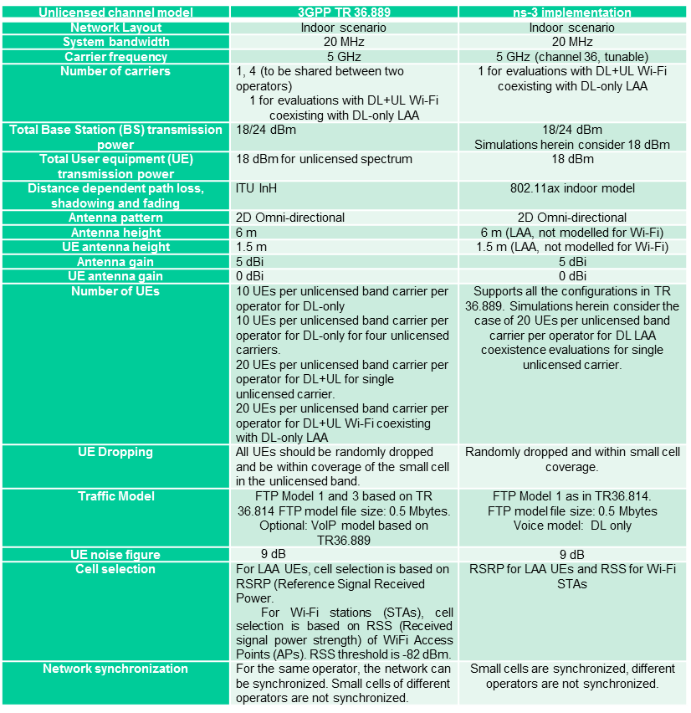
Indoor scenario details

Slide 43
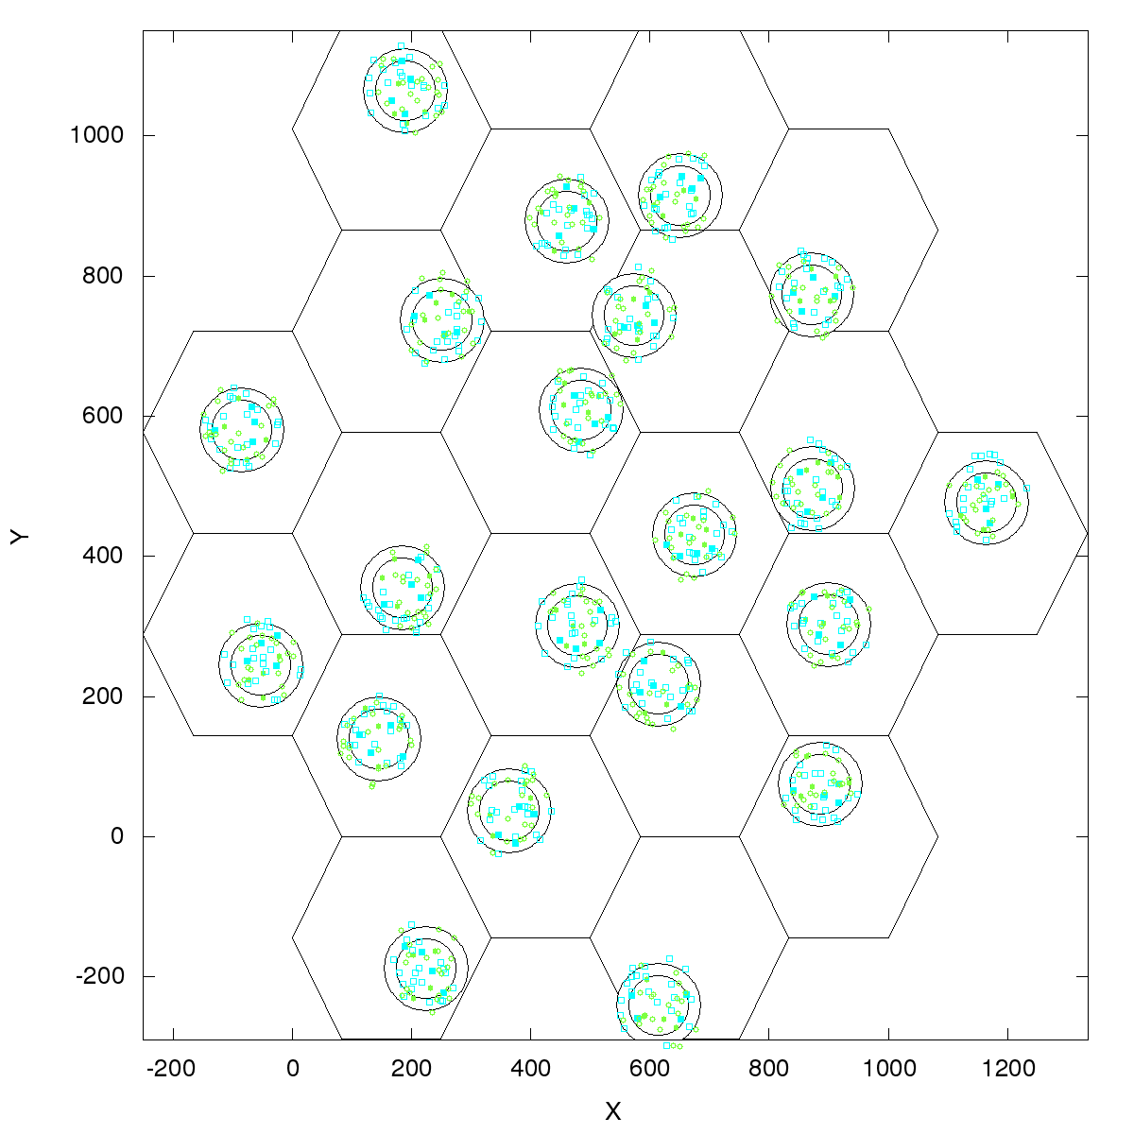
Outdoor 3GPP scenario
Outdoor layout: hexagonal macrocell layout. 7 macro sites and 3 cells per site. 1 Cluster per cell. 4 small cells per operator per cluster, uniformly dropped. ITU UMi channel model.
Figure source: 3GPP TR 36.889 V13.0.0 (2015-05)

Slide 44
References
ns-3 Wiki page:
  https://www.nsnam.org/wiki/LAA-WiFi-Coexistence
    module documentation
    references to various publications
    documentation on reproducing results
Code:
  http://code.nsnam.org/laa/ns-3-lbt

Slide 45
Sample results

Slide 46
Gnuplot
src/tools/gnuplot.{cc,h}
C++ wrapper around gnuplot
classes:
  Gnuplot
  GnuplotDataset
    Gnuplot2dDataset, Gnuplot2dFunction
    Gnuplot3dDataset, Gnuplot3dFunction

Slide 47
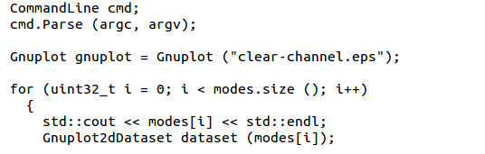

Enabling gnuplot for your code
examples/wireless/wifi-clear-channel-cmu.cc
produce a plot file that
will generate an EPS figure
one dataset per mode
Add data to dataset
Add dataset to plot

Slide 48
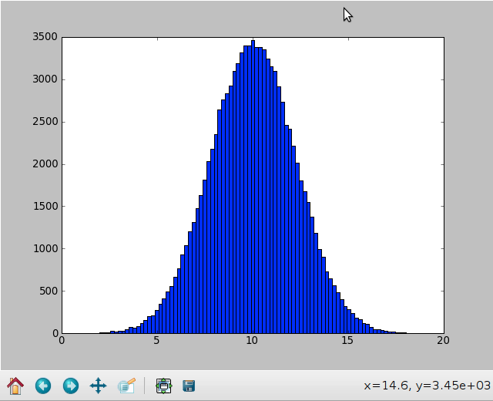
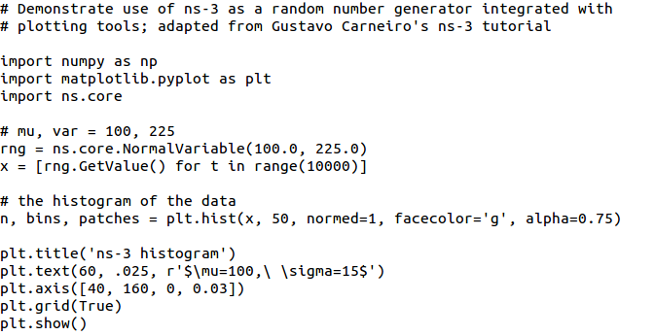
Matplotlib
src/core/examples/sample-rng-plot.py

Slide 49
ns-3 Training: Packets

Slide 50
ns-3 Packet
Packet is an advanced data structure with the following capabilities
  Supports fragmentation and reassembly
  Supports real or virtual application data
  Extensible
  Serializable (for emulation)
  Supports pretty-printing
  Efficient (copy-on-write semantics)

Slide 51
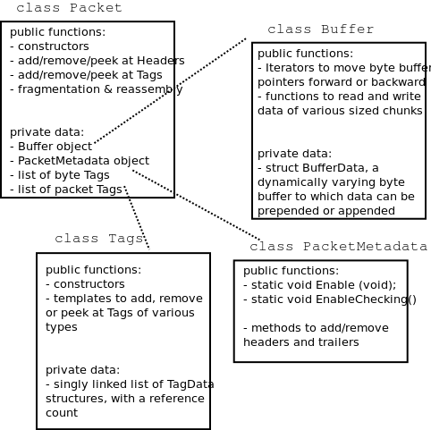
ns-3 Packet structure
Analogous to an mbuf/skbuff

Slide 52
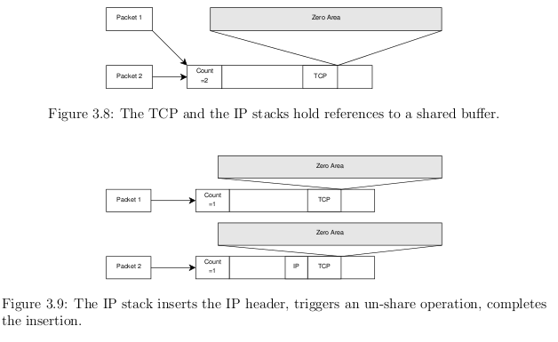
Copy-on-write
Copy data bytes only as needed
Figure source: Mathieu Lacage's Ph.D. thesis

Slide 53
Headers and trailers
Most operations on packet involve adding and removing an ns3::Header
class ns3::Header must implement four methods:
Serialize()
Deserialize()
GetSerializedSize()
Print()

Slide 54
Headers and trailers (cont.)
Headers are serialized into the packet byte buffer with Packet::AddHeader() and removed with Packet::RemoveHeader()
Headers can also be 'Peeked' without removal
Ptr<Packet> pkt = Create<Packet> ();
UdpHeader hdr; // Note: not heap allocated
pkt->AddHeader (hdr);
Ipv4Header iphdr;
pkt->AddHeader (iphdr);

Slide 55
Packet tags
Packet tag objects allow packets to carry around simulator-specific metadata
  Such as a "unique ID" for packets or
Tags may associate with byte ranges of data, or with the whole packet
  Distinction is important when packets are fragmented and reassembled
Tags presently are not preserved across serialization boundaries (e.g. MPI)

Slide 56
PacketTag vs. ByteTag
Two tag types are available: PacketTag and ByteTag
  ByteTags run with bytes
  PacketTags run with packets
When Packet is fragmented, both copies of Packet get copies of PacketTags
When two Packets are merged, only the PacketTags of the first are preserved
PacketTags may be removed individually; ByteTags may be removed all at once

Slide 57
Tag example
Here is a simple example illustrating the use of tags from the code in src/internet/model/udp-socket-impl.cc:
  Ptr<Packet> p; // pointer to a pre-existing packet
  SocketIpTtlTag tag
  tag.SetTtl (m_ipMulticastTtl); // Convey the TTL from UDP layer to IP layer
  p->AddPacketTag (tag);
This tag is read at the IP layer, then stripped (src/internet/model/ipv4-l3-protocol.cc):
  uint8_t ttl = m_defaultTtl;
  SocketIpTtlTag tag;
  bool found = packet->RemovePacketTag (tag);
  if (found)
  {
  ttl = tag.GetTtl ();
  }

Slide 58
Packet metadata
Packets may optionally carry metadata
  record every operation on a packet's buffer
  implementation of Packet::Print for pretty-printing of the packet
  sanity check that when a Header is removed, the Header was actually present to begin with
Not enabled by default, for performance reasons
To enable, insert one or both statements:
  Packet::EnablePrinting ();
  Packet::EnableChecking ();

Slide 59
Ptr<Packet>
Packets are reference counted objects that support the smart pointer class Ptr
Use a templated "Create" method instead of CreateObject for ns3::Objects
Typical creation:
  Ptr<Packet> pkt = Create<Packet> ();
In model code, Packet pointers may be const or non-const; often Packet::Copy() is used to obtain non-const from const
  Ptr<const Packet> cpkt = ...;
  Ptr<Packet> p = cpkt->Copy ();

