Slide 1
ns-3 Training

Slide 2
Outline
Wi-Fi in detail
Support of standard features
Architecture
Configuration via helpers
Advanced use case: LAA-Wifi-Coexistence
SpectrumWifiPhy
Adding a LBT Access Manager
Scenario support
Output data processing

Slide 3
Wi-Fi Overview
WiFi module features
DCF implementation (Basic + RTS/CTS)
802.11 a/b/g/n/ac (2.4 & 5 GHz) PHY
MSDU/MPDU aggregation
QoS support (EDCA)
Infrastructure and ad-hoc modes
Many rate adaptation algorithms
AWGN-based error models
Unsupported features
MIMO
11ac advanced features (Tx beamforming, Mu-MIMO)
Related modules
Mesh (802.11s) and WAVE (802.11p/vehicular)

Slide 4
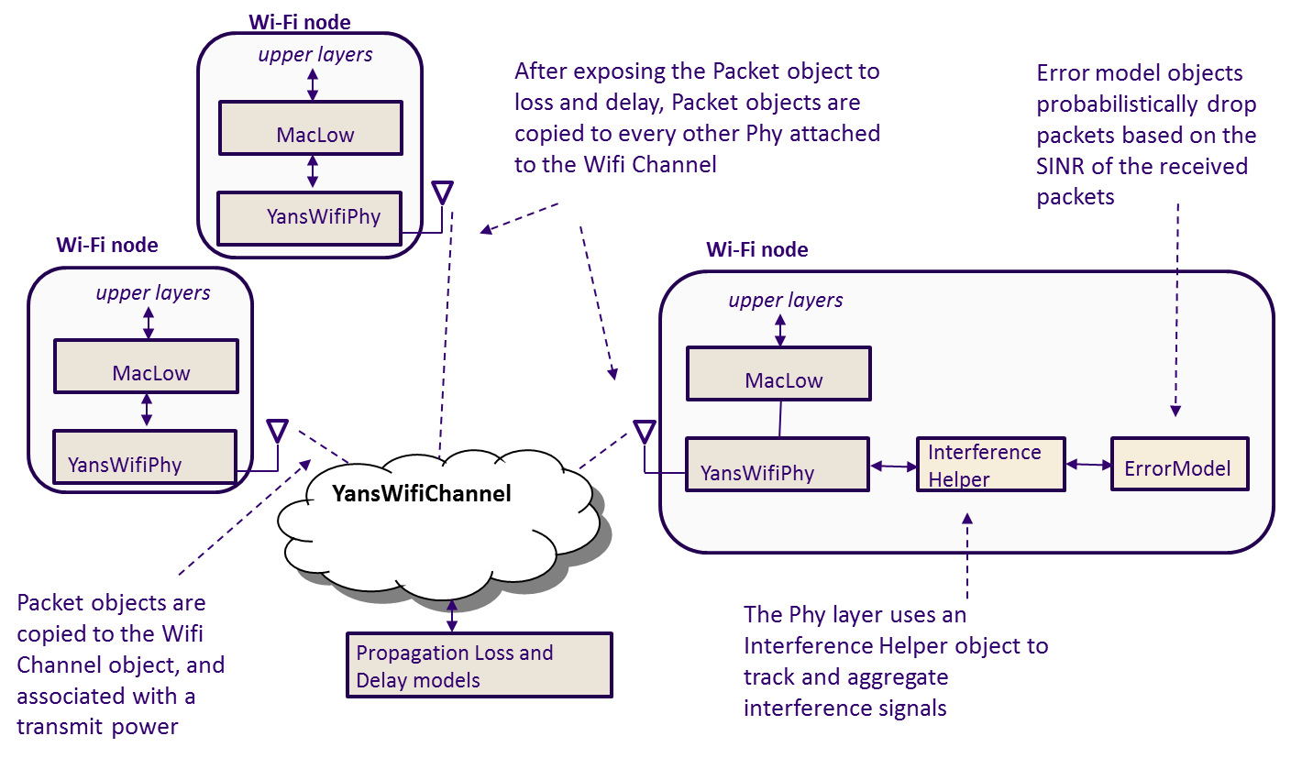
Current Wi-Fi PHY abstraction

Slide 5
Spectrum Module
Dev 1
(SpectrumPhy)
Dev 2
(SpectrumPhy)
Dev N
(SpectrumPhy)
SpectrumValue
SpectrumValue
SpectrumValue
SpectrumChannel
Three key pieces
SpectrumValue, SpectrumChannel, SpectrumPhy
SpectrumValue is the signal abstraction being passed through to the channel (and to the users)
A vector of sub-bands representing center frequency, bandwidth, and sub-band power specral density
SpectrumChannel delays/attenuates/modifies the transmitted signal as specified before providing copies to all receivers
Automatically converts signals with different resolutions
Inheriting from SpectrumPhy allows different types of devices to interact through the wireless channel

Slide 6
Nodes, Mobility, and Position
ALL nodes have to be created before simulation starts
Position Allocators setup initial position of nodes
List, Grid, Random position…
Mobility models specify how nodes will move
Constant position, constant velocity/acceleration, waypoint…
Trace-file based from mobility tools such as SUMO, BonnMotion (using NS2 format)
Routes Mobility using Google API (*)
(*) Presented in WNS3 - 2015

Slide 7
Position Allocation Examples
List MobilityHelper mobility; // place two nodes at specific positions (100,0) and (0,100) Ptr<ListPositionAllocator> positionAlloc = CreateObject<ListPositionAllocator> (); positionAlloc->Add (Vector (100, 0, 0)); positionAlloc->Add (Vector (0, 100, 0)); mobility.SetPositionAllocator(positionAlloc);
Grid Position
MobilityHelper mobility;
// setup the grid itself: nodes are laid out started from (-100,-100) with 20 per row, the x
// interval between each object is 5 meters and the y interval between each object is 20 meters
mobility.SetPositionAllocator ("ns3::GridPositionAllocator",
"MinX", DoubleValue (-100.0),
"MinY", DoubleValue (-100.0),
"DeltaX", DoubleValue (5.0),
"DeltaY", DoubleValue (20.0),
"GridWidth", UintegerValue (20),
"LayoutType", StringValue ("RowFirst"));
Random Rectangle Position
// place nodes uniformly on a straight line from (0, 1000)
MobilityHelper mobility;
Ptr<RandomRectanglePositionAllocator> positionAloc = CreateObject<RandomRectanglePositionAllocator>();
positionAloc->SetAttribute("X", StringValue("ns3::UniformRandomVariable[Min=0.0|Max=100.0]"));
positionAloc->SetAttribute("Y", StringValue("ns3::ConstantRandomVariable[Constant=50.0]"));
mobility.SetPositionAllocator(positionAloc);

Slide 8
Mobility Model Example
Constant Position
MobilityHelper mobility;
mobility.SetMobilityModel ("ns3::ConstantPositionMobilityModel");
mobility.Install (nodes);
Constant Speed
MobilityHelper mobility;
mobility.SetMobilityModel ("ns3::ConstantVelocityMobilityModel");
mobility.Install (nodes);
Ptr<UniformRandomVariable> rvar = CreateObject<UniformRandomVariable>();
for (NodeContainer::Iterator i = nodes.Begin (); i != nodes.End (); ++i){
Ptr<Node> node = (*i);
double speed = rvar->GetValue(15, 25);
node->GetObject<ConstantVelocityMobilityModel>()->SetVelocity(Vector(speed,0,0));
}
Trace-file based
std::string traceFile = “mobility_trace.txt”;
// Create Ns2MobilityHelper with the specified trace log file as parameter
Ns2MobilityHelper ns2 = Ns2MobilityHelper (traceFile);
ns2.Install (); // configure movements for each node, while reading trace file
Notes:
Explain key differences of these models and under what situations would I use each one.

Slide 9
Interesting ns-3 extensions
ns-3-highway-mobility (https://code.google.com/p/ns-3-highway-mobility/)
Implement IDM and MOBIL change lane, highway class, traffic-lights.
Based on ns-3.8
No longer maintained
Virtual Traffic Lights (PROMELA) (https://dsn.tm.kit.edu/misc_3434.php)
Manhattan IDM mobility model
NLOS propagation loss models
(Virtual) Traffic Light applications

Slide 10
Propagation Models
Propagation Loss
ITUR1411, LogDistance, ThreeLogDistance, Range, TwoRayGround, Friis
Nakagami, Jakes
Obstacle model (*)
Propagation Delay
Constant Speed
Random
Be careful when using YansWifiChannelHelper::Default() the LogDistance propagation model is added. Calling AddPropagationLoss() again will add a second propagation loss model.
(*) Presented in WNS3 2015

Slide 11
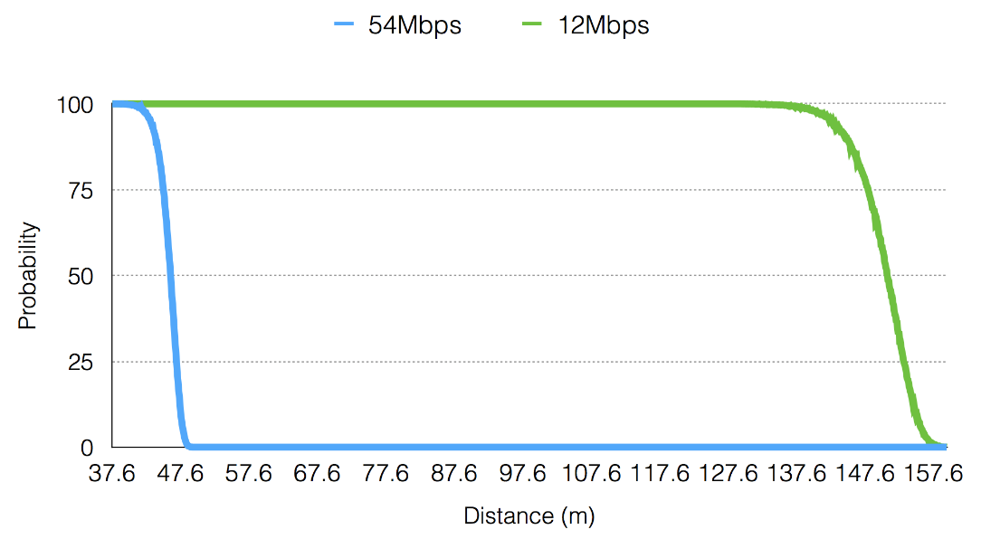
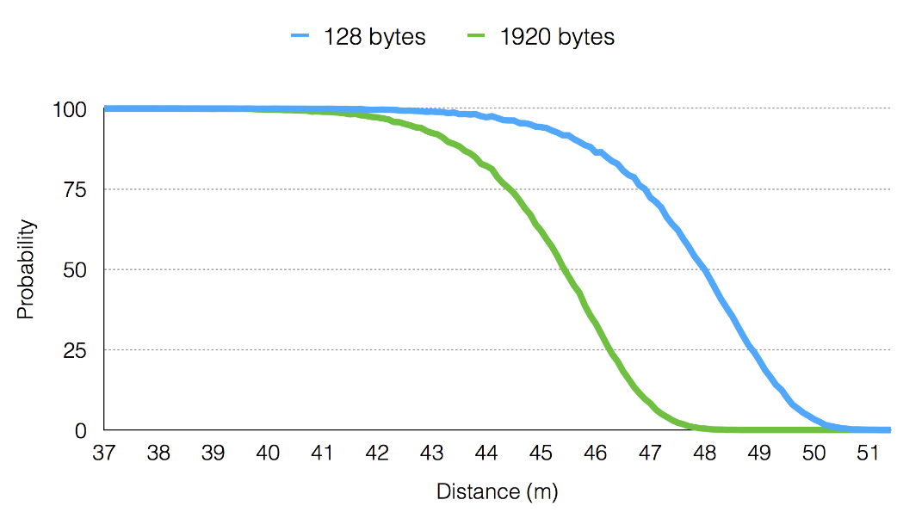
Communication Range
Depends on many factors
Propagation loss model and PHY configuration
Frame size (big vs small)
Transmission mode (6Mbps vs 54 Mbps)

Slide 12
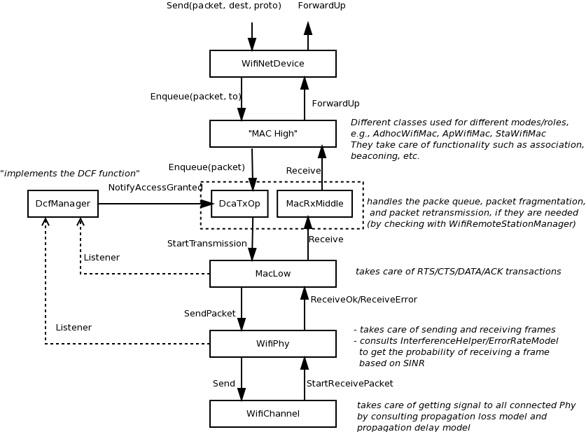
Wi-Fi Architecture

Slide 13
MAC High
Presently, three MAC high models
AdhocWifiMac: simplest one
ApWifiMac: beacon, associations by STAs
StaWifiMac: association based on beacons
All inherit from RegularWifiMac, which handles QoS and non-QoS support

Slide 14
Rate controls
The following rate control algorithms can be used by the MAC low layer:
Algorithms found in real devices:
ArfWifiManager (default for WifiHelper), OnoeWifiManager, ConstantRateWifiManager, MinstrelWifiManager, MinstrelHtWifiManager
Algorithms in literature:
IdealWifiManager, AarfWifiManager, AmrrWifiManager, CaraWifiManager, RraaWifiManager, AarfcdWifiManager, ParfWifiManager, AparfWifiManager
Example use of constant rate
std::string phyMode ("OfdmRate54Mbps");
wifi.SetRemoteStationManager ("ns3::ConstantRateWifiManager",
"DataMode",StringValue (phyMode),
"ControlMode",StringValue (phyMode));

Slide 15
MAC Middle/Low
Three components:
MacLow
RTS/CTS/DATA/ACK transactions
Aggregation, Block acks
DcfManager
implements the DCF
DcaTxop and EdcaTxopN:
One for NQoS, the other for QoS
Packet queue
Fragmentation/Retransmissions

Slide 16
Physical layer
No AGC model
Sync on first RX with energy > detection threshold
Collision: the error model will likely cause a drop of the packet
No capture effect: won’t re-sync on a stronger packet

Slide 17
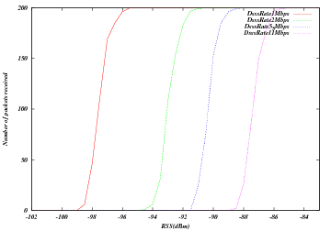
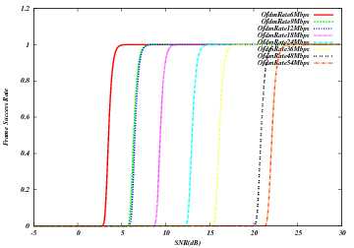
Error models
Based on analytical models with error bounds
Three implementations with different bounds: YansErrorRateModel, NistErrorRateModel, DssErrorRateModel
DsssErrorRateModel
NistErrorRateModel (OFDM)

Slide 18
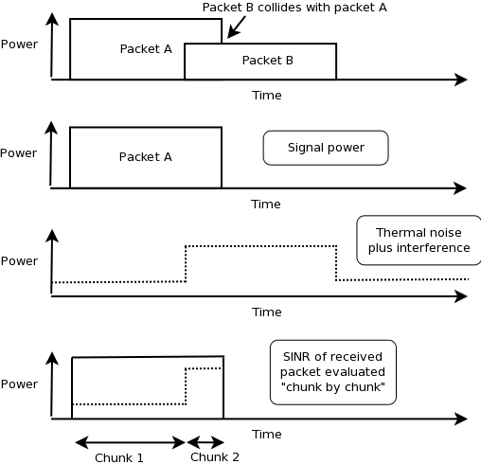
Interference helper
SINR evaluated on chunk-by-chunk basis

Slide 19
Configuring 802.11n/ac
Example programs include
examples/wireless/ht-wifi-network.cc
examples/wireless/vht-wifi-network.cc
examples/wireless/wifi-aggregation.cc
Setting the WifiPhyStandard will set most defaults reasonably
WifiHelper wifi;
wifi.SetStandard (WIFI_PHY_STANDARD_80211ac);
WifiMacHelper mac;
802.11ac uses 80 MHz channel by default; 802.11n uses 20 MHz

Slide 20
802.11n/ac rate controls
Possible options are IdealWifiManager, MinstrelHtWifiManager, and ConstantRateWifiManager
examples:
src/wifi/examples/ideal-wifi-manager-example.cc
src/wifi/examples/minstrel-ht-wifi-manager-example.cc

Slide 21
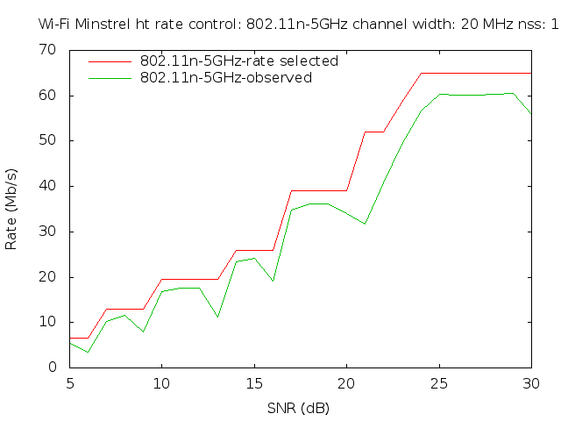
Example output for MinstrelHt
$ ./waf --run "minstrel-ht-wifi-manager-example --standard=802.11n-5GHz"
$ gnuplot minstrel-ht-802.11n-5GHz-20MHz-LGI-1SS.plt

Slide 22
Typical configuration
std::string phyMode ("DsssRate1Mbps");
NodeContainer ap;
ap.Create (1);
NodeContainer sta;
sta.Create (2);
WifiHelper wifi;
wifi.SetStandard (WIFI_PHY_STANDARD_80211b);
YansWifiPhyHelper wifiPhy = YansWifiPhyHelper::Default ();
// ns-3 supports RadioTap and Prism tracing extensions for 802.11
wifiPhy.SetPcapDataLinkType (YansWifiPhyHelper::DLT_IEEE802_11_RADIO);
YansWifiChannelHelper wifiChannel;
// reference loss must be changed since 802.11b is operating at 2.4GHz
wifiChannel.SetPropagationDelay ("ns3::ConstantSpeedPropagationDelayModel");
wifiChannel.AddPropagationLoss ("ns3::LogDistancePropagationLossModel",
"Exponent", DoubleValue (3.0),
"ReferenceLoss", DoubleValue (40.0459));
wifiPhy.SetChannel (wifiChannel.Create ());

Slide 23
Typical configuration (cont.)
// Add a non-QoS upper mac, and disable rate control
WifiMacHelper wifiMac;
wifi.SetRemoteStationManager ("ns3::ConstantRateWifiManager",
"DataMode",StringValue (phyMode),
"ControlMode",StringValue (phyMode));
// Setup the rest of the upper mac
Ssid ssid = Ssid ("wifi-default");
// setup ap.
wifiMac.SetType ("ns3::ApWifiMac",
"Ssid", SsidValue (ssid));
NetDeviceContainer apDevice = wifi.Install (wifiPhy, wifiMac, ap);
NetDeviceContainer devices = apDevice;
// setup sta.
wifiMac.SetType ("ns3::StaWifiMac",
"Ssid", SsidValue (ssid),
"ActiveProbing", BooleanValue (false));
NetDeviceContainer staDevice = wifi.Install (wifiPhy, wifiMac, sta);
devices.Add (staDevice);

Slide 24
Typical configuration (cont.)
// Configure mobility
MobilityHelper mobility;
Ptr<ListPositionAllocator> positionAlloc = CreateObject<ListPositionAllocator> ();
positionAlloc->Add (Vector (0.0, 0.0, 0.0));
positionAlloc->Add (Vector (5.0, 0.0, 0.0));
positionAlloc->Add (Vector (0.0, 5.0, 0.0));
mobility.SetPositionAllocator (positionAlloc);
mobility.SetMobilityModel ("ns3::ConstantPositionMobilityModel");
mobility.Install (ap);
mobility.Install (sta);
// other set up (e.g. InternetStack, Application)

Slide 25
Athstats helper
Hooks Wi-Fi traces to provide debugging similar to Madwifi drivers
Example athstats output from example ./waf --run wifi-ap
m_txCount m_rxCount unused short long exceeded rxError
0 0 0 0 0 0 0 0 0 0 0M
0 60 0 0 0 0 0 0 0 0 0M
0 123 0 0 0 0 0 0 0 0 0M
0 122 0 0 0 0 0 0 0 0 0M
0 122 0 0 0 0 0 0 0 0 0M
0 122 0 0 0 0 0 0 0 0 0M
0 122 0 0 0 0 2 0 0 0 0M
0 122 0 0 0 0 23 0 0 0 0M
0 122 0 0 0 0 14 0 0 0 0M
0 122 0 0 0 0 14 0 0 0 0M
0 122 0 0 0 0 26 0 0 0 0M
0 122 0 0 0 0 12 0 0 0 0M

Slide 26
LTE/Wi-Fi Coexistence

Slide 27
Use case: LAA Wi-Fi Coexistence
ns-3 has been extended to support scenarios for LTE LAA/Wi-Fi Coexistence
Methodology defined in 3GPP Technical Report TR36.889
Enhancements needed:
Wireless models (LBT access manager, SpectrumWifiPhy, propagation/fading models)
Scenario support (traffic models)
Output data processing

Slide 28
Indoor 3GPP scenario

Slide 29
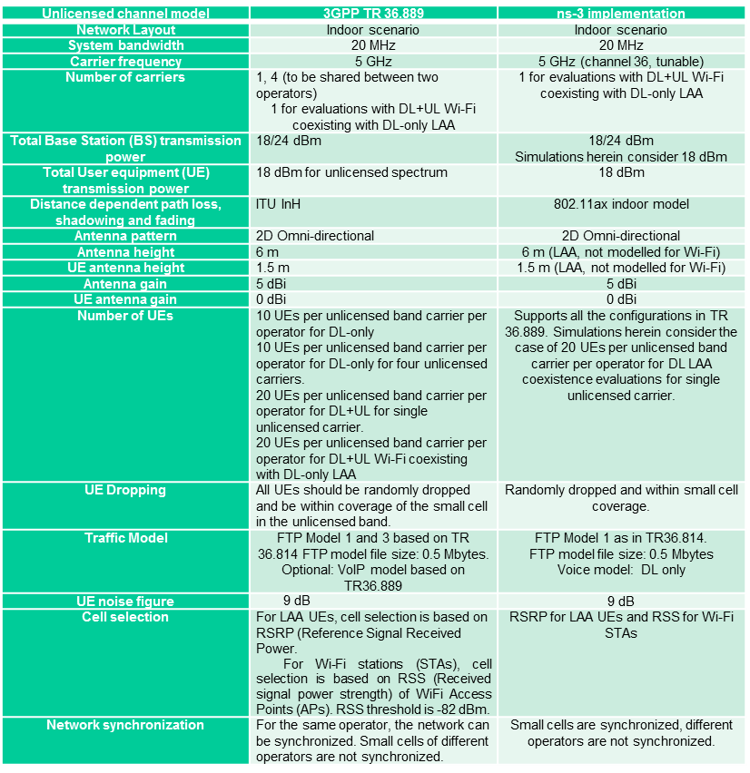
Indoor scenario details

Slide 30
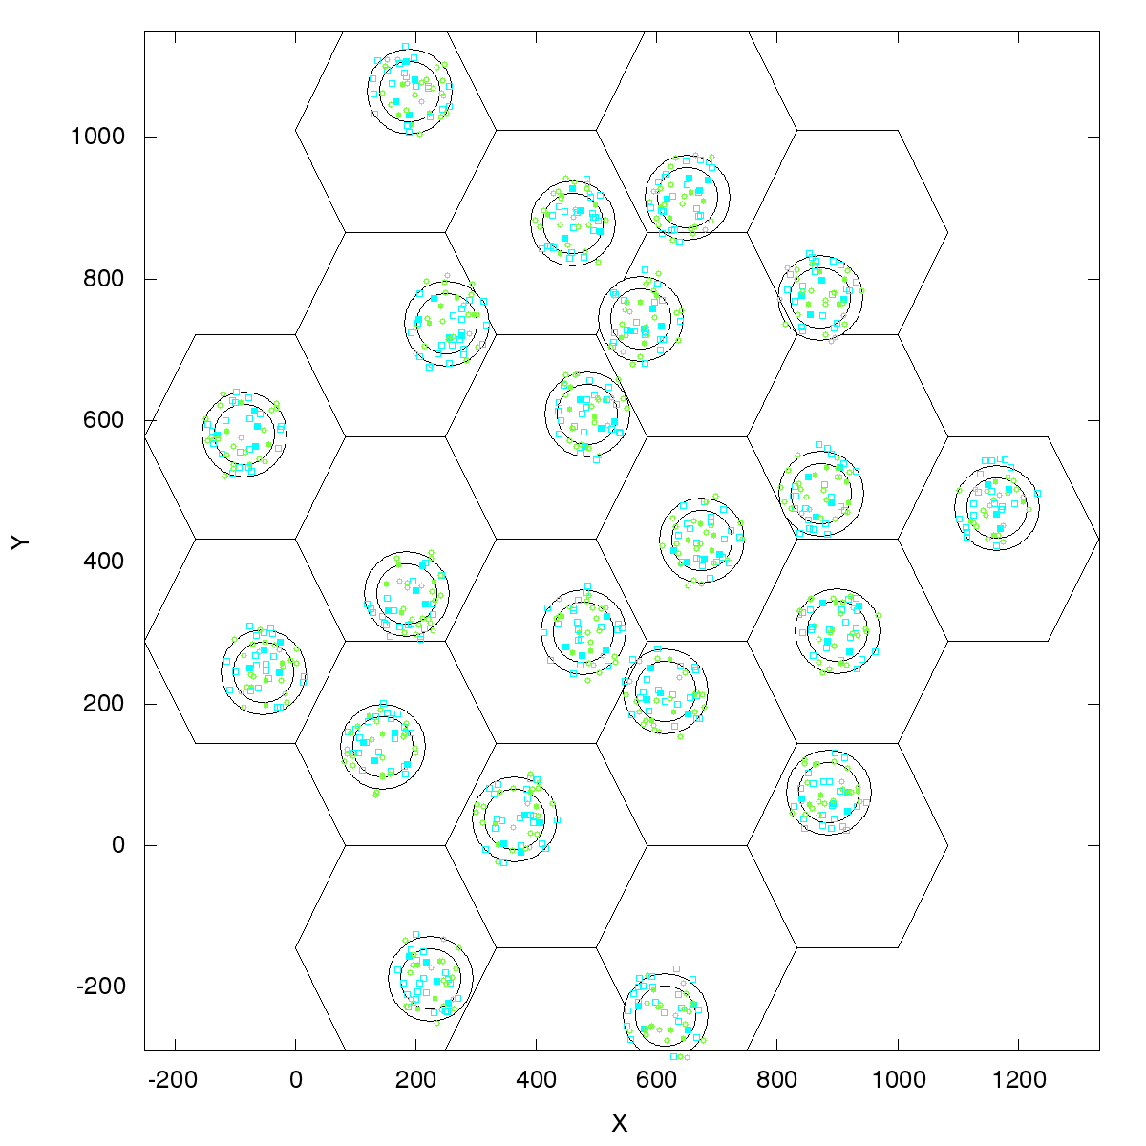
Outdoor 3GPP scenario
Outdoor layout: hexagonal macrocell layout. 7 macro sites and 3 cells per site. 1 Cluster per cell. 4 small cells per operator per cluster, uniformly dropped. ITU UMi channel model.
Figure source: 3GPP TR 36.889 V13.0.0 (2015-05)

Slide 31
References
ns-3 Wiki page:
https://www.nsnam.org/wiki/LAA-WiFi-Coexistence
module documentation
references to various publications
documentation on reproducing results
Code:
http://code.nsnam.org/laa/ns-3-lbt

Slide 32
Sample results

Slide 33
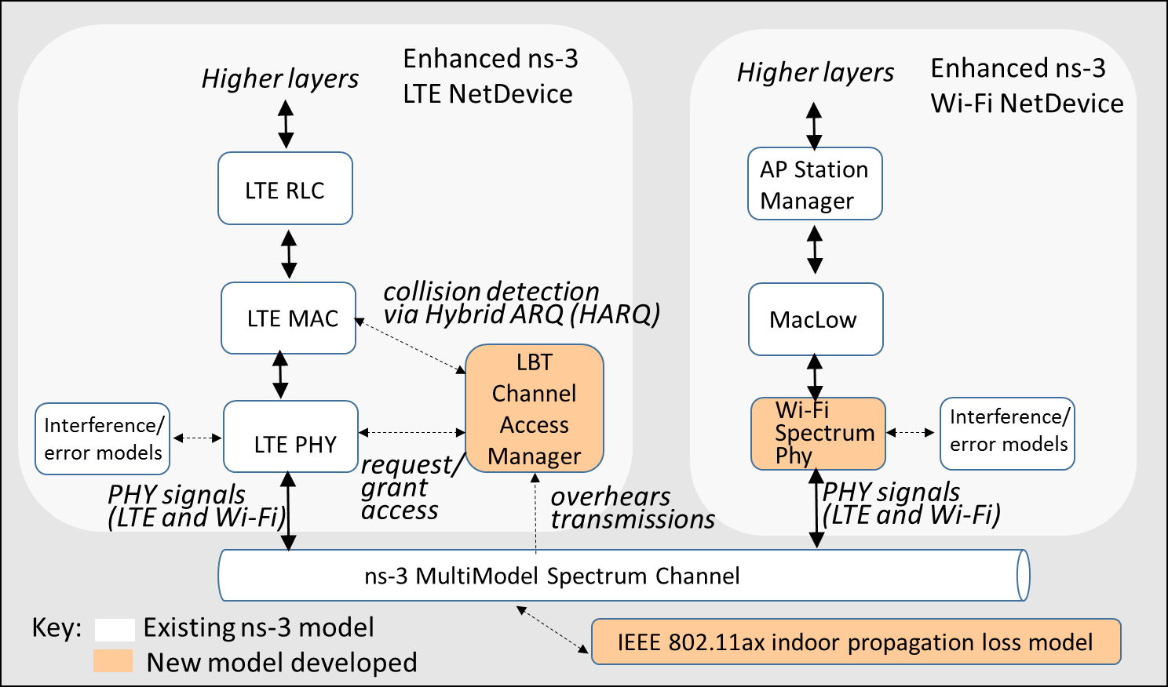
Wi-Fi enhancements

Slide 34
Model enhancements: Wi-Fi
Spectrum Wi-Fi Phy implementation
Wi-Fi preamble detection based on AWGN and TGn Channel Model D
Wi-Fi RSS-based AP selection and roaming
Wi-Fi MIMO approximations to support 2x2 DL, 1x2 DL on AWGN and TGn Model D

Slide 35
Model enhancements: LTE
LTE interference model relies on the simplifying assumption that all interfering signals are LTE and are synchronized at the subframe level.
LTE inteference model has been enhanced to handle inteference by signals of any type.
This relies on the ns-3 Spectrum framework.
The reception of LTE signals is evaluated by chunks, where each chunk is identified by a constant power spectral density.

Slide 36
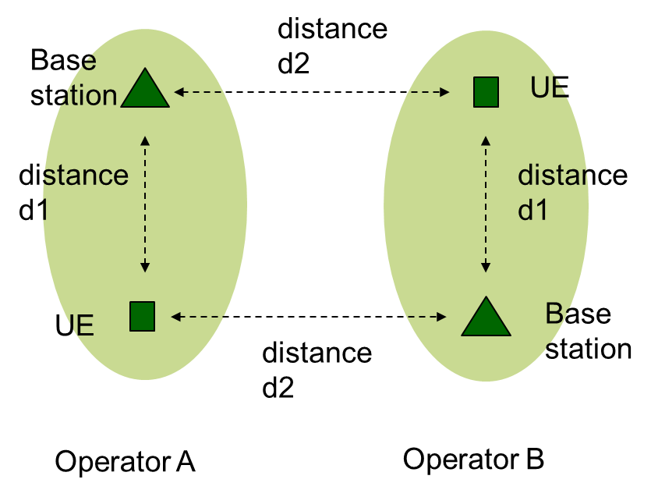
Scenario
An initial test scenario, useful for testing basic model operation in a small scale setting, grew into TR36.889-like indoor and outdoor scenarios
D1 and d2 can vary and operator A and B can be both LTE or Wi-Fi

Slide 37
Output experiment scripts
Shell scripts and gnuplot helpers to manage configuration and data output
(demonstrate)

Slide 38
Status
Portions are being migrated into ns-3-dev
SpectrumWifiPhy in ns-3.26
LTE components, propagation model likely in ns-3.27
Scenario helper may be rewritten
Trying to decompose into pieces easy to merge
For more information:
https://www.nsnam.org/wiki/LAA-WiFi-Coexistence

