Slide 1

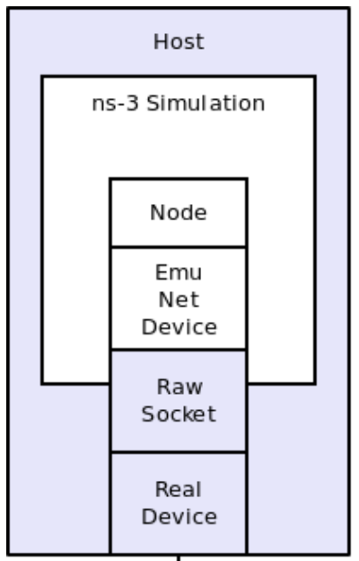
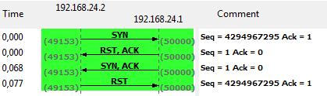
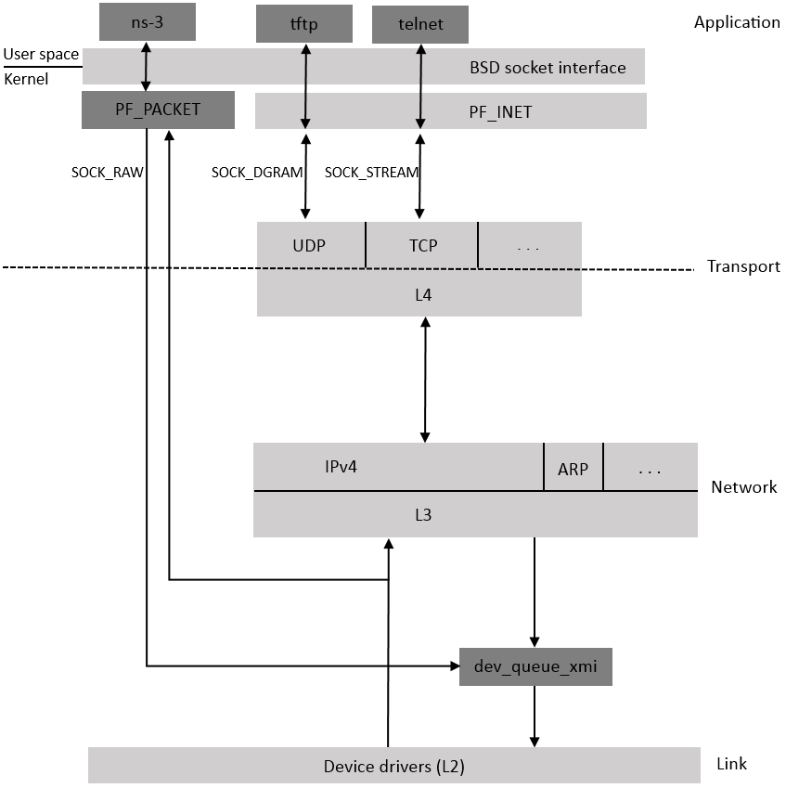
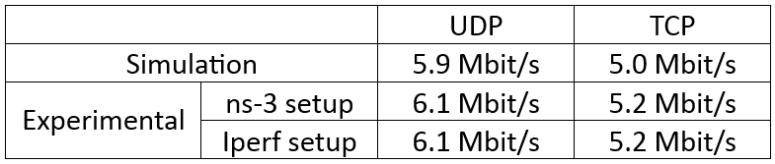
IEEE 802.11 transmission between two ns-3 applications over real interfaces using EmuNetDevice
Sébastien Deronne, Laurent Salingros, Véronique Moeyaert and Sébastien Bette
University of Mons, Faculty of Engineering, Electromagnetism and Telecommunication Department
sebastien.deronne@umons.ac.be
I. Introduction
  Raw socket enables ns-3 to send/receive packets directly to/from the wireless card, without being encapsulated by the Linux TCP/IP stack (Figure 2).
  Once a packet is received on the wireless interface, it will be sent to both the corresponding application and the Raw Socket.
  Open a Raw Socket in ns-3 using EmuNetDevice:
Firewall configuration:
  A received TCP packet is forwarded to both:
    ns-3: TCP port open.
    Linux protocol stack: TCP port close.
  Linux replies with a RST packet to indicate to the sender that the port he is trying to contact is close (Figure 3).
    → TCP connection initialization fails!
Objective: control all the parameters used by the Internet protocol stack and tune the IEEE 802.11 standard parameters.
Tool: ns-3 EmuNetDevice module to inject traffic on real network interfaces.
→ Communication over a real Wi-Fi transmission using ns-3 EmuNetDevice (Figure 1).
AP
STA
Figure 1 - 802.11 wireless testbed piloted by ns-3.
Figure 3 - Competition between RST and ACK responses respectively sent by Linux and ns-3 after the reception of a TCP SYN packet.
II. Experimental system
IEEE 802.11 wireless cards:
  Wireless cards entirely supported by the Linux kernel.
  Open source driver to access to the internal variables.
  Atheros drivers:
    Ath5k: IEEE 802.11a/b/g
    Ath9k: IEEE 802.11a/b/g/n
  Cards using the Atheros chipset: D-Link DWA-520 and DWA-547.
Raw socket:
  Filter TCP SYN RST segments thanks to the Linux NetFilter firewall: only SYN ACK packets are sent.
    → TCP connection initialization succeed!
  Same problem when an UDP packet arrives on a close port, where Linux replies with an "ICMP Port Unreachable“ packet.
  → filter ICMP Port Unreachable packets!
III. Measurements
Compare testbed measurements with ns-3 simulation results obtained under the same conditions:
Simulation and experimental results are very close! Difference comes from average back-off value used by manufacturer.
In simulation, average back-off value is based on the standard:
  Average IEEE 802.11b standard back-off: 310 µs.
We measured the average back-off value from pcap traces:
  Average back-off value in our experimental system: 276 µs.
IV. Conclusion
Real 802.11 wireless transmission to establish a communication between two ns-3 applications.
Modification of any parameter of the protocol stack.
Open source wireless drivers to tune all Wi-Fi parameters.
Figure 2 - Packet reception process used by the operating system.

