Slide 1

Sébastien Deronne, Véronique Moeyaert and Sébastien Bette
Electromagnetism and Telecommunication Department
Faculty of Engineering - University of Mons (Belgium)
Simulation of 802.11 Radio-over-Fiber Networks using ns-3.
Workshop on ns-3, Cannes (France)
March 5th, 2013

Slide 2
Talk outline
Introduction: Radio-over-Fiber (RoF) networks
Motivation
IEEE 802.11 RoF implementation in ns-3
Model validation & exploitation
Conclusions & future works

Slide 3
Talk outline
Introduction: Radio-over-Fiber (RoF) networks
Motivation
IEEE 802.11 RoF implementation in ns-3
Model validation & exploitation
Conclusions & future works

Slide 4
Radio-over-Fiber systems: merge optical & wireless networks!
Current needs:
  Higher data throughput
  → bring the fiber close to the users (FTTx).
  Connection everywhere and at anytime
  → massive deployment of wireless systems.
Promising solution => Radio-over-Fiber systems combine:
  Optical networks: capacity and transparency.
  Wireless networks: flexibility and mobility.

Slide 5
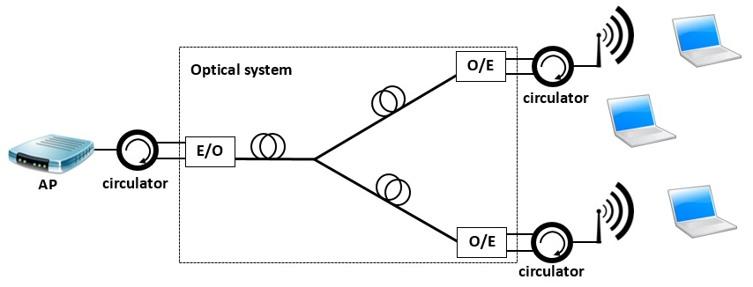
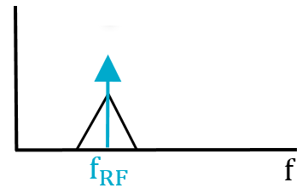
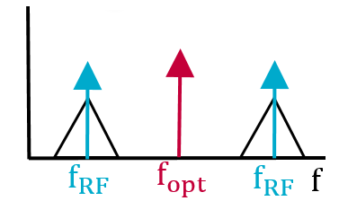
What is a radio-over-fiber system?
RF signal imposed on the optical carrier and transmitted through an optical network.
Converted back to the electrical domain and transmitted over the radio channel to the mobile stations.
Example: 802.11 RoF system

Slide 6
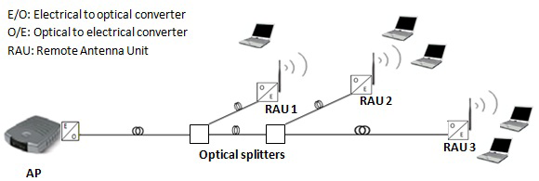
The utilization of RoF extends radio coverage while reducing RF propagation effects
Advantages to use a RoF architecture:
  Centralize whole processing functions at the central site: simplify maintenance and reduce antennas complexity.
  Reduce RF channel effects (↘ attenuation, ↘ fading, …);
  No handover issues;
  Same architecture to distribute several radio services (Wi-Fi, 4G, WiMAX, ZigBee, …)

Slide 7
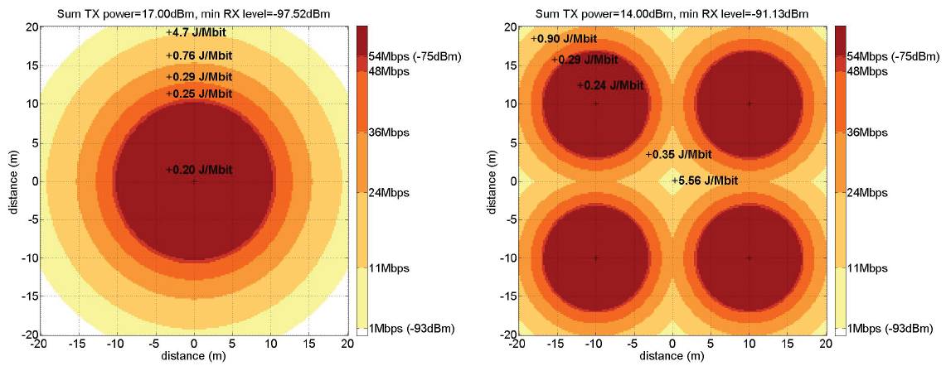
The utilization of RoF increases radio coverage while reducing power consumption
Advantages to use a RoF architecture:
  Increase coverage [1];
  Reduce emitted power [1].
[1] Y. Josse, B. Fracasso, and P. Pajusco, Model for energy efficiency in radio over fiber distributed indoor antenna wi-fi network, on Proceedings of the 14th International Symposium on Wireless Personal Multimedia Communications (WPMC), pages 131{135, 2011.

Slide 8
Talk outline
Introduction: Radio-over-Fiber (RoF) networks
Motivation
IEEE 802.11 RoF implementation in ns-3
Model validation & exploitation
Conclusions & future works

Slide 9
The performance analysis of Radio-over-Fiber networks require a simulation model in ns-3
Transmission techniques to propagate a RF signal with good performance over long optical fiber distances:
  modulation format
  chromatic dispersion effect
  type of fiber
  …
Investigation of the network performance in RoF systems:
  capacity, latency, quality of service, …
  impact of the physical layer on the MAC performance
  protocol optimization regarding of the architecture
  …
  → require a network simulator to quantify MAC performance !
  BUT: no RoF modules developed for ns-3 …
  → implement RoF in ns-3 !!!

Slide 10
Talk outline
Introduction: Radio-over-Fiber (RoF) networks
Motivation
IEEE 802.11 RoF implementation in ns-3
Model validation & exploitation
Conclusions & future works

Slide 11
The Wi-Fi PHY layer needs to be changed in ns-3 to support IEEE 802.11 RoF simulations
Optical links between the AP and wireless stations = propagation delay ↗
  keep MAC layer
  change PHY layer
Model assumptions:
  Physical layer imperfections are not considered.
  Optical channel = delay & loss computation.
  Delay: time needed by the radio signal to travel along the fiber link.
  Linear loss: attenuation introduced by the optical link (electrical loss = 2 x optical loss !).

Slide 12
The Wi-Fi PHY layer needs to be changed in ns-3 to support IEEE 802.11 RoF simulations
Most of ns-3 Wi-Fi modules can still be used for IEEE 802.11 RoF simulations.
ns-3 Wi-Fi PHY layer needs to be changed!

Slide 13
A new PHY module has been implemented to relay packets from one channel to another.
OpticalChannel: compute delay and loss of optical transmissions.
WirelessChannel: YansWifiChannel modified to fit with our implementation.
ApWifiPhy:
  Instance attached to the access point.
  YansWifiPhy modified to handle with the OpticalChannel module.
StaWifiPhy:
  Instance attached to each station.
  YansWifiPhy modified to handle with the WirelessChannel module.
RofRelayWifiPhy:
  Instance attached to each remote antenna.
  New physical layer module which forwards packets from one channel to another.

Slide 14
A new device model has been implemented to set the position of remote antenna units.
WifiNetDevice:
Hold together all objects used by AP and stations.
MAC & PHY layers + channel.
Ability to set the position of AP and stations.
RofRelayDevice:
Hold together all objects used by a remote antenna.
PHY layer + channel.
Ability to set the position of each distributed antenna in the network.
The position of each device is used by the Optical Channel and the Wireless Channel: propagation delay and propagation loss depend on distance.

Slide 15
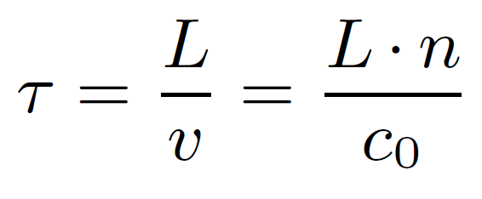
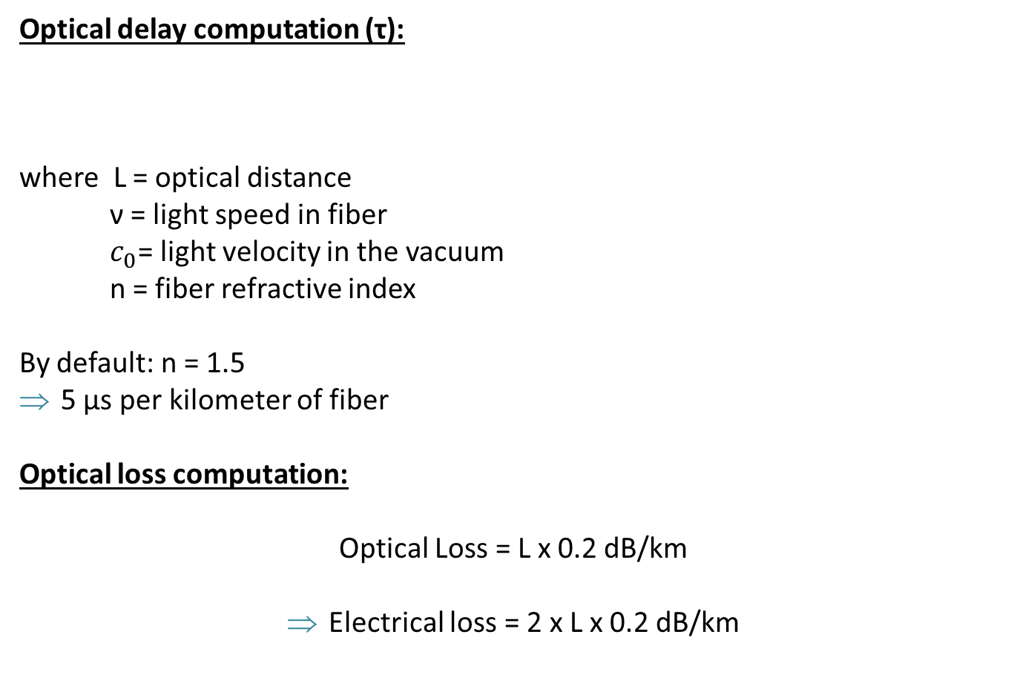
Optical channel module computations
Optical delay computation (τ):
where L = optical distance
ν = light speed in fiber
$c_{0}$= light velocity in the vacuum
n = fiber refractive index
By default: n = 1.5
5 µs per kilometer of fiber
Optical loss computation:
Optical Loss = L x 0.2 dB/km
Electrical loss = 2 x L x 0.2 dB/km

Slide 16
Optical channel module behaves differently for upstream and downstream signals.
Signal sent by the AP: sent to all RAUs attached to the OpticalChannel module.
Signal sent by a RAU: only transmitted to the AP and is not received by other RAUs.

Slide 17
Talk outline
Introduction: Radio-over-Fiber (RoF) networks
Motivation
IEEE 802.11 RoF implementation in ns-3
Model validation & exploitation
Conclusions & future works

Slide 18
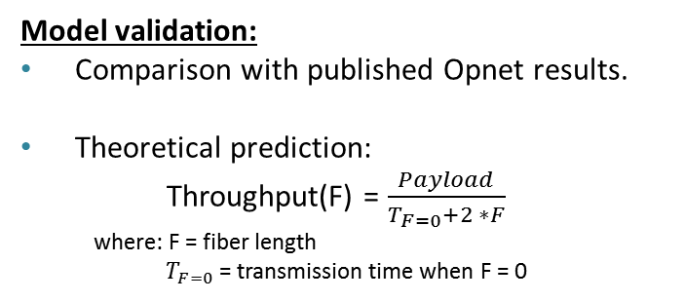
Model validation is done using a simple Radio-over-Fiber configuration
Model validation:
Comparison with published Opnet results.
Theoretical prediction:
Throughput(F) = $\frac{Payload}{T_{F=0}+2 ∗F}$
  where: F = fiber length
  $T_{F=0}$ = transmission time when F = 0
802.11b over RoF
802.11g over RoF

Slide 19
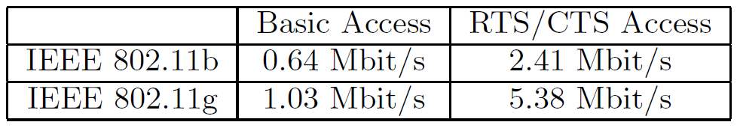
We used our model for the simulation of RoF distributed antenna systems.
Interest: study performance of RoF distributed antenna systems.
Considered scenario:
  4 RAUs & 4 stations where groups of station(s) are hidden from each other.
  Each station receives only once all frames transmitted by the AP and do not hear the traffic sent by other stations.
  Basic access versus RTS/CTS access.
Results:
RTS/CTS access performs better than basic access (also confirmed in A. Das et al. , “Effects on IEEE 802.11 MAC Throughput in Wireless LAN over Fiber Systems”, in Journal of Lightwave Technology, Vol. 25, No. 11, November 2007.).

Slide 20
Talk outline
Introduction: Radio-over-Fiber (RoF) networks
Motivation
IEEE 802.11 RoF implementation in ns-3
Model validation & exploitation
Conclusions & future works

Slide 21
Conclusions
Tool to support the simulation of IEEE 802.11 radio-over-fiber networks in ns-3.
Validated through comparisons with theoretical predictions and with Opnet simulation results.
Model supports the simulation of Distributed Antenna Systems.
Wiki page: https://www.nsnam.org/wiki/index.php/NS-3_optical_network_models
Code soon online!

Slide 22
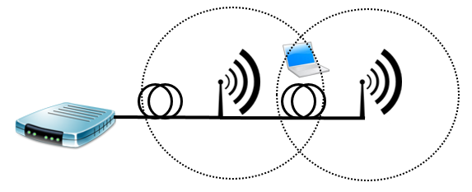
Future work 1: Wi-Fi receiver model to handle with simulcast conditions
Scenario: coverage of the remote antennas overlap with each others.
When a packet is transmitted by a station: the AP receives several times the same signal quite close in time and in power (simulcast)
ns-3 Wi-Fi model doesn’t handle with simulcast…
→ Change existing Wi-Fi receiver model to handle with simulcast conditions !

Slide 23
Future work 2: provide a more accurate optical channel model
Our OpticalChannel module: compute delay & loss.
Doesn’t support other optical properties (dispersion effect, nonlinearities…)
Optical network components are currently being developed for ns-3.
→ integrate those modules to provide a more accurate optical channel model!

Slide 24
Future work 3: a protocol- independent Radio-over-Fiber model
Radio-over-Fiber model supports Wi-Fi radio signals.
Same model could be used for different wireless protocols (Wi-Fi, ZigBee, WiMAX, ...).
→ develop a protocol-independent Radio-over-Fiber model !

Slide 25
Thank you !

