Slide 1
NS-3 Consortium
Annual Meeting

Slide 2
Agenda
Consortium overview
History, structure, membership
Budget status
Activities in the past year
WNS3 2016 (review) and 2017 (plans)
Open source project status and discussion
Maintainer status and sustainment
Summary of recent software activity
Future directions
Modular build and code contributions
git and development/maintainer tools
Any other business?

Slide 3
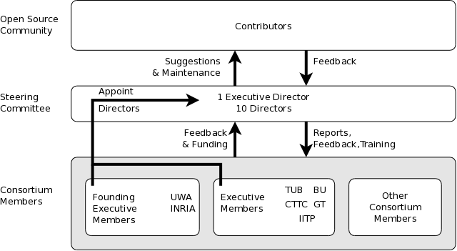
Consortium organization
Established in 2012 to help sustain the open source project
More details at http://www.nsnam.org/consortium/about

Slide 4
Current Membership
Founding Executive Members
INRIA, University of Washington
Additional Executive Members
Bucknell, CTTC, Georgia Tech, INESCTEC
Regular Members
Lawrence Livermore National Laboratory
NITK Surathkal

Slide 5
Current Steering Committee
Mike Clarke (University of Washington)
Sumit Roy (University of Washington)
Tom Henderson * (University of Washington)
Gérard Giraudon (INRIA)
Walid Dabbous (INRIA)
Marc Barrett (INRIA)
Lorenza Giupponi (CTTC)
Manuel Ricardo (INESC Porto)
George Riley (Georgia Institute of Technology)
Felipe Perrone (Bucknell University)
* Executive Director

Slide 6
Theory vs Practice
Theory: Raise modest amounts of funding, primarily from several industrial users who become recurring members, to pay for full-time software engineers
Practice: Raise small amounts of funding, primarily from annual meeting, to pay for annual meeting and low-cost infrastructure/services.

Slide 7
Budget status
Consortium accounts hold roughly $10,000, prior to WNS3 revenue/expense
Includes 2016 membership from NITK Surathkal and LLNL
WNS3 operated at small net loss in 2015
WNS3 2016 projects to result in a net gain

Slide 8
2015-16 activities
Note: All meeting minutes of the steering committee and annual meetings are archived on our website http://www.nsnam.org
Welcomed Lorenza Giupponi to the steering committee to replace Nicola Baldo
Welcomed NITK Surathkal as a new regular member for 2016
Coordinated the organization of WNS3 2016 (setting dates, attendance fees, discuss live streaming, etc.)

Slide 9
WNS3 past and present
Thanks to Brian Swenson, Hajime Tazaki, and Eric Gamess (proceedings chair) for WNS3 2016
No significant issues arose during WNS3 review process
We decided not to spend the fees associated with professionally recording WNS3/training
2017 edition of WNS3 scheduled for June 2017, hosted by INESC Porto

Slide 10
Planned next steps
Update main web site to be more mobile-friendly and expose more demos of ns-3 usage
May use some funding to explore use of Amazon Web Services (AWS) to access HPC infrastructure, and document the findings
Finalize TPC chairs for WNS3 2017 and begin preparation

Slide 11
Discussion points
WNS3 remote participation and video archiving?
More industrial involvement, both code and funding contributions
if anyone has new ideas
Opportunities for research/government funding?
Windows Visual Studio priority/status?
WNS3 and/or training-- how to improve?

Slide 12
Open source project status
ns-3.24 (Sept. 2015)
Main model update was 802.11ac
ns-3.25 (March 2016)
802.11n/ac improvements
traffic-control module
refactored TCP congestion control architecture
Project not selected for Google Summer of Code, but one student funded for ESA Summer of Code in Space
three unfunded summer students

Slide 13
Current issues
TCP Hamilton
Trace Replay Application
web-browsing traffic model
loss models for Teraherz channels
GPSR
LEAR extensions to DSR
WiFi WFQ queues
Mobility Service Interface
UAN WOSS framework
WiFi WFQ queues
Review by maintainers,
Iteration with contributors
ns-3-dev

Slide 14
Modules with very active maintainers
utilities
devices
protocols
visualizer
DCE
bridge
spectrum
applications
config-
store
aodv
csma
internet
(IPv4/v6)
tap-bridge
dsdv
flow-monitor
energy
fdnetdevice
traffic-
control
uan
olsr
netanim
mpi
point-to-
point
virtual-
net-device
click
stats
mobility
lr-wpan
wifi
network
nix-vector-
routing
topology-
read
lte
propagation
wimax
core
openflow
BRITE
mesh
14

Slide 15
Other maintainers sought
Help for ns-3 DCE
ns-3 bibliography list
contributed code curator
website maintenance
documentation translations
etc.

Slide 16
Contributed code
Long-term goal is to split ns-3 into many packages (libraries) that may evolve independently, and provide tool to manage dependencies
ns-3 "core" shrinks to much smaller scope
Need to accommodate binary packages
Need to support easy discovery of modules and module status

Slide 17
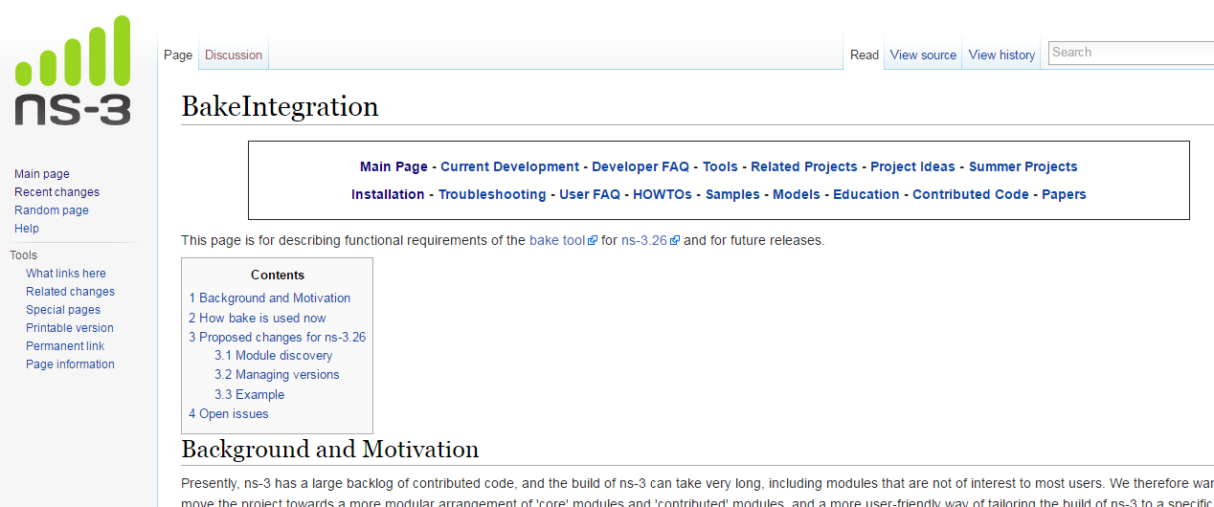
Proposal: Use 'bake' build tool
specific ns-3.26 release plan posted, soliciting comments
https://www.nsnam.org/wiki/BakeIntegration

Slide 18
Contributed code management/status
Let communities of interest form and plug into upstream core releases somehow
Provide objective or reputation-based systems to convey model status to users; for example:

Slide 19
Binary packages
Recent discussion on ns-developers list about providing Debian library packages
Should ns-3 start coordinating with downstream package managers?
How do we want to provide for source distributions?

Slide 20
git and git workflow
Many of our more recent maintainers prefer git and the git workflow
Git development tools for code review and patch/branch management are superior to our current ones
Discussions ongoing about when/how to possibly cut over to git

