Slide 1
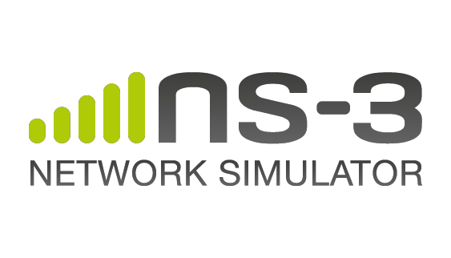
ns-3 Introduction
Tom Henderson (University of Washington)
July 2014

Slide 2
Agenda
ns-3 project overview
  What is ns-3?
  Why use ns-3?
  Project organization
  Relationship to ns-2
  Future directions
Getting started with ns-3

Slide 3
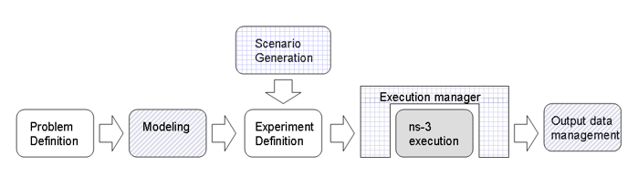
Discrete event network simulator
Model of the evolution of a networked system through discrete events in time
Used for experimentation and education

Slide 4
ns-3 simulation basics
Simulation time advances in discrete jumps from event to event
C++ functions schedule events to occur at specific simulation times
A simulation scheduler orders the event execution
Simulation::Run() gets it all started
Simulation stops at specific time or when events end

Slide 5
Software overview
ns-3 is written in C++, with bindings available for Python
  simulation programs are C++ executables or Python programs
  ~350,000 lines of C++ (estimate based on cloc source code analysis)
ns-3 is a GNU GPLv2-licensed project
ns-3 is mainly supported for Linux, OS X, and FreeBSD
  Windows Visual Studio port available
ns-3 is not backwards-compatible with ns-2

Slide 6
Software orientation
Key differences from other network simulators:
1) Command-line, Unix orientation
  vs. Integrated Development Environment (IDE)
2) Simulations and models written directly in C++ and Python
  vs. a domain-specific simulation language

Slide 7
Software organization
Two levels of ns-3 software and libraries
1) Several supporting libraries, not system-installed, can be in parallel to ns-3
Netanim
pybindgen
Click routing
ns-3
2) ns-3 modules exist
within the ns-3 directory
module
module
module
module
module
module

Slide 8
Current models
utilities
devices
protocols
visualizer
bridge
mesh
config-
store
applications
aodv
csma
spectrum
internet
(IPv4/v6)
dsdv
flow-monitor
energy
emu
netanim
tap-bridge
olsr
mpi
point-to-
point
uan
click
stats
mobility
virtual-
net-device
network
nix-vector-
routing
topology-
read
lte
propagation
lr-wpan
wifi
core
openflow
BRITE
wimax
8

Slide 9
Current models
utilities
devices
protocols
visualizer
bridge
mesh
config-
store
applications
aodv
Node class
NetDevice ABC
Address types
(Ipv4, MAC, etc.)
Queues
Socket ABC
Ipv4 ABCs
Packet sockets
csma
spectrum
internet
(IPv4/v6)
dsdv
flow-monitor
energy
emu
Packets
Packet Tags
Packet Headers
Pcap/ascii file writing
tap-bridge
olsr
netanim
mpi
point-to-
point
uan
click
stats
Smart pointers
Dynamic types
Attributes
Callbacks
Tracing
Logging
Random Variables
mobility
virtual-
net-device
network
nix-vector-
routing
topology-
read
lte
Events
Scheduler
Time arithmetic
propagation
lr-wpan
wifi
core
openflow
BRITE
wimax
9

Slide 10
Python bindings
ns-3 uses a program called PyBindGen to generate Python bindings for all libraries
v
v
v
v
C++
header
Intermediate
Python
program
C++
bindings
code
Python
module
(py)gccxml
PyBindGen
C++ compiler

Slide 11
Agenda
ns-3 project overview
  What is ns-3?
  Why use ns-3?
  Project organization
  Relationship to ns-2
  Future directions
Getting started with ns-3

Slide 12
Why use ns-3?
You want to study network performance or protocol operation in a controllable or scalable environment
You are comfortable writing C++ or Python code, and combining ns-3 with other code
You like the idea of working on an active open source project
ns-3 has the models you are looking for
  or you can provide/integrate what is lacking

Slide 13
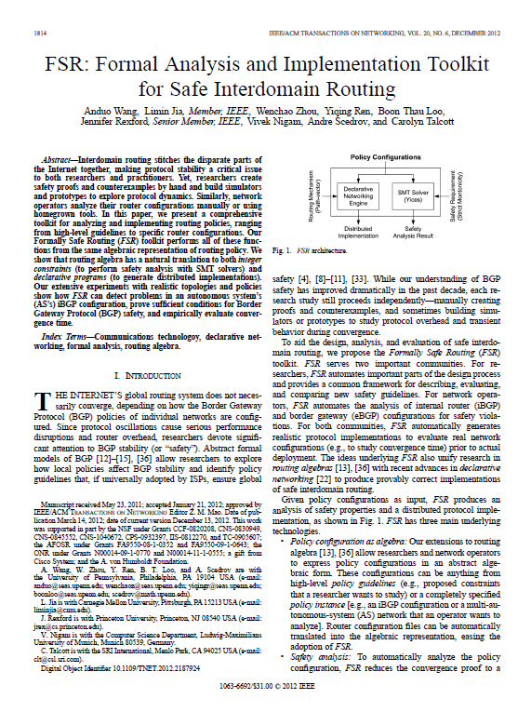
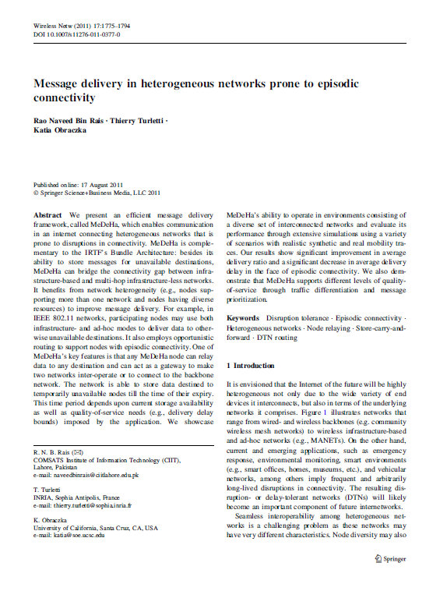
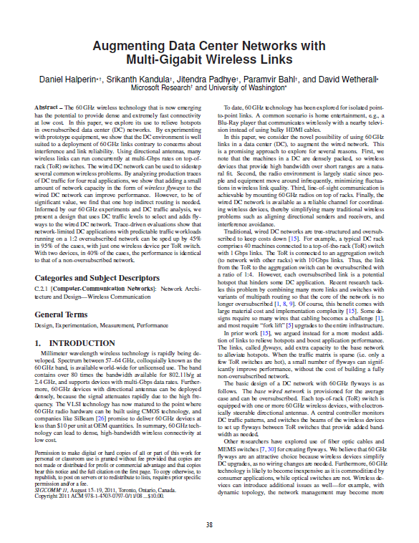
What have people done with ns-3?
~750 publications to date
  search of 'ns-3 simulator' on IEEE and ACM digital libraries

Slide 14
Examples of recent publications
L. Salameh et al., "HACK: Hierarchical ACKs for Efficient Wireless Medium Utilization," Proceedings of 2014 Usenix Annual Technical Conference (best paper award winner), June 2014.
A. Azgin et al., "Mobility Study for Named Data Networking in Wireless Access Networks," Proceedings of IEEE ICC 2014, June 2014.
Wong S.-H and Gary Chan, "Topology Optimization for Wireless Mesh with Directional Antennas," Proceedings of IEEE ICC 2014, June 2014.
C. Gouveia et al., "Development and implementation of Portuguese smart distribution system," Electric Power Systems Research, Elsevier, vol. 116, June 2014.
M. Alharthi et al., "An Acumen/NS-3 integration for modeling networked Cyber-Physical Systems," 2014 Biennial Symposium on Communications (QSBC), June 2014.
L. Ciarletta et al., "Simulation and platform tools to develop safe flock of UAVs: a CPS application-driven research," 2014 International Conference on Unmanned Aircraft Systems (ICUAS), May 2014.

Slide 15
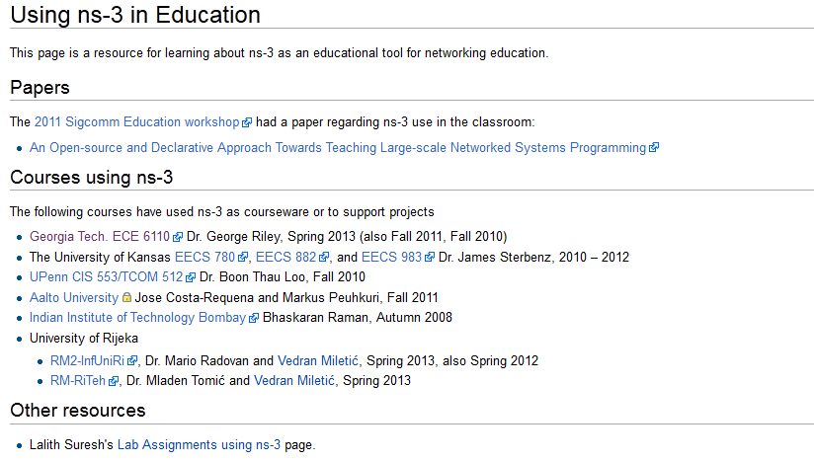
What have people done with ns-3?
Educational use (from ns-3 wiki)

Slide 16
Statistics (July 2014)
3900 subscribers to ns-3-users
1440 subscribers to ns-developers
~ 15 maintainers
~ 150 authors/contributors
ns-3-users group subscribers vs time

Slide 17
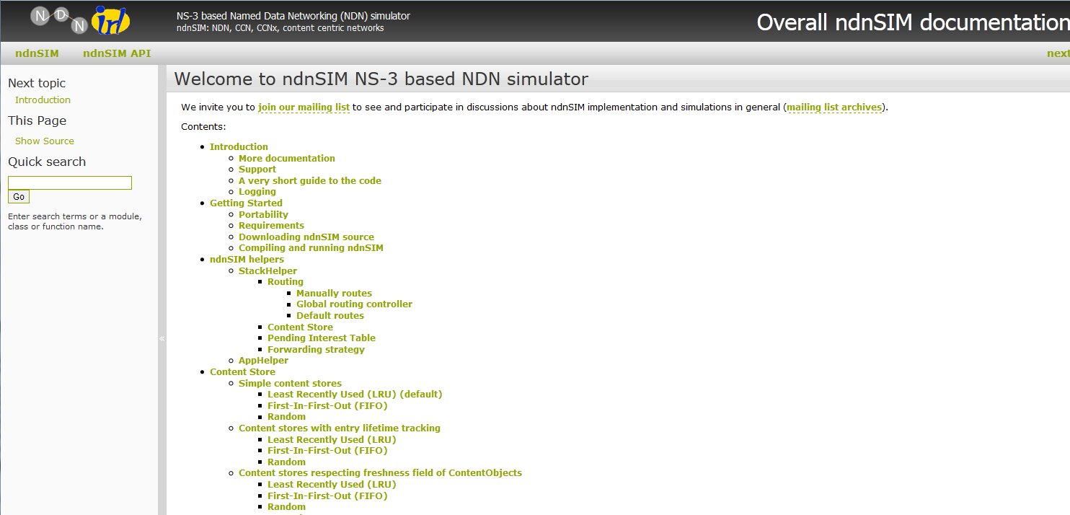
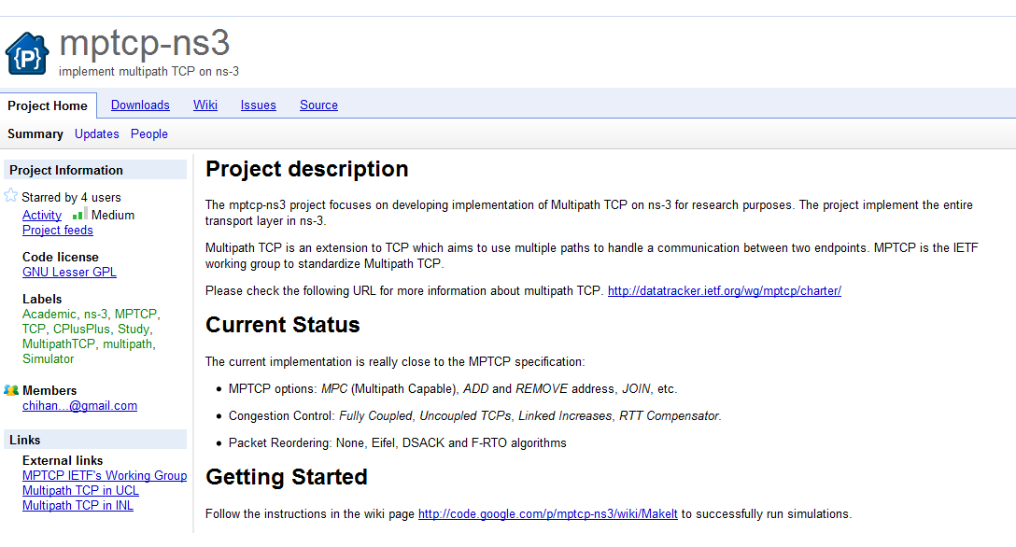
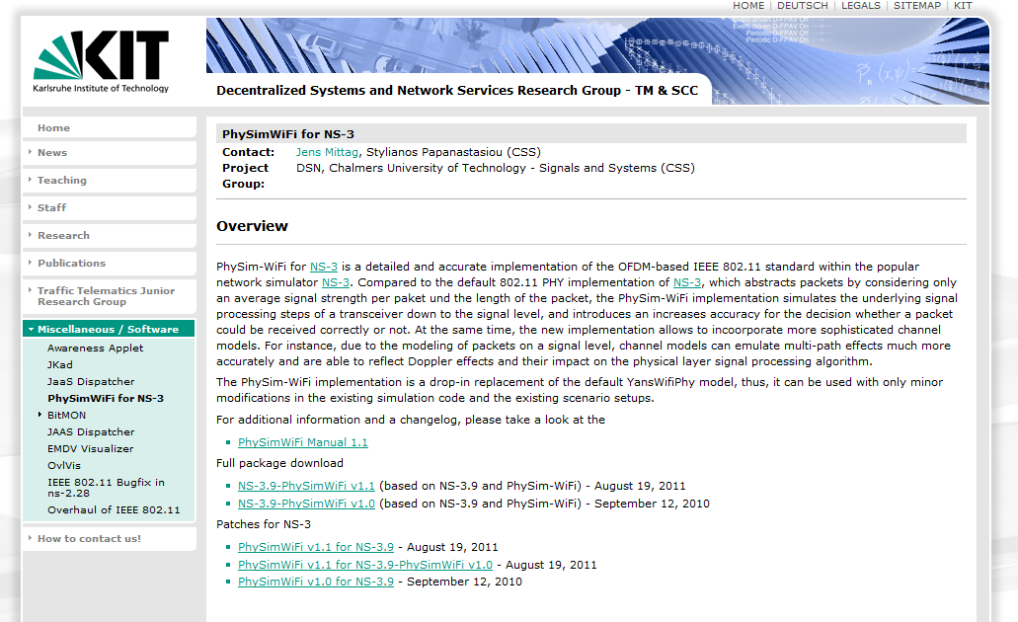
Contributed code and associated projects

Slide 18
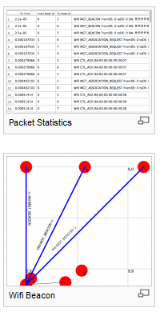
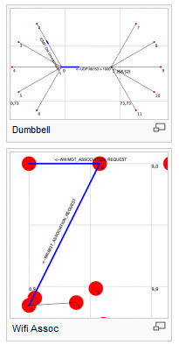
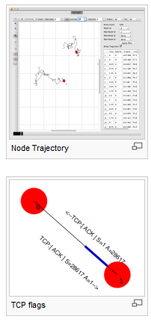
NetAnim
"NetAnim" by George Riley and John Abraham
  see the 'ns3share' channel on YouTube
pyviz

Slide 19
Emulation support
Support moving between simulation and testbeds or live systems
A real-time scheduler, and support for two modes of emulation
Linux is only operating system supported
Must run simulator in real time
  GlobalValue::Bind (“SimulatorImplementationType”, StringValue (“ns3::RealTimeSimulatorImpl”));
Must enable checksum calculations across models
  GlobalValue::Bind (“ChecksumEnabled”, BooleanValue (true));
Must sometimes run as root

Slide 20
ns-3 emulation modes
real machine
ns-3
ns-3
virtual
machine
virtual
machine
real
machine
real
machine
ns-3
Testbed
1) ns-3 interconnects real or virtual machines
2) testbeds interconnect ns-3 stacks
Various hybrids of the above are possible

Slide 21
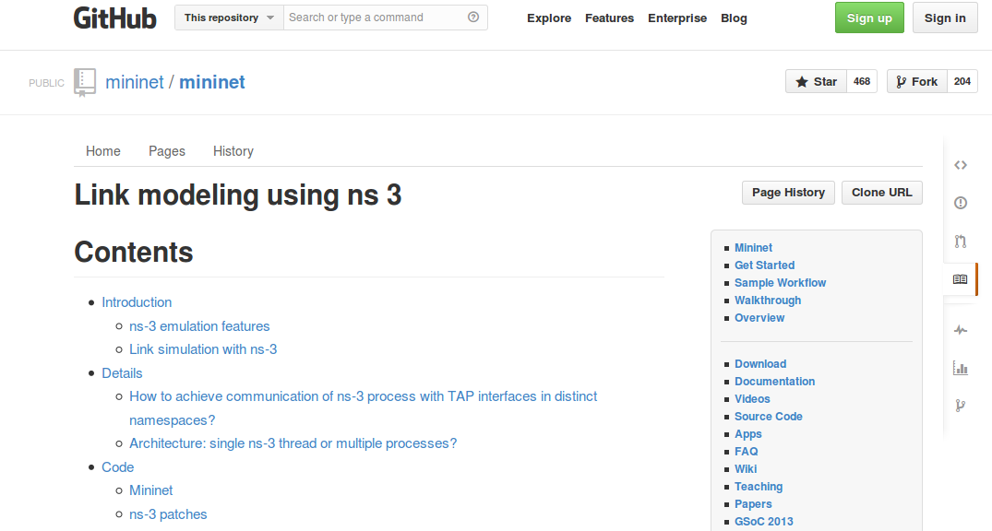
Example use case: mininet
Mininet is popular in the Software-Defined Networking (SDN) community
Mininet uses "TapBridge" integration
  https://github.com/mininet/mininet/wiki/Link-modeling-using-ns-3

Slide 22
Direct Code Execution
Lightweight virtualization of kernel and application processes, interconnected by simulated networks
Benefits:
  Implementation realism in controlled topologies or wireless environments
  Model availability
  Debugging a whole network within a single process
Limitations:
  Not as scalable as pure simulation
  Tracing more limited
  Configuration different

Slide 23
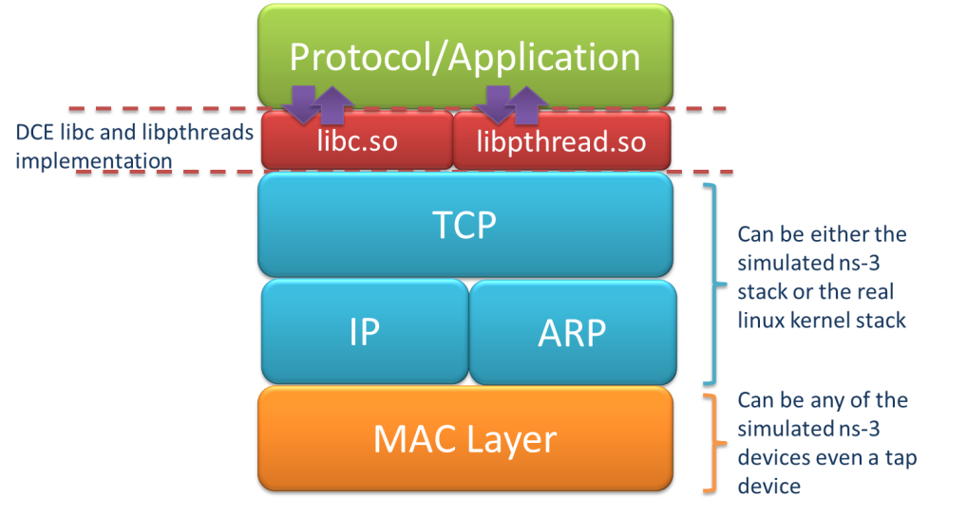
Direct Code Execution implementation
DCE/ns-3 framework requires the virtualization of a series of services
  Multiple isolated instances of the same protocol on the same machine
System calls are captured and treated by DCE
Network stack protocols calls are captured and redirected
To perform its work DCE
re-implement the Linux
program loader and parts
of libc and libpthread

Slide 24
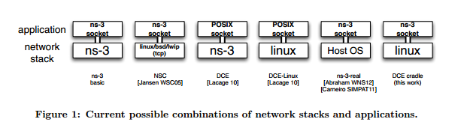
DCE modes
DCE modes in context of possible approaches
Figure source: DCE Cradle: Simulate Network Protocols with Real Stacks for Better Realism, Tazaki et al, WNS3 2013.

Slide 25
Agenda
ns-3 project overview
  What is ns-3?
  Why use ns-3?
  Project organization
  Relationship to ns-2
  Future directions
Getting started with ns-3

Slide 26
ns-3 project goals
Develop an extensible simulation environment for networking research
  1) a tool aligned with the experimentation needs of modern networking research
  2) a tool that elevates the technical rigor of network simulation practice
  3) an open-source project that encourages community contribution, peer review, and long-term maintenance and validation of the software

Slide 27
How the project operates
Project provides three annual software releases
Users interact on mailing lists and using Bugzilla bug tracker
Code may be proposed for merge
  Code reviews occur on a Google site
Maintainers (one for each module) fix or delegate bugs, participate in reviews
Project has been conducting annual workshop and developer meeting around SIMUTools through 2013
  ns-3 Annual Meeting in Atlanta, May 2014
Google Summer of Code (March-August) five of the past six summers

Slide 28


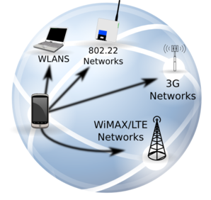




ns-3: An Open Source Network Simulator
ns-3 is a discrete-event network simulator targeted for research and educational use
model developers
Research
ns-3 software
NS-3 Consortium
ns-3 maintainers
Education

Slide 29
Goals of the NS-3 Consortium
The NS-3 Consortium is a collection of organizations cooperating to support and develop the ns-3 software.
It operates in support of the open source project
  by providing a point of contact between industrial members and ns-3 developers,
  by sponsoring events in support of ns-3 such as users' days and workshops,
  by guaranteeing maintenance support for ns-3's core, and
  by supporting administrative activities necessary to conduct a large open source project.

Slide 30









Acknowledgment of support

Slide 31
Agenda
ns-3 project overview
  What is ns-3?
  Why use ns-3?
  Project organization
  Relationship to ns-2
  Future directions
Getting started with ns-3

Slide 32
ns timeline
1990
2000
2010
1988: REAL (Keshav)
1990s: ns-1
regular
releases
1996: ns-2
1997-2000: DARPA VINT
2001-04: DARPA SAMAN, NSF CONSER
2006: NSF CISE CRI Awards
Inputs: yans,
GTNetS, ns-2
ns-3 core development (2006-08)
June 2008: ns-3.1
June 2014: ns-3.20

Slide 33
Relationship to ns-2
ns-3 is a new simulator, without backward compatibility
Similarities to ns-2:
C++ software core
GNU GPLv2 licensing
ported ns-2 models: random variables, error models, OLSR, Calendar Queue scheduler
Differences:
Python scripting (or C++ programs) replaces OTcl
most of the core rewritten
new animators, configuration tools, etc. are in work
ns-2 is no longer actively maintained/supported

Slide 34
Agenda
ns-3 project overview
  What is ns-3?
  Why use ns-3?
  Project organization
  Relationship to ns-2
  Future directions
Getting started with ns-3

Slide 35
Development Priorities
Software modularity and long-term maintenance
Improved integration of direct code execution
Improved integration with container-based and testbed-based experiment infrastructures
Simulation-based experiment management
Usability

Slide 36
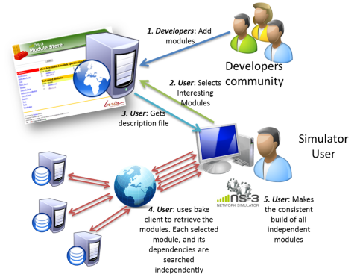
Modularity
Open source project maintains a (more stable) core
Models migrate to a more federated development process
"bake" tool (Lacage and Camara)
Components:
build client
"module store" server
module metadata
Figure source: Daniel Camara

Slide 37
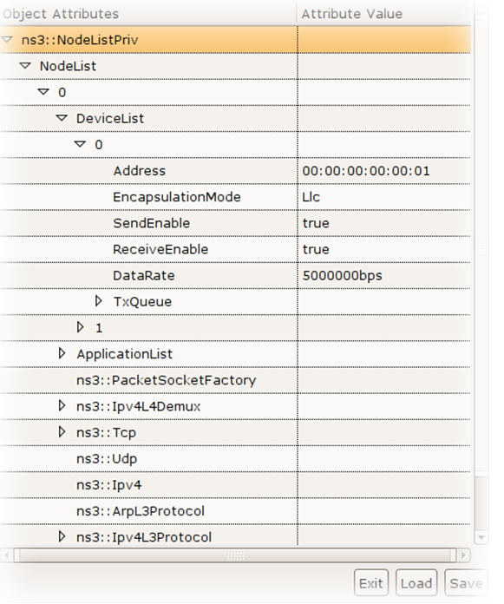
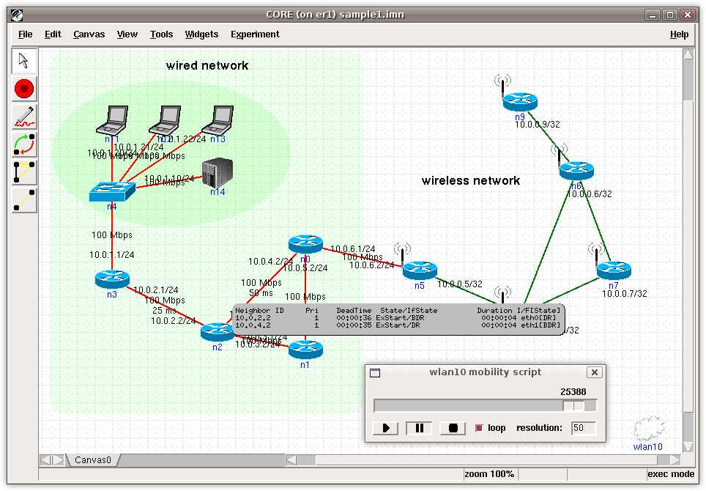
Container-based Integration
Common Open Research Emulator (CORE)
  http://pf.itd.nrl.navy.mil
Python-based framework using ns-3 Python bindings, distributed computing library, and ns-3 TapBridge framework
Figure source:
Jeff Ahrenholz

Slide 38
General issues with hybrid environments
Ease of use
  Configuration management and coherence
  Information coordination (two sets of state)
    e.g. IP/MAC address coordination
  Output data exists in two domains
  Debugging
Error-free operation (avoidance of misuse)
  Synchronization, information sharing, exception handling
    Checkpoints for execution bring-up
    Inoperative commands within an execution domain
    Deal with run-time errors
  Soft performance degradation (CPU) and time discontinuities

Slide 39
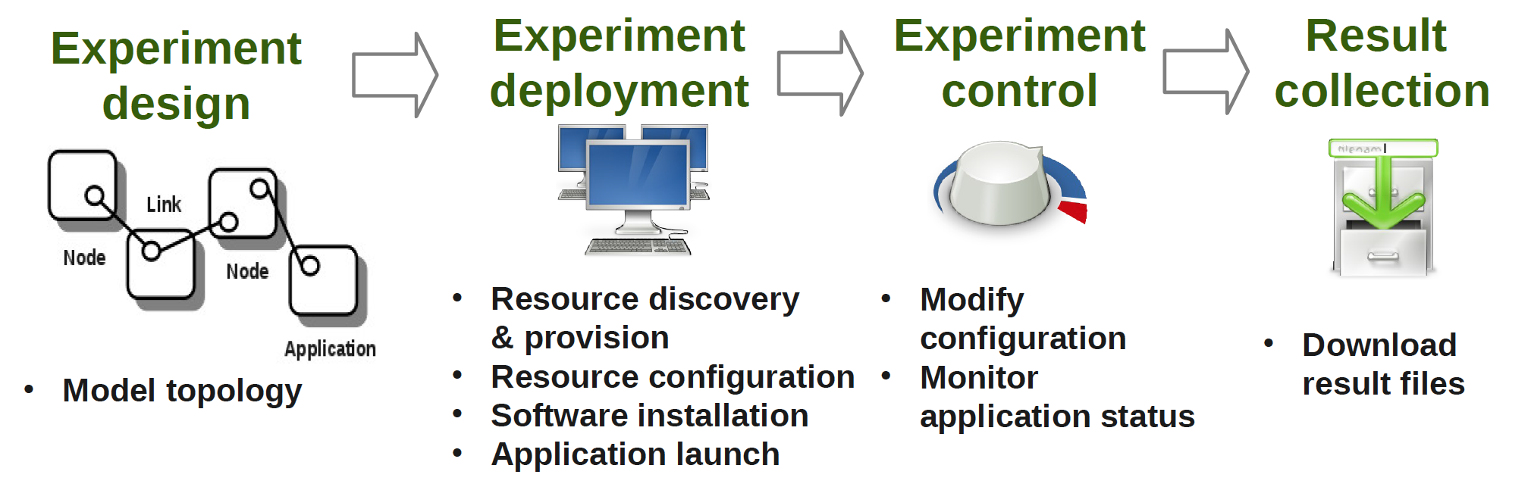
Network Experiment Management Framework (NEPI)
Network experiment management framework to automate experiment life-cycle
Allows scenarios involving heterogeneous resources (ns-3, PlanetLab, netns, …)
Wiki: http://nepi.inria.fr
Figure source: Alina Quereilhac, INRIA

Slide 40
SAFE: Simulation Automation Framework
Data collection, transient analysis, management of independent replications, graphical configuration and visualization
In ns-2 realm, similar to projects like ANSWER, ns2measure, and Akaroa2
Simulation client
Server host
ns-3
Simulation client
ns-3
Experiment execution
manager
Results database
Simulation client
ns-3
Client hosts
Figure source: Felipe Perrone

Slide 41
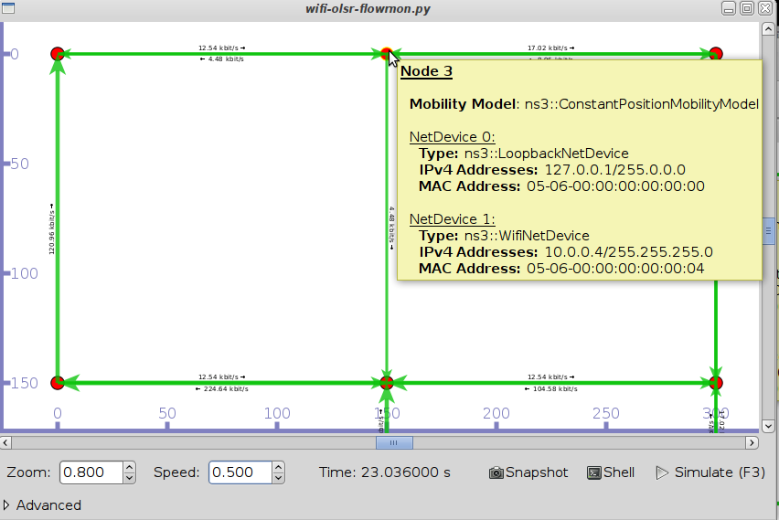
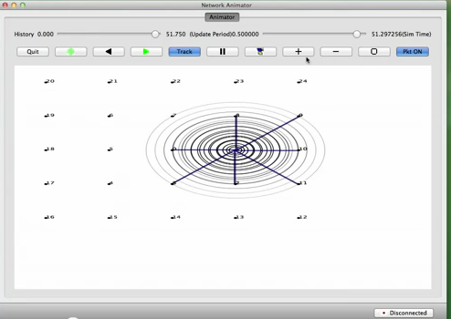
Usability
Animation and visualization
Linkage to external tools (topology, mobility, statistics)
Improved helper APIs
PyVis (Carneiro)
NetAnim (Riley and Abraham)
pyviz
NetAnim

Slide 42
Agenda
ns-3 project overview
  What is ns-3?
  Why use ns-3?
  Project organization
  Relationship to ns-2
  Future directions
Getting started with ns-3

Slide 43
Getting started with ns-3
Finding what you need
Contributing to the project

Slide 44
Resources
Web site:
  http://www.nsnam.org
Mailing lists:
  https://groups.google.com/forum/#!forum/ns-3-users
  http://mailman.isi.edu/mailman/listinfo/ns-developers
Wiki:
  http://www.nsnam.org/wiki/
Tutorial:
  http://www.nsnam.org/docs/tutorial/tutorial.html
IRC: #ns-3 at freenode.net

Slide 45
Suggested steps
Work through the ns-3 tutorial
Browse the source code and other project documentation
  manual, model library, Doxygen, wiki
  ns-3 Consortium tutorials (March 2013)
    http://www.nsnam.org/consortium/activities/annual-meeting-march-2013/
Ask on ns-3-users mailing list if you still have questions
  We try to answer most questions

Slide 46
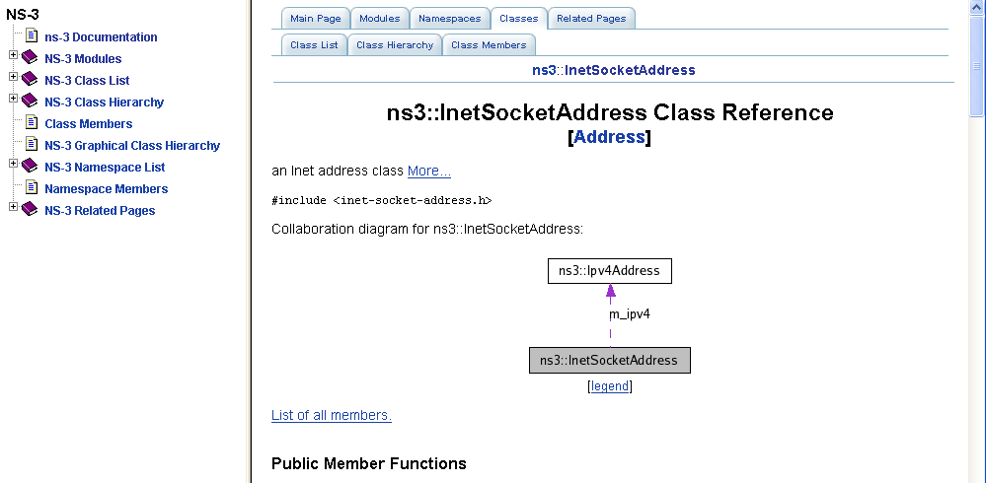
APIs
Most of the ns-3 API is documented with Doxygen
  http://www.stack.nl/~dimitri/doxygen/

Slide 47
Reading existing code
Much insight can be gained from reading ns-3 examples and tests, and running them yourselves
Many core features of ns-3 are only demonstrated in the core test suite (src/core/test)
Stepping through code with a debugger is informative
  callbacks and templates make it more challenging than usual

Slide 48
FAQs
Does ns-3 have a Windows version?
  Yes, for Visual Studio 2012
  http://www.nsnam.org/wiki/Ns-3_on_Visual_Studio_2012
Does ns-3 support Eclipse or other IDEs?
  Instructions have been contributed by users
  http://www.nsnam.org/wiki/HOWTO_configure_Eclipse_with_ns-3
Is ns-3 provided in Linux or OS X package systems (e.g. Debian packages)?
  No

Slide 49
Contributing
Any amount of help is appreciated!
  Reporting stale documentation to webmaster@nsnam.org
  Contributing small patches
  Writing new documentation
  Reporting bugs
  Fixing bugs
  Reviewing code of others
  Contributing new code
  Becoming a maintainer

Slide 50
New project ideas
Visit the wiki under "Project Ideas" tab
  http://www.nsnam.org/wiki/Project_Ideas
Students, consider to apply for Google Summer of Code 2015
  A 10-week summer job that mentors a student project on ns-3
  Students apply in March 2015 timeframe
  http://www.nsnam.org/wiki/GSOC2014Projects

Slide 51
Questions?

