Slide 1
Network Simulation with ns-3
  Presenter: George Riley
  Georgia Institute of Technology
Spring Simulation Conference
April 12, 2010

Slide 2
Overview
Network Simulation Basics
Survey of Network Simulation Tools
Ns-3 Details
“Frameworks” for Ns-3
Questions

Slide 3
Network Simulation Basics - 1
Discrete Event Simulation
  Events model packet transmission, receipt, timers, etc.
  Future events maintained in sorted Event List
  Processing events results in zero or more new events
    Packet transmit event generates a future packet receipt event at next hop

Slide 4
Network Simulation Basics - 2
Create Topology
  Nodes, Links, Queues, Routing, etc.
Create Data Demand on Network
  Web Browsers, FTP transfers, Peer-to-Peer Searching and Downloads, On--Off Data Sources, etc.
Run the Simulation
Analyze Results

Slide 5
Network Simulation Basics - 3
TCP Client 1
TCP Server 1
100 Mbps, 5ms
100 Mbps, 5ms
10 Mbps, 20ms
100 Mbps, 5ms
100 Mbps, 5ms
TCP Client 2
TCP Server 2

Slide 6
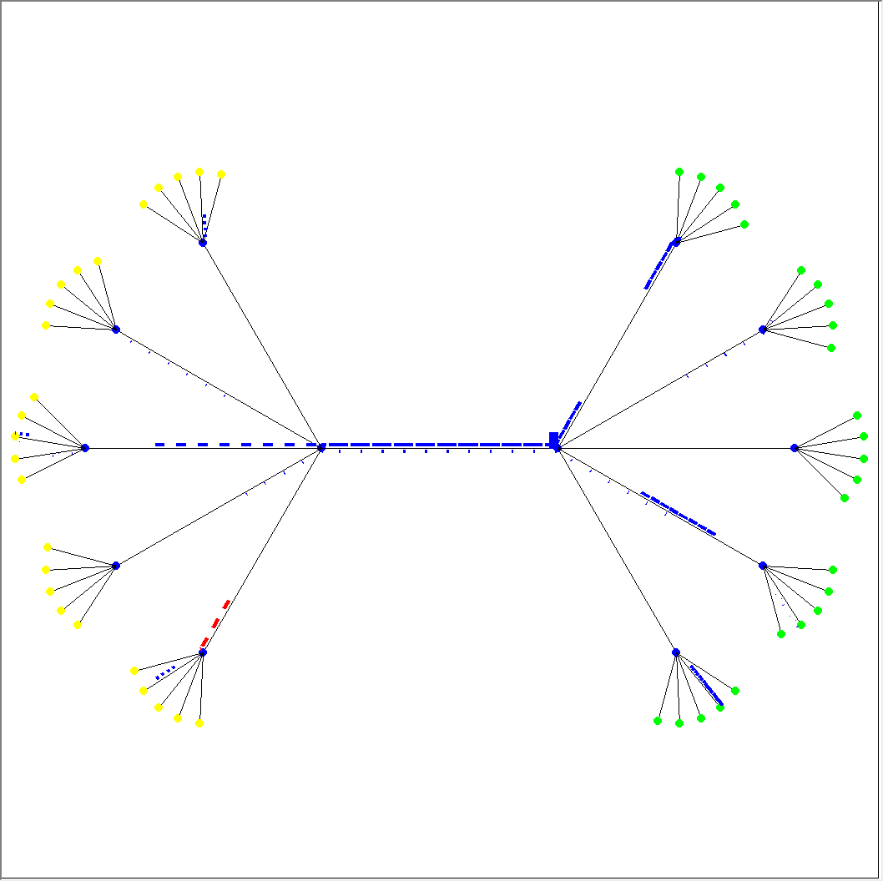
Network “Events”
Simulated Packets

Slide 7
Network “Models”
Network “Nodes”
  End-Systems, Routers, Hubs, NATs
  What should a node contain?
Applications – (How much detail?)
  Produce “data demand” on the simulated network
  Bulk TCP Transfer (very common)
  TCP/UDP “On-Off” application
  Web Browsing
  Peer to Peer File Transfers
  Video Streaming
  VOIP
  Chat

Slide 8
Network “Models” Continued
Protocols
  TCP-UDP-IPV4-IPV6
    How much detail? Checksums?
    Socket interface?
      Blocking vs. Non-Blocking
      Finite vs. Infinite buffers
  Routing Protocols (Not always used/needed)
    BGP – OSPF – EIGRP – OLSR – DSR – AODV
  Multicast Protocols
    PIM-SM/DM - DVMRP

Slide 9
Network “Models” Continued
Packets
  How much detail?
  Real Data or “Dummy”
  Abstract or array of bytes?
Routers and Queuing
  Output Queues / Input Queues
  Route Lookup Delays
  Fast-Path
  Routing Table Representation
  Queuing methods
    DropTail, Red, Priority

Slide 10
Network “Models” Continued
Network Interfaces
  Wired/Wireless
  Layer 2 protocols
    802.3, 802.11
Links
  Ethernet (10/100/1000Mb)
    Physical location of each station?
  Point-to-Point
  Wireless
    How much detail in PHY layer
Mobility Models
  Random Waypoint – Random Walk – Specific Waypoint - Swarming

Slide 11
Analyzing Results
Trace File
  Log every packet receipt, transmit, queue, drop
Built-in Statistics Gathering
  Link Utilization, Queue Occupancy, Throughput, Loss Rate
Custom Tracing
  User specifies which packets/links/nodes to trace
    Reduces size of trace file and post-analysis time

Slide 12
Distributed Simulation
Simulator A
Simulator B
Remote Link
Remote Link

Slide 13
Network Emulation

Slide 14
Simulation Tools
Venerable ns-2
  Original “design” by Steve McCanne
  TCP/C++ Hybrid
  Open Source
    Numerous contributions
    Hundreds of models
  De-facto Standard in Academic Research
Georgia Tech Network Simulator (GTNetS)
  Completely C++
  Designed for Distributed Simulation
    Scalable to more than 1 Million Network Elements
    BGP++ model of BGP (based on Zebra open source)

Slide 15
Simulation Tools - Continued
OPNET
  Commercial, closed source tool
  De-facto standard in Military and DoD programs
  Full-Featured, nice GUI
  Sophisticated Data Analysis features
Qualnet
  Commercial, closed source
  Competes primarily with OPNET
    Strengths are in wireless models and protocols
    Scalability
  Based on public-domain “GloMoSim” tools

Slide 16
Simulation Tools - Continued
SSFNet
  Both Java and C++ versions
  Designed for “parallel” simulation
    Shared Memory multiprocessor
  Originally developed at Dartmouth
    Now supported at UIUC
OMNet++
  C++ engine
  Very popular in European Community

Slide 17
The NS-3 Team
Partially funded by US NSF “Community Resource Initiative (CRI) grant
Two Co-Principal Investigators
  Tom Henderson (Boeing/UW)
  George Riley (Georgia Tech)
Other PI’s
  Sally Floyd (ICSI)
  Sumit Roy (UW)
Two full-time staff
  Craig Dowell (UW)
  Josh Pelkey(GT)
Numerous Volunteers
  Matthew Lacage, INRIA France
  Gustavo Carniero, Spain
  Joe Kopena, Grad Student, Drexel University

Slide 18
NS-3 Focus Areas
  - Core:
    Scalability improvements,
    Modularity,
    class design for realism and abstraction
  Integration
    Use of outside software, emulation, and virtualization
  Wireless
    Wi-Fi, cellular, small mobile devices
  Education
    Animation, educational scripts, integration with courseware and projects
  Maintenance
    Validation, documentation, distribution, project management

Slide 19
NS-3 Key Features
Flexible Event Scheduler
  Any member function on any object can be an event handler, with arbitrary parameter lists
Trace output in ascii, or Pcap format
  Use existing Pcap tools (eg. Wireshark)
Numerous trace points enabled via callbacks
Python Bindings for most Public Functions
Emulation mode
  Integration with real networks/packets
  Real-Time Scheduler
Doxygen documentation
Mercurial Code Repository
Formal review/check-in procedure
Quarterly releases

Slide 20
NS-3 Key Design Decisions
Use of “smart pointers” to ease memory management burden on code developers
Use of “object aggregation”, to allow extension of object functionality without adding additional virtual functions to base class.
  Similar to Microsoft “Component Object Model”
Integrated tracing frame work based on type-safe callbacks
Simulation event scheduling on arbitrary functions with arbitrary argument lists
Packet objects manage sequential array of bytes with helper functions to add/remove headers and data

Slide 21
Features in Recent Releases
Four releases (ns-3.4 through ns-3.7)
ns-3.4: Apr 2009:
- Tap Device
- Object names
- new Wifi models
- calendar queue
scheduler
- allinone build
system
ns-3.5: July 2009:
- 802.11e MAC EDCA
- 802.11n A-MSDU
frame aggregation
- 802.11b PHY
- Nakagami loss
- Gamma, Erlang,
Zipf random variables
ns-3.6: Oct 2009:
- Minstrel rate control
- WiFi Athstats and
5/10MHz channels
- IPv6 radvd, ICMP
- 802.11s mesh
- Nix-vector routing
- Flow Monitor
ns-3.7: Jan 2010:
- 802.11p PHY
- AODV
- Waypoint mobility
- NetAnim
- IPv6 Extension and
Option headers
Google Summer of Code
Three student projects

Slide 22
NS-3.8 Release Details
Estimated release date, April 27
8 new features merged
  WiMAX
    Provide an accurate MAC and PHY level implementation of the 802.16 specification
    Point-to-Multipoint (PMP) mode and WirelessMAN-OFDM PHY
    Consists of convergence sublayer, MAC common part sublayer, physical layer

Slide 23
NS-3.8 Release Details
  2) Distributed simulation with MPI
    Allows distributed simulation along point-to-point links
    Interfaces with MPI to support inter-process communication
  3) 802.11n block ACK
    Implement 802.11n compressed block ACK mechanism
  4) Topology read system
    Reads Inet and Orbis formats
    Generates large point-to-point topologies easily

Slide 24
NS-3.8 Release Details
  5) Gauss-Markov Mobility Model
    3-D adaptation of the Gauss-Markov mobility model
    Model contains both memory and variability
  6) Steady state random waypoint mobility model
    Based on random waypoint mobility (RWM) model
    Initial values are not from uniform distribution but from stationary distribution of RWM model

Slide 25
NS-3.8 Release Details
  7) Two ray ground radio propagation model
    Ported from ns-2
  8) Matrix propagation loss model
    Uses two-dimensional matrix of pathloss indexed by source and destination nodes

Slide 26
Google Summer of Code, 2010 Projects
Click Modular Router Integration
  Software architecture for building flexible and configurable routers
  Widely used in research
  Exists in ns-2
Network Simulation Cradle for IPv4
  Last year during GSoC, successfully ported NSC
  NSC allows Linux TCP code over ns-3's IPv4 stack
  This extends the effort to completely port the Linux TCP/IPv4 stack

Slide 27
Google Summer of Code, 2010 Projects
EMULAB Support and Integration
  Attempt to emulate ns-3 and Emulab
  Investigate whether Emulab scripting could be moved to Python/ns-3
  Or whether ns-3 simulations need to generate Tcl for Emulab and attempt to do this integration
Satellite networks
  Investigate the architecture needed to support ETSI-BSM interfaces
  Implement simple satellite return links, like bent-pipe and basic DVB-RCS

Slide 28
Google Summer of Code, 2010 Projects
Cognitive Networks
  Implement routing protocols for cognitive networks
3GPP Long Term Evolution (LTE)
  Focus on the implementation of a subset of the functionality of LTE
Underwater acoustic network (UAN) framework
  Extend the currently proposed UAN modules to support a wider variety of common underwater networking scenarios

Slide 29
Google Summer of Code, 2010 Projects
TCP Validation
  Review ns-3 TCP implementations and testing them for conformance to RFC 5681
  Implement a test suite that will ensure that ns-3's TCP implementation is accurate
TCP Congestion Avoidance
  Implement different congestion control algorithms
  Reno, Westwood, Vegas, Cubic, etc.

Slide 30
NS-3.9 Tentative Information
Estimated release data, July 27
Possible New Features
  Underwater Acoustic Network Device
  Network Address Translation
  Spectrum framework
  Wireless animation
  Distributed wireless simulation
  TCP work

Slide 31
Growth of NS-3
Lines of C++ code (wc src/ directory)
  ns-3.4: 110,000
  ns-3.8: 250,000
Release downloads:
  Jan 2009: 1700
  Jan 2010: 10,300
Authors
  ns-3.4: 27
  ns-3.8: 55
New maintainers
  Josh Pelkey, Pavel Boyko, Kirill Andreev, Sebastien Vincent
ns-3 users subscriber count

Slide 32
NS-3 Basics
Written completely in C++
  Heavy use of Templates
  C++ Namespace (ns3)
Simulation programs are C++ executables
Python bindings for public API’s provided
NS-3 uses the “waf” build system
  Instead of ./configure; make use
  ./waf
Builds a dynamic library
    Both a debug and optimized version

Slide 33
The Basic NS-3 Data Flow Model
Application
Application
Application
Application
Sockets-like
API
Protocol
stack
Protocol
stack
Packet(s)‏
Node
Node
NetDevice
NetDevice
NetDevice
Channel
NetDevice
Channel

Slide 34
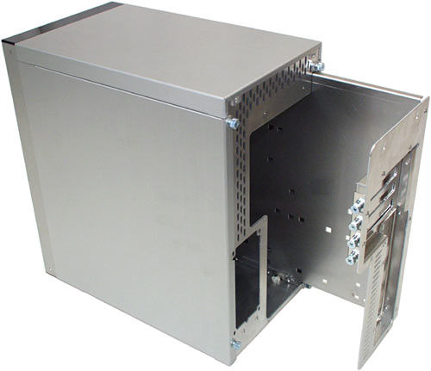


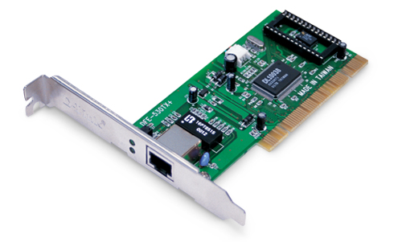
NS-3 Node Structure
A Node is a husk of a computer to which applications, stacks, and NICs are added
Application
Application
Application

Slide 35
NS-3 Node Object
Two key abstractions are maintained:
1) applications use an (asynchronous, for now) sockets API
2) the boundary between IP and layer 2 mimics the boundary at the device-independent sub-layer in Linux
  i.e., Linux Packet Sockets

Slide 36
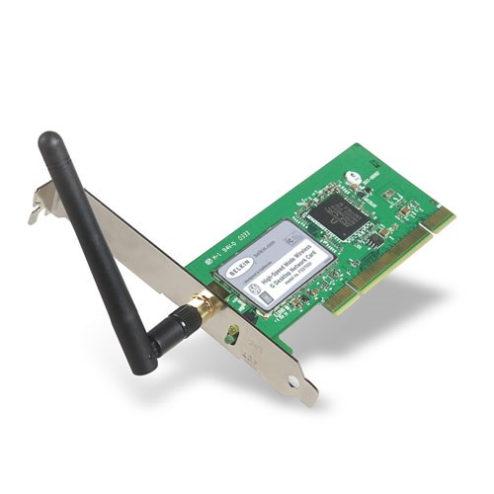
NS-3 Net Devices and Channels
Net Devices are strongly bound to Channels
of a matching type
WifiChannel
WifiNetDevice

Slide 37
NS-3 Packets
Each NS-3 Packet contains
  Byte buffer with packet data
    Protocol Headers
    Optional Data Payload
    Suitable for sending on an actual network as is.
  Packet Tags
    Format and Type-free “extra” information about the packet
      Eg. A Flow Identifier
  Packet Meta-Data
    Enables packets to “print themselves”
Implemented with Smart Pointers and Copy-on-Write Semantics

Slide 38
NS-3 Smart Pointers
ns-3 uses reference-counting smart pointers at its APIs to limit memory leaks
  Or “pass by value” or “pass by reference to const” where appropriate
A “smart pointer” behaves like a normal pointer (syntax) but does not lose memory when reference count goes to zero
Use them like built-in pointers:
Ptr<MyClass> p = CreateObject<MyClass> ();
p->method ();

Slide 39
NS-3 Validation
Can you trust ns-3 simulations?
  Can you trust any simulation?
  Onus is on the researcher to verify results
ns-3 strategies:
  Open source benefits
  Validation of models on testbeds
  Reuse of code
  Unit tests
  Event driven validation tests

Slide 40
New NSF award: “Frameworks for ns-3”
Four years, awarded on 3 March 2010
PIs/groups involved:
  Univ. of Washington (Tom Henderson)
  Georgia Tech. (George Riley)
  Bucknell University (Felipe Perrone)
Scope:
  Automation frameworks
  Scenario management
  Education
  Software maintenance

Slide 41
Frameworks for ns-3
What do we mean by frameworks?
  Extensions to ns-3 outside of the core and models
  Helping users with their workflow
Scenario
Generation
Visualization
Animation
Educational
script library
Execution manager
Problem
Definition
Modeling
Experiment
Definition
ns-3
execution
Output data
management
Optional: Connections to
NICs or to virtual machines (VMs)
Framework to
manage hybrid
ns-3/testbed/VM
experiments
Iterate as needed

Slide 42
Future project directions
Google Summer of Code 2010
Upcoming ns-3 major merges
  ns-3-simu
  ns-3 parallel (shared memory)
Considering a U.S.-based workshop in late summer

Slide 43
NS-3 Summary
ns-3 is an emerging simulator to replace ns-2
Consider ns-3 if you are interested in:
  Open source and collaboration
  More faithful representations of real computers and the Internet
  Integration with testbeds
  A powerful low-level API
  Python scripting
ns-3 needs you!

Slide 44
Resources
Web site:
  http://www.nsnam.org
Mailing list:
  http://mailman.isi.edu/mailman/listinfo/ns-developers
IRC: #ns-3 at freenode.net
Tutorial:
  http://www.nsnam.org/docs/tutorial/tutorial.html
Code server:
  http://code.nsnam.org
Wiki:
  http://www.nsnam.org/wiki/index.php/Main_Page

Slide 45
Questions?

Slide 46
Modeling the PHY Channel
Experimental Evaluation of Wireless Assumptions
  Kotz et. al, MSWiM 2004
Link-Level Measurements from an 802.11b Mesh Network
  Aguayo et. al, SIGCOMM 2004
Measurement-Based Physical Layer Modeling for Wireless Network Simulations
  Reddy et. al, Mascots 2007

Slide 47
PHY Layer Models
Free-Space (Friis) Model
Pr(d) = Received Power
d = Distance
Pt = Transmit Power
Gt = Antenna Gain at Transmitter
Gr = Antenna Gain at Receiver
λ = Wavelength
L = “System Loss” (L >= 1)

Slide 48
PHY Layer Models
Two-Ray Ground Reflection Model
ht = Height of transmitter
hr = Height of receiver
dc = Crossover Distance
  Use above only if d > dc

Slide 49
PHY Layer Models
Shadowing Model
d0 = “Close-in Distance”
β = Path loss exponent
XdB = Log-Normal Random Variable

Slide 50
Kotz – Wireless Assumptions
The world is flat
Radio transmission range is circular
All radios have equal range
If I can hear you, you can hear me
  Symmetry
If I can hear you at all, I can hear you perfectly
Signal strength is a simple function of distance

Slide 51
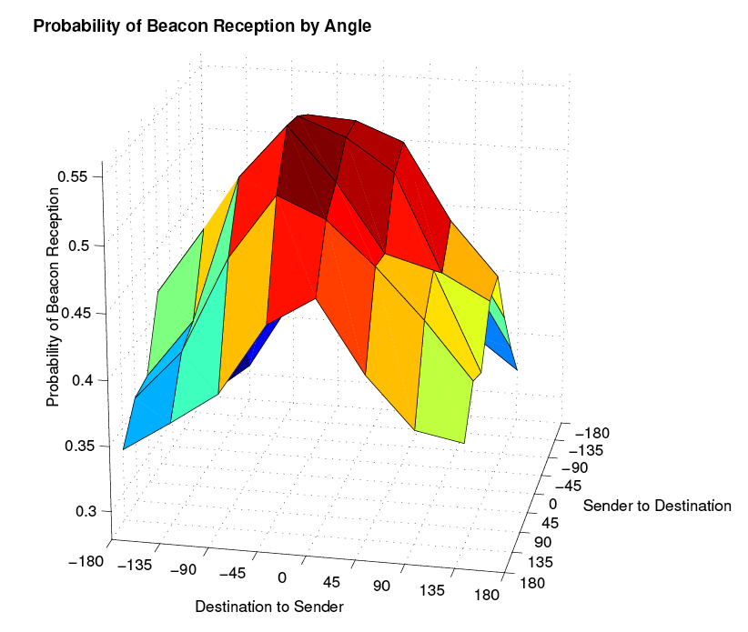
Kotz – Antenna Angle

Slide 52
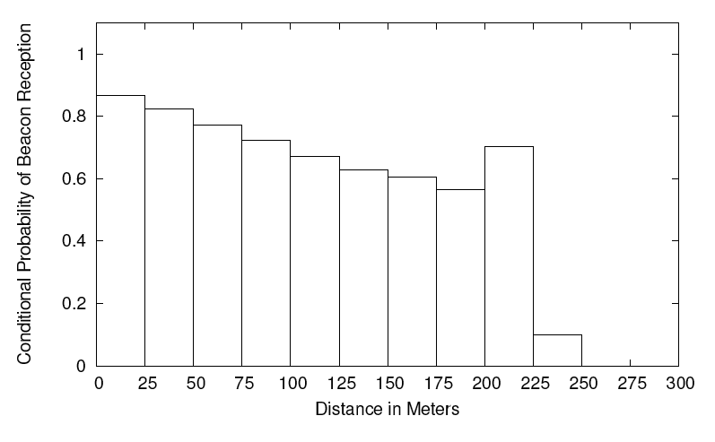
Kotz – Conditional Rx Probability

Slide 53
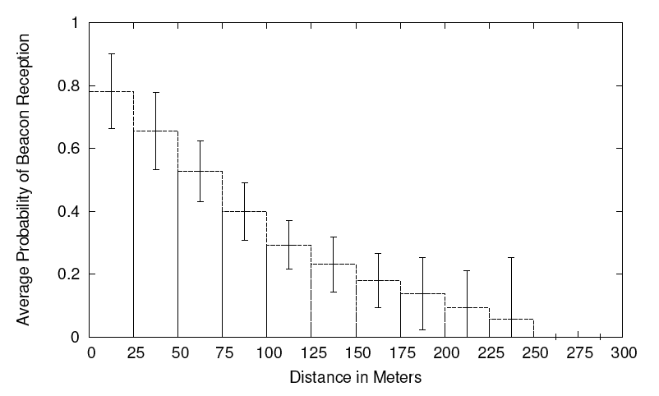
Kotz – Rx Probability vs. Distance

Slide 54
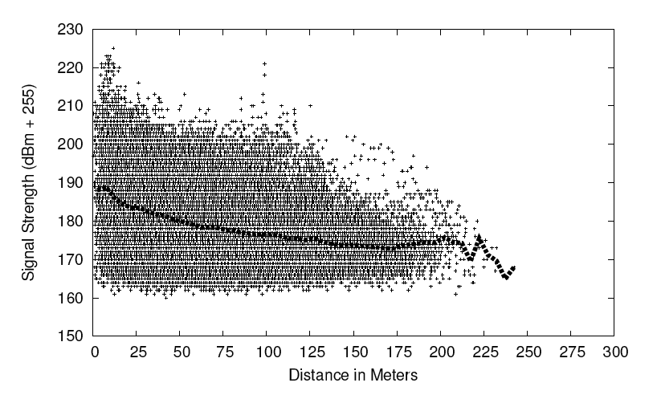
Kotz – Rx Signal Strength

Slide 55
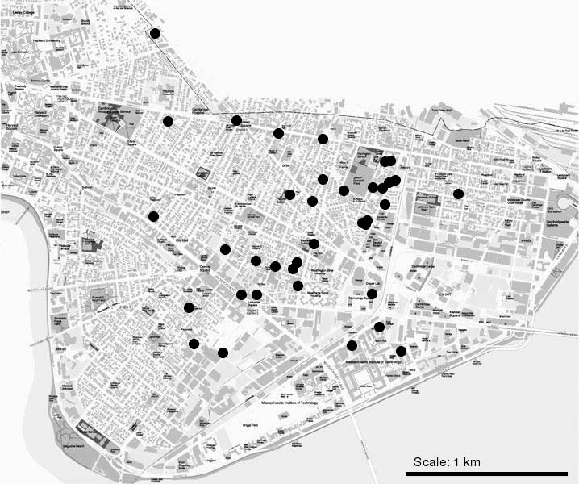
Aguayo - Cambridge Roofnet Map

Slide 56
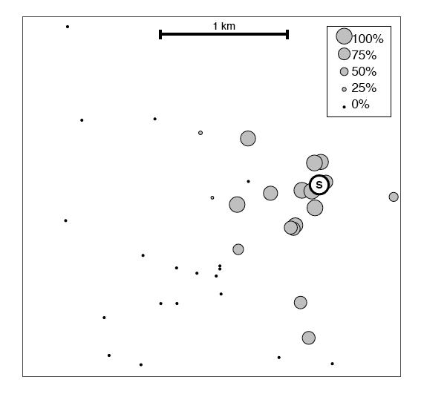
Packet Delivery Map 1

Slide 57
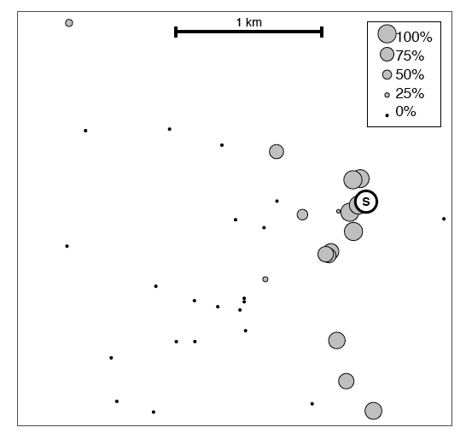
Packet Delivery Map 2

Slide 58
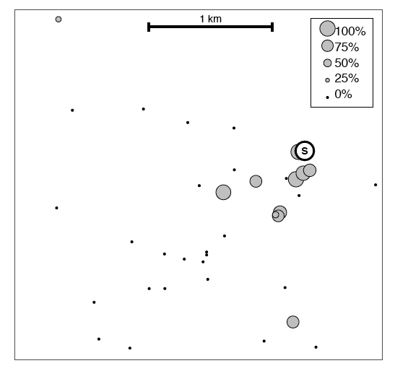
Packet Delivery Map 3

Slide 59
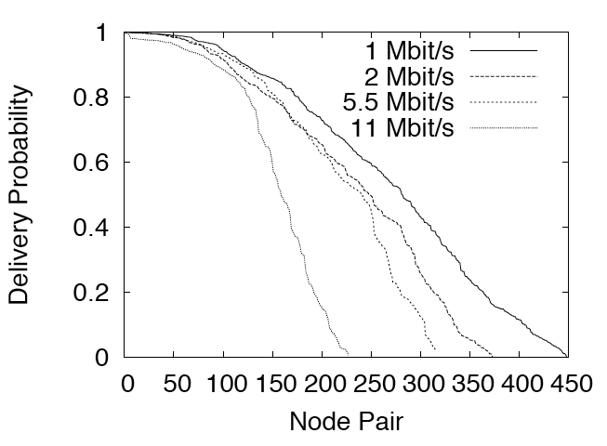
Delivery Fraction

Slide 60
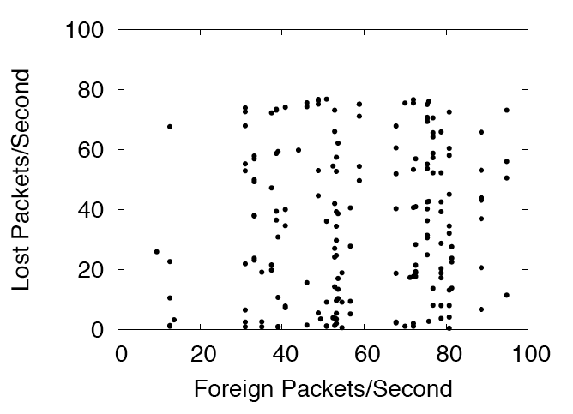
Effect of “Foreign Packets”

Slide 61
Reddy – Measurement Study
Single base station, sending constant beacons
Single laptop receiver, at varying distances from the base station
Garmin V GPS on the laptop, reporting position
Two different wireless chip sets
  RaLink
  Atheros
Hack Linux drivers to record retry statistics and received signal strength indications
Disable rate adaptation algorithms
High RTS threshold to disable RTS/CTS exchange
Constant Tx power of 20dBm
Operate in IEEE 802.11 Channel 16

Slide 62
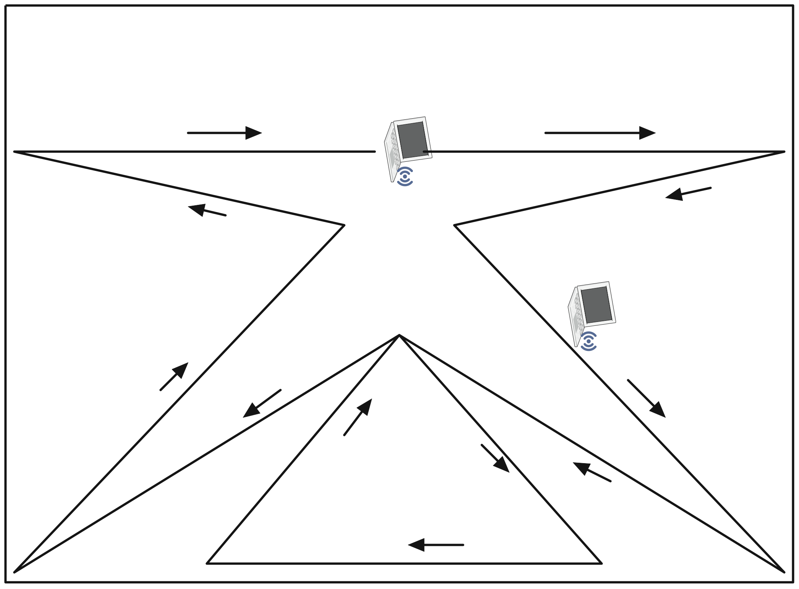
Reddy – Mobility Pattern

Slide 63
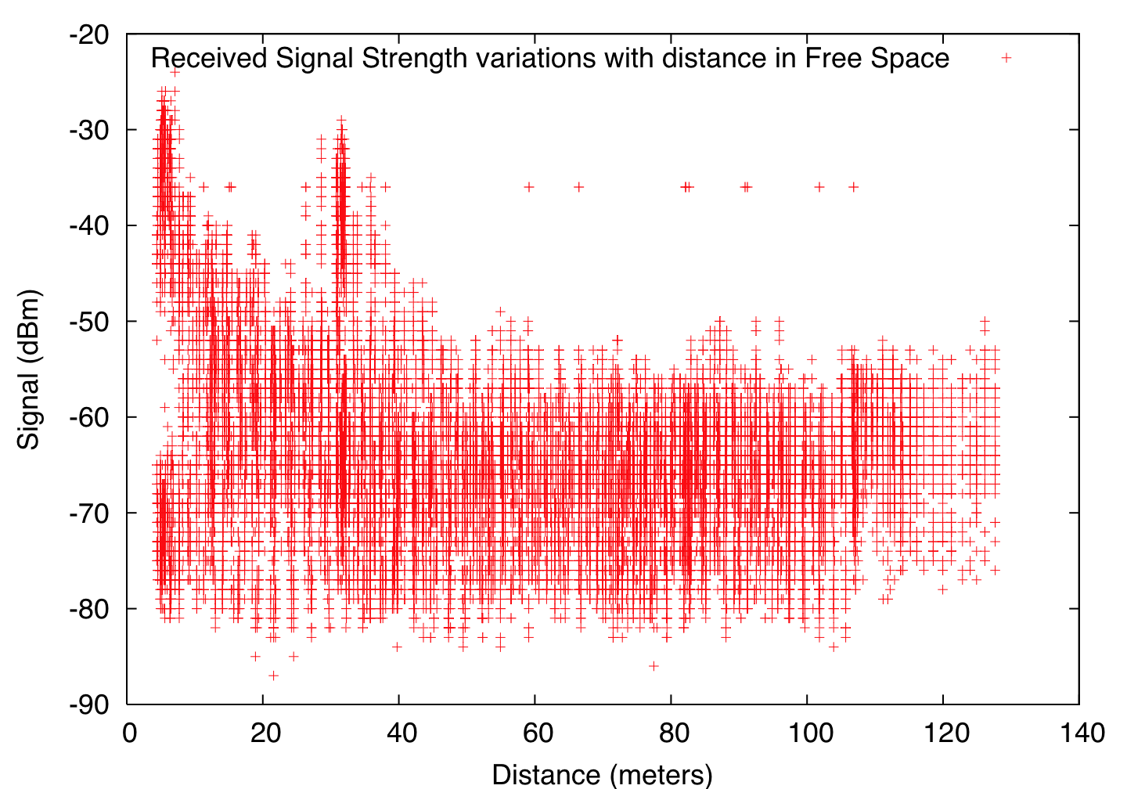
Reddy – RSS Measurement Results

Slide 64
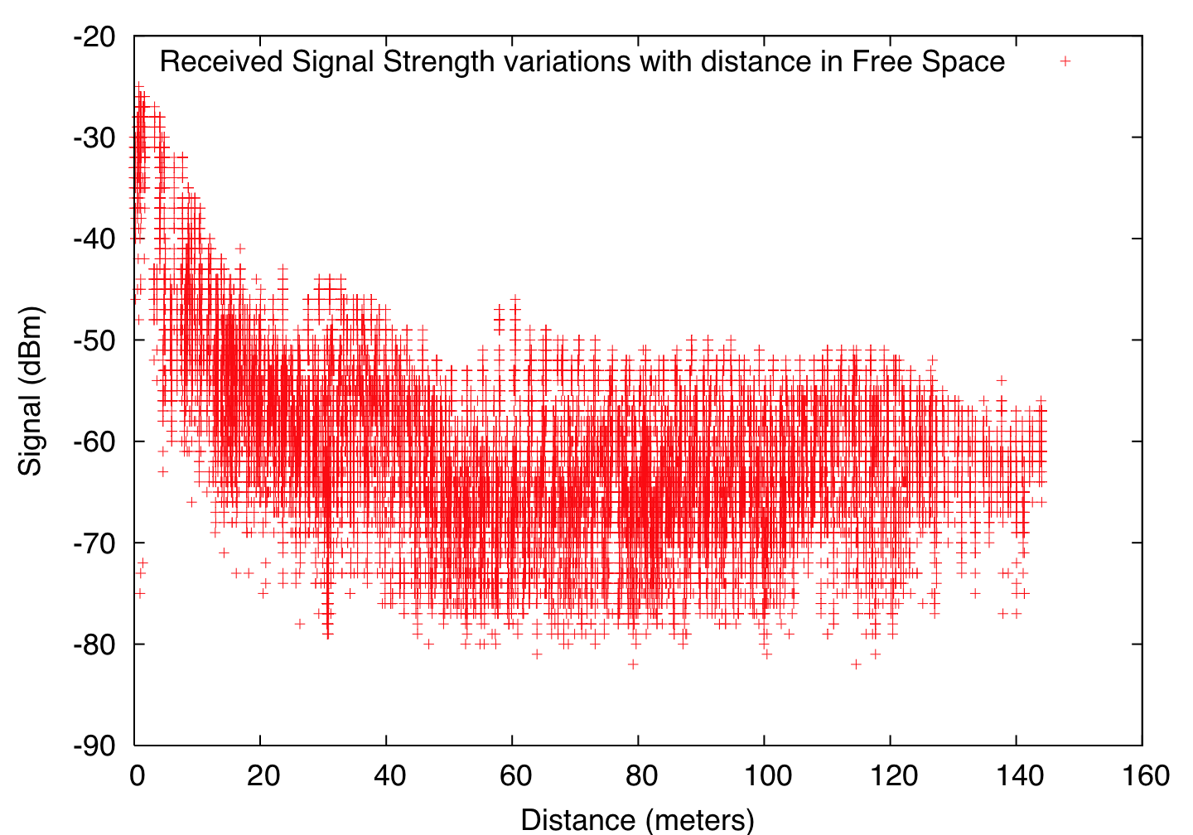
Reddy – Results (Antenna Angle)

Slide 65
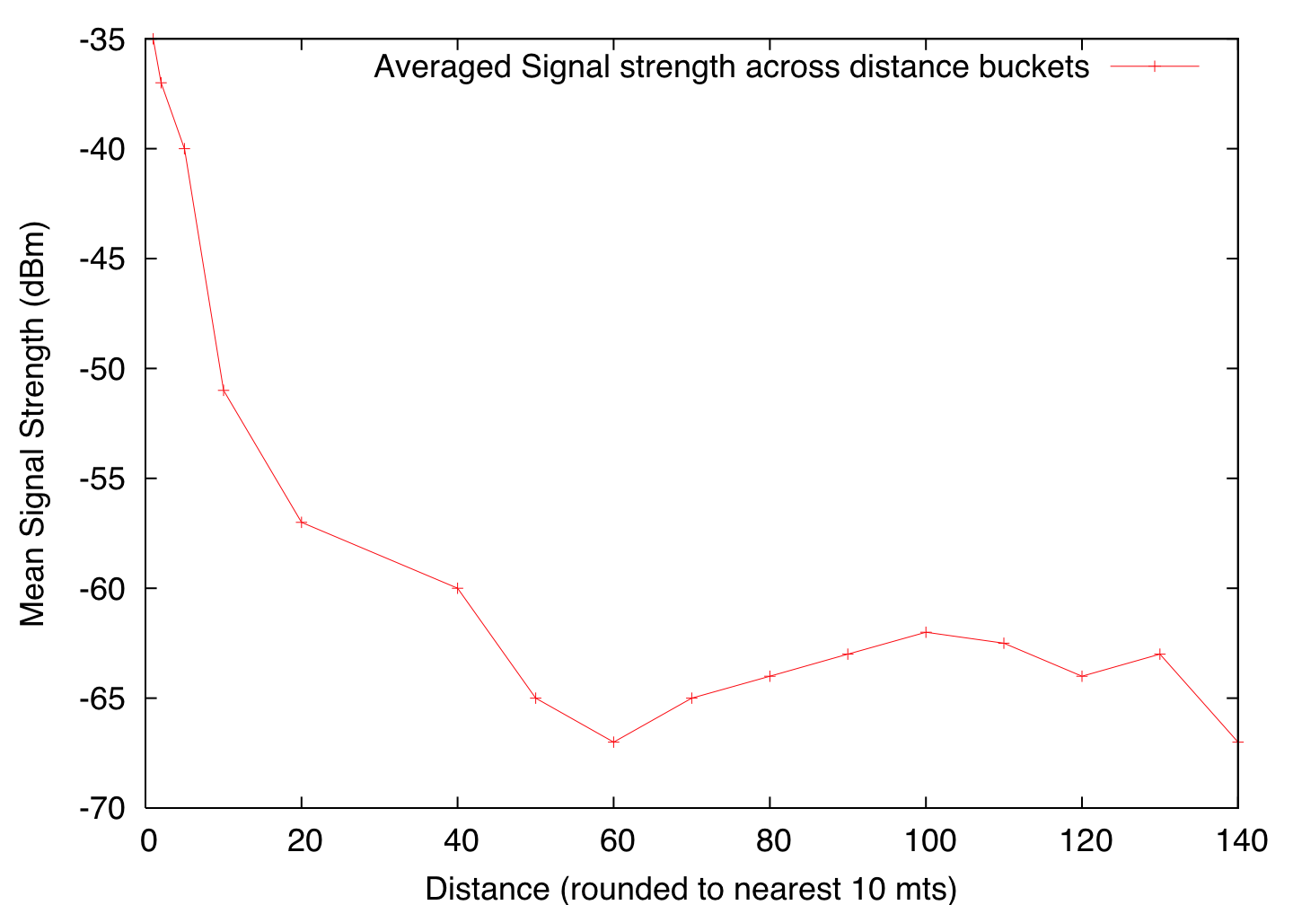
Reddy – Measurement, Average RSS

Slide 66
PHY Layer Models
Stochastic
Compute Pr(d) (Sk(t)) with Friis Model
• Choose uniform random variable,
packet error proportional to SNIR(k,t)

Slide 67
Questions
?

