Slide 1
ns-3 Training

Slide 2
Logistics
Introductions
Wireless access
Wiki page:
  http://www.nsnam.org/wiki/Training2014

Slide 3
ns-3 training goals
Learn about the project overall, and where to get additional help
Understand the architecture and design goals of the software
Learn how to write new code for the simulator
Learn about selected topics in more detail
Answer your questions

Slide 4
ns-3 training agenda
Monday: Overview of ns-3
  Session 1: Overview
  Session 2: Core, basic models, I/O
  Session 3: Tracing
  Session 4: Writing new code
Tuesday: Special topics
  Session 1: WiFi and mobile network simulations
  Session 2: LTE
  Session 3: Parallel, distributed simulations
  Session 4: DCE and Emulation

Slide 5
ns-3 training agenda: Monday morning
8:30-10h00: ns-3 overview
10:00-10:15: 15-minute coffee break
10:15-12:00: ns-3 core
Overview of software and models
Running and understanding an existing example
Basic animation and visualization (netanim, flow monitor)
Integrating other tools and libraries
object model
scheduler
callbacks
etc.

Slide 6
ns-3 training agenda: Monday afternoon
1:30-3:00: Tracing and data collection
3:00-3:15: 15-minute coffee break
3:15-5:00: Writing new software, Q&A
Tracing subsystem in depth
Data collection framework
Writing new examples and models

Slide 7
ns-3 project goals
Develop an extensible simulation environment for networking research
  1) a tool aligned with the experimentation needs of modern networking research
  2) a tool that elevates the technical rigor of network simulation practice
  3) an open-source project that encourages community contribution, peer review, and long-term maintenance and validation of the software

Slide 8
How the project operates
Project provides three annual software releases
Users interact on mailing lists and using Bugzilla bug tracker
Code may be proposed for merge
  Code reviews occur on a Google site
Maintainers (one for each module) fix or delegate bugs, participate in reviews
Project has been conducting annual workshop and developer meeting around SIMUTools through 2013
  Some additional meetings on ad hoc basis
Google Summer of Code (March-August) five of the past six summers

Slide 9









Acknowledgment of support

Slide 10
Goals of the consortium
The NS-3 Consortium is a collection of organizations cooperating to support and develop the ns-3 software.
It operates in support of the open source project
  by providing a point of contact between industrial members and ns-3 developers,
  by sponsoring events in support of ns-3 such as users' days and workshops,
  by guaranteeing maintenance support for ns-3's core, and
  by supporting administrative activities necessary to conduct a large open source project.

Slide 11
What is ns-3?

Slide 12
Discrete-event simulation basics
Simulation time moves in discrete jumps from event to event
C++ functions schedule events to occur at specific simulation times
A simulation scheduler orders the event execution
Simulation::Run() gets it all started
Simulation stops at specific time or when events end

Slide 13
Preliminaries
ns-3 is written in C++, with bindings available for Python
  simulation programs are C++ executables or Python programs
  ~300,000 lines of mostly C++ (estimate based on cloc source code analysis)
ns-3 is a GNU GPLv2-licensed project
ns-3 is mainly supported for Linux, OS X, and FreeBSD
  Windows Visual Studio port available
ns-3 is not backwards-compatible with ns-2

Slide 14
ns timeline
1990
2000
2010
1988: REAL (Keshav)
1990s: ns-1
regular
releases
1996: ns-2
1997-2000: DARPA VINT
2001-04: DARPA SAMAN, NSF CONSER
2006: NSF CISE CRI Awards
Inputs: yans,
GTNetS, ns-2
ns-3 core development (2006-08)
June 2008: ns-3.1
December 2013: ns-3.19

Slide 15
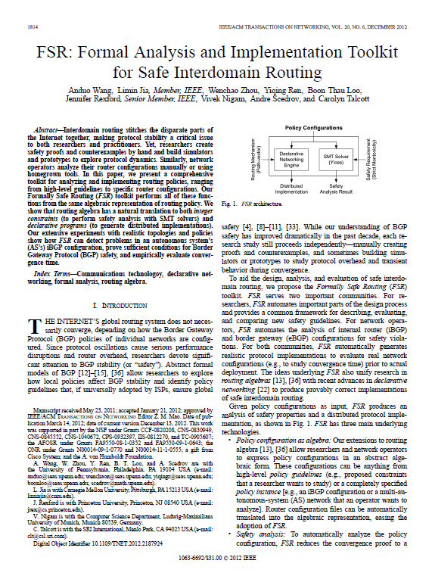
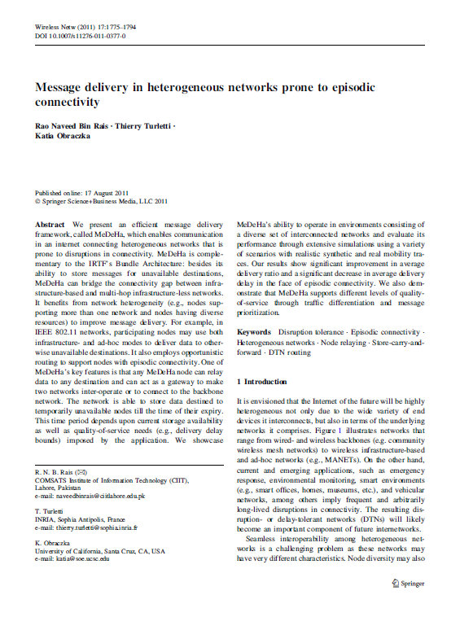
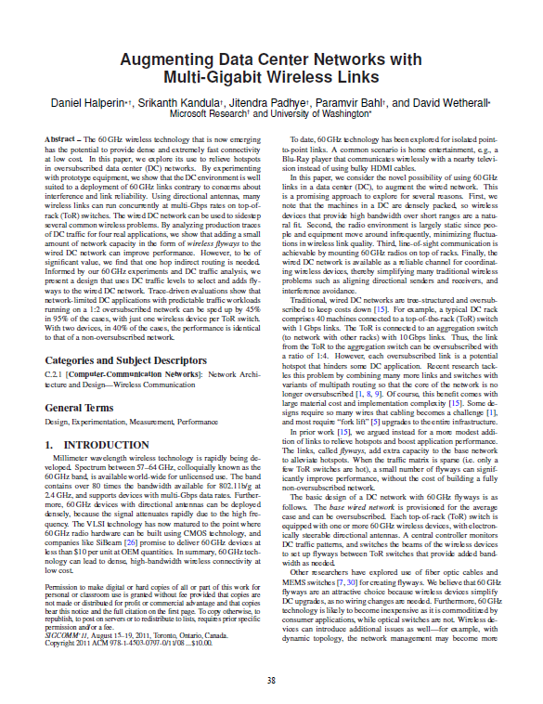
What have people done with ns-3?
~300 publications (March 2013)
  search of 'ns-3 simulator' on IEEE and ACM digital libraries

Slide 16
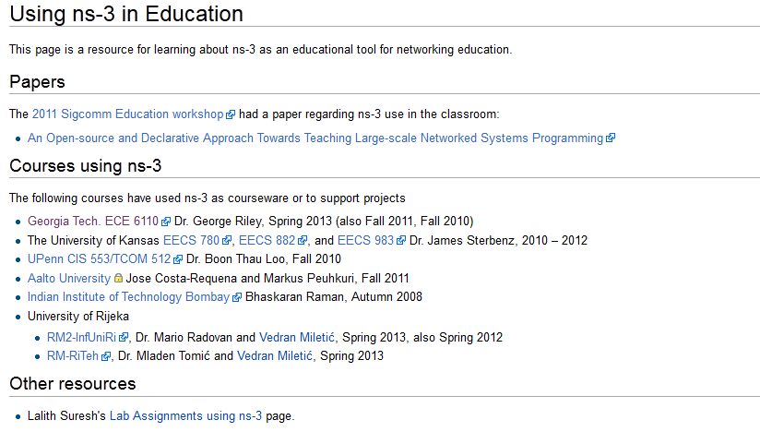
What have people done with ns-3?
Educational use (from ns-3 wiki)

Slide 17
Software introduction
Download the latest release
  wget http://www.nsnam.org/releases/ns-allinone-3.19.tar.bz2
  tar xjf ns-allinone-3.19.tar.bz2
Clone the latest development code
  hg clone http://code.nsnam.org/ns-3-allinone
Q. What is "hg clone"?
A. Mercurial (http://www.selenic.com) is our source code control tool.

Slide 18
Software for ns-3 training
Two versions
1) ns-allinone package
  wget https://www.nsnam.org/tutorials/consortium14/ns-allinone-3.20.training.tar.bz2
  tar xjf ns-allinone-3.20.training.tar.bz2
2) bake package
  wget https://www.nsnam.org/tutorials/consortium14/bake-ns-3.20.training.tar.bz2
  tar xjf bake-ns-3.20.training.tar.bz2

Slide 19
Python bindings
ns-3 uses a program called PyBindGen to generate Python bindings for all libraries
v
v
v
v
C++
header
Intermediate
Python
program
C++
bindings
code
Python
module
(py)gccxml
PyBindGen
C++ compiler

Slide 20
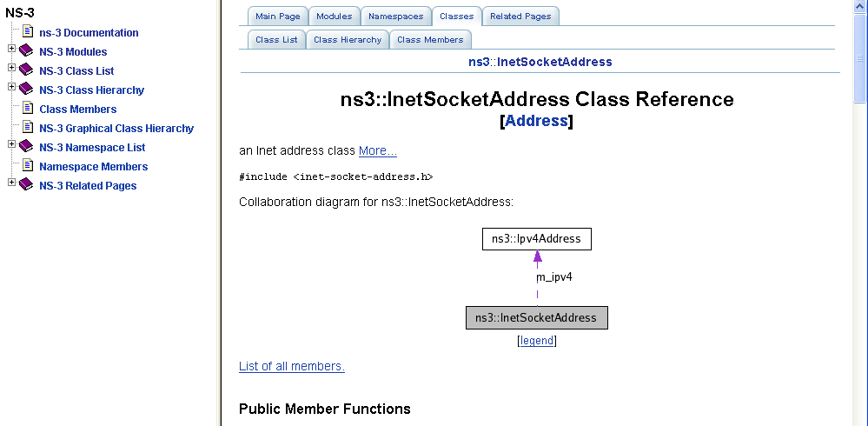
APIs
Most of the ns-3 API is documented with Doxygen
  http://www.stack.nl/~dimitri/doxygen/

Slide 21
mixed-wireless example
Placeholder slide
./waf --run mixed-wireless
./waf --pyrun examples/wireless/mixed-wireless.py

Slide 22
PyViz overview
Developed by Gustavo Carneiro
Live simulation visualizer (no trace files)
Useful for debugging
  mobility model behavior
  where are packets being dropped?
Built-in interactive Python console to debug the state of running objects
Works with Python and C++ programs

Slide 23
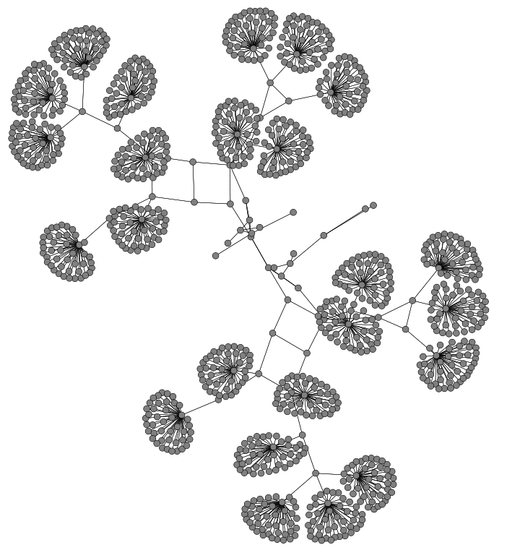
Pyviz screenshot (Graphviz layout)
NS-3 Annual Meeting
May 2014

Slide 24
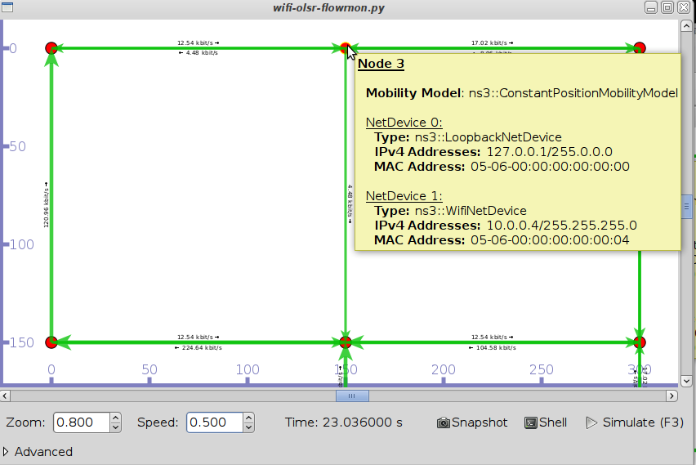
Pyviz and FlowMonitor
src/flow-monitor/examples/wifi-olsr-flowmon.py

Slide 25

Enabling PyViz in your simulations
Make sure PyViz is enabled in the build
If program supports CommandLine parsing, pass the option
  --SimulatorImplementationType=
  ns3::VisualSimulatorImpl
Alternatively, pass the "--vis" option

Slide 26
FlowMonitor
Network monitoring framework found in src/flow-monitor/
Goals:
  detect all flows passing through network
  stores metrics for analysis such as bitrates, duration, delays, packet sizes, packet loss ratios
G. Carneiro, P. Fortuna, M. Ricardo, "FlowMonitor-- a network monitoring framework
for the Network Simulator ns-3," Proceedings of NSTools 2009.

Slide 27
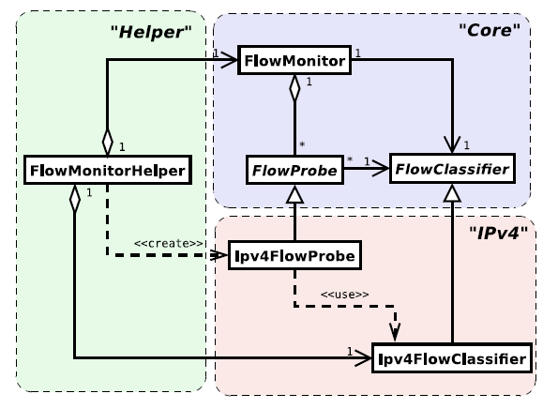
FlowMonitor architecture
Basic classes
  FlowMonitor
  FlowProbe
  FlowClassifier
  FlowMonitorHelper
IPv6 coming in
ns-3.20 release
Figure credit: G. Carneiro, P. Fortuna, M. Ricardo, "FlowMonitor-- a network monitoring
framework for the Network Simulator ns-3," Proceedings of NSTools 2009.

Slide 28
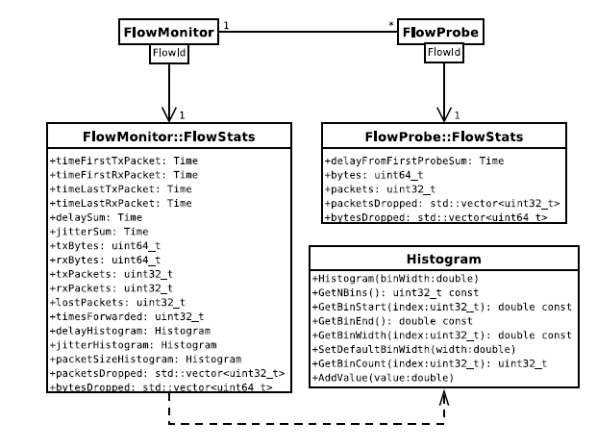
FlowMonitor statistics
Statistics gathered

Slide 29
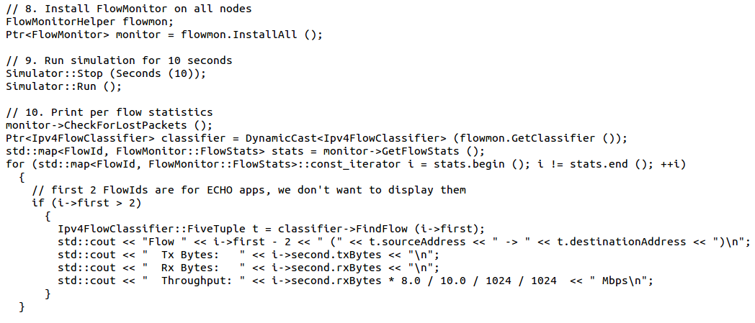
FlowMonitor configuration
example/wireless/wifi-hidden-terminal.cc

Slide 30
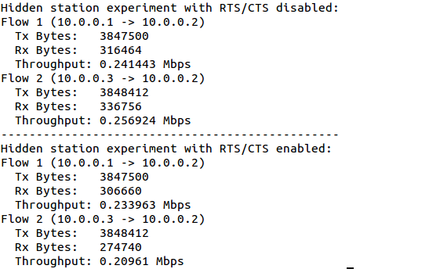
FlowMonitor output
This program exports statistics to stdout
Other examples integrate with PyViz

Slide 31
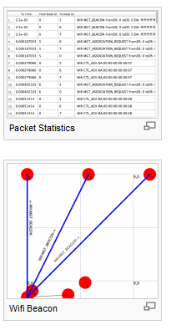
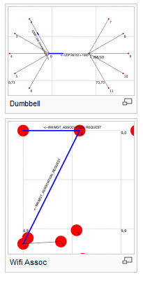
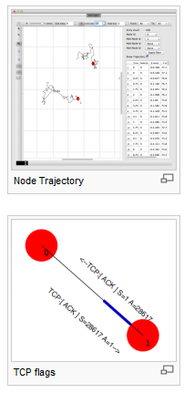
NetAnim
"NetAnim" by George Riley and John Abraham
pyviz

Slide 32
NetAnim key features
Animate packets over wired-links and wireless-links
  limited support for LTE traces
Packet timeline with regex filter on packet meta-data.
Node position statistics with node trajectory plotting (path of a mobile node).
Print brief packet-meta data on packets

Slide 33
Software organization
Two levels of ns-3 software and libraries
1) Several supporting libraries, not system-installed, can be in parallel to ns-3
Netanim
pybindgen
Click routing
ns-3
2) ns-3 modules exist
within the ns-3 directory
module
module
module
module
module
module

Slide 34
Current models
utilities
devices
protocols
visualizer
bridge
mesh
config-
store
applications
aodv
csma
spectrum
internet
(IPv4/v6)
dsdv
flow-monitor
energy
emu
netanim
tap-bridge
olsr
mpi
point-to-
point
uan
click
stats
mobility
virtual-
net-device
network
nix-vector-
routing
topology-
read
lte
propagation
lr-wpan
wifi
core
openflow
BRITE
wimax
34

Slide 35
Current models
utilities
devices
protocols
visualizer
bridge
mesh
config-
store
applications
aodv
Node class
NetDevice ABC
Address types
(Ipv4, MAC, etc.)
Queues
Socket ABC
Ipv4 ABCs
Packet sockets
csma
spectrum
internet
(IPv4/v6)
dsdv
flow-monitor
energy
emu
Packets
Packet Tags
Packet Headers
Pcap/ascii file writing
tap-bridge
olsr
netanim
mpi
point-to-
point
uan
click
stats
Smart pointers
Dynamic types
Attributes
Callbacks
Tracing
Logging
Random Variables
mobility
virtual-
net-device
network
nix-vector-
routing
topology-
read
lte
Events
Scheduler
Time arithmetic
propagation
lr-wpan
wifi
core
openflow
BRITE
wimax
35

Slide 36
Module organization
models/
examples/
tests/
bindings/
doc/
wscript

Slide 37
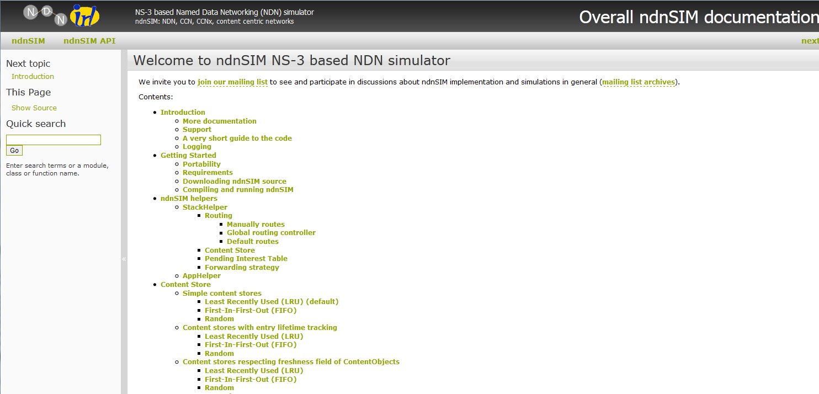
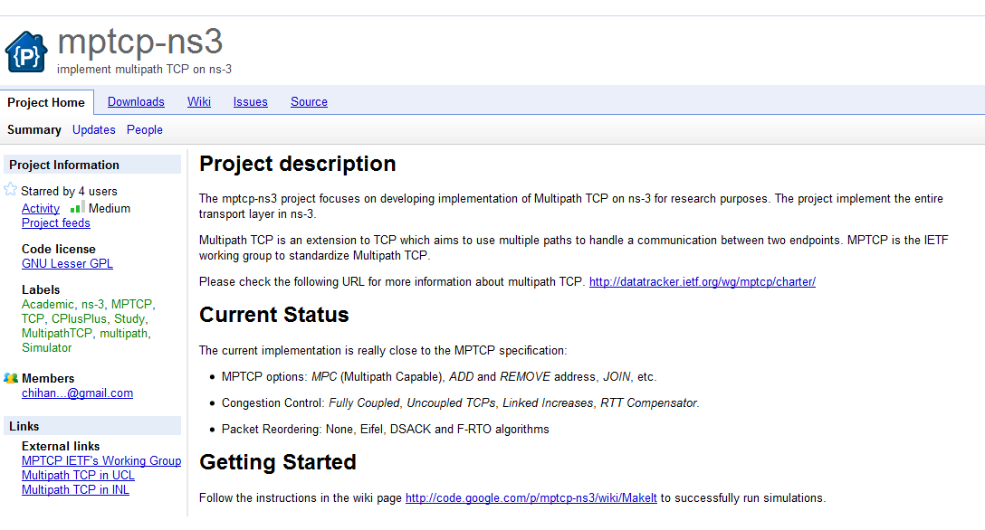
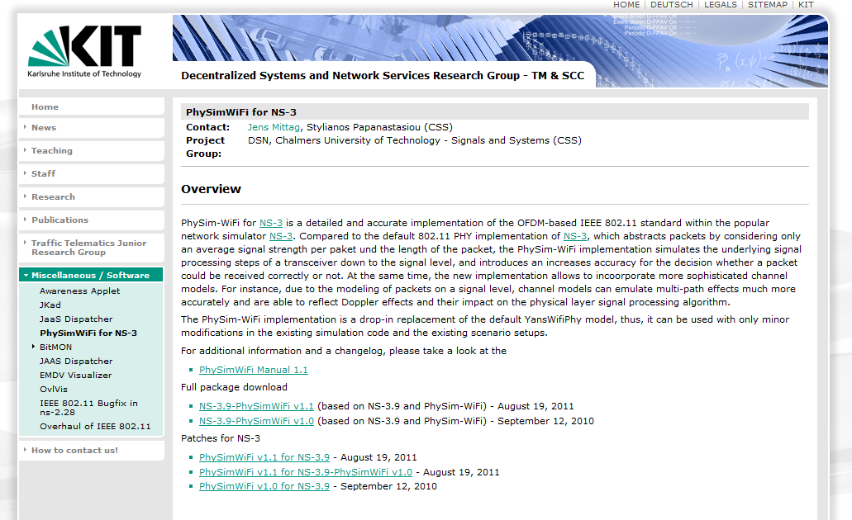
Contributed code and associated projects

Slide 38
Integrating other tools and libraries

Slide 39
Gnuplot
src/tools/gnuplot.{cc,h}
C++ wrapper around gnuplot
classes:
  Gnuplot
  GnuplotDataset
    Gnuplot2dDataset, Gnuplot2dFunction
    Gnuplot3dDataset, Gnuplot3dFunction

Slide 40
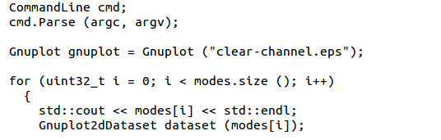

Enabling gnuplot for your code
examples/wireless/wifi-clear-channel-cmu.cc
produce a plot file that
will generate an EPS figure
one dataset per mode
Add data to dataset
Add dataset to plot

Slide 41
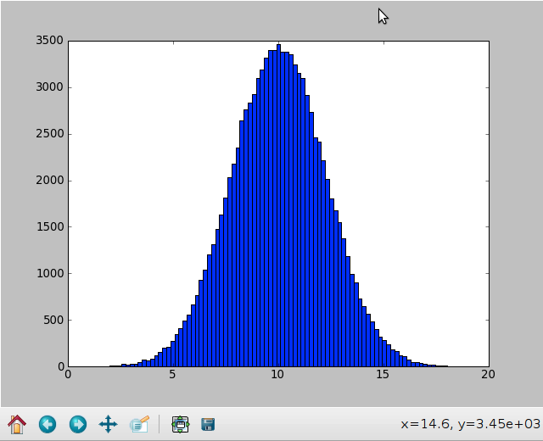
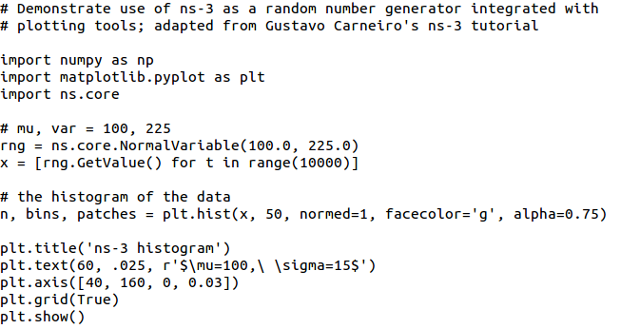
Matplotlib
src/core/examples/sample-rng-plot.py

Slide 42
Other libraries
ns-3 supports additional libraries (click, openflow, nsc)
ns-3 has optional libraries (libxml2, gsl, mysql)
both are typically enabled/disabled through the wscript
users are free to write their own Makefiles or wscripts to do something special

Slide 43
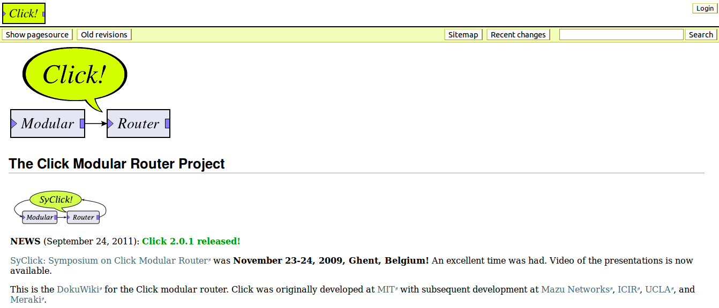
Click Modular Router

Slide 44
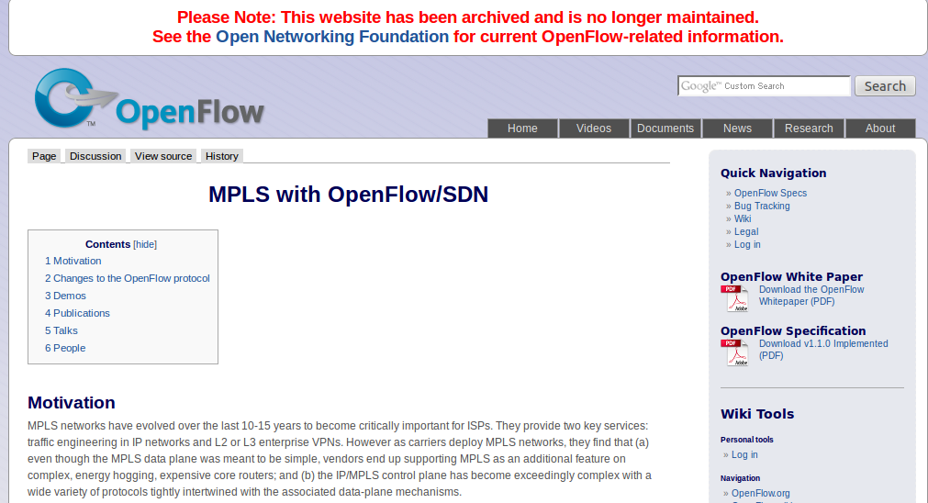
OpenFlow Switch

Slide 45
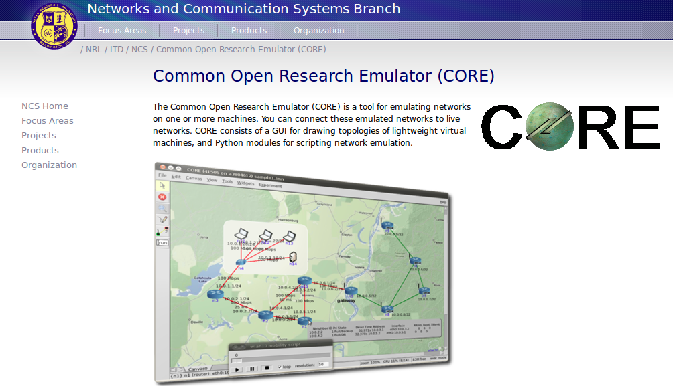
CORE emulator

Slide 46
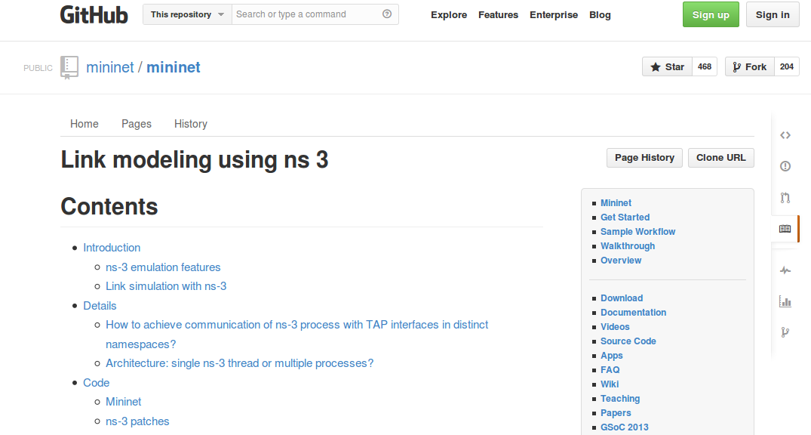
mininet emulator

Slide 47
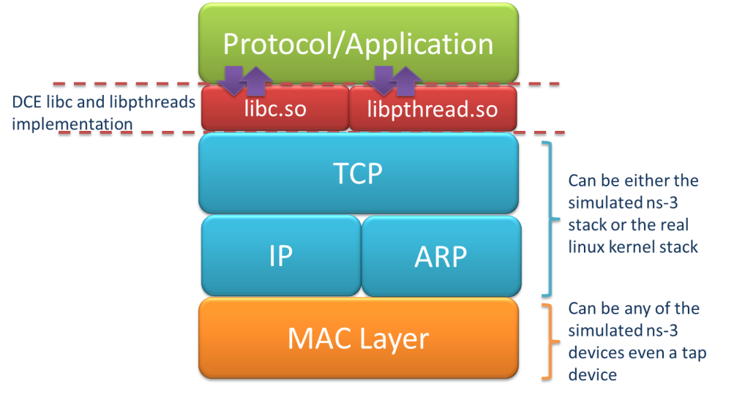
Direct Code Execution
DCE/ns-3 framework requires the virtualization of a series of services
  Multiple isolated instances of the same protocol on the same machine
System calls are captured and treated by DCE
Network stack protocols calls are captured and redirected
To perform its work DCE
re-implement the Linux
program loader and parts
of libc and libpthread

Slide 48
ns-3 emulation modes
real machine
ns-3
ns-3
virtual
machine
virtual
machine
real
machine
real
machine
ns-3
Testbed
1) ns-3 interconnects real or virtual machines
2) testbeds interconnect ns-3 stacks
Various hybrids of the above are possible

Slide 49
ns-3 build systems

Slide 50
Software building
Two levels of ns-3 build
1) bake (a Python-based build system to control an ordered build of
ns-3 and its libraries)
Network
Simulation
Cradle
pybindgen
click routing
ns-3
2) waf, a build system written in Python
module
module
module
module
module
module
3) build.py (a custom Python build script to control an ordered build of
ns-3 and its libraries) <--- may eventually be deprecated

Slide 51
ns-3 uses the 'waf' build system
Waf is a Python-based framework for configuring, compiling and installing applications.
  It is a replacement for other tools such as Autotools, Scons, CMake or Ant
  http://code.google.com/p/waf/
For those familiar with autotools:
configure ./waf configure
make ./waf build

Slide 52
waf configuration
Key waf configuration examples
  ./waf configure
    --enable-examples
    --enable-tests
    --disable-python
    --enable-modules
Whenever build scripts change, need to reconfigure
Demo: ./waf --help
./waf configure --enable-examples --enable-tests --enable-modules='core'
Look at: build/c4che/_cache.py

Slide 53
wscript example
## -*- Mode: python; py-indent-offset: 4; indent-tabs-mode: nil; coding: utf-8; -*-
def build(bld):
obj = bld.create_ns3_module('csma', ['network', 'applications'])
obj.source = [
'model/backoff.cc',
'model/csma-net-device.cc',
'model/csma-channel.cc',
'helper/csma-helper.cc',
]
headers = bld.new_task_gen(features=['ns3header'])
headers.module = 'csma'
headers.source = [
'model/backoff.h',
'model/csma-net-device.h',
'model/csma-channel.h',
'helper/csma-helper.h',
]
if bld.env['ENABLE_EXAMPLES']:
bld.add_subdirs('examples')
bld.ns3_python_bindings()

Slide 54
waf build
Once project is configured, can build via ./waf build or ./waf
waf will build in parallel on multiple cores
waf displays modules built at end of build
Demo: ./waf build
Look at: build/ libraries and executables

Slide 55
Running programs
./waf shell provides a special shell for running programs
  Sets key environment variables
  ./waf --run sample-simulator
  ./waf --pyrun src/core/examples/sample-simulator.py

Slide 56
Build variations
Configure a build type is done at waf configuration time
debug build (default): all asserts and debugging code enabled
  ./waf -d debug configure
optimized
  ./waf -d optimized configure
static libraries
  ./waf --enable-static configure

Slide 57
Controlling the modular build
One way to disable modules:
  ./waf configure --enable-modules='a','b','c'
The .ns3rc file (found in utils/ directory) can be used to control the modules built
Precedence in controlling build
  1) command line arguments
  2) .ns3rc in ns-3 top level directory
  3) .ns3rc in user's home directory
Demo how .ns3rc works

Slide 58
Building without wscript
The scratch/ directory can be used to build programs without wscripts
Demo how programs can be built without wscripts

Slide 59
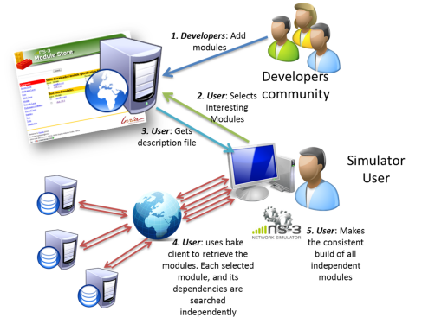
bake overview
Open source project maintains a (more stable) core
Models migrate to a more federated development process
"bake" tool (Lacage and Camara)
Components:
build client
"module store" server
module metadata
Figure source: Daniel Camara

Slide 60
Placeholder slide for demoing bake
Demo: ./waf build
Look at: build/ libraries and executables

