Slide 1
ns-3 Training

Slide 2
Discrete-event simulation basics
Simulation time moves in discrete jumps from event to event
C++ functions schedule events to occur at specific simulation times
A simulation scheduler orders the event execution
Simulation::Run() gets it all started
Simulation stops at specific time or when events end

Slide 3
Software orientation
Key differences from other tools:
1) Command-line, Unix orientation
vs. Integrated Development Environment (IDE)
2) Simulations and models written directly in C++ and Python
vs. a domain-specific simulation language

Slide 4
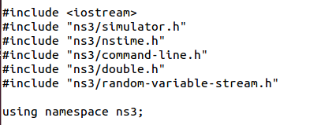
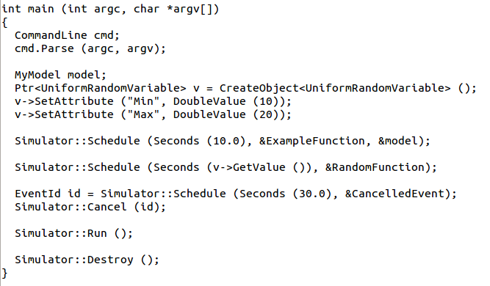
Simulator example

Slide 5

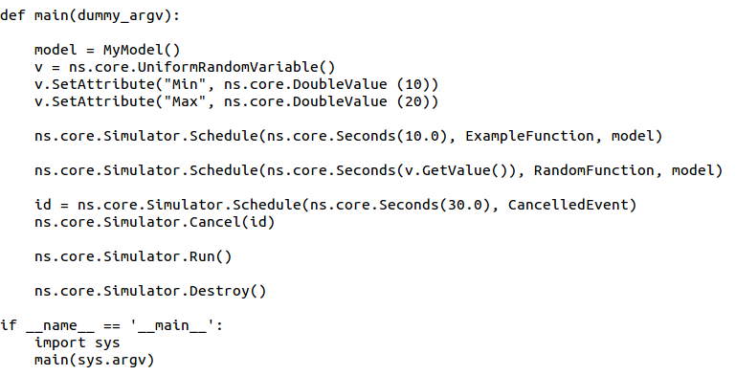
Simulator example (in Python)

Slide 6
Simulation program flow
Handle program inputs
Configure topology
Run simulation
Process outputs

Slide 7

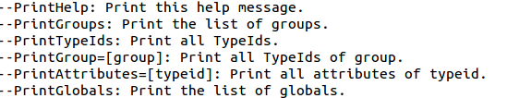
Command-line arguments
Add CommandLine to your program if you want command-line argument parsing
Passing --PrintHelp to programs will display command line options, if CommandLine is enabled
./waf --run "sample-simulator --PrintHelp"

Slide 8
Time in ns-3
Time is stored as a large integer in ns-3
Minimize floating point discrepancies across platforms
Special Time classes are provided to manipulate time (such as standard operators)
Default time resolution is nanoseconds, but can be set to other resolutions
Time objects can be set by floating-point values and can export floating-point values
double timeDouble = t.GetSeconds();

Slide 9
Events in ns-3
Events are just function calls that execute at a simulated time
i.e. callbacks
another difference compared to other simulators, which often use special "event handlers" in each model
Events have IDs to allow them to be cancelled or to test their status

Slide 10
Simulator and Schedulers
The Simulator class holds a scheduler, and provides the API to schedule events, start, stop, and cleanup memory
Several scheduler data structures (calendar, heap, list, map) are possible
A "RealTime" simulation implementation is possible
aligns the simulation time to wall-clock time

Slide 11
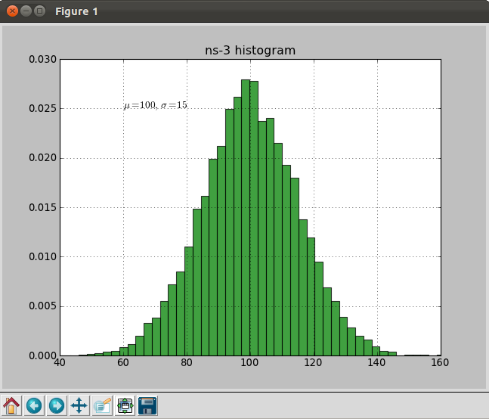
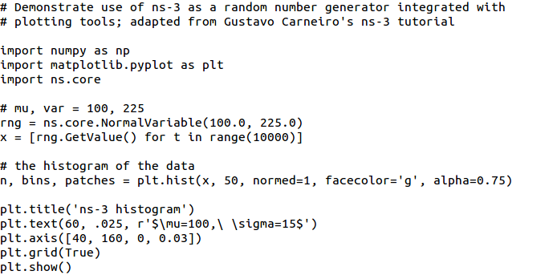
Random Variables
from src/core/examples/sample-rng-plot.py
Currently implemented distributions
Uniform: values uniformly distributed in an interval
Constant: value is always the same (not really random)
Sequential: return a sequential list of predefined values
Exponential: exponential distribution (poisson process)
Normal (gaussian), Log-Normal, Pareto, Weibull, triangular

Slide 12
Random variables and independent replications
Many simulation uses involve running a number of independent replications of the same scenario
In ns-3, this is typically performed by incrementing the simulation run number
not by changing seeds

Slide 13
ns-3 random number generator
Uses the MRG32k3a generator from Pierre L'Ecuyer
http://www.iro.umontreal.ca/~lecuyer/myftp/papers/streams00.pdf
Period of PRNG is 3.1x10^57
Partitions a pseudo-random number generator into uncorrelated streams and substreams
Each RandomVariableStream gets its own stream
This stream partitioned into substreams

Slide 14
Run number vs. seed
If you increment the seed of the PRNG, the streams of random variable objects across different runs are not guaranteed to be uncorrelated
If you fix the seed, but increment the run number, you will get an uncorrelated substream

Slide 15
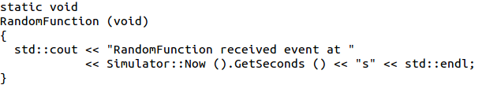
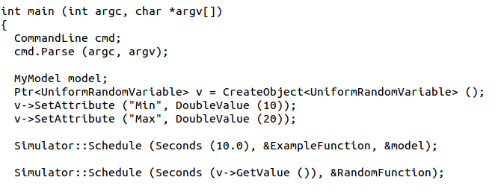
Putting it together
Example of scheduled event
Demo real-time, command-line, random variables...

Slide 16
Walkthrough of WiFi Internet example

Slide 17
The basic model
Application
Application
Application
Application
Sockets-like
API
Protocol
stack
Protocol
stack
Packet(s)‏
Node
Node
NetDevice
NetDevice
NetDevice
Channel
NetDevice
Channel

Slide 18
Example program
examples/wireless/wifi-simple-adhoc-grid.cc
examine wscript for necessary modules
'internet', 'mobility', 'wifi', 'config-store', 'tools'
we'll add 'visualizer'
./waf configure --enable-examples --enable-modules=...

Slide 19
Example program
(5x5) grid of WiFi ad hoc nodes
OLSR packet routing
Try to send packet from one node to another
Source (node 24) by default
WiFi
Goal is to read and
understand the high-level
ns-3 API
Sink (node 0) by default

Slide 20
Fundamentals
Key objects in the simulator are Nodes, Packets, and Channels
Nodes contain Applications, “stacks”, and NetDevices

Slide 21
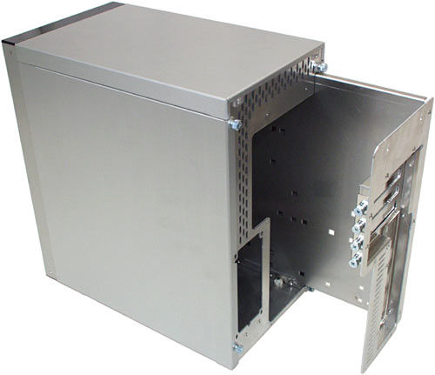


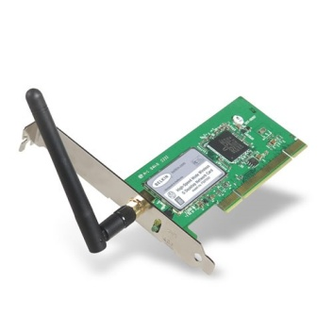
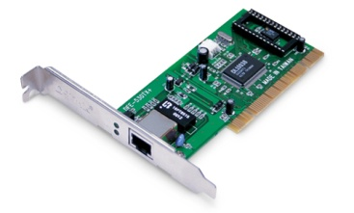
Node basics
A Node is a shell of a computer to which applications, stacks, and NICs are added
Application
Application
Application
“DTN”

Slide 22
NetDevices and Channels
NetDevices are strongly bound to Channels of a matching type
Nodes are architected for multiple interfaces
WifiChannel
WifiNetDevice

Slide 23
Internet Stack
Internet Stack
Provides IPv4 and some IPv6 models currently
No non-IP stacks in ns-3.19
but no dependency on IP in the devices, Node, Packet, etc.
IEEE 802.15.4-based models introduced for ns-3.20

Slide 24
Other basic models in ns-3
Devices
WiFi, WiMAX, CSMA, Point-to-point, Bridge
Error models and queues
Applications
echo servers, traffic generator
Mobility models
Packet routing
OLSR, AODV, DSR, DSDV, Static, Nix-Vector, Global (link state)

Slide 25
ns-3 Packet
Packet is an advanced data structure with the following capabilities
Supports fragmentation and reassembly
Supports real or virtual application data
Extensible
Serializable (for emulation)
Supports pretty-printing
Efficient (copy-on-write semantics)

Slide 26
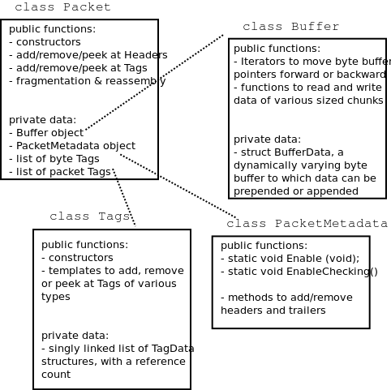
ns-3 Packet structure
Analogous to an mbuf/skbuff

Slide 27
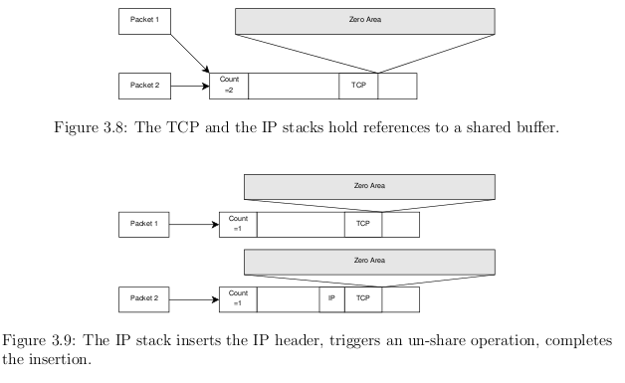
Copy-on-write
Copy data bytes only as needed
Figure source: Mathieu Lacage's Ph.D. thesis

Slide 28
Structure of an ns-3 program
int main (int argc, char *argv[])
{
// Set default attribute values
// Parse command-line arguments
// Configure the topology; nodes, channels, devices, mobility
// Add (Internet) stack to nodes
// Configure IP addressing and routing
// Add and configure applications
// Configure tracing
// Run simulation
}

Slide 29
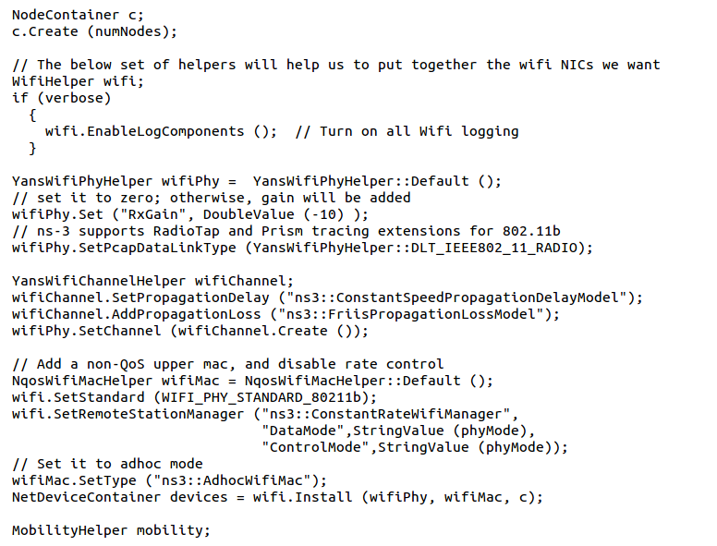
Review of example program

Slide 30
Helper API
The ns-3 “helper API” provides a set of classes and methods that make common operations easier than using the low-level API
Consists of:
container objects
helper classes
The helper API is implemented using the low-level API
Users are encouraged to contribute or propose improvements to the ns-3 helper API

Slide 31
Containers
Containers are part of the ns-3 “helper API”
Containers group similar objects, for convenience
They are often implemented using C++ std containers
Container objects also are intended to provide more basic (typical) API

Slide 32
The Helper API (vs. low-level API)
Is not generic
Does not try to allow code reuse
Provides simple 'syntactical sugar' to make simulation scripts look nicer and easier to read for network researchers
Each function applies a single operation on a ''set of same objects”
A typical operation is "Install()"

Slide 33
Helper Objects
NodeContainer: vector of Ptr<Node>
NetDeviceContainer: vector of Ptr<NetDevice>
InternetStackHelper
WifiHelper
MobilityHelper
OlsrHelper
... Each model provides a helper class

Slide 34
Example program
(5x5) grid of WiFi ad hoc nodes
OLSR packet routing
Try to send packet from one node to another
Source (node 24) by default
WiFi
Let’s look closely at how
these objects are created
Sink (node 0) by default

Slide 35
Installation onto containers
Installing models into containers, and handling containers, is a key API theme
NodeContainer c;
c.Create (numNodes);
...
mobility.Install (c);
...
internet.Install (c);
...

Slide 36
Mobility models in ns-3
The MobilityModel interface:
void SetPosition (Vector pos)
Vector GetPosition ()
StaticMobilityModel
Node is at a fixed location; does not move on its own
RandomWaypointMobilityModel
(works inside a rectangular bounded area)
Node pauses for a certain random time
Node selects a random waypoint and speed
Node starts walking towards the waypoint
When waypoint is reached, goto first state
RandomDirectionMobilityModel
works inside a rectangular bounded area)
Node selects a random direction and speed
Node walks in that direction until the edge
Node pauses for random time
Repeat
y
z
x
3D Cartesian coordinate system

Slide 37
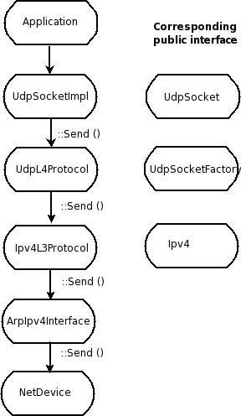
Internet stack
The public interface of
the Internet stack is
defined (abstract base
classes) in
src/network/model
directory
The intent is to support
multiple implementations
The default ns-3 Internet
stack is implemented in
src/internet-stack

Slide 38
ns-3 TCP
Several options exist:
native ns-3 TCP
Tahoe, Reno, NewReno (others in development)
TCP simulation cradle (NSC)
Use of virtual machines or DCE (more on this later)
To enable NSC:
internetStack.SetNscStack ("liblinux2.6.26.so");

Slide 39
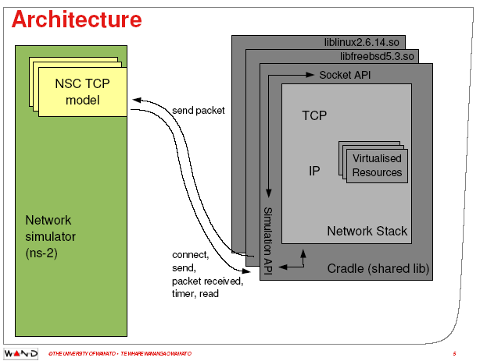
ns-3 simulation cradle
Port by Florian Westphal of Sam Jansen’s Ph.D. work
Figure reference: S. Jansen, Performance, validation and testing with the Network
Simulation Cradle. MASCOTS 2006.

Slide 40
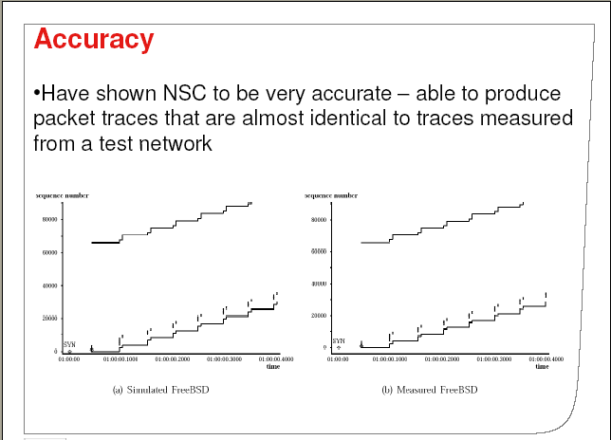
ns-3 simulation cradle
For ns-3:
Linux 2.6.18
Linux 2.6.26
Linux 2.6.28
Others:
FreeBSD 5
lwip 1.3
OpenBSD 3
Other simulators:
ns-2
OmNET++
Figure reference: S. Jansen, Performance, validation and testing with the Network
Simulation Cradle. MASCOTS 2006.

Slide 41
IPv4 address configuration
An Ipv4 address helper can assign addresses to devices in a NetDevice container
Ipv4AddressHelper ipv4;
ipv4.SetBase ("10.1.1.0", "255.255.255.0");
csmaInterfaces = ipv4.Assign (csmaDevices);
...
ipv4.NewNetwork (); // bumps network to 10.1.2.0
otherCsmaInterfaces = ipv4.Assign (otherCsmaDevices);

Slide 42
Applications and sockets
In general, applications in ns-3 derive from the ns3::Application base class
A list of applications is stored in the ns3::Node
Applications are like processes
Applications make use of a sockets-like API
Application::Start () may call ns3::Socket::SendMsg() at a lower layer

Slide 43
Sockets API
Plain C sockets
int sk;
sk = socket(PF_INET, SOCK_DGRAM, 0);
struct sockaddr_in src;
inet_pton(AF_INET,”0.0.0.0”,&src.sin_addr);
src.sin_port = htons(80);
bind(sk, (struct sockaddr *) &src, sizeof(src));
struct sockaddr_in dest;
inet_pton(AF_INET,”10.0.0.1”,&dest.sin_addr);
dest.sin_port = htons(80);
sendto(sk, ”hello”, 6, 0, (struct sockaddr *) &dest, sizeof(dest));
char buf[6];
recv(sk, buf, 6, 0);
}
ns-3 sockets
Ptr<Socket> sk =
udpFactory->CreateSocket ();
sk->Bind (InetSocketAddress (80));
sk->SendTo (InetSocketAddress (Ipv4Address (”10.0.0.1”), 80), Create<Packet> (”hello”, 6));
sk->SetReceiveCallback (MakeCallback (MySocketReceive));
[…] (Simulator::Run ())
void MySocketReceive (Ptr<Socket> sk, Ptr<Packet> packet)
{
...
}

Slide 44
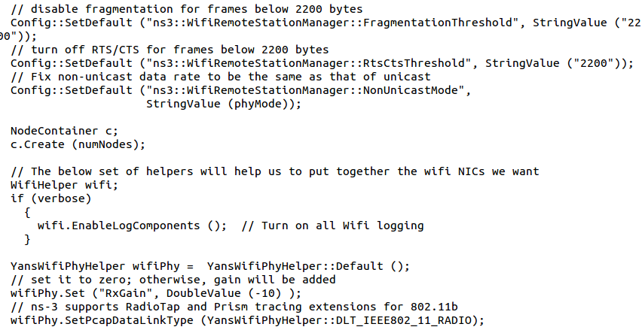
Attributes and default values

Slide 45
ns-3 attribute system
Problem: Researchers want to identify all of the values affecting the results of their simulations
and configure them easily
ns-3 solution: Each ns-3 object has a set of attributes:
A name, help text
A type
An initial value
Control all simulation parameters for static objects
Dump and read them all in configuration files
Visualize them in a GUI
Makes it easy to verify the parameters of a simulation

Slide 46
Short digression: Object metadata system
ns-3 is, at heart, a C++ object system
ns-3 objects that inherit from base class ns3::Object get several additional features
dynamic run-time object aggregation
an attribute system
smart-pointer memory management (Class Ptr)
We focus here on the attribute system

Slide 47
Use cases for attributes
An Attribute represents a value in our system
An Attribute can be connected to an underlying variable or function
e.g. TcpSocket::m_cwnd;
or a trace source

Slide 48
Use cases for attributes (cont.)‏
What would users like to do?
Know what are all the attributes that affect the simulation at run time
Set a default initial value for a variable
Set or get the current value of a variable
Initialize the value of a variable when a constructor is called
The attribute system is a unified way of handling these functions

Slide 49
How to handle attributes
The traditional C++ way:
export attributes as part of a class's public API
walk pointer chains (and iterators, when needed) to find what you need
use static variables for defaults
The attribute system provides a more convenient API to the user to do these things

Slide 50
Navigating the attributes
Attributes are exported into a string-based namespace, with filesystem-like paths
namespace supports regular expressions
Attributes also can be used without the paths
e.g. “ns3::WifiPhy::TxGain”
A Config class allows users to manipulate the attributes

Slide 51
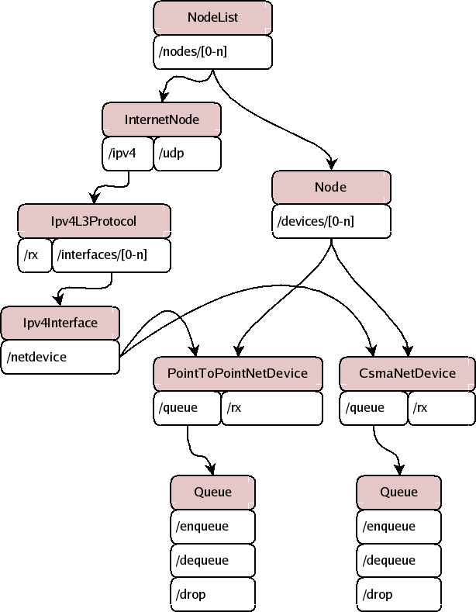
Attribute namespace
strings are used to describe paths through the namespace
Config::Set ("/NodeList/1/$ns3::Ns3NscStack<linux2.6.26>/net.ipv4.tcp_sack", StringValue ("0"));

Slide 52
Navigating the attributes using paths
Examples:
Nodes with NodeIds 1, 3, 4, 5, 8, 9, 10, 11:
“/NodeList/[3-5]|[8-11]|1”
UdpL4Protocol object instance aggregated to matching nodes:
“/$ns3::UdpL4Protocol”

Slide 53
What users will do
e.g.: Set a default initial value for a variable
Config::Set (“ns3::WifiPhy::TxGain”, DoubleValue (1.0));
Syntax also supports string values:
Config::Set (“WifiPhy::TxGain”, StringValue (“1.0”));
Attribute
Value

Slide 54
Fine-grained attribute handling
Set or get the current value of a variable
Here, one needs the path in the namespace to the right instance of the object
Config::SetAttribute(“/NodeList/5/DeviceList/3/Phy/TxGain”, DoubleValue(1.0));
DoubleValue d; nodePtr->GetAttribute ( “/NodeList/5/NetDevice/3/Phy/TxGain”, v);
Users can get Ptrs to instances also, and Ptrs to trace sources, in the same way

Slide 55
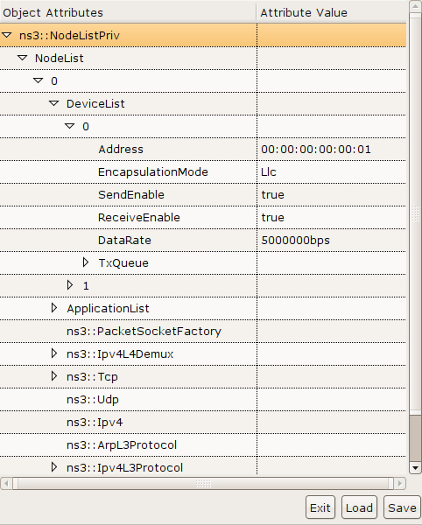
ns-3 attribute system
Object attributes are organized and documented in the Doxygen
Enables the construction of graphical configuration tools:

Slide 56
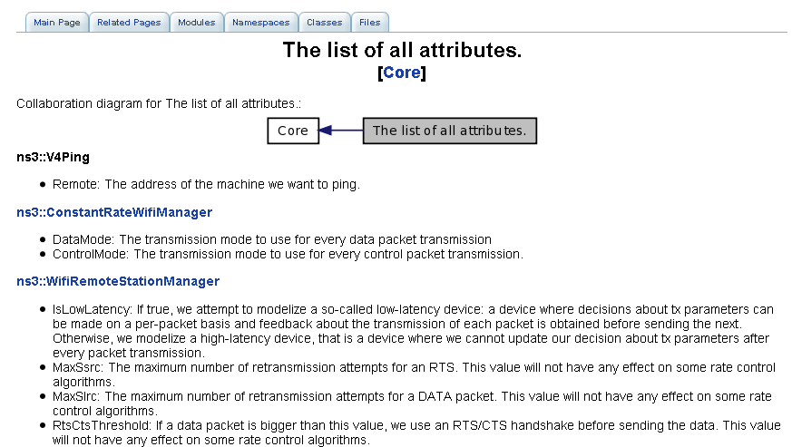
Attribute documentation

Slide 57
Options to manipulate attributes
Individual object attributes often derive from default values
Setting the default value will affect all subsequently created objects
Ability to configure attributes on a per-object basis
Set the default value of an attribute from the command-line:
CommandLine cmd;
cmd.Parse (argc, argv);
Set the default value of an attribute with NS_ATTRIBUTE_DEFAULT
Set the default value of an attribute in C++:
Config::SetDefault ("ns3::Ipv4L3Protocol::CalcChecksum",
BooleanValue (true));
Set an attribute directly on a specic object:
Ptr<CsmaChannel> csmaChannel = ...;
csmaChannel->SetAttribute ("DataRate",
StringValue ("5Mbps"));

Slide 58
Object names
It can be helpful to refer to objects by a string name
“access point”
“eth0”
Objects can now be associated with a name, and the name used in the attribute system

Slide 59
Names example
NodeContainer n;
n.Create (4);
Names::Add ("client", n.Get (0));
Names::Add ("server", n.Get (1));
...
Names::Add ("client/eth0", d.Get (0));
...
Config::Set ("/Names/client/eth0/Mtu", UintegerValue (1234));
Equivalent to:
Config::Set (“/NodeList/0/DeviceList/0/Mtu”, UintegerValue (1234));

Slide 60
Tracing and statistics
Tracing is a structured form of simulation output
Example (from ns-2):
+ 1.84375 0 2 cbr 210 ------- 0 0.0 3.1 225 610
- 1.84375 0 2 cbr 210 ------- 0 0.0 3.1 225 610
r 1.84471 2 1 cbr 210 ------- 1 3.0 1.0 195 600
r 1.84566 2 0 ack 40 ------- 2 3.2 0.1 82 602
+ 1.84566 0 2 tcp 1000 ------- 2 0.1 3.2 102 611
Problem: Tracing needs vary widely
would like to change tracing output without editing the core
would like to support multiple outputs

Slide 61
Tracing overview
Simulator provides a set of pre-configured trace sources
Users may edit the core to add their own
Users provide trace sinks and attach to the trace source
Simulator core provides a few examples for common cases
Multiple trace sources can connect to a trace sink

Slide 62
Tracing in ns-3
ns-3 configures multiple 'TraceSource' objects (TracedValue, TracedCallback)
Multiple types of 'TraceSink' objects can be hooked to these sources
A special configuration namespace helps to manage access to trace sources
TracedValue
Config::Connect ("/path/to/traced/value", callback1);
TraceSource
Config::Connect ("/path/to/trace/source", callback2);
TraceSource
unattached

Slide 63
NetDevice trace hooks
Example: CsmaNetDevice
NetDevice::
ReceiveCallback
CsmaNetDevice::Send ()
MacTx
MacRx
MacDrop
queue
Sniffer
PromiscSniffer
MacTxBackoff
PhyTxBegin
PhyRxEnd
PhyRxDrop
PhyTxDrop
PhyTxEnd
CsmaNetDevice::
TransmitStart()
CsmaNetDevice::
Receive()
CsmaChannel

