Slide 1
ns-3 Training
A tutorial on the implementation of TCP in ns-3
June 2017
ns-3 Training, June 2017

Slide 2
Objectives of this tutorial
To provide an overview of TCP implementation in ns-3
  Learn about the different implementations of TCP in ns-3
  Understand the architecture of natively implemented TCP in ns-3
  Walk through a simple TCP example
  Introduce how to write new TCP extensions
  Learn about writing test cases for new extensions
  Learn about the ongoing work related to TCP in ns-3
ns-3 Training, June 2017

Slide 3
Outline of the presentation
TCP implementations in ns-3
History of ns-3 TCP
Algorithms for congestion control and loss recovery
Implementation of ns-3 TCP
Demonstration of example programs
How to add a new TCP extension in ns-3?
Sample test cases for new TCP extension
Overview of the ongoing work
Review
ns-3 Training, June 2017

Slide 4
TCP implementations in ns-3
ns-3 Training, June 2017

Slide 5
TCP implementations in ns-3
Presently there are following implementations of TCP available for ns-3:
  a native implementation of TCP in ns-3 (ns-3 TCP)
  support for Network Simulation Cradle (NSC)
  support for Direct Code Execution (DCE)
  others (e.g., combining virtual machines with ns-3)
ns-3 TCP model supports:
  a full bidirectional TCP
  connection setup
  connection teardown
ns-3 Training, June 2017

Slide 6
History of ns-3 TCP
ns-3 Training, June 2017

Slide 7
History of ns-3 TCP
Until ns-3.10
  it was a port of TCP model from GTNetS (Georgia Tech Network Simulator)
For ns-3.10
  it was substantially rewritten by Adriam Tam in 2011
For ns-3.25
  the module was refactored as a part of GSoC 2015 project by Natale Patriciello
  one of the major changes involved how congestion control algorithms are implemented (more details to follow)
  other notable change was about automating the tests
  Target is to align the implementation with that of Linux
ns-3 Training, June 2017

Slide 8
Algorithms for congestion control and loss recovery
ns-3 Training, June 2017

Slide 9
Congestion control algorithms
NewReno (default)
Westwood, Westwood+
Hybla
HighSpeed
Vegas
Scalable
Veno
Binary Increase Congestion Control (BIC)
Yet another HighSpeed TCP (YeAH)
Illinois
H-TCP
Low Extra Delay Background Transport (LEDBAT)
ns-3 Training, June 2017

Slide 10
Loss detection and recovery algorithms
Fast retransmit
Fast recovery
Selective Acknowledgements (SACK)
ns-3 Training, June 2017

Slide 11
Implementation of ns-3 TCP
ns-3 Training, June 2017

Slide 12
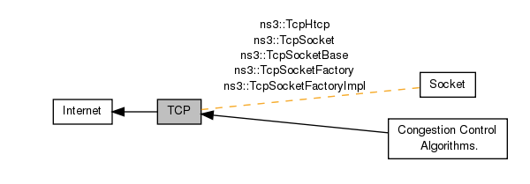
TCP implementation in ns-3
Source code can be found at: src/internet/model/
  tcp-header.{h,cc}
  tcp-socket.{h,cc}
  tcp-socket-base.{h,cc}
  tcp-socket-factory-impl.{h,cc}
  tcp-l4-protocol.{h,cc}
  tcp-congestion-ops.{h,cc}
  ...
ns-3 Training, June 2017

Slide 13
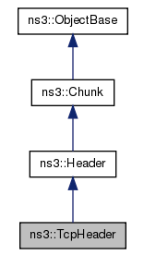
TcpHeader class
This class implements the TCP header and contains:
  port numbers
  sequence numbers
  acknowledgment numbers
  flags
  …
It also contains:
  setters and getters
  methods for serialization
  and deserialization
ns-3 Training, June 2017

Slide 14
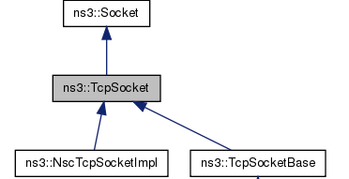
TcpSocket class
This class:
  is an abstract base class for all TcpSockets
  contains TcpSocket attributes that can be reused across different implementations.
Examples of such attributes include:
  SndBufSize
  RcvBufSize
  SegmentSize
  InitialCwnd
  DelAckCount
  DelAckTimeout
  …
ns-3 Training, June 2017

Slide 15
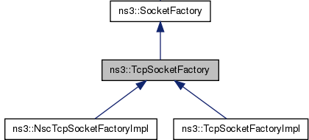
TcpSocketFactory class
This class:
  is an abstract base class
  defines API for TCP sockets
  contains global default variables to initialize new sockets
ns-3 Training, June 2017

Slide 16
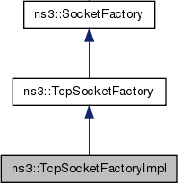
TcpSocketFactoryImpl class
This class:
  is an implementation of socket factory for ns-3 TCP
  creates sockets of type TcpSocketBase
ns-3 Training, June 2017

Slide 17
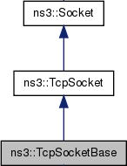
TcpSocketBase class
This class:
  is a base class for the implementation of TCP stream socket
  contains essential components of TCP and provides a socket interface for upper layers to call
Examples of components include:
  Connection orientation
  Sliding window mechanism
  Fast retransmit
  Fast recovery
  Enable/disable window scaling, timestamps
  Congestion state machine
  Congestion control interface
ns-3 Training, June 2017

Slide 18
TcpSocketState class
This class:
  records the congestion state of a connection
  saves the information that is passed between the socket and the congestion control algorithms
Examples of such information include:
  the current value of congestion window
  the current congestion state (CA_OPEN, CA_RECOVERY, etc)
  the current value of slow start threshold
  Last sequence number acknowledged
  Next sequence number to be transmitted
  …
ns-3 Training, June 2017

Slide 19
TcpCongestionOps class
This class:
  is an abstract class for congestion control
  provides an interface between the main socket code and congestion control; variables are stored in TcpSocketState
  inspired by the design in Linux
Some methods implemented in this class include:
  GetSsThresh (Ptr<TcpSocketState>, uint32_t)
  IncreaseWindow (Ptr<TcpSocketState>, uint32_t)
  CongestionStateSet (Ptr<TcpSocketState>, TcpSocketState::TcpCongState_t)
  PktsAcked (Ptr<TcpSocketState>, uint32_t, Time)
ns-3 Training, June 2017

Slide 20
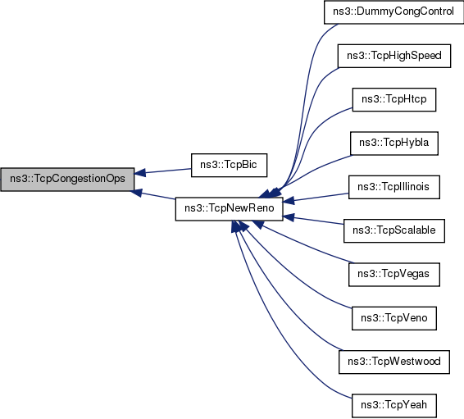
TcpCongestionOps class
ns-3 Training, June 2017

Slide 21
Demonstration of example programs:
examples/tcp/
ns-3 Training, June 2017

Slide 22
How to add a new TCP extension in ns-3?
ns-3 Training, June 2017

Slide 23
Steps to add a new TCP extension in ns-3
Create tcp-new.{h,cc} files for the new TCP extension in src/internet/model/
Create a class for new TCP extension, which can be inherited from TcpCongestionOps (or TcpNewReno as shown before)
Some of the following methods may require a specific implementation for the new TCP extension:
  GetSsThresh
  IncreaseWindow
  PktsAcked
Make necessary modifications in src/internet/wscript
Configure and build ns-3 (resolve errors, if any)
Setup an example program for this extension (or use an existing one).
Write tests and update the documentation in src/internet/doc/tcp.rst
ns-3 Training, June 2017

Slide 24
Sample test cases for new TCP extension
ns-3 Training, June 2017

Slide 25
Sample test cases for new TCP extension
Some of the following test cases are very commonly used across different TCP extensions
  CwndIncrementTest
  CwndDecrementTest
Some TCP extensions need exclusive test cases, such as in the case of LEDBAT
  LEDBAT should be same as NewReno during Slow Start
  LEDBAT should be same as NewReno when timestamps are disabled
Individual algorithms can be tested too
  test the working of slow start algorithm
  test the working of window scaling algorithm
ns-3 Training, June 2017

Slide 26
Overview of the ongoing work
ns-3 Training, June 2017

Slide 27
Ongoing work
MPTCP model
in
ns-3
DCTCP, TCP Prague
models in
ns-3
TCP BBR model
in
ns-3
TCP Evaluation
Suite for
ns-3
ns-3 Training, June 2017

Slide 28
Review
ns-3 Training, June 2017

Slide 29
Review
Different TCP implementations can be used with ns-3
ns-3 TCP has been recently refactored
The new architecture is simple and user friendly for
  adding new congestion control algorithms
  testing them
Scope to develop more extensions
  e.g., TCP extensions for Data Center Networks
ns-3 Training, June 2017

Slide 30
Thank you!
ns-3 Training, June 2017

