Slide 1
ns-3 Training

Slide 2
Outline
Main emulation devices
  Tap Bridge
  FdNetDevice
  NetmapNetDevice (coming soon)

Slide 3
Emulation support
Support moving between simulation and testbeds or live systems
A real-time scheduler, and support for two modes of emulation
Linux is only operating system supported
Must run simulator in real time
  GlobalValue::Bind (“SimulatorImplementationType”, StringValue (“ns3::RealTimeSimulatorImpl”));
Must enable checksum calculations across models
  GlobalValue::Bind (“ChecksumEnabled”, BooleanValue (true));
Must run as root

Slide 4
ns-3 emulation modes
real machine
ns-3
ns-3
virtual
machine
virtual
machine
real
machine
real
machine
ns-3
Testbed
1) ns-3 interconnects real or virtual machines
2) testbeds interconnect ns-3 stacks

Slide 5
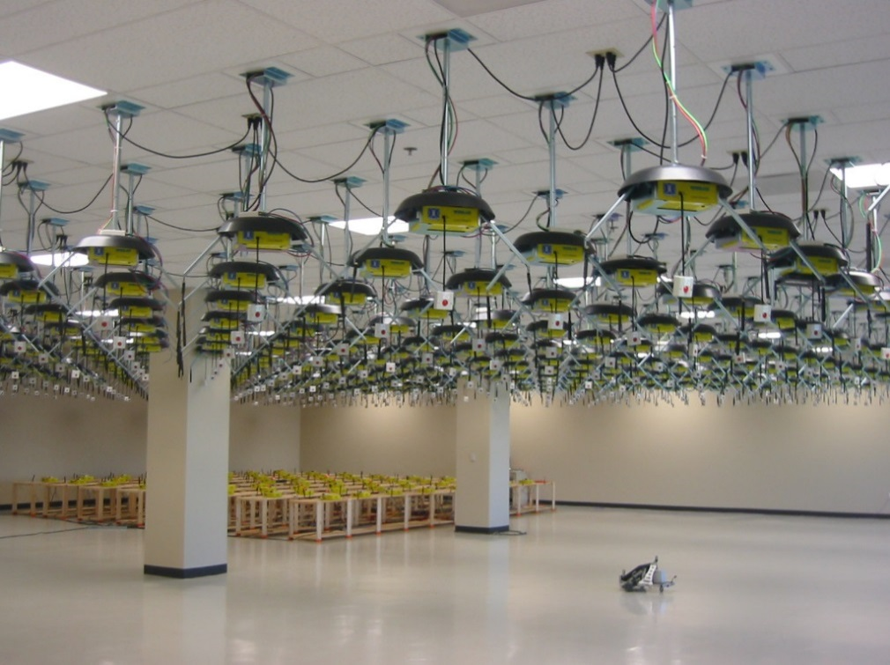
Example use case: testbeds
Support for use of Rutgers WINLAB ORBIT radio grid

Slide 6
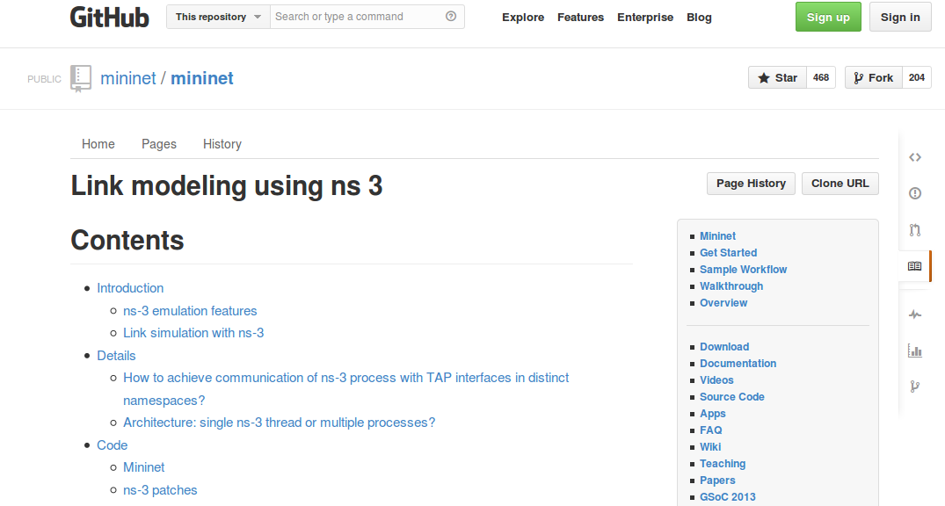
Example use case: mininet
Mininet is popular in the Software-Defined Networking (SDN) community
Mininet uses "TapBridge" integration
  https://github.com/mininet/mininet/wiki/Link-modeling-using-ns-3

Slide 7
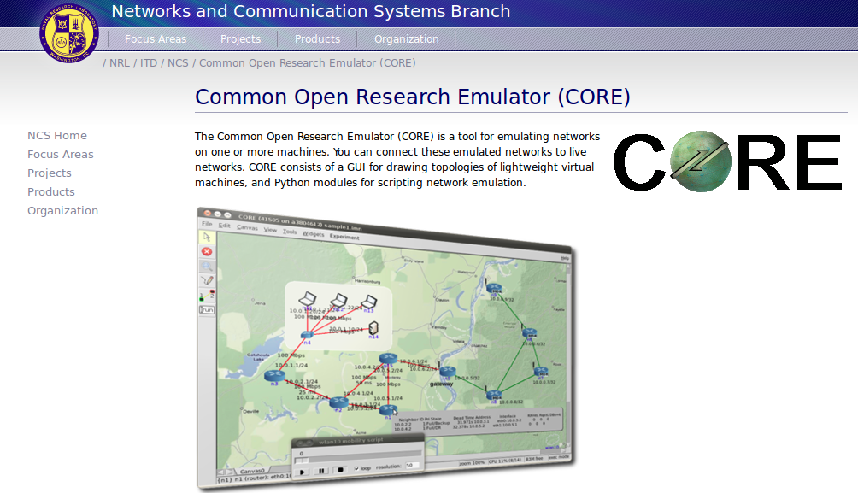
CORE emulator

Slide 8
Emulation Devices

Slide 9
Device models
File Descriptor Net Device (FdNetDevice)
  read and write traffic using a file descriptor provided by the user
  this file descriptor can be associated to a TAP device, to a raw socket, to a user space process generating/consuming traffic, etc.
Tap Bridge
  Integrate Tun/Tap devices with ns-3 devices

Slide 10
“TapBridge": netns and ns-3 integration
Linux
ns-3
Wifi
ghost node
ghost node
Container
Container
TapBridge
TapBridge
WiFi
WiFi
tapX
tapY
/dev/tunX
/dev/tunY
Tap device pushed into namespaces; no bridging needed

Slide 11
TapBridge modes
ConfigureLocal (default mode)
  ns-3 configures the tap device
  useful for host to ns-3 interaction
UseLocal
  user has responsibility for device creation
  ns-3 informed of device using “DeviceName” attribute
UseBridge
  TapDevice connected to existing Linux bridge

Slide 12
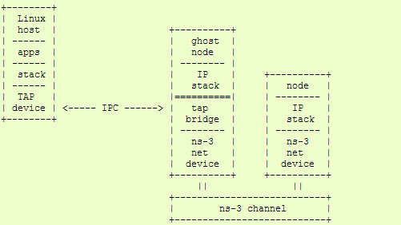
ConfigureLocal
ns-3 ensures that Mac addresses
are consistent

Slide 13
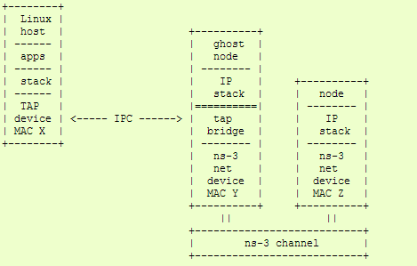
UseLocal
Mac X spoofed to Mac Y

Slide 14
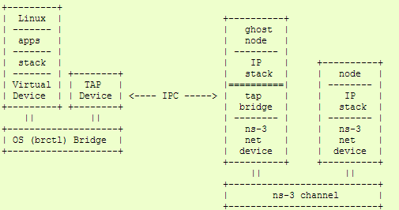
UseBridge
ns-3 devices must support SendFrom()
(i.e. bridging)

Slide 15
FdNetDevice
Unified handling of reading/writing from file descriptor
Three supported helper configurations:
  EmuFdNetDeviceHelper (to associate the ns-3 device with a physical device in the host machine)
  TapFdNetDeviceHelper (to associate the ns-3 device with the file descriptor from a tap device in the host machine) (not the same as TapBridge)
  PlanetLabFdNetDeviceHelper (to automate the creation of tap devices in PlanetLab nodes, enabling ns-3 simulations that can send and receive traffic though the Internet using PlanetLab resource.

Slide 16
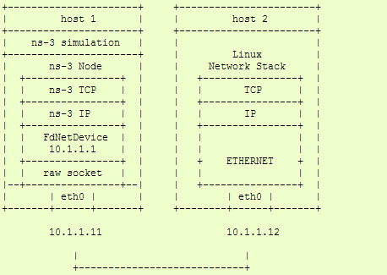
EmuFdNetDeviceHelper
Device performs MAC spoofing to separate emulation from host traffic

Slide 17
ns-3 over host sockets
Two publications about how to run ns-3 applications over real hosts and sockets
  "Simulator-agnostic ns-3 Applications", Abraham and Riley, WNS3 2012
  Gustavo Carneiro, Helder Fontes, Manuel Ricardo, "Fast prototyping of network protocols through ns-3 simulation model reuse", Simulation Modelling Practice and Theory (SIMPAT), vol. 19, pp. 2063–2075, 2011.

Slide 18
Generic Emulation Issues
Ease of use
  Configuration management and coherence
  Information coordination (two sets of state)
    e.g. IP/MAC address coordination
  Output data exists in two domains
  Debugging can be more challenging
Error-free operation (avoidance of misuse)
  Synchronization, information sharing, exception handling
    Checkpoints for execution bring-up
    Inoperative commands within an execution domain
    Deal with run-time errors
  Soft performance degradation (CPU) and time discontinuities

Slide 19
Netmap NetDevice coming soon
2017 ESA Summer of Code project by Pasquale Imputato
Netmap allows ns-3 to gain direct access to the network device, bypassing the host networking stack mapingthe device memory in user space area.
Support for flow control and BQL (see discussion in traffic control presentation)
Pasquale reports that the pps achievable with the NetmapNetDevice at lowest layer (i.e., the write method) is up to 1.38 Mpps on the e1000e adapter on the i7 cpu at full frequency of 3.8 GHZ.
Latency is also reduced due to better flow control

Slide 20
ns-3 Training

Slide 21
Distributed simulation
By default, ns-3 runs a single threaded event loop on a single CPU core
  Multi-core machines or multiple machines not used
Performance is limited (CPU cycles and memory)
    ~10⁴ packet receives/wall clock second/core *
  heavyweight applications may consume memory (DCE, routing tables in very large topologies)
* Peter Barnes, WNS3 training 2016

Slide 22
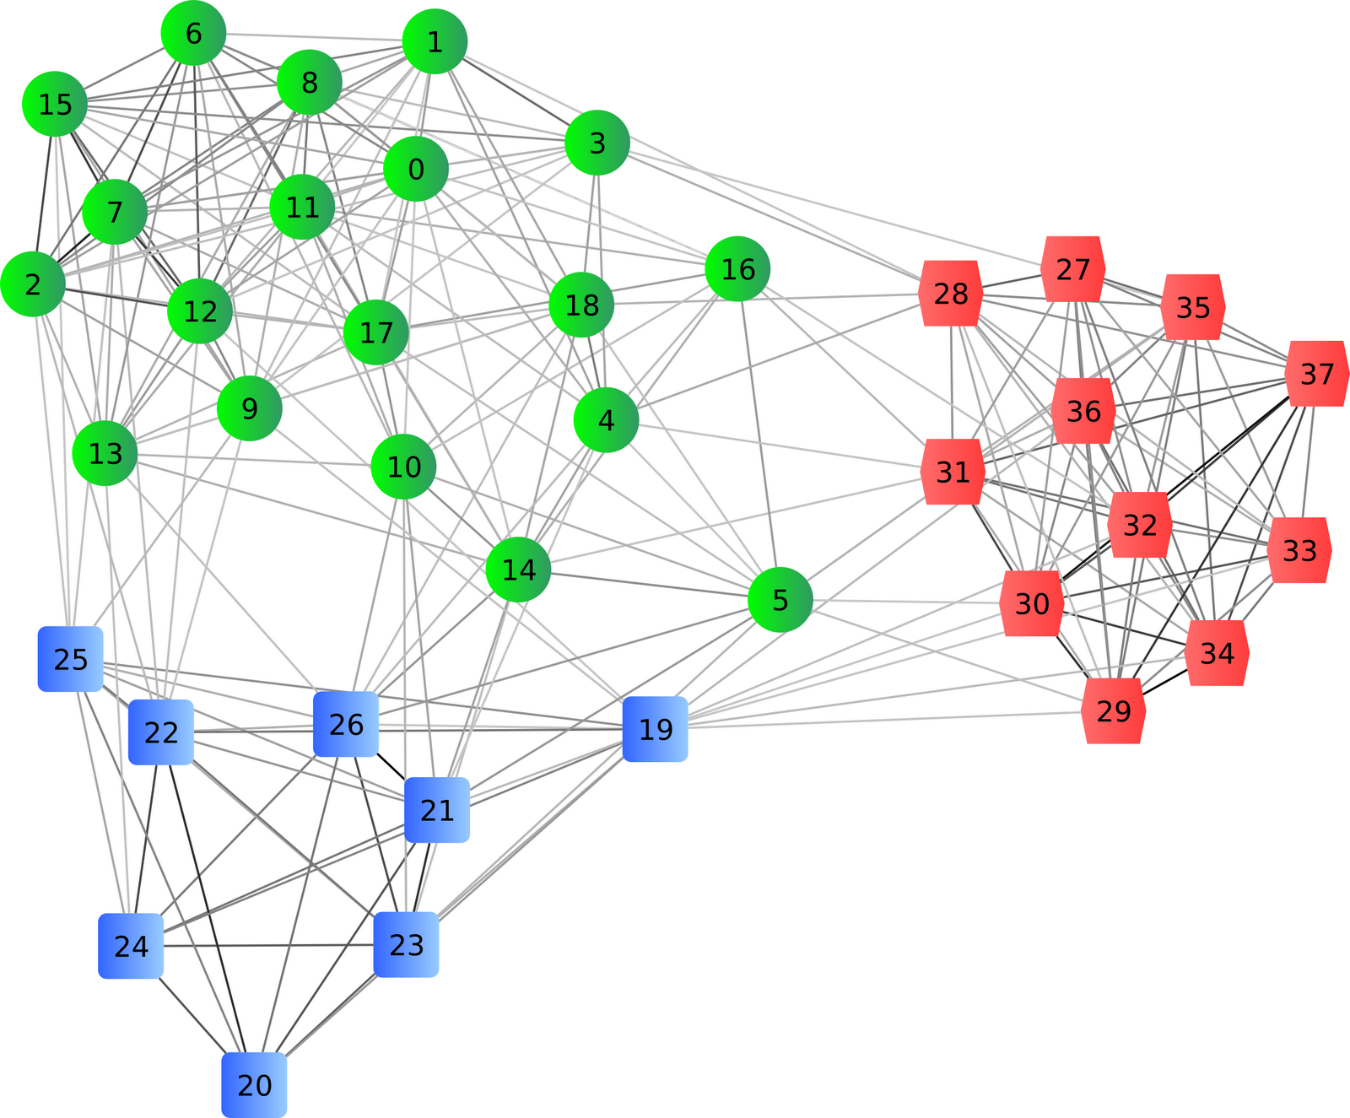
Distributed simulation
Decompose model into Logical Processes
  Separate objects and event queues
  Execute independently
  Events for other LPs become messages
  ~ MPI Ranks
LP 1
LP 3
LP 2
http://www.enggprojects.in/2011/07/adaptive-de-clustering-of-data.html

Slide 23
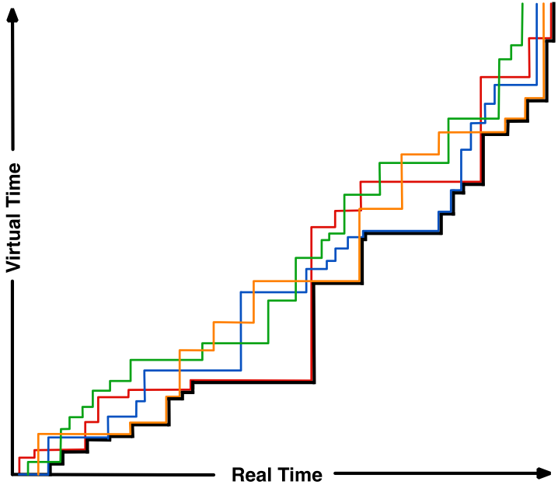
Virtual time evolution
Sometimes ahead in virtual time, sometimes behind
Time evolution constrained by slowest LP
No causality violations
  Hallmark of conservative execution

Slide 24
Using MPI in ns-3
    Need to install MPI on the host system (OpenMPI or MPICH libraries)
    Need to pass ‘--enable-mpi’ to ‘./waf configure’
      Followed by usual build
    Only point-to-point links may be used to separate LPs
      needs some level of propagation delay to support lookahead in each LP
      splitting of wireless channels not presently supported
    The ns-3 scenario has to be constructed by assigning nodes to LPs manually

Slide 25
Running with ‘mpirun’
waf can’t distinguish sequential and parallel
  Need to specify mpirun and number of ranks explicitly
Running Parallel Scripts with waf and mpirun
$ ./waf --run simple-distributed Waf: Entering directory `build/debug' Waf: Leaving directory `build/debug' 'build' finished successfully (2.118s) This simulation requires 2 and only 2 logical processors. Command [‘build/debug/src/mpi/examples/ns3-dev-simple-distributed-debug'] exited with code 1 # Multiple ranks on a single computer: $ ./waf --run simple-distributed --command-template="mpirun -np 2 %s" Waf: Entering directory `build/debug' Waf: Leaving directory `build/debug' 'build' finished successfully (2.104s) At time 1.02264s packet sink received 512 bytes from 10.1.1.1 port 49153 total Rx 512 bytes At time 1.0235s packet sink received 512 bytes from 10.1.2.1 port 49153 total Rx 512 bytes At time 1.02437s packet sink received 512 bytes from 10.1.3.1 port 49153 total Rx 512 bytes At time 1.02524s packet sink received 512 bytes from 10.1.4.1 port 49153 total Rx 512 bytes # Multiple computers: $ mpirun –np 2 ./waf –run simple-distributed

Slide 26
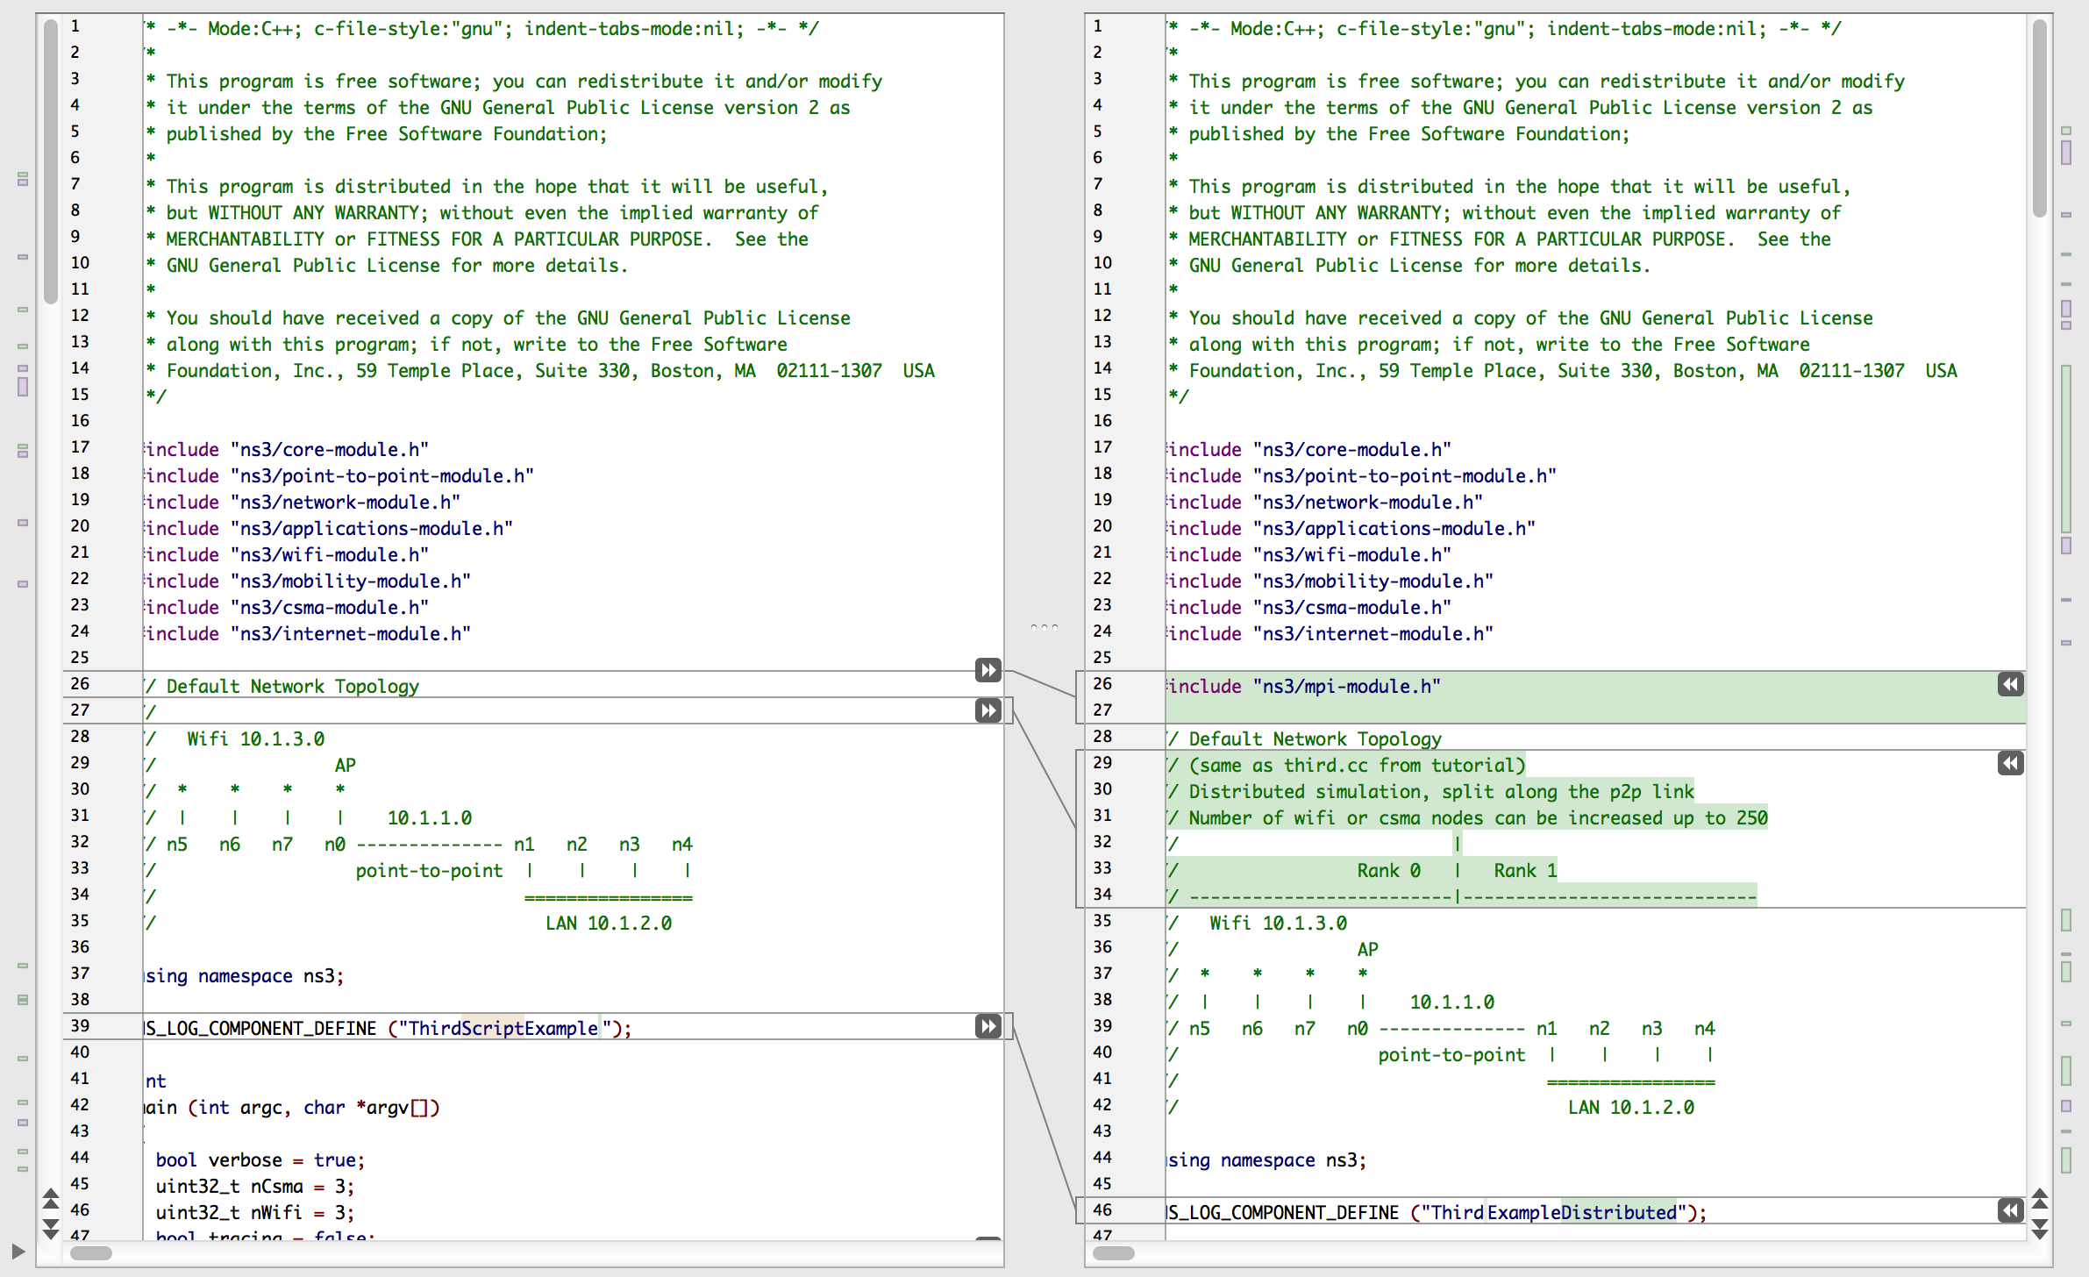
examples/tutorial/third.cc src/mpi/examples/third-distributed.cc
Example
Include mpi-module.h
Same topology, split across Point-to-point link
1
2

Slide 27
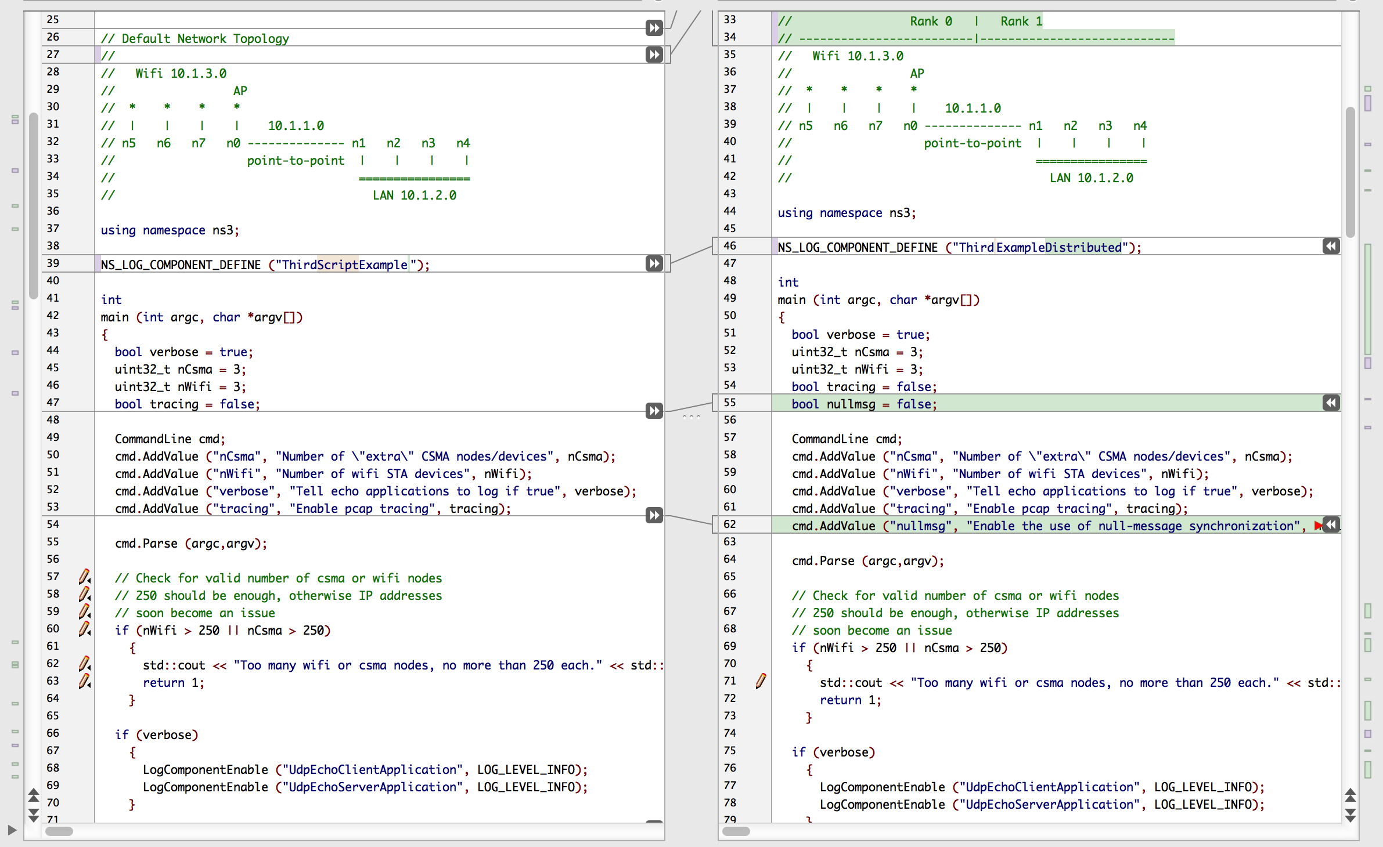
examples/tutorial/third.cc src/mpi/examples/third-distributed.cc
Example
Different log component name
Command line argument to select Null message
1
2

Slide 28
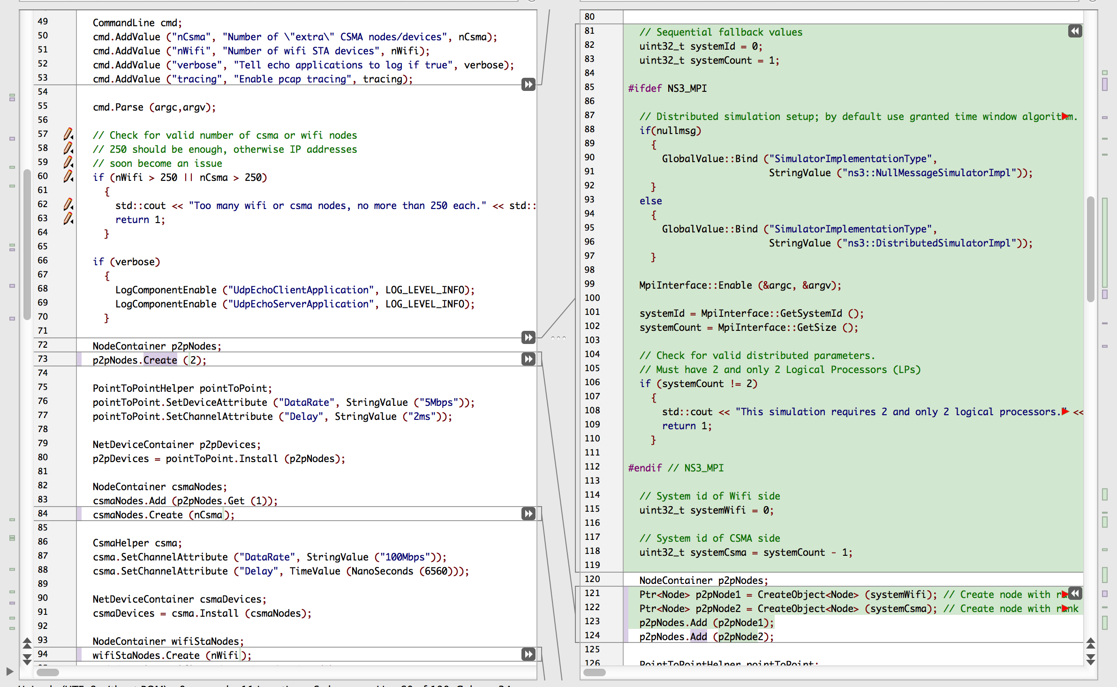
examples/tutorial/third.cc src/mpi/examples/third-distributed.cc
Example
Condition on NS3_MPI
Null message selector
Initialize MPI
Get rank #, number of ranks
Check number of ranks
Use symbolic names for each rank
Create point-to-point nodes
1
2
3
4
5
6
7

Slide 29
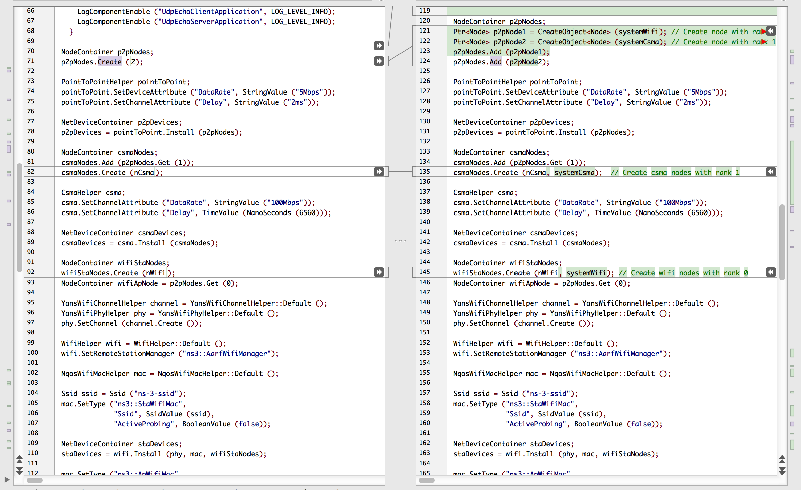
examples/tutorial/third.cc src/mpi/examples/third-distributed.cc
Example
Create CSMA nodes on one rank
Create Wifi nodes on another rank
1
2

Slide 30
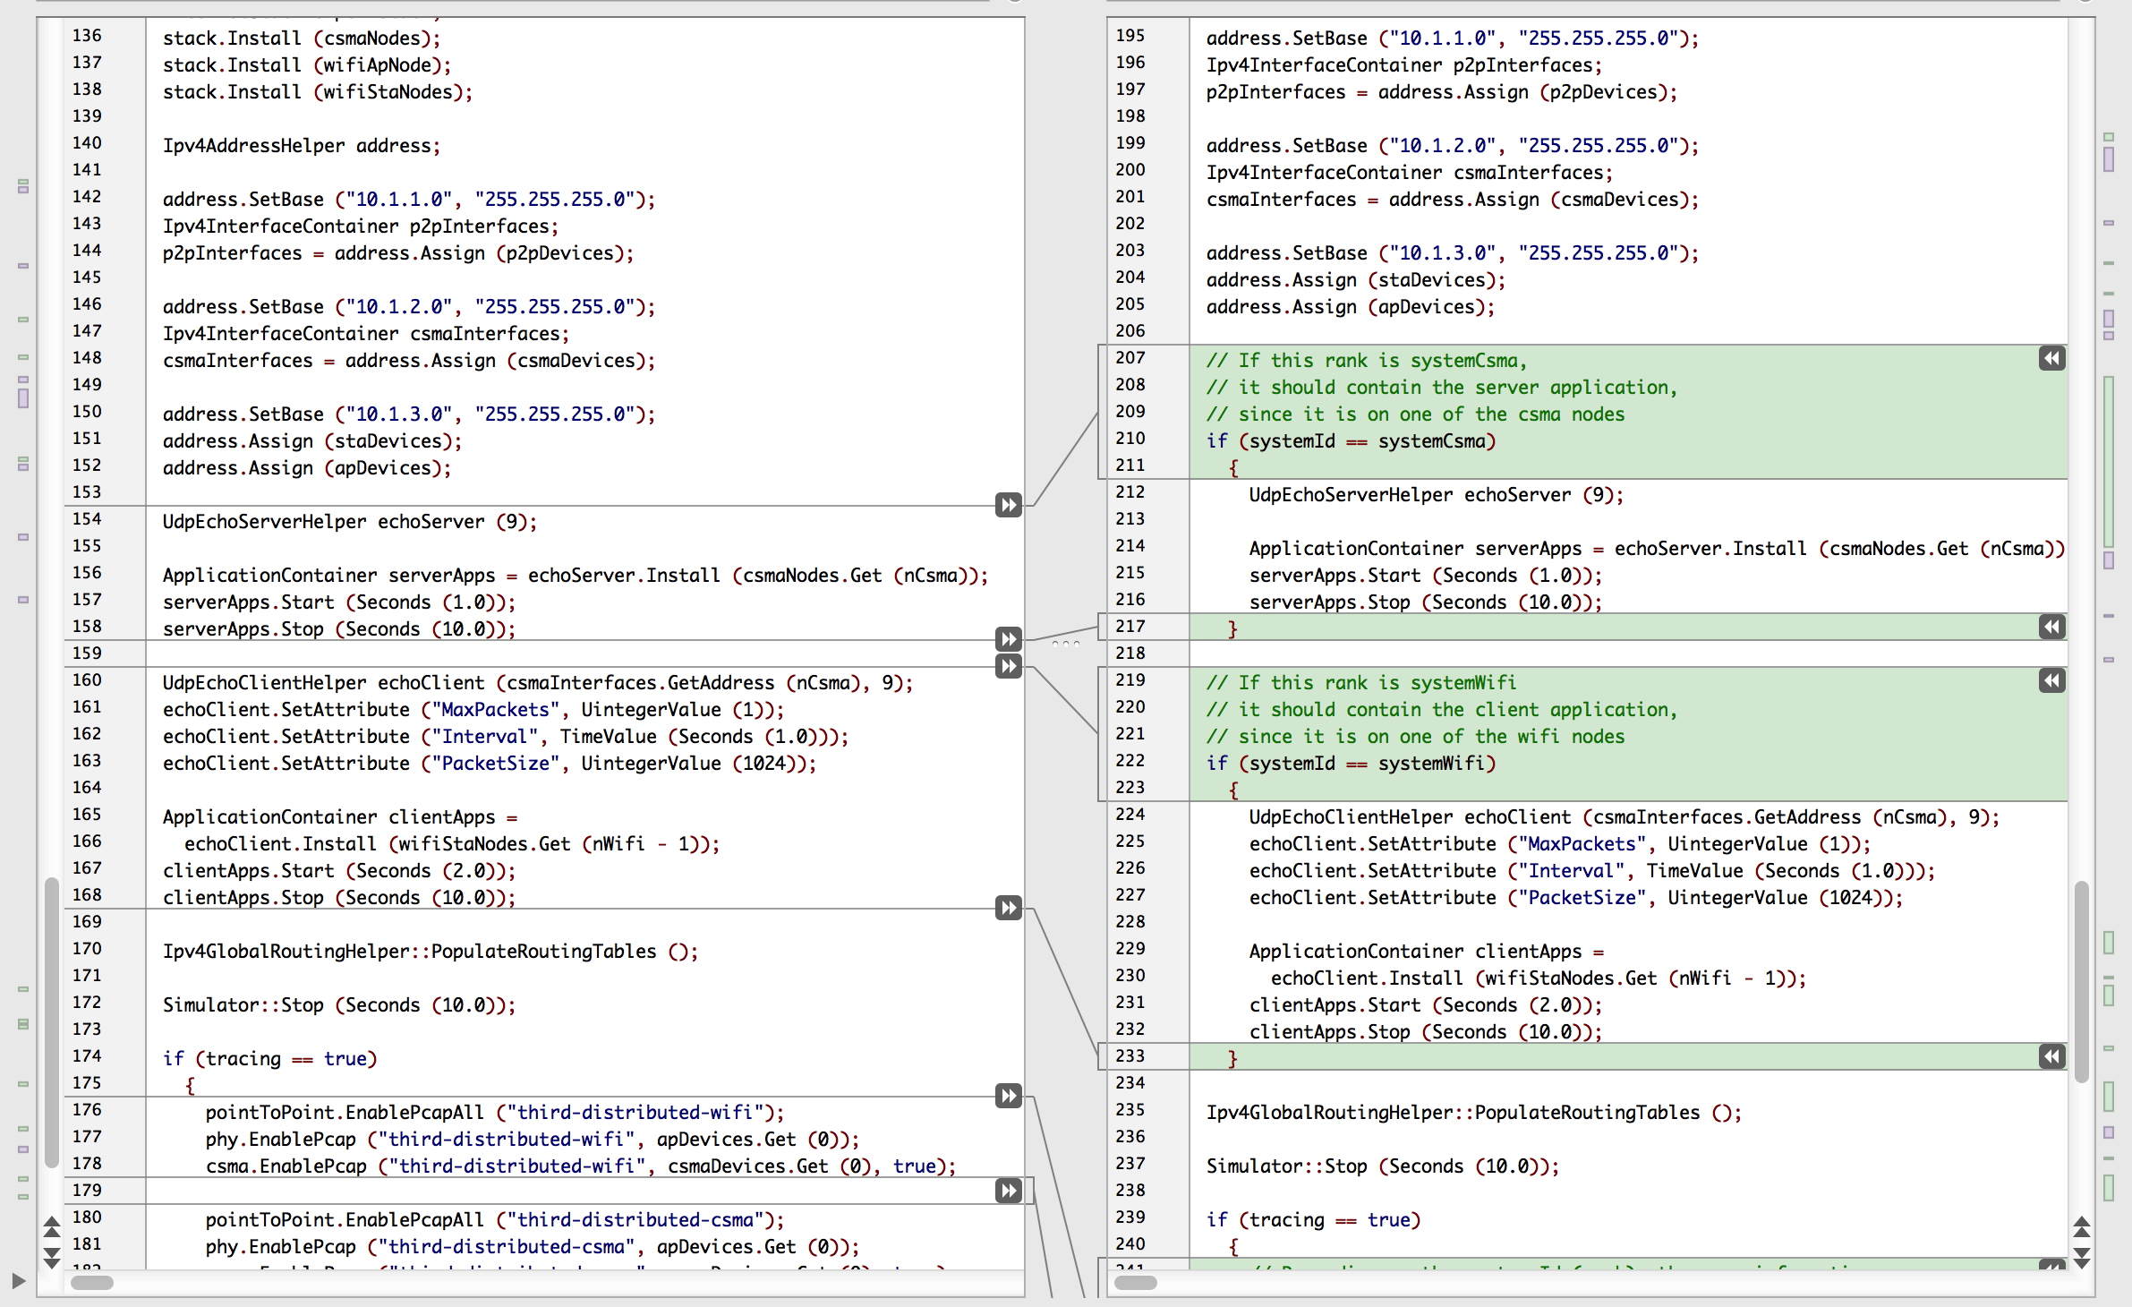
examples/tutorial/third.cc src/mpi/examples/third-distributed.cc
Example
Install devices, addresses and Internet stack everywhere
Install applications only on rank-local nodes
1
2
2

Slide 31
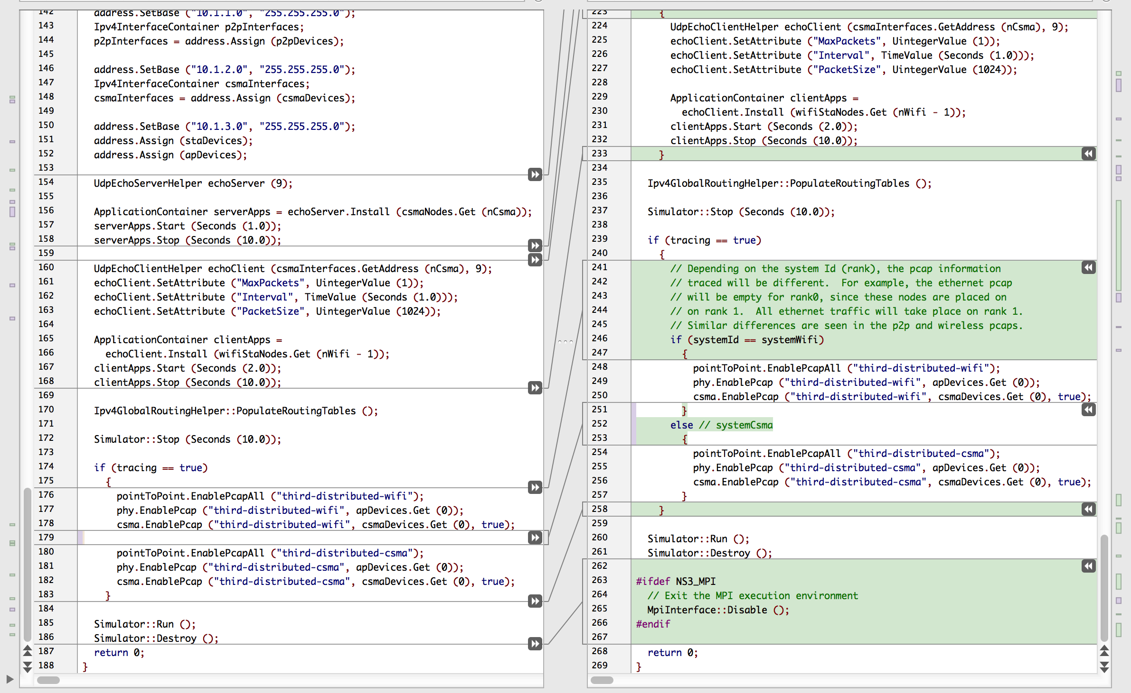
examples/tutorial/third.cc src/mpi/examples/third-distributed.cc
Example
Enable PCAP tracing on local nodes?
Close MPI cleanly
1
2

Slide 32
Script Output–Identical
Example
$ ./waf –run third
Waf: Entering directory `build/debug' Waf: Leaving directory `build/debug' 'build' finished successfully (2.152s) At time 2s client sent 1024 bytes to 10.1.2.4 port 9 At time 2.01796s server received 1024 bytes from 10.1.3.3 port 49153 At time 2.01796s server sent 1024 bytes to 10.1.3.3 port 49153 At time 2.03364s client received 1024 bytes from 10.1.2.4 port 9
$ ./waf --run third-distributed \ --command-template="mpirun -n 2 %s --tracing"
Waf: Entering directory `build/debug' Waf: Leaving directory `build/debug' 'build' finished successfully (2.050s) At time 2s client sent 1024 bytes to 10.1.2.4 port 9 At time 2.01796s server received 1024 bytes from 10.1.3.3 port 49153 At time 2.01796s server sent 1024 bytes to 10.1.3.3 port 49153 At time 2.03364s client received 1024 bytes from 10.1.2.4 port 9

