Slide 1
ns-3 Training

Slide 2
Outline
Experience from several recent personal use cases with ns-3
LAA/Wi-Fi Coexistence
Smart Grid networks
AQM performance
Public-safety based LTE networks

Slide 3
LTE/Wi-Fi Coexistence case study

Slide 4
Use case: LAA Wi-Fi Coexistence
ns-3 has been extended to support scenarios for LTE LAA/Wi-Fi Coexistence
Methodology defined in 3GPP Technical Report TR36.889
Enhancements needed:
Wireless models (LBT access manager, SpectrumWifiPhy, propagation/fading models)
Scenario support (traffic models)
Output data processing

Slide 5
Indoor 3GPP scenario

Slide 6
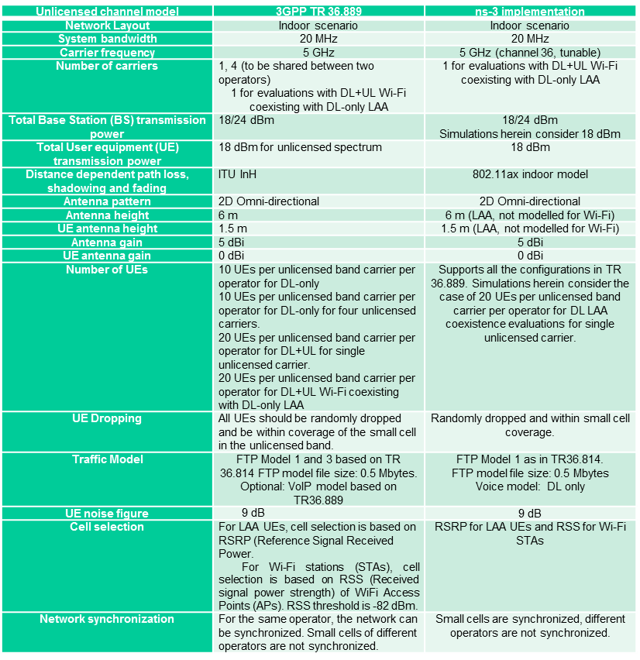
Indoor scenario details

Slide 7
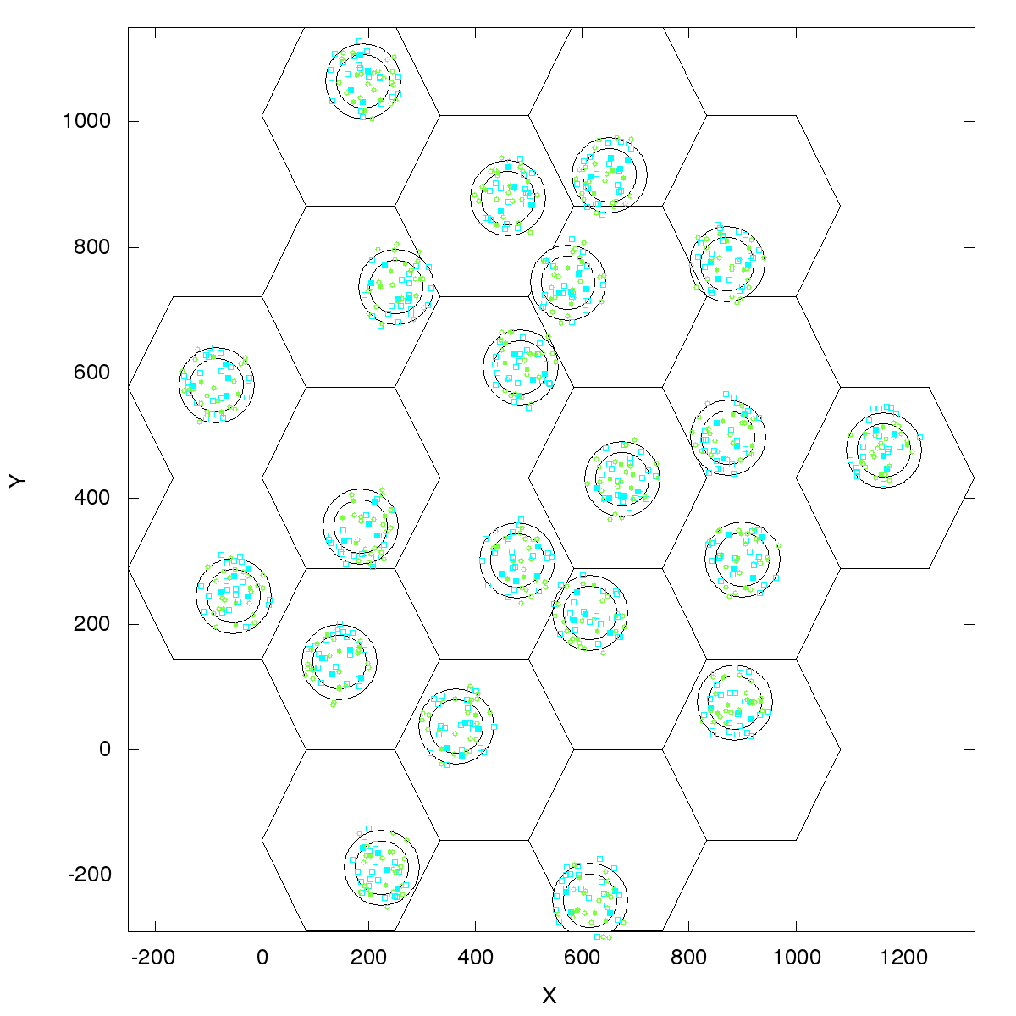
Outdoor 3GPP scenario
Outdoor layout: hexagonal macrocell layout. 7 macro sites and 3 cells per site. 1 Cluster per cell. 4 small cells per operator per cluster, uniformly dropped. ITU UMi channel model.
Figure source: 3GPP TR 36.889 V13.0.0 (2015-05)

Slide 8
References
ns-3 Wiki page:
https://www.nsnam.org/wiki/LAA-WiFi-Coexistence
module documentation
references to various publications
documentation on reproducing results
Code:
git clone https://bitbucket.org/ns3lteu/ns-3-dev-lbt

Slide 9
Sample results

Slide 10
Lessons learned
Think about the data and results you want, and work backwards from there
As much, or more time, spent on scenario development than on model development
Choose the right levels of abstraction in the scenario
Several rewrites may be needed as project evolves

Slide 11
Key concepts
Configuration and execution management
Tracing (gathering output data)
Design for future sharing of your code
Good APIs (attributes, trace sources), tests, and documentation

Slide 12
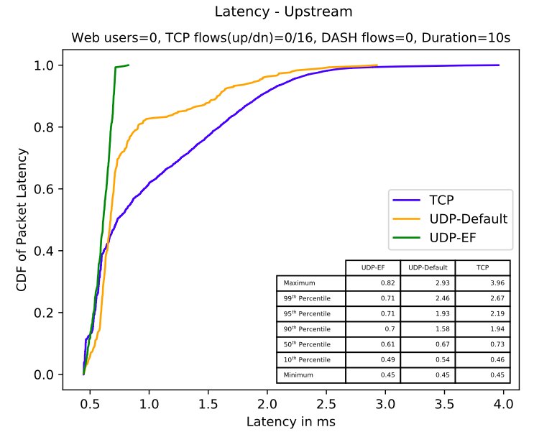
Example
Pass UDP data (marked as EF and best effort) and TCP data through a prioritized queue
Plot CDF of data including percentiles
Repeat for different traffic configurations, different queue configurations

Slide 13
Design aspects
What plotting framework am I using?
Matplotlib can meet requirements
How to manage multiple replications
Bash script, expose configuration as command line arguments
How to obtain the output data
Hook SojournTime trace source of the queue?
Or do I want to also capture device latency?
Other design questions
What flavor of TCP?
How long should simulation trials run for?
etc.

Slide 14
Simulator core
Simulation time
Events
Simulator and Scheduler
Command line arguments
Random variables
Execute a function
(may generate additional events)
Virtual time
Advance the virtual time
to the next event (function)

Slide 15
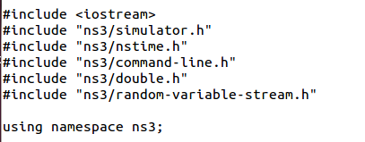
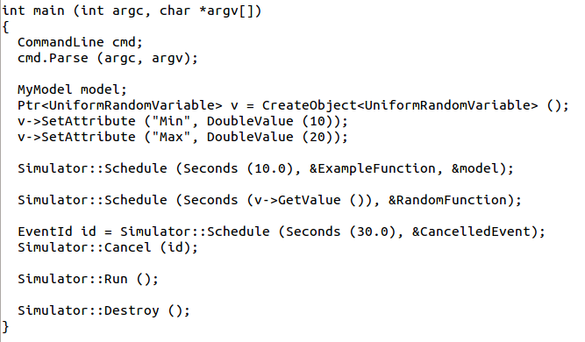
Simulator example

Slide 16
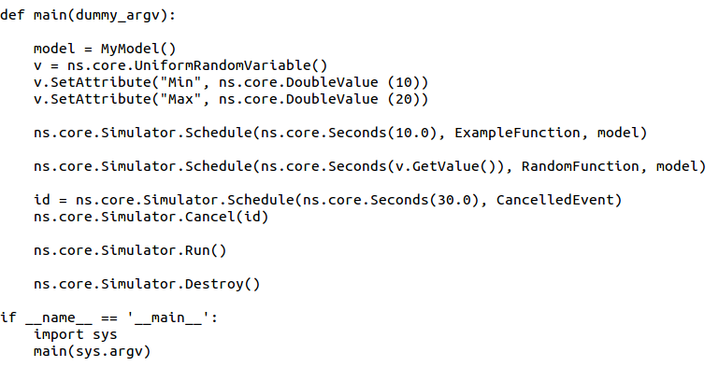
Simulator example (in Python)

Slide 17
Simulation program flow
Handle program inputs
Configure topology
Run simulation
Process outputs

Slide 18
Command-line arguments
Add CommandLine to your program if you want command-line argument parsing
Passing --PrintHelp to programs will display command line options, if CommandLine is enabled
./waf --run "sample-simulator --PrintHelp"

Slide 19
Time in ns-3
Time is stored as a large integer in ns-3
Minimize floating point discrepancies across platforms
Special Time classes are provided to manipulate time (such as standard operators)
Default time resolution is nanoseconds, but can be set to other resolutions
Note: Changing resolution is not well used/tested
Time objects can be set by floating-point values and can export floating-point values
double timeDouble = t.GetSeconds();
Best practice is to avoid floating point conversions where possible and use Time arithmetic operators

Slide 20
Events in ns-3
Events are just function calls that execute at a simulated time
i.e. callbacks
this is another difference compared to other simulators, which often use special "event handlers" in each model
Events have IDs to allow them to be cancelled or to test their status

Slide 21
Simulator and Schedulers
The Simulator class holds a scheduler, and provides the API to schedule events, start, stop, and cleanup memory
Several scheduler data structures (calendar, heap, list, map) are possible
"RealTime" simulation implementation aligns the simulation time to wall-clock time
two policies (hard and soft limit) available when the simulation and real time diverge

Slide 22
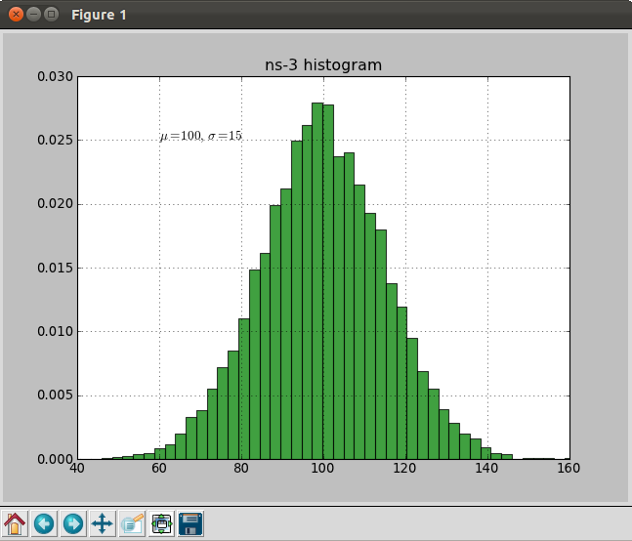
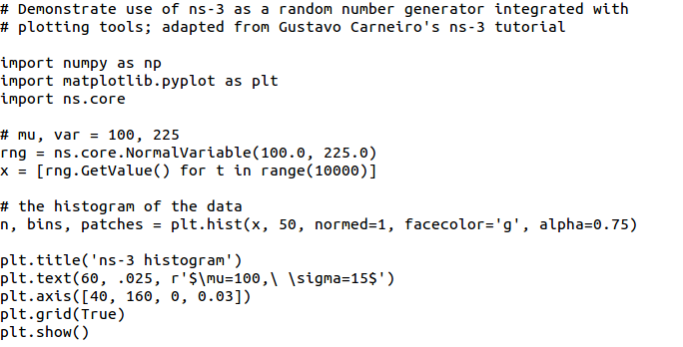
Random Variables
from src/core/examples/sample-rng-plot.py
Currently implemented distributions
Uniform: values uniformly distributed in an interval
Constant: value is always the same (not really random)
Sequential: return a sequential list of predefined values
Exponential: exponential distribution (poisson process)
Normal (gaussian), Log-Normal, Pareto, Weibull, triangular

Slide 23
Random variables and independent replications
Many simulation uses involve running a number of independent replications of the same scenario
In ns-3, this is typically performed by incrementing the simulation run number
not by changing seeds

Slide 24
ns-3 random number generator
Uses the MRG32k3a generator from Pierre L'Ecuyer
http://www.iro.umontreal.ca/~lecuyer/myftp/papers/streams00.pdf
Period of PRNG is 3.1x10^57
Partitions a pseudo-random number generator into uncorrelated streams and substreams
Each RandomVariableStream gets its own stream
This stream partitioned into substreams

Slide 25
Key Terminology
Seed: A set of values that generates an entirely new PRNG sequence
Stream: The PRNG sequence is divided into non-overlapping intervals called streams
Run Number (substream): Each stream is further divided to substreams, indexed by a variable called the run number.

Slide 26
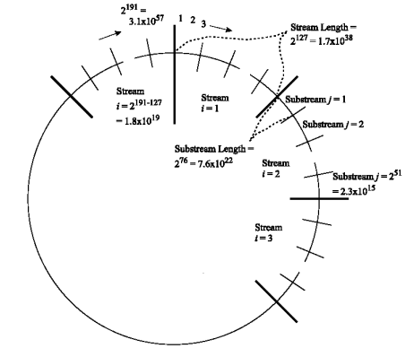
Streams and Substreams
Incrementing the
Run Number will move
all streams to a new
substream
Each ns-3
RandomVariableStream
object is assigned to a
stream (by default,
randomly)
Figure source: Pierre L’Ecuyer, Richard Simard, E. Jack Chen, and W. David Kelton.
An object-oriented random number package with many long streams and substreams. Operations Research, 2001.

Slide 27
Run number vs. seed
If you increment the seed of the PRNG, the streams of random variable objects across different runs are not guaranteed to be uncorrelated
If you fix the seed, but increment the run number, you will get uncorrelated streams

Slide 28
Setting the stream number
The ns-3 implementation provides access to 2^64 streams
2^63 are placed in a pool for automatic assignment, and 2^63 are reserved for fixed assignment
Users may optionally assign a stream number index to a random variable using the SetStream () method.
This allows better control over selected random variables
Many helpers have AssignStreams () methods to do this across many such random variables

Slide 29
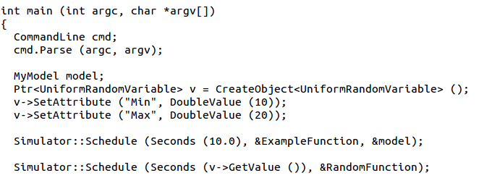
Putting it together
Example of scheduled event
Demo real-time, command-line, random variables...

Slide 30
ns-3 Training: Packets

Slide 31
ns-3 Packet
Packet is an advanced data structure with the following capabilities
Supports fragmentation and reassembly
Supports real or virtual application data
Extensible
Serializable (for emulation)
Supports pretty-printing
Efficient (copy-on-write semantics)

Slide 32
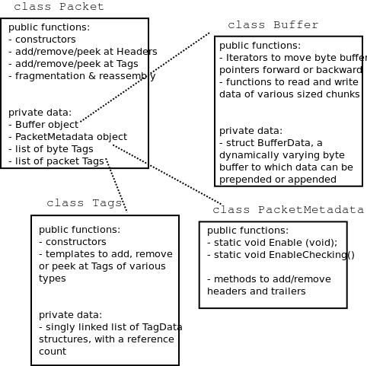
ns-3 Packet structure
Analogous to an mbuf/skbuff

Slide 33
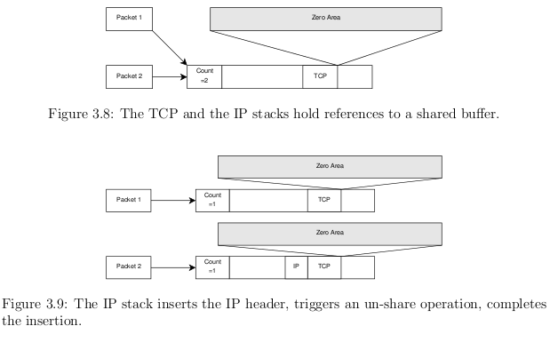
Copy-on-write
Copy data bytes only as needed
Figure source: Mathieu Lacage's Ph.D. thesis

Slide 34
Headers and trailers
Most operations on packet involve adding and removing an ns3::Header
class ns3::Header must implement four methods:
Serialize()
Deserialize()
GetSerializedSize()
Print()

Slide 35
Headers and trailers (cont.)
Headers are serialized into the packet byte buffer with Packet::AddHeader() and removed with Packet::RemoveHeader()
Headers can also be 'Peeked' without removal
Ptr<Packet> pkt = Create<Packet> ();
UdpHeader hdr; // Note: not heap allocated
pkt->AddHeader (hdr);
Ipv4Header iphdr;
pkt->AddHeader (iphdr);

Slide 36
Packet tags
Packet tag objects allow packets to carry around simulator-specific metadata
Such as a "unique ID" for packets or cross-layer info
Tags may associate with byte ranges of data, or with the whole packet
Distinction is important when packets are fragmented and reassembled
Tags presently are not preserved across serialization boundaries (e.g. MPI)

Slide 37
PacketTag vs. ByteTag
Two tag types are available: PacketTag and ByteTag
ByteTags run with bytes
PacketTags run with packets
When Packet is fragmented, both copies of Packet get copies of PacketTags
When two Packets are merged, only the PacketTags of the first are preserved
PacketTags may be removed individually; ByteTags may be removed all at once

Slide 38
Tag example
Here is a simple example illustrating the use of tags from the code in src/internet/model/udp-socket-impl.cc:
Ptr<Packet> p; // pointer to a pre-existing packet
SocketIpTtlTag tag
tag.SetTtl (m_ipMulticastTtl); // Convey the TTL from UDP layer to IP layer
p->AddPacketTag (tag);
This tag is read at the IP layer, then stripped (src/internet/model/ipv4-l3-protocol.cc):
uint8_t ttl = m_defaultTtl;
SocketIpTtlTag tag;
bool found = packet->RemovePacketTag (tag);
if (found)
{
ttl = tag.GetTtl ();
}

Slide 39
Packet metadata
Packets may optionally carry metadata
record every operation on a packet's buffer
implementation of Packet::Print for pretty-printing of the packet
sanity check that when a Header is removed, the Header was actually present to begin with
Not enabled by default, for performance reasons
To enable, insert one or both statements:
Packet::EnablePrinting ();
Packet::EnableChecking ();

Slide 40
Ptr<Packet>
Packets are reference counted objects that support the smart pointer class Ptr
Use a templated "Create" method instead of CreateObject for ns3::Objects
Typical creation:
Ptr<Packet> pkt = Create<Packet> ();
In model code, Packet pointers may be const or non-const; often Packet::Copy() is used to obtain non-const from const
Ptr<const Packet> cpkt = ...;
Ptr<Packet> p = cpkt->Copy ();

Slide 41
ns-3 Training

Slide 42
Example program walkthrough
We will use the program at:
examples/traffic-control/queue-discs-benchmark.cc
$ ./waf --run 'queue-discs-benchmark'

Slide 43
Structure of an ns-3 program
int main (int argc, char *argv[])
{
// Set default attribute values
// Parse command-line arguments
// Configure the topology; nodes, channels, devices, mobility
// Add (Internet) stack to nodes
// Configure IP addressing and routing
// Add and configure applications
// Configure tracing
// Run simulation
// Handle any post-simulation data processing
}

Slide 44
Helper API
The ns-3 “helper API” provides a set of classes and methods that make common operations easier than using the low-level API
Consists of:
container objects
helper classes
The helper API is implemented using the low-level API
Users are encouraged to contribute or propose improvements to the ns-3 helper API

Slide 45
Containers
Containers are part of the ns-3 “helper API”
Containers group similar objects, for convenience
They are often implemented using C++ std containers
Container objects also are intended to provide more basic (typical) API

Slide 46
The Helper API (vs. low-level API)
Is not generic
Does not try to allow code reuse
Provides simple 'syntactical sugar' to make simulation scripts look nicer and easier to read for network researchers
Each function applies a single operation on a ''set of same objects”
A typical operation is "Install()"

Slide 47
Helper Objects
NodeContainer: vector of Ptr<Node>
NetDeviceContainer: vector of Ptr<NetDevice>
InternetStackHelper
WifiHelper
MobilityHelper
OlsrHelper
... Each model provides a helper class

Slide 48
Installation onto containers
Installing models into containers, and handling containers, is a key API theme
NodeContainer c;
c.Create (numNodes);
...
mobility.Install (c);
...
internet.Install (c);
...

Slide 49
Native IP models
IPv4 stack with ARP, ICMP, UDP, and TCP
IPv6 with ND, ICMPv6, IPv6 extension headers, TCP, UDP
IPv4 routing: RIPv2, static, global, NixVector, OLSR, AODV, DSR, DSDV
IPv6 routing: RIPng, static

Slide 50
IP address configuration
An Ipv4 (or Ipv6) address helper can assign addresses to devices in a NetDevice container
Ipv4AddressHelper ipv4;
ipv4.SetBase ("10.1.1.0", "255.255.255.0");
csmaInterfaces = ipv4.Assign (csmaDevices);
...
ipv4.NewNetwork (); // bumps network to 10.1.2.0
otherCsmaInterfaces = ipv4.Assign (otherCsmaDevices);

Slide 51
Applications and sockets
In general, applications in ns-3 derive from the ns3::Application base class
A list of applications is stored in the ns3::Node
Applications are like processes
Applications make use of a sockets-like API
Application::Start () may call ns3::Socket::SendMsg() at a lower layer

Slide 52
Sockets API
Plain C sockets
int sk;
sk = socket(PF_INET, SOCK_DGRAM, 0);
struct sockaddr_in src;
inet_pton(AF_INET,”0.0.0.0”,&src.sin_addr);
src.sin_port = htons(80);
bind(sk, (struct sockaddr *) &src, sizeof(src));
struct sockaddr_in dest;
inet_pton(AF_INET,”10.0.0.1”,&dest.sin_addr);
dest.sin_port = htons(80);
sendto(sk, ”hello”, 6, 0, (struct sockaddr *) &dest, sizeof(dest));
char buf[6];
recv(sk, buf, 6, 0);
}
ns-3 sockets
Ptr<Socket> sk =
udpFactory->CreateSocket ();
sk->Bind (InetSocketAddress (80));
sk->SendTo (InetSocketAddress (Ipv4Address (”10.0.0.1”), 80), Create<Packet> (”hello”, 6));
sk->SetReceiveCallback (MakeCallback (MySocketReceive));
[…] (Simulator::Run ())
void MySocketReceive (Ptr<Socket> sk, Ptr<Packet> packet)
{
...
}

Slide 53
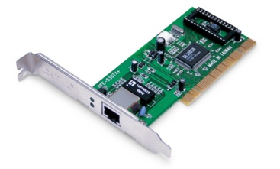
NetDevice trace hooks
Example: CsmaNetDevice
NetDevice::
ReceiveCallback
CsmaNetDevice::Send ()
MacTx
MacRx
MacDrop
queue
Sniffer
PromiscSniffer
MacTxBackoff
PhyTxBegin
PhyRxEnd
PhyRxDrop
PhyTxDrop
PhyTxEnd
CsmaNetDevice::
TransmitStart()
CsmaNetDevice::
Receive()
CsmaChannel

