Slide 1
ns-3 Direct Code Execution (DCE)
ns-3 Annual Meeting
June 2018

Slide 2
Outline
DCE Introduction
Download and Installation of DCE with Bake
DCE examples with custom application:
iperf
ping
Q&A

Slide 3
Credits
DCE originated with Mathieu Lacage (INRIA), was substantially developed by Emilio Mancini and Frederic Urbani (INRIA), and finished off by Hajime Tazaki
DCE leverages the bake build system substantially developed by Daniel Camara (INRIA)
DCE is presently maintained by Hajime Tazaki and Matthieu Coudron.

Slide 4
Goals
Lightweight virtualization of kernel and application processes, interconnected by simulated networks
Benefits:
Implementation realism in controlled topologies or wireless environments
Model availability
Debugging a whole network within a single process
Limitations:
Not as scalable as pure simulation
Tracing more limited
C or C++ applications only

Slide 5
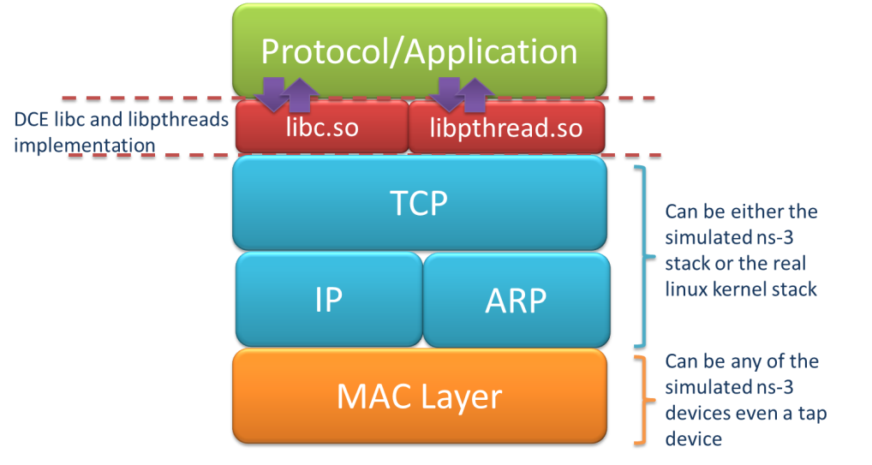
Direct Code Execution
DCE/ns-3 framework requires the virtualization of a series of services
Multiple isolated instances of the same protocol on the same machine
System calls are captured and treated by DCE
Network stack protocols calls are captured and redirected
To perform its work, DCE re-implements the Linux program loader and parts of libc and libpthread

Slide 6
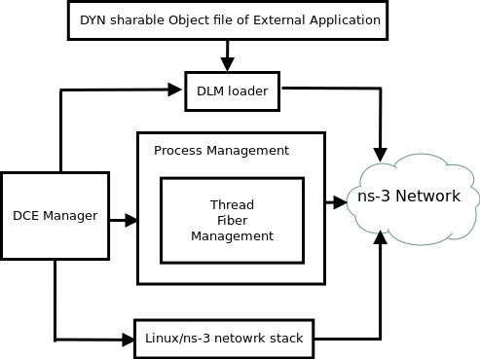
DCE Components

Slide 7
DCE modes
DCE modes in context of possible approaches
Figure source: DCE Cradle: Simulate Network Protocols with Real Stacks for Better Realism, Tazaki et al, WNS3 2013.

Slide 8
References
Direct Code Execution: Revisiting Library OS Architecture for Reproducible Network Experiments
Tazaki et al, CONEXT 2013
http://hal.archives-ouvertes.fr/docs/00/88/08/70/PDF/con013-hal.pdf
DCE Cradle: Simulate Network Protocols with Real Stacks for Better Realism
Tazaki et al, WNS3 2013
http://hal.archives-ouvertes.fr/docs/00/78/15/91/PDF/wns3-2013.pdf
NetDev 1.1 talk (Feb. 2016): "LibOS as a regression test framework for Linux networking"
https://www.youtube.com/watch?v=FNGkMFmboEc

Slide 9
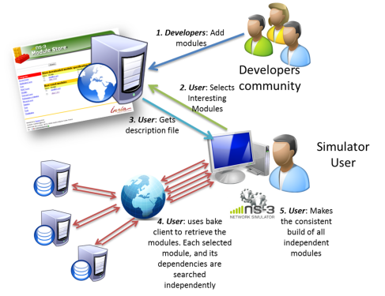
bake overview
Open source Integration tool to simplify the build process by automatically builds the software with required dependencies.
"bake" tool
(Lacage and Camara)
Components:
build client
"module store" server
module metadata
Figure source: Daniel Camara

Slide 10
bake basics
bake can be used to build the Python bindings toolchain, Direct Code Execution, Network Simulation Cradle, etc.
Steps to setup DCE and using Bake
export BAKE_HOME=`pwd`/bake // Set environment variables export PATH=$PATH:$BAKE_HOME // to locate bake export PYTHONPATH=$PYTHONPATH:$BAKE_HOME
./bake.py configure -e <module>
./bake.py check // bake tool dependency
./bake.py show // <module> related dependency
./bake.py download // Download <module> specific source
./bake.py build // Build the source code

Slide 11
Placeholder slide for demoing bake
Demo: bake.py configure -e ns-allinone-3.25
Look at: build/ libraries and executables
Manual available at: https://www.nsnam.org/docs/bake/tutorial/html/index.html

Slide 12
bakeconf example
<module name="ns-allinone-3.28">
<source type="none"/>
<depends_on name="netanim-3.108" optional="True"/>
<depends_on name="nsc-0.5.3" optional="True"/>
<depends_on name="pybindgen-ns3.27-castxml" optional="True"/>
<depends_on name="pyviz-prerequisites" optional="True"/>
<depends_on name="click-ns-3.25" optional="True"/>
<depends_on name="openflow-ns-3.25" optional="True"/>
<depends_on name="pygccxml-1.9.1" optional="True"/>
<depends_on name="BRITE" optional="True"/>
<depends_on name="ns-3.28" optional="False"/>
<build type="none"/>
</module>

Slide 13
Iperf example in DCE
ns-3-dce/example/dce-iperf.cc
iperf: it is a widely used tool for network performance measurement and tuning.
[text source: Wikipedia]
iper f client
iper f server
Node 0
5Mbps
Node 1
10.1.1.1
10.1.1.2
1 ms

Slide 14
Step by step example - What we need to do!
Create the nodes
Create stack
Create devices
Set addresses
Connect devices
Create DCE
Configuration the applications to run
Set start time for server and client
Set simulation time
Start simulation

Slide 15
Step by step example - What we need to do!
Create the nodes
Create stack
Create devices
Set addresses
Connect devices
Create DCE
Configuration the applications to run
Set start time for server and client
Set simulation time
Start simulation
Standard ns-3 procedures
DCE specific

Slide 16
Application configuration in DCE
DceApplicationHelper dce;
dce.SetStackSize (1 << 20); // 1MB, default: 8kB
dce.SetBinary ("application");
dce.ResetArguments ();
dce.ResetEnvironment ();
dce.AddArgument ("first");
dce.AddArguments ("second");
dce.AddArguments ("third");
dce.Install (nodes.Get (0));
Sample Command: application first second third

Slide 17
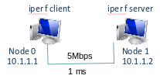
Step by step example iperf
int main (int argc, char *argv[])
{
// Select network stack
std::string stack = "ns3";
// Node Container creation
NodeContainer nodes;
nodes.Create (2);
// Device and channel creation
PointToPointHelper pointToPoint;
NetDeviceContainer devices;

Slide 18
Step by step example iperf
// Select Stack type
if (stack == “ns3”) {
InternetStackHelper stack;
stack.Install (nodes);
dceManager.Install (nodes);
} else if (stack == “linux”) {
dceManager.SetNetworkStack (
“ns3::LinuxSocketFdFactory ”, “Library”,
StringValue (“liblinux.so”));
dceManager.Install (nodes);
LinuxStackHelper stack;
stack.Install (nodes);
} else if (stack == “freebsd”) {
...
}

Slide 19
Step by step example iperf
// Node0-Node1 setup
Ipv4AddressHelper address;
// Node0-Node1 addresses
address.SetBase ("10.1.1.0", "255.255.255.252");
NetDeviceContainer devices;
// connecting nodes
devices = p2p.Install (nodes.Get (0), nodes.Get (1));
// assign addresses
Ipv4InterfaceContainer interfaces = address.Assign (devices);
// setup ip routes
Ipv4GlobalRoutingHelper::PopulateRoutingTables ();
if (stack == "linux")
{
LinuxStackHelper::PopulateRoutingTables ();
}

Slide 20
Step by step example iperf
DceManagerHelper dceManager;
dceManager.Install (nodes);
DceApplicationHelper dce;
ApplicationContainer apps;
dce.SetStackSize (1 << 20); // 1MB stack
dce.SetBinary ("iperf"); // Launch iperf client on node 0
dce.ResetArguments (); // clean arguments
dce.ResetEnvironment (); // clean environnent
dce.AddArgument ("-c"); // client
dce.AddArgument ("10.1.2.2"); //target machine address
dce.AddArgument ("-i"); // interval
dce.AddArgument ("1");
dce.AddArgument ("--time"); // how long
dce.AddArgument ("10");
apps = dce.Install (nodes.Get (0)); //install application
apps.Start (Seconds (0.7)); //start at 0.7 simulation time
apps.Stop (Seconds (20)); //stop at 20s simulation time
dce.SetBinary ("iperf"); // Launch iperf server on node 2
dce.ResetArguments (); // clean arguments
dce.ResetEnvironment (); // clean environnent
dce.AddArgument ("-s"); // server
dce.AddArgument ("-P"); // number of paralell servers
dce.AddArgument ("1");
apps = dce.Install (nodes.Get (2));
apps = dce.Install (nodes.Get (2));
apps.Start (Seconds (0.6));
DCE Setup

Slide 21
Step by step example iperf
// Simulation stop time
Simulator::Stop (Seconds (40.0));
// Run
Simulator::Run ();
// Stop
Simulator::Destroy ();
return 0;
}

Slide 22
With/without linux kernel
ns-3 stack
-./waf --run "dce-iperf --stack=ns3"
Linux stack
./waf --run "dce-iperf --stack=linux"
More options
- ./waf --run "dce-iperf --PrintHelp"

Slide 23
Step by step example – iperf, ns-3
Generated
elf-cache – program files
exitprocs – execution process information
files-0 files-1 – execution filesystem
files-x
files-x corresponds to “/” of the machine x
files-x/var/log/<pid>/
cmdline – command executed
status – execution information
stderr – standard error output
stdout – standard output
syslog – syslog output

Slide 24
Build Custom Application for DCE: Ping
Collect the source code and untar:
wget http://www.skbuff.net/iputils/iputils-s20101006.tar.bz2
tar xvjf iputils-s20101006.tar.bz2
Add extra LDFLAGS in Makefile
LDFLAGS+=-pie -rdynamic
Build ping application
make CFLAGS=-fPIC ping
Check binary is read to execute in DCE
readelf -h ping

Slide 25
Header Section of Ping binary
Magic: 7f 45 4c 46 02 01 01 00 00 00 00 00 00 00 00 00
Class: ELF64
Data: 2's complement, little endian
Version: 1 (current)
OS/ABI: UNIX - System V
ABI Version: 0
Type: DYN (Shared object file)
Machine: Advanced Micro Devices X86-64
Version: 0x1

Slide 26
Running Ping Example
Ping example: ns-3-dce/myscripts/ping/dce-ping.cc
./waf --run dce-ping
Need to update DCE_PATH to external application
assert failed. cond="exeFullPath.length () > 0", msg="Executable 'ping'
not found ! Please check your DCE_PATH and DCE_ROOT
environment variables.", file=../model/dce-manager.cc, line=262
Fix the DCE_PATH
export DCE_PATH=$DCE_PATH:/path/to/ping

Slide 27
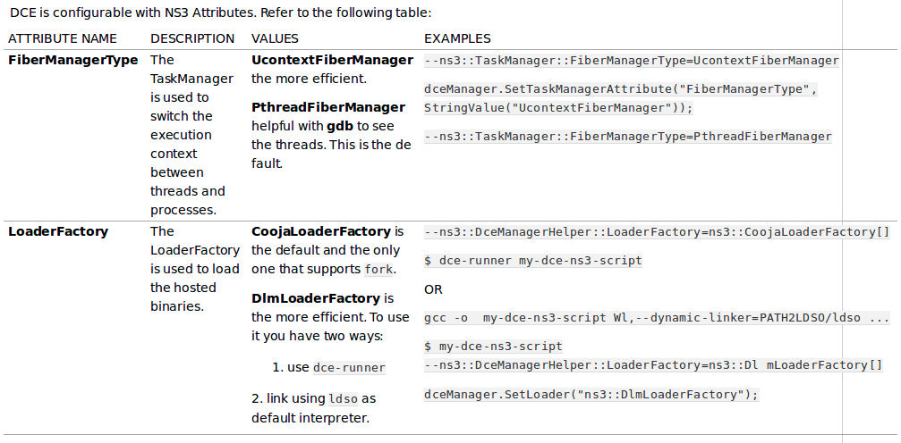
Tuning DCE

Slide 28
Practical issues
All software must be re-compiled with –fpic and linked with –pie to generate the code as Position Independent Code (PIC)
Executables need to be installed to a place where DCE can find it
Applications may require system dependencies
Requires coverage of selected POSIX calls
Execution must be managed (e.g. start/stop time)
How much stack size to allocate to programs?
Programs generate output (stdout, stderr, files)

Slide 29
Advantages of DCE
Simulation with Linux network stack.
Allow userspace applications to run inside ns-3.
Debug posix based applications in single address space.

Slide 30
Future Work
Support for latest linux kernel using Linux Kernel Library (LKL).

