Slide 1
ns-3 Training
ns-3 Annual Meeting
June 2018

Slide 2
ns-3 training goals
Make attendees more productive with ns-3
  Learn about the project scope, and where to get additional help
  Understand the architecture and design goals of the software
  Introduce how to write new code for the simulator
  Learn about selected topics in more detail
  Answer your questions

Slide 3
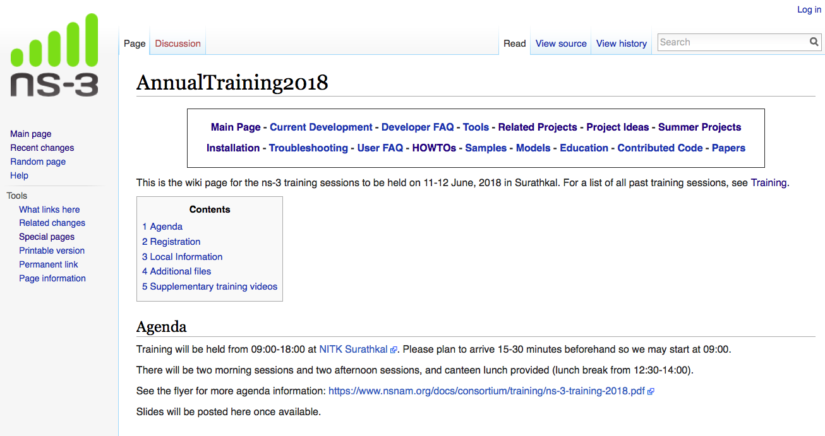
ns-3 training wiki page
https://www.nsnam.org/wiki/AnnualTraining2018

Slide 4
Agenda and Instructors
Monday: ns-3 overview (T. Henderson)
  project overview
  software overview
  simulator introduction via sample workflows
Tuesday AM: traffic control (M. Tahiliani)
Tuesday AM: ns-3 advanced modes: DCE, MPI, emulation (S. Jain and T. Henderson)
Tuesday PM: Wi-Fi (S. Deronne)
Tuesday PM: LTE (N. Patriciello)

Slide 5
Project overview

Slide 6
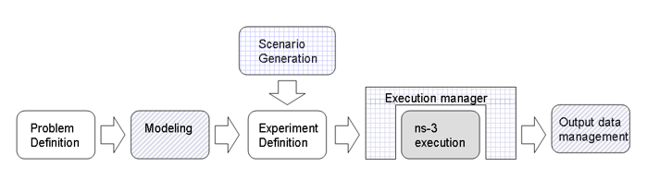
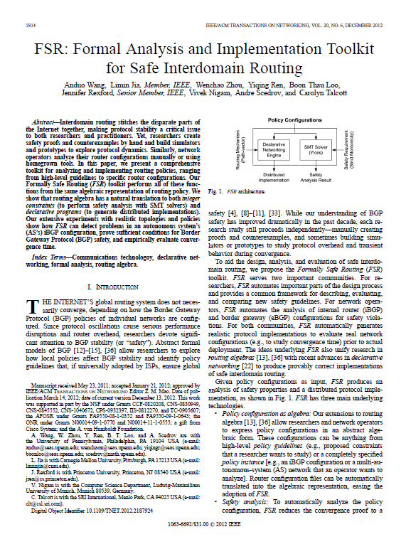
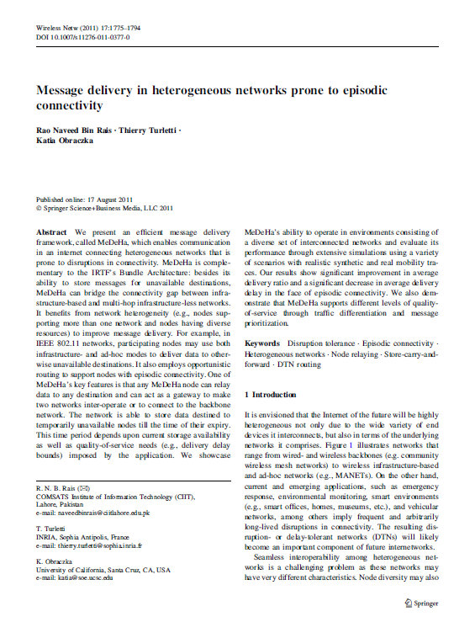
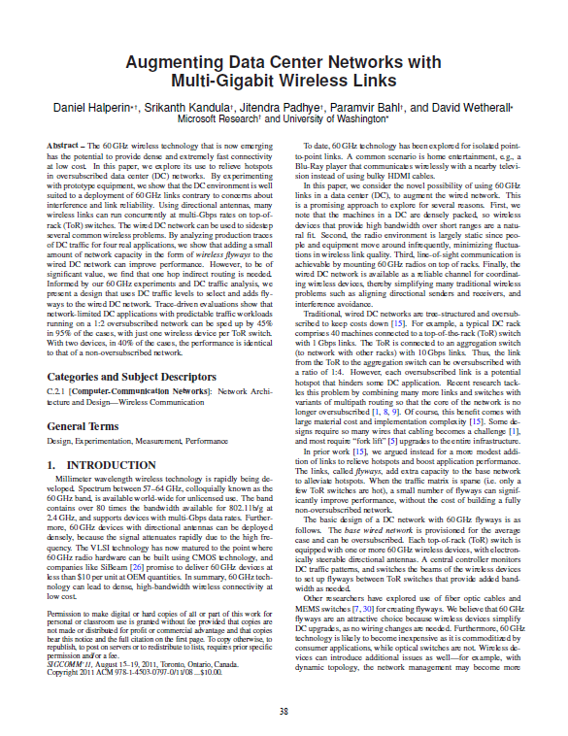
ns-3 in a nutshell
Purpose: Tool for network performance analysis
Users: Researchers and academia
Development model: Open source, community maintained

Slide 7
ns timeline
1990
2000
2010
1988: REAL (Keshav)
regular
releases
1990s: ns-1
1996: ns-2
1997-2000: DARPA VINT
2001-04: DARPA SAMAN, NSF CONSER
2006: NSF CISE CRI Awards
Inputs: yans,
GTNetS, ns-2
ns-3 core development (2006-08)
June 2008: ns-3.1
June 2018: ns-3.29

Slide 8
ns-3 discrete-event simulation basics
Simulation time moves in discrete jumps from event to event
C++ functions schedule events to occur at specific simulation times
A simulation scheduler orders the event execution
Simulation::Run() executes a single-threaded event list
Simulation stops at specific time or when events end
Execute a function
(may generate additional events)
Virtual time
Advance the virtual time
to the next event (function)

Slide 9
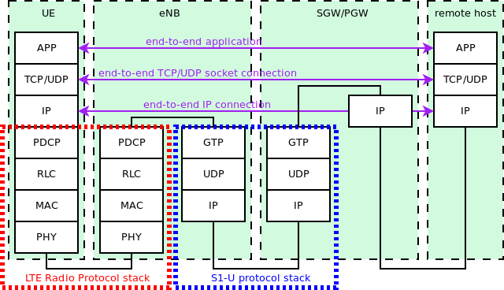
Packet level simulation overview
More
abstraction
Less
abstraction
More
abstraction

Slide 10
Network performance evaluation options
ns-3 enables researchers to more easily move between simulations, test beds, and experiments
Direct Code
Execution
Emulation
modes
ns-3 core
Test and evaluation options
Pure
simulation
Simulation
cradles
Virtual/Physical
test beds
Field
experiments
Live
networks
Increasing realism
Increasing complexity

Slide 11
ns-3 overview
ns-3 is a leading open source, packet-level network simulator oriented towards network research, featuring a high-performance core enabling parallelization across a cluster (for large scenarios), ability to run real code, and interaction with testbeds

Slide 12
Software overview

Slide 13
Software overview
ns-3 is written in C++, with bindings available for Python
  simulation programs are C++ executables or Python programs
  ~350,000 lines of C++ (cloc estimate)
  almost exclusively C++98, beginning to use C++11
ns-3 is a GNU GPLv2-licensed project
ns-3 is mainly supported for Linux, OS X, and FreeBSD
  Windows Visual Studio port in progress
ns-3 is not backwards-compatible with ns-2

Slide 14
The basic ns-3 architecture
Application
Application
Application
Application
Sockets-like
API
Protocol
stack
Protocol
stack
Packet(s)‏
Node
Node
NetDevice
NetDevice
NetDevice
Channel
NetDevice
Channel

Slide 15
Software orientation
Key differences from other network simulators:
1) Command-line, Unix orientation
  vs. Integrated Development Environment (IDE)
2) Simulations and models written directly in C++ and Python
  vs. a domain-specific simulation language

Slide 16
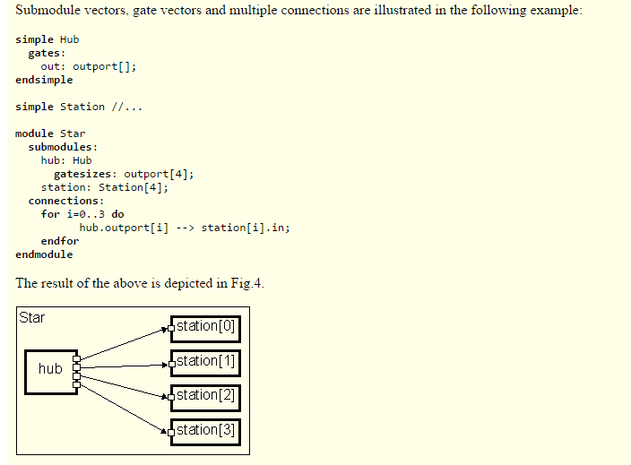
ns-3 not written in a high-level language
Example of OMNeT++ Network Description (NED) language
Figure excerpted from http://www.ewh.ieee.org/soc/es/Nov1999/18/ned.htm

Slide 17
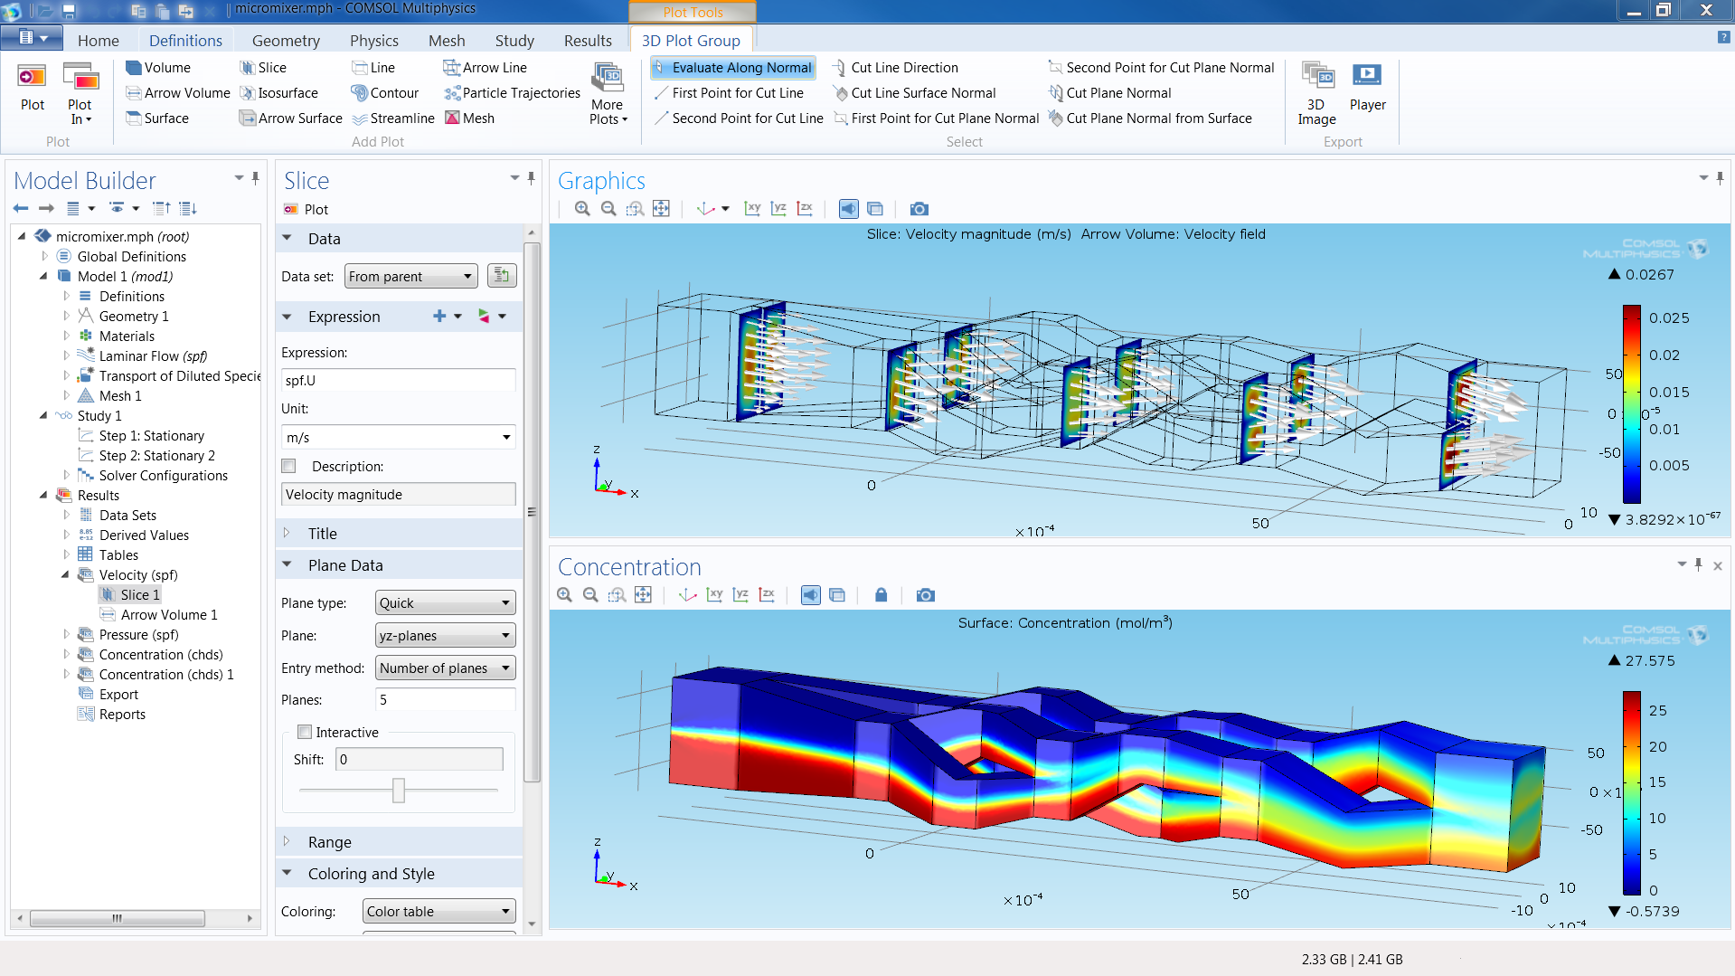
ns-3 does not have a graphical IDE
Figure source: https://www.comsol.com/comsol-multiphysics

Slide 18
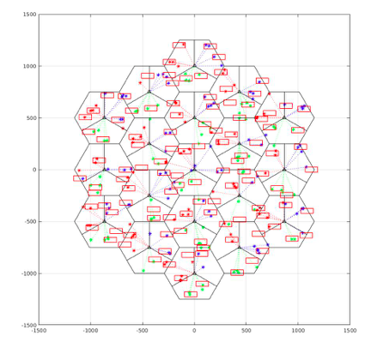
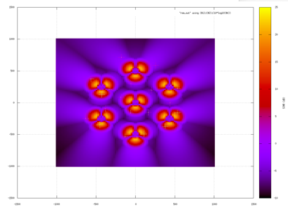
ns-3 uses outside programs for graphics
Network cell structure showing eNBs,
UEs, and buildings
Radio environment map showing
signal strength from eNBs
Matplotlib
gnuplot

Slide 19
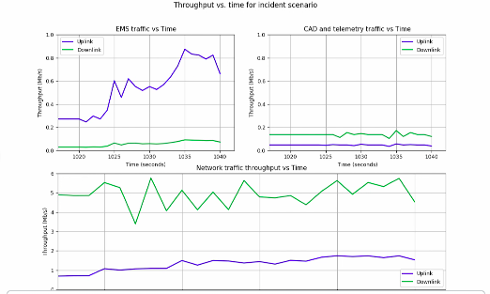
ns-3 uses scripting for plotting
Raw trace data generated by ns-3
EmsVideo_1_Server 942.36392953 RX 1012 1061 U 2395
EmsVideo_1_Client 942.37317727 TX 1012 1061 U 2398
EmsVideo_1_Client 942.377 RX 64 113 U 2397
WebBrowsingGraphics_0_Server 942.38092876 TX 1024 1073 U 2399
WebBrowsingGraphics_0_Client 942.394 RX 1024 1073 U 2399
AvlAssetPerimeter_1_Server 942.42492988 RX 1408 1457 U 2401
Used to measure KPIs
Animated

Slide 20
Software organization
Two levels of ns-3 software and libraries
1) Several supporting libraries, not system-installed, can be in parallel to ns-3
Netanim
pybindgen
Click routing
ns-3
2) ns-3 modules exist
within the ns-3 directory
module
module
module
module
module
module

Slide 21
Modules
utilities
devices
protocols
visualizer
bridge
mesh
config-
store
applications
internet-apps
aodv
Node class
NetDevice ABC
Address types
(Ipv4, MAC, etc.)
Queues
Socket ABC
Ipv4 ABCs
Packet sockets
csma
spectrum
internet
(IPv4/v6)
dsdv
flow-monitor
energy
emu
Packets
Packet Tags
Packet Headers
Pcap/ascii file writing
tap-bridge
traffic-control
olsr
netanim
mpi
point-to-
point
uan
click
stats
Smart pointers
Dynamic types
Attributes
Callbacks
Tracing
Logging
Random Variables
mobility
virtual-
net-device
network
nix-vector-
routing
topology-
read
lte
Events
Scheduler
Time arithmetic
propagation
lr-wpan
wifi
core
openflow
BRITE
wimax
21

Slide 22
Module organization
models/
examples/
tests/
bindings/
doc/
wscript

Slide 23
ns-3 programs
ns-3 programs are C++ executables that link the needed shared libraries
  or Python programs that import the needed modules
The ns-3 build tool, called 'waf', can be used to run programs
waf will place headers, object files, libraries, and executables in a 'build' directory

Slide 24
Python bindings
ns-3 uses a program called PyBindGen to generate Python bindings for all libraries
v
v
v
v
C++
header
Intermediate
Python
program
C++
bindings
code
Python
module
(py)gccxml
PyBindGen
C++ compiler

Slide 25
Python bindings status
API scanning for Python used to use a tool called gccxml
ns-3 has moved to the successor, CastXML
  requires a development installation of clang
Automated testing currently only for Linux 64-bit systems
  MacOS bindings require some manual changes

Slide 26
Integrating other tools and libraries

Slide 27
Other libraries
more sophisticated scenarios and models typically leverage other libraries
ns-3 main distribution uses optional libraries (libxml2, gsl, mysql) but care is taken to avoid strict build dependencies
the 'bake' tool (described later) helps to manage library dependencies
users are free to write their own Makefiles or wscripts to do something special

Slide 28
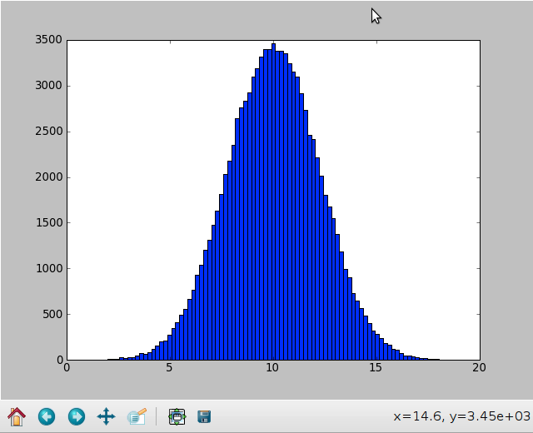
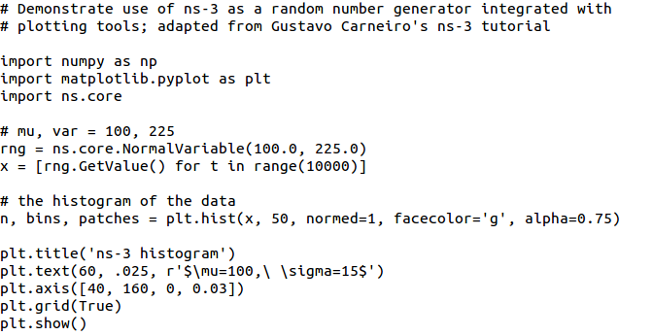
Matplotlib
src/core/examples/sample-rng-plot.py

Slide 29
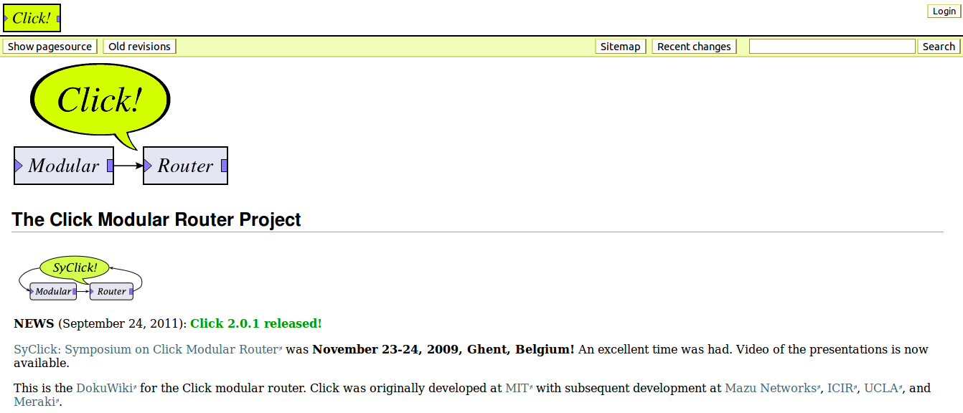
Click Modular Router

Slide 30
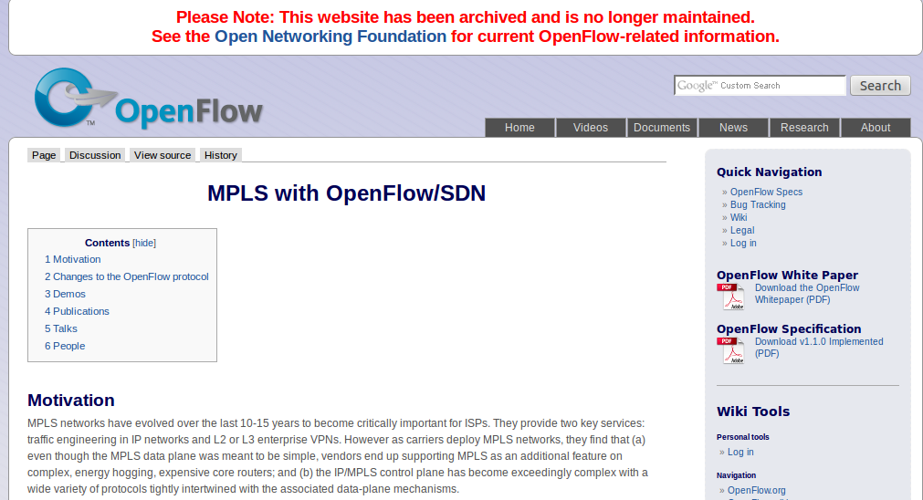
OpenFlow Switch

Slide 31
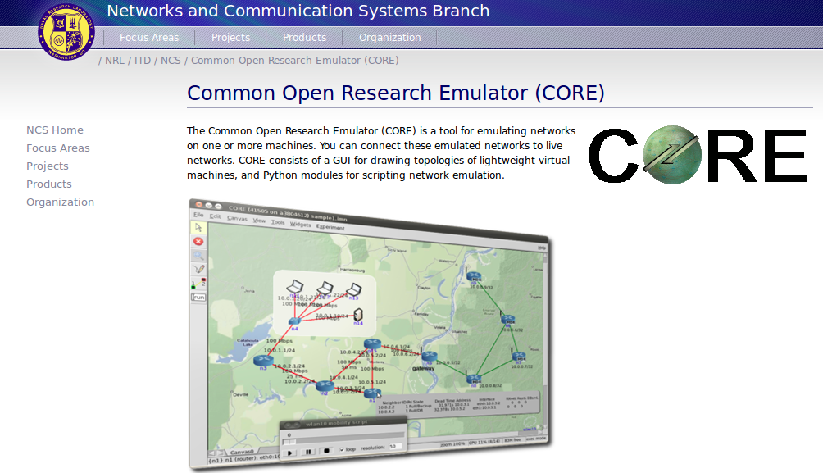
CORE emulator

Slide 32
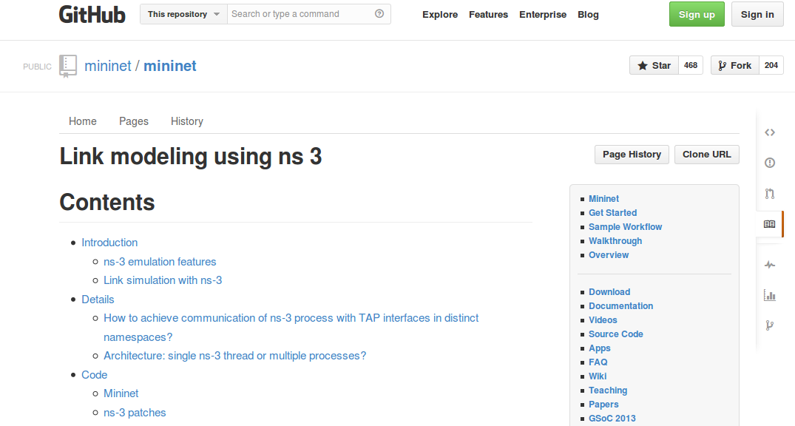
mininet emulator

Slide 33
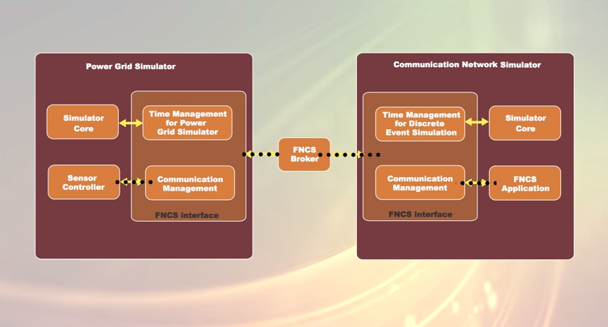
Co-simulation frameworks have emerged
PNNL's FNCS framework integrates ns-3 with transmission and distribution simulators
Image source: PNNLgov YouTube video:
Introducing FNCS: Framework for Network Co-Simulation

Slide 34
FAQs
Does ns-3 have a Windows version?
  A new Windows Visual Studio release is underway
  Windows 10 ’Linux subsystem’ also worksDoes ns-3 support Eclipse or other IDEs?
  Instructions have been contributed by users
  http://www.nsnam.org/wiki/HOWTO_configure_Eclipse_with_ns-3
Is ns-3 provided in Linux or OS X package systems (e.g. Debian packages)?
  Not officially, but some package maintainers exist

Slide 35
Summarizing
ns-3 models are written in C++ and compiled into libraries
  Python bindings are optionally created
ns-3 programs are C++ executables or Python programs that call the ns-3 public API and can call other libraries
ns-3 is oriented towards the command-line
ns-3 uses no domain specific language
ns-3 is not compatible with ns-2

Slide 36
Project overview

Slide 37
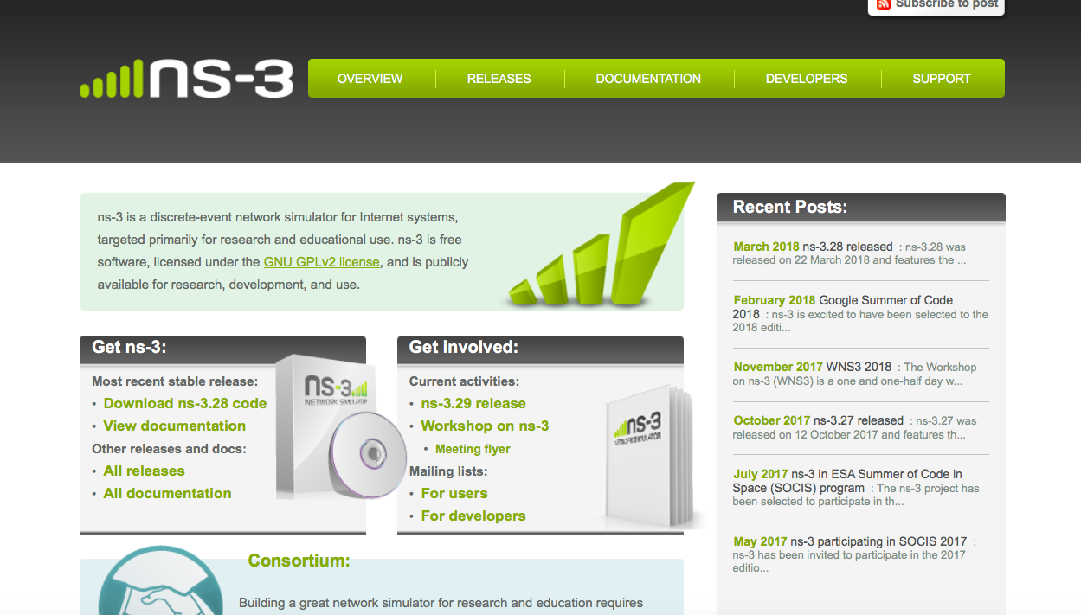
ns-3 main website
Project home: https://www.nsnam.org

Slide 38
How the project operates
Project provides three annual software releases
Users interact on mailing lists and using Bugzilla bug tracker
Code may be proposed for merge
  Code reviews occur on a Google site
Maintainers (one for each module) fix or delegate bugs, participate in reviews
Project has been conducting annual workshop and developer meeting around SIMUTools through 2013
  Some additional meetings on ad hoc basis
Summer projects (Google Summer of Code, ESA Summer of Code in Space, others...)

Slide 39
Maintainers, Authors, Users
~10-15 maintainers at any given time
228 authors credited in AUTHORS file
Over 8000 subscribers to ns-3-users Google Groups forum
Over 1500 subscribers to ns-developers mailing list
Various project forks exist (on Github and elsewhere)

Slide 40
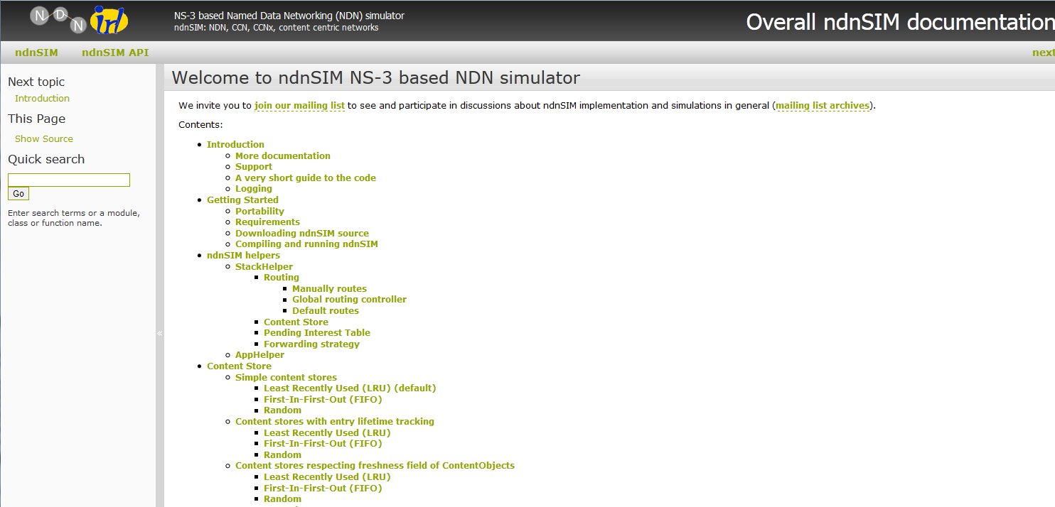
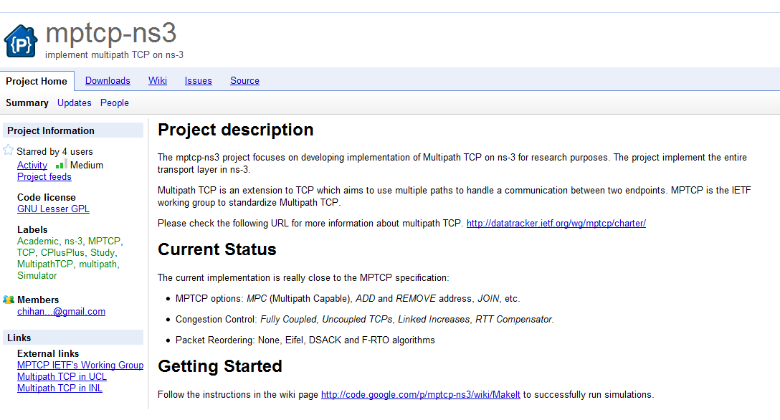
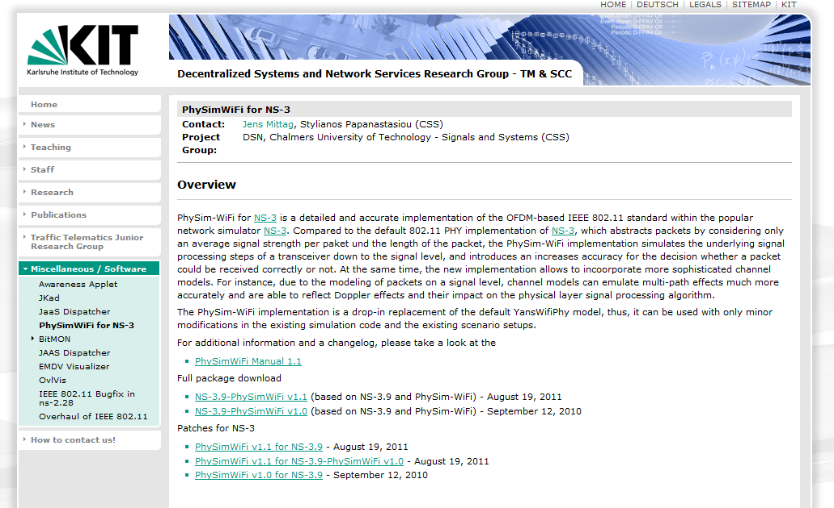
Contributed code and associated projects

Slide 41
Migrating to an ns-3 app store
Developed by: Abhijith Anilkumar, National Institute of Technology Karnataka, India.
Goal: Support modularization of ns-3 codebase.
Beta site: https://apps.nsnam.org
Sim4Net Workshop, Dec. 2018
41

Slide 42
Sustainment
The NS-3 Consortium is a collection of organizations cooperating to support and develop the ns-3 software.
It operates in support of the open source project
  by providing a point of contact between industrial members and ns-3 developers,
  by sponsoring events in support of ns-3 such as users' days and workshops,
  by guaranteeing maintenance support for ns-3's core, and
  by supporting administrative activities necessary to conduct a large open source project.

Slide 43
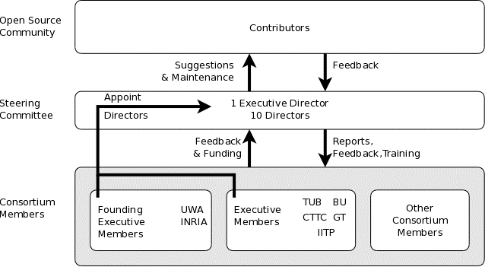
ns-3 Consortium governance
INESC

Slide 44











Acknowledgment of support

