Slide 1
ns-3 training
Tom Henderson
ns-3 annual meeting 2019
June 17-21, Florence, Italy

Slide 2
Agenda and Instructors
Monday: ns-3 overview (Tom Henderson)
  software overview
  sample program and experiments (M/M/1 queue)
Tuesday AM: TCP (Tom Henderson)
Tuesday AM: Wi-Fi (Sebastien Deronne)
Tuesday PM: LTE (Zoraze Ali)
Tuesday PM: sensor networks (Tommaso Pecorella and Davide Magrin)
Wiki: https://www.nsnam.org/wiki/AnnualTraining2019

Slide 3
Working with training code
See the wiki page for instructions on how to get and update the code used in this training
https://www.nsnam.org/wiki/AnnualTraining2019

Slide 4
What is ns-3?
Software to build models of computer networks, to conduct performance evaluation studies
Question: Can LTE safely co-exist with Wi-Fi?

Slide 5
Network Performance Analysis Fundamentals
Studies are conducted to try to answer questions
“Can LTE safely co-exist with Wi-Fi?”
  Question is too broad; need to sharpen its focus
Guideline 1: Clearly state the goals of the study and define the scope
Guideline 2: Select performance metrics
Refined question: ”Can a specific unlicensed variant of LTE (LAA) operate in the same spectrum as a Wi-Fi network, without impacting Wi-Fi system throughput and latency more than another co-located Wi-Fi network would impact it?”

Slide 6
Network Performance Analysis Fundamentals (cont.)
What do you mean by “throughput” and “latency”?
  How measured? (precise definition)
  What statistics? (average throughput, 99%th percentile, worst-case, etc.)?
Guideline 3: Select system and experimental parameters

Slide 7
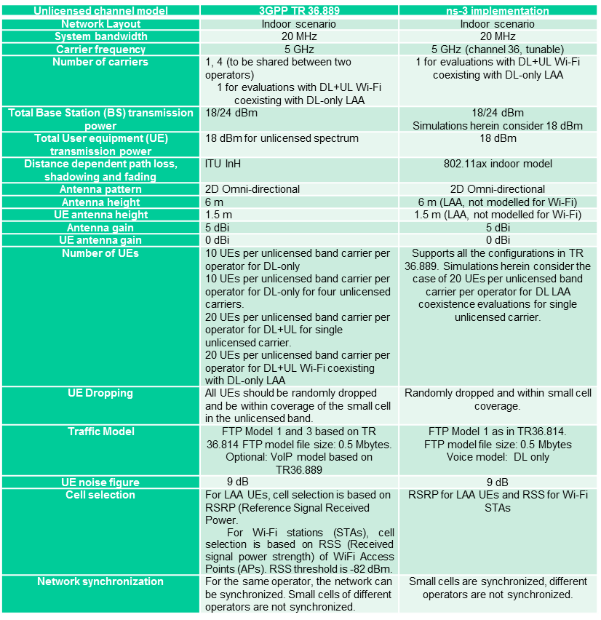
Network Performance Analysis Fundamentals (cont.)
Figure from: http://arxiv.org/abs/1604.06826

Slide 8
Network Performance Analysis Fundamentals (cont.)
Guideline 4: Design experiments
  Select evaluation techniques
  Select factors and their values
Example: Place two Wi-Fi networks in same region, fully load the system, and plot a CDF of observed throughputs per station. Repeat by replacing one Wi-Fi network with LAA.

Slide 9
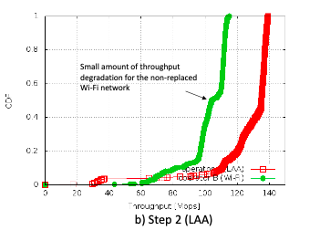
Aside: What is a ‘CDF’?
A cumulative distribution function measures the probability that samples fall below a specified value: For random variable X, F(x) = P(X <= x)
Why interesting?
  Many networked systems are designed with concerns about worst-case behavior
  A CDF provides a sense of the spread of the data samples
Wi-Fi throughput
measurements
LAA throughput
measurements
40 % of Wi-Fi
throughputs
are below 80 Mb/s

Slide 10
Network Performance Analysis Fundamentals (cont.)
Guideline 5: Analyze and interpret data, and iterate
  Almost never a one-shot process
  Often need to dig deeper into model or scenario, to mine it for fine-grained detail
Guideline 6: Make your results easy to reproduce
  For others, and by yourself (at a later date)

Slide 11
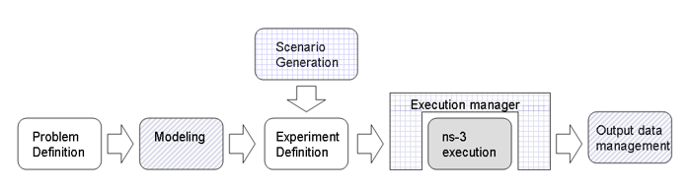
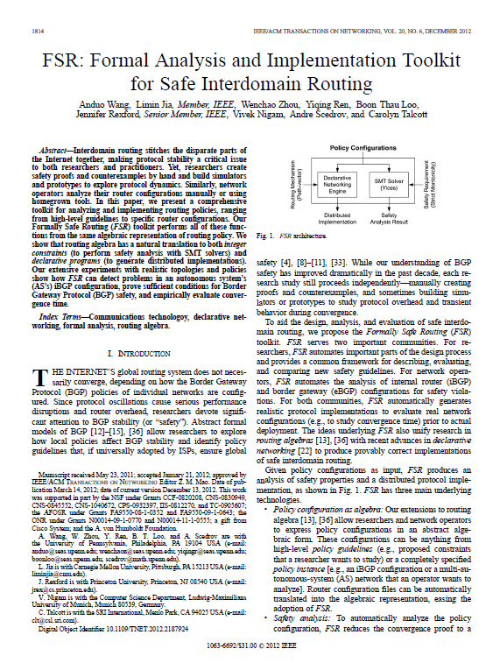
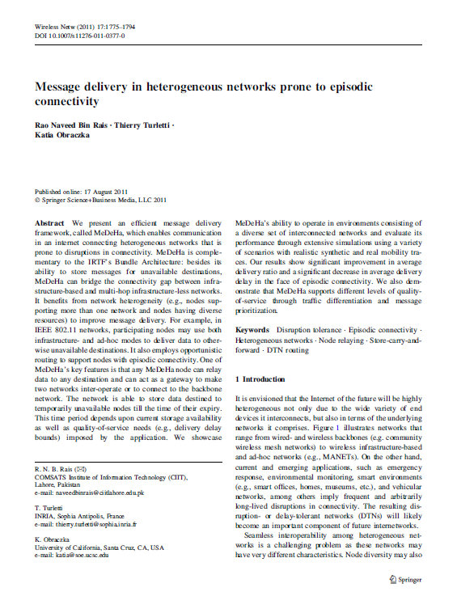
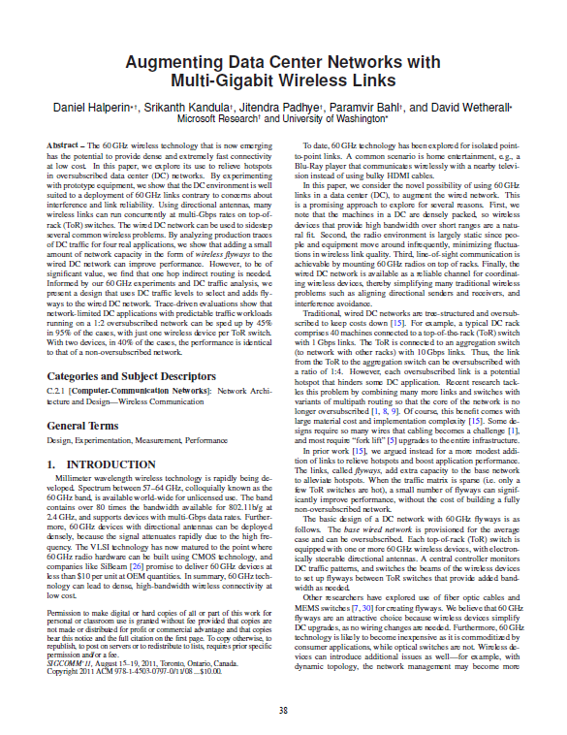
What is ns-3?
We have just hinted at a workflow:

Slide 12
Performance evaluation alternatives
Mathematical analysis
Numerical computing packages (e.g., MATLAB)
Packet-level simulators
System-level simulators
Testbeds, prototypes
Field trials

Slide 13
What is ns-3? (cont.)
ns-3 also has modes of operation that allows it to interact with real-world software and networks
Direct Code
Execution
Emulation
modes
ns-3 core
Test and evaluation options
Spread-
sheets
Pure
simulation
Simulation
cradles
Virtual/Physical
test beds
Field
experiments
Live
networks
Increasing realism
Increasing complexity

Slide 14
What is ns-3? (cont.)
ns-3 is a leading open source, packet-level network simulator oriented towards network research, featuring a high-performance core enabling parallelization across a cluster (for large scenarios), ability to run real code, and interaction with testbeds

Slide 15
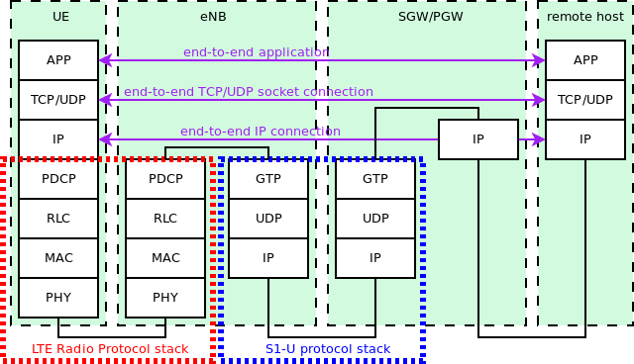
What is ns-3? (cont.)
Packet-level network simulation: The main unit of modeling is the packet and entities that exchange packets.
More
abstraction
Less
abstraction
More
abstraction

Slide 16
ns-3 from the ground up
ns-3 is written in C++
  most code conforms to C++98 standard (starting to use C++11), and makes use of the STL (standard template library)
  ns-3 makes use of a collection of C++ design patterns and enhancements with applicability to network simulation
  ns-3 experiments can be written in Python (more on that later)
ns-3 programs make use of standard C++, ns-3 libraries written in C++, and (optionally) third-party C++ libraries
ns-3’s build system requires a working Python (soon to require Python 3)
Various other tools can be used to handle output data
  We’ll focus on Python matplotlib and Gnuplot

Slide 17
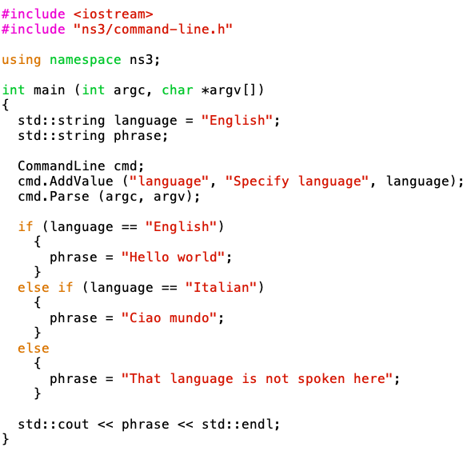
Example ns-3 program
Located in scratch/ns3-hello-world.cc
This is basic C++, except:
we are using methods
defined in an ‘ns3’
namespace
2) The object ‘cmd’ is an instance of the CommandLine C++ class.
CommandLine exists in C++ namespace ‘ns3’.
CommandLine objects process command-line arguments.

Slide 18
ns-3 from the top down
Rather than (just) CommandLine objects, ns-3 combines objects like ‘Packets’, ‘Nodes’, ‘Applications’, etc.
Application
Application
Application
Application
Sockets-like
API
Protocol
stack
Protocol
stack
Packet(s)‏
Node
Node
NetDevice
NetDevice
NetDevice
Channel
NetDevice
Channel

Slide 19
Discrete-event simulation basics
We are trying to represent the operation of a network within a single C++ program
We need a notion of virtual time and of events that occur at specified (virtual) times
We need a data structure (scheduler) to hold all of these events in temporal order
We need an object (simulator) to walk the list of events and execute them at the correct virtual time
We can choose to ignore things that conceptually might occur between our events of interest, focusing only on the (discrete) times with interesting events

Slide 20
Discrete-event simulation basics (cont.)
Simulation time moves in discrete jumps from event to event
C++ functions schedule events to occur at specific simulation times
A simulation scheduler orders the event execution
Simulation::Run() executes a single-threaded event list
Simulation stops at specified time or when events end
Execute a function
(may generate additional events)
Virtual time
Advance the virtual time
to the next event (function)

Slide 21
ns-3 simulation basics and terminology
A simulation ‘run’ or ‘replication’ usually consists of the following workflow
  Before the notional ‘time 0’, create the scenario objects and pre-populate the scheduler with some initial events
  Define stopping criteria; either a specific future virtual time, or when certain criteria are met
  Start the simulation (which initializes objects, at ‘time 0’)
Before time 0,
create and configure
objects, and insert
some events into
the schedule
Execute a function
(may generate additional events)
Virtual time
Advance the virtual time
to the next event (function)
Time 0
Stop at time 60

Slide 22
Virtual time in ns-3
Time is stored as a large integer in ns-3
  Minimize floating point discrepancies across platforms
Special Time classes are provided to manipulate time (such as standard operators)
Default time resolution is nanoseconds, but can be set to other resolutions
  Note: Changing resolution is not well used/tested
Time objects can be set by floating-point values and can export floating-point values
  double timeDouble = t.GetSeconds();
  Best practice is to avoid floating point conversions where possible and use Time arithmetic operators

Slide 23
Key building blocks: Callback and function pointer
C++ methods are often invoked directly on objects
Unlike CommandLine.AddValue(),
we more generally need to
call functions at some
future (virtual) time.
Some program element
could assign a function
pointer, and a (later)
program statement could call
(execute) the method

Slide 24
Events in ns-3
Events are just functions (callbacks) that execute at a simulated time
  nothing is special about functions or class methods that can be used as events
Events have IDs to allow them to be cancelled or to test their status

Slide 25
Simulator and Scheduler
The Simulator class holds a scheduler, and provides the API to schedule events, start, stop, and cleanup memory
Several scheduler data structures (calendar, heap, list, map) are possible
"Realtime" simulation implementation aligns the simulation time to wall-clock time
  two policies (hard and soft limit) available when the simulation and real time diverge

Slide 26
Simulator core
Simulation time (✓)
Events (✓)
Simulator and Scheduler (✓)
Command line arguments
Random variables
Example program walkthrough
Execute a function
(may generate additional events)
Virtual time
Advance the virtual time
to the next event (function)

Slide 27

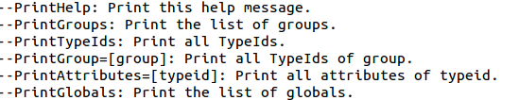
CommandLine arguments
Add CommandLine to your program if you want command-line argument parsing
Passing --PrintHelp to programs will display command line options, if CommandLine is enabled
./waf --run ”ns3-hello-world --PrintHelp"

Slide 28
Random Variables and Run Number
Many ns-3 objects use random variables to model random behavior of a model, or to force randomness in a protocol
  e.g. random placement of nodes in a topology
Many simulation uses involve running a number of independent replications of the same scenario, by changing the random variable streams in use
  In ns-3, this is typically performed by incrementing the simulation run number

Slide 29
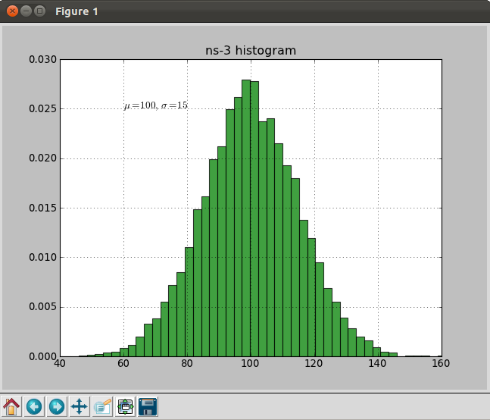
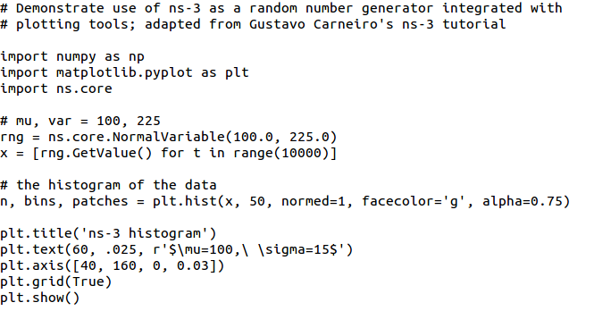
Random Variables
Currently implemented distributions
  Uniform: values uniformly distributed in an interval
  Constant: value is always the same (not really random)
  Sequential: return a sequential list of predefined values
  Exponential: exponential distribution (poisson process)
  Normal (gaussian), Log-Normal, Pareto, Weibull, Triangular, Zipf, Zeta, Deterministic, Empirical
from src/core/examples/sample-rng-plot.py

Slide 30
Key terminology
Seed: A set of values that generates an entirely new PRNG sequence
Stream: The PRNG sequence is divided into non-overlapping intervals called streams
Run Number (substream): Each stream is further divided to substreams, indexed by a variable called the run number.

Slide 31
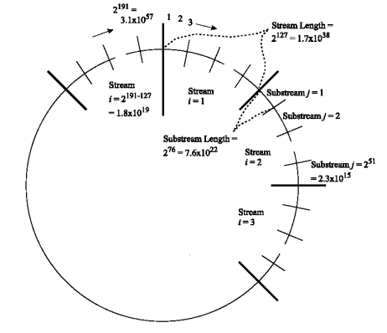
Streams and Substreams
Incrementing the
Run Number will move
all streams to a new
substream
Each ns-3
RandomVariableStream
object is assigned to a
stream (by default,
randomly)
Figure source: Pierre L’Ecuyer, Richard Simard, E. Jack Chen, and W. David Kelton.
An object-oriented random number package with many long streams and substreams. Operations Research, 2001.

Slide 32

Setting the stream number
The ns-3 implementation provides access to 2^64 streams
2^63 are placed in a pool for automatic assignment, and 2^63 are reserved for fixed assignment
Users may optionally assign a stream number index to a random variable using the SetStream () method.
  This allows better control over selected random variables
  Many helpers have AssignStreams () methods to do this across many such random variables

Slide 33
Run number vs. seed
If you increment the seed of the PRNG, the streams of random variable objects across different runs are not guaranteed to be uncorrelated
If you fix the seed, but increment the run number, you will get uncorrelated streams
Set RngRun, not RngSeed!

Slide 34
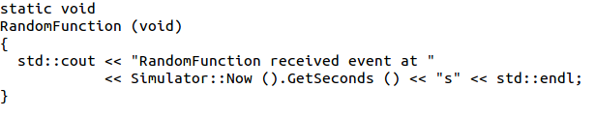
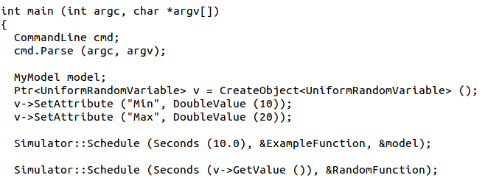
Example walk-through
Example program: src/core/examples/sample-simulator.cc
Demo command line usage, event scheduling, random variables

Slide 35
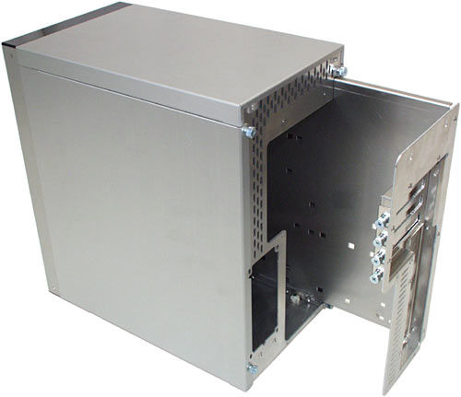


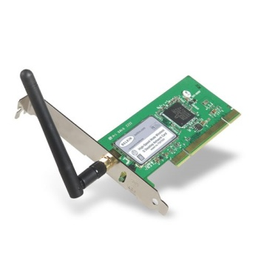
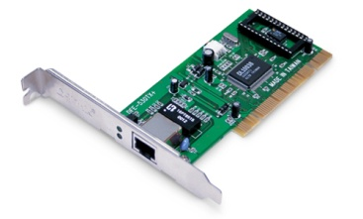
Node basics
An ns-3 Node is a shell of a computer, to which applications, protocol stacks, and NetDevices are added
Application
Application
Application
“DTN”

Slide 36
ns-3 example scenario
Most simulations involve packet exchanges such as depicted below
Application
Application
Application
Application
Sockets-like
API
Protocol
stack
Protocol
stack
Packet(s)‏
Node
Node
NetDevice
NetDevice
NetDevice
Channel
NetDevice
Channel

Slide 37
Simulation setup
We have already explained the operation of the start of the program (configuring default values and command line arguments)
int
main (int argc, char *argv[])
{
DataRate dataRate = DataRate ("100Mbps");
...
CommandLine cmd;
cmd.AddValue("distance","the distance between the two nodes",distance);
...
cmd.Parse (argc, argv);

Slide 38
Nodes and ns-3 Objects
The next statements create the scenario, usually starting with the Node objects:
Ptr<Node> senderNode = CreateObject<Node> ();
Ptr<Node> receiverNode = CreateObject<Node> ();
NodeContainer nodes;
nodes.Add (senderNode);
nodes.Add (receiverNode);
What is CreateObject<Node> ()?
What is a NodeContainer?

Slide 39
class ns3::Object
ns-3 is, at heart, a C++ object system
ns-3 objects that inherit from base class ns3::Object get several additional features
  smart-pointer memory management (Class Ptr)
  dynamic run-time object aggregation
  an attribute system
Instead of:
Node* senderNode = new Node;
in ns-3, we write
Ptr<Node> senderNode = CreateObject<Node> ();
Create a new Node object on the heap
Create a smart pointer to hold objects of type Node

Slide 40
ns-3 attributes
Attributes are special member variables that the Object system exposes in a way to facilitate configuration
An Attribute can be connected to an underlying variable or function
  e.g. TcpSocket::m_cwnd;
  or a trace source

Slide 41
Helper API
The ns-3 “helper API” provides a set of classes and methods that make common operations easier than using the low-level API
Consists of:
  container objects
  helper classes
The helper API is implemented using the low-level API
Each function applies a single operation on a ''set of same objects”
  A typical operation is "Install()"

Slide 42
Containers
Containers are part of the ns-3 “helper API”
Containers group similar objects, for convenience
  They are often implemented using C++ std containers
Container objects also are intended to provide more basic (typical) API

Slide 43
Helper API examples
NodeContainer: vector of Ptr<Node>
NetDeviceContainer: vector of Ptr<NetDevice>
InternetStackHelper
WifiHelper
MobilityHelper
OlsrHelper
... many ns-3 models provide a helper class

Slide 44
Installation onto containers
Installing models into containers, and handling containers, is a key API theme
NodeContainer c;
c.Create (numNodes);
...
mobility.Install (c);
...
internet.Install (c);
...

Slide 45
Native IP models
IPv4 stack with ARP, ICMP, UDP, and TCP
IPv6 with ND, ICMPv6, IPv6 extension headers, TCP, UDP
IPv4 routing: RIPv2, static, global, NixVector, OLSR, AODV, DSR, DSDV
IPv6 routing: RIPng, static

Slide 46
IP address configuration
An Ipv4 (or Ipv6) address helper can assign addresses to devices in a NetDevice container
Ipv4AddressHelper ipv4;
ipv4.SetBase ("10.1.1.0", "255.255.255.0");
csmaInterfaces = ipv4.Assign (csmaDevices);
...
ipv4.NewNetwork (); // bumps network to 10.1.2.0
otherCsmaInterfaces = ipv4.Assign (otherCsmaDevices);

Slide 47
Applications and sockets
In general, applications in ns-3 derive from the ns3::Application base class
  A list of applications is stored in the ns3::Node
  Applications are like processes
Applications make use of a sockets-like API
  Application::Start () may call ns3::Socket::SendMsg() at a lower layer

Slide 48
Sockets API
Plain C sockets
int sk;
sk = socket(PF_INET, SOCK_DGRAM, 0);
struct sockaddr_in src;
inet_pton(AF_INET,”0.0.0.0”,&src.sin_addr);
src.sin_port = htons(80);
bind(sk, (struct sockaddr *) &src, sizeof(src));
struct sockaddr_in dest;
inet_pton(AF_INET,”10.0.0.1”,&dest.sin_addr);
dest.sin_port = htons(80);
sendto(sk, ”hello”, 6, 0, (struct sockaddr *) &dest, sizeof(dest));
char buf[6];
recv(sk, buf, 6, 0);
}
ns-3 sockets
Ptr<Socket> sk =
udpFactory->CreateSocket ();
sk->Bind (InetSocketAddress (80));
sk->SendTo (InetSocketAddress (Ipv4Address (”10.0.0.1”), 80), Create<Packet> (”hello”, 6));
sk->SetReceiveCallback (MakeCallback (MySocketReceive));
[…] (Simulator::Run ())
void MySocketReceive (Ptr<Socket> sk, Ptr<Packet> packet)
{
...
}

Slide 49
Mobility and position
The MobilityHelper combines a mobility model and position allocator.
Position Allocators setup initial position of nodes (only used when simulation starts):
  List: allocate positions from a deterministic list specified by the user;
  Grid: allocate positions on a rectangular 2D grid (row first or column first);
  Random position allocators: allocate random positions within a selected form (rectangle, circle, …).
Mobility models specify how nodes will move during the simulation:
  Constant: position, velocity or acceleration;
  Waypoint: specify the location for a given time (time-position pairs);
  Trace-file based: parse files and convert into ns-3 mobility events, support mobility tools such as SUMO, BonnMotion (using NS2 format) , TraNS

Slide 50
Propagation
Propagation module defines:
  Propagation loss models:
  Calculate the Rx signal power considering the Tx signal power and the respective Rx and Tx antennas positions.
  Propagation delay models:
  Calculate the time for signals to travel from the TX antennas to RX antennas.
Propagation delay models almost always set to:
  ConstantSpeedPropagationDelayModel: In this model, the signal travels with constant speed (defaulting to speed of light in vacuum)

Slide 51
Propagation (cont.)
Propagation loss models:
  Many propagation loss models are implemented:
    Abstract propagation loss models:
    FixedRss, Range, Random, Matrix, …
    Deterministic path loss models:
    Friis, LogDistance, ThreeLogDistance, TwoRayGround, …
    Stochastic fading models:
    Nakagami, Jakes, …

Slide 52
Propagation (cont.)
  A propagation loss model can be “chained” to another one, making a list. The final Rx power takes into account all the chained models.
  Example: path loss model + shadowing model + fading model

Slide 53
NetDevices and Channels
Some types of NetDevices are strongly bound to Channels of a matching type
More recently, NetDevices use a channel allowing multiple signal types to coexist
SpectrumChannel
CsmaChannel
CsmaNetDevice

Slide 54
NetDevices and traces
ns-3 TraceSource objects are callbacks that may be hooked to obtain trace data from the simulator
Example: CsmaNetDevice
NetDevice::
ReceiveCallback
CsmaNetDevice::Send ()
MacTx
MacRx
MacDrop
queue
Sniffer
PromiscSniffer
MacTxBackoff
PhyTxBegin
PhyRxEnd
PhyRxDrop
PhyTxDrop
PhyTxEnd
CsmaNetDevice::
TransmitStart()
CsmaNetDevice::
Receive()
CsmaChannel

Slide 55
ns-3 program structure
Handle program inputs
Configure topology
Run simulation
Process outputs

Slide 56
Placeholder
Review examples/tutorial/first.cc

Slide 57
Next steps
Code organization and build system
Documentation system
Packet objects and queues
Walkthrough of ‘mm1-queue.cc’ example
  Simple experiment management
  Objects, attributes, tracing
  Logging and debugging

