Slide 1
ns-3 training
Tom Henderson
ns-3 annual meeting 2019
June 17-21, Florence, Italy

Slide 2
Next steps
Code organization and build system
Documentation system
Packet objects and queues
Walkthrough of ‘mm1-queue.cc’ example
  Simple experiment management
  Objects, attributes, tracing
  Logging and debugging

Slide 3
Software orientation
Key differences from other network simulators:
1) Command-line, Unix orientation
  vs. Integrated Development Environment (IDE)
2) Simulations and models written directly in C++ and Python
  vs. a domain-specific simulation language

Slide 4
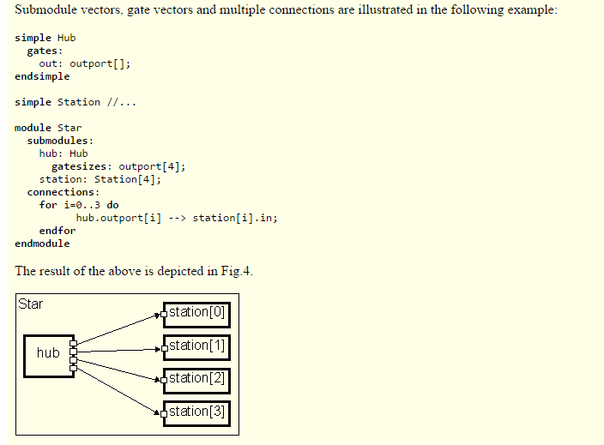
ns-3 not written in a high-level language
Example of OMNeT++ Network Description (NED) language
Figure excerpted from http://www.ewh.ieee.org/soc/es/Nov1999/18/ned.htm

Slide 5
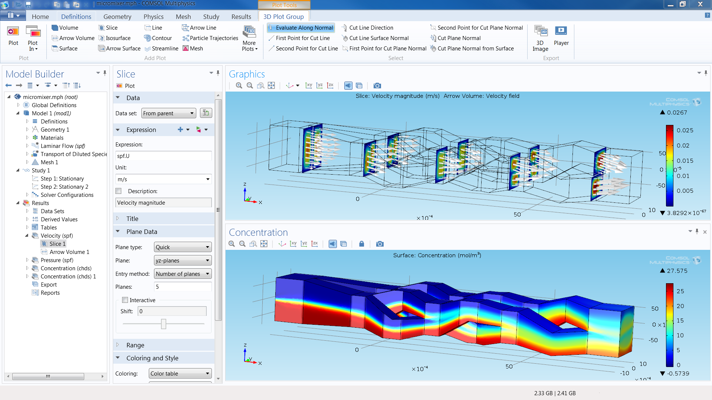
ns-3 does not have a graphical IDE
Figure source: https://www.comsol.com/comsol-multiphysics

Slide 6
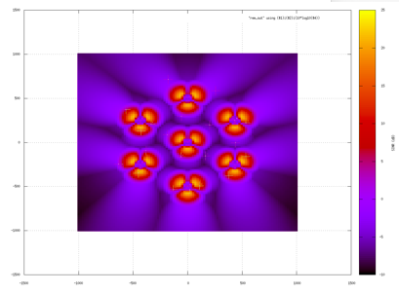
ns-3 uses outside programs for graphics
Radio environment map showing
signal strength from eNBs
LTE radio environment
map (REM)
Will experiment with
this on Tuesday
gnuplot

Slide 7
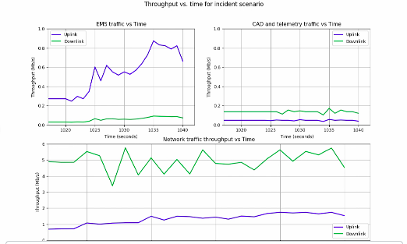
ns-3 users typically write scripts to plot
Raw trace data generated by ns-3
EmsVideo_1_Server 942.36392953 RX 1012 1061 U 2395
EmsVideo_1_Client 942.37317727 TX 1012 1061 U 2398
EmsVideo_1_Client 942.377 RX 64 113 U 2397
WebBrowsingGraphics_0_Server 942.38092876 TX 1024 1073 U 2399
WebBrowsingGraphics_0_Client 942.394 RX 1024 1073 U 2399
AvlAssetPerimeter_1_Server 942.42492988 RX 1408 1457 U 2401
Used to measure KPIs
Animated

Slide 8
Visualization
No preferred visualizer for ns-3
Two tools have been developed over the years, with some scope limitations
  Pyviz
    FlowMonitor (statistics with Pyviz linkage)
  NetAnim (George Riley and John Abraham)
Support is lagging for these tools (help wanted)

Slide 9
PyViz overview
Developed by Gustavo Carneiro
Live simulation visualizer (no trace files)
Useful for debugging
  mobility model behavior
  where are packets being dropped?
Built-in interactive Python console to debug the state of running objects
Works with Python and C++ programs

Slide 10
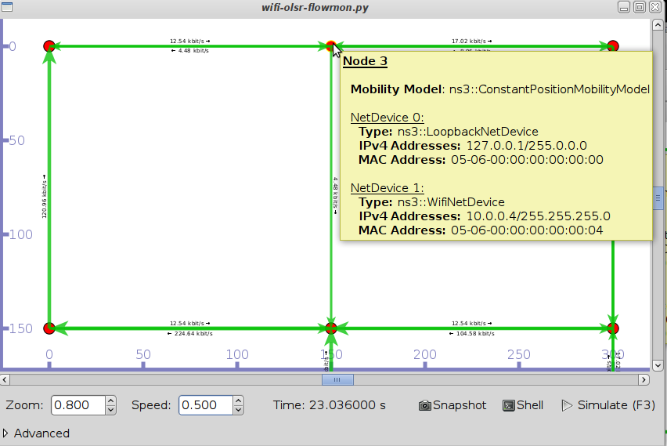
Pyviz and FlowMonitor
Example screenshot from:
./waf --run src/flow-monitor/examples/wifi-olsr-flowmon.py --vis

Slide 11

Enabling PyViz in your simulations
Make sure PyViz is enabled in the build
If program supports CommandLine parsing, pass the option
  --SimulatorImplementationType=
  ns3::VisualSimulatorImpl
Alternatively, pass the "--vis" option

Slide 12
FlowMonitor
Network monitoring framework found in src/flow-monitor/
Goals:
  detect all flows passing through network
  stores metrics for analysis such as bitrates, duration, delays, packet sizes, packet loss ratios
Plan to discuss more on Tuesday
G. Carneiro, P. Fortuna, M. Ricardo, "FlowMonitor-- a network monitoring framework
for the Network Simulator ns-3," Proceedings of NSTools 2009.

Slide 13
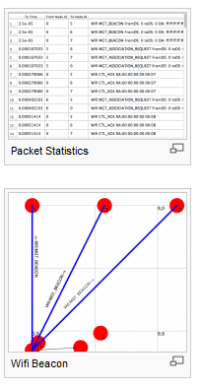
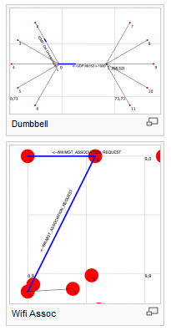
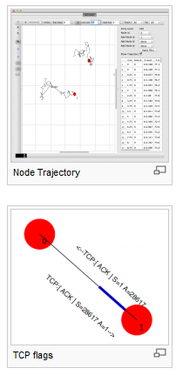
NetAnim
"NetAnim" by George Riley and John Abraham
pyviz

Slide 14
NetAnim key features
Animate packets over wired-links and wireless-links
  limited support for LTE traces
Packet timeline with regex filter on packet meta-data.
Node position statistics with node trajectory plotting (path of a mobile node).
Print brief packet-meta data on packets

Slide 15
Software organization
Two levels of ns-3 software and libraries
1) Several supporting libraries, not system-installed, can be in parallel to ns-3
Netanim
pybindgen
Click routing
ns-3
2) ns-3 modules exist
within the ns-3 directory
module
module
module
module
module
module

Slide 16
Typical module source code organization
model/
examples/
test/
bindings/
doc/
wscript/

Slide 17
Modules in ns-3 mainline
utilities
devices
protocols
visualizer
bridge
mesh
config-
store
applications
internet-apps
aodv
Node class
NetDevice ABC
Address types
(Ipv4, MAC, etc.)
Queues
Socket ABC
Ipv4 ABCs
Packet sockets
csma
spectrum
internet
(IPv4/v6)
dsdv
flow-monitor
energy
emu
Packets
Packet Tags
Packet Headers
Pcap/ascii file writing
tap-bridge
traffic-control
olsr
netanim
mpi
point-to-
point
uan
click
stats
Smart pointers
Dynamic types
Attributes
Callbacks
Tracing
Logging
Random Variables
mobility
virtual-
net-device
network
nix-vector-
routing
topology-
read
lte
Events
Scheduler
Time arithmetic
propagation
lr-wpan
wifi
core
openflow
BRITE
wimax

Slide 18
ns-3 programs
ns-3 programs are C++ executables that link the needed shared libraries
  or Python programs that import the needed modules
The ns-3 build tool, called 'waf', can be used to run programs
waf will place headers, object files, libraries, and executables in a 'build' directory

Slide 19
Python bindings
ns-3 uses a program called PyBindGen to generate Python bindings for all libraries
v
v
v
v
C++
header
Intermediate
Python
program
C++
bindings
code
Python
module
CastXML
(py)gccxml
PyBindGen
C++ compiler

Slide 20
Python bindings status
API scanning for Python used to use a tool called gccxml
ns-3 has moved to the successor, CastXML
  requires a development installation of clang
Automated testing currently only for Linux 64-bit systems
  MacOS API scanning is not tested

Slide 21
waf operation
This slide is a placeholder to demonstrate Waf operation
  ‘waf build’ will compile and link source code into executables
  ‘waf --run’ will run an executable in a special shell that knows the path to ns-3 libraries
  New option: ‘waf --run-no-build’ will skip the build step

Slide 22
waf configuration
Key waf configuration examples
  ./waf configure
    --enable-examples
    --enable-tests
    --disable-python
    --enable-modules
Whenever build scripts change, need to reconfigure
Demo: ./waf --help
./waf configure --enable-examples --enable-tests --enable-modules='core'
Look at: build/c4che/_cache.py

Slide 23
wscript example
## -*- Mode: python; py-indent-offset: 4; indent-tabs-mode: nil; coding: utf-8; -*-
def build(bld):
obj = bld.create_ns3_module('csma', ['network', 'applications'])
obj.source = [
'model/backoff.cc',
'model/csma-net-device.cc',
'model/csma-channel.cc',
'helper/csma-helper.cc',
]
headers = bld.new_task_gen(features=['ns3header'])
headers.module = 'csma'
headers.source = [
'model/backoff.h',
'model/csma-net-device.h',
'model/csma-channel.h',
'helper/csma-helper.h',
]
if bld.env['ENABLE_EXAMPLES']:
bld.add_subdirs('examples')
bld.ns3_python_bindings()

Slide 24
waf build
Once project is configured, can build via ./waf build or ./waf
waf will build in parallel on multiple cores
waf displays modules built at end of build
Demo: ./waf build
Look at: build/ libraries and executables

Slide 25
Running programs
./waf shell provides a special shell for running programs
  Sets key environment variables
  ./waf --run sample-simulator
  ./waf --pyrun src/core/examples/sample-simulator.py

Slide 26
Build variations
Configuring a build type is done at waf configuration time
debug build (default): all asserts and debugging code enabled
  ./waf -d debug configure
optimized
  ./waf -d optimized configure
static libraries
  ./waf --enable-static configure

Slide 27
Controlling the modular build
One way to disable modules:
  ./waf configure --enable-modules='a','b','c'
The .ns3rc file (found in utils/ directory) can be used to control the modules built
Precedence in controlling build
  1) command line arguments
  2) .ns3rc in ns-3 top level directory
  3) .ns3rc in user's home directory
Demo how .ns3rc works

Slide 28
Building without wscript
The scratch/ directory can be used to build programs without wscripts
Demo how programs can be built without wscripts

Slide 29
Integrating other tools and libraries

Slide 30
Other libraries
more sophisticated scenarios and models typically leverage other libraries
ns-3 main distribution uses optional libraries (libxml2, gsl, mysql) but care is taken to avoid strict build dependencies
  The Waf wscripts can be consulted as examples
  example: sqlite3 in src/stats/wscript
the 'bake' tool (described later) helps to manage library dependencies
users are free to write their own Makefiles or wscripts to do something special

Slide 31
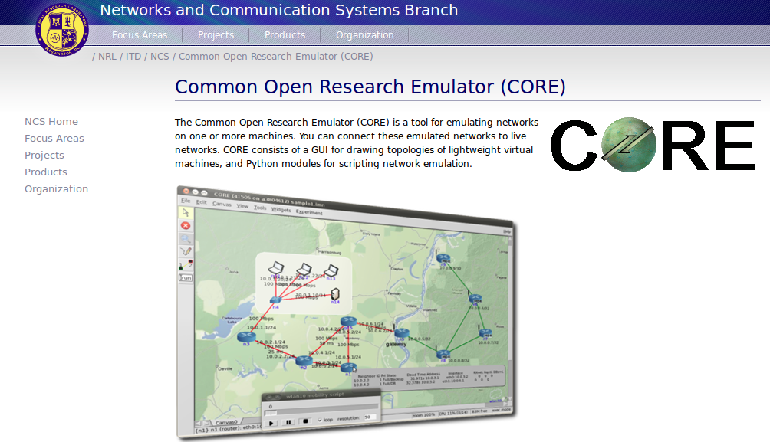
CORE emulator

Slide 32
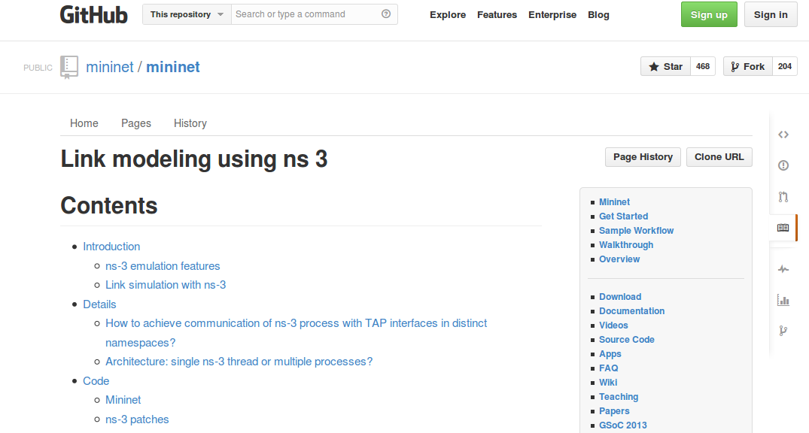
mininet emulator

Slide 33
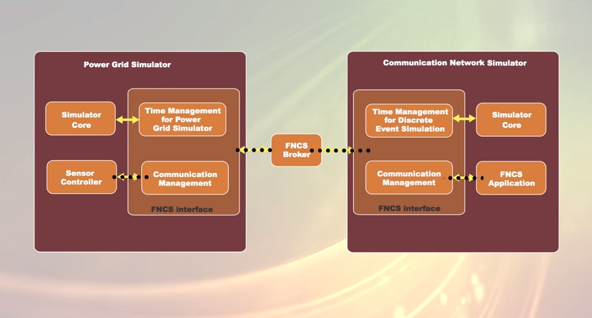
Co-simulation frameworks have emerged
PNNL's FNCS framework integrates ns-3 with transmission and distribution simulators
Image source: PNNLgov YouTube video:
Introducing FNCS: Framework for Network Co-Simulation

Slide 34
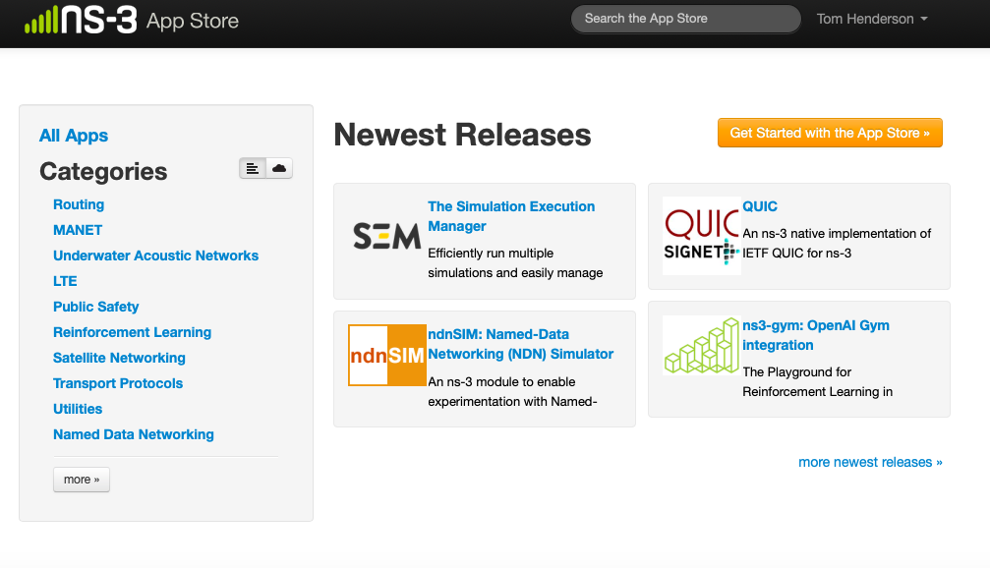
ns-3 App Store
Project is migrating away from a centralized repository to a modular system called the ‘ns-3 App Store’
  https://apps.nsnam.org

Slide 35
Documentation overview
Placeholder slide: online browsing of
  Doxygen
  ns-3 manual, model library, tutorial
  wiki
  command-line help

