Slide 1
ns-3 training
Tom Henderson
ns-3 annual meeting 2019
June 17-21, Florence, Italy

Slide 2
ns-3 Packet
Packet is an advanced data structure with the following capabilities
Supports fragmentation and reassembly
Supports real or virtual application data
Extensible
Serializable (for emulation)
Supports pretty-printing
Efficient (copy-on-write semantics)

Slide 3
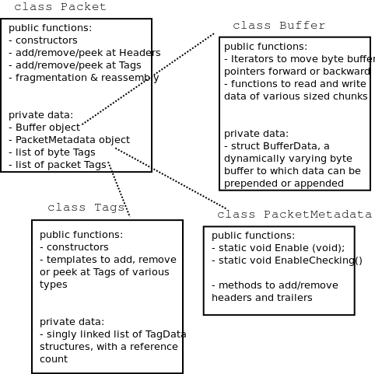
ns-3 Packet structure
Analogous to an mbuf/skbuff

Slide 4
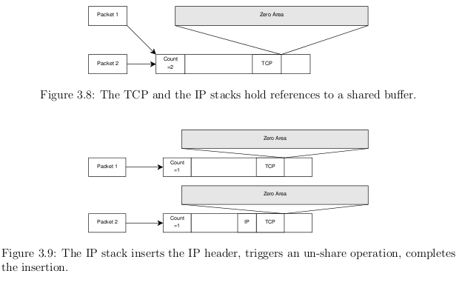
Copy-on-write
Copy data bytes only as needed
Figure source: Mathieu Lacage's Ph.D. thesis

Slide 5
Headers and trailers
Most operations on packet involve adding and removing an ns3::Header
class ns3::Header must implement four methods:
Serialize()
Deserialize()
GetSerializedSize()
Print()

Slide 6
Headers and trailers (cont.)
Headers are serialized into the packet byte buffer with Packet::AddHeader() and removed with Packet::RemoveHeader()
Headers can also be 'Peeked' without removal
Ptr<Packet> pkt = Create<Packet> ();
UdpHeader hdr; // Note: not heap allocated
pkt->AddHeader (hdr);
Ipv4Header iphdr;
pkt->AddHeader (iphdr);

Slide 7
Packet tags
Packet tag objects allow packets to carry around simulator-specific metadata
Such as a "unique ID" for packets or cross-layer info
Tags may associate with byte ranges of data, or with the whole packet
Distinction is important when packets are fragmented and reassembled
Tags presently are not preserved across serialization boundaries (e.g. MPI)

Slide 8
PacketTag vs. ByteTag
Two tag types are available: PacketTag and ByteTag
ByteTags run with bytes
PacketTags run with packets
When Packet is fragmented, both copies of Packet get copies of PacketTags
When two Packets are merged, only the PacketTags of the first are preserved
PacketTags may be removed individually; ByteTags may be removed all at once

Slide 9
Tag example
Here is a simple example illustrating the use of tags from the code in src/internet/model/udp-socket-impl.cc:
Ptr<Packet> p; // pointer to a pre-existing packet
SocketIpTtlTag tag
tag.SetTtl (m_ipMulticastTtl); // Convey the TTL from UDP layer to IP layer
p->AddPacketTag (tag);
This tag is read at the IP layer, then stripped (src/internet/model/ipv4-l3-protocol.cc):
uint8_t ttl = m_defaultTtl;
SocketIpTtlTag tag;
bool found = packet->RemovePacketTag (tag);
if (found)
{
ttl = tag.GetTtl ();
}

Slide 10
Packet metadata
Packets may optionally carry metadata
record every operation on a packet's buffer
implementation of Packet::Print for pretty-printing of the packet
sanity check that when a Header is removed, the Header was actually present to begin with
Not enabled by default, for performance reasons
To enable, insert one or both statements:
Packet::EnablePrinting ();
Packet::EnableChecking ();

Slide 11
Ptr<Packet>
Packets are reference counted objects that support the smart pointer class Ptr
Use a templated "Create" method instead of CreateObject for ns3::Objects
Typical creation:
Ptr<Packet> pkt = Create<Packet> ();
In model code, Packet pointers may be const or non-const; often Packet::Copy() is used to obtain non-const from const
Ptr<const Packet> cpkt = ...;
Ptr<Packet> p = cpkt->Copy ();

Slide 12
Queues in ns-3
Queues are objects for storing packets
A templated Queue class exists to support a few use cases
simple queues such as a DropTail
WifiMacQueue
a Linux-like QueueDisc class
Enqueue
Dequeue
Common operations: GetNBytes (); GetNPackets (); etc.

Slide 13
Linux-like TC architecture in ns-3
Figure source: Stefano Avallone (2017 training)

Slide 14
Debugging support
Assertions: NS_ASSERT (expression);
Aborts the program if expression evaluates to false
Includes source file name and line number
Unconditional Breakpoints: NS_BREAKPOINT ();
Forces an unconditional breakpoint, compiled in
Debug Logging (not to be confused with tracing!)
Purpose
Used to trace code execution logic
For debugging, not to extract results!
Properties
NS_LOG* macros work with C++ IO streams
E.g.: NS_LOG_UNCOND (”I have received ” << p->GetSize () << ” bytes”);
NS_LOG macros evaluate to nothing in optimized builds
When debugging is done, logging does not get in the way of execution performance

Slide 15
Debugging support (cont.)
Logging levels:
NS_LOG_ERROR (...): serious error messages only
NS_LOG_WARN (...): warning messages
NS_LOG_DEBUG (...): rare ad-hoc debug messages
NS_LOG_INFO (...): informational messages (eg. banners)
NS_LOG_FUNCTION (...):function tracing
NS_LOG_PARAM (...): parameters to functions
NS_LOG_LOGIC (...): control flow tracing within functions
Logging ”components”
Logging messages organized by components
Usually one component is one .cc source file
NS_LOG_COMPONENT_DEFINE ("OlsrAgent");
Displaying log messages. Two ways:
Programatically:
LogComponentEnable("OlsrAgent", LOG_LEVEL_ALL);
From the environment:
NS_LOG="OlsrAgent" ./my-program

Slide 16
Running C++ programs through gdb
The gdb debugger can be used directly on binaries in the build directory
An easier way is to use a waf shortcut
./waf --command-template="gdb %s" --run <program-name>

Slide 17
Running C++ programs through valgrind
valgrind memcheck can be used directly on binaries in the build directory
An easier way is to use a waf shortcut
./waf --command-template="valgrind %s" --run <program-name>
Note: disable GTK at configure time when running valgrind (to suppress spurious reports)
./waf configure --disable-gtk --enable-tests ...

Slide 18
Testing
ns-3 models need tests verifiable by others (often overlooked)
Onus is on the simulation project to validate and document results
Onus is also on the researcher to verify results
ns-3 strategies:
regression tests
Aim for event-based rather than trace-based
unit tests for verification
validation of models on testbeds where possible
reuse of code

Slide 19
Test framework
ns-3-dev is checked nightly on multiple platforms
Linux gcc-4.x, i386 and x86_64, OS X, FreeBSD clang, and Cygwin (occasionally)
./test.py will run regression tests
Walk through test code, test terminology (suite, case), and examples of how tests are run

Slide 20
Improving performance
Debug vs optimized builds
./waf -d debug configure
./waf -d debug optimized
Build ns-3 with static libraries
./waf --enable-static
Use different compilers (icc)
has been done in past, not regularly tested

