Slide 1
ns-3 training
Tom Henderson
ns-3 annual meeting 2019
June 17-21, Florence, Italy

Slide 2
Outline
TCP
  tcp-variants-comparison.cc example
  Connection of TCP trace sources at runtime
  PCAP tracing
  Flow Monitor tracing and processing
Flow Monitor
  PyViz demonstration
Bake and DCE (included in another presentation)

Slide 3
History of ns-3 TCP
Until ns-3.10
  it was a port of TCP model from GTNetS (Georgia Tech Network Simulator)
For ns-3.10
  it was substantially rewritten by Adriam Tam in 2011
For ns-3.25
  the module was refactored as a part of GSoC 2015 project by Natale Patriciello
  one of the major changes involved how congestion control algorithms are implemented (more details to follow)
  other notable change was about automating the tests
  Target is to align the implementation with that of Linux
ns-3 Training, June 2019
slide credit: Mohit Tahiliani

Slide 4
Congestion control algorithms
NewReno (default)
Westwood, Westwood+
Hybla
HighSpeed
Vegas
Scalable
Veno
Binary Increase Congestion Control (BIC)
Yet another HighSpeed TCP (YeAH)
Illinois
H-TCP
Low Extra Delay Background Transport (LEDBAT)
Data Center TCP (DCTCP)-- under review
ns-3 Training, June 2019

Slide 5
Loss detection and recovery algorithms
Loss detection
  Traditional timeout
  Traditional 3 DUPACKs
  SACK
  RACK (under review)
Recovery mechanisms
  Traditional timeout
  NewReno fast retransmit and recovery
  Proportional Rate Reduction (PRR)
ns-3 Training, June 2019

Slide 6
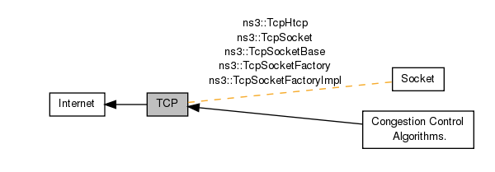
TCP implementation in ns-3
Loss Recovery
Algorithms
Source code can be found at: src/internet/model/
  tcp-header.{h,cc}
  tcp-socket.{h,cc}
  tcp-socket-base.{h,cc}
  tcp-socket-factory-impl.{h,cc}
  tcp-l4-protocol.{h,cc}
  tcp-congestion-ops.{h,cc}
  tcp-recovery-ops.{h,cc}
  ...
ns-3 Training, June 2019

Slide 7
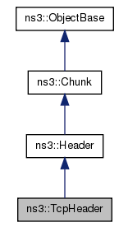
TcpHeader class
This class implements the TCP header and contains:
  port numbers
  sequence numbers
  acknowledgment numbers
  flags
  …
It also contains:
  setters and getters
  methods for serialization
  and deserialization
ns-3 Training, June 2019

Slide 8
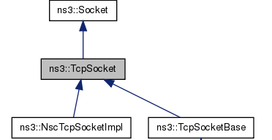
TcpSocket class
This class:
  is an abstract base class for all TcpSockets
  contains TcpSocket attributes that can be reused across different implementations.
Examples of such attributes include:
  SndBufSize
  RcvBufSize
  SegmentSize
  InitialCwnd
  DelAckCount
  DelAckTimeout
  …
ns-3 Training, June 2019

Slide 9
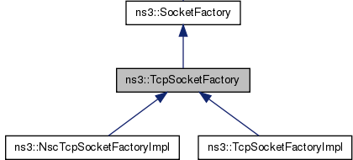
TcpSocketFactory class
This class:
  is an abstract base class
  defines API for TCP sockets
  contains global default variables to initialize new sockets
ns-3 Training, June 2019

Slide 10
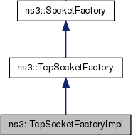
TcpSocketFactoryImpl class
This class:
  is an implementation of socket factory for ns-3 TCP
  creates sockets of type TcpSocketBase
ns-3 Training, June 2019

Slide 11
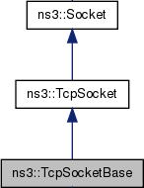
TcpSocketBase class
This class:
  is a base class for the implementation of TCP stream socket
  contains essential components of TCP and provides a socket interface for upper layers to call
Examples of components include:
  Connection orientation
  Sliding window mechanism
  Fast retransmit
  Fast recovery
  Enable/disable window scaling, timestamps
  Congestion state machine
  Congestion control interface
ns-3 Training, June 2019

Slide 12
TcpSocketState class
This class:
  records the congestion state of a connection
  saves the information that is passed between the socket and the congestion control algorithms
Examples of such information include:
  the current value of congestion window
  the current congestion state (CA_OPEN, CA_RECOVERY, etc)
  the current value of slow start threshold
  Last sequence number acknowledged
  Next sequence number to be transmitted
  …
ns-3 Training, June 2019

Slide 13
TcpCongestionOps class
This class:
  is an abstract class for congestion control
  provides an interface between the main socket code and congestion control; variables are stored in TcpSocketState
  inspired by the design in Linux
Some methods implemented in this class include:
  GetSsThresh (Ptr<TcpSocketState>, uint32_t)
  IncreaseWindow (Ptr<TcpSocketState>, uint32_t)
  CongestionStateSet (Ptr<TcpSocketState>, TcpSocketState::TcpCongState_t)
  PktsAcked (Ptr<TcpSocketState>, uint32_t, Time)
ns-3 Training, June 2019

Slide 14
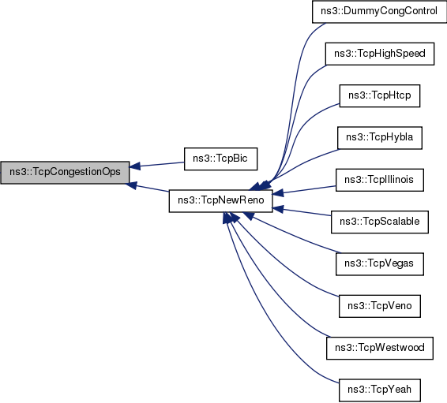
TcpCongestionOps class
ns-3 Training, June 2019

Slide 15
Example review
found in examples/tcp/tcp-variants-comparison.cc
  based on past WNS3 paper:
    http://www.ittc.ku.edu/resilinets/papers/Gangadhar-Nguyen-Umapathi-Sterbenz-2013.pdf
  PCAP output
  flow monitor output
  the need to defer connection of trace sinks until after time 0

