Slide 1
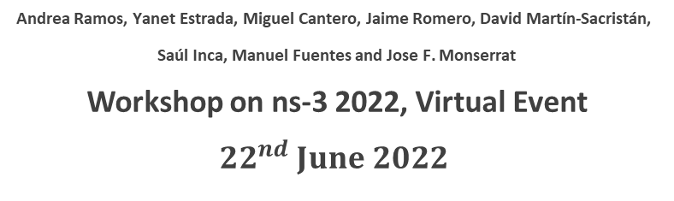
Implementation and Calibration of the 3GPP Industrial Channel Model for ns-3
Andrea Ramos, Yanet Estrada, Miguel Cantero, Jaime Romero, David Martín-Sacristán,
Saúl Inca, Manuel Fuentes and Jose F. Monserrat
Workshop on ns-3 2022, Virtual Event
$${22}^{nd} June 2022$$

Slide 2
Agenda
Motivation
3GPP Industrial Channel Model
NS-3 Implementation
  Propagation Model
  Spectrum Model
Results
Conclusion
Future Lines

Slide 3

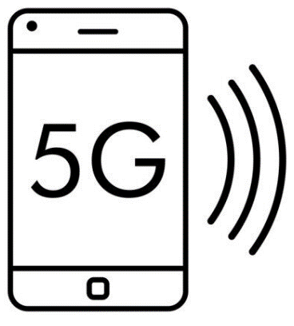


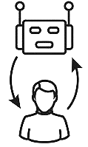



Motivation
New Radio will be a crucial technology for Industry 4.0 connectivity
System-level Simulation (SLS) results used for network optimisation
ns-3 simulator as a selected tool for a large research community

Slide 4

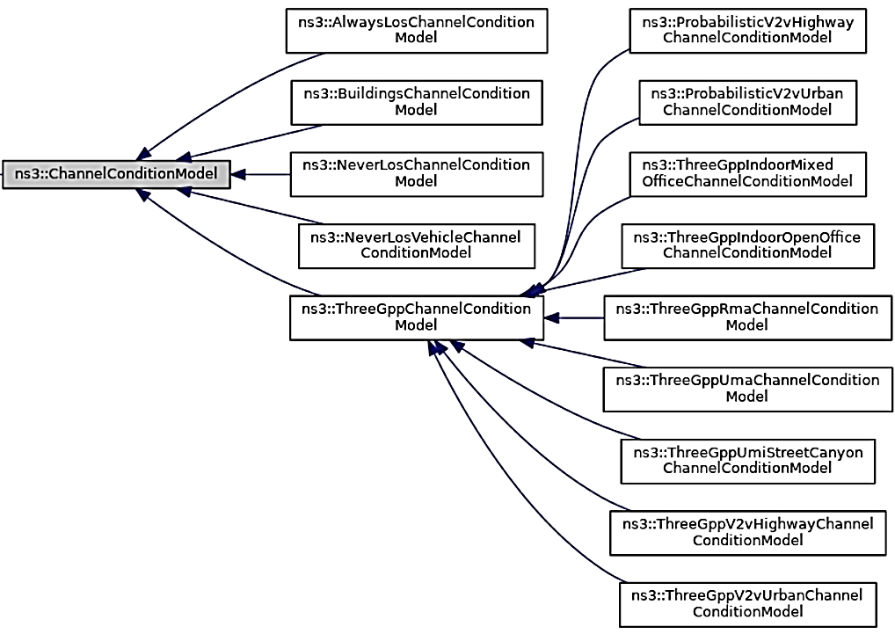
Motivation
Currently, Third Generation Partnership Project (3PP) Channel models are within ns-3
The implementation of the Indoor Factory channel model within ns-3 will be an essential contribution to this ns-3 community
ns-3. 2021. ns-3 Network Simulator. https://www.nsnam.org/

Slide 5



Industrial Channel Model
Sub-Scenarios of 3GPP Industrial Channel Model (TR 38.901)
Dense Low
Clutter density > 40%
BS antenna height < clutter height
Sparse Low
Clutter density < 40%
BS antenna height < clutter height
Dense High
Clutter density > 40%
BS antenna height > clutter height
Sparse High
Clutter density < 40%
BS antenna height > clutter height

Slide 6
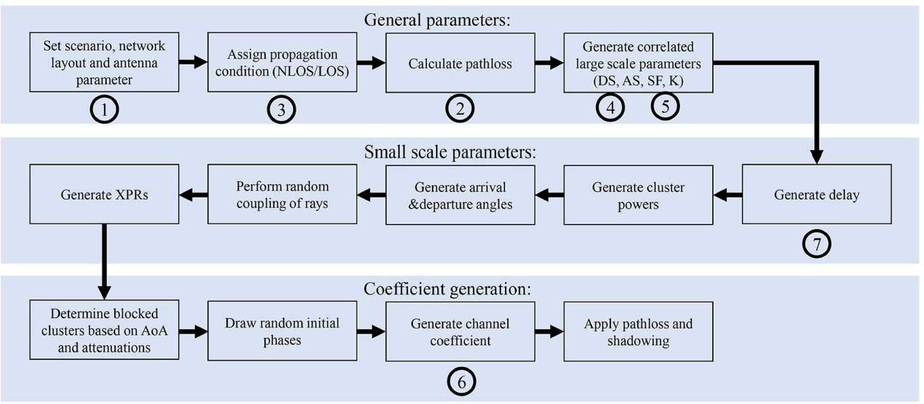
Industrial Channel Model
“TR 38.901: Study on channel model for frequencies from 0.5 to 100 GHz, V16.1.0,” 3GPP, Tech. Rep., 2020”.

Slide 7
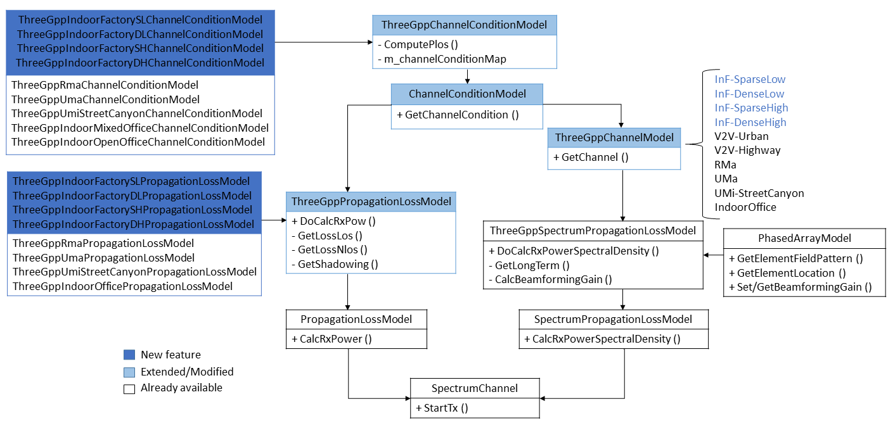
NS-3 Implementation
Propagation Model

Slide 8
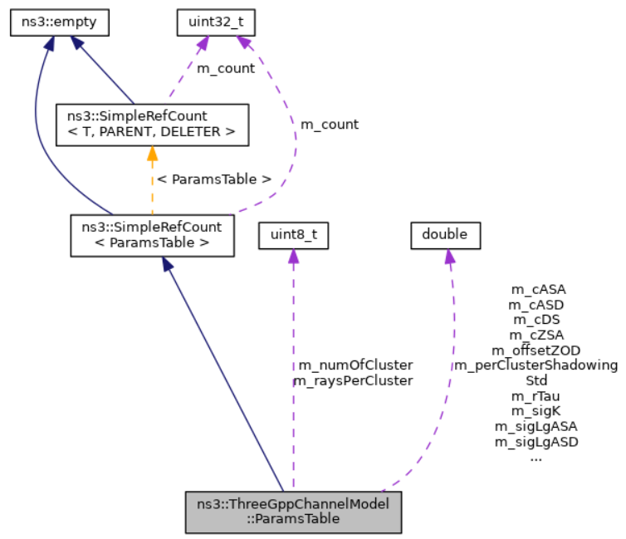
NS-3 Implementation
Spectrum Model
  The main class of ThreeGppChannelModel, was modified
  Cross correlation matrix is constructed following the new large-scale parameters for the four sub-scenarios, following the 3GPP TR 38,901 specifications in Table 7.5-6
  Small-scale parameters are not implemented
ns-3. 2021. ns-3 Network Simulator. https://www.nsnam.org/

Slide 9
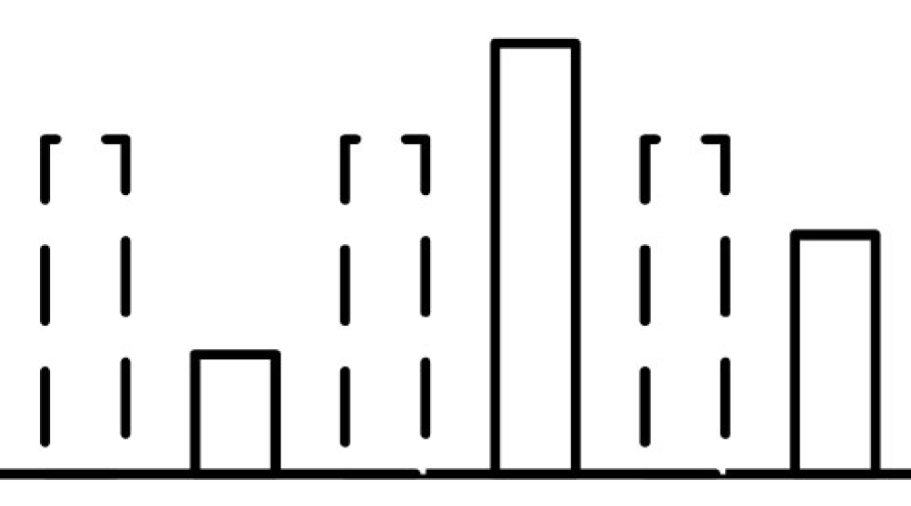
Calibration and Results
Sub-scenario Deployment
Simulation Parameters
Outputs
Carrier frequency 3,5 GHz and 28 GHz
1 element, Isotropic antenna gain pattern for both BS and UT
BS height: 1.5 m for InF-SL and InF-DL
BS-height: 8 m for for InF-SH and InF-DH
Low clutter density 20%, clutter height 2 m
High clutter density: 60%, clutter height 6 m
Coupling loss – serving cell
Geometry with and without noise
Delay spread
Angle spread (SD, ZSD, ASA, ZSA)
18 BSs
180 UTs
Small Hall: 120x60 m
Big Hall: 300x150 m
Four NLoS Sub-Scenarios
Sparse Low, Dense Low, Sparse High, Dense High

Slide 10
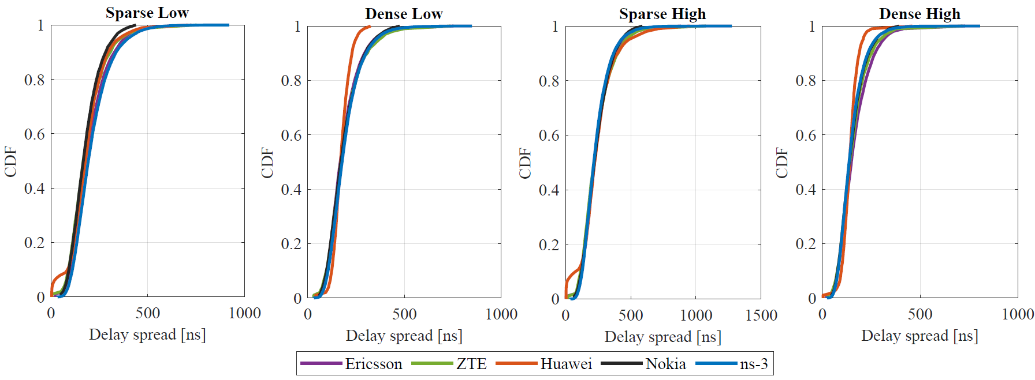
Calibration and Results
Delay Spread
For this particular KPI, the results in red are different from the rest of the references in some areas. However, the results of this work fit perfectly within the calibration curves.

Slide 11
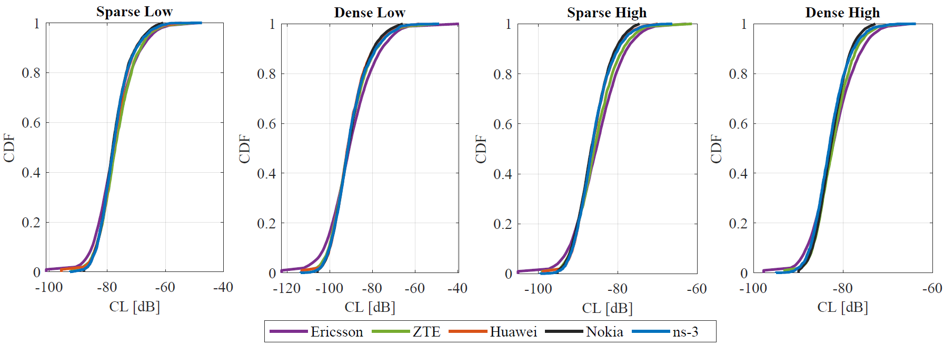
Calibration and Results
Coupling Loss
It can be appreciated that the range of values is slightly different. The high scenarios (InF-SH and InF-DH) have narrower ranges, and the sparse ones (InF-SL and InF-SH) have higher top values

Slide 12
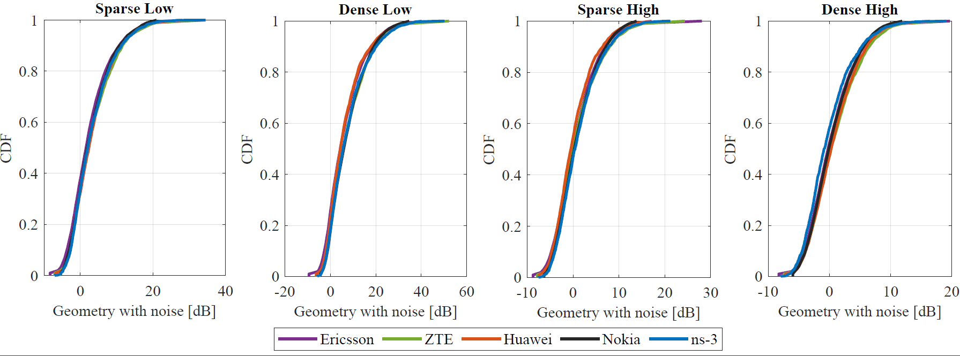
Calibration and Results
Geometry with noise
The highest levels of interference signals are reached in low scenarios ( InF-SL and InF-DL )

Slide 13
Conclusion
This paper detailed the implementation process of the InF channel model, defined in 3GPP Release-16, as an extension tool for the ns-3 open-source simulator
Our results were compared with the results of the 3GPP Tdoc R1-190970 companies
As a main contribution to the research community, this work permits easily updating the ns-3 simulator (Repository https://gitlab.com/andre.ramosp/ns-3-inf-channel-modelling)

Slide 14
Future Lines
Thanks to this work, new initiatives have been launched to use ns-3 as a reliable tool to evaluate industrial scenarios using the Indoor Factory channel model implemented
This implementation triggers the study of new use cases and the impact of industrial scenarios
For future work, we may upload these updates for the next versions of the ns-3 simulator

Slide 15
Thank you

