Slide 1
IEEE 802.11 PSM in ns-3: A Novel Implementation and Evaluation under Channel Congestion
Shyam Krishnan Venkateswaran$†$, Ching-Lun Tai$†$, Yoav Ben-Yehezkel$△$, Yaron Alpert $△$, and Raghupathy Sivakumar$†$
$†$Georgia Institute of Technology, $△$^{Texas Instruments}
Workshop on ns-3 (WNS3) – June 22, 2022

Slide 2
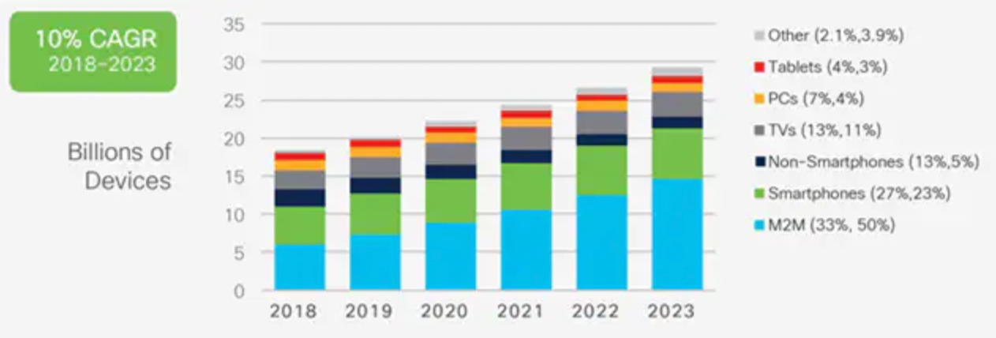
Towards Ultra-dense Networks
Local Area Networks are becoming denser by the day
Over 28 Billion Internet connected devices are expected by end of 2023 ^{[1]}

Slide 3
Towards Ultra-dense Networks
Local Area Networks are becoming denser by the day
Over 28 Billion Internet connected devices are expected by end of 2023 ^{[1]}
Smart Phones and tablets
Personal Computers
TVs and Streaming devices
Periodic and sparse reporting IoT devices constitute a prominent use case
Smart doorbells
Smart thermostats
Soil moisture sensors

Slide 4
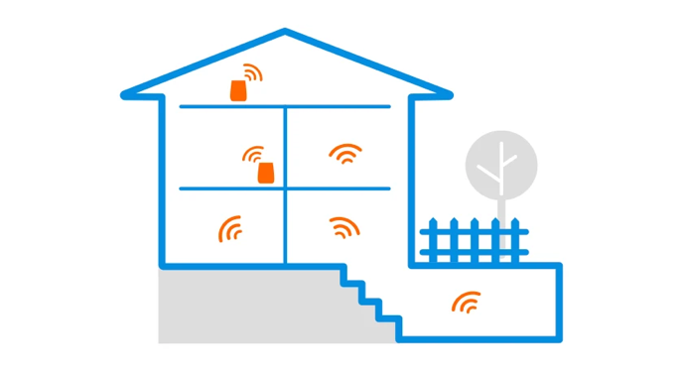
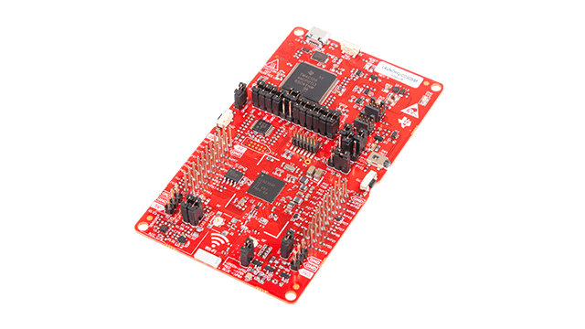
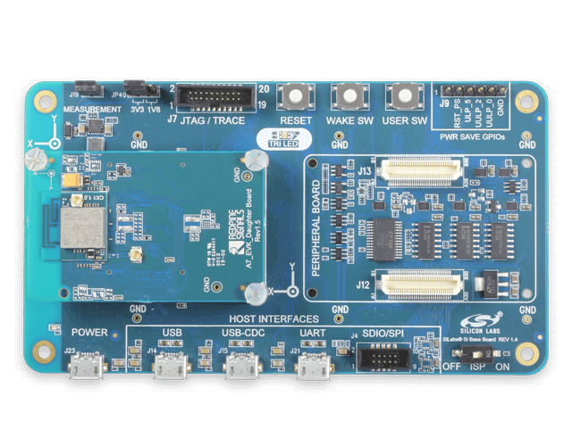
Wi-Fi as an IoT Solution
Wi-Fi is
Wi-Fi supports low power operation allowing battery-operated client devices to enter Sleep states
Power Save Mechanism (PSM) allows power saving up to 99% for connectivity maintenance^{[2]}
Newer Wi-Fi standards have provisions designed specifically for IoT
Ubiquitous
Standardized
Customizable with tradeoffs
Low-power operation friendly
TI CC3235
Wi-Fi is becoming an increasingly suitable choice for mid-range low-power IoT
Silabs RS9116

Slide 5
Key Contributions
An open-source model for PSM that integrates with the Wi-Fi module in ns-3 that handles uplink (UL) and downlink (DL) unicast and multicast traffic
Using a comprehensive power model, a detailed evaluation of power performance of PSM in congested network scenarios
Insight into the impact of bidirectional nature of TCP traffic on power consumption in the presence of network congestion

Slide 6
PSM – A Primer
Power Saving (PS) stations (STA) set the Power Management (PM) bit in UL data frames to 1
AP buffers packets for power saving stations at least till next relevant beacon
Buffer status for PS stations are indicated through the Traffic Indication Map (TIM) element in beacons
Stations can retrieve buffered unicast packets by polling the AP (PS-POLL)
AP delivers buffered multicast packets after every Delivery TIM (DTIM) beacon
Packet for PS STA received at AP
AID in TIM
Tx
Beacon
Beacon
Rx PS-POLL
Tx Buffered Pkt
Rx ACK
Legend
$$AP$$
Rx
SLEEP
No buffered packets
More data = 0
Rx
Rx
Tx PS-POLL
Rx Packet
Tx ACK
$$PS STA$$
t

Slide 7
PSM Model – Related Work
PSM has been an area of active research owing to the exponential increase in low power devices
Ref. [3] and [4] use a PSM model in ns-2 – which is no longer maintained
Many works such as [5], [6], [7] implement models within custom simulators in C++ or MATLAB for evaluation
Ref. [8] uses a PSM model in ns-3 but is not open source
An open-source model for PSM in ns-3 is necessary for reproducibility and standardized evaluation

Slide 8
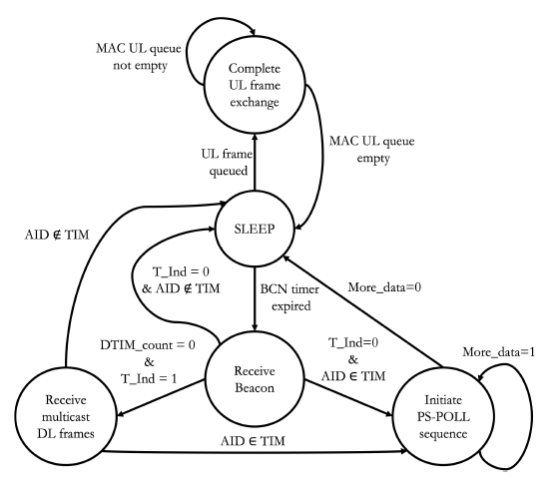
PSM Model in ns-3
Major changes:
AP and STA MAC models are modified
New MAC queues at STA and AP to buffer packets
AP buffers packets for all PS STAs
STA MAC utilizes the ‘SLEEP’ PHY state
PS STAs receive all beacons
Traffic Indication Map (TIM) element is implemented and added to beacons
State Diagram for PSM implementation
TIM element format

Slide 9
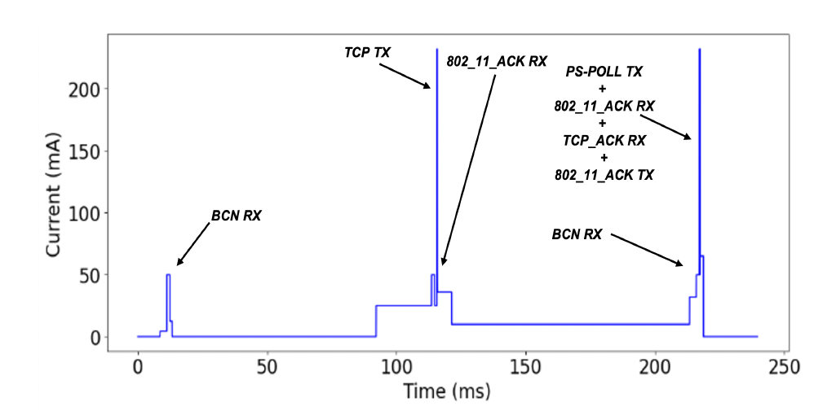
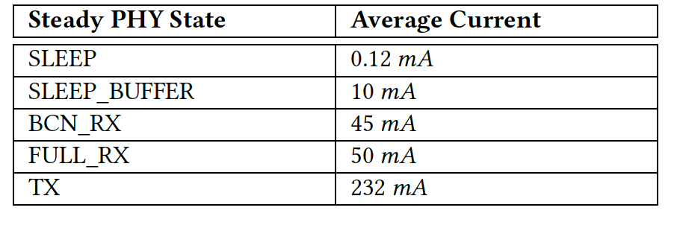
Power Modeling
Model is calibrated to a State-of-Art low power IoT chip (TI CC3235)
Power model recognizes traffic type and accounts for state transitions
Power Model - Calibration
TCP uplink – Estimated Power Consumption

Slide 10
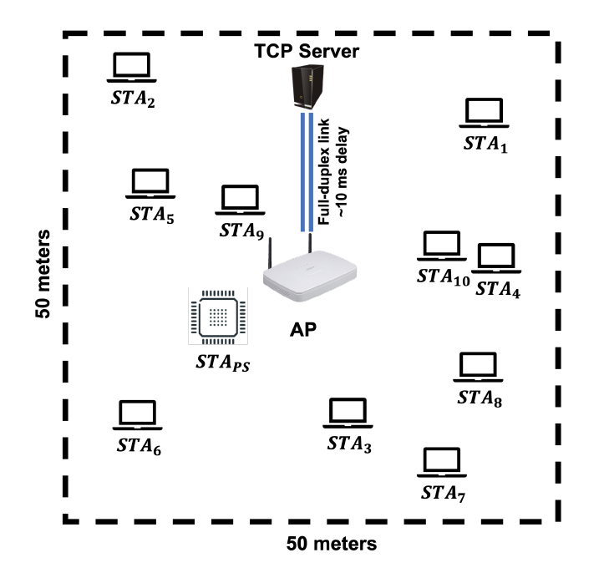
Simulation Setup
PS STA (STA_{PS}) sends one TCP UL packet to TCP server every second
Other STAs offer constant bit rate (CBR) UL UDP traffic
Total offered load (load%) is measured as
$$load\%= \frac{\sum_{n_{STA}}^{ }{Offered Traffic}}{Max PHY rate}$$
Awake Time($T_{awake}\%$) is the percentage of time that STA_{PS} is not in SLEEP state
Simulation setup for nSTA=10

Slide 11
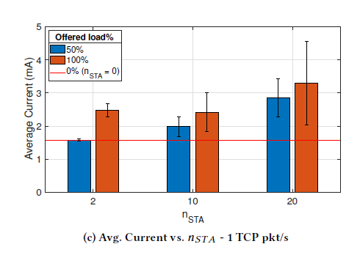
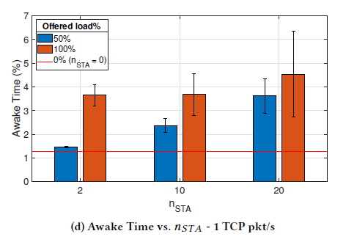
TCP Power Performance with High Load
For TCP UL traffic, as network load increases from 0% to 100% with $n_{STA}=20$,
$I_{avg}$ increases from 1.58 mA to 3.29 mA - a 108% increase
$T_{awake}\%$ increases from 1.28% to 4.52% - a 254% increase
Power consumption increases with increased total network load

Slide 12
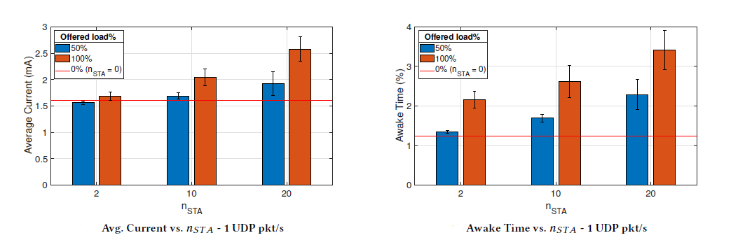
Effect of Bidirectional Traffic Flow
As network load increases from 0% to 100% with $n_{STA}=10$,
$I_{avg}$ increases by 53% for TCP traffic and by 28% for UDP traffic
$T_{awake}\%$ increases by 187% for TCP traffic and by 112% for UDP traffic
Bidirectional nature of TCP traffic compounds the effect of network congestion on PSM power performance

Slide 13
Summary and Future Work
We develop and validate an open-source model for PSM in ns-3
With sparse TCP UL traffic, a station using PSM can stay awake for up to 254% longer with 20 contending stations consuming over 108% more current
Bidirectional flow of TCP traffic increases the power consumption with PSM as network congestion increases – over 75% more time awake with 10 contending stations
For future work, we plan to model, evaluate, and optimize Target Wake Time (Wi-Fi 6) as a scheduling solution in tandem with Wi-Fi power save methods for low power operation

Slide 14
Thank you

Slide 15
References
[1] Cisco 2020: Cisco Annual Internet Report (2018–2023) White Paper.
[2] Venkateswaran, Shyam Krishnan, et al. "Extending Battery Life for Wi-Fi-Based IoT Devices: Modeling, Strategies, and Algorithm." Proceedings of the 19th ACM International Symposium on Mobility Management and Wireless Access. 2021.
[3] Ronny Krashinsky and Hari Balakrishnan. 2002. Minimizing Energy for Wireless Web Access with Bounded Slowdown. In Proceedings of the 8th annual international conference on Mobile computing and networking. 119–130.
[4] Xijian Chen, Yi Xie, and Chengyan Wang. 2011. Implementation and Analysis of IEEE 802.11 PSM in ns-2. In 2011 International Conference on Machine Learning and Cybernetics, Vol. 3. 1250–1255.
[5] Jung-Ryun Lee and Dong-Ho Cho. 2006. An Energy-efficient Downlink Multiple Access Control Considering Congestion in Wireless LANs.
[6] Yi Li, Xin Zhang, and Kwan L. Yeung. 2015. A Novel Delayed Wakeup Scheme for Efficient Power Management in Infrastructure-based IEEE 802.11 WLANs. In 2015 IEEE Wireless Communications and Networking Conference (WCNC)
[7] Yu Zhang, Mingfei Wei, Chen Cheng, Xianjin Xia, Tao Gu, Zhigang Li, and Shining Li. 2017. Exploiting Delay-aware Load Balance for Scalable 802.11 PSM in Crowd Event Environments. Wireless Communications and Mobile Computing 2017
[8] Prawit Chumchu. 2015. An Extension to IEEE 802.11 Power Save Mode for ns-3. In 2015 Seventh International Conference on Ubiquitous and Future Networks. 799–804

