Slide 1
Department of Electrical & Computer Engineering
Florida International University
Integration of WAVE and OpenFlow for Realization of SDN-based VANETs in ns-3
Juan V. Leon, Yacoub Hanna, and Kemal Akkaya
Advanced Wireless & Security Lab (ADWISE)
E-mail: {jleon148, yhann002, and kakkaya} @ fiu.edu

Slide 2
Contents
Motivation
Implementation
Integrating WAVE for OFSWITCH13 Module
Extending TLV OXM-MATCH
Performance Evaluation
Distance and RSU Density Effects on Setup Delay
Scalability Experiments
Conclusions

Slide 3
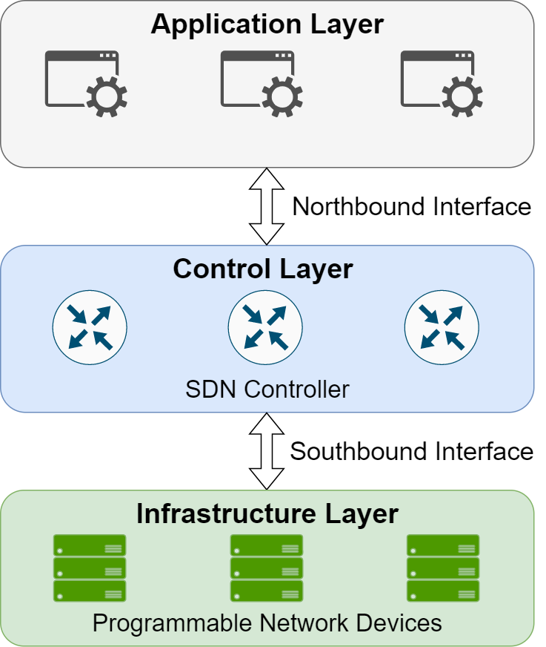
Motivation
Software Defined Networking (SDN) is based on the idea of separation of data and control planes.
SDN offers:
Flexibility against dynamic conditions due through the use of a centralized controller.
It is effective dealing with interoperability challenges due to its use of standard protocol for controller and switch communications (i.e., OpenFlow)

Slide 4
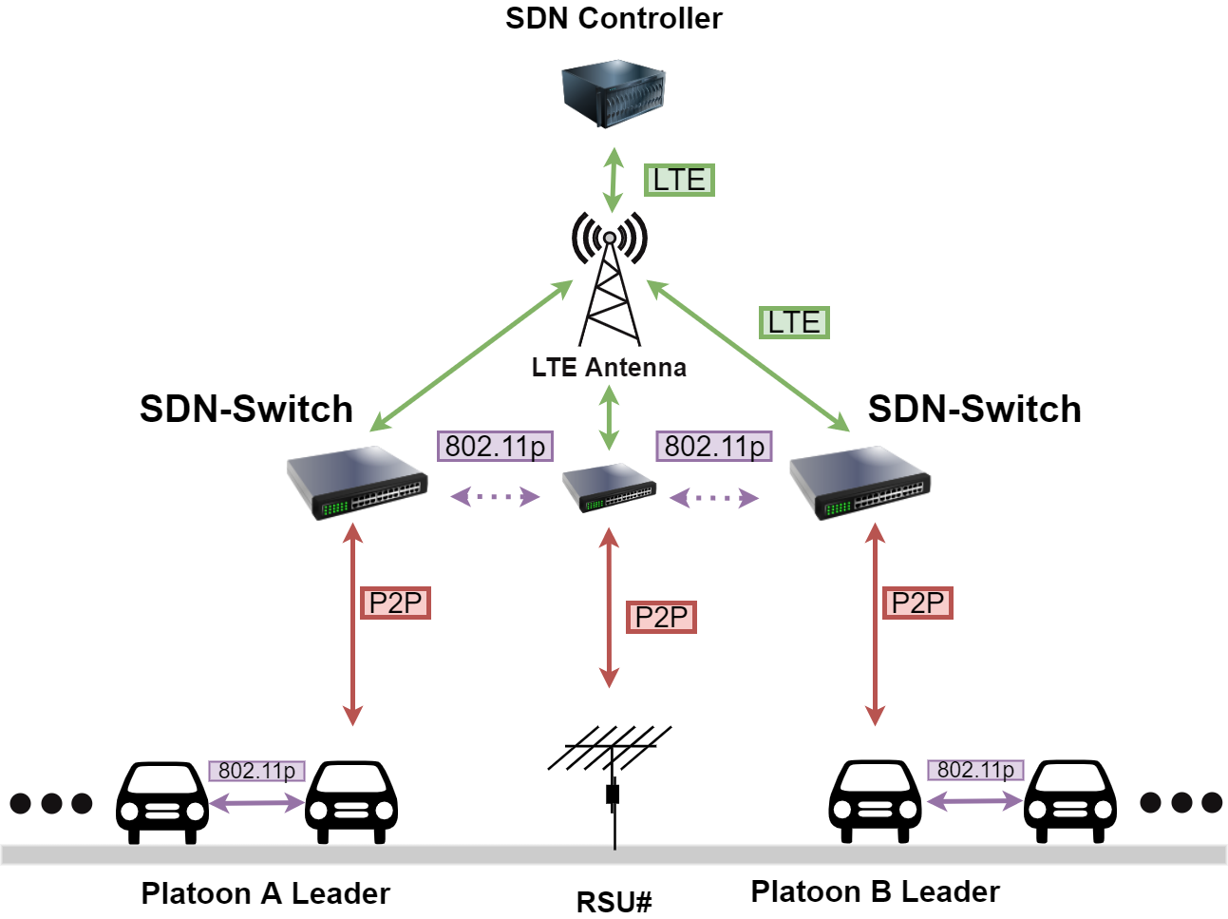
Motivation
The use of SDN has been shifting from wired/optical networking to applications where the data channel or control channel are based on wireless technologies.
In the field of vehicular ad hoc networks (VANETs) the networking of vehicles is based on the use of a wireless interface specifically designed for safety purposes (802.11p).
SDN is a perfect tool for VANETs to remotely control vehicles for safety and traffic optimization.

Slide 5
Challenge
Most evaluations tools for SDN applications assume a wired control channel through CSMA-CD which limits the capacity to evaluate other type of applications such as VANET applications.
ns-3 has included SDN capabilities through the OFSWITCH13 module and it offers 802.11p capabilities through the WAVE module.
The OFSWITCH13 module only allows for connections to the switches through the use of CSMA-CD producing two major limitations.

Slide 6
Proposal
Ofswitch13 Module
Extended
Ofswitch13 Module
- SDN Switches can only be used with CSMANETDEVICE.
-Limited HEADERS to be matched using Type Length Value structures.
- SDN Switches can use LTE (Control Channel) and WAVE (Data Channel) devices.
- Included TLV structure that defines the fields in a WSMP packet.
VANETs require wireless technologies.
No new TLV structures and fields can be matched by SDN switch.

Slide 7
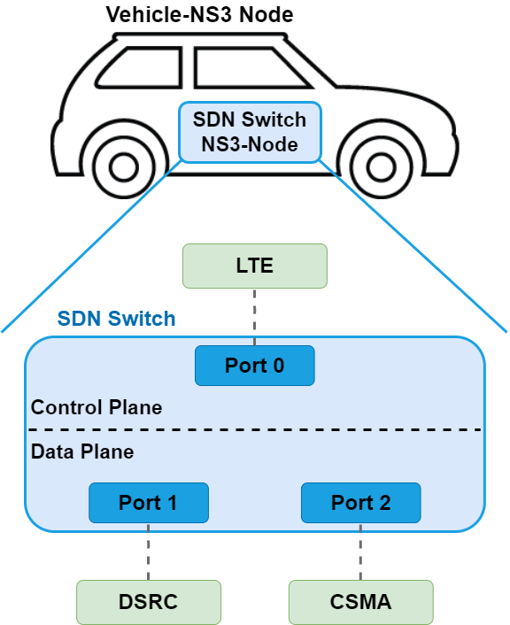
Implementation
The OFSWITCH13 module in ns-3 assumes that multiple end devices will be connected to an individual switch.
However, our setup in VANET is a bit different.
Specifically, we would like to create a VANET architecture where each SDN switch will only service one individual end device (i.e., a vehicle or RSU).

Slide 8
Implementation
Binding the SDN Control Channel:
In the ofswitch13-device definition, there was no available method to explicitly bind the NETDEVICE for the control channel with the socket that will establish the SDN controller to SDN switch communication.
A modification is done to the StartControllerConnection() method to include a call to the method BindToNetDevice() inherited from the NS3::Socket class.

Slide 9
Implementation
Port Integration:
The next modification was made to the ofswitch13-port class. In particular, two methods were modified.
The first method to be modified is the OFSwitch13Port::NotifyConstructionCompleted() method. This is where we link the reception of packets at the NETDEVICE level with the higher layer port reception abstraction.
To do this, each NETDEVICE, will need to have add a new method called SetOpenFlowReceiveCallback().
By linking this method to the original ofswitch13-port::Receive method we enable the NETDEVICES in the lower layers to call higher layers receive method.

Slide 10
Implementation
The next method to be modified is the OFSwitch13Port:: Send(). Similarly, there needs to be a link made between the OFSwitch13Port::Send() method and the Send method of the underlying NETDEVICE.
Since the underlying NETDEVICE is a WAVENETDEVICE, we proceed to WaveNetDevice::Send X() method. This enables the SDN switch to send or receive packets through its ports without having to worry about the underlying network protocols.

Slide 11
Implementation
Extending TLV OXM-MATCH:
The NetBee library was used to parse the packets and insert/extract values into their OXM Match fields but starting from OFSWITCH13 version 4.0.0 the dependence on the NetBee library was removed leaving little to no documentation regarding how to include new custom Match fields.
Two modifications are needed to be able to use a custom OXM TLV structure:
The first is that the OXM match structure itself needs to be defined. This includes its type (i.e., Protocol Number) and which Field values it posseses.
Second, the size of the different fields that will be contained within that OXM TLV structure needs to be known and defined.
To do this, the management utility called DPCTL and its underlying dependencies needs to be updated to recognize its field along with inserting/extracting the new OXM match structure.

Slide 12
Implementation
Creating OXM TLV Fields:
The class declaration DPCTL.h needs to modified in order to include a new OXM Match field. The Match field will allow the DPCTL utility to recognize what size does the custom match field has and consequently, the set of methods to properly insert values to the match field.
Next, DPCTL.c class definition needs to be modified. From here, the method parse_match() needs to be modified to be able to recognize and then extract its actual content to parse it into a format acceptable by our custom OXM Match field.
To this end, the methods ofl_structs_match_put16(), ofl_structs_match_put32() and ofl_structs_match_put64() may be used depending on the size of the variable used to contain our custom field.

Slide 13
Implementation
Creating OXM TLV Structure:
The first class to be modified is the class declaration packet_handle_std.c. We modify the method packet_parse(). Here, we define the methods that will be used when we identify our OXM Match structure.
Subsequently, in flow_table.c class, we create a new oxm_id with our custom OXM Match structure name. This allows our new OXM Match structure to be recognized by Openflow.
Next, the structure definition will take place within the LIB directory. Here, the class definition packet.h needs to be updated to include our definition of the custom OXM Match structure.
We also need to modify the class declaration ofl_packet.h from the directory OFLIB. This is done by linking the name of our custom structure type to a predefined constant value.
Finally, in class declaration openflow.h, within the directory INCLUDE, we link our structure to the OXM TLV format.

Slide 14
Performance Evaluation
Simulation Setup:
We devised a series of experiments utilizing the WAVE module alongside the LTE module.
The experiments are based on a platooning application commonly used in the VANET environment.

Slide 15
Performance Evaluation
Metrics and Benchmarking:
We used the following metrics to measure the performance of our approach.
Setup Delay: This measurement is used to show how long it takes the SDN controller to contact each individual switch to establish a connection.
Network Overhead: The use of broadcast packets among RSUs adds to the network's overhead. This metric is measured by the number of extra messages that was generated within the network.
Average Packet Delay: This statistic quantifies the time it takes for a packet to reach at its target vehicle (i.e., the leading platoon leader) from the point of origin.
To compare with an alternative approach, we considered using Ad-hoc On Demand Distance Vector (AODV) routing which is a distributed solution to address the connectivity among the two platoon leaders.

Slide 16
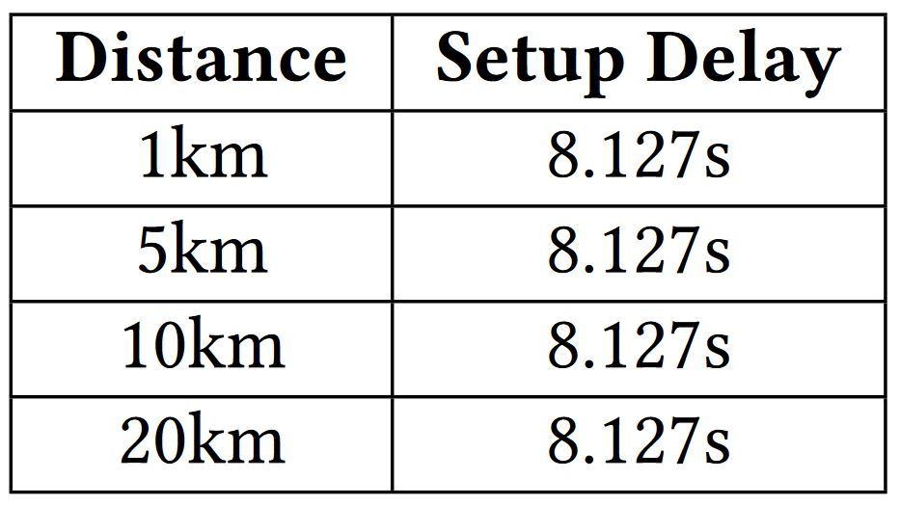
Performance Evaluation
Distance Density Effects on Setup Delay:
The first experiment consists of increasing the distance between the controller and the SDN enabled switches.
In this experiment we utilized 50 RSUs and 12 vehicles.
When the distance between our controller and switches was increased the setup delay was not affected.
We attribute this result to the low latency offered by the LTE module which indicates that realization of SDN for real-time applications is possible and effective.

Slide 17
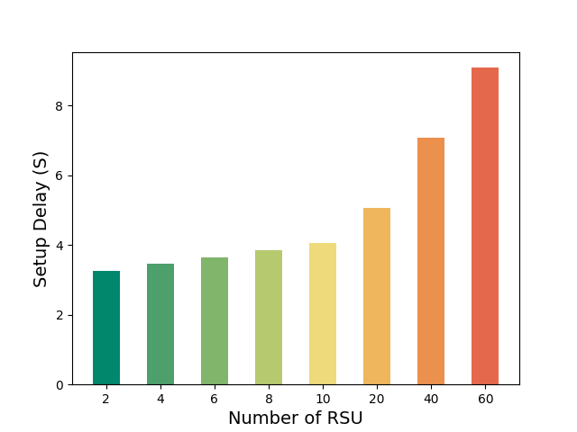
Performance Evaluation
RSU Density Effects on Setup Delay:
The next experiment consisted on changing the total amount of RSU.
We first try a low density of RSU in order to observe the effects of progressively increasing it until the density of RSUs is enough to saturate the field area.
We perform this experiment in a 250x250 meter size field with a total of 12 vehicles.
We can observe a considerable difference in the SDN setup delay as we increase the number of RSUs.
Yet, one important observation is the fact that the setup delay will increase linearly in relation to the node count even in extreme high node count scenarios.

Slide 18
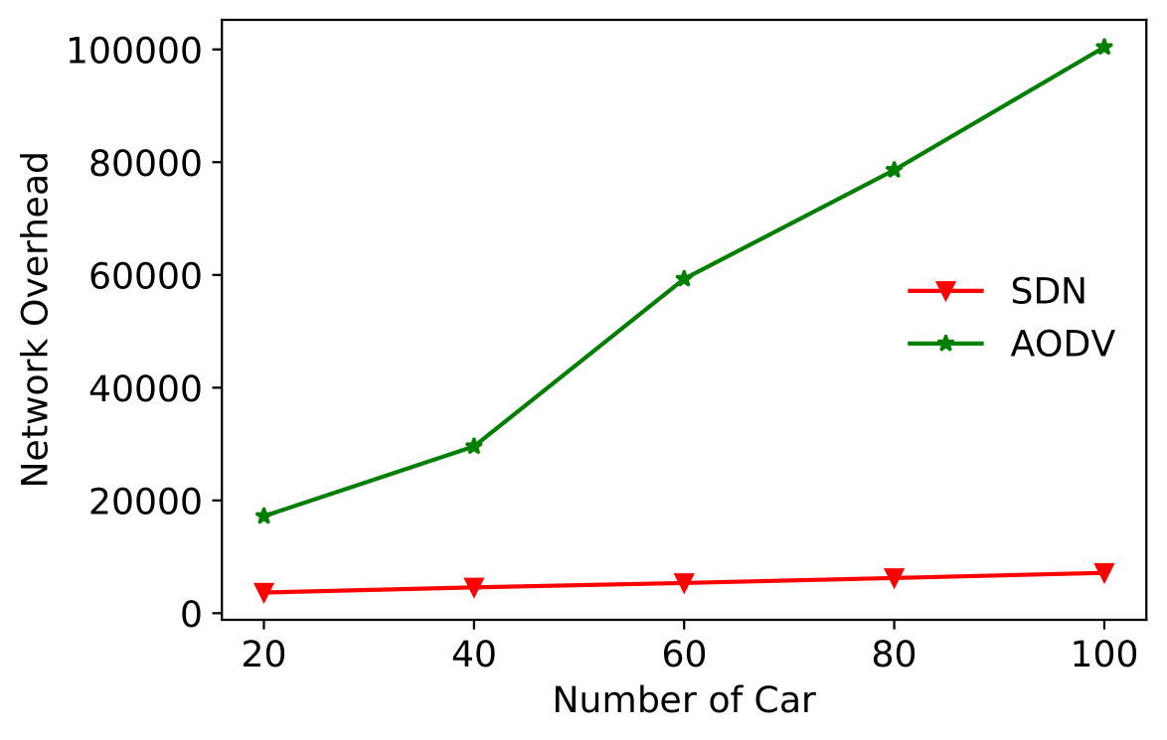
Performance Evaluation
Scalability Experiments:
In these evaluations, we explore how the number of vehicles affects the performance of the SDN-based network.
When comparing the vehicles noise (increasing the number of vehicles) we will compare the performance of our approach against the AODV benchmark.
Network Overhead:
When we increase the number of vehicles producing background traffic the overhead for AODV increases exponentially.
In the case of the SDN approach, there is an increase but its growth is linear.

Slide 19
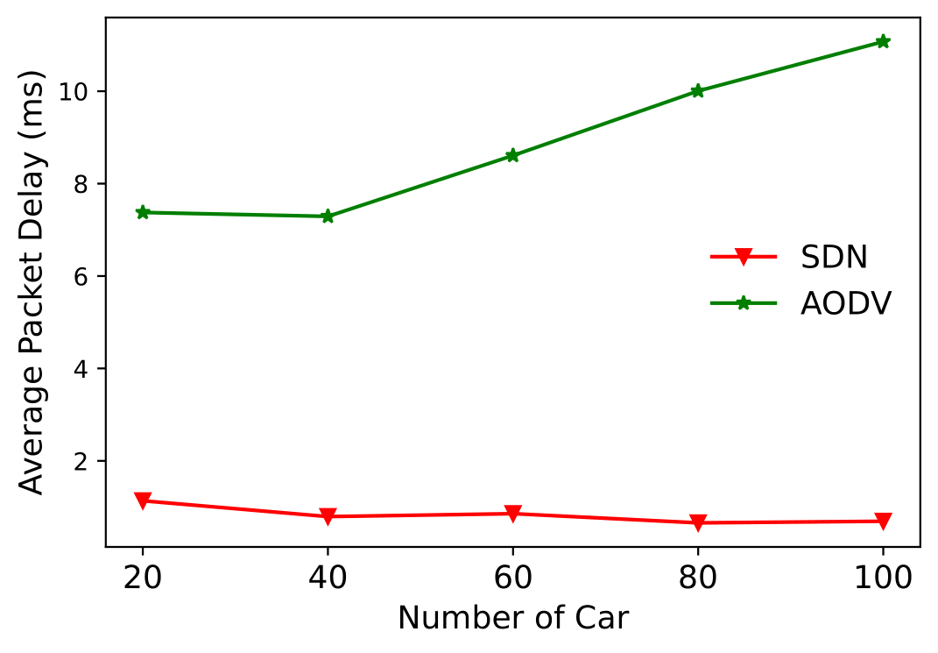
Performance Evaluation
Average Packet Delay:
We can observe an upward trend in the delay for AODV as the amount of background traffic grows with the increasing number of vehicles.
In comparison to our SDN approach, where the rules are previously installed, we can easily distinguish between background noise and an actual BSM since the SDN switches only need to inspect the packet's MAC addresses to know if it is supposed to be dropped or re-transmitted.

Slide 20
Summary
In this paper, we introduced extensions to ns-3 OFSWITCH13 Module to support an enriched set of functions for the SDN switches.
We also extended the possible OXM TLV structures that are available for the module in order to be able to match the new header fields that introduced by utilizing the WAVE protocol stack.
The steps detailed here can also serve as guide to anyone interested in developing custom headers or implementing new modules in conjunction with the OFSWITCH13 module.
Finally, we assessed the performance of our implementation using a classic VANETs application and observing it under a variety of scenarios.

Slide 21
Thank you for your attention!
Questions?

