Slide 1
Symbolic ns-3 for Efficient Exhaustive Testing:
Design, Implementation, and Simulations
Jianfei Shao, Minh Vu, Mingrui Zhang, Asmita Jayswal, Lisong Xu
School of Computing, University of Nebraska-Lincoln
https://symbolicns3.github.io

Slide 2
Outline
Why Symbolic ns-3 (sym-ns-3)?
How it works?
How to make it more efficient?
Conclusions

Slide 3
Exhaustive Testing
What is it?
Exhaustively test something (protocol/network) for all possible cases
When do we need it?
Evaluate all possible performance of a protocol/network
Find the worst-case performance of a protocol/network
Detect the bugs of a protocol/network

Slide 4
Exhaustive Testing Example 1
Two senders each sends a packet to the receiver simultaneously
Problem: What are all possible arrival time differences?
Measurement: diff = Arrival time of pkt0 − arrival time of pkt1
All possible link delays
d0 ∈ [1, 1000] ms
d1 ∈ [1, 1000] ms
snd0
pkt0
rcv
pkt1
snd1
delay d0
delay d1

Slide 5
Using ns-3
snd0
pkt0
rcv
pkt1
snd1
d0 ∈ [1, 1000]
d1 ∈ [1, 1000]
How to find all possible diff values?
ns-3 script simulates the network for a specific (d0, d1) and reports diff
shell script runs the ns-3 script for all possible (d0, d1)
Simulation result
All reported diff values = [-999, 999] ms
Simulation time
The simulation time for one (d0, d1) ≈ 0.5 seconds
Total number of (d0, d1) = 1000 x 1000 = 1,000,000
Total simulation time for all possible (d0, d1) ≈ 6 days
Exhaustive testing is time-consuming with ns-3!

Slide 6
Using Our sym-ns-3
snd0
pkt0
rcv
pkt1
snd1
d0 ∈ [1, 1000]
d1 ∈ [1, 1000]
How to find all possible diff values?
sym-ns-3 script simulates the network for a symbolic (d0, d1) and reports diff
Simulation result
All reported diff values = [-999, 999] ms
Same simulation results as ns-3
Simulation time
The simulation time for a symbolic (d0, d1) ≈ 1 minute
Significantly faster than ns-3
sym-ns-3 is more efficient for exhaustive testing than ns-3

Slide 7
Outline
Why sym-ns-3?
How it works?
How to make it more efficient?
Conclusions

Slide 8
sym-ns-3
Goal
Efficient exhaustive testing
How?
Based on symbolic execution
Simulates a group of equivalent cases together instead of each case separately

Slide 9
Background on Symbolic Execution
A variable may have a symbolic value (a set of values specified by constraints) instead of only a specific value.
When a program is executed symbolically, both branches instead of one branch of an if statement are explored.
Pseudocode example
Execution tree
initial constraints
1<= d0 <= 1000
1<= d1 <= 1000
sym 1<= d0 <= 1000
sym 1<= d1 <= 1000
if (d0 > d1){
…// simulate accordingly
diff = d0 – d1;
} else {
…// simulate accordingly
diff = d0 – d1;
}
yes
no
d0 > d1
final constraints
1<= d0 <= 1000
1<= d1 <= 1000
d0 > d1
simulation result
diff ∈ [1, 999]
final constraints
1<= d0 <= 1000
1<= d1 <= 1000
d0 <= d1
simulation result
diff ∈ [-999, 0]

Slide 10
Branches
Symbolic execution runs equivalent cases together as branches, and thus is more efficient for exhaustive testing.
Branch 1
All the equivalent cases following the same red execution path
Branch 2
All the equivalent cases following the same green execution path
Execution tree
initial constraints
1<= d0 <= 1000
1<= d1 <= 1000
yes
no
sym 1<= d0 <= 1000
sym 1<= d1 <= 1000
if (d0 > d1){
…// simulate accordingly
diff = d0 – d1;
} else {
…// simulate accordingly
diff = d0 – d1;
}
d0 > d1
sym 1<= d0 <= 1000
sym 1<= d1 <= 1000
if (d0 > d1){
…// simulate accordingly
diff = d0 – d1;
} else {
…// simulate accordingly
diff = d0 – d1;
}
final constraints
1<= d0 <= 1000
1<= d1 <= 1000
d0 > d1
simulation result
diff ∈ [1, 999]
final constraints
1<= d0 <= 1000
1<= d1 <= 1000
d0 <= d1
simulation result
diff ∈ [-999, 0]
Branch 1
Branch 2

Slide 11
How sym-ns-3 modifies ns-3?
Have explored three different methods to modify ns-3
Currently choose method 3
Future, both methods 2 and 3
variables
management functions
variables
management functions
Symbolic Class
Symbolic Class
attributes
attributes + new
attributes + new
attributes
variables
functions
variables
modified functions
new variables
management functions
variables
modified functions
Symbolic Class variable
variables
functions
ns-3 module
sym-ns-3 module
sym-ns-3 module
sym-ns-3 module
Method 1
Method 2
Method 3
more functionalities
less development

Slide 12
Example 1 scripts of ns3 vs sym-ns-3
snd0
pkt0
rcv
pkt1
snd1
d0 ∈ [1, 1000]
d1 ∈ [1, 1000]
... // Other setup code
Ptr<Symbolic> sym0 = CreateObject<Symbolic>();
sym0->SetMinMax(1, 1000);
uint32_t d0 = sym0->GetSymbolicUintValue();
p2p[0].SetChannelAttribute("Delay",TimeValue(Time(d0)));
Ptr<Symbolic> sym1 = CreateObject<Symbolic>();
sym1->SetMinMax(1, 1000);
uint32_t d1 = sym1->GetSymbolicUintValue();
p2p[1].SetChannelAttribute("Delay",TimeValue(Time(d1)));
... // Simulation execution
... // Other setup code
uint32_t d0 = 1;
p2p[0].SetChannelAttribute("Delay",TimeValue(Time(d0)));
uint32_t d1 = 1;
p2p[1].SetChannelAttribute("Delay",TimeValue(Time(d1)));
... // Simulation execution
Symbolic Class
a symbolic management function
get symbolic value
use existing attribute
ns-3 script
sym-ns-3 script (method 3)

Slide 13
Exhaustive Testing Example 2 – TCP Performance
Problem: Find all possible performance of TCP
All possible network delays
Forward delay: d0 ∈ [1, 1000] ms
Backward delay: d1 ∈ [1, 1000] ms
Measurement: Number of received data packets in 2000 ms
Limit the max number of data packets to 2 in order to manually check the simulation results
delay d0
snd
rcv
delay d1

Slide 14
Results
snd
d0 ∈ [1, 1000]
rcv
d1 ∈ [1, 1000]
ns-3
Take about 6 days to run 1000x1000 (d0, d1) cases, each about 0.5 seconds
sym-ns-3
Take about 3 hours and explore about 140 branches for symbolic (d0, d1)
Simulation result summary
2d0 + d1 (3-way handshake) | 3d0 + 2d1 (3-way handshake + 1 RTT) | Num of received data packets | Comments
[1999, 3000] | [2999, 5000] | 0 | long three-way handshake
[1000, 1998] | [1999, 3497] | 1 | just enough time to transmit one data packet
[3, 1331] | [5, 1998] | 2 | otherwise
Takes only about 3 hours for 1 millions of TCP tests

Slide 15
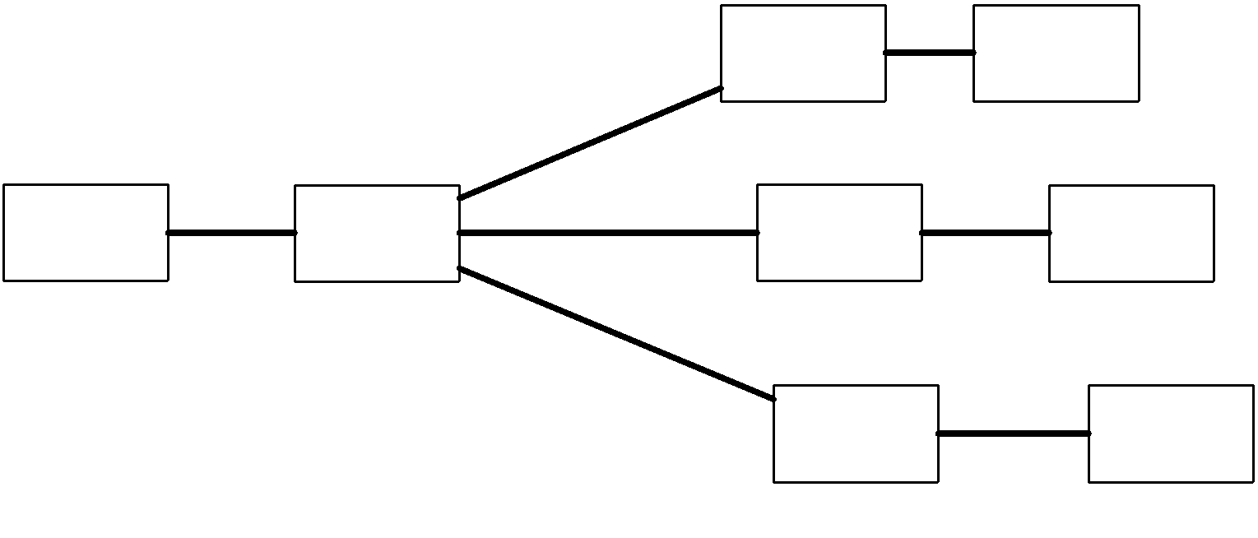
Exhaustive Testing Example 3 – IP Reachability
Problem: Find all 10.x.x.x addresses reachable from node 0 using ping
ping

Slide 16
Simulation Times
ping
ns-3
Take about 100 days to run 256x256x256 = 16,777,216 cases (10.x.x.x), each about 0.5 seconds
sym-ns-3
Take about 15 minutes and explore about 30 branches for symbolic IP destination 10.x.x.x
Necessary to check each IP to detect all possible bugs

Slide 17
Reported Ping RTTs
ping
Destination IP | Ping RTT (ms)
10.1.0.1 | 0
10.1.0.2, 10.1.255.255, 10.2.0.1, 10.2.255.255, 10.3.0.1, 10.3.255.255, 10.4.0.1, 10.4.255.255 | 10
10.2.0.2, 10.5.0.1, 10.5.255.255 | 70
10.5.0.2 | 72
10.3.0.2, 10.6.0.1, 10.6.255.255 | 110
10.6.0.2 | 116
10.4.0.2, 10.7.0.1, 10.7.255.255 | 150
10.7.0.2 | 164
Others | No reply for ping
Takes only about 15 minutes for 16 millions of ping tests

Slide 18
Outline
Why sym-ns-3?
How it works?
How to make it more efficient?
Conclusions

Slide 19
Making sym-ns-3 More Efficient
Notice we can make sym-ns-3 even more efficient
Goal: Reduce the number of branches
How? Redesign and rewrite simulator so that different cases share the same execution path as much as possible
So far, we have redesigned and rewritten
ns-3 event schedulers (ACM Transactions on Modeling and Computer Simulation 2022)
ns-3 routers (this WNS3 paper)

Slide 20
Redesign IP Routers
Redesign the code that compares symbolic IP addresses
Details in our WNS3 paper
Illustrating example - find the interface for a destination IP (dst)
original code: 5 branches (num of entries)
rewritten code: 3 branches (num of interfaces), keeping same simulation results
original code
rewritten code
entry1
if (dst matches entry1) //branch 1
return interface1
else if (dst matches entry2) //branch 2
return interface1
else if (dst matches entry3) //branch 3
return interface2
else if (dst matches entry4) //branch 4
return interface2
else //branch 5
return interface0
entry1
if (dst matches entry1 or entry2) //branch 1
return interface1
else if (dst matches entry3 or entry4) //branch 2
return interface2
else //branch 3
return interface0
entry2
entry2
entry3
entry4
entry3
other
entry4
other

Slide 21
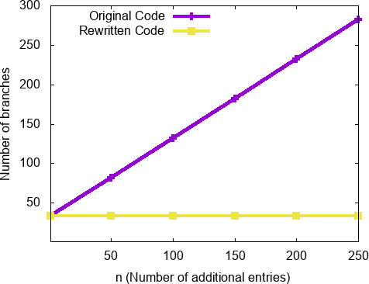
Exhaustive Testing Example 3
IP reachability example
Add multiple additional entries to routing table
Rewritten code reduces the number of branches
Destination | Mask | Interface
10.5.1.0 | 255.255.255.0 | 2
… | … | …
10.5.n.0 | 255.255.255.0 | 2
Additional entries to routing table of node 2

Slide 22
Outline
Why sym-ns-3?
How it works?
How to make it more efficient?
Conclusions

Slide 23
Conclusion
sym-ns-3 for efficient exhaustive testing
Future work
Continue improving the efficiency
More support for symbolic floating-point numbers
Project webpage (code, documents): https://symbolicns3.github.io
Acknowledgement: Supported in part by NSF-CCF-1918204

Slide 24
Backup Slides

Slide 25
Running ns-3 vs sym-ns-3
sym-ns-3
Each branch is conceptually a virtual machine running a copy of sym-ns-3.
Virtual Machine
ns-3
Symbolic Execution Platform
S2E symbolically executes
big software systems
https://github.com/S2E/s2e
Operating System
Operating System
Running ns-3
Running sym-ns-3

Slide 26
Redesign Event Schedulers
Redesign the code that compares symbolic event timestamps
Details in ACM Transactions on Modeling and Computer Simulation 2022
Illustrating example - determine whether event e1 or e2 executes first
original code: 3 branches
rewritten code: 2 branches, while keeping same simulation results
original code
rewritten code
if (e1.t < e2.t) { //branch 1
… // execute event e1
… // execute event e2
} else if (e1.t == e2.t) { //branch 2
… // execute event e1
… // execute event e2
} else { //branch 3
… // execute event e2
… // execute event e1
}
before
if (e1.t <= e2.t) { //branch 1
… // execute event e1
… // execute event e2
} else { //branch 2
… // execute event e2
… // execute event e1
}
before
same
time
same
time
after
after

