Slide 1
Clipping for Faster Wireless Network Simulation in ns-3
Presenter: Benjamin Newton
Team: Michael Scoggin, Anand Ganti, Vincent Hietala, and Uzoma Onunkwo
Workshop on ns-3 (WNS3) 2022
June 22, 2022
SAND2022-8307 C

Slide 2
Outline
Motivation
How clipping works
Results
Contrived Static Grid Comparison
Realistic 5G Simulation
Future work

Slide 3
Large-Scale Wireless Network Simulation Vision
Researchers should be able to run experiments with:
Millions of mobile nodes
Hundreds of cell towers
Thousands of WiFi access points
Large ad hoc networks
Realistic node movement
Normal rates/patterns of data transfer
Accurate simulation of every level of the network stack
Tweakable Parameters
Sensible runtimes
Repeatable and reproducible
1.5 second 5G simulation
required over 10 hours to
simulate fewer than 6,000
nodes.

Slide 4
Where is the Research to Advance this Vision?
Google Scholar search: “large scale wireless network simulation”
In the top 10 hits (as of June 2022):
Most were for wireless sensor networks.
Only 3 papers really matched
Written ~17 years ago
Simulating only about 3,000-5,000 nodes.
There appear to be very few recent papers concentrating on this topic

Slide 5
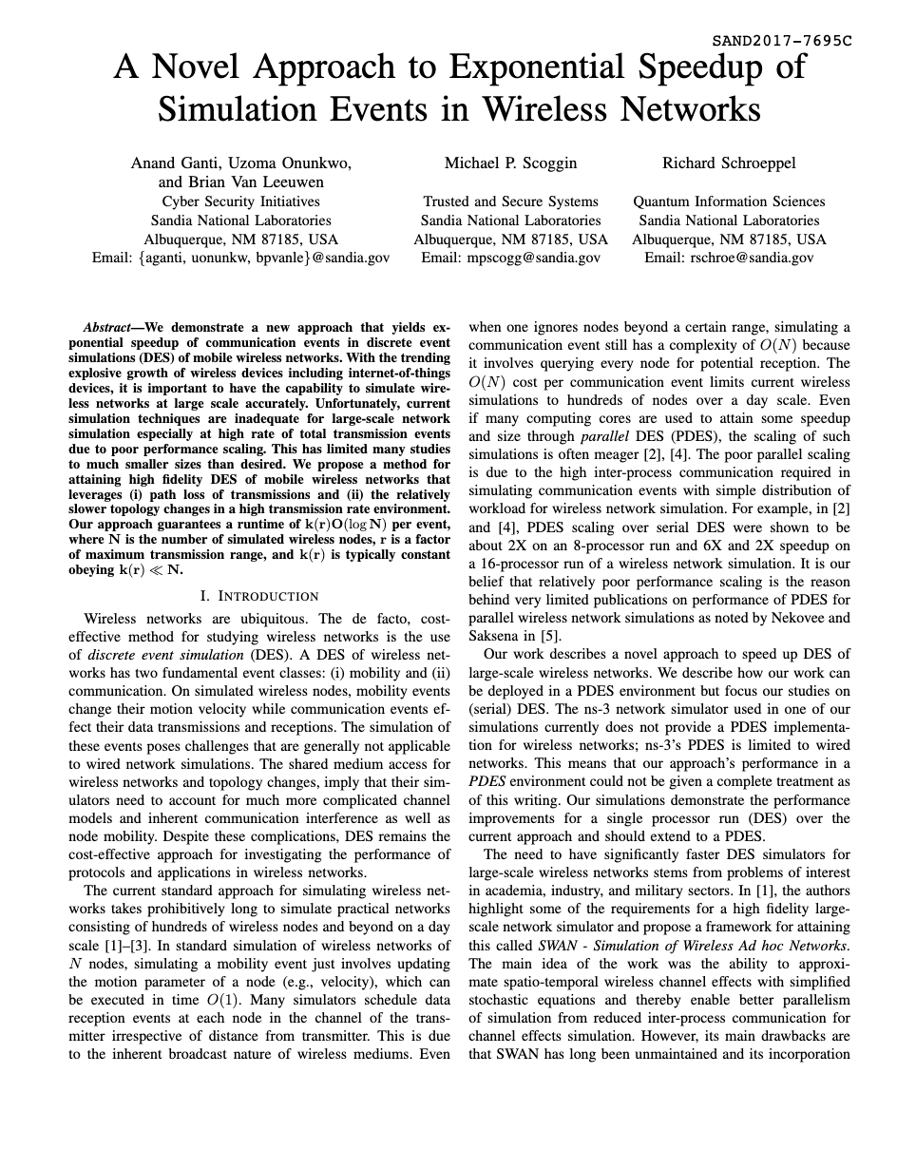
PDES in ns-3
Currently ns-3 supports PDES, but only for wired links.
Static delay values enable conservative synchronization guarantees.
PDES for wireless mobile nodes is hard.
Optimistic PDES requires the ability to reverse every function
Until wireless PDES works, are there other viable optimizations?
We present a clipping optimization that applies efficiently to static and mobile networks

Slide 6
Events Scheduled on Every Node
…
Receive event for every node
Receive N | 10.008
Receive M | 10.0078
Receive L | 10.0075
Receive K | 10.007
Receive J | 10.0068
Receive I | 10.0067
Receive H | 10.0066
Receive G | 10.0065
Receive F | 10.0064
Receive E | 10.0062
Receive D | 10.006
Receive C | 10.005
Receive B | 10.001
Transmission radius
Event Priority Queue
A
B
ns-3 sends every packet to every wireless receiver in the same channel in a simulation
This can be inefficient for certain large-scale simulations

Slide 7
Clipping Avoids Extra Overhead
Receive events only for nodes within clipping radius
…
Receive D | 10.006
Receive C | 10.005
Receive B | 10.001
Transmission radius
Event Priority Queue
A
B
Clipping radius
C
D
Clipping: Only schedule receive events on nodes within some clipping radius

Slide 8
Determining Nodes Within the Clipping Radius
Need to be able to list all the nodes
within A’s clipping radius. {B,C,D}
A
Compute distance from A to
every other node.
B
Clipping radius
Bad idea
C
D

Slide 9
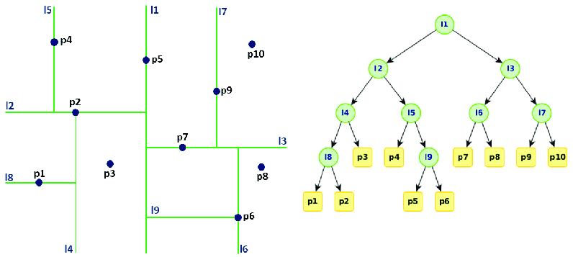
Spatial Indexing
[John Anzola, et. al.]
Instead, use a k-d tree space partitioning data structure to
organize node locations for fast ”look up” of nodes within range.

Slide 10
Contrived Static Grid Simulation
Grid of N nodes spaced d units apart
…
width
…
transmission range
clipping range
d
width
Each node transmits a single broadcast message
Clip Range = 519 meters (intentionally small)
Node Separation = 367 meters
Notes:
d*($\sqrt{N}$-1)

Slide 11
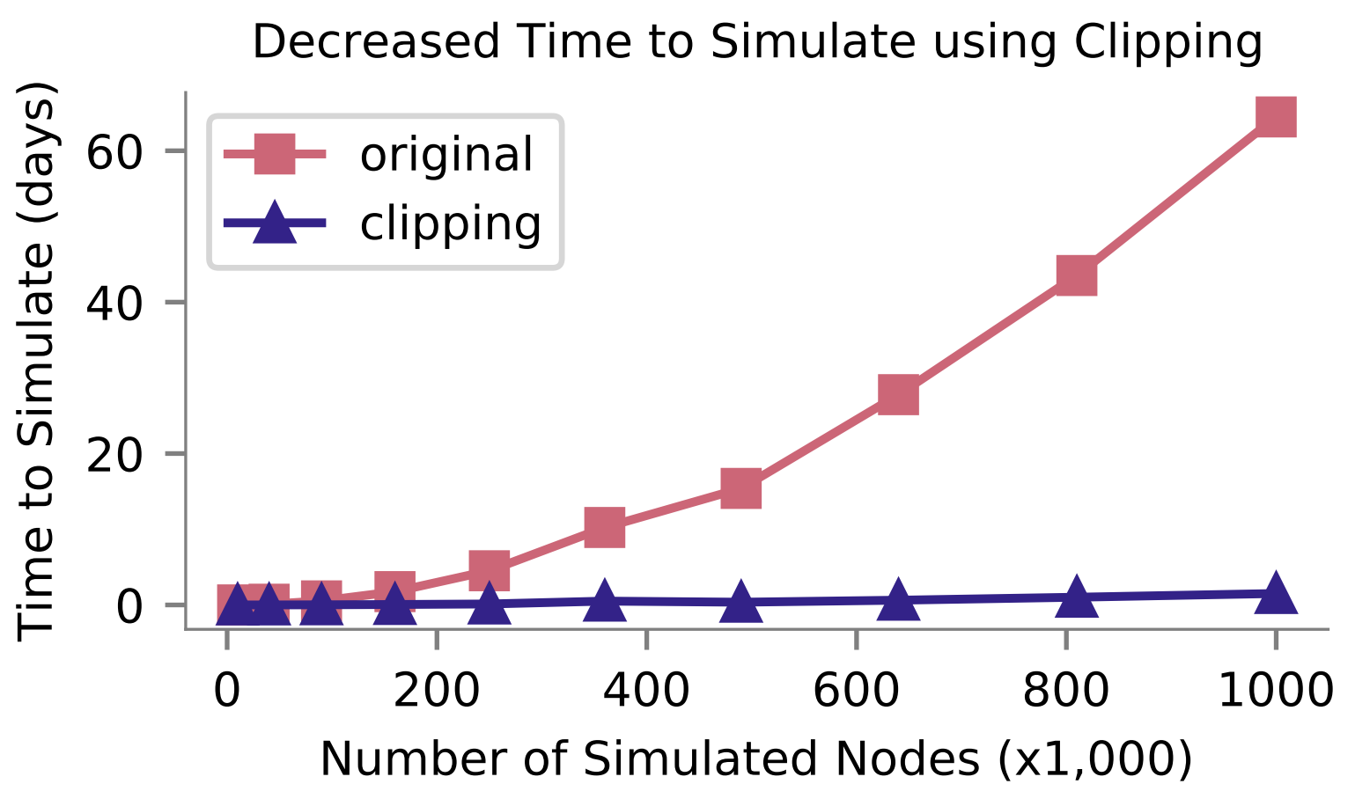
Decreased Time to Simulate
~64 days
1 million nodes
~43x speedup
~36 hours
Notes:
Intel Xeon Gold 6244 Processor

Slide 12
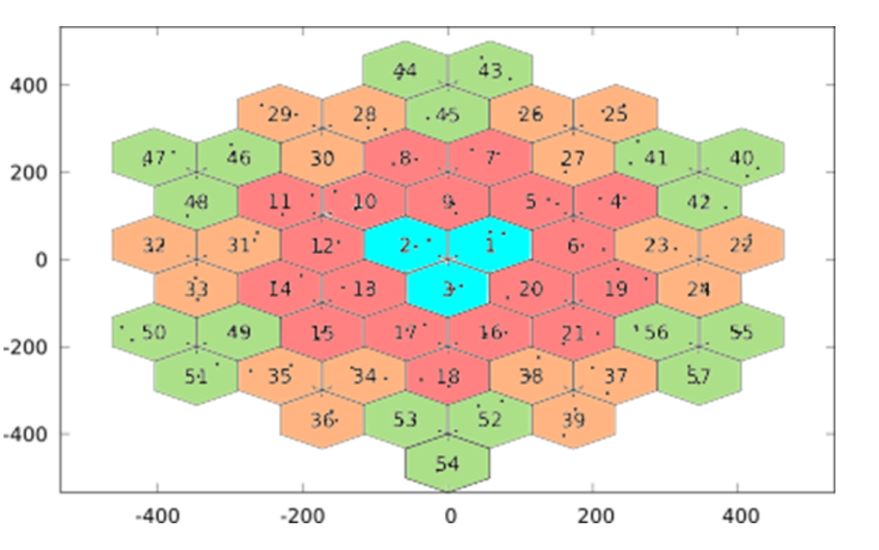
5G Simulation
5G Simulation code from CTTC (lena-lte-comparison)
19 5G cell towers
each with 3 gNodeBs
each with N UEs (user equipment)
1.5 second simulation (.5 seconds setup/tear down)
Stationary Nodes
Network quickly saturated as N grows, allows for validating accuracy even with heavy congestion
Transmission radius is about 2 km
5G is one of the most challenging simulations to speed up since a large amount of processing time is required for the complex protocol
[CTTC]

Slide 13
5G Simulation - Speedup
10 km
original
~2x
speedup
~3x
speedup

Slide 14
5G Simulation - Throughput
Smaller clipping radius
excludes some interference
resulting in higher throughput

Slide 15
5G Simulation – Throughput Error
Clipping at 3km yields very accurate throughput.

Slide 16
5G Simulation – Mean Delay
Maximum deviation in delay of 7.45 ms (17.87%) for 2km,
and 1.85 ms (4.71%) for 3 km

Slide 17
Future Work & Conclusion
Future Work
Aggregate interference from distant regions
Develop tools to assist in setting clipping radius
More complex clipping for directional antennas, etc
Clipping
Up to 43x speedup for contrived network
2 - 3x speedup for complex 5G network
Minimal impact on fidelity
Awaiting integration into ns-3
We hope clipping will be a useful tool for those designing and testing the next generation of large-scale wireless networks.

Slide 18
Questions?
Happy to answer any questions
bdnewto@sandia.gov

Slide 19
Backup Content

Slide 20
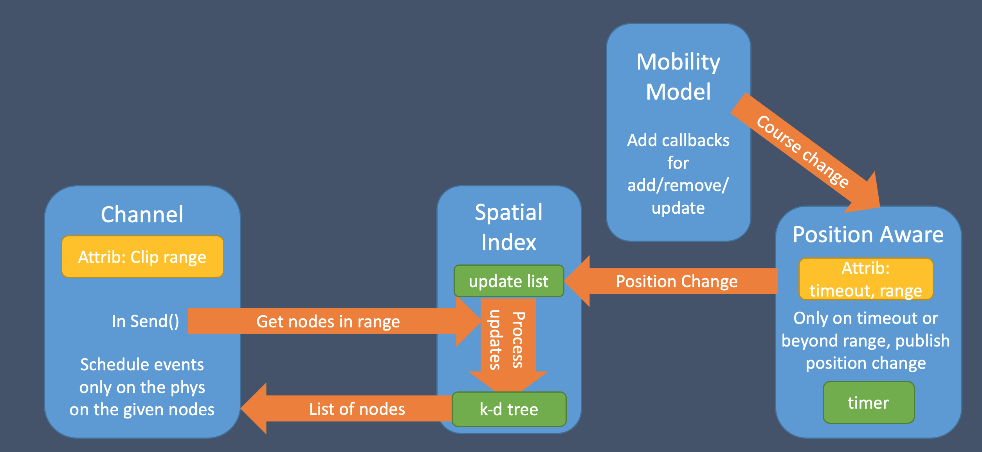
System Diagram
Position Aware “buffers” position updates. Spatial Index maintains a k-d tree of
node positions. Channel now gets “nodes in range” before scheduling receive events.

