Slide 1
ns3-fl: Simulating Federated Learning with ns-3
Emily Ekaireb, Xiaofan Yu, Kazim Ergun, Quanling Zhao, Kai Lee, Muhammad Huzaifa, Tajana Rosing

Slide 2
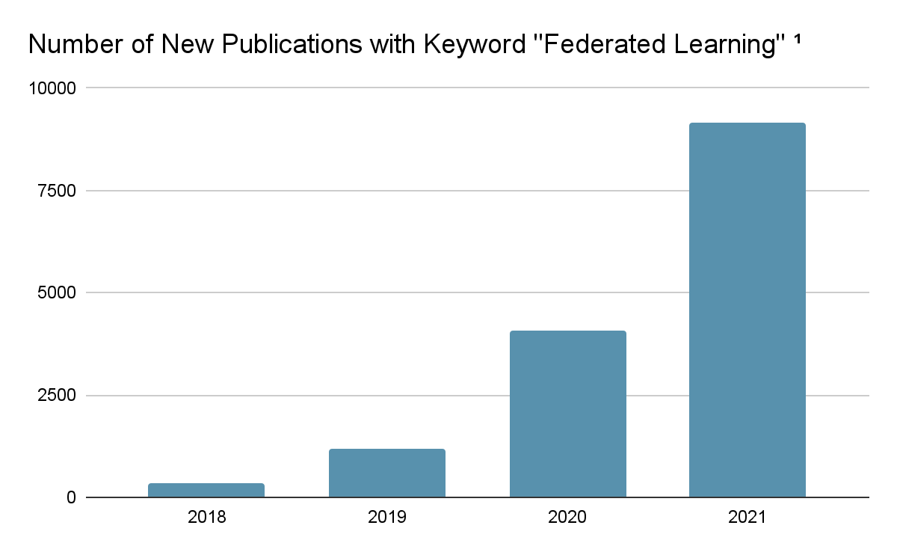
Federated Learning
1. This data was taken from Google Scholar results for “Federated Learning”

Slide 3
Practical Performance of FL
Practical performance of FL is dependent on:
Data
Dataset
Data distribution
Independently and Identically Distributed (IID) or non-IID
Network
Quality of communication between clients and server
Network heterogeneity
Algorithm
Federated Learning process
Server
model updates
Client
Client
local data
local data

Slide 4
Existing FL Simulators
Existing FL simulation tools have limited support for network component
FedJAX [Google Research ‘21], FedML [NeurIPS ‘20], flsim [IEEE INFOCOM ‘20]
Support algorithmic development, and provide standard datasets, models and algorithms
No network component
FLPrivacy [CIKM ‘20]
Configurable privacy scenarios
Static network settings → presetting clients drop outs and latencies for each client
Our contribution: ns3-fl
Considers data, network, and algorithm
Estimates energy consumption with power model

Slide 5
Our Contribution: ns3-fl
ns3-fl can be used to study tradeoffs and design decisions in FL deployments
Configurability in algorithm → number of selected clients per round, number of epochs, client selection policy, type of algorithm
Configurability in data → Dataset, Data distribution (IID vs Non IID)
Configurability in network → Network topology, network quality and type
Can study:
Energy trade-offs (computational vs communication)
Effects on real clock convergence time
Effects on accuracy

Slide 6
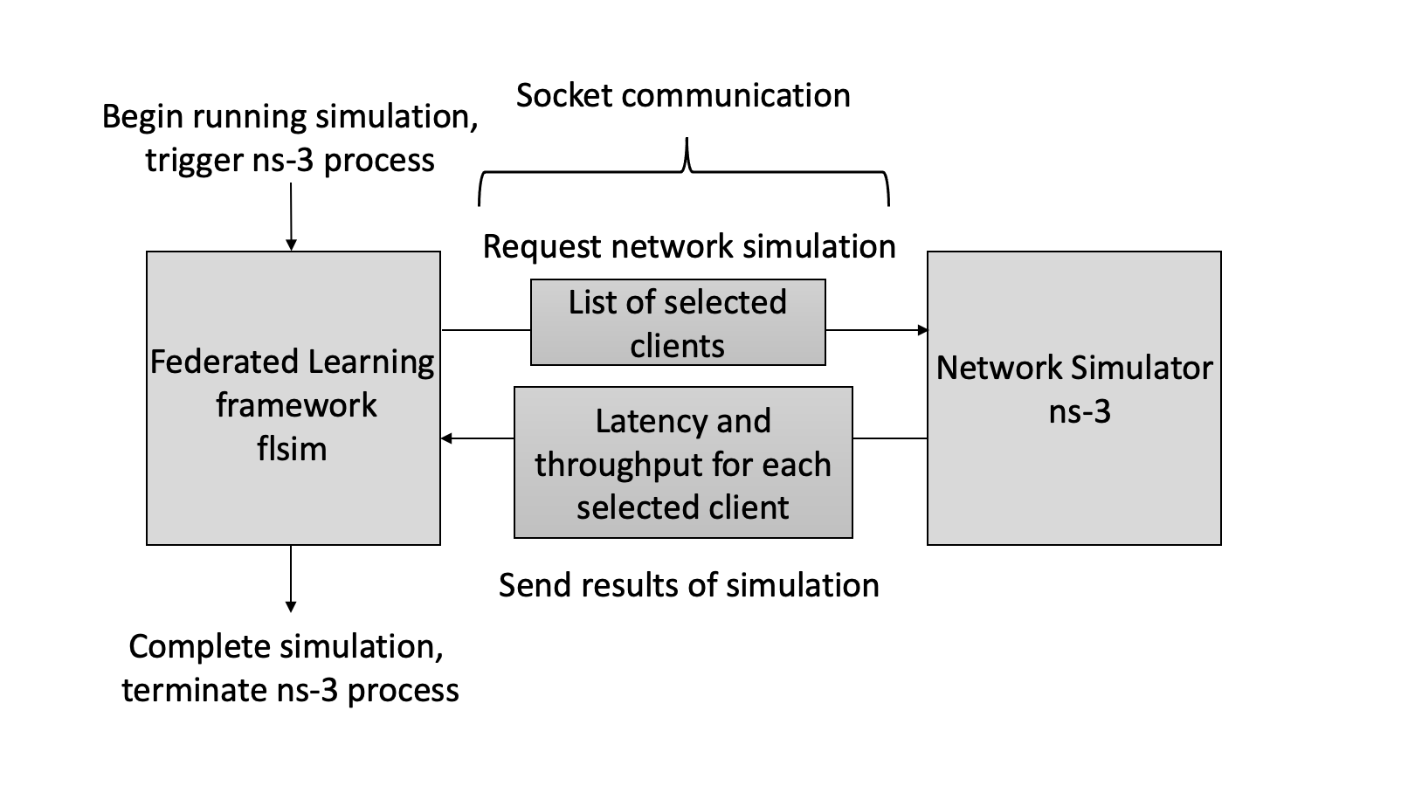
Architectural Overview of ns3-fl

Slide 7
Software Blocks
Flsim
Developed for experimental FL research
Configurable options for datasets, data distribution, models, and server types (algorithm)
Simulates Federated Learning and data distribution
ns-3
A discrete event network simulator
Supports different communication models (wifi, ethernet, etc) and provides loss/error rate models
Simulates network
ns3-fl
flsim
ns-3
Training Simulation
Network Simulation
FL Algorithm
Network Statistics
Data Distribution
Power Calculation

Slide 8
Learning Model
Synchronous FL (FedAvg¹)
Asynchronous FL (FedAsync²)
Update Global Model
Update Global Model
Server
Server
Client
Client
Client
Client
local data
Client
local data
local data
Client
local data
local data
local data
1. Brendan McMahan, Eider Moore, Daniel Ramage, Seth Hampson, and Blaise Aguera y Arcas. 2017. Communication-efficient learning of deep networks from decentralized data. In Artificial Intelligence and Statistics. PMLR, 1273–1282.
2. Cong Xie, Oluwasanmi Koyejo, and Indranil Gupta. 2019. Asynchronous Federated Optimization. ArXiv abs/1903.03934 (2019).

Slide 9
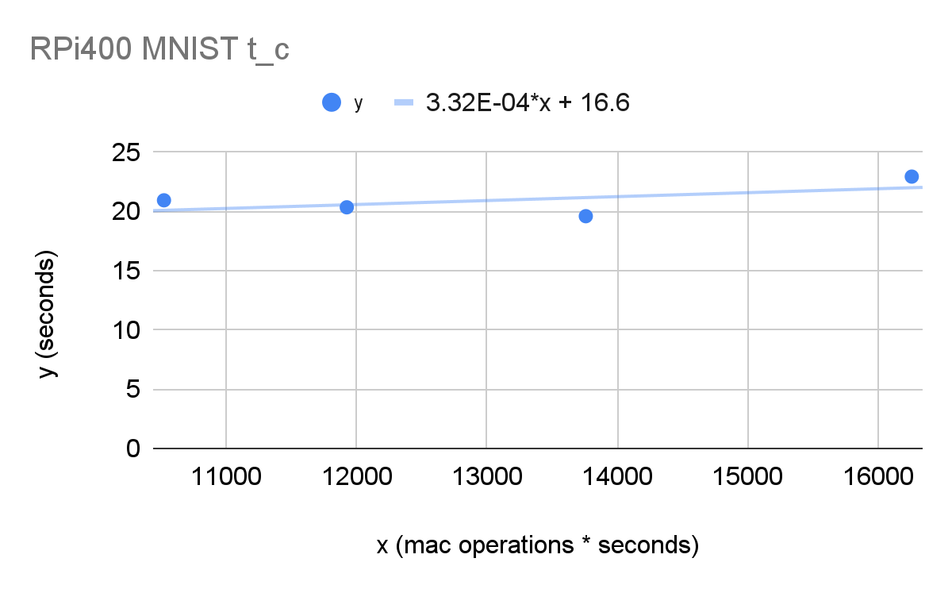
Power Model
Transmission Energy
Computational Energy
Computational Time
Computational Power
Where is number of local epochs per round,
is the number of MAC operations/epoch
is the CPU frequency

Slide 10
Network Model
local data
local data
Latency
Where is the downlink time
is the computation time
is the uplink time
Throughput
Where is the number of
bytes received by the server
from the client
Client
Client
Server
Client
Client
local data
local data

Slide 11
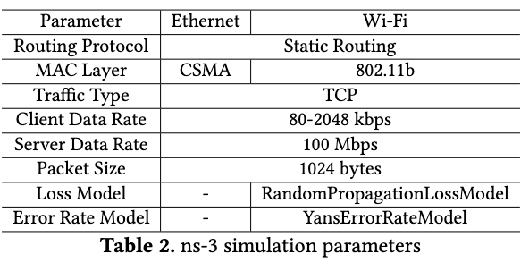
Experimental Setup
Algorithms
FedAvg [1]
FedAsync [2]
Dataset
MNIST, FashionMNIST, CIFAR-10
IID → samples on each client follow dataset distribution
Non-IID → sample one class from each client with uniform label distribution
Network
McMahan, Brendan, et al. "Communication-efficient learning of deep networks from decentralized data." Artificial Intelligence and Statistics. PMLR, 2017.
Xie, Cong, Sanmi Koyejo, and Indranil Gupta. "Asynchronous federated optimization." arXiv preprint arXiv:1903.03934 (2019).

Slide 12
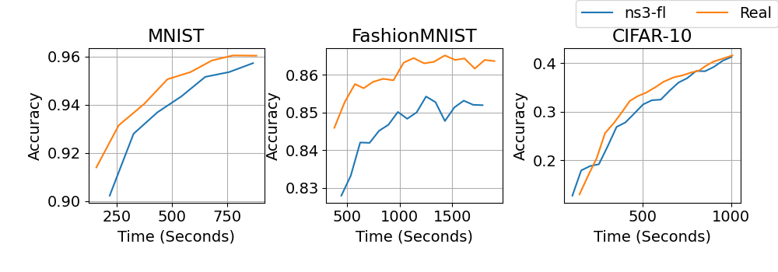
Validation with Real Deployment
Convergence validation of ns3-fl against a real RPi deployment with 6 clients and one server on various datasets.
Results show at most 1.6% difference in the accuracy and 0.9% difference in the convergence times.

Slide 13
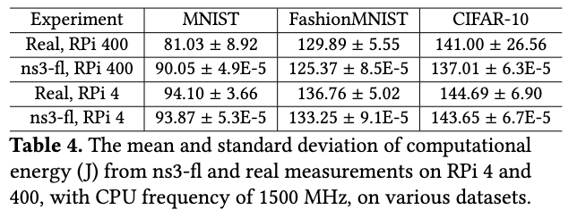
Validation with Real Deployment
10.5% Difference for RPi 400
2.6% Difference for RPi 4

Slide 14
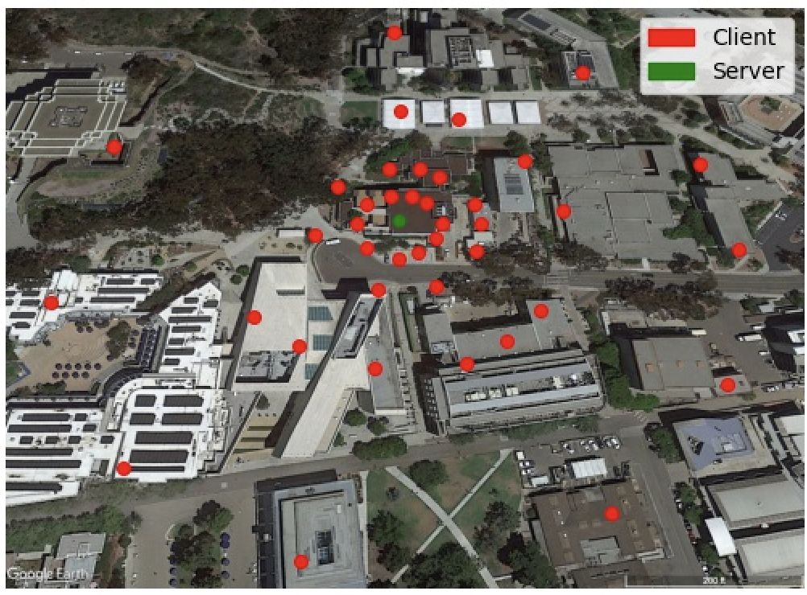
Large-Scale Deployment Simulation
Training over 40 Raspberry Pis, placed on the UCSD campus
Demonstrate how ns3-fl can assist design of FL deployments

Slide 15
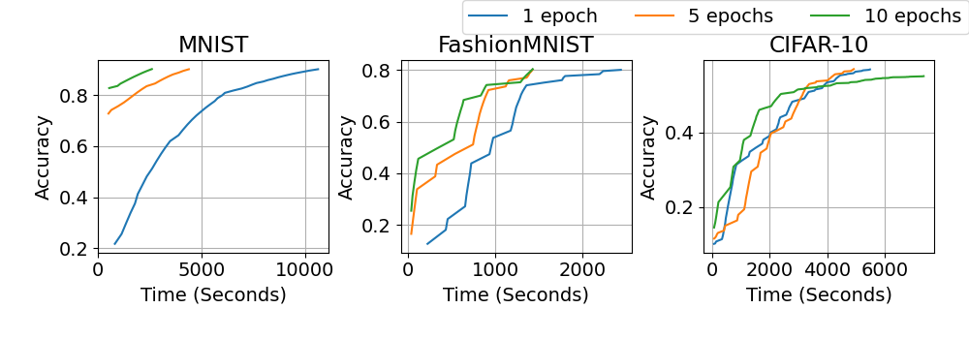
Large-Scale Deployment Simulation
Convergence of ns3-fl when varying the local epochs per round over a Wi-Fi network.

Slide 16
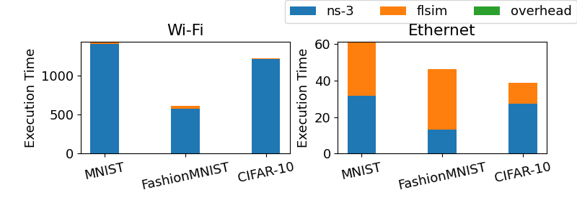
Simulation Performance
Breakdown of Execution Time (Seconds) of ns3-fl on a Synchronous FL Round over a Wi-Fi Network and an Ethernet Network.

Slide 17
Summary
ns3-fl is a Federated Learning Simulator
Data, Network, and Algorithm
Compared against real deployment of RPis:
1.6% difference in the accuracy
0.9% difference in the convergence times
10.5% difference in the energy consumption
Can be easily extended by users to utilize different datasets, FL algorithms, and networks
Can help in design of FL deployments
Thank you for listening! Any questions?

Slide 18
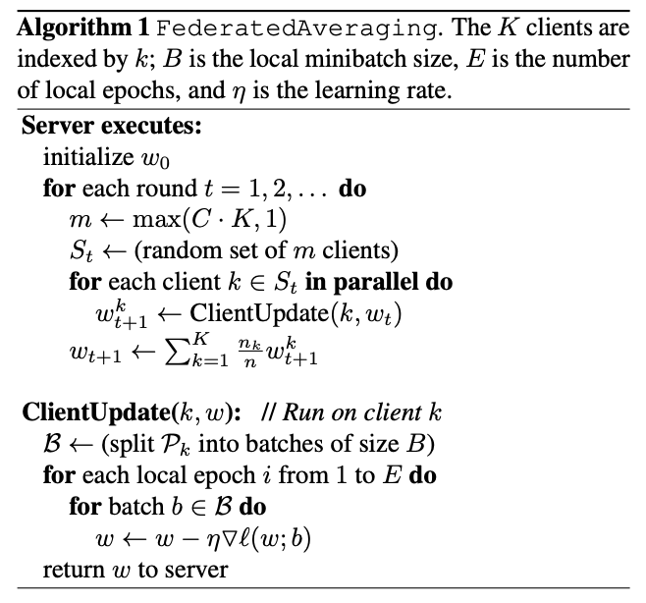
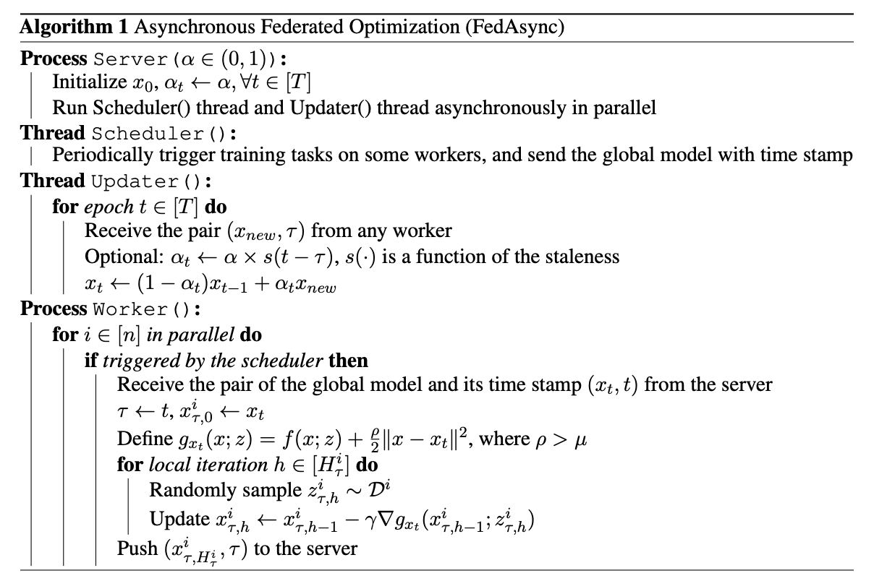
Learning Model
FedAvg¹
FedAsync²
1. Brendan McMahan, Eider Moore, Daniel Ramage, Seth Hampson, and Blaise Aguera y Arcas. 2017. Communication-efficient learning of deep networks from decentralized data. In Artificial Intelligence and Statistics. PMLR, 1273–1282.
2. Cong Xie, Oluwasanmi Koyejo, and Indranil Gupta. 2019. Asynchronous Federated Optimization. ArXiv abs/1903.03934 (2019).

Slide 19
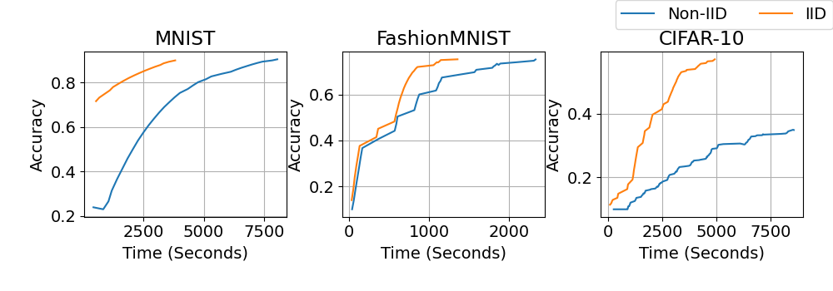
Large-Scale Deployment Simulation
Convergence of ns3-fl when varying the local
epochs per round over a Wi-Fi network.
Convergence of training on IID v. Non IID data
distribution over a Wi-Fi network.

Slide 20
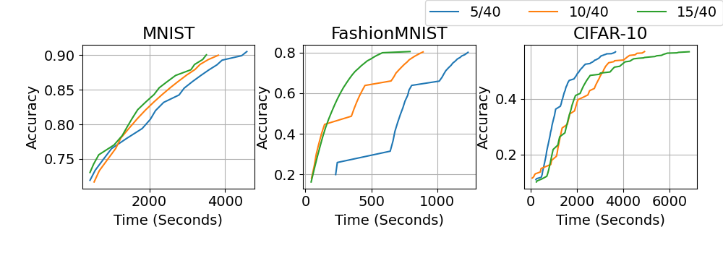
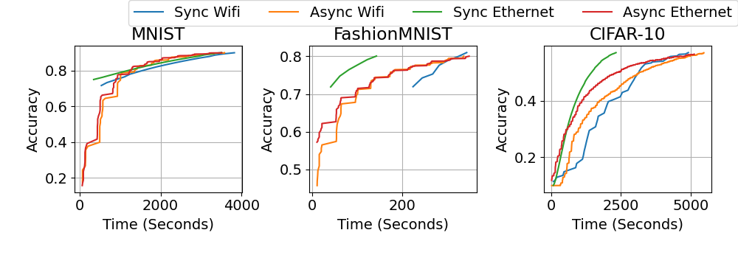
Large-Scale Deployment Simulation
Convergence of ns3-fl when selecting 5, 10, or 15 clients per round over a Wi-Fi network.
Convergence of ns3-fl when using synchronous FL and asynchronous FL over a Ethernet and Wi-Fi network.

Slide 21
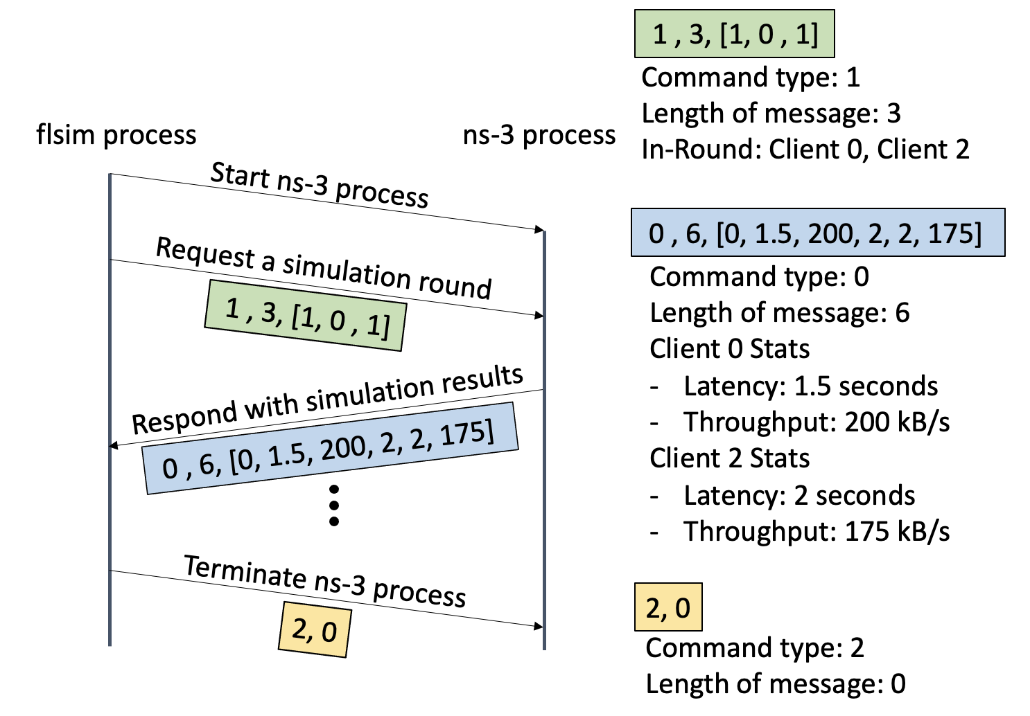
Implementation: Sync FL Process Comm.

Slide 22
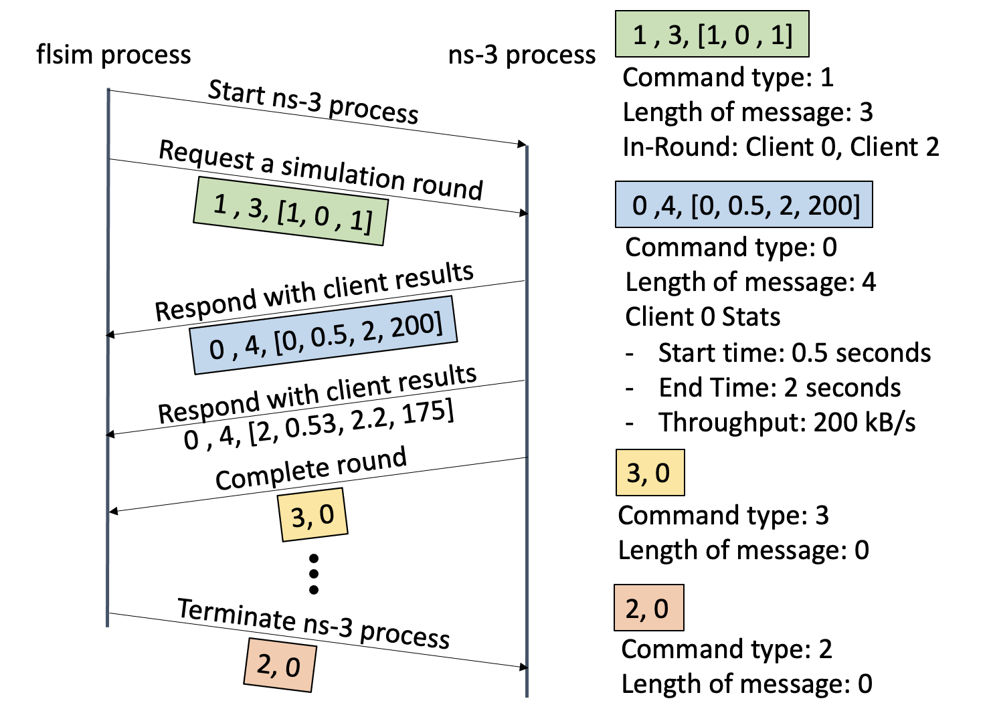
Implementation: Async FL Process Comm.

Slide 23
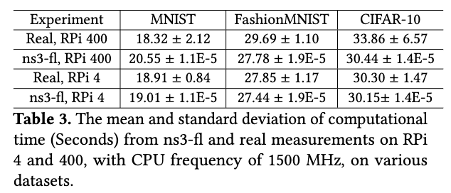
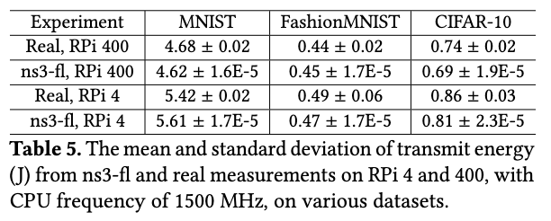
More Power Model Results

