Slide 1
Implementation and Evaluation of IEEE 802.11ax Channel Sounding Frame Exchange in ns-3
WNS3 2023, June 28–29, 2023, Arlington, VA, USA
Jingyuan Zhang
School of ECE
Georgia Institute of Technology
Stefano Avallone
Computer Engineering Department
University of Naples
Douglas M. Blough
School of ECE
Georgia Institute of Technology

Slide 2
Background
Missing feature of MU-MIMO in ns-3
- No functionality of CSI feedback
Reasons for adding channel sounding in ns-3
- Channel sounding is a critical step to implement MIMO-related simulation (beamforming, multi-user MIMO) in IEEE 802.11ax.
- Instantaneous channel matrix is a key component for coordinated null steering, which is one of multi-AP coordination schemes for upcoming IEEE 802.11be.

Slide 3
Contributions
Implementation of channel sounding frame exchange in MAC layer based on IEEE 802.11ax
- Functionality to generate new frames in ns-3 that are required for channel sounding
- Frame exchange logic for channel sounding for both single-user (SU) and multi-user (MU) cases
- Functionality to generate well-structured beamforming reports with various choices of CSI resolutions and quantity according to IEEE 802.11ax
- A simple multi-user scheduler for MU-MIMO, which selects users for channel sounding and MU-MIMO data transmission.

Slide 4
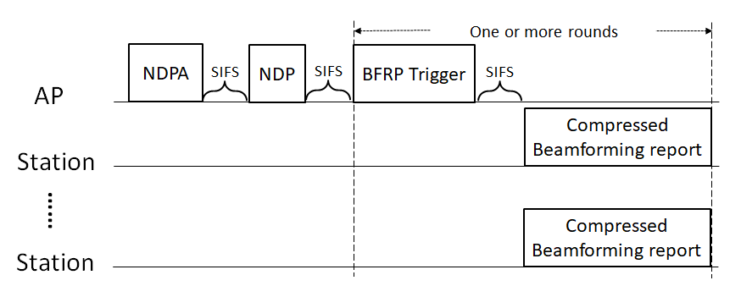
Preliminaries
Channel Sounding in IEEE 802.11ax
Single-user case:
Multi-user case:

Slide 5
Preliminaries
Frame Formats
NDPA frame format
STA Info:
Resource unit (RU) range
Number of columns in compressed beamforming matrix
Subcarrier grouping
Codebook size
Compressed Beamforming Report frame

Slide 6
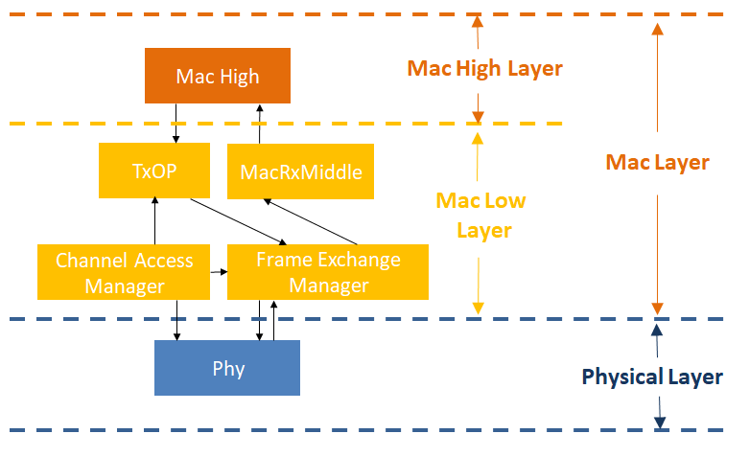
Implementation of Channel Sounding Protocol
HE Capability configuration
HeConfiguration, HeCapabilities, WifiMac
Code Structure
Structures of new frames
CtrlTriggerUserInfoField, CtrlNdpaHeader (new),
WifiActionHeader, HeMimoControlHeader (new), HeCompressedBfReport(new), HeMuExclusiveBfReport (new)
Frame exchange
and user scheduling
HeFrameExchangeManager, RrMultiUserScheduler,
MultiUserScheduler,
HeRu, WifiTxTimer
Management of channel information and channel sounding frames
ChannelSounding (new),
CsBeamformer (new), CsBeamformee (new)
ns-3 WiFi module framework
Modified and added classes

Slide 7
Implementation of Channel Sounding Protocol
HE Capability Configuration
HE PHY Capabilities Information fields related to channel sounding in IEEE 802.11ax:
Ng = 16 SU Feedback
Ng = 16 MU Feedback
Codebook Size (ϕ, ψ) = {4, 2} SU Feedback
Codebook Size (ϕ, ψ) = {7, 5} MU Feedback
Max Nc
Contribution:
The above 5 attributes are added in the class of HeConfiguration.
ns-3 users are allowed to configure these parameters by calling SetAttribute().

Slide 8
Implementation of Channel Sounding Protocol
New Frames - NDPA Frame (Control frame)
New Frames – BFRP Trigger Frame (Control frame)
NDPA header
New member variable in CtrlTriggerUserInfoField:
- m_bfrpTriggerDependentUserInfo
Main methods:
SetBfrpTriggerDepUserInfo
GetBfrpTriggerDepUserInfo
A new class called CtrlNdpaHeader is added in ctrl-header.h and ctrl-header.cc.
Member variables:
m_dialogToken: the field of Sounding Dialog Token
m_staInfoFields: STA Info fields
Main methods:
AddStaInfoField
FindStaInfoWithAid

Slide 9
Implementation of Channel Sounding Protocol
New Frames - Beamforming Report Frame (Management frame)
HeMimoControlHeader
Built based on STA Info field in NDPA frame
HeCompressedBfReport
- Built based on HE MIMO Control field and channel information
HeMuExclusiveBfReport
- Built based on HE MIMO Control field and channel information

Slide 10
Implementation of Channel Sounding Protocol
Management of Channel Information and Channel Sounding Frames
ChannelSounding
(Base class)
Channel information struct:
ChannelInfo: { m_stStreamSnr, m_phi, m_psi, m_deltaSnr}
Main member variables:
- m_channelInfoList: a list of struct ChannelInfo storing acquired CSI
Main methods:
GenerateNdpaFrame
GetBfReportInfo
CheckAllChannelInfoReceived
CheckChannelSounding
CsBeamformer
(Derived class)
Main member variables:
m_heMimoControlHeader
m_channelInfo
Main methods:
CalculateChannelInfo
GetNdpaInfo
GetNdpInfo
GenerateBfReport
CsBeamformee
(Derived class)

Slide 11
Implementation of Channel Sounding Protocol
Multi-User Scheduling
Primary goal: Schedule as many stations as possible in the current TXOP
RrMultiUserScheduler::TryChannelSounding()
Channel sounding scheduling
Add stations one by one until the estimated duration of the channel sounding process exceeds the current TXOP or the maximum number of supported users is reached
Allocate equal-sized RUs to various stations in MU case
Generate NDPA frame, NDP frame and BFRP trigger frame (if it is an MU case)
MU-MIMO data transmission scheduling
Schedule MU-MIMO data transmission in the current TXOP if there is remaining time in the current TXOP after channel sounding is completed.
Schedule MU-MIMO data transmission in a new TXOP if the is remaining time in current TXOP is not enough.

Slide 12
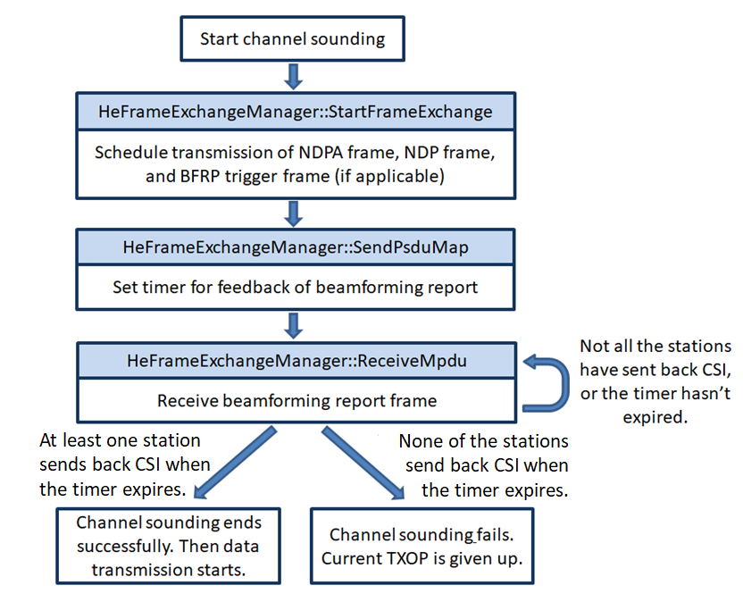
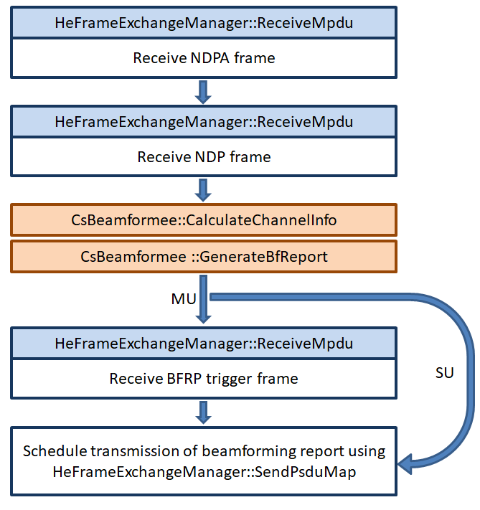
Implementation of Channel Sounding Protocol
Frame Exchange Process
AP side
Station side

Slide 13
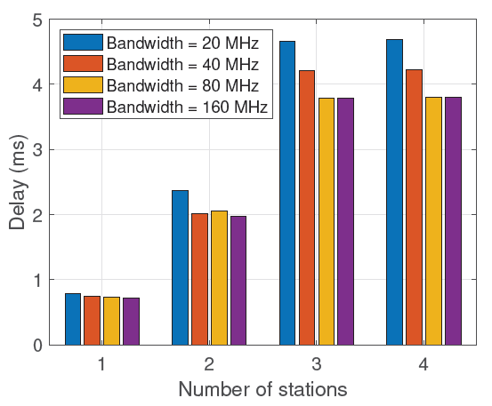
Simulation - Impact of Channel Sounding on Latency
Worst-Case Channel Sounding Duration vs. Number of Stations
The sounding duration is short for the single-user case, while the duration is non-negligible with 3 and 4 stations.
The sounding duration generally decreases as the channel bandwidth increases.
Sounding Duration vs. Number of Stations (Nr = 4, Nc = 4, Ng = 4, Codebook Size = (6,4) and (9,7), HE MCS0)

Slide 14
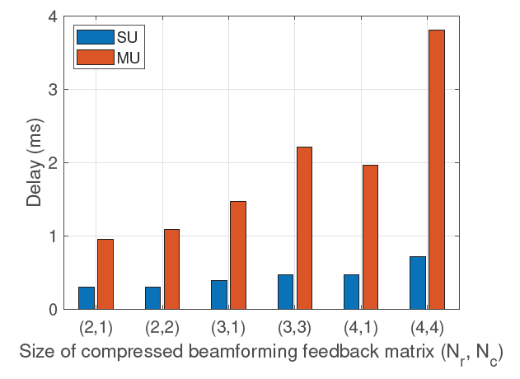
Simulation - Impact of Channel Sounding on Latency
Worst-Case Channel Sounding Duration vs. Size of Compressed Beamforming Feedback Matrix
Sounding duration increase when the matrix size increases from (2, 1) to (4, 4):
- 140% increase in SU case
- nearly 300% in the MU case
SU case vs. MU case
- HE MU Exclusive Beamforming Report field
Sounding Duration vs. Size of beamforming Feedback Matrix (𝑁𝑟 , 𝑁𝑐 ) (Bandwidth = 160MHz, Ng = 4, Codebook Size = (6,4) and (9,7), HE MCS0, 4 Stations for MU Case)

Slide 15
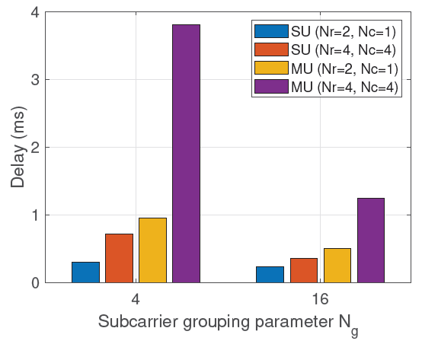
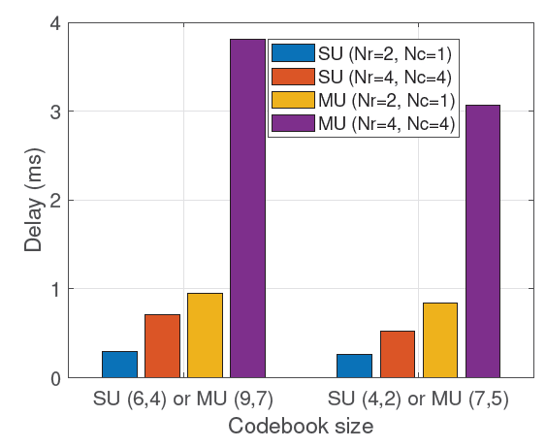
Simulation - Impact of Channel Sounding on Latency
Overhead Reduction by Adjustment of Subcarrier Grouping
Overhead Reduction by Adjustment of Codebook Size
Sounding Duration vs. Subcarrier Grouping (Bandwidth = 160MHz, Codebook Size = (6,4) and (9,7), HE MCS0, 4 Stations for MU Case)
Sounding Duration vs. Codebook Size (Bandwidth = 160MHz, Ng = 4, HE MCS0, 4 Stations for MU Case)
It is more effective to reduce channel sounding duration by tuning the subcarrier grouping than the codebook size.

Slide 16
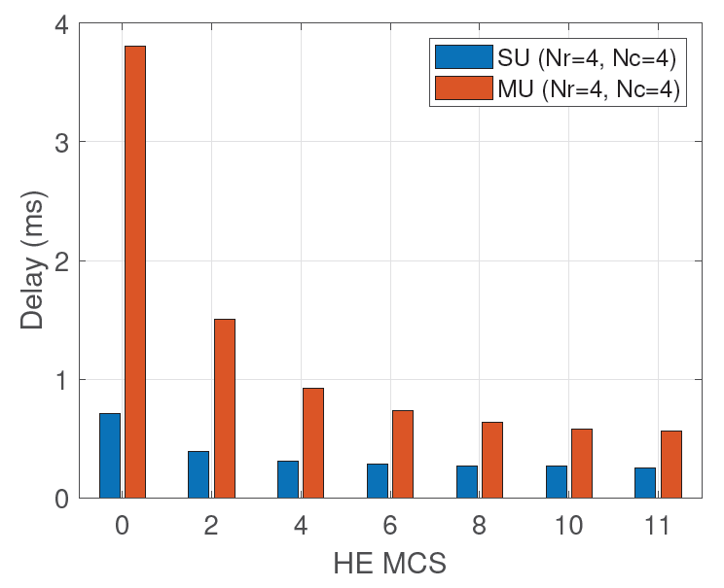
Simulation - Impact of Channel Sounding on Latency
Overhead Reduction with Higher MCS Levels
Duration reduction when MCS increases from HE MCS0 to HE MCS11:
- 65% reduction in SU case
- 85% reduction in MU case
Sounding Duration vs. MCS (Bandwidth = 160MHz, Ng = 4, Codebook Size = (6,4) and (9,7), 4 Stations for MU Case)

Slide 17
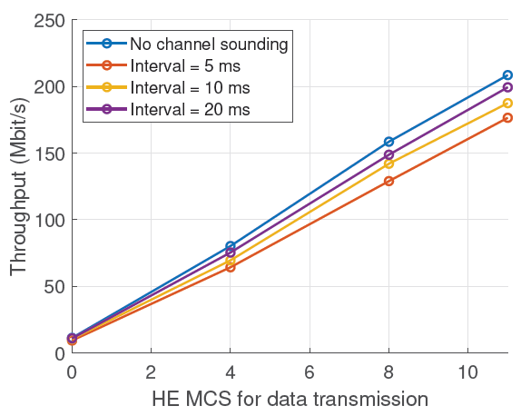
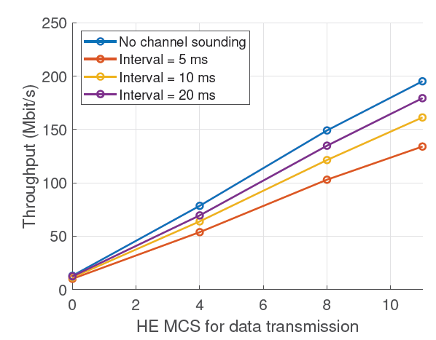
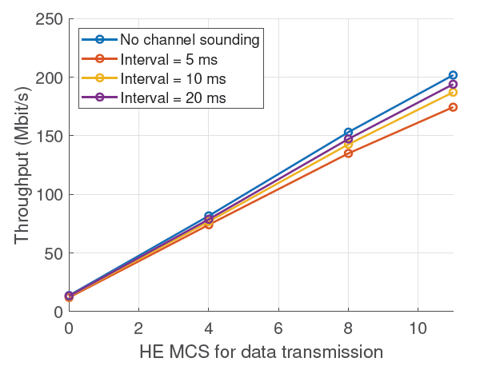
Simulation - Impact of Channel Sounding on Throughput
Throughput vs. Channel Sounding Intervals
(a) Scenario 1: 2 stations with 1 stream per station, (𝑁𝑟 , 𝑁𝑐 ) = (4, 1)
(b) Scenario 2: 2 stations with 2 streams per station (only 1 station
is selected for downlink data transmission), (𝑁𝑟 , 𝑁𝑐 ) = (4, 2)
(c) Scenario 3: 1 station with 2 streams, (𝑁𝑟 , 𝑁𝑐 ) = (4, 2)
The throughput drops monotonically as the channel sounding interval becomes shorter.
The greatest impact on throughput occurs for Scenario 2, because it is MU case and it has the largest channel matrix feedback.

Slide 18
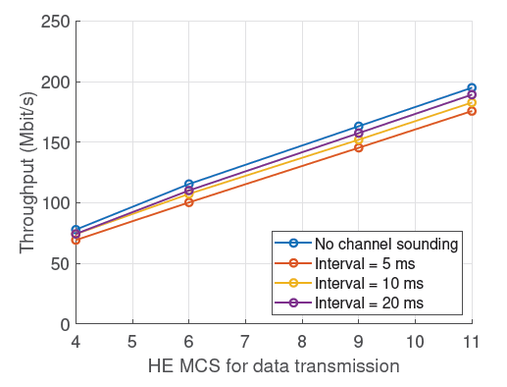
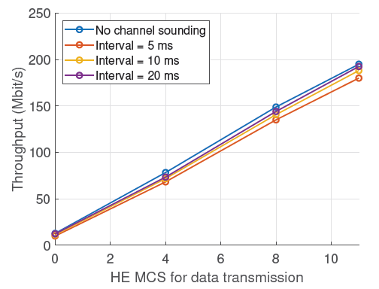
Simulation - Impact of Channel Sounding on Throughput
Throughput vs. MCS level
(a) HE MCS 4 is used for beamforming report feedback
(b) Same HE MCS is used for beamforming report feedback and
MU-MIMO data transmission
If the power constraint at users is not considered and a higher MCS level is used for both uplink CSI feedback and downlink data transmission, there is very little additional benefit, as compared to using HE MCS4 for beamforming report frames.

Slide 19
Conclusions
Implementation of MAC-layer CSI feedback process in ns-3:
- New channel sounding frames
- Frame exchange logic in both SU and MU cases
- Multi-user scheduler for channel sounding and MU-MIMO data transmission
Evaluation of channel sounding overhead and impact of channel sounding on network throughput

Slide 20
Thank you for listening !

