Slide 1
ns-3 Implementation of Sub-Terahertz and Millimeter Wave Drop-based NYU Channel Model (NYUSIM)
Hitesh Poddar*, Tomoki Yoshimura†, Matteo Pagin ‡, Theodore S. Rappaport*,
Art Ishii† and Michele Zorzi‡
*{hiteshp, tsr}@nyu.edu
†{yoshimurat, ishiia}@sharplabs.com
‡{paginmatte, zorzi}@dei.unipd.it
2023 Workshop in ns-3
28th June 2023
This work is supported by the NYU WIRELESS industrial affiliates program and the commissioned research (No.04201) from the National Institute of Information and Communications Technology (NICT), JAPAN.

Slide 2
Agenda
THz Spectrum and Applications
NYUSIM 3-D Statistical Channel Model (SCM)
NYUSIM 4.0: Sub-THz and mmWave Channel Simulator
Overview of NYUSIM in ns-3
Implementation of NYUSIM 4.0 in ns-3
Results
Conclusions

Slide 3
New Consumer Usage above 100 GHz
FCC ET DOCKET 18-21 SPECTRUM HORIZONS
Unlicensed Operation
Maximum EIRP of 40 dBm (average) and 43 dBm (peak) for mobile.
Maximum EIRP of 82-2 $×$(51- $GTX$) dBm (average) and
85-2 $×$(51- $GTX$) dBm (peak) for fixed point-to-point.
Out-of-band emission limit 90 pW/cm² at three meters.
FCC Approved on March 15th 2019
Frequency Band (GHz) | Contiguous Bandwidth (GHz)
116-123 | 7
174.8-182 | 7.2
185-190 | 5
244-246 | 2
Total | 21.2
Spectrum Horizons Experimental Radio Licenses
Frequency within 95 GHz to 3 THz.
No interference protection from pre-allocated services.
Interference analysis before license grant.
Rules on Licensed spectrum deferred until sufficient technical and market data is obtained (NYU Thrust area).
Only 16 % of the available spectrum (116-246 GHz), primarily due to the forbidden bands in US246.
[1] http://mmwavecoalition.org/wp-content/uploads/2019/02/DOC-356297A1-FCC-Report-Order.pdf
[2] https://www.fcc.gov/document/fcc-opens-spectrum-horizons-new-services-technologies-0

Slide 4
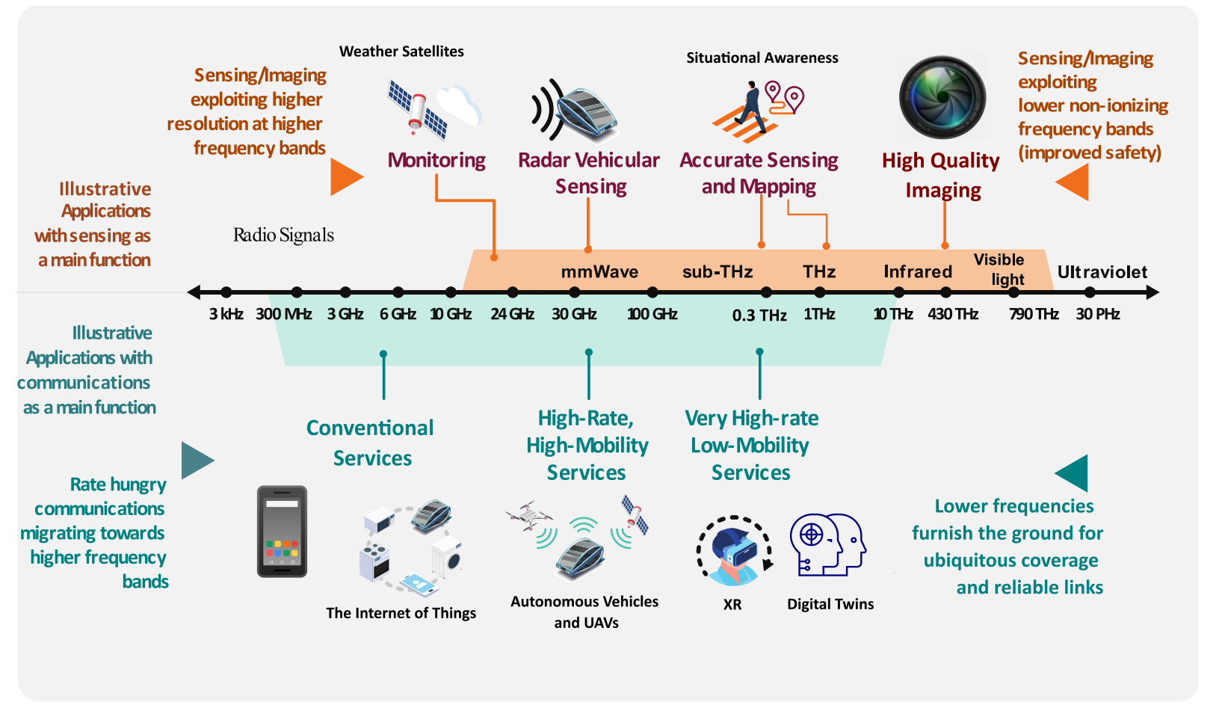
Moving up to Terahertz (THz)
Moving to THz enables higher communication data rate and higher sensing resolution [1].
Novel applications [1, 2]:
Extended reality (XR)
Wireless cognition
Spectroscopy
Joint communications and sensing (JCS)
Sub-THz (100-300 GHz) is the current frontier leading to THz regime.
[2]
[1] T. S. Rappaport, Y. Xing, O. Kanhere, S. Ju, A. Alkhateeb, G. C. Trichopoulos, A. Madanayake, S. Mandal, “Wireless Communications and Applications Above 100 GHz: Opportunities and Challenges for 6G and Beyond (Invited),” IEEE ACCESS, Vol. 7, No. 7, June 2019. https://ieeexplore.ieee.org/document/8732419
[2] C. Chaccour, M. N. Soorki, W. Saad, M. Bennis, P. Popovski and M. Debbah, "Seven Defining Features of Terahertz (THz) Wireless Systems: A Fellowship of Communication and Sensing," in IEEE Communications Surveys & Tutorials, vol. 24, no. 2, pp. 967-993, Secondquarter 2022, doi: 10.1109/COMST.2022.3143454. https://ieeexplore.ieee.org/abstract/document/9681870

Slide 5
NYUSIM Channel Model (1/3)
NYUSIM spatial statistical channel model is based on physical clusters and measured data [1]
Omnidirectional channel impulse response (CIR) is based on clusters and given by [2]
$N$: The number of time clusters
$M_{n}$: The number of cluster subpaths in $n$th time cluster
$a_{m,n}$: Amplitude of $m$th subpath in $n$th time cluster
$φ_{m,n}$: Phase of $m$th subpath in $n$th time cluster
$τ_{m,n}$: Absolute time delay of $m$th subpath in $n$th time cluster
$Θ_{m,n}$: Angle of departure (AOD) of $m$th subpath in $n$th time cluster
$Φ_{m,n}$: Angle of arrival (AOA) of $m$th subpath in $n$th time cluster
Directional CIR with antenna patterns is given by
$G_{tx}(\vec{Θ})$: TX antenna pattern
$G_{rx}(\vec{Φ})$: RX antenna pattern
[1] G. R. Maccartney, T. S. Rappaport, S. Sun, and S. Deng, “Indoor office wideband millimeter-wave propagation measurements and channel models at 28 and 73 GHz for ultra-dense 5G wireless networks,” IEEE Access, vol. 3, pp. 2388–2424, 2015. https://ieeexplore.ieee.org/document/7289335
[2] M. K. Samimi and T. S. Rappaport, “3-D millimeter-wave statistical channel model for 5G wireless system design,” IEEE Trans. on Microwave Theory and Techniques, vol. 64, no. 7, pp. 2207–2225, July 2016.
https://ieeexplore.ieee.org/document/7501500

Slide 6
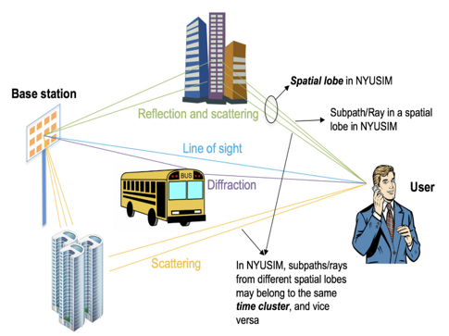
NYUSIM Channel Model (2/3)
Time-cluster spatial-lobe (TCSL) method motivated by observations from measurements [1][2]
Time cluster: multipath components (MPCs) travel close in time, but arrive from different directions
Spatial lobe: main directions of arrival (or departure) where energy arrives over several hundred ns
Propagation channel
[1] M. K. Samimi and T. S. Rappaport, “3-D millimeter-wave statistical channel model for 5G wireless system design,” IEEE Trans. on Microwave Theory and Techniques, vol. 64, no. 7, pp. 2207–2225, July 2016. https://ieeexplore.ieee.org/abstract/document/7501500
[2] S. Sun, T. S. Rappaport, M. Shafi, P. Tang, J. Zhang, and P. J. Smith, “Propagation models and performance evaluation for 5G millimeterwave bands”, IEEE Trans. on Vehicular Tech., vol. 67, no. 9, Sep. 2018. https://ieeexplore.ieee.org/abstract/document/8386686
.

Slide 7
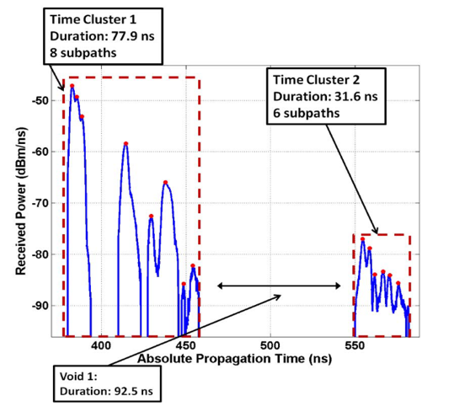
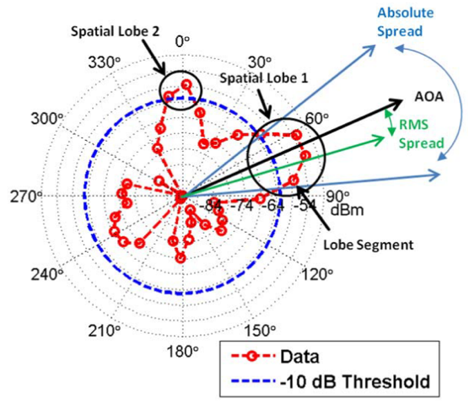
NYUSIM Channel Model (3/3)
How to find time clusters and spatial lobes?
Partitioning on PDP by minimum void time interval (MTI):
6 ns indoor scenario [2]; 25 ns outdoor scenario [1]
Partitioning on PAS (power angular spectrum) done by spatial lobe threshold (SLT):
-10 dB indoor scenario; -10 dB outdoor scenario [1][2]
[1] M. K. Samimi and T. S. Rappaport, “3-D millimeter-wave statistical channel model for 5G wireless system design,” IEEE Trans. on Microwave Theory and Techniques, vol. 64, no. 7, pp. 2207–2225, July 2016. https://ieeexplore.ieee.org/abstract/document/7501500
[2] S. Ju, Y. Xing, O. Kanhere, and T. S. Rappaport, "Millimeter Wave and Sub-Terahertz Spatial Statistical Channel Model for an Indoor Office Building," IEEE Journal on Selected Areas in Communications, Special Issue on Terahertz Communications and Networking, May 2020. https://ieeexplore.ieee.org/abstract/document/9411894

Slide 8
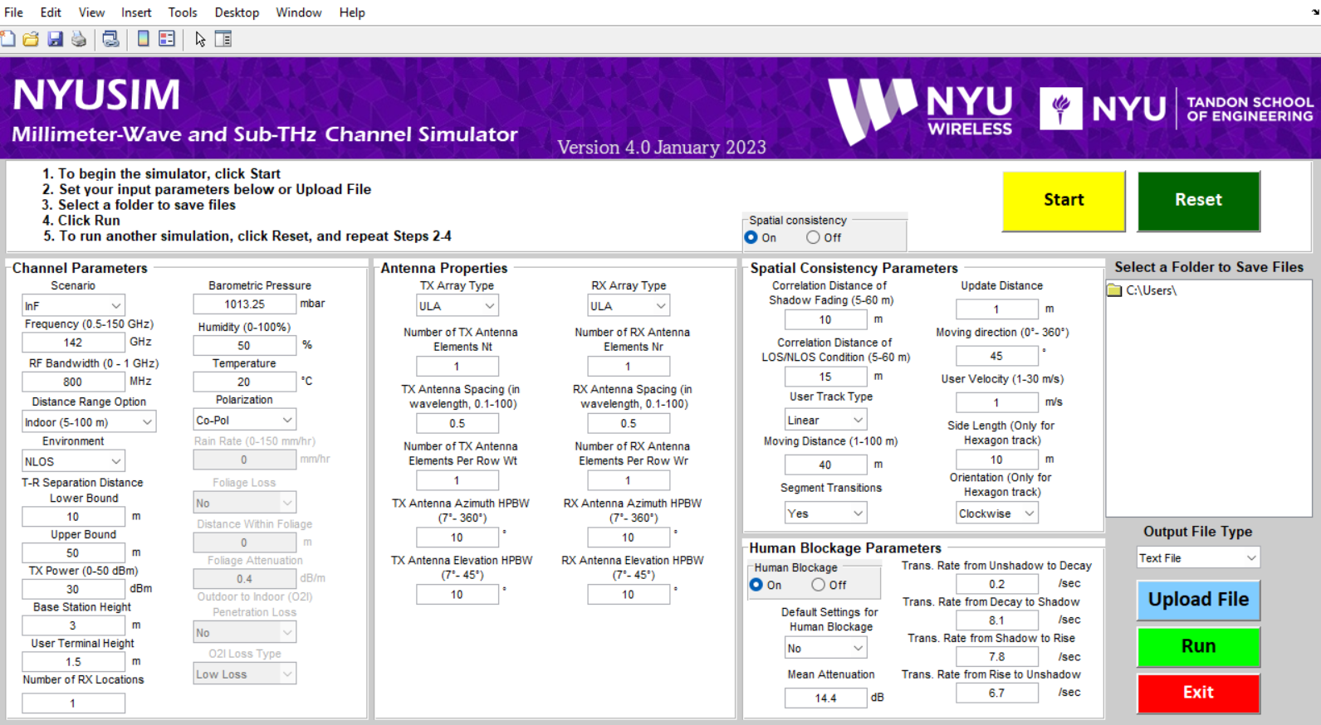
NYUSIM 4.0: Sub-THz and mmWave Wireless Channel Simulator
- Open-source software [1, 2] developed in MATLAB with more than 100,000 downloads as of 2023.
- Available on Windows and MAC OS.
- Channel models built over 2 TB of outdoor and indoor measurement data collected from 2012 - 2022.
- Supports drop-based and spatial-consistency-based channel simulations for all scenarios [3, 4].
- Used for Physical-level simulations of the downlink channel [5].
- Download @ https://wireless.engineering.nyu.edu/nyusim/
Frequency range: 0.5 GHz – 150 GHz, Bandwidth: 0 Hz (CW) – 1 GHz
Scenarios: Urban Microcell (UMi), Urban Macrocell (UMa), Rural Macrocell (RMa), Indoor Hotspot (InH), and Indoor Factories (InF).
[1] S. Sun, G. R. MacCartney Jr., and T. S. Rappaport, “A Novel Millimeter-Wave Channel Simulator and Applications for 5G Wireless Communications,” 2017 IEEE International Conference on Communications (ICC), May 2017.
[2] S. Ju, O. Kanhere, Y. Xing and T. S. Rappaport, “A Millimeter-Wave Channel Simulator NYUSIM with Spatial Consistency and Human Blockage,” 2019 IEEE Global Communications Conference (GLOBECOM), Hawaii, USA, Dec. 2019, pp. 1-6
[3] S. Sun, et. al, “Propagation models and performance evaluation for 5G millimeter-wave bands”, IEEE Trans. on Vehicular Tech., vol. 67, no. 9, pp. 8422–8439, Sep. 2018. https://ieeexplore.ieee.org/abstract/document/8386686
[4] S. Ju, and T. S. Rappaport, “Millimeter-wave Extended NYUSIM Channel Model for Spatial Consistency,” 2018 IEEE Global Communications Conference (GLOBECOM), Abu Dhabi, UAE, Dec. 2018, pp. 1-6.
https://ieeexplore.ieee.org/abstract/document/8647188
[5] J. Lota, et. al, “5G uniform linear arrays with beamforming and spatial multiplexing at 28, 37, 64, and 71 GHz for outdoor urban communication: A two-level approach,” IEEE Transaction on Vehicular Technology, vol. 66, no. 11, pp. 9972-9985, Nov. 2017. https://ieeexplore.ieee.org/abstract/document/8012543

Slide 9
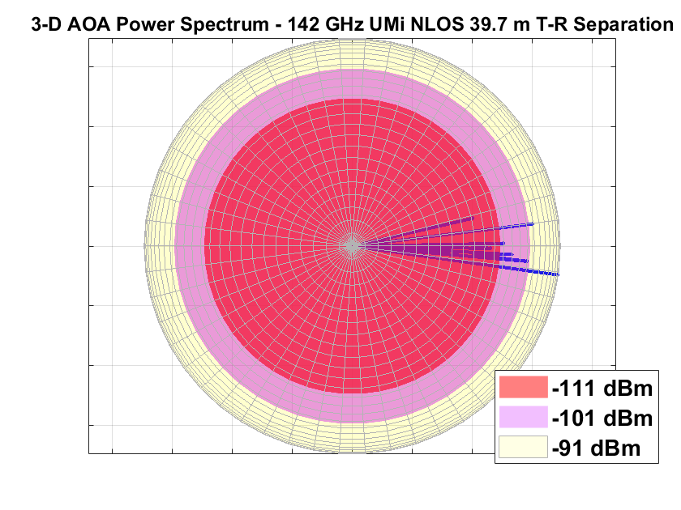
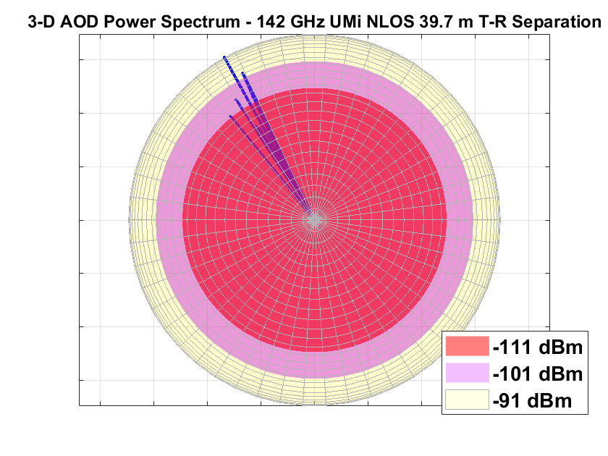
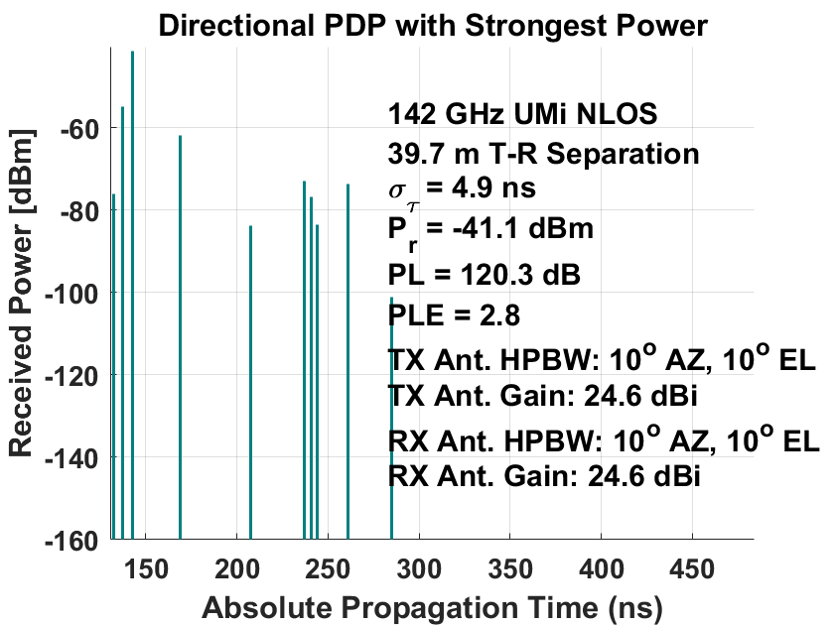
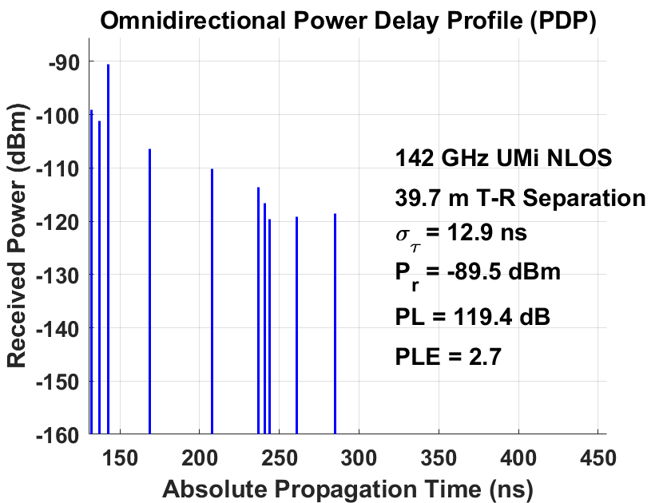
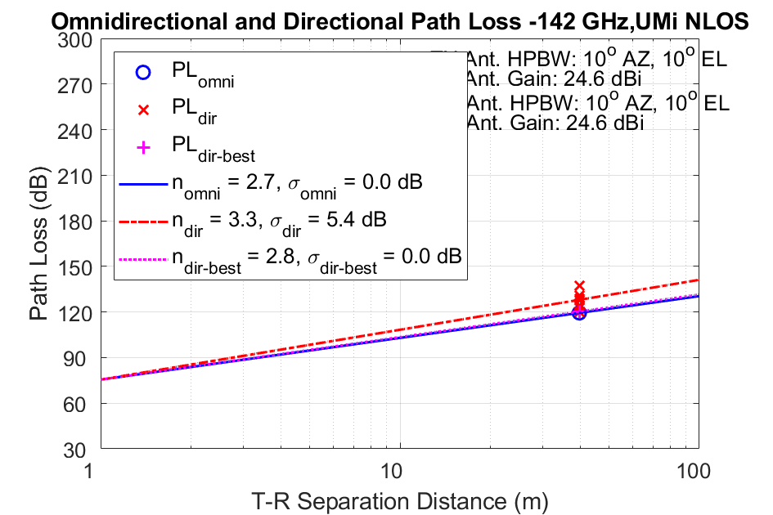
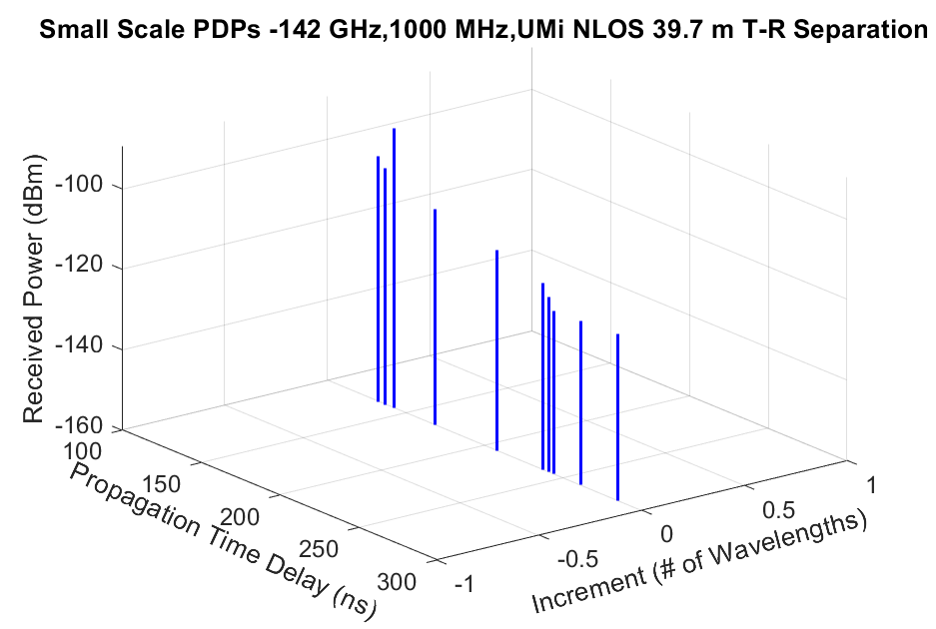
NYUSIM Channel Simulator
- Outdoor Extension
All data provided to users in “OmniPDPInfo.txt”, “OmniPDPInfo.mat”, “DirPDPInfo.txt”, and “DirPDPInfo.mat” [1]

Slide 10
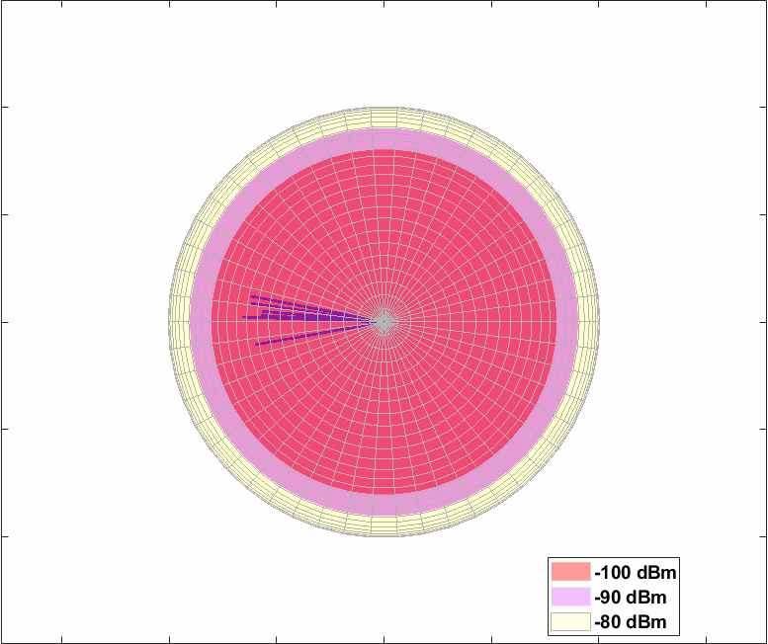
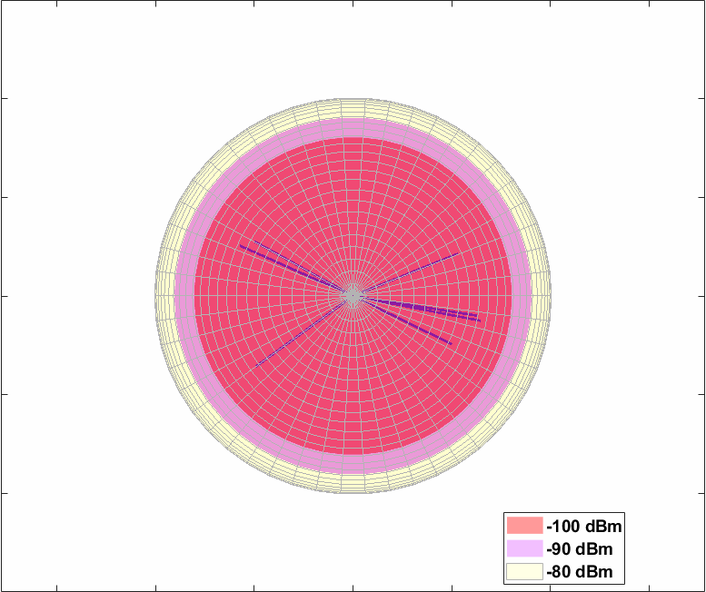
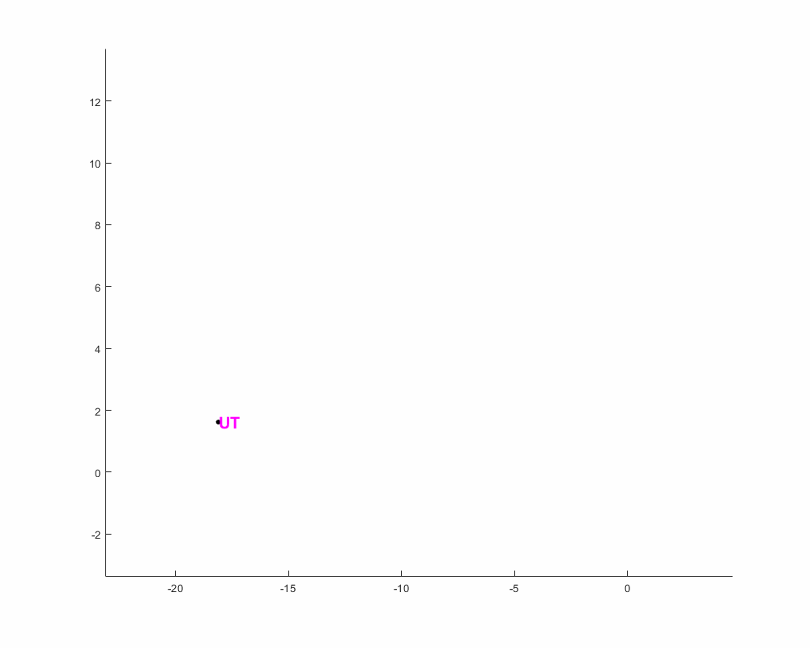
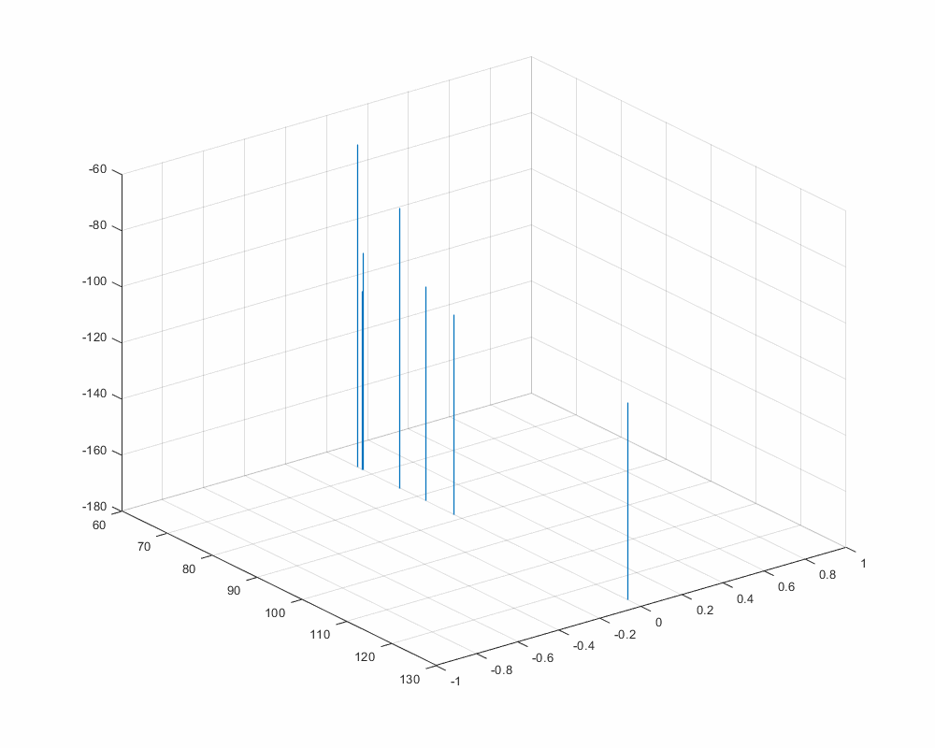
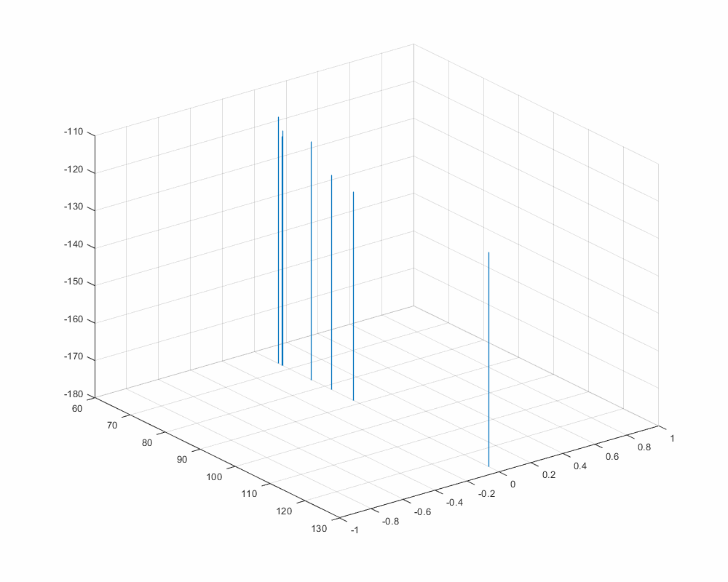
NYUSIM 4.0: Sub-THz and mmWave Wireless Channel Simulator
User trajectory in shadow fading map
3-D AOD power spectrum evolution
3-D AOA power spectrum evolution
Directional PDP evolution with strongest power
Omnidirectional PDP evolution
[1] NYUSIM, https://wireless.engineering.nyu.edu/nyusim/

Slide 11
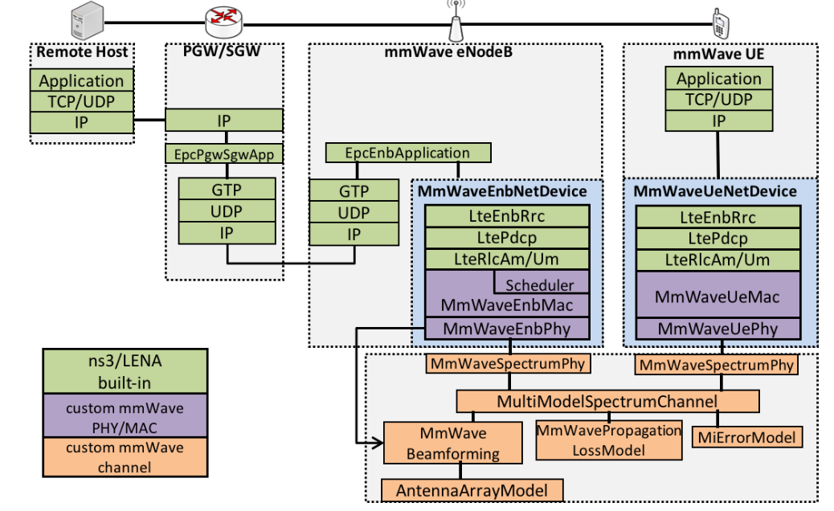
NYUSIM 4.0 in ns-3
ns-3 is an open-source discrete-event network simulator in C++ [1].
Used by researchers worldwide to investigate and analyze complex wireless networks and design new protocols.
mmWave [2] is ns-3, a very popular end-to-end full-stack simulation module built-in ns-3 for 5G networks.
ns-3 currently uses the 3GPP Statistical Channel Model (SCM) based on TR 38.901 release 15.
Fig. ns-3 mmWave module architecture [2]
[1] https://www.nsnam.org/
[2] M. Mezzavilla et al., "End-to-End Simulation of 5G mmWave Networks," in IEEE Communications Surveys & Tutorials, vol. 20, no. 3, pp. 2237-2263, third quarter 2018, doi: 10.1109/COMST.2018.2828880. https://ieeexplore.ieee.org/abstract/document/8344116

Slide 12
Limitation of 3GPP SCM
Work in [1] demonstrates that 3GPP SCM oversimplifies the actual wireless channel in outdoor
scenarios.
The 3GPP SCM has a limited frequency range (0.5 – 100 GHz) which prevents researchers from
studying future wireless networks operating above 100 GHz.
As engineers are limited to using just the 3GPP SCM there is minimal understanding of the impact of
the wireless channel model on the end-to-end network performance.
NYUSIM 4.0 in ns-3 overcomes the above limitations and enables researchers to use a real-world measurement-based channel model and study the impact of lower-layer discrepancies on Higher Layers [2].
[1] T. S. Rappaport, S. Sun, and M. Shafi, “Investigation and comparison of 3GPP and NYUSIM channel models for 5G wireless communications,” in IEEE 86th Vehicular Technology Conference (VTC-Fall), 2017, pp.1–5. https://ieeexplore.ieee.org/abstract/document/8287877
[2] Poddar, H., Yoshimura, T., Pagin, M., Rappaport, T. S., Ishii, A., & Zorzi, M. (2023). Full-Stack End-To-End mmWave Simulations Using 3GPP and NYUSIM Channel Model in ns-3. https://arxiv.org/abs/2302.12385

Slide 13
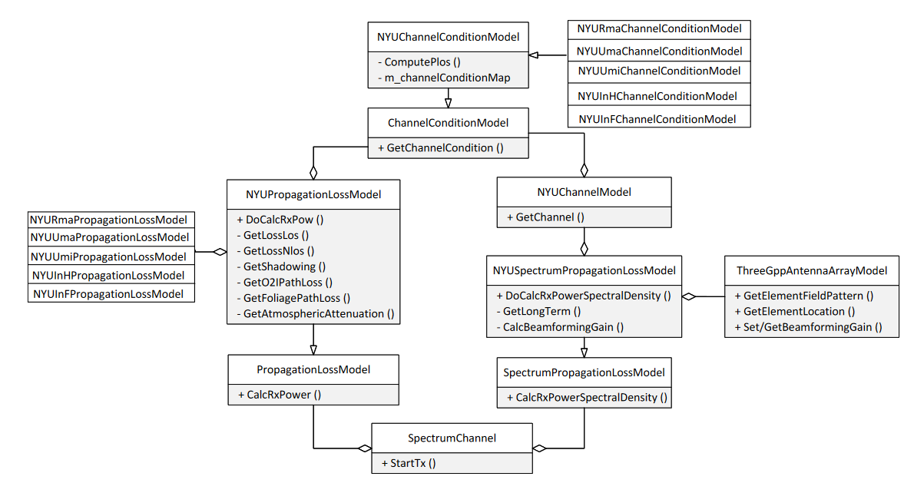
Implementation of NYUSIM 4.0 in ns-3 (1/8)
Three main components [1]:
i) NYUChannelConditionModel: Determines LOS/NLOS channel condition.
ii) NYUPropagationLossModel: Models large-scale fading – path loss and shadowing.
iii) NYUSpectrumPropagationLossModel: Computes small-scale fading – fast fading and frequency selective fading.
ThreeGppAntennaArrayModel [2] present in ns-3 is used to model the antennas for NYUSIM.
Fig. UML diagram for NYUSIM implementation in ns-3 [1]
[1] Poddar, H., Yoshimura, T., Pagin, M., Rappaport, T. S., Ishii, A., & Zorzi, M. (2023). ns-3 implementation of Sub-Terahertz and Millimeter Wave Drop-based NYU Channel Model (NYUSIM), submitted, Workshop in ns-3 (WNS3-2023), Washington, USA, June 2023. https://arxiv.org/abs/2305.01828
[2] Mattia Rebato, Michele Polese, and Michele Zorzi. Multi-sector and multi-panel performance in 5G mmwave cellular networks. In IEEE Global Communications Conference (GLOBECOM), pages 1–6, 2018. https://ieeexplore.ieee.org/abstract/document/8647528

Slide 14
Implementation of NYUSIM 4.0 in ns-3:
LOS Probability Models (2/8)
Statistically determine the likelihood of a mobile device in LOS/NLOS channel condition [1].
3GPP SCM LOS probability models are inaccurate for UMi and UMa scenarios [2].
NYU (squared) LOS probability models: Applicable for UMi, and UMa scenarios were created based on measurements conducted at 28 GHz and 73 GHz in New York City [2, 3].
RMa scenario uses the 3GPP SCM LOS probability [4] models.
InH scenario uses the 5GCM InH LOS probability model [5] because of its similarity to NYU (squared) model.
InF scenario uses the average of the 3GPP InF LOS probability models.
[1] Poddar, H., Yoshimura, T., Pagin, M., Rappaport, T. S., Ishii, A., & Zorzi, M. (2023). ns-3 implementation of Sub-Terahertz and Millimeter Wave Drop-based NYU Channel Model (NYUSIM), submitted, Workshop in ns-3 (WNS3-2023), Washington, USA, June 2023. https://arxiv.org/abs/2305.01828
[2] T. S. Rappaport, S. Sun, and M. Shafi, “Investigation and comparison of 3GPP and NYUSIM channel models for 5G wireless communications,” in IEEE 86th Vehicular Technology Conference (VTC-Fall), 2017, pp. 1–5. https://ieeexplore.ieee.org/document/8287877
[3] Samimi, M. K., Rappaport, T. S., & MacCartney, G. R. (2015). Probabilistic omnidirectional path loss models for millimeter-wave outdoor communications. IEEE Wireless Communications Letters, 4(4), 357-360. https://ieeexplore.ieee.org/abstract/document/7070688
[4] 3GPP, “Study on channel model for frequencies from 0.5 to 100 GHz,” Technical Report (TR) 38.901, Jan. 2020, version 16.1.0. https://www.etsi.org/deliver/etsi_tr/138900_138999/138901/16.01.00_60/tr_138901v160100p.pdf
[5] T. S. Rappaport, Y. Xing, G. R. MacCartney, A. F. Molisch, E. Mellios, and J. Zhang, “Overview of millimeter wave communications for fifth-generation (5G) wireless networks—With a focus on propagation models,” vol. 65, no. 12, pp. 6213–6230, 2017. https://ieeexplore.ieee.org/abstract/document/7999294

Slide 15
Implementation of NYUSIM 4.0 in ns-3:
Large-scale path loss models (3/8)
Predicts received power at the mobile device as a function of distance from the transmitter.
NYUSIM uses a close-in (CI) free space reference distance path loss model with 1 m as free space reference distance in all scenarios.
CI path loss model has superior accuracy and less sensitivity to error as seen in measurements in different scenarios [1].
$${PL}^{CI}\left(f,d\right)\left[dB\right]=FSPL\left(f, 1 m\right)\left[dB\right]+10η\log\left(d\right) [dB]+$$
$$AT\left[dB\right]+O2I\left[dB\right]+FL\left[dB\right]+χ_{σ}^{CI}[dB]$$
Where f: frequency in GHz, d: 2D Tx-Rx distance, FSPL: free space path loss at a reference distance of 1 m, $η$: path loss exponent, AT: atmospheric attenuation, FL: foliage loss, $χ_{σ}^{CI}$ : shadow fading
[1] Sun, S., Rappaport, T. S., Thomas, T. A., Ghosh, A., Nguyen, H. C., Kovacs, I. Z., & Partyka, A. (2016). Investigation of prediction accuracy, sensitivity, and parameter stability of large-scale propagation path loss models for 5G wireless communications. IEEE transactions on vehicular technology, 65(5), 2843-2860. https://ieeexplore.ieee.org/abstract/document/7434656

Slide 16
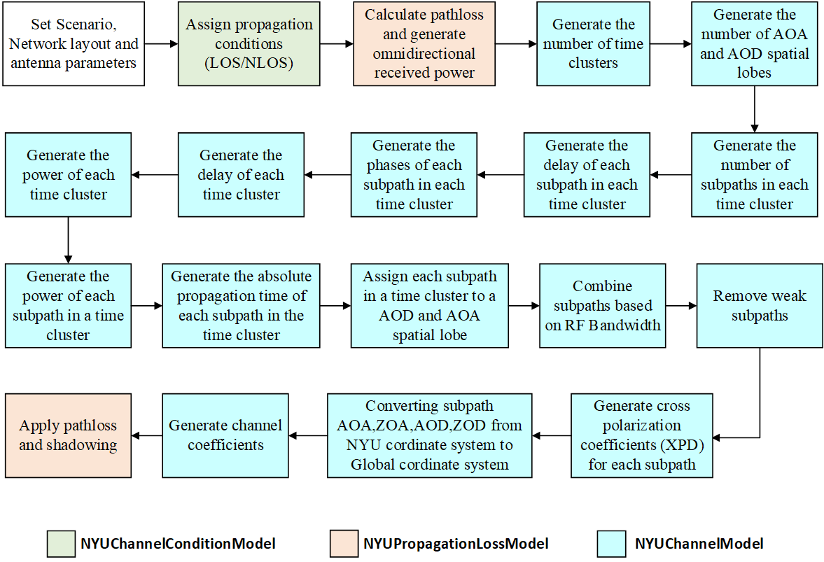
Implementation of NYUSIM 4.0 in ns-3:
Small-scale Models and Channel Generation (4/8)
Capture the wireless channel’s time-varying nature and help in statistically reproducing the Channel Impulse Response (CIR) [1].
3GPP SCM uses the Joint Delay Angle Probability density function.
NYUSIM uses Time Cluster Spatial Lobe (TCSL) approach.
TCSL is born out of measurements conducted in different scenarios and frequency bands over the past decade.
[1] Poddar, H., Yoshimura, T., Pagin, M., Rappaport, T. S., Ishii, A., & Zorzi, M. (2023). ns-3 implementation of Sub-Terahertz and Millimeter Wave Drop-based NYU Channel Model (NYUSIM), submitted, Workshop in ns-3 (WNS2-2023), Washington, USA, June 2023. https://arxiv.org/abs/2305.01828

Slide 17
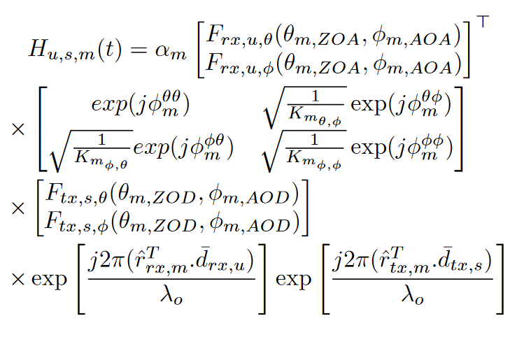
Implementation of MIMO Channel Matrix for NYUSIM 4.0 in ns-3 (5/8)
MIMO channel matrix like 3GPP SCM TR 38.901[1] is implemented for NYUSIM in ns-3 with minor modifications [2].
M: Total Multipaths
H_{u,s,m}: Channel coefficients for multipath m.
τ_{i:} Delay of i^{th} multipath
Antenna pattern at Rx
Polarization matrix
Antenna pattern at Tx
Spatial signature of Rx
Spatial signature of Tx
The Polarization coefficients are obtained from the NYUSIM channel model [2].
3GPP SCM TR 38.901 Antenna Patterns is used [1].
[1] 3GPP. Technical Specification Group Radio Access Network; Study on channel model for frequencies from 0.5 to 100 GHz (Release 17), TR 38.901, Mar. 2022.
[2] Poddar, H., Yoshimura, T., Pagin, M., Rappaport, T. S., Ishii, A., & Zorzi, M. (2023). ns-3 implementation of Sub-Terahertz and Millimeter Wave Drop-based NYU Channel Model (NYUSIM), Workshop in ns-3 (WNS3-2023), Washington, USA, June 2023. https://arxiv.org/abs/2305.01828

Slide 18
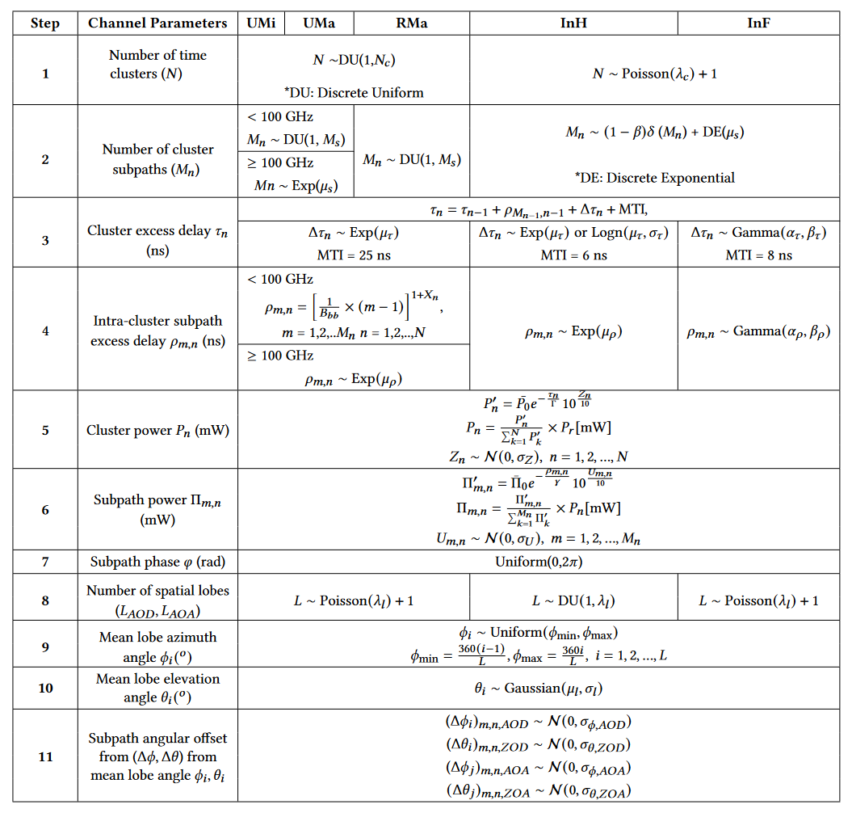
Implementation of NYUSIM 4.0 in ns-3 (6/8)
Statistical Distributions derived from measurement data for UMi, UMa, RMa, InH, and InF scenarios [1].
Measurements conducted from 2011-2022 on 28 GHz, 38 GHz, 73 GHz, and 140 GHz frequency bands in scenarios listed above.
These Statistical Distributions have been in MATLAB-based NYUSIM since 2016 and are now implemented in ns-3.
[1] Poddar, H., Yoshimura, T., Pagin, M., Rappaport, T. S., Ishii, A., & Zorzi, M. (2023). ns-3 implementation of Sub-Terahertz and Millimeter Wave Drop-based NYU Channel Model (NYUSIM), submitted, Workshop in ns-3 (WNS3-2023), Washington, USA, June 2023. https://arxiv.org/abs/2305.01828

Slide 19
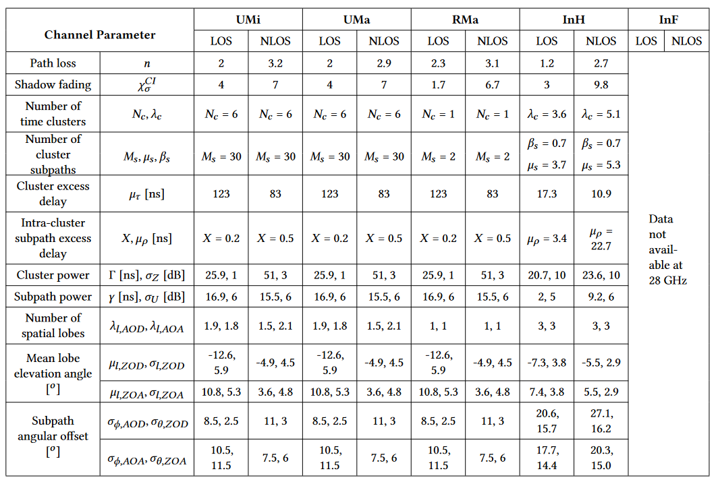
Implementation of NYUSIM 4.0 in ns-3 (7/8)
Channel Parameters for NYUSIM at 28 GHz [1]
[1] Poddar, H., Yoshimura, T., Pagin, M., Rappaport, T. S., Ishii, A., & Zorzi, M. (2023). ns-3 implementation of Sub-Terahertz and Millimeter Wave Drop-based NYU Channel Model (NYUSIM), submitted, Workshop in ns-3 (WNS3-2023), Washington, USA, June 2023. https://arxiv.org/abs/2305.01828

Slide 20
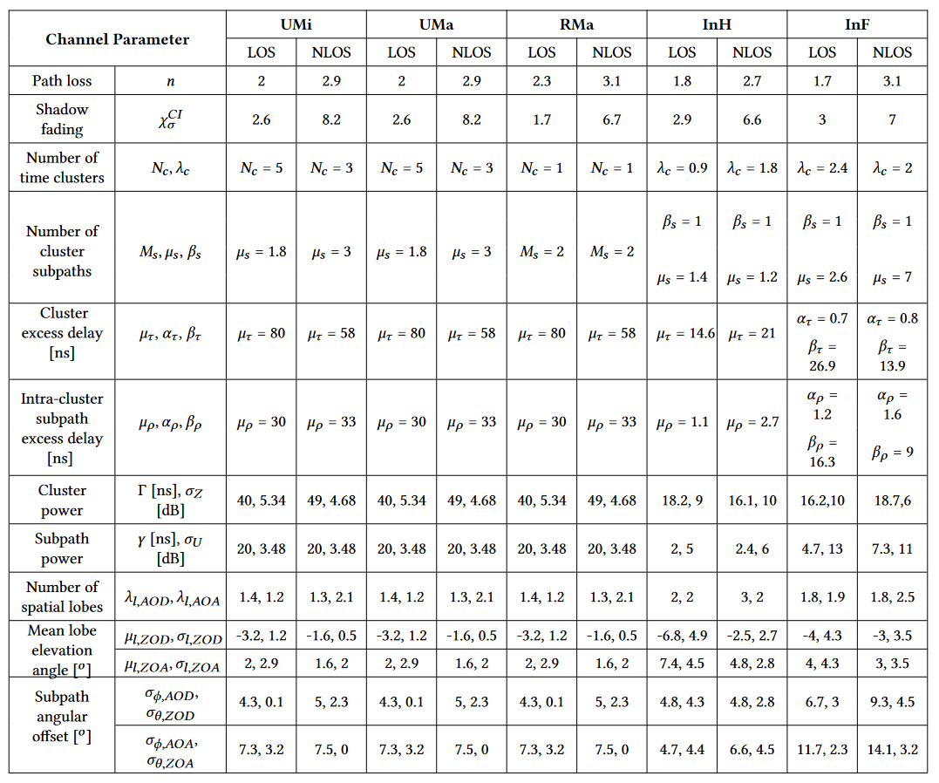
Implementation of NYUSIM 4.0 in ns-3 (8/8)
Channel Parameters for NYUSIM at 140 GHz [1]
[1] Poddar, H., Yoshimura, T., Pagin, M., Rappaport, T. S., Ishii, A., & Zorzi, M. (2023). ns-3 implementation of Sub-Terahertz and Millimeter Wave Drop-based NYU Channel Model (NYUSIM), submitted, Workshop in ns-3 (WNS3-2023), Washington, USA, June 2023 https://arxiv.org/abs/2305.01828 .

Slide 21
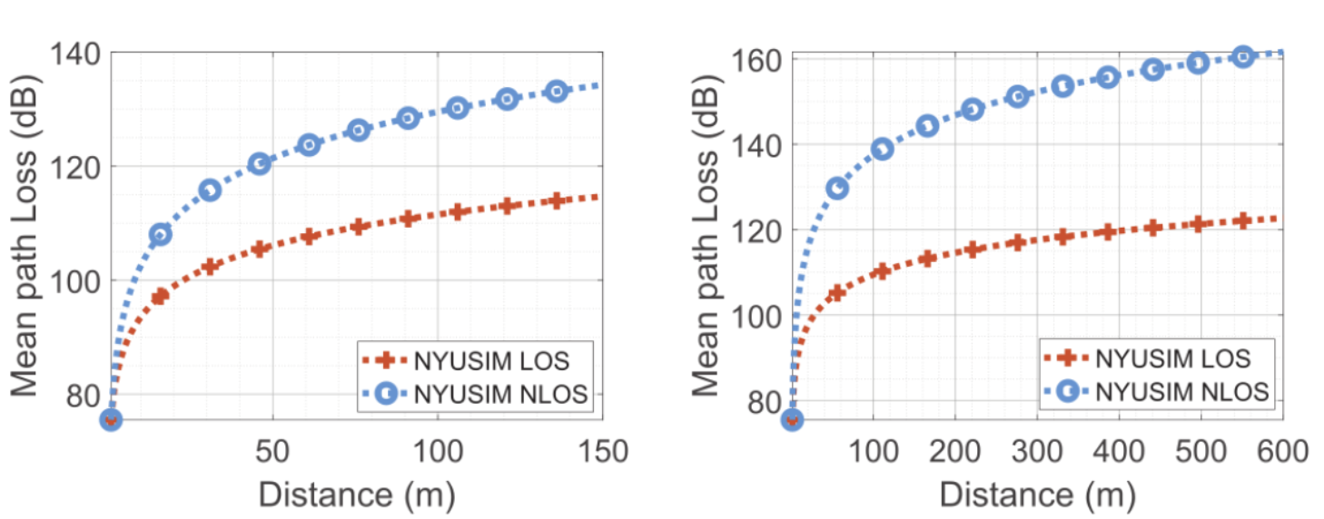
Large-Scale Path Loss Computation
UMi
UMa
RMa
InH
InF
Mean path loss (dB) vs. distance (m) at 142 GHz computed using CI path loss model for NYUSIM in UMi, UMa, RMa, InH and InF scenarios.

Slide 22
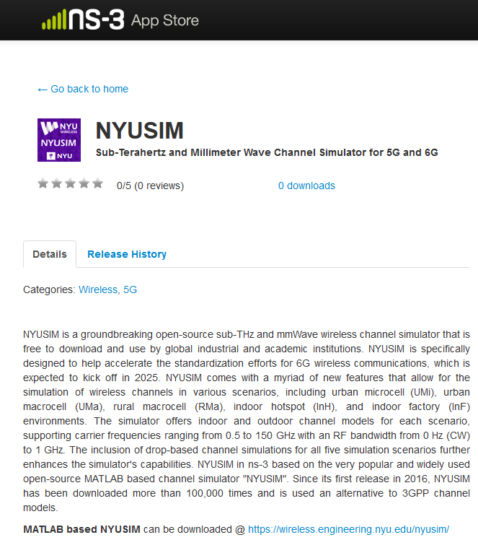
NYUSIM in ns-3
We are now on the ns-3 App Store. Code to be released for users by the end of July.

Slide 23
Conclusions
Channel modeling is vital to understand radio propagation in mmWave and sub-THz bands.
NYUSIM channel model is based on real-world radio propagation collected from 2012-2023.
NYUSIM is an active open-source project developed and maintained by several generations of graduate students at NYU WIRELESS research center.
NYUSIM in ns-3 will allow researchers to use an alternate channel model other than 3GPP SCM.
NYUSIM is the world's first wireless channel simulator to support frequencies beyond 100 GHz for all 3GPP listed scenarios enabling researchers to study and design end-to-end systems for the sub-THz bands.

Slide 24
Industrial Affiliates
Acknowledgement to our NYU WIRELESS Industrial Affiliates and NSF
This work is supported by the NYU WIRELESS Industrial Affiliate Program and National Science Foundation (NSF) (Award Number: 2037845, 1909206).

