Slide 1
Link Discovery Extension to ns-3’s Terahertz Communication Module
Farhan Siddiqui¹ and Bikash Mazumdar²
Dickinson College¹
Tezpur University²
Workshop on ns-3 (June 2023, Virginia)

Slide 2
OUTLINE
Introduction
ns-3 Terahertz Module
Motivation for Adding Link Discovery Feature
Implementation of Link Discovery Extension
Testing and Evaluation
Conclusion and Future Work

Slide 3
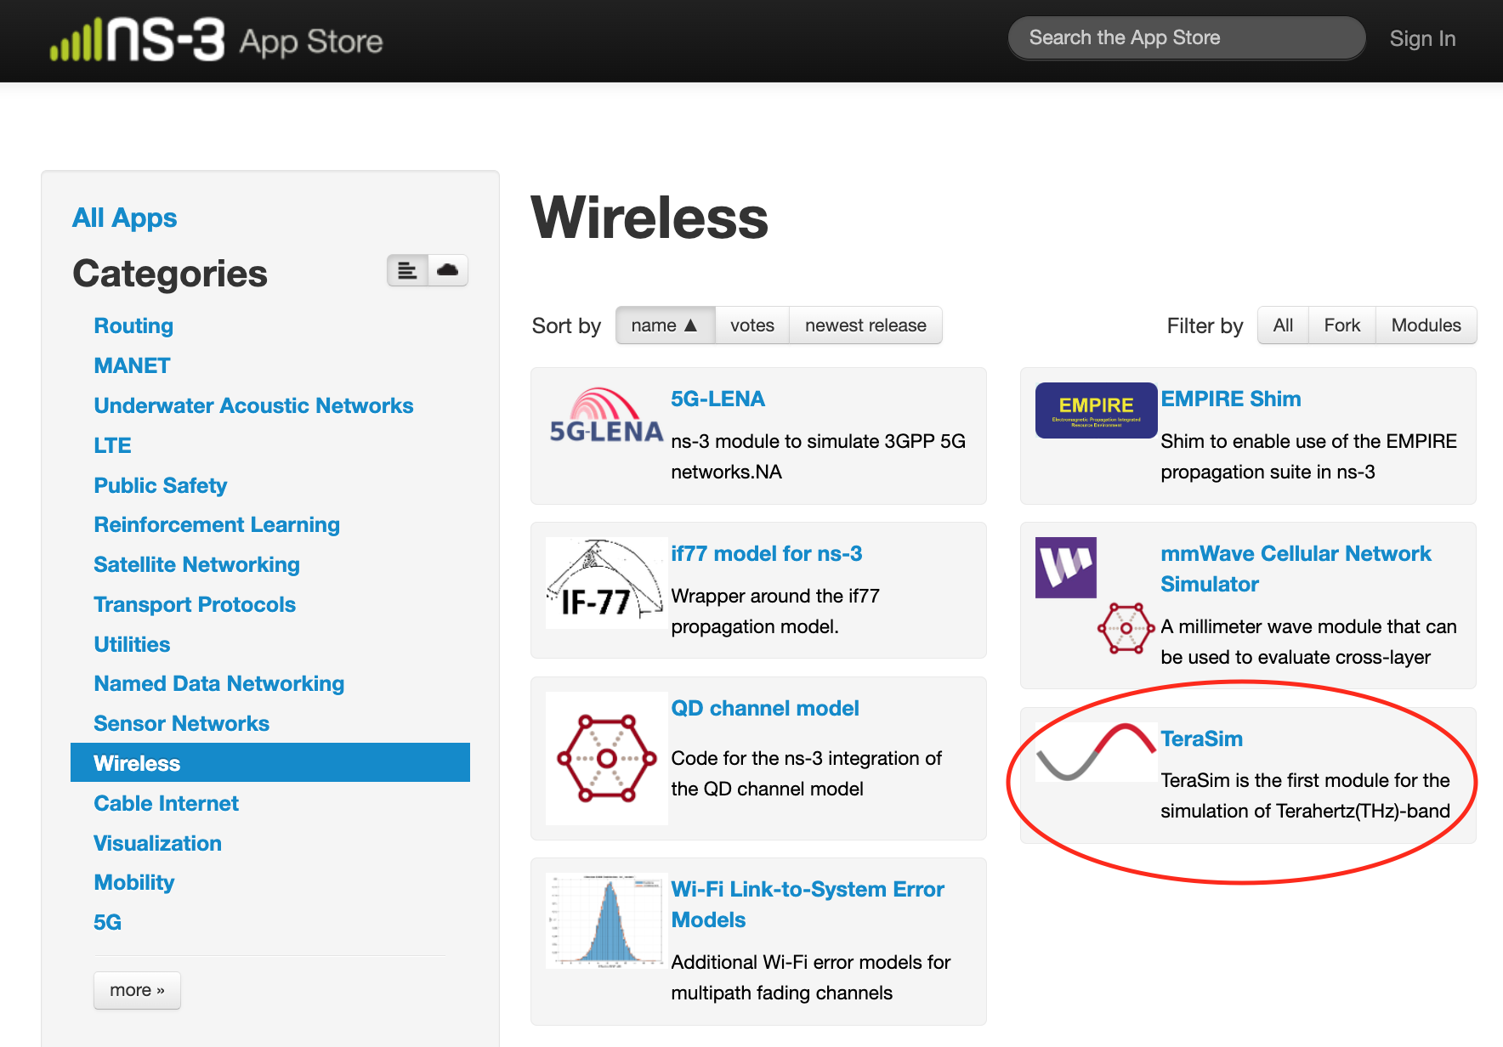
Introduction

Slide 4
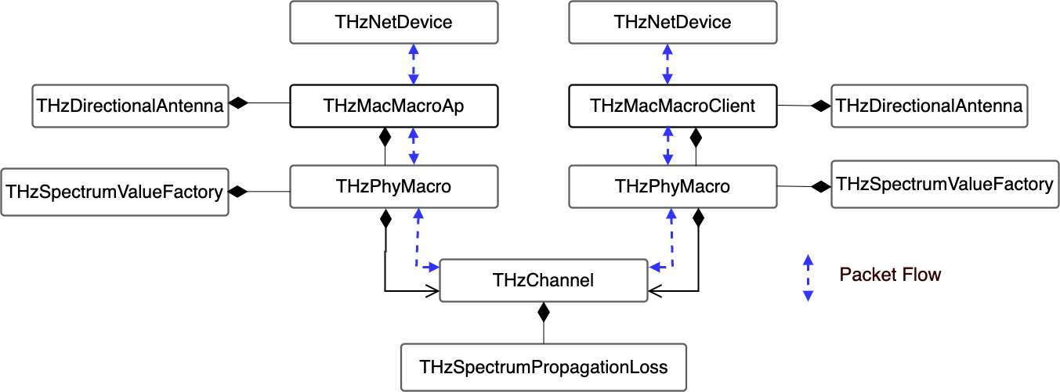
ns-3 Terahertz Module (TeraSim)
ns-3 Terahertz Module – THz Band Simulation

Slide 5
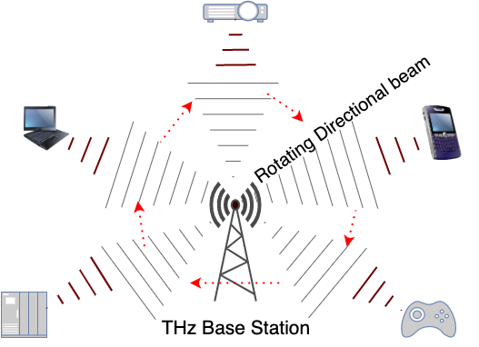
ns-3 Terahertz Module (TeraSim)
Uplink data communication (MAC)
Directional antennas
Assumption: User Equipment (UE) antenna beam always points toward the Access Point (AP)
AP antenna beam rotates 360º

Slide 6
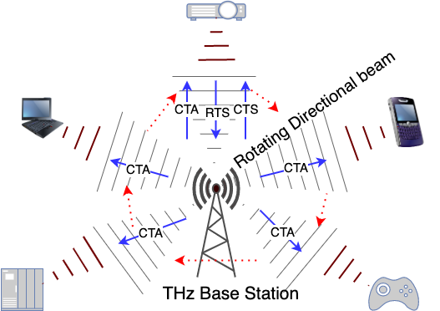
ns-3 Terahertz Module
UE-AP handshake & data transmission
CTA: Call-to-Action
RTS: Request-to-Send
CTS: Clear-to-Send
Data

Slide 7
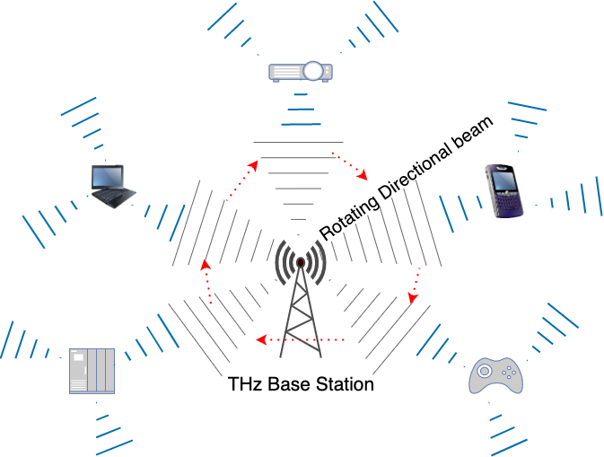
Link Discovery Extension
Allow UEs to automatically discover the AP
Enable UE Antenna Rotations
Implement the Discovery Protocol at the MAC layer on UE side

Slide 8
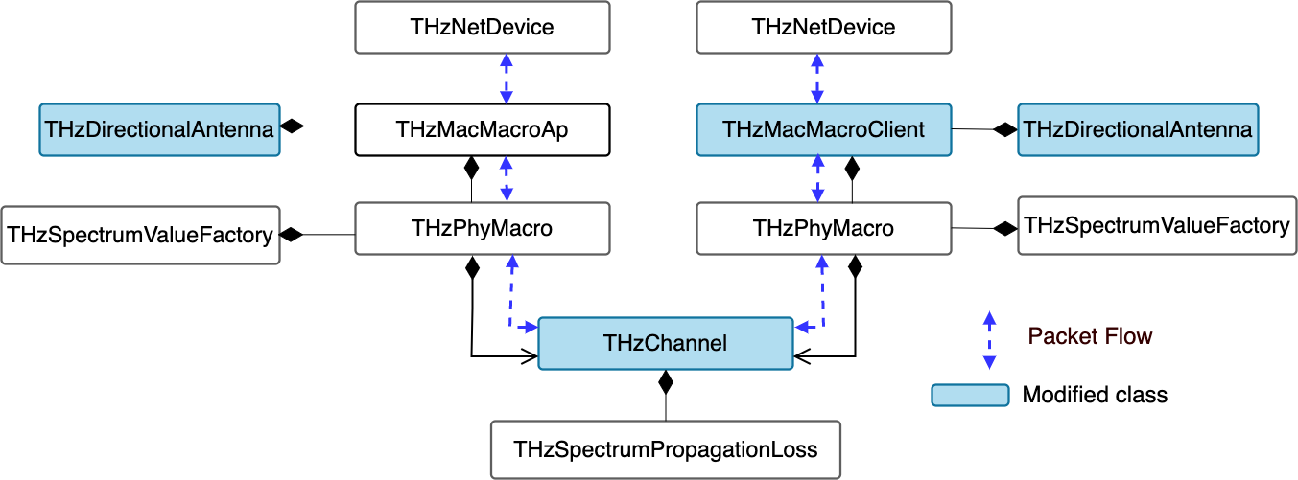
Classes Modified
Notes:
Altered classes highlighted.

Slide 9
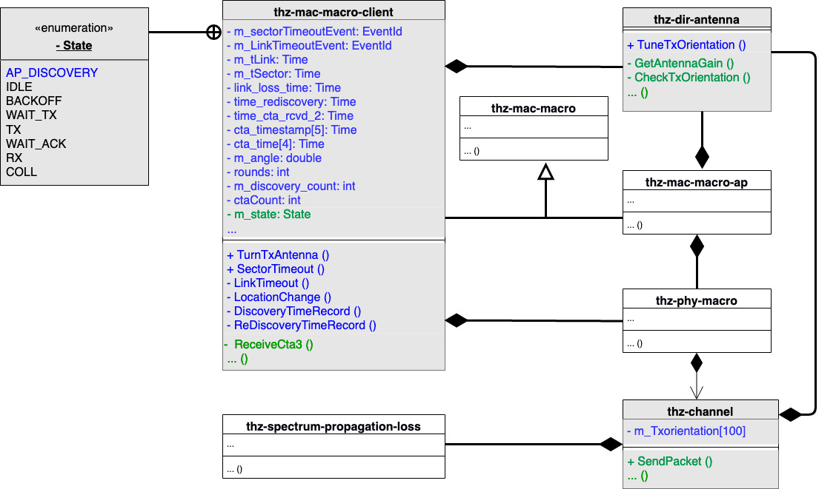
Functions and Fields Added/ Modified
Notes:
Altered classes highlighted.

Slide 10
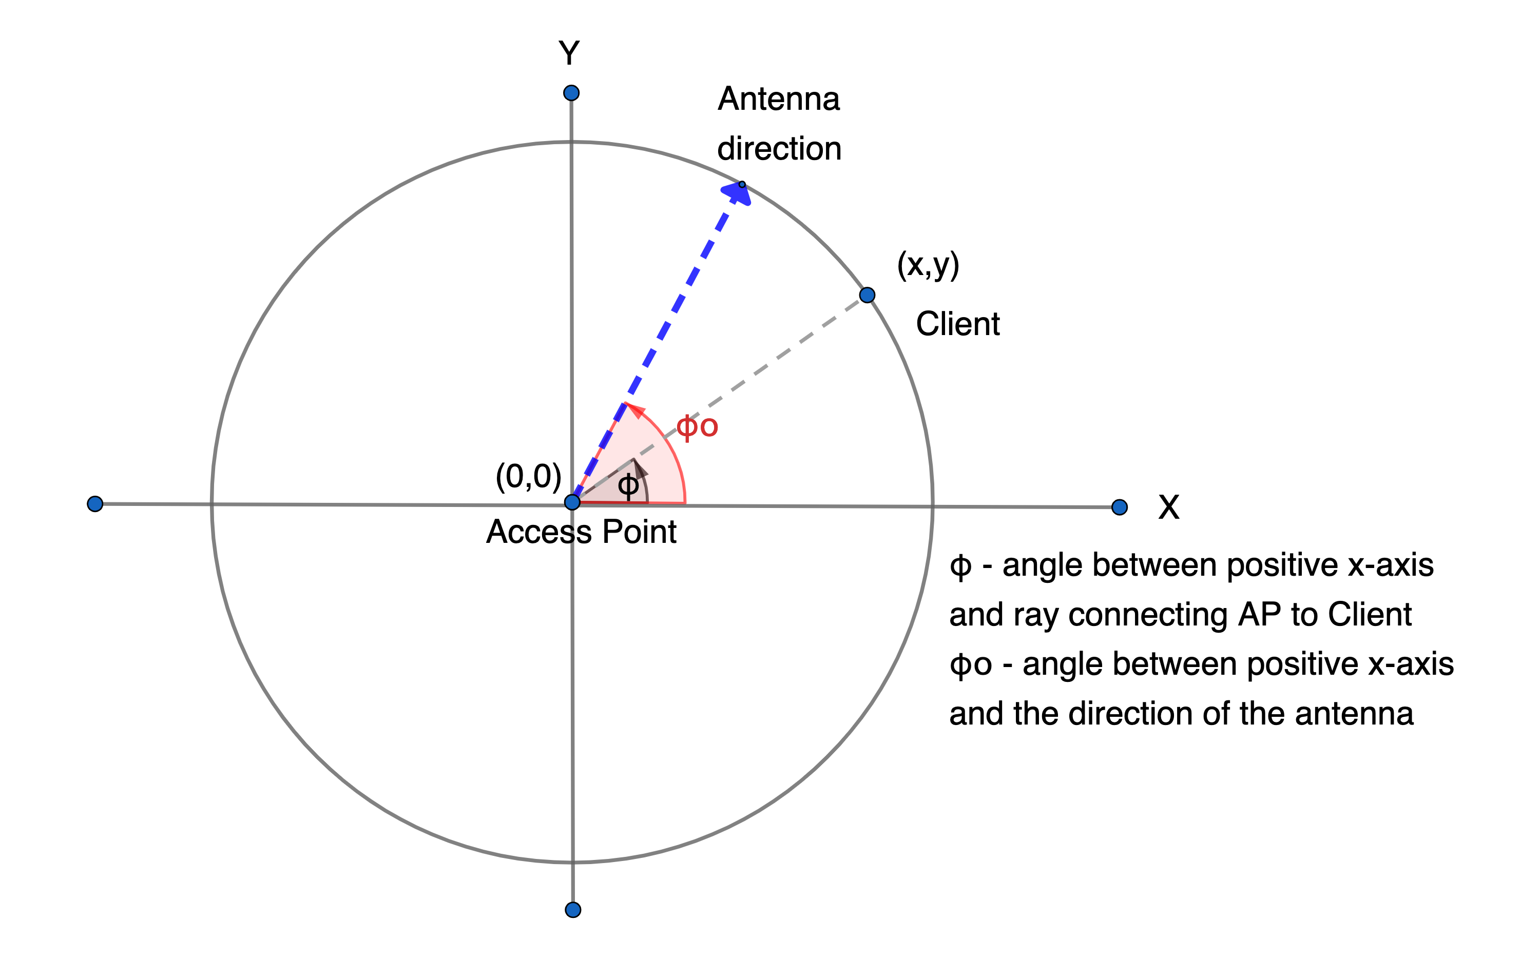
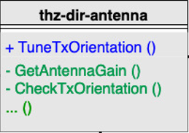
THz Directional Antenna Class
Antenna Gain
(RxGain + TxGain) value used to compute rxPower

Slide 11
THz Directional Antenna Class

Slide 12
THz Channel Class
THzDirectionalAntenna::GetAntennaGain
m_totalGain = itt->first->GetDirAntenna ()->GetAntennaGain (XnodeMobility, YnodeMobility, m_XnodeMode, m_YnodeMode, m_Rxorientation, m_Txorientation[dev_index]);
m_Txorientation[dev_index] : Azimuthal orientation of client antenna
SpectrumPropagationLoss::CalcRxPowerDA
rxPower = m_loss->CalcRxPowerDA (txParams, XnodeMobility, YnodeMobility, m_totalGain);
m_totalGain is a factor in the rxPower calculation

Slide 13
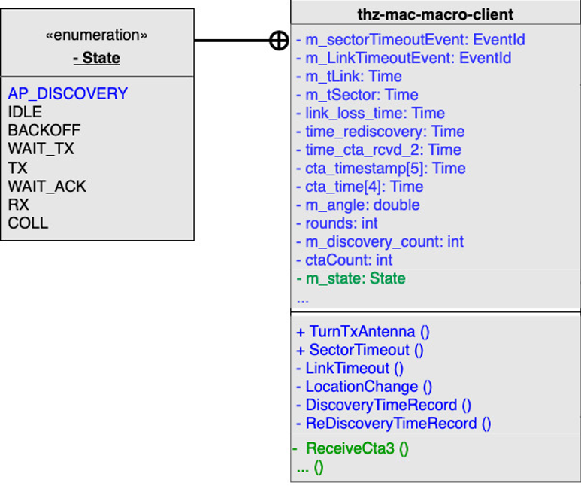
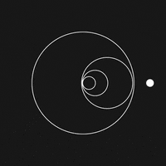
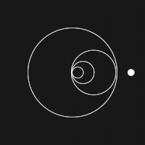
THz Mac Macro Client Class
Gif source: https://giphy.com/gifs/animation-design-color-3oz8xNLkJqQSztRQ3K

Slide 14
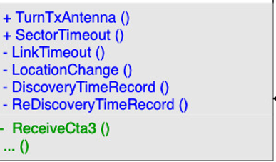
THz Mac Macro Client Class
AP Discovery
AP_Discovery state ----> Idle state
Timers
Sector timer (AP_Discovery state )
CTA timer (Idle state)
CTA timeout
Change in client location/antenna orientation
Increase in AP Cycle time

Slide 15
THz Mac Macro Client Class
AP Discovery
AP_Discovery state ----> Idle state
Timers
Sector timer (AP_Discovery state )
CTA timer (Idle state)
CTA timeout
Change in client location/antenna orientation
Increase in AP Cycle time

Slide 16
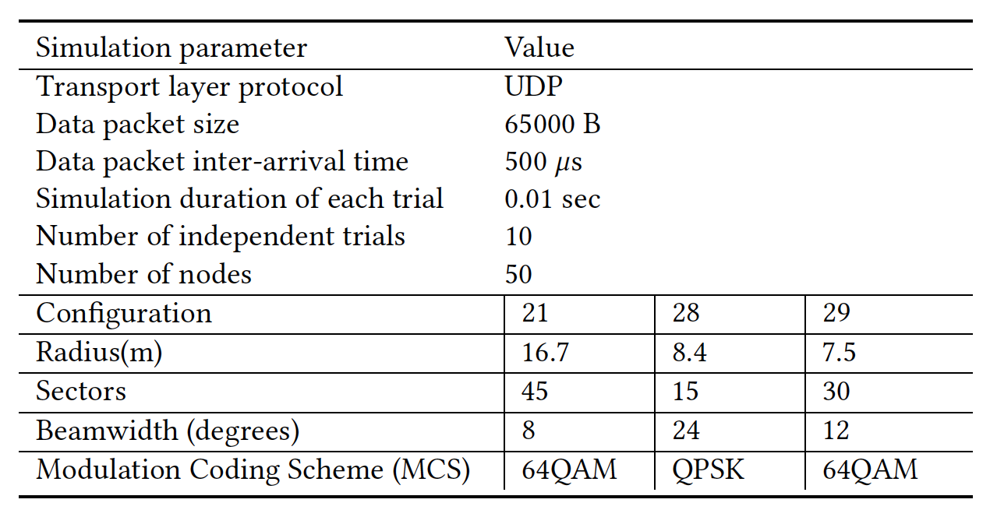
Evaluation Metrics and Simulation Parameters
Metrics
AP Discovery Time (Initial Discovery)
AP Rediscovery Time (After Relocation)

Slide 17
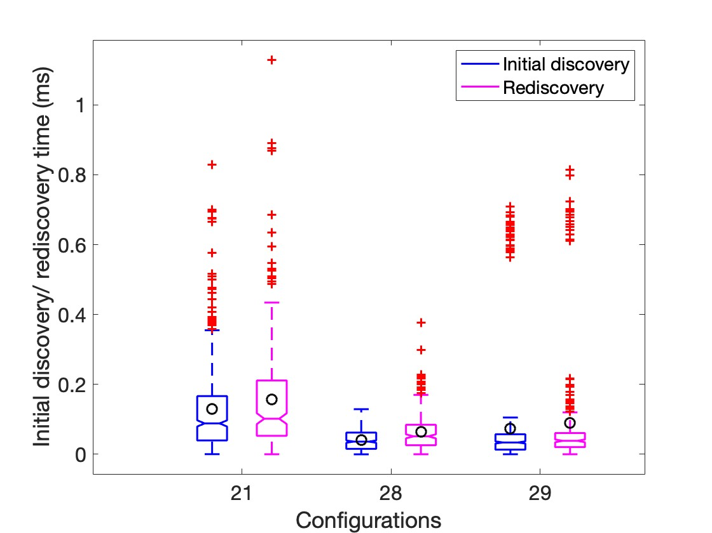
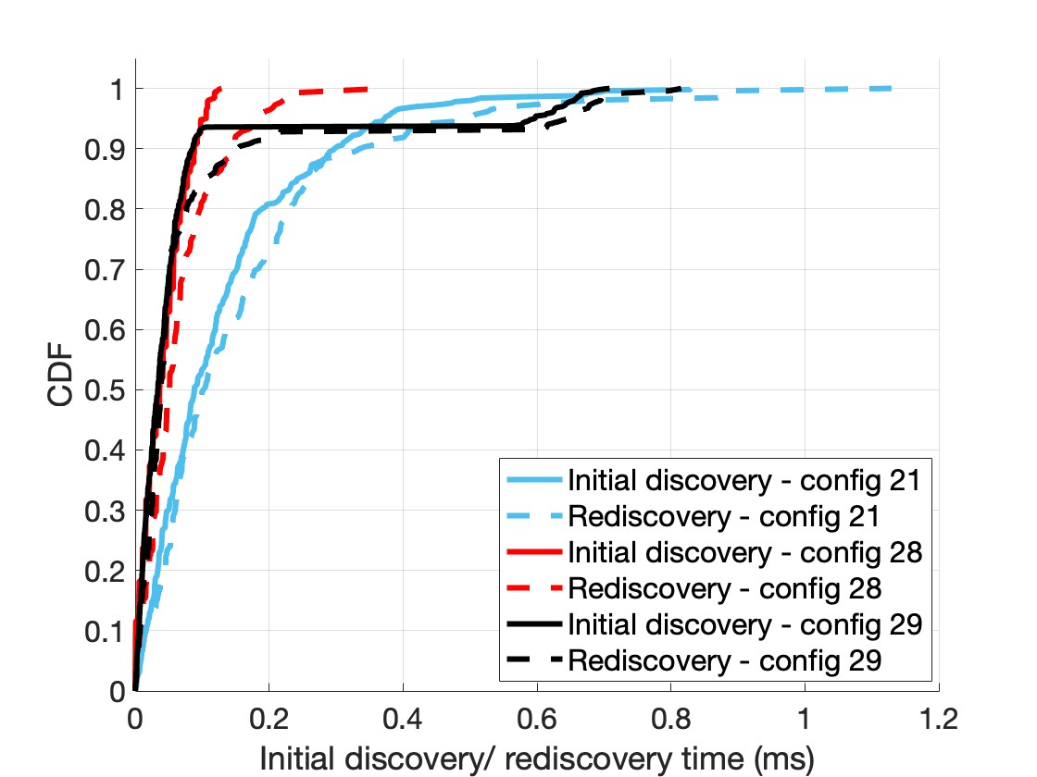
Results

Slide 18
Results

Slide 19
Conclusion and Future Work
Extended TeraSim (originally model released June 2021) to support Link Discovery/ Rediscovery
Code Made Publicly Available
Further Extend TeraSim to Support Downlink Data Communication
Design an Intelligent Rediscovery Scheme
Test with other MCS and beamwidth values

Slide 20
Thank You!
Questions?

