Slide 1
Verification of ns-3 Wi-Fi Rate Adaptation Models on AWGN Channels
Juan V Leon Rosas, Thomas R. Henderson, Sumit Roy
University of Washington

Slide 2
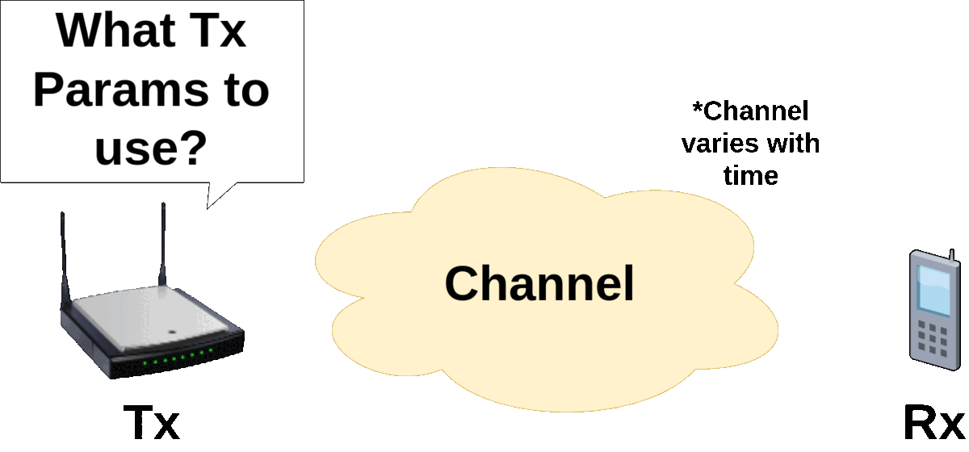
Rate Adaptation - Overview
Rate Adaptation Algorithms (RAA) for Wi-Fi refer to algorithms used to select a Modulation and Coding Scheme (MCS), and possibly other parameters, well matched to the current channel conditions.
In general, RAAs are a popular research topic because:
They are not standardized (vendors implement proprietary algorithms)
They involve the management of many configuration parameters
They can greatly affect performance
1

Slide 3
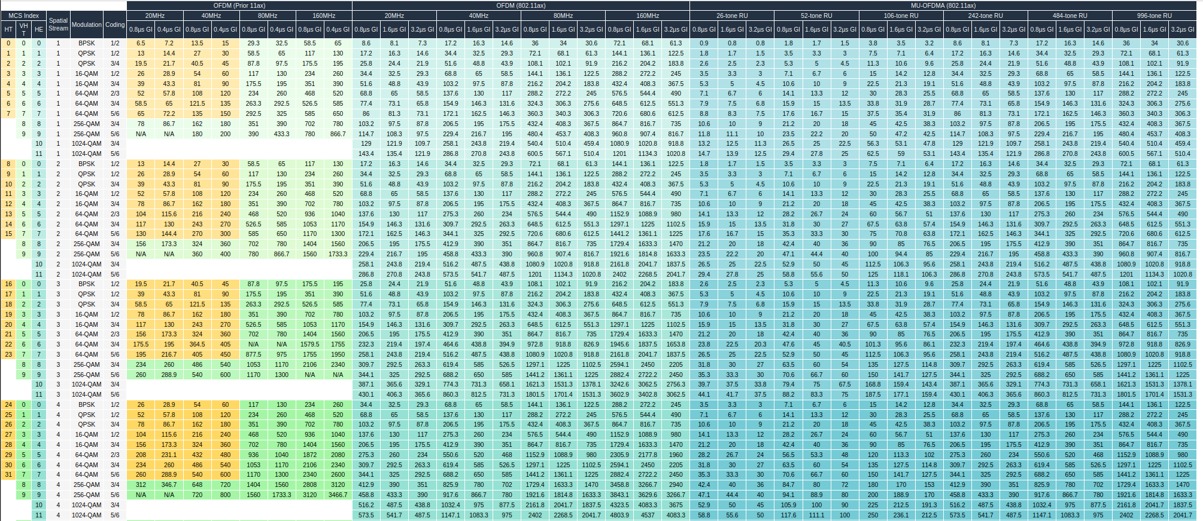
RAA Parameters – MCS Table
The primary parameter a RAA can tune is the Modulation and Coding Scheme (MCS). The set of available MCS is based on the standard, channel width, and SNR. The Number of Spatial Streams and Guard Interval also influence the available data rate
[1]
Lots of combinations to manage!
2
[1] F. Verges. “MCS TABLE” SemFioNetworks. Accessed: Jun. 15, 2023. [Online]. Available: https://semfionetworks.com/blog/mcs-table-updated-with-80211ax-data-rates/
Notes:
Mention that before in other standards the table was simpler but with time it has become more complex

Slide 4
Types of RAAs
Different types of RAAs can be classified based on how they gain information on the channel state:
Measurement Based – Explicit Feedback: This type of RAA relies on the receiver providing the SNR to the sender via control frames such as RTS/CTS or ACK
a
Sampling Based – Implicit Feedback: The sender calculates the Frame/MPDU error rate using the information gained from ACK frames
3

Slide 5
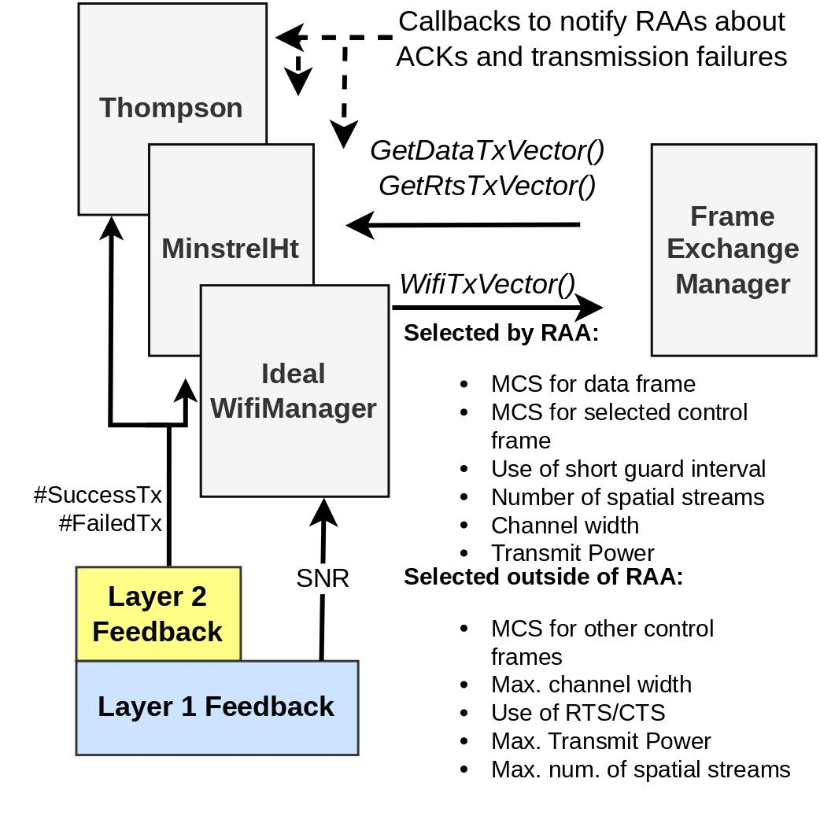
ns-3 Implementation of RAAs
ns-3 has 3 RAAs for modern (HT and above) standards:
Ideal WifiManager is based on the idea of an (idealized) feedback channel
MinstrelHt is very popular since it is used in the Linux Kernel
Thompson Sampling is a classical approach to the multi-armed bandit problem
[2]
4
[2] This is Figure 1 from our paper
Notes:
Remember to overview the figure

Slide 6
Ideal Wifi Manager – General Implementation
Receiver sends to transmitter a tag (PacketTag) in a control frame which carries the SNR of the last received frame
To select an MCS for Tx, the SNR should support a Bit Error Rate (BER) below 1e-6
1. Stores the SNR of the last received frame from each sender
3. Uses a lookup table to determine which MCS can provide a BER below a certain threshold given the SNR of the last frame
2. Tags a control frame to send the SNR back to the transmitter
4. Repeats steps 1-2...
5. Repeats step 3 ...
5

Slide 7
MinstrelHt Vs. ThompsonSampling – General Concept (1)
MinstrelHt:
Two distinct states: Exploring (Sampling) or Exploiting
During exploration it chooses a random MCS to gain knowledge on the channel state
During exploitation it chooses the best MCS based on the statistics gained during exploration and exploitation
Uses heuristics such as a retry chain or other heuristics such as ones that prevent it from sampling rates with very high probability of success.
Decays statistics using Exponentially Weighted Moving Average (EWMA)
ThompsonSampling (TS):
Even though TS is considered a Sampling-Based RAA, there is no distinction between the exploring and exploiting states
All updates on transmission outcomes are used to evolve the statistics. So, it is always sampling the channel (Exploring)
From the collected statistics, the MCS that will offer the highest throughput with the highest probability of success will be chosen. Always exploiting the statistics it has gained (Exploiting)
Pure Statistical Approach no heuristics
Decays statistics using an exponential decay

Slide 8
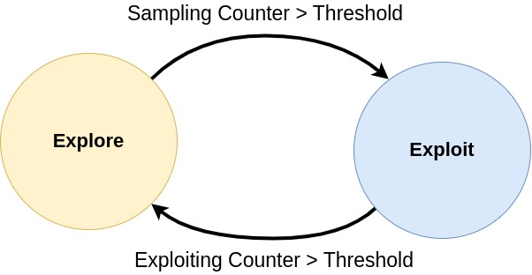
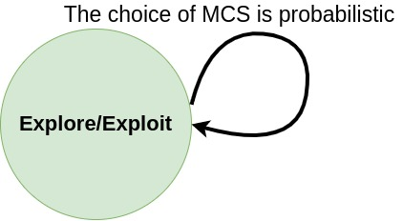
MinstrelHt Vs. ThompsonSampling – General Concept
MinstrelHt:
The transition between exploring and exploiting happens when specific counters exceed a certain threshold.
Uses heuristics to sample more intelligently than randomly
ThompsonSampling (TS):
Successful and Failed transmissions update the parameters of a beta distributed random variable
Each time an MCS is requested for Tx, the beta distributed variable of each MCS is sampled and the MCS that provides the highest (success probability * data rate) will be selected.
6
Notes:
Mention stuff from previous slide
Mention that around 10% of frames will be exploratory

Slide 9
MinstrelHt – Retry Chain
Transmitter
Receiver
Best throughput MCS
X
...
Second best throughput MCS
X
The ns-3 model does not implement enhanced heuristics to reduce samples of lower rates than a successfully working higher rate
Time
...
Max. probability MCS
7
Note: acknowledgements
are not shown
Notes:
In general a frame is attempted 7 times, 1 BEST TP, 2 BEST TP2 and 3 Best Prob

Slide 10
Objectives
Confirm that all rate controls make the appropriate MCS selection for all possible configurations
Compare and contrast the throughput performance of all three rate controls for a time-varying AWGN SISO channel
Compare and contrast the convergence performance of MinstrelHt and ThompsonSampling to a step change in the channel SNR
8

Slide 11
Testing of Parameter Combinations
Approach:
Configured a script to run each possible combination of Channel Width, G.I and NSS for each standard (802.11ac, 802.11an and 802.11ax)
Swept a range of SNR to force RAAs to pick all possible MCS
Compared achieved rates against published MCS tables
Findings:
All RAAs could achieve the expected data rate corresponding to an MCS
All RAAs could select all possible MCSs given the SNR range
If MinstrelHt is using a 80 MHz channel width it might try to sample using a 40 MHz channel width resulting in slower convergence time for standards with a larger amount of parameter combinations to explore
9

Slide 12
Throughput Comparison - Scenario Description
Every simulation instance distance between STAs is increased by 1 m
Each instance is repeated 5 times
Simulation Parameter | Value
ns-3 Version | 3.37
Wi-Fi Standard | 802.11ac
Spatial Streams | 1
Channel Width | 20 MHz
Short Guard Interval | Enabled
Propagation Loss Model | Log Distance
Application | Saturating 1420 bytes packets
Preamble Detection Model | Disabled
Simulation Duration | 30 seconds (five trials averaged)
10

Slide 13
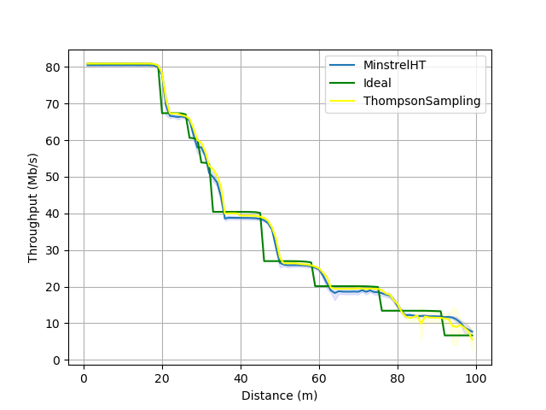
Throughput Comparison - Result
[3]
All RAAs offer comparable throughput
In certain regions Ideal underperforms due to having very low BER tolerance
11
[3] This is figure 4 from our paper
Notes:
-Mention that the trade off between less correct transmission or more transmissions that all might not be correct
-Mention that the cost of higher throughput for Minstrel or TS is the tradeoff in higher amount of retransmissions (Latency)

Slide 14
Convergence Evaluation - Approach
Performance is sensitive to how fast an RAA converges to a new rate upon a channel change
Ideal RAA converges immediately but it is not a practical RAA
Sampling Based approaches have some dampening of the response built into the algorithm to suppress transient losses such as collisions
Since ThompsonSampling and MintrelHt operate so differently we had to produce different convergence definitions
12

Slide 15
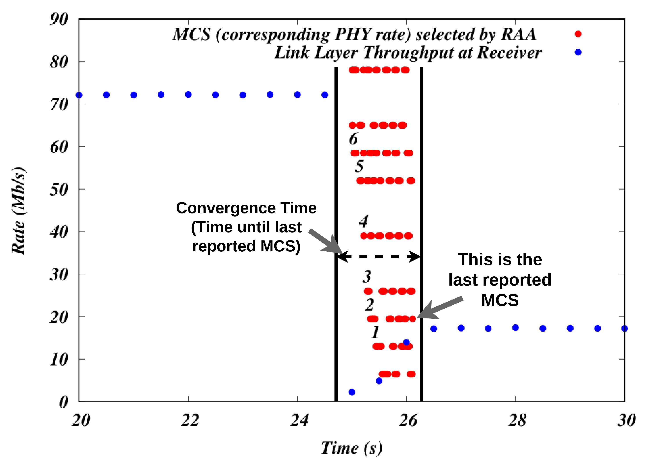
Convergence Definition - MinstrelHt
[4]
13
[4] This is figure 6.a from our paper

Slide 16
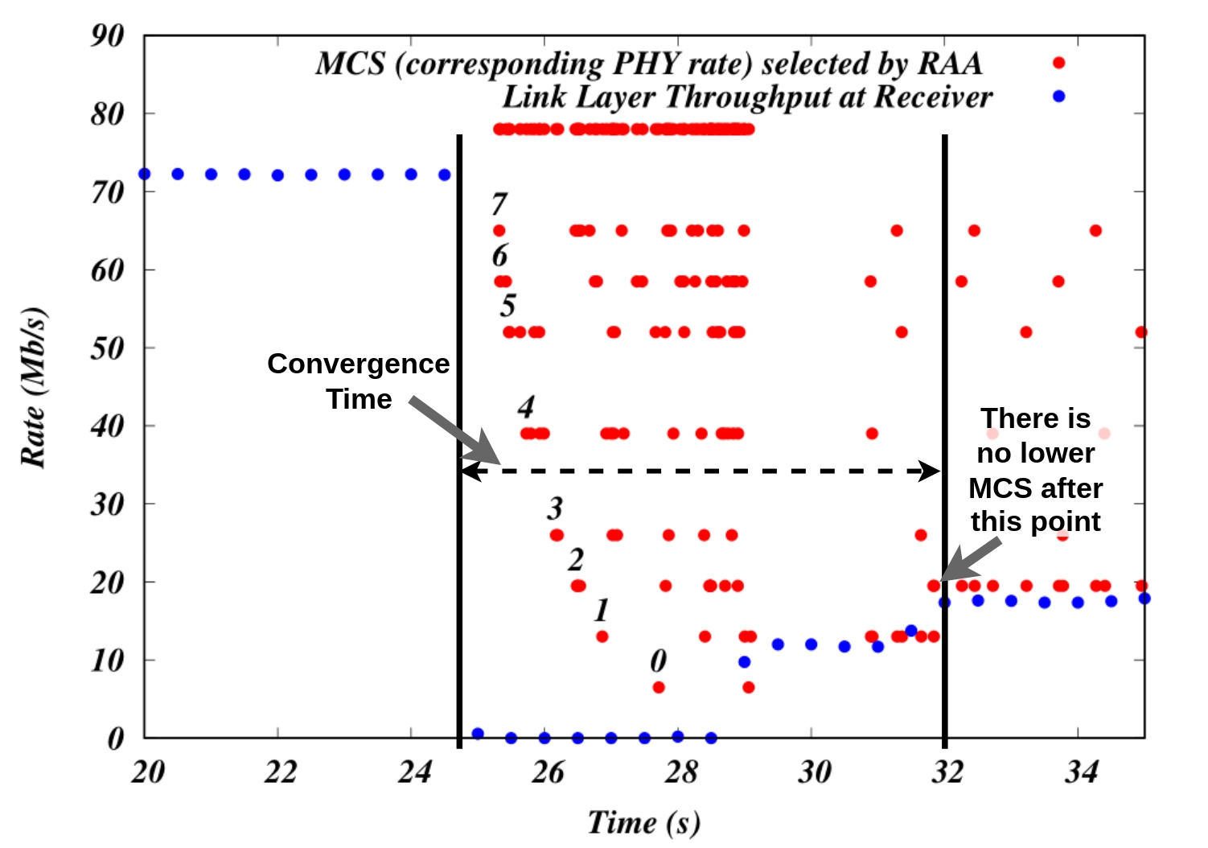
Convergence Definition - ThompsonSampling
[5]
14
[5] This is figure 6.b from our paper

Slide 17
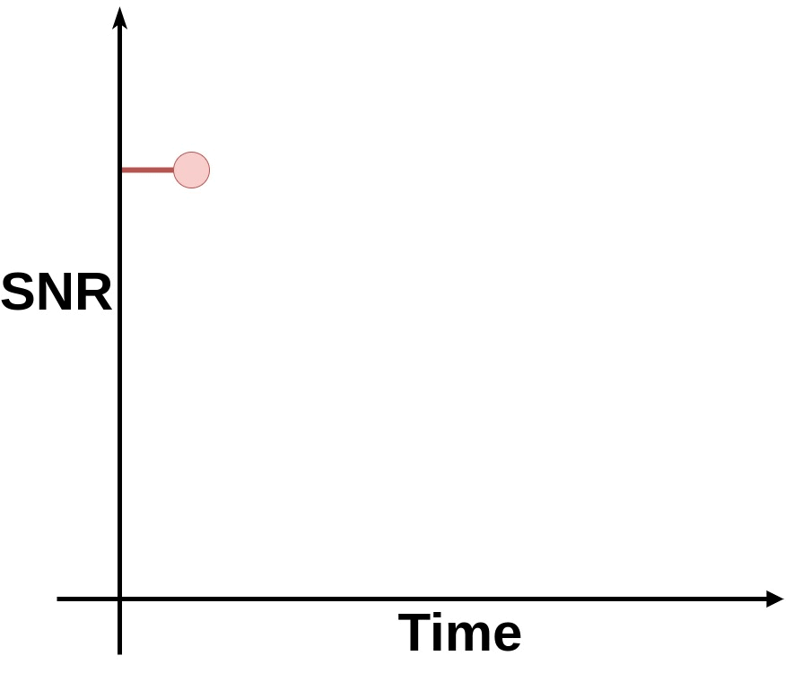
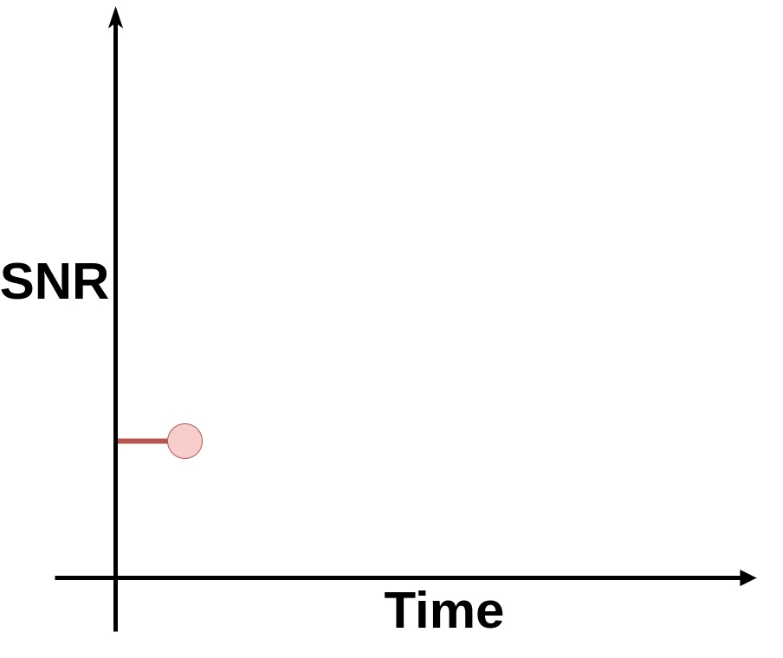
Convergence – Scenario Description
Fixed RSSI -> Step response (step size 0.1dB)
Case 1: SNR 31dB to SNR 11 dB (MCS 8 -> MCS 2)
Case 2: SNR 11dB to SNR 31 dB (MCS 2 -> MCS 8)
15

Slide 18
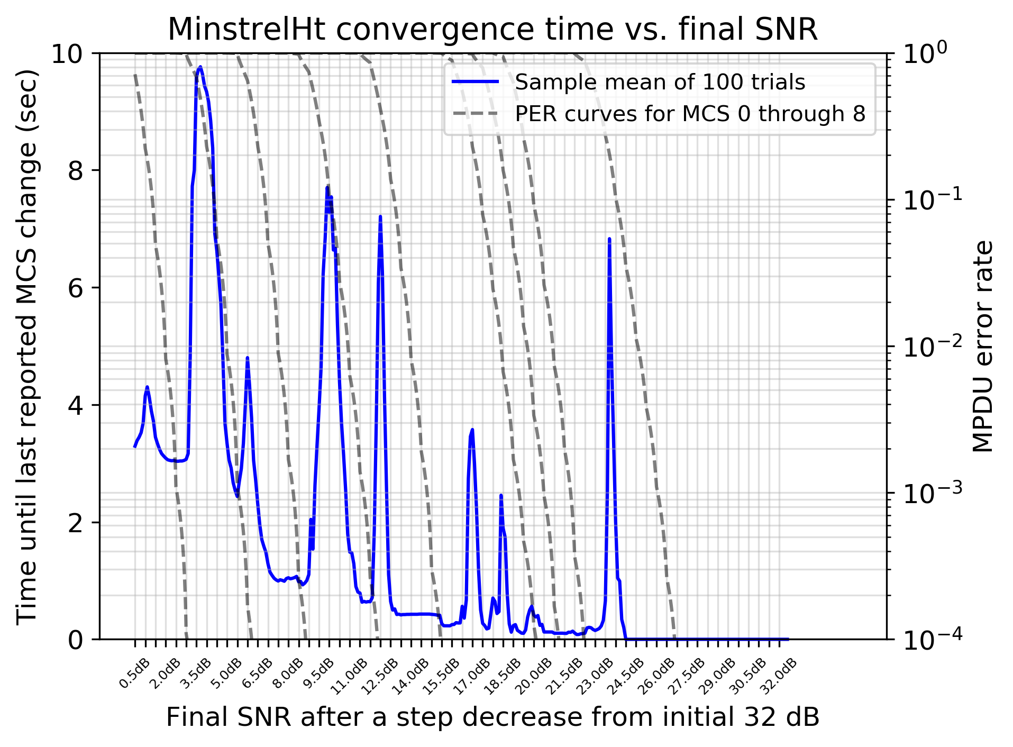
MinstrelHt – Results (Step Decrease)
Strong peaks at transition regions between MCS
Tradeoff between higher throughput (higher MCS) and the better frame success ratio (lower MCS)
Thick peaks in low SNR -> missing control frames
Trend: Increase in convergence time as a function of the resulting SNR
16
Notes:
This trend can be attributed to the way in which MinstrelHt statistics evolve over time. Specifically, when fast rates are used, or when sampling occurs, a larger number of attempts can be made for a higher MCS (i.e., a specific number of MPDUs sent using that MCS), compared to slower rates, which limit the number of attempts that can be made within a given time interval. Consequently, as more attempts are made for a particular MCS, MinstrelHt can accumulate more information on that MCS, leading to a faster convergence time. An additional interesting aspect of the plot is the wider peaks observed in regions where the SNR is less than 10.8 dB. We hypothesized that an additional effect was coming into play in these regions. Wi-Fi acknowledgments are sent at selected basic rates of 6, 12, or 24 Mbps, and at certain SNR regions, the selection of an appropriate acknowledgment rate can be difficult, leading to lost acknowledgments as well. To confirm this hypothesis, we conducted an experiment in which control frames were forcibly set to use 6 Mbps to ensure their robustness. The results are not shown here due to space, but this modified experiment also resulted in narrow peaks for these low SNR regions.

Slide 19
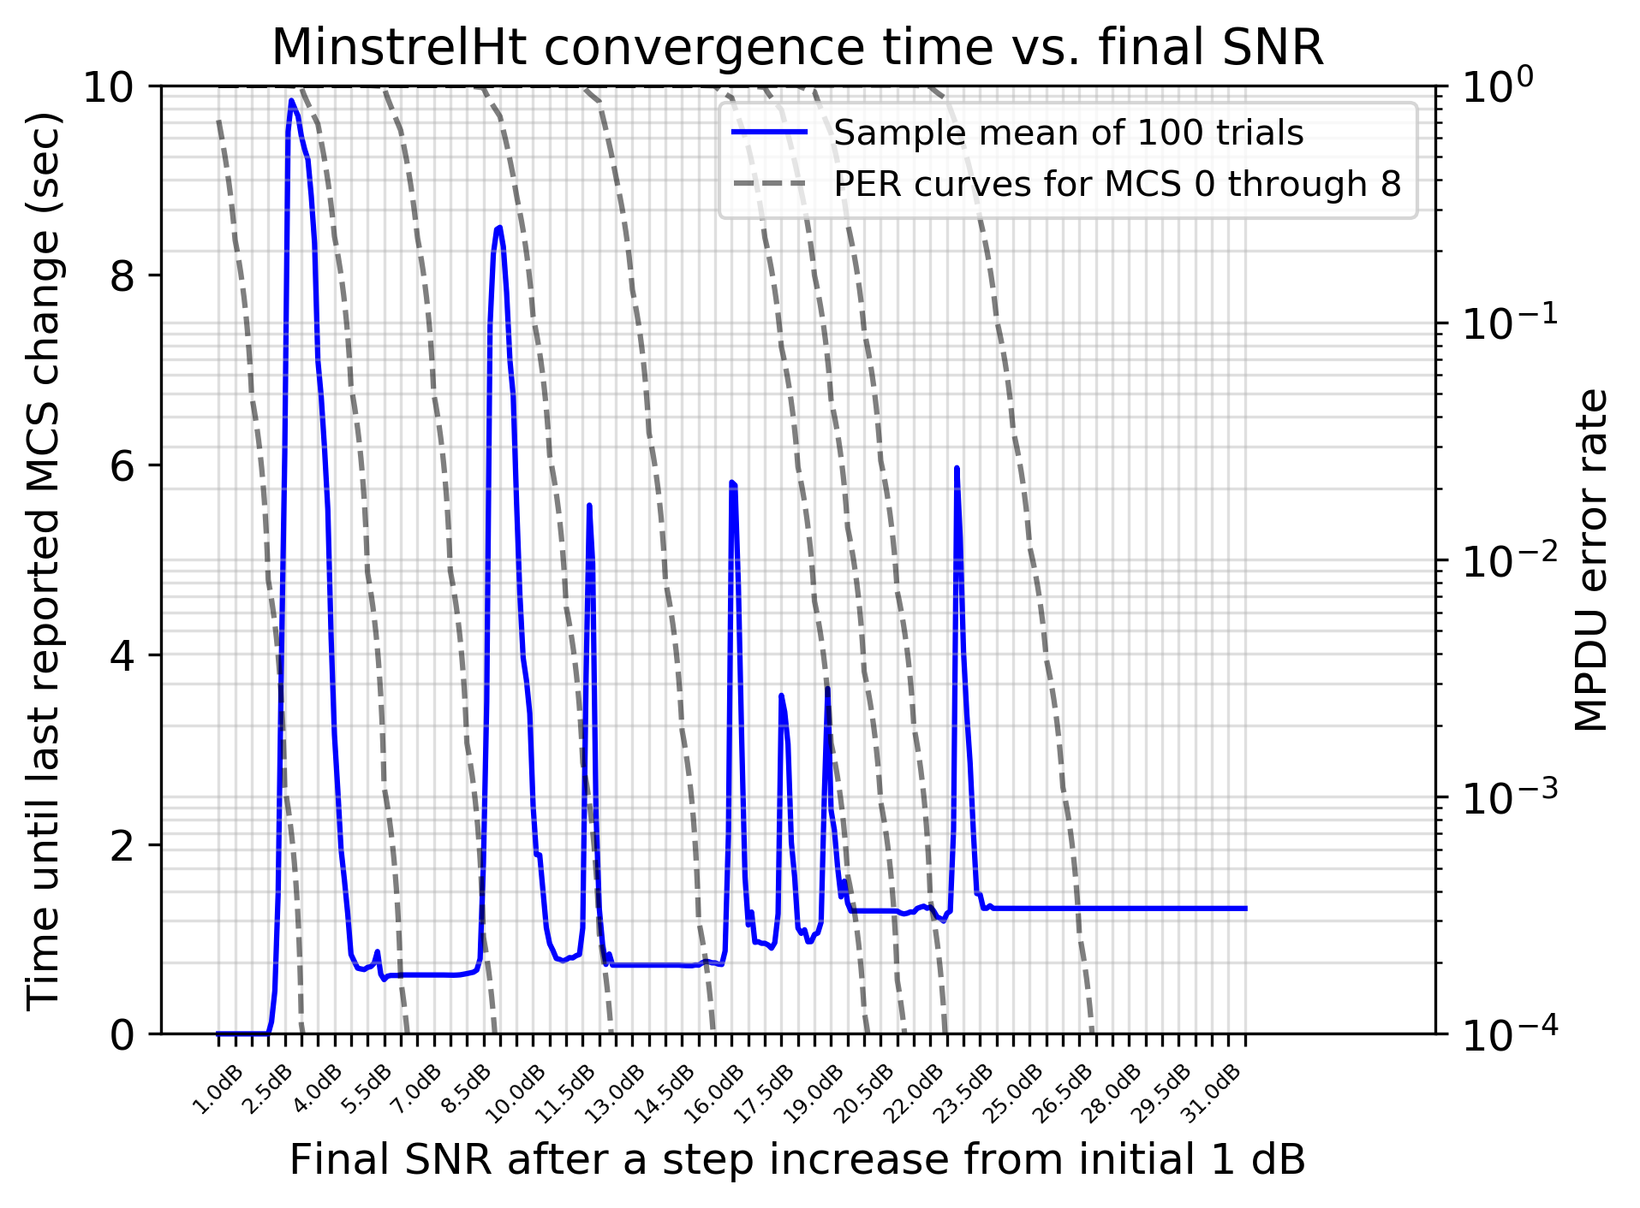
MinstrelHt – Results (Step Increase)
Trend: Small increases in convergence time as a function of the resulting SNR
Trend is due to MinstrelHt converging to a less than optimal rate
Such small increase in convergence time can be attributed to MinstrelHt avoidance of re-sampling very robust rates.
17

Slide 20
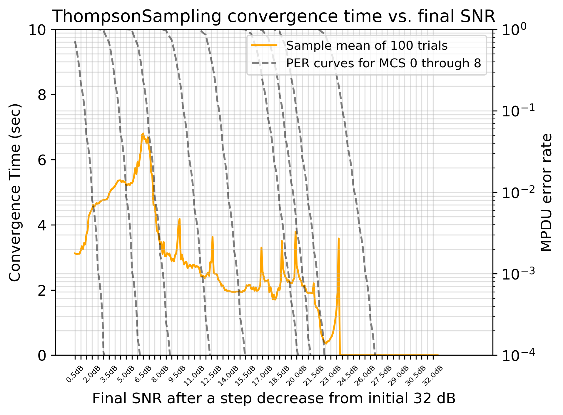
ThompsonSampling – Results (Step Decrease)
Trend: Large increases in convergence time as a function of the resulting SNR. Trend changes for SNR < 5 dB
Trend is attributed to the time it takes to decay previously built-up statistics
For SNR < 5 dB convergence time decreases because only one rate can be supported so no time is wasted locking onto a suboptimal rate
18

Slide 21
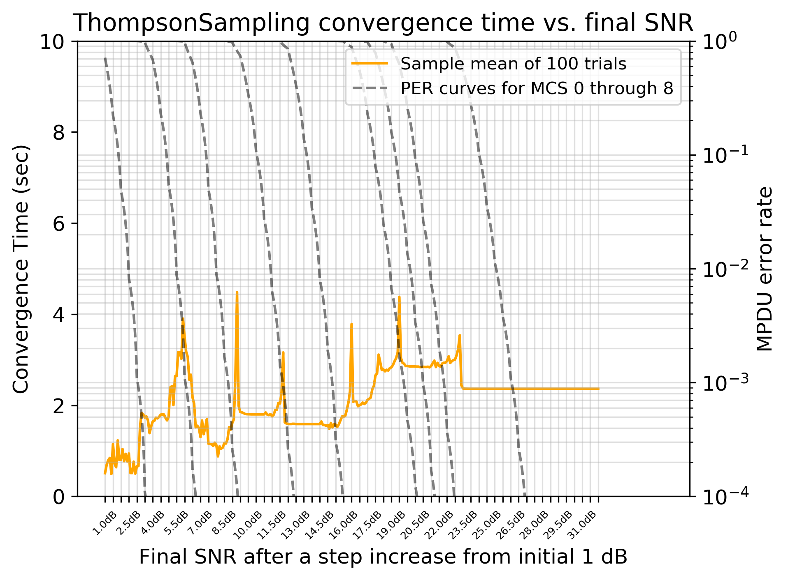
ThompsonSampling – Results (Step Increase)
Trend: Increase in convergence time as a function of the resulting SNR. Trend changes for SNR > 23 dB
Trend is attributed to the tendency of TS to converge on a less than optimal rate necessitating the decay of statistics to select a different rate
19

Slide 22
Conclusion – Lessons Learned & Recommendations
All tested ns-3 RAAs were verified to achieve appropriate MCS in most situations
ThompsonSampling lacks the heuristics to cope with low SNR
The use of short guard interval was not in line with reported practice
In a simple SNR step change we showed that the convergence time will increase if the resulting SNR corresponds to a transition region on the PER curves for each MCS.
Future improvements to the ns-3 PHY abstraction to focus on incorporating CSI for MIMO, and models for operation in time-varying fading channels
20
Notes:
Mention New raas will also be needed in ns-3 for 802.11ax/be features such as OFDMA and spatial reuse
Mention due to space constraints we did not present results of the convergence behavior when changing decay parameters

Slide 23
Thank you for your attention. Please ask any questions you may have.

Slide 24
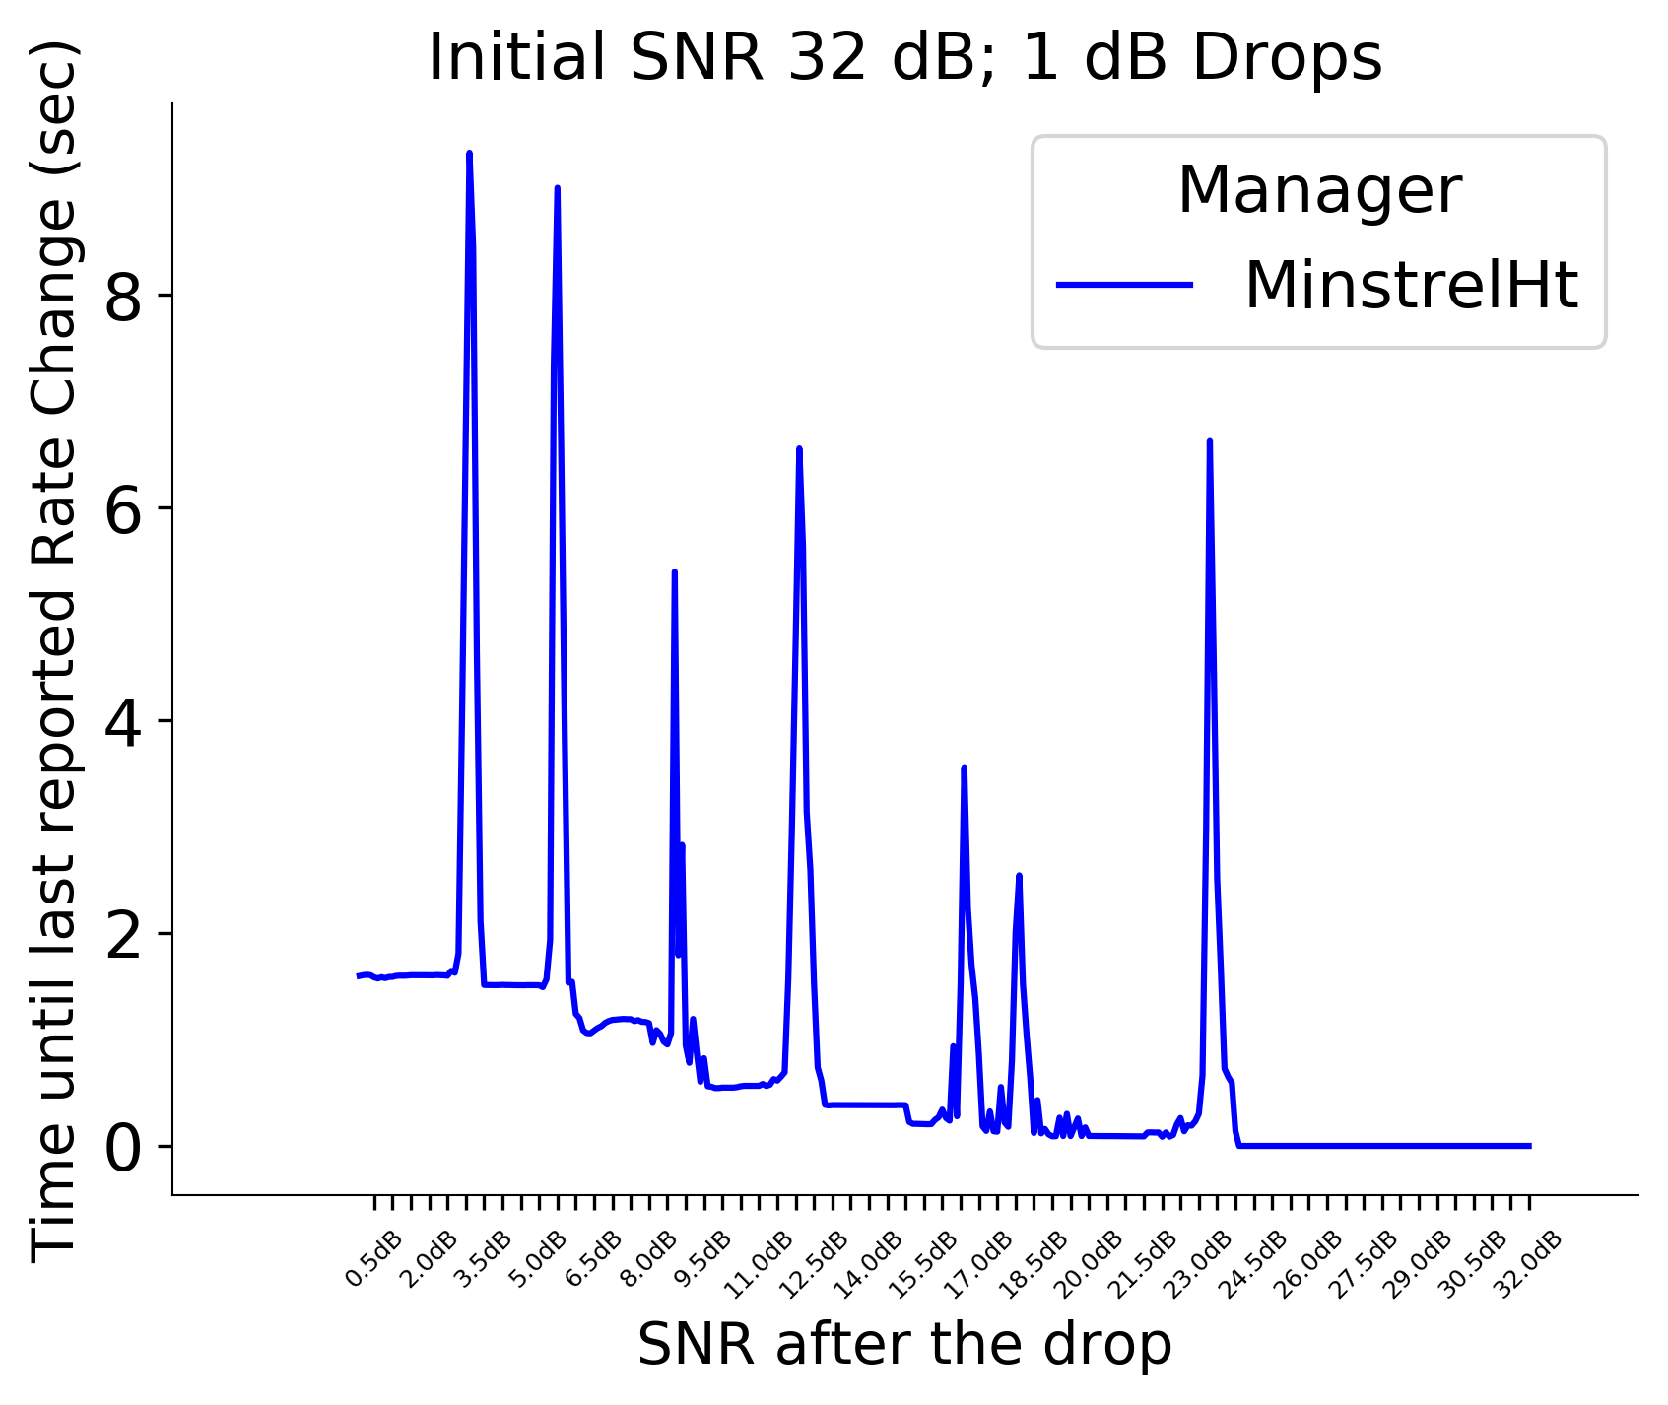
MinstrelHt – Slide 18 Backup
Experiment repeated with forced 6 Mbps Control Frames

