Slide 1
Linux-like Socket Statistics Utility for ns-3
Aditya R. Rudra, Sharvani Laxmi Somayaji, Satvik Singh, Saurabh Dhananjay Mokashi, Abhinaba
Rakshit, Dayma Khan, and Mohit P. Tahiliani
Wireless Information Networking Group
National Institute of Technology Karnataka, Surathkal, Mangalore, India
Workshop on ns-3 (WNS3-2023)
June 28, 2023

Slide 2
Outline of the presentation
1. Introduction to Socket Statistics in ns-3
2. Overview of Socket Statistics module in ns-3
3. Methodology
4. Validation and Results
5. Performance
6. Conclusions and Future Work
5. Conclusion

Slide 3
Introduction to Socket Statistics in ns-3
1. Introduction
Accurate and comprehensive statistics collection is essential for evaluating network protocol performance and efficiency
ns-3 supports various techniques for collecting network-related statistics, but it requires a high level of proficiency and experience
Socket Statistics, a new socket monitoring utility inspired by the ss utility in Linux, is introduced in ns-3
Socket Statistics provides a user-friendly API for easy collection and storage of socket information from any ns-3 node
The introduced ss module in ns-3 is validated with trace sources and compared in terms of heap memory consumption and execution time
Socket Statistics provides a useful tool for monitoring network behavior without requiring advanced proficiency in ns-3

Slide 4
1. Introduction
Existing Monitoring Techniques in ns-3
Method | Drawback(s)
Flow Monitor Utility in ns-3 | Retransmissions by the transport protocols are classified as a new packet Packets queued for transmission below network level at the end of simulation are considered as lost
Tracing via Trace Sources/Sinks in ns-3 | Users might have to create their own trace source Extracting multiple information requires creating separate individual hooks to the trace sources
PCAP and ASCII Tracing in ns-3 | PCAP traces can be very large and can take up a significant amount of disk space ASCII traces provide less detailed information than PCAP traces

Slide 5
2. Overview of Socket Statistics module in ns-3
Overview of Socket Statistics module in ns-3
Based on Linux functionality with extensions
Implemented in a new class called SocketStatistics and a helper called SocketStatisticsHelper
Provides information on sockets at a specific time and on a regular interval basis
Configurable and customizable through user-friendly APIs
Modularized with two core classes: SocketStatisticsHelper and SocketStatistics
SocketStatisticsHelper collects end-to-end socket statistics and is responsible for all central features
SocketStatistics class searches and iterates through nodes and their associated sockets during the simulation

Slide 6
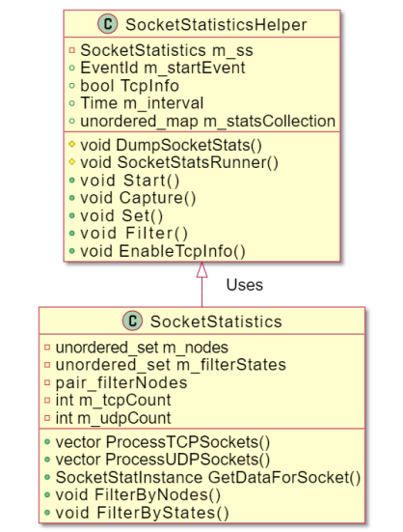
2. Overview of Socket Statistics module in ns-3
Overview of Socket Statistics module in ns-3
SocketStatistics class responsible for collecting information on TCP and UDP sockets
Extracts socket properties such as state of the socket, number of bytes transmitted and received, and associated local and peer addresses
Captures TCP metrics such as cwnd, RTT, and RTO and stores them in m_statsCollection for each socket
Allows for the retrieval of all information at once, unlike trace sources and sinks
Figure 1: Class Diagram of SocketStatistics Module

Slide 7
2. Overview of Socket Statistics module in ns-3
Overview of Socket Statistics module in ns-3
User-specified filtering takes place in the SocketStatistics class, which iterates through sockets and returns the required list to the SocketStatisticsHelper class
Provides filtering capabilities via specific flags, allowing users to segregate sockets based on protocols like TCP, UDP, or on internal TCP state information such as RTO, RTT, and cwnd
A single simulation typically contains one SocketStatisticsHelper instance and an associated SocketStatistics instance
SocketStatistics class iterates through the list of nodes and does the filtering while SocketStatisticsHelper parses through the options enabled and calls the corresponding functionality in the helper class.

Slide 8
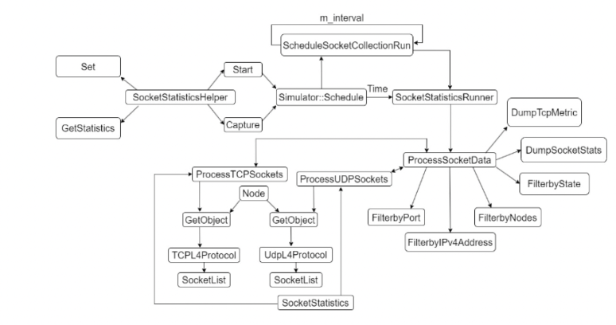
Flow of calls
3. Methodology
The Socket Statistics module allows users to retrieve various socket-related information.
The Set function manipulates bool values to display either TCP state information, TCP information, or UDP information. The SocketStatisticsHelper class provides two methods of collecting statistics based on user requirements.
The SocketStatisticsHelper class provides two methods of collecting statistics based on user requirements.
Figure 2: Flow of Calls Describing the Working of
SocketStatistics Module

Slide 9
Start and Capture methods
3. Methodology
The Start method accumulates statistical data periodically throughout a predetermined duration.
The Capture method gathers statistical data at a specific moment in time.
ScheduleSocketCollectionRun function is invoked to schedule SocketStatsRunner function, which calls the ProcessSocketData function to collect statistics.
The ProcessSocketData checks whether the user wants TCP or UDP information before collecting statistics.
Figure 3: Typical use of Start method
Figure 4: Typical use of Capture method
12

Slide 10
Retrieving Socket Information
3. Methodology
The GetStatistics function retrieves socket information of a specific socket on a node.
GetStatistics returns information stored in m_statsCollection, where all socket information is stored.
The stats are dumped by default to files in the `ss-results/` directory, with a .ss file for each socket
Some of the statistics stored in m_statsCollection include:
socket state
bytes sent/received
socket type
local/peer addresses
12

Slide 11
Validation
4. Validation and Results
For validation of Socket Statistics module in ns-3, we utilize three distinct TCP variants:
TCP Cubic
TCP Linux Reno
TCP BBR
We have collected socket information such as cwnd and RTT, and have generated multiple plots.
We have compared the generated plots with trace sources obtained from similar experimental scenarios.
Our aim is to ensure correct functioning of Socket Statistics module and its output consistency with expected results from trace sources.
12

Slide 12
4. Validation and Results
Figure 5: Congestion Window: Trace Sources vs Socket Statistics
Figure 6: Round Trip Time: Trace Sources vs Socket Statistics
12

Slide 13
Validation: Results
4. Validation and Results
Comparison plots show similarity between results obtained through "tracing" technique and ss method
Slight differences between the two can be attributed to inherent characteristics of each method
Tracing: constantly monitors changes in attribute values and records statistics
ss method: extracts statistics at fixed time intervals resulting in a "step-curve" appearance of the plot
Disparities become less noticeable as the interval between extractions is reduced
Results obtained from ss align with trace sources, indicating consistency between them
12

Slide 14
Performance Evaluation
5. Performance
Three variants of the same dumbbell topology tested - one with added functionality (ss), one using trace sources for tracing, and one without any.
We dynamically increase of nodes on both sides to test ns-3’s performance
Results indicate that as the number of nodes increases, there is an accompanying rise in memory consumption, which is attributed to the generation of dump files.
Analysis of simulation completion time shows that as the number of nodes increases, there is an increase in simulation completion time.
12

Slide 15
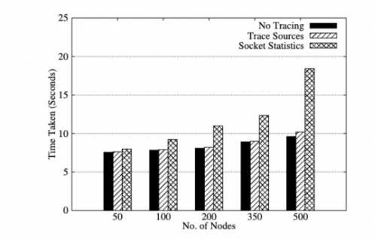
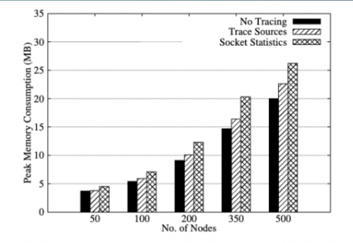
5. Performance
Figure 7: Memory Consumed Using Socket Statistics
Figure 8: Time Taken for Simulation Using Socket Statistics
12

Slide 16
Conclusions and Future Work
6. Conclusions
This project (MR: https://gitlab.com/nsnam/ns-3-dev/-/merge_requests/1415) introduces the Socket Statistics module for ns-3, which offers a simplified API and improved socket information collection compared to existing tracing techniques.
The ss module presents a valuable addition to ns-3 for network simulation and analysis.
The module was implemented and tested for performance and accuracy and demonstrated precise correspondence with trace sources.
Additional data output methods such as database, binary file, and JSON can be incorporated for greater flexibility and compatibility with various systems.
Adding more options to control the level of detail stored in memory, for example, some users may not require per-socket statistics or other figures, and having the ability to customize the data stored in the memory would be beneficial.
More filtering options, such as the ability to generate summaries, would be helpful for users who require a high-level overview of the socket statistics.
Currently, the utility only supports TCP and UDP sockets, but we aim to develop routines for gathering statistics for raw sockets and packet sockets in the future.
12

Slide 17
Questions?

