Slide 1
Emerging ns-3 support for 802.11ax
Stefano Avallone
Sébastien Deronne

Slide 2
Outline
11ax OFDMA
MAC: current status and next steps
PHY: current status and next steps
11ax OBSS-PD based spatial reuse

Slide 3
11ax OFDMA

Slide 4
OFDMA
OFDMA is a multiple access technique based on OFDM
Multiple simultaneous transmissions over distinct sets of OFDM subcarriers
OFDM subcarriers can be grouped into sets of predefined size named Resource Units (RUs)
26-tone RU (≅2 MHz)
52-tone RU (≅4 MHz)
106-tone RU (≅8 MHz)
242-tone RU (≅20 MHz)
484-tone RU (≅40 MHz)
996-tone RU (≅80 MHz)
2x996-tone RU (≅160 MHz)

Slide 5
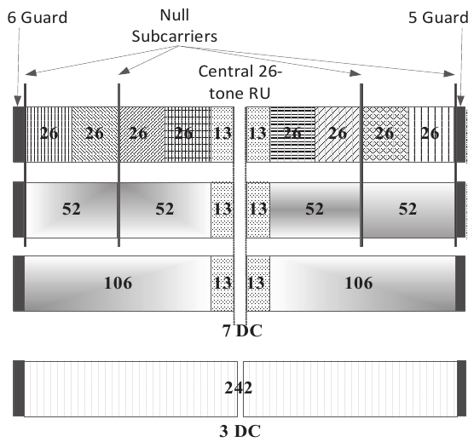
RU Allocation over 20 MHz

Slide 6
OFDMA MAC
802.11ax APs are allowed to
transmit simultaneously to multiple STAs (DL MU)
schedule transmissions from multiple STAs (UL MU)
… by using OFDMA, MU-MIMO or both
An UL MU transmission is preceded by a Trigger Frame
sent by the AP
providing STAs with infos about UL transmission
RU, MCS, TX power, ...

Slide 7
Acknowledgment of DL MU PPDUs
After a DL MU transmission, how can we handle acknowledgment from multiple stations?
1st solution (already in 802.11ac)
SIFS
SIFS
SIFS
SIFS
SIFS
SIFS
AP
HE MU PPDU
BAR
BAR
STA1
BA/Ack
STA2
BA/Ack
STA3
BA/Ack

Slide 8
Acknowledgment of DL MU PPDUs (cont.)
But… UL MU is now possible
DL MU PPDU
SIFS
SIFS
HE TB PPDU
A-MPDU 1
MU-BAR
Trigger
Frame
A-MPDU 2
AP
...
A-MPDU n
STAs
BlockAck
BlockAck
BlockAck
BlockAck

Slide 9
Acknowledgment of DL MU PPDUs (cont.)
Yet another possibility
DL MU PPDU
SIFS
HE TB PPDU
A-MPDU 1 with MU-BAR Trigger Frame
A-MPDU 2 with MU-BAR Trigger Frame
AP
...
A-MPDU n with MU-BAR Trigger Frame
STAs
BlockAck
BlockAck
BlockAck
BlockAck

Slide 10
Acknowledgment of UL MU PPDUs
The newly introduced Multi-STA Block Ack carries acknowledgment information for multiple stations
SIFS
SIFS
HE TB PPDU
Trigger
Frame
(Basic)
Multi-STA
Block Ack
AP
STAs
SU PPDU
A-MPDU 1
SU PPDU
A-MPDU 2
...
A-MPDU n

Slide 11
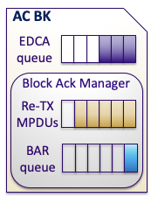
ns-3: Current wifi stack
WifiMac
WifiMac enqueues MSDUs into EDCA queues
VI
QosTxop
VO
QosTxop
BE
QosTxop
BK
QosTxop
MacLow
WifiPhy

Slide 12
ns-3: Current wifi stack
WifiMac
WifiMac enqueues MSDUs into EDCA queues
QosTxop selects the frame to be (re-)transmitted
MacLow performs aggregation and passes the resulting frame to the PHY layer
VI
QosTxop
VO
QosTxop
BE
QosTxop
BK
QosTxop
MacLow
WifiPhy

Slide 13
HE APs behavior
WifiMac
An HE AP gaining channel access can choose among:
SU transmission
DL MU transmission
UL MU transmission
...on a per frame basis
How to extend the ns-3 architecture to support DL/UL MU transmissions?
VI
QosTxop
VO
QosTxop
BE
QosTxop
BK
QosTxop
MacLow
WifiPhy

Slide 14
Multi-user support in ns-3
aggregation
(optional, HE APs only)
OFDMA
Manager
WifiMac
VI
QosTxop
VO
QosTxop
BE
QosTxop
BK
QosTxop
transmission
type?
If MacLow receives a non-broadcast QoS data frame, it asks the OFDMA Manager the type of transmission to make
MacLow
WifiPhy

Slide 15
Multi-user support in ns-3
aggregation
(optional, HE APs only)
OFDMA
Manager
WifiMac
VI
QosTxop
VO
QosTxop
BE
QosTxop
BK
QosTxop
In case of DL OFDMA
(AID, TID) pair for each receiver
TX vector including per station infos (RU, MCS, NSS)
Trigger Frame payload (for MU acknowledgment only)
In case of UL OFDMA
Trigger Frame payload
MacLow
WifiPhy

Slide 16
Multi-user support in ns-3
aggregation
(optional, HE APs only)
OFDMA
Manager
WifiMac
VI
QosTxop
VO
QosTxop
BE
QosTxop
BK
QosTxop
MacLow
prepares a PSDU for each (AID, TID) pair
including TF if 3rd ack seq
enqueues BARs (1st ack seq) or a MU-BAR (2nd ack seq)
passes a set of PSDUs down to the PHY layer
MacLow
WifiPhy

Slide 17
OFDMA Manager
OfdmaManager is an abstract base class
The only concrete subclass so far is RrOfdmaManager
Return DL-OFDMA if the AP has frames to send to at least one STA
Return UL-OFDMA if an appropriate attribute is true and DL-OFDMA was previously returned
Thus alternating DL OFDMA and UL OFDMA
The maximum number of STAs that can be granted an RU is configurable through an attribute
STAs are granted equal sized RUs
STAs are served in a round robin fashion
The MCS selected for a STA is the one used to transmit a SU frame to that STA

Slide 18
ns-3 support for 11ax OFDMA at MAC layer
Completed
DL OFDMA with all ack sequences
Block Acks are not sent as UL MU
Improve handling of failure cases
UL OFDMA with Multi-STA Block Ack
Next steps
MU-RTS Trigger Frame
MU EDCA Parameter set
UORA (UL OFDMA-based Random Access)

Slide 19
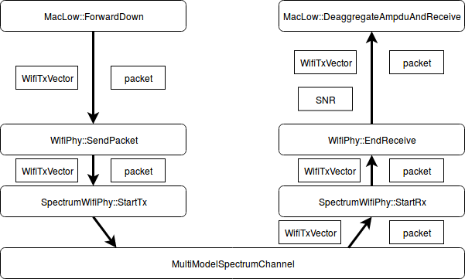
PHY changes to support OFDMA
Current ns-3 implementation is not designed for OFDMA:
PHY-MAC interface: packet + TXVECTOR ⇒ but… MU-PPDU contains multiple packets!
Multiple RX events for each MPDU in A-MPDU ⇒ but … different A-MPDU size per user in MU-PPDU!
and lot more ...

Slide 20
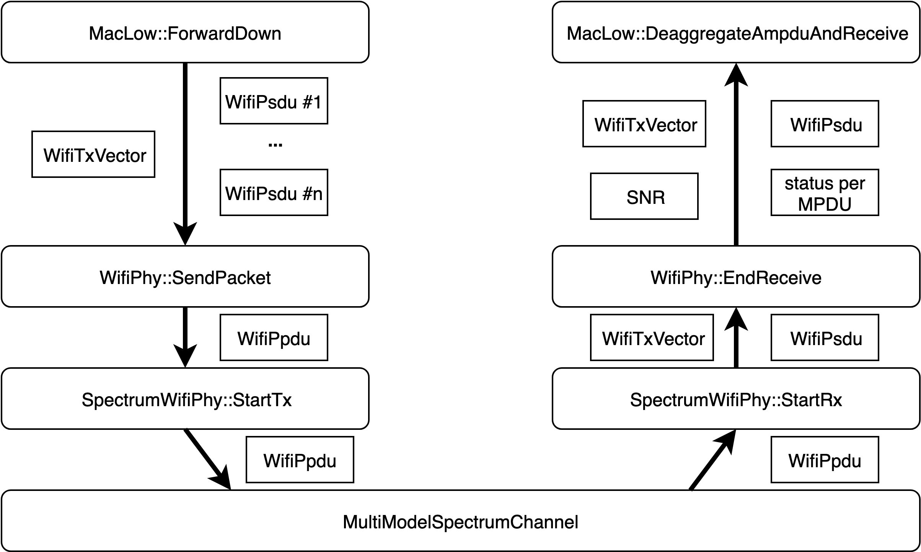
PHY changes to support OFDMA (cont.)
MAC/PHY interface extensions
packet -> map of PSDUs (SU: single PSDU)
A-MPDU simplified: single RX event, MPDUs hold by WifiPsdu, ...
Transport PPDU instead of packet
WifiPpdu: holds map of PSDUs, PHY headers, modulation class, preamble, …
PHY RX picks corresponding PSDU from MU PPDU
RUs information in MU PPDU;
PHY has knowledge of its STA_ID (from MAC, after association);

Slide 21
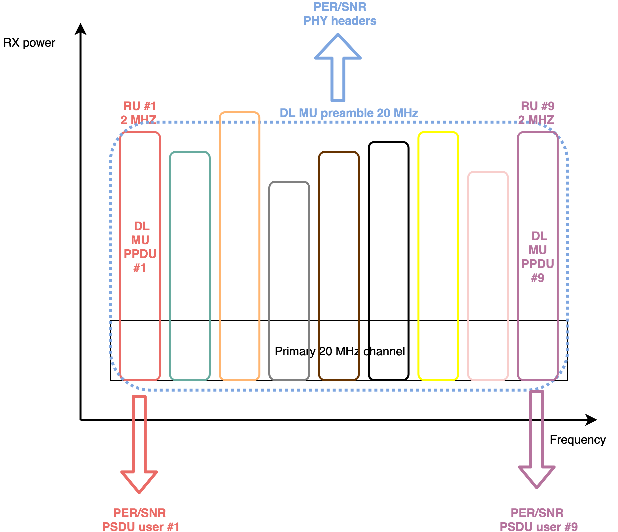
PHY changes to support OFDMA (cont.)
InterferenceHelper initially designed for YANS:
No consideration of spectrum occupancy for incoming signals!
Rework InterferenceHelper to handle SNR & PER per RU
2 parts in MU PPDU: non-OFDMA & OFDMA
PSDU reception: SNR calculated for the corresponding RU ⇒ PER of PSDU
InterferenceHelper will keep track of RX powers in all possible RUs ⇒ 11ax only with Spectrum model!

Slide 22
ns-3 support for 11ax OFDMA at PHY layer
Main implementation steps:
Some pre-OFDMA refactoring needed
DL-OFDMA
SNR & PER calculation per RU (InterferenceHelper)
UL-OFDMA
Current status:
Various reworks in existing PHY implementation done
First 11ax DL-OFDMA simulation (MAC + PHY) successfully run :-)
InterferenceHelper extension for OFDMA in progress
UL-OFDMA PHY just started
PCAP tracing to be extended for OFDMA

Slide 23
11ax OBSS-PD based spatial reuse

Slide 24
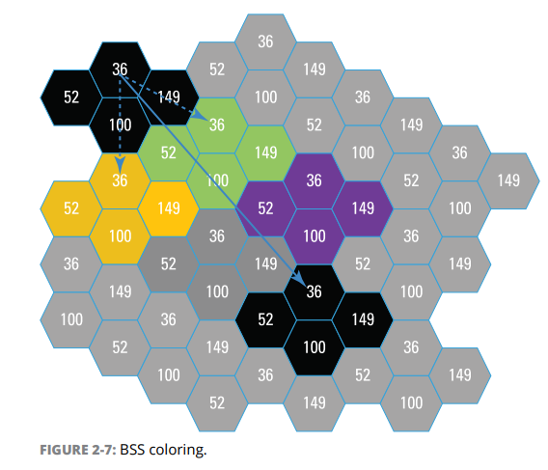
11ax OBSS_PD Spatial Reuse
BSS coloring:
BSS color = numerical identifier of the BSS.
BSS color is transported in HE SIG-A
11ax STA able to differentiate between BSSs using BSS color identifier.

Slide 25
11ax OBSS_PD Spatial Reuse (cont.)
Spatial reuse: Ignore transmissions from an OBSS and therefore transmit at the same time.
Legacy case:
11ax case:

Slide 26
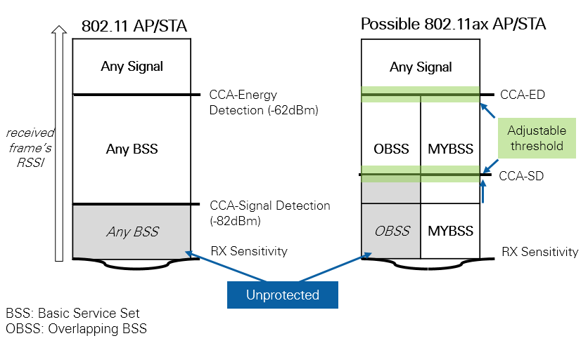
11ax OBSS_PD Spatial Reuse (cont.)
OBSS_PD algorithm:
select appropriate threshold (between CCA-SD/PD and CCA-ED);
reset PHY to CCA-IDLE if OBSS below the OBSS_PD threshold.

Slide 27
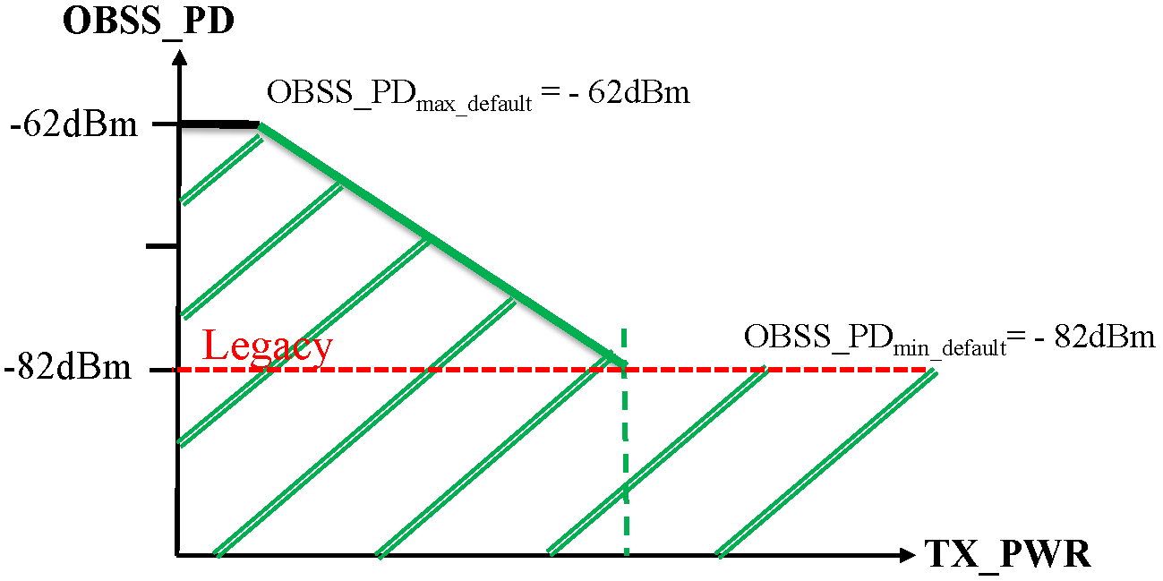
11ax OBSS_PD Spatial Reuse (cont.)
TX power restriction: If STA ignored inter-BSS PPDU, it shall start an OBSS_PD SR transmit power restriction period.

Slide 28
ns-3 changes to support OBSS_PD based SR
Missing proper CCA-SD/PD and CCA-ED thresholds in ns-3: rework PHY thresholds & add preamble detection model
BSS color info in HE PHY header: add & transport PHY headers between TX and RX PHYs
Handle HE-SIG-A: additional reception stage
Implement OBSS_PD SR algorithm (based on constant threshold)
⇒ will be available in ns-3.30!

Slide 29
PHY CCA thresholds
RX sensitivity: (Default: -101 dBm)
Filter out all signals with received power lower than this threshold (simulation speed)
CCA preamble detection (PD) threshold:
Modelled by the preamble detection model
Default CCA-PD: pass if RSSI >= -82 dBm threshold & SNR >= 4dB
CCA Energy Detection (ED) threshold: (Default: -62 dBm)
If the total energy (i.e. sum of all signals tracked by InterferenceHelper) is above this threshold, PHY state is declared as CCA_BUSY.

Slide 30
11ax PPDU reception
Multi-stage reception model:
CCA-SD is run 4 μs after a reception event ⇒ If the preamble is successfully detected: IDLE -> RX.
After L-SIG, PHY checks if L-SIG is successfully received. ⇒ If L-SIG fails: RX -> IDLE (or CCA_BUSY if energy above CCA-ED).
11ax signals have additional stage before payload RX starts:
⇒ checks if HE-SIG-A is successfully received and read BSS color.
After PPDU duration, PHY checks if payload is successfully received ⇒ packet is either forwarded up or dropped.

Slide 31
OBSS_PD spatial reuse algorithm
ObssPdAlgorithm:
Base class, can be subclassed to support custom implementations.
Inform PHY that it shall be reset to IDLE and determine whether power restrictions shall be applied.
ConstantObssPdAlgorithm:
OBSS_PD threshold is constant (attribute);
OBSS_PD algorithm is triggered once HE-SIG is received (callback);
If this is an OBSS frame (by looking at BSS color): ⇒ request to reset PHY to IDLE if RSSI < OBSS_PD

Slide 32
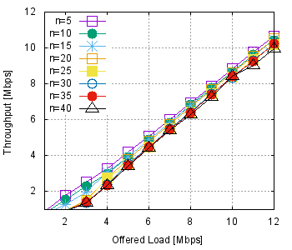
OBSS_PD spatial reuse simulations
Throughput vs offered load vs OBSS_PD threshold
OBSS_PD threshold: [-82; -62] dBm
Dense 11ax scenario: 7 APs working on same channel, with 5-40 stations per BSS (OBSS_PD = -72 dBm)

Slide 33
Code repository
https://gitlab.com/stavallo/ns-3-dev
wifi-next: “stable” branch
wifi-phy-next and wifi-mac-next: for reviewed stuff
wifi-staging: dangerous!

