Slide 1
EESM-log-SGN: State-of-the-art PHY Layer Abstraction for Complex Network Simulation
A Hands-On Tutorial
2021 WNS-3 Workshop
Sian Jin, Thomas R. Henderson
ACK: Sumit Roy, Sebastien Deronne, Jun Hyeon Park
NSF ICE-T 1836725

Slide 2
Prior to talk
Prerequisite:
  MATLAB 2020b or later version
  MATLAB WLAN Toolbox 2020b or later version
  MATLAB Parallel Computing Toolbox 2020b or later version (optional)
Matlab Code: https://github.com/sianjin/EESM-log-SGN
ns-3 code: https://gitlab.com/sderonne/ns-3-11be/-/tree/log_sgn_ofdma_mu_mimo_phy_abstraction

Slide 3
Outline
Motivations for efficient PHY layer abstraction
Principles of EESM-log-SGN
Implementation guide of EESM-log-SGN
Demo of MATLAB offline link simulation steps (main part of this tutorial)
Demo of ns-3 online network simulation steps

Slide 4
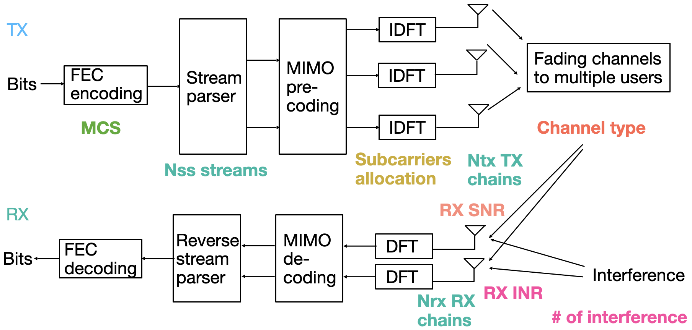
What is PHY layer abstraction?
PHY layer abstraction represents packet error rate (PER) as a function of
Subcarriers allocation
MIMO dimension
Channel type
MCS
RX SNR
RX INR
Full PHY simulation block diagram

Slide 5
What is PHY layer abstraction?
PHY layer abstraction represents packet error rate (PER) as a function of
Subcarriers allocation
MIMO dimension
Channel type
MCS
RX SNR
RX INR
Full PHY simulation block diagram

Slide 6
What is PHY layer abstraction?
PHY layer abstraction represents packet error rate (PER) as a function of
Subcarriers allocation
MIMO dimension
Channel type
MCS
RX SNR
RX INR
Full PHY simulation block diagram

Slide 7
What is PHY layer abstraction?
PHY layer abstraction represents packet error rate (PER) as a function of
Subcarriers allocation
MIMO dimension
Channel type
MCS
RX SNR
RX INR
Full PHY simulation block diagram

Slide 8
What is PHY layer abstraction?
PHY layer abstraction represents packet error rate (PER) as a function of
Subcarriers allocation
MIMO dimension
Channel type
MCS
RX SNR
RX INR
Full PHY simulation block diagram

Slide 9
What is PHY layer abstraction?
PHY layer abstraction represents packet error rate (PER) as a function of
Subcarriers allocation
MIMO dimension
Channel type
MCS
RX SNR
RX INR
Full PHY simulation block diagram

Slide 10
What is PHY layer abstraction?
PHY layer abstraction represents packet error rate (PER) as a function of
Subcarriers allocation
MIMO dimension
Channel type
MCS
RX SNR
RX INR
Compare
Packet error or success
Full PHY simulation block diagram

Slide 11
What is PHY layer abstraction?
MAC layer
MacLow
SendPacket
Success/fail
Success/fail
PHY layer
WifiPhy
PHY entity
getReceptionStatus
getReceptionStatus
Success/fail
Interference helper
Configuration parameters
PER
Error model
ns-3 WifiNetDevice example

Slide 12
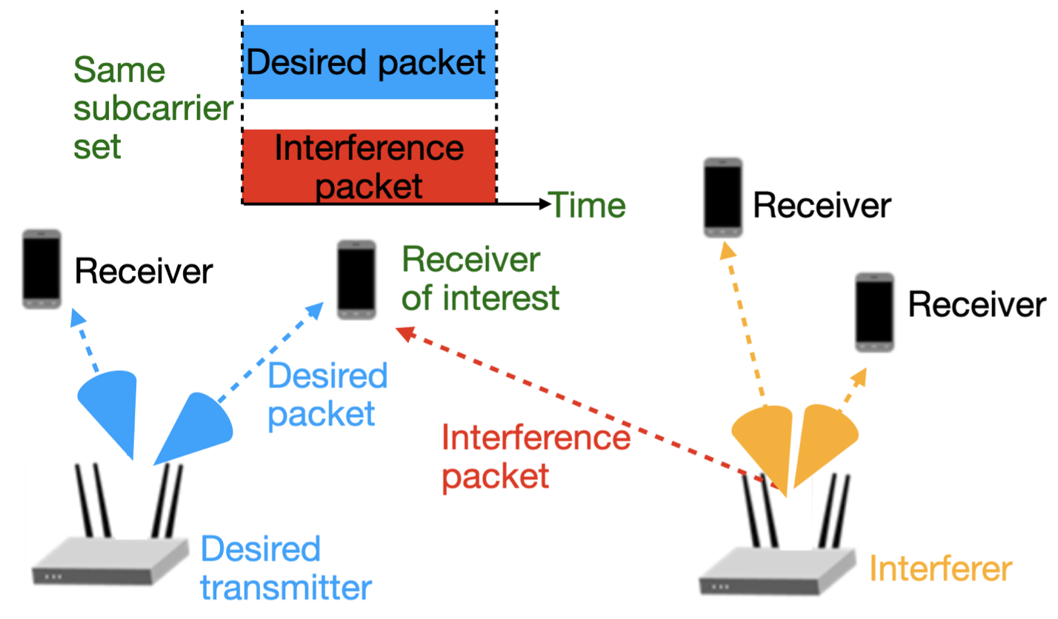
Issues with PHY layer abstractions
Exploding Complexity
Increasing MIMO dimensions
Complex channels
Greater co-channel interference (denser networks)
Higher order of MU transmissions

Slide 13
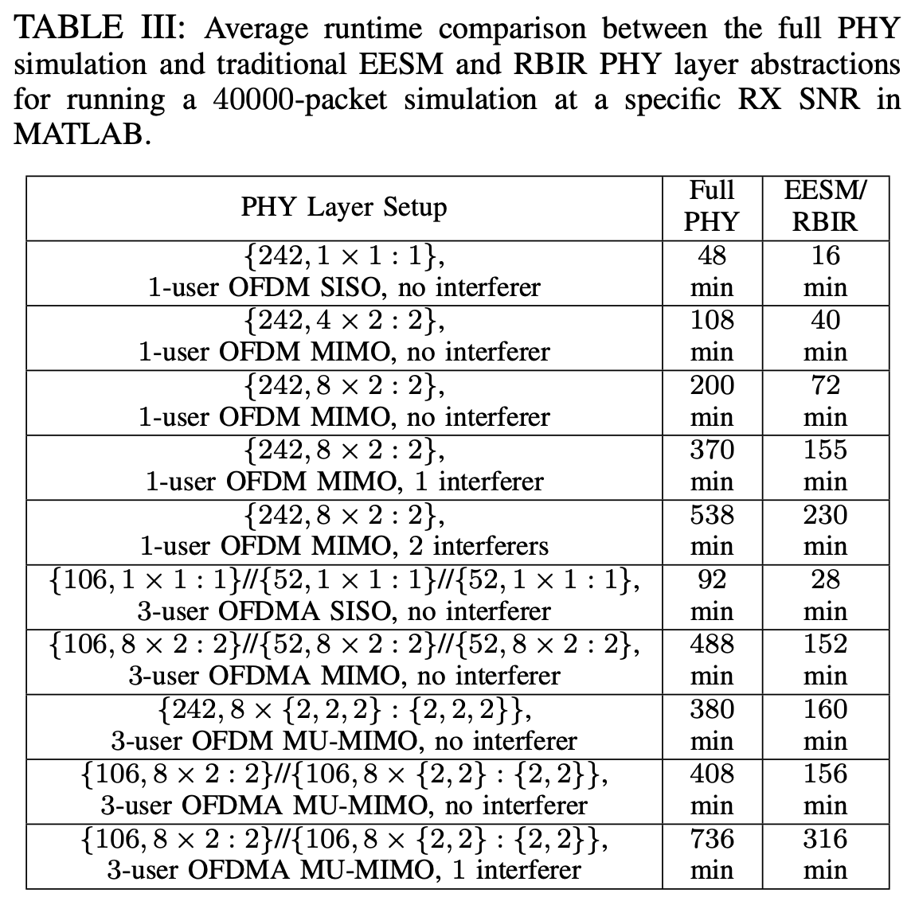
PHY layer complexity: runtimes
Single link, 40,000 packets, targeting [10⁻², 1] avg PER
Increasing MIMO dimensions
Complex channels
Greater interference (denser network)
Higher order of MU transmissions

Slide 14
PHY layer complexity: runtimes
Single link, 40,000 packets, targeting [10⁻², 1] avg PER
Increasing MIMO dimensions
Complex channels
Greater interference (denser network)
Higher order of MU transmissions
Very large runtime for running full PHY simulation (end-to-end encoding/decoding modulation/demodulating steps)

Slide 15
PHY layer complexity: runtimes
Single link, 40,000 packets, targeting [10⁻², 1] avg PER
Increasing MIMO dimensions
Complex channels
Greater interference (denser network)
Higher order of MU transmissions
Very large runtime for running full PHY simulation (end-to-end encoding/decoding modulation/demodulating steps)
Need improved PHY layer abstractions: preserve simulation accuracy while reducing run-times

Slide 16
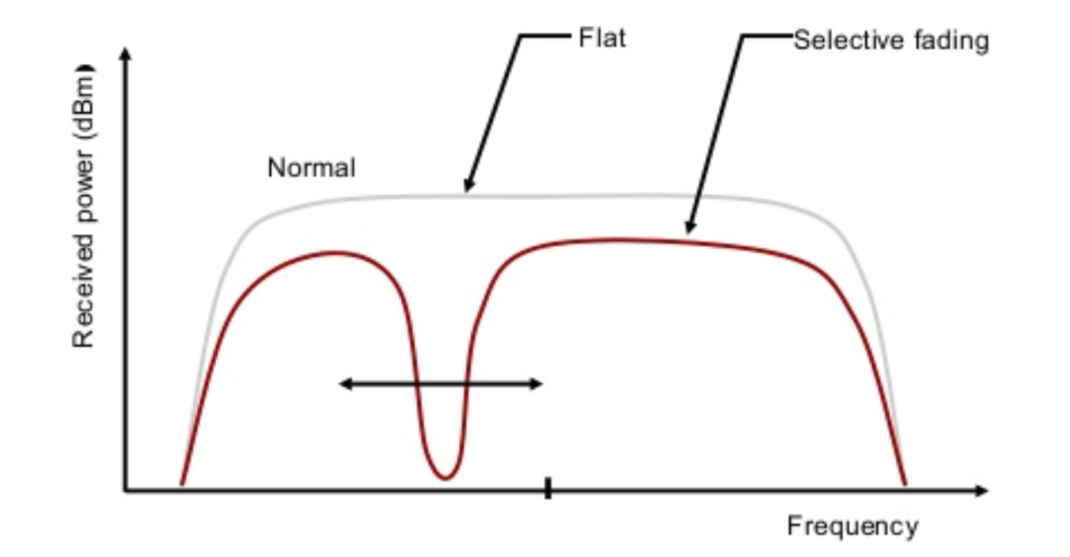
History of ns-3 PHY layer abstractions
802.11a PHY layer abstraction - YANS model (2006) [1]
  OFDM, SISO, IID AWGN channel
  Based on analytical bounds to obtain PER
[1] Mathieu Lacage and Thomas R. Henderson. 2006. Yet another network simulator. Proc. 2006 workshop on ns-2: the IP network simulator (WNS2 '06)

Slide 17
History of ns-3 PHY layer abstractions
802.11n PHY layer abstraction - link-to-system (L2S) mapping (2017) [2]
  OFDM, SISO, IID frequency-selective channel
  Based on link simulations results and lookup tables to obtain PER
  Require channel generation in ns-3; slow
[2] Rohan Patidar, Sumit Roy, Thomas R. Henderson, and Amrutha Chandramohan. 2017. Link-to-System Mapping for ns-3 Wi-Fi OFDM Error Models. Proc. of Workshop on ns-3 (WNS3 '17).

Slide 18
History of ns-3 PHY layer abstractions
Modeling complex WiFi PHY - EESM-log-SGN (2020-2021) [3,4]
  OFDM/OFDMA MIMO/MU-MIMO, IID frequency-selective channel, interference
  Based on link simulations results and lookup tables to obtain PER
  Does not require channel generation in ns-3; fast
[3] Sian Jin, Sumit Roy, Weihua Jiang, and Thomas R. Henderson. 2020. Efficient Abstractions for Implementing TGn Channel and OFDM-MIMO Links in ns-3. WNS3 2020. ACM, New York, NY, USA, 33–40.
[4] Sian Jin, Sumit Roy, and Thomas R. Henderson. 2021. Efficient PHY Layer Abstraction for Fast Simulations in Complex System Environments. IEEE TCOM. Early access.

Slide 19
Outline
Motivations for efficient PHY layer abstraction
Principles of EESM-log-SGN
Implementation guide of EESM-log-SGN
Demo of MATLAB offline link simulation steps (main part of this tutorial)
Demo of ns-3 online network simulation steps

Slide 20
PHY layer assumptions
Channel model: independent and identically distributed (IID) frequency-selective fading channel
IID over time: each packet in the simulation experiences an indep. channel realization
Channel instance is invariant during the transmission of each packet (block fading)
Packet
Packet
Channel gain
Packet
Packet
Time
[4] Sian Jin, Sumit Roy, and Thomas R. Henderson. 2021. Efficient PHY Layer Abstraction for Fast Simulations in Complex System Environments. IEEE TCOM. Early access.

Slide 21
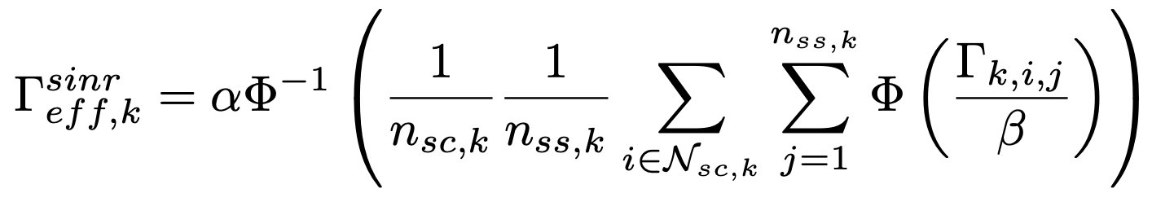

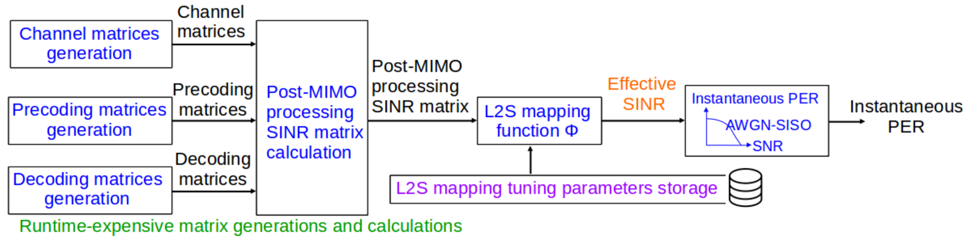
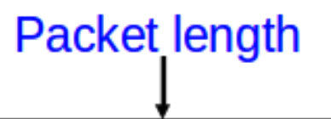
Traditional PHY layer abstraction [5]
L2S mapping suggested by IEEE TGax group:
for i-th subcarrier and j-th stream
[5] IEEE TGax Group, “IEEE p802.11 Wireless Lans: 11ax Evaluation Methodology,” 2016.

Slide 22
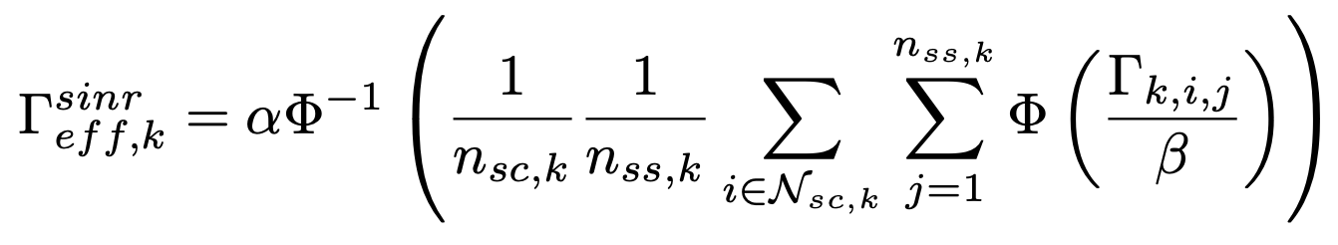
Traditional PHY layer abstraction [5]
Over an OFDM/OFDMA MIMO/MU-MIMO system, abstracting the post-MIMO processing SINRs over all subcarriers and spatial streams into a a single scalar metric - effective SINR
The single effective SINR is a convenient metric to describe the packet-level performance for a network simulator
L2S mapping function

Slide 23
Traditional PHY layer abstraction [5]
Over an OFDM/OFDMA MIMO/MU-MIMO system, abstracting the post-MIMO processing SINRs over all subcarriers and spatial streams into a a single scalar metric - effective SINR
The single effective SINR is a convenient metric to describe the packet-level performance for a network simulator
2 popular L2S mapping functions: EESM and RBIR
L2S mapping function

Slide 24
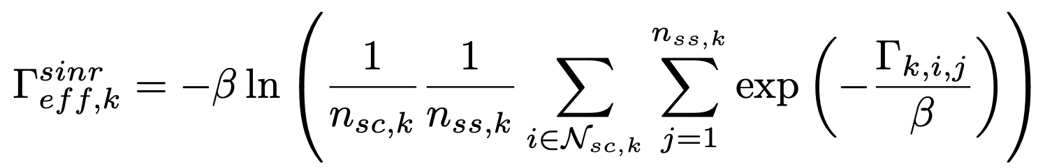
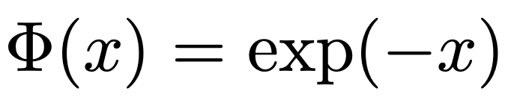
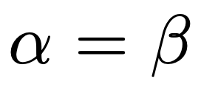
Traditional PHY layer abstraction [5]
Over an OFDM/OFDMA MIMO/MU-MIMO system, abstracting the post-MIMO processing SINRs over all subcarriers and spatial streams into a a single scalar metric - effective SINR
The single effective SINR is a convenient metric to describe the packet-level performance for a network simulator
2 popular L2S mapping functions: EESM and RBIR
For EESM, and
L2S mapping function

Slide 25
Traditional PHY layer abstraction
Runtime
Single link, 40,000 packets, targeting [10⁻², 1] avg PER
Runtime reduces; but still large & increases with MIMO dimension, MU dimension, # of interferers

Slide 26
Key Observation
L2S mapping suggested by IEEE TGax group:
Observation: upper layer only needs instantaneous PER

Slide 27
Key Observation
L2S mapping suggested by IEEE TGax group:
Observation: upper layer only needs instantaneous PER
Q1: Can we bypass runtime-expensive matrix calculation and directly store average PER (mean of instantaneous PER)?

Slide 28
Key Observation
L2S mapping suggested by IEEE TGax group:
Observation: upper layer only needs instantaneous PER
Q1: Can we bypass runtime-expensive matrix calculation and directly store average PER (mean of instantaneous PER)?
No variance, skewness, kurtosis, time correlation information

Slide 29
Key Observation
L2S mapping suggested by IEEE TGax group:
Observation: upper layer only needs instantaneous PER
Q2: Can we bypass runtime-expensive matrix calculation and directly model instantaneous PER?

Slide 30
Key Observation
L2S mapping suggested by IEEE TGax group:
Observation: upper layer only needs instantaneous PER
Q2: Can we bypass runtime-expensive matrix calculation and directly model instantaneous PER?
Cannot provide models of instantaneous PERs for different packet lengths

Slide 31
Key Observation
L2S mapping suggested by IEEE TGax group:
Observation: upper layer only needs instantaneous PER
Q3: Can we bypass runtime-expensive matrix calculation and directly model effective SNR?

Slide 32
Key Observation
L2S mapping suggested by IEEE TGax group:
Observation: upper layer only needs instantaneous PER
Q3: Can we bypass runtime-expensive matrix calculation and directly model effective SNR?
Effective SNR is insensitive to packet length and is easy to be mapped into instantaneous PER

Slide 33
New Method: EESM-log-SGN
L2S mapping:
Assume IID channel, model effective SNR distribution, and directly outputs IID effective SINRs
Packet
Effective SNR
Packet
Packet
Packet
Time

Slide 34
New Method: EESM-log-SGN
L2S mapping:
Under IID channel & EESM L2S mapping function, effective SNR distribution follows:
Log-skew generalized normal (log-SGN) distribution

Slide 35
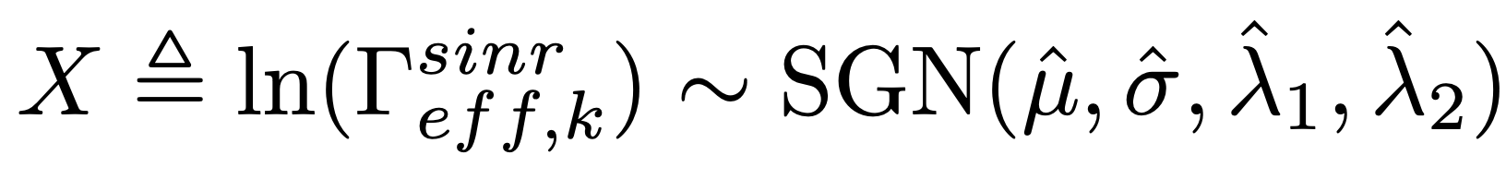
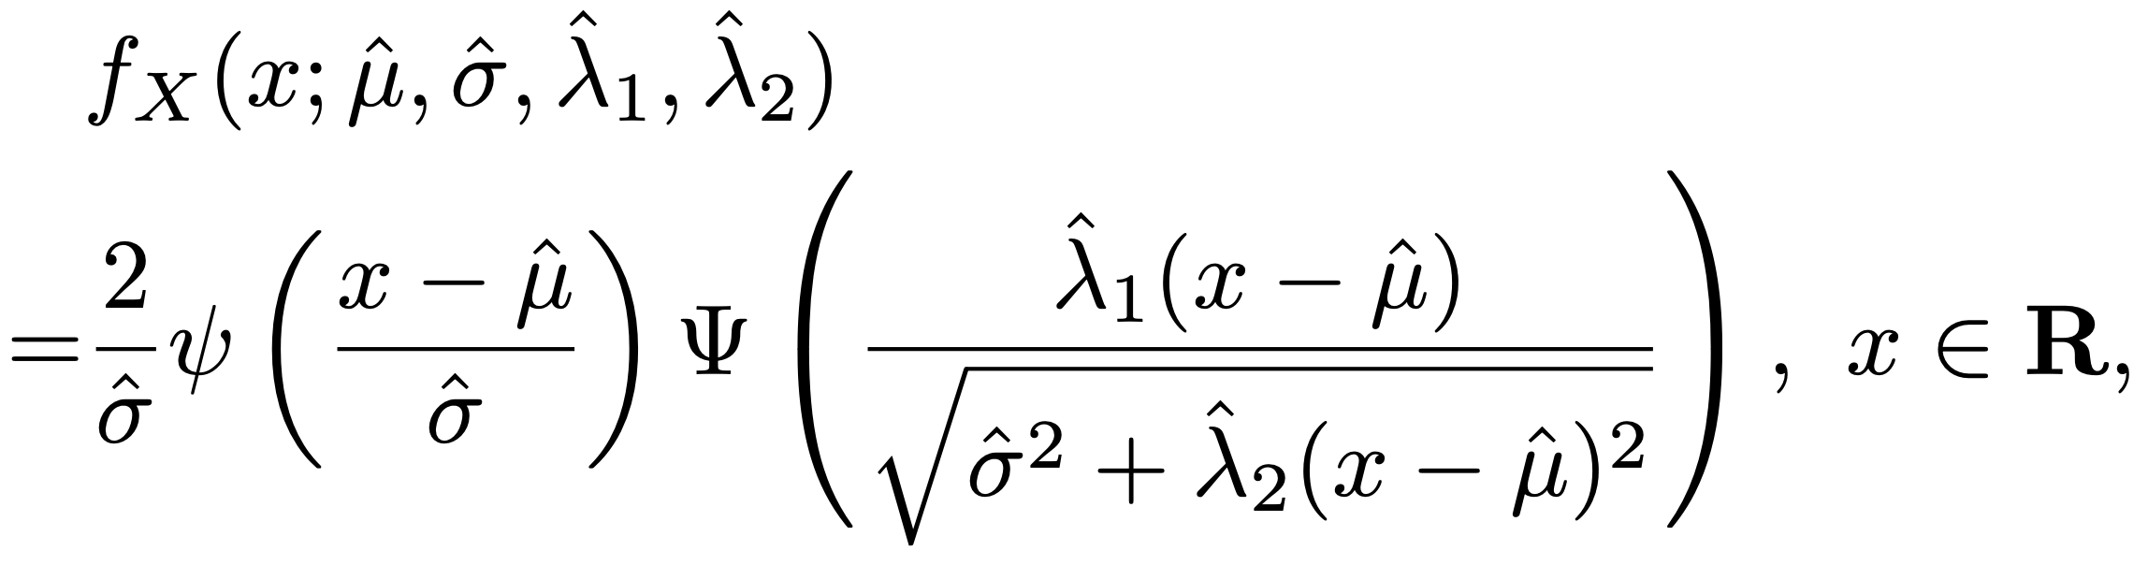
New Method: EESM-log-SGN
L2S mapping:
Under IID channel & EESM L2S mapping function, effective SNR distribution follows:
Log-skew generalized normal (log-SGN) distribution
PDF of X

Slide 36
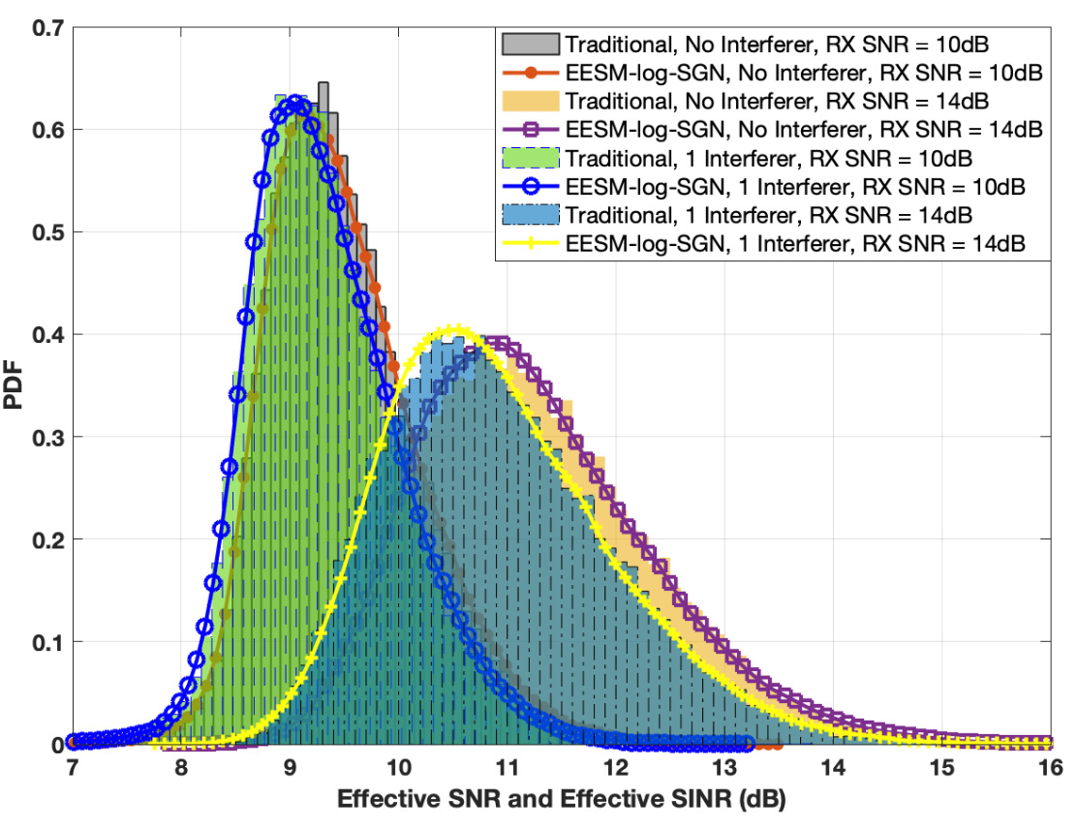
New Method: EESM-log-SGN
L2S mapping:
Under IID channel & EESM L2S mapping function, effective SNR distribution follows:
Log-skew generalized normal (log-SGN) distribution
PDF of X

Slide 37
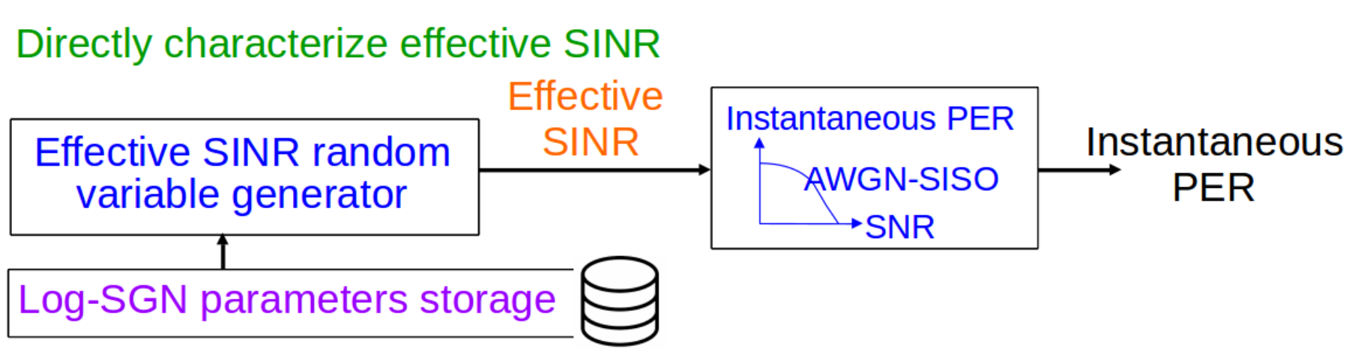
New Method: EESM-log-SGN
log-SGN distribution

Slide 38
New Method: EESM-log-SGN
log-SGN distribution

Slide 39
New Method: EESM-log-SGN
log-SGN parameters depend on: OFDM/OFDMA MIMO/MU-MIMO, bandwidth, MCS, channel types, SNR and INR
log-SGN distribution

Slide 40
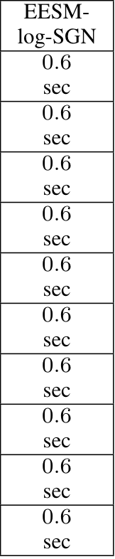
New Method: EESM-log-SGN
Single link, 40,000 packets, targeting [10⁻², 1] avg PER
Runtime of the proposed method is significantly smaller and insensitive to system dim change!

Slide 41
Outline
Motivations for efficient PHY layer abstraction
Principles of EESM-log-SGN
Implementation guide of EESM-log-SGN
Demo of MATLAB offline link simulation steps (main part of this tutorial)
Demo of ns-3 online network simulation steps

Slide 42
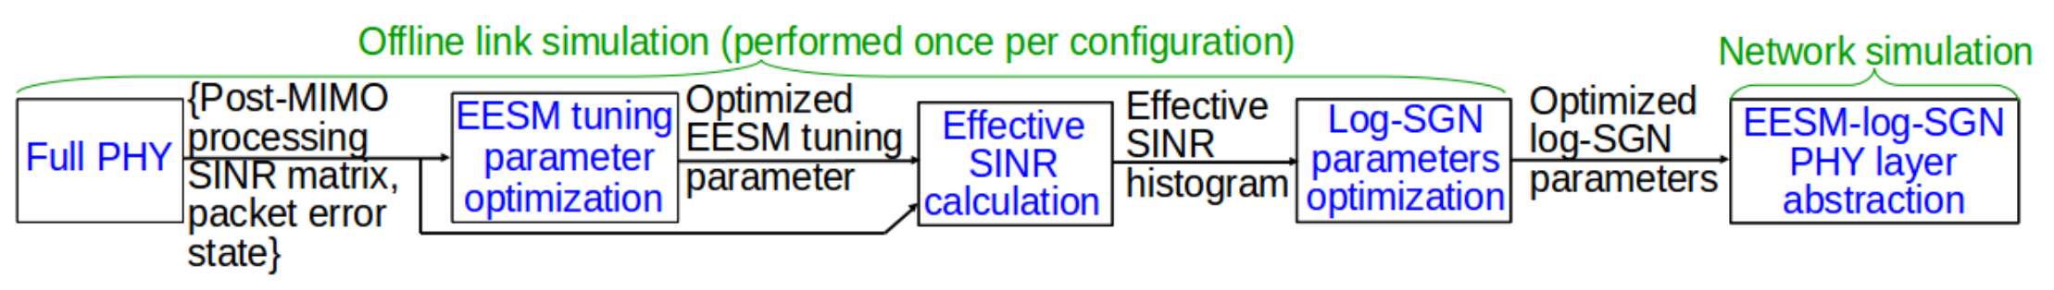

General implementation flow

Slide 43
Full PHY simulation
Compute packet error states
Packet error or success
Compare

Slide 44
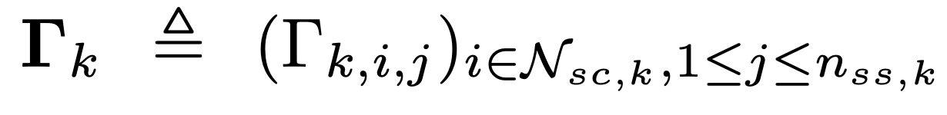
Full PHY Simulation
Compute post-MIMO processing SINR
i.e., SINR on different subcarriers and streams

Slide 45


# of Packets per Full PHY Simulation
For achieving average PER at , running n packets per simulation
can achieve PER estimation accuracy bound
For example, for achieving average PER down to 0.01, it’s recommended to run n=40000 packets per simulation

Slide 46
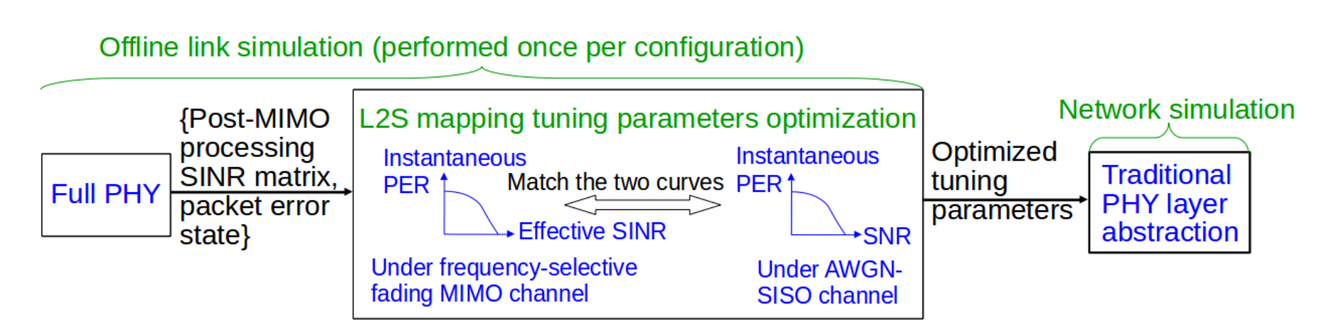
EESM tuning parameter optimization
Overview

Slide 47
EESM tuning parameter optimization
Algorithm
Objective:

Slide 48

EESM tuning parameter optimization
Algorithm
Packet error states
Objective:
Satisfied
Effective SINR
Post-MIMO processing SINR

Slide 49
EESM tuning parameter optimization
Algorithm
Packet error states
Objective:
Satisfied
Effective SINR
Post-MIMO processing SINR
Not satisfied
Update

Slide 50
Effective SINR histogram generation

Slide 51
Effective SINR histogram generation
Effective SINR formula:

Slide 52
Effective SINR histogram generation
Effective SINR formula:

Slide 53
Log-SGN parameters optimization

Slide 54
Log-SGN parameters optimization

Slide 55
Log-SGN parameters optimization

Slide 56
EESM-log-SGN PHY layer abstraction

Slide 57
EESM-log-SGN PHY layer abstraction

Slide 58
Outline
Motivations for efficient PHY layer abstraction
Principles of EESM-log-SGN
Implementation guide of EESM-log-SGN
Demo of MATLAB offline link simulation steps (main part of this tutorial)
Demo of ns-3 online network simulation steps

Slide 59
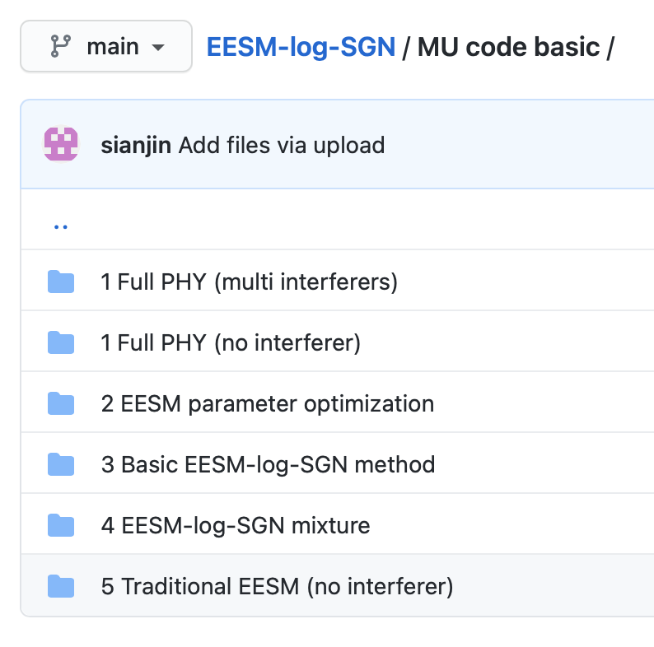
MATLAB link simulation
Matlab Code: https://github.com/sianjin/EESM-log-SGN
Link simulation flow:

Slide 60
PHY configuration 1
Full PHY simulation
Communication system: IEEE 802.11ax
  Coding and modulation: LDPC at MCS 4
OFDM with 242 subcarriers
1×1 SISO with 1 stream
Channel type: TGax channel model-D
RX SNR = TX SNR - path loss (dB)
Interference-free case
Simulate 4000 packets

Slide 61
11ax subcarrier allocation
Full PHY simulation
[5] MathWorks, “802.11ax Parameterization for Waveform Generation and Simulation,” 2020. web: https://www.mathworks.com/help//wlan/ug/802-11ax-parameterization-for-waveform-generation-and-simulation.html.

Slide 62
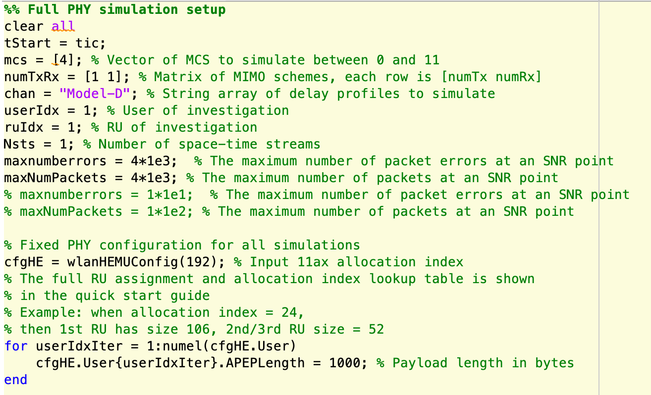
PHY configuration 1
Full PHY simulation
Open: MU code basic/1 Full PHY (no interferer)/fullPHY.m
Communication system: IEEE 802.11ax
  Coding and modulation: LDPC at MCS 4
242-tone OFDM (allocation idx 192)
1×1 SISO with 1 stream
Channel type: TGax channel model-D
RX SNR = [11,15,19,23] dB (set in getBox0SimParams.m)
Interference-free case
Packet length = 1000 byte
Simulate 4000 packets

Slide 63
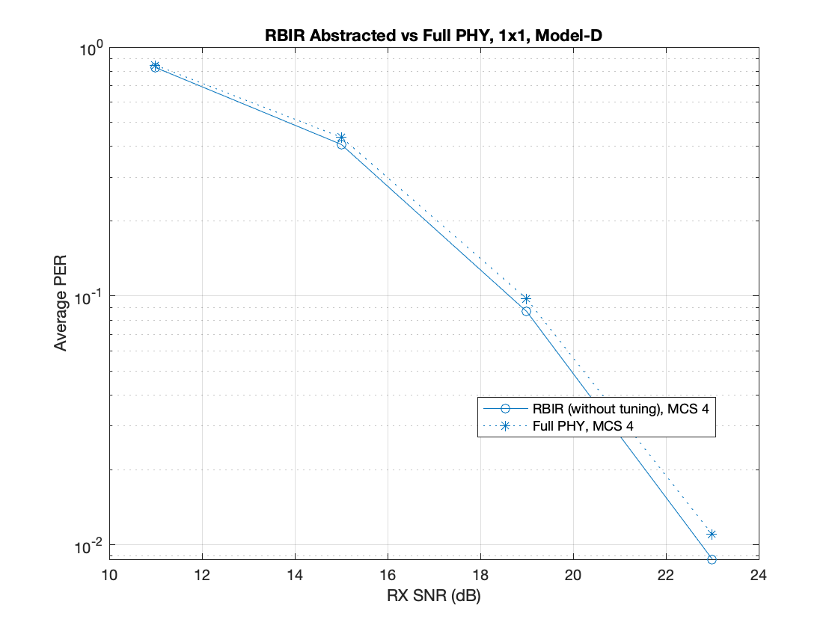

PHY configuration 1
Full PHY simulation
Open: MU code basic/1 Full PHY (no interferer)/fullPHY.m
Outputs of full PHY simulation:
  “sinrPer_Config192_Model-D_1-by-1_MCS4.mat”
  4000 {post-MIMO processing SINR matrix, packet error state} pairs for each RX SNR
A figure on the right
  Full PHY and RBIR prediction
  2 curves match -> full PHY simulation is a success

Slide 64
PHY configuration 1
EESM tuning parameter optimization
Copy “sinrPer_Config192_Model-D_1-by-1_MCS4.mat” generated in Step 1 into MU code basic/2 EESM parameter optimization

Slide 65
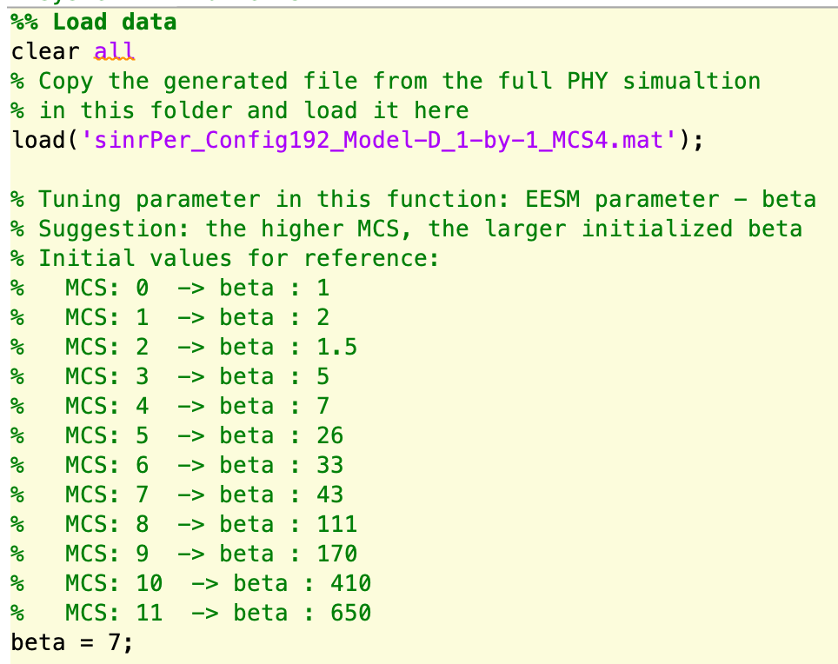
PHY configuration 1
EESM tuning parameter optimization
Open: MU code basic/2 EESM parameter optimization/eesmAbstractionPerVsEffSinr.m
Load: “sinrPer_Config192_Model-D_1-by-1_MCS4.mat”
  Select initial EESM tuning parameter beta according to the MCS
  Run eesmAbstractionPerVsEffSinr.m to optimize beta value

Slide 66
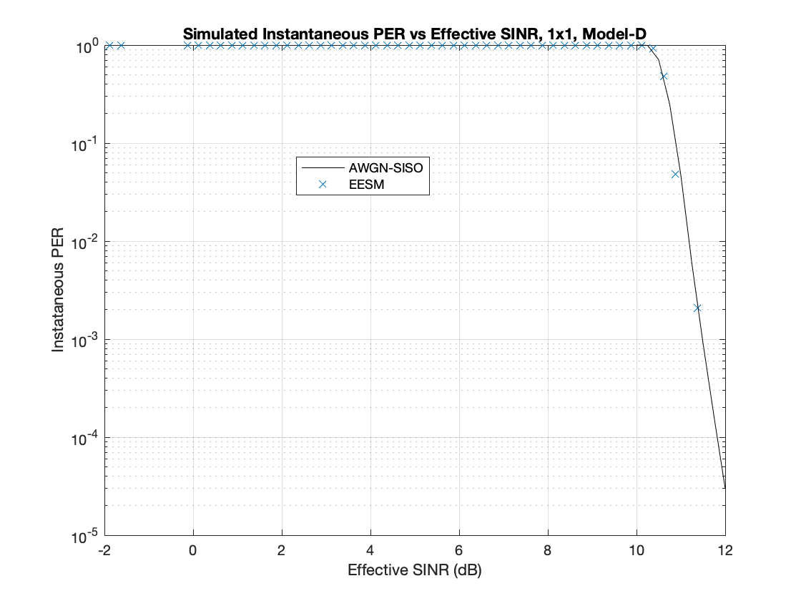
PHY configuration 1
EESM tuning parameter optimization
Open: MU code basic/2 EESM parameter optimization/eesmAbstractionPerVsEffSinr.m
Outputs of EESM tuning parameter optimization:
  “eesmEffSinr_Config192_Model-D_1-by-1_MCS4.mat”
  Optimized EESM tuning parameter (beta)
A figure on the right showing:

Slide 67
PHY configuration 1
EESM tuning parameter optimization
Copy:
“sinrPer_Config192_Model-D_1-by-1_MCS4.mat” generated in Step 1 & “eesmEffSinr_Config192_Model-D_1-by-1_MCS4.mat” generated in Step 2
into MU code basic/ 3 Basic EESM-log-SGN method

Slide 68
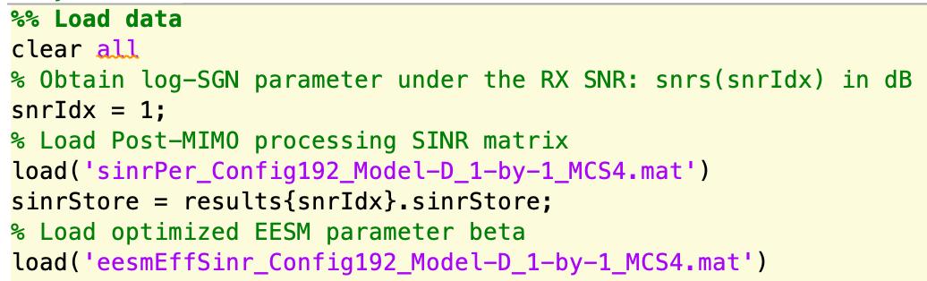
PHY configuration 1
Log-SGN parameters optimization
Open: MU code basic/3 Basic EESM-log-SGN method/eesmLogSGNBasic.m
  Load: “sinrPer_Config192_Model-D_1-by-1_MCS4.mat” & “eesmEffSinr_Config192_Model-D_1-by-1_MCS4.mat”
Choose the RX SNR snrs(snrIdx) that we want to simulate
  Choose snrIdx = 1 in this example
  Run eesmLogSGNBasic.m to obtain effective SINR histogram and statistically fit the histogram into the log-SGN distribution

Slide 69
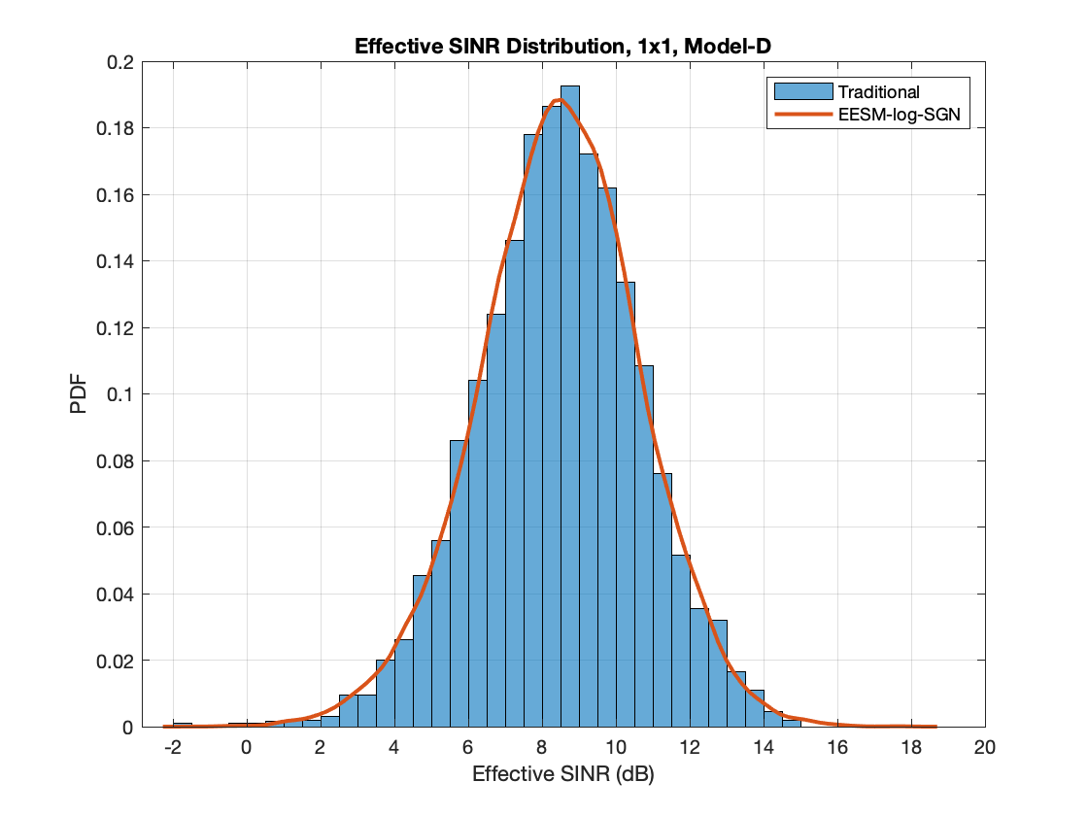
PHY configuration 1
Log-SGN parameters optimization
Open: MU code basic/3 Basic EESM-log-SGN method/eesmLogSGNBasic.m
Outputs of log-SGN parameters optimization:
  snr_LogSGNParam_Config192_Model-D_1-by-1_MCS4.mat
  Can be converted into snr_LogSGNParam_Config192_Model-D_1-by-1_MCS4.txt in ns-3 format via logSGNmat2txt.m
A figure on the right
  Effective SINR histogram under traditional L2S mapping
  Optimized log-SGN distribution by EESM-log-SGN method

Slide 70
PHY configuration 2
Full PHY simulation
Communication system: IEEE 802.11ax
  Coding and modulation: LDPC at MCS 5
OFDM with 242 subcarriers
1×1 SISO with 1 stream
Channel type: TGax channel model-B
RX SNR = TX SNR - path loss (dB)
Interference-free case
Simulate 4000 packets

Slide 71
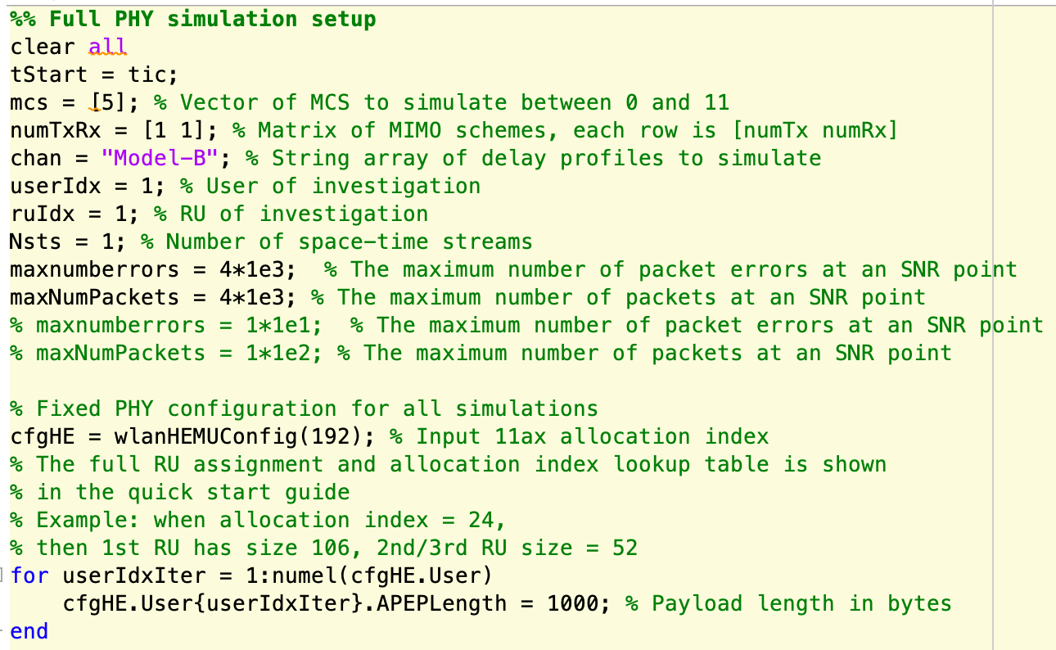
PHY configuration 2
Full PHY simulation
Open: MU code basic/1 Full PHY (no interferer)/fullPHY.m
Communication system: IEEE 802.11ax
  Coding and modulation: LDPC at MCS 5
242-tone OFDM (allocation idx 192)
1×1 SISO with 1 stream
Channel type: TGax channel model-B
RX SNR = [14,21,25,28] dB (set in getBox0SimParams.m)
Interference-free case
Packet length = 1000 byte
Simulate 4000 packets

Slide 72
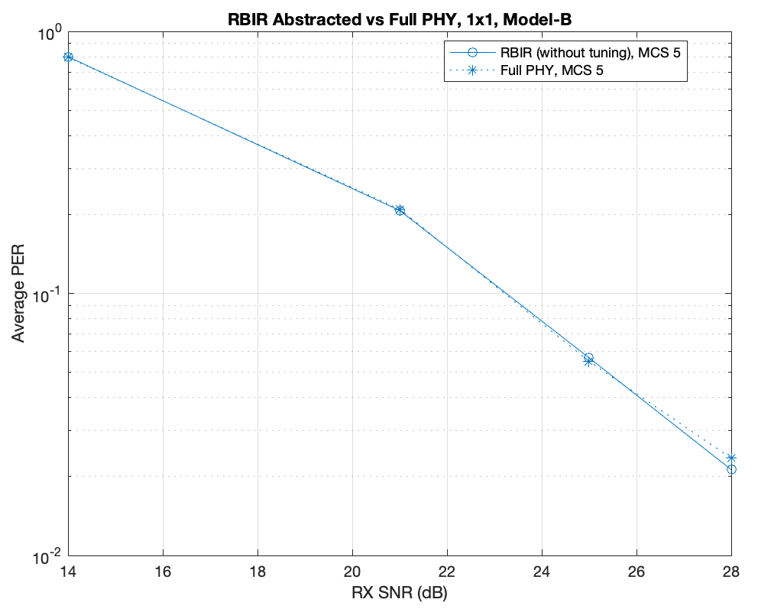
PHY configuration 2
Full PHY simulation
Open: MU code basic/1 Full PHY (no interferer)/fullPHY.m
Outputs of full PHY simulation:
  “sinrPer_Config192_Model-B_1-by-1_MCS5.mat”
  4000 {post-MIMO processing SINR matrix, packet error state} pairs for each RX SNR
A figure on the right
  Full PHY and RBIR prediction
  2 curves match -> full PHY simulation is a success

Slide 73
PHY configuration 2
EESM tuning parameter optimization
Copy “sinrPer_Config192_Model-B_1-by-1_MCS5.mat” generated in Step 1 into MU code basic/2 EESM parameter optimization

Slide 74
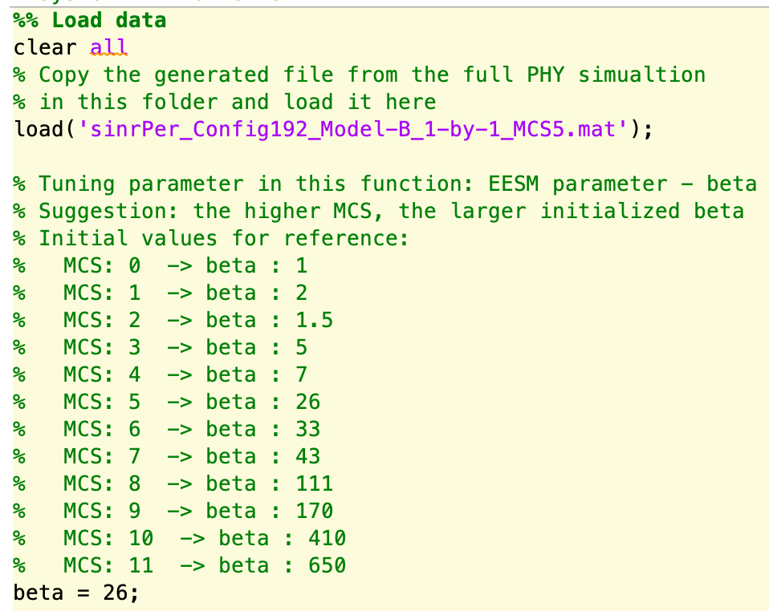
PHY configuration 2
EESM tuning parameter optimization
Open: MU code basic/2 EESM parameter optimization/eesmAbstractionPerVsEffSinr.m
Load: “sinrPer_Config192_Model-B_1-by-1_MCS5.mat”
  Select initial EESM tuning parameter beta according to the MCS
  Run eesmAbstractionPerVsEffSinr.m to optimize beta value

Slide 75
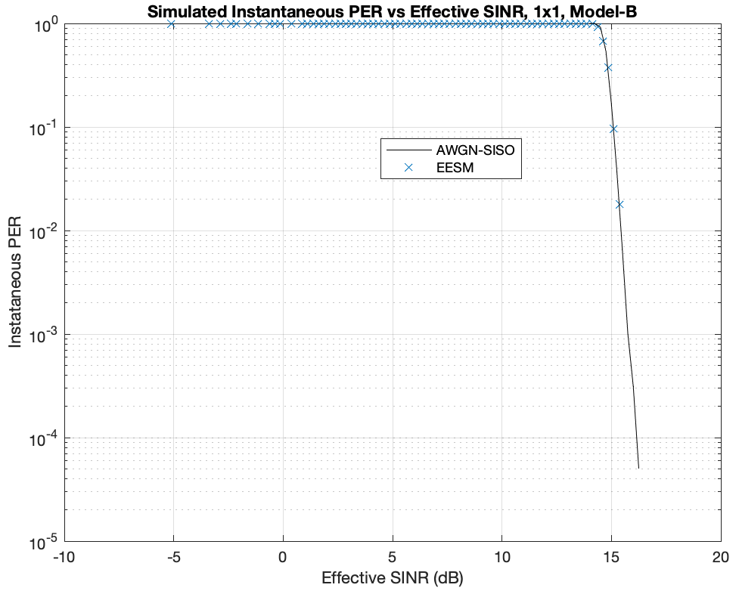
PHY configuration 2
EESM tuning parameter optimization
Open: MU code basic/2 EESM parameter optimization/eesmAbstractionPerVsEffSinr.m
Outputs of EESM tuning parameter optimization:
  “eesmEffSinr_Config192_Model-B_1-by-1_MCS5.mat”
  Optimized EESM tuning parameter (beta)
A figure on the right showing:

Slide 76
PHY configuration 2
EESM tuning parameter optimization
Copy:
“sinrPer_Config192_Model-B_1-by-1_MCS5.mat” generated in Step 1 & “eesmEffSinr_Config192_Model-B_1-by-1_MCS5.mat” generated in Step 2
into MU code basic/ 3 Basic EESM-log-SGN method

Slide 77
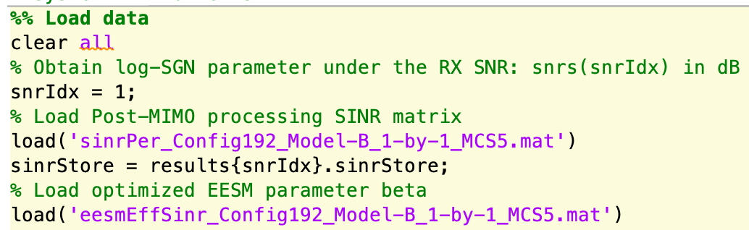
PHY configuration 2
Log-SGN parameters optimization
Open: MU code basic/3 Basic EESM-log-SGN method/eesmLogSGNBasic.m
  Load: “sinrPer_Config192_Model-B_1-by-1_MCS5.mat” & “eesmEffSinr_Config192_Model-B_1-by-1_MCS5.mat”
Choose the RX SNR snrs(snrIdx) that we want to simulate
  Run eesmLogSGNBasic.m to obtain effective SINR histogram and statistically fit the histogram into the log-SGN distribution

Slide 78
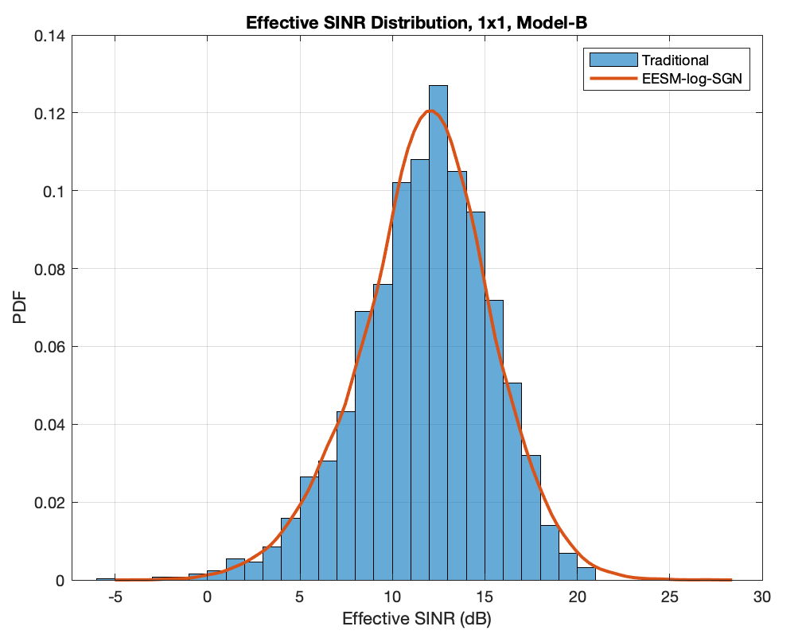
PHY configuration 2
Log-SGN parameters optimization
Open: MU code basic/3 Basic EESM-log-SGN method/eesmLogSGNBasic.m
Outputs of log-SGN parameters optimization:
  snr_LogSGNParam_Config192_Model-B_1-by-1_MCS5.mat
  Can be converted into snr_LogSGNParam_Config192_Model-B_1-by-1_MCS5.txt in ns-3 format via logSGNmat2txt.m
A figure on the right
  Effective SINR histogram under traditional L2S mapping
  Optimized log-SGN distribution by EESM-log-SGN method

Slide 79
Outline for the following presentation
Motivations for efficient PHY layer abstraction
Principles of EESM-log-SGN
Implementation guide of EESM-log-SGN
Demo of MATLAB offline link simulation steps (main part of this tutorial)
Demo of ns-3 online network simulation steps

Slide 80
Backup slides

Slide 81
History of ns-3 Error Models
YANS model
  Original ns-3 Wi-Fi PHY is based on OFDM, SISO, frequency-flat additive white Gaussian noise (AWGN) channel, and can be easily computed
  However, frequently-selective fading channels commonly occur in OFDM system, and this greatly impacts system performance

Slide 82
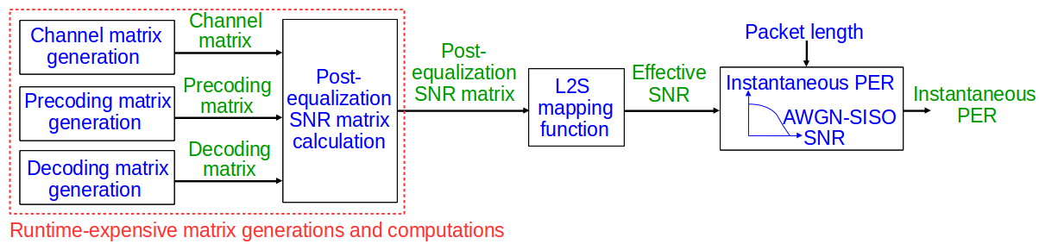
History of ns-3 Error Models
Link-to-system (L2S) mapping
  A traditional abstraction for OFDM MIMO based PHY over a frequency-selective channel
  Block diagram suggested by IEEE TGax group:

Slide 83
Backup slides
Simulation steps to implement L2S suggested by IEEE TGax group

Slide 84
Full PHY simulation and PHY configuration
TX
IDFT
Fading channels to multiple users
FEC encoding
MIMO pre-coding
IDFT
Bits
Stream parser
MCS
IDFT
Channel type
Subcarriers allocation
Ntx TX chains
Nss streams
RX
RX SNR
Reverse stream parser
MIMO de-coding
DFT
FEC decoding
Bits
DFT
Interference
RX INR
Nrx RX chains
# of interference

Slide 85
PHY configuration example
Communication system: IEEE 802.11ax
  Coding and modulation: LDPC at MCS 4
OFDMA allocation with 52 subcarriers
8×2 MIMO with 2 streams
Channel type: TGax channel model-D
  Widely used in IEEE 802.11 system evaluation
  Include frequency selectivity & antenna correlation
  Speed of the scatters/users: 0.089km/h (small Doppler)
  Inter-carrier interference (ICI) can be ignored
  Coherence time = 0.978s >> packet transmission time (~ hundred us), slow fading
RX SNR = TX SNR - path loss (dB)

Slide 86
History of ns-3 PHY layer abstractions
Modeling complex WiFi PHY - EESM-log-SGN (2020-2021) [3,4]
  OFDM/OFDMA, MIMO/MU-MIMO, IID frequency-selective channel, inter-user interference
  Based on link simulations results and lookup tables to obtain PER
  Does not require channel generation in ns-3; fast
Extension to more realistic WiFi channel - EESM-log-AR (2021) [5]
  OFDM, MIMO, time-varying frequency-selective channel
[3] Sian Jin, Sumit Roy, Weihua Jiang, and Thomas R. Henderson. 2020. Efficient Abstractions for Implementing TGn Channel and OFDM-MIMO Links in ns-3. WNS3 2020. ACM, New York, NY, USA, 33–40.
[4] Sian Jin, Sumit Roy, and Thomas R. Henderson. 2021. Efficient PHY Layer Abstraction for Fast Simulations in Complex System Environments. IEEE TCOM. Early access.
[5] Sian Jin, Sumit Roy, and Thomas R. Henderson. 2021. EESM-log-AR: An Efficient Error Model for OFDM MIMO Systems over Time-Varying Channels. Accepted in WNS3 2021.

Slide 87
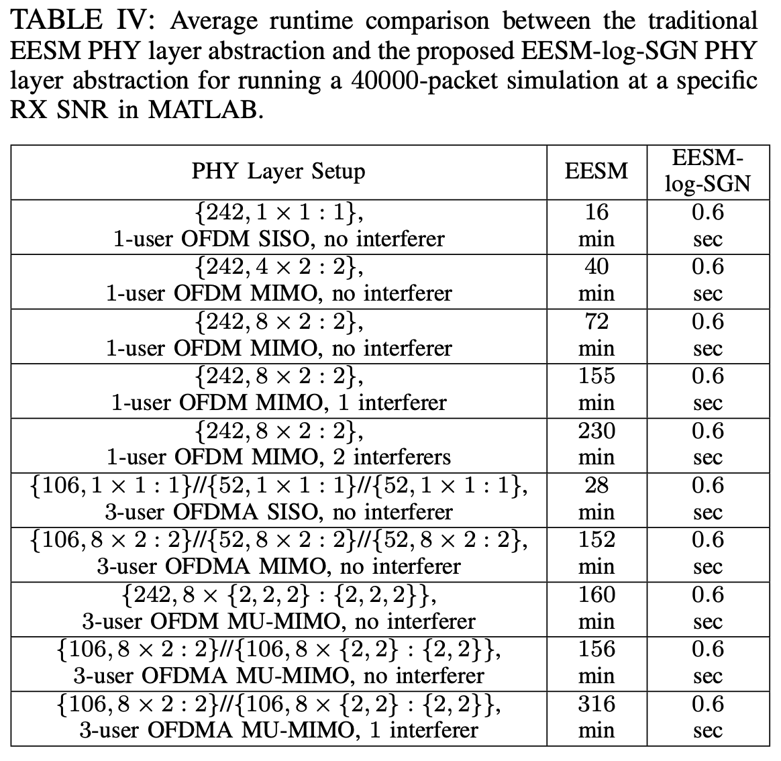
EESM-log-SGN
Runtime
Runtime of EESM-log-SGN:
Small & insensitive to the change of MIMO dimension, MU dimension, # of interferers
* The runtime here is the recurring cost in network simulation. Before running these network simulations, the non-recurring (performed once per configuration) offline full PHY simulation cost on page 5 is still needed to obtain the parameters for network simulation.

Slide 88
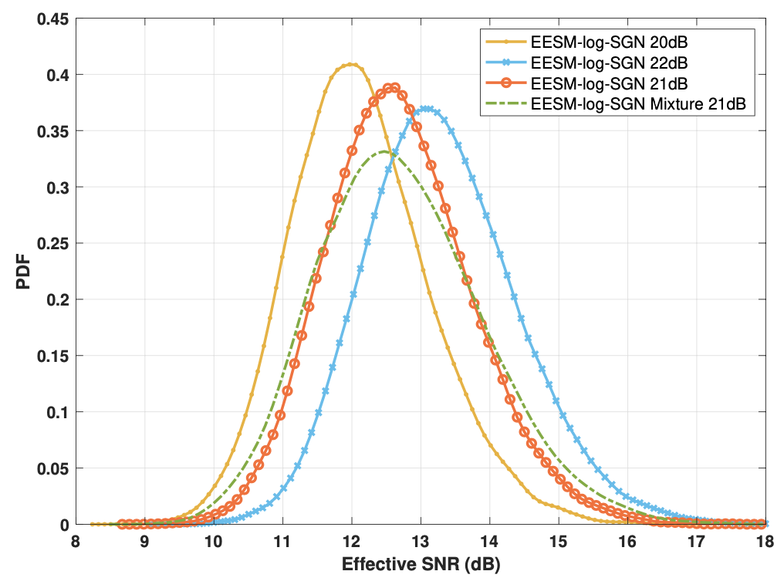
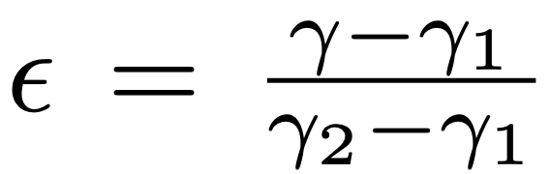
Storage-complexity aspects
Handling wide range of RX SNRs and INRs: challenge & principle
Fact: effective SNR/INR depends on RX SNR/INR
Challenge: cannot store effective SNR/INR
distribution under any RX SNR/INR
Solution: interpolate effective SNR/INR for
any RX SNR/INR using a small # of stored
effective SNR distributions - mixture model
Estimated distribution
Stored distributions

Slide 89
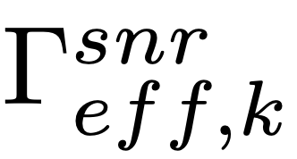
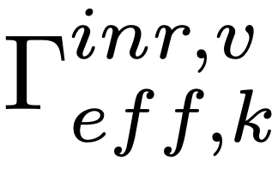
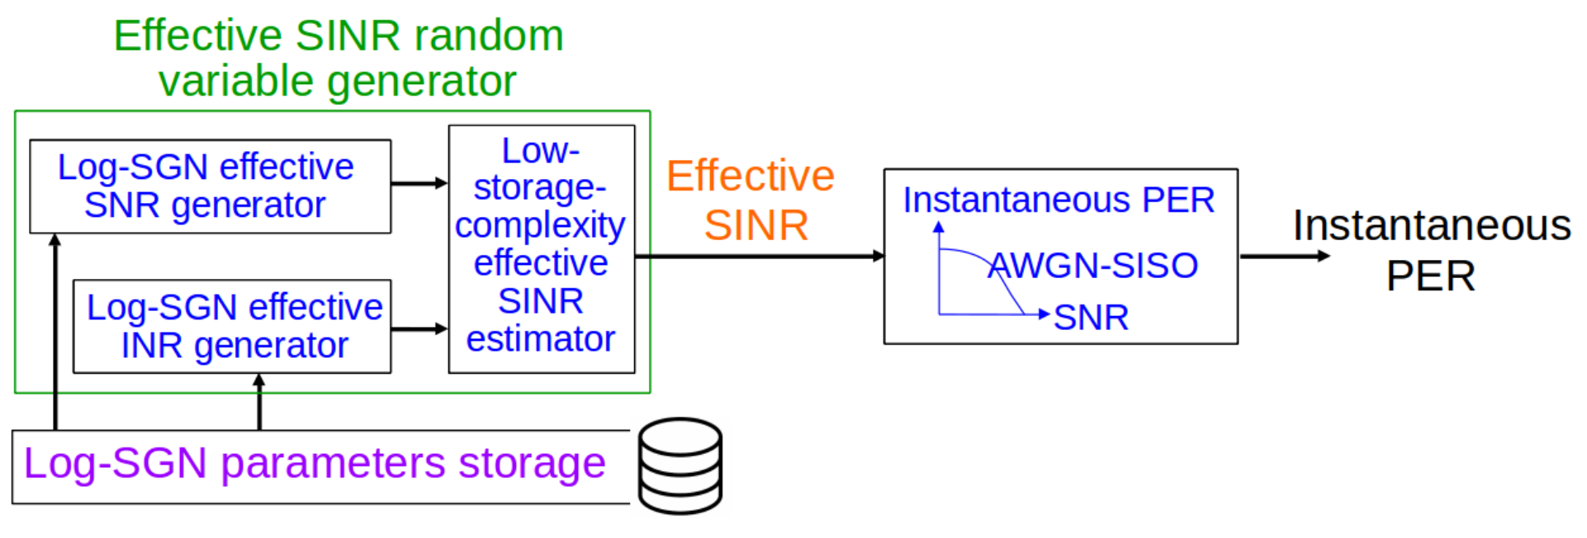
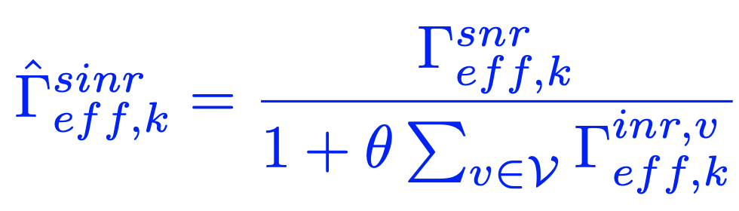
Storage-complexity aspects
Handling numerous interference setups: challenge & principle
Effective SNR : the effective SINR under the interference-free scenario with a certain RX SNR
Effective INR : the effective SINR with signal from an interferer v only and with a certain RX INR
Solution: estimate effective SINR from effective SNR & effective INR - low storage complexity (LSC) solution
Effective SNR
|V|: # of interferers
Estimated effective SINR
Effective INR

Slide 90
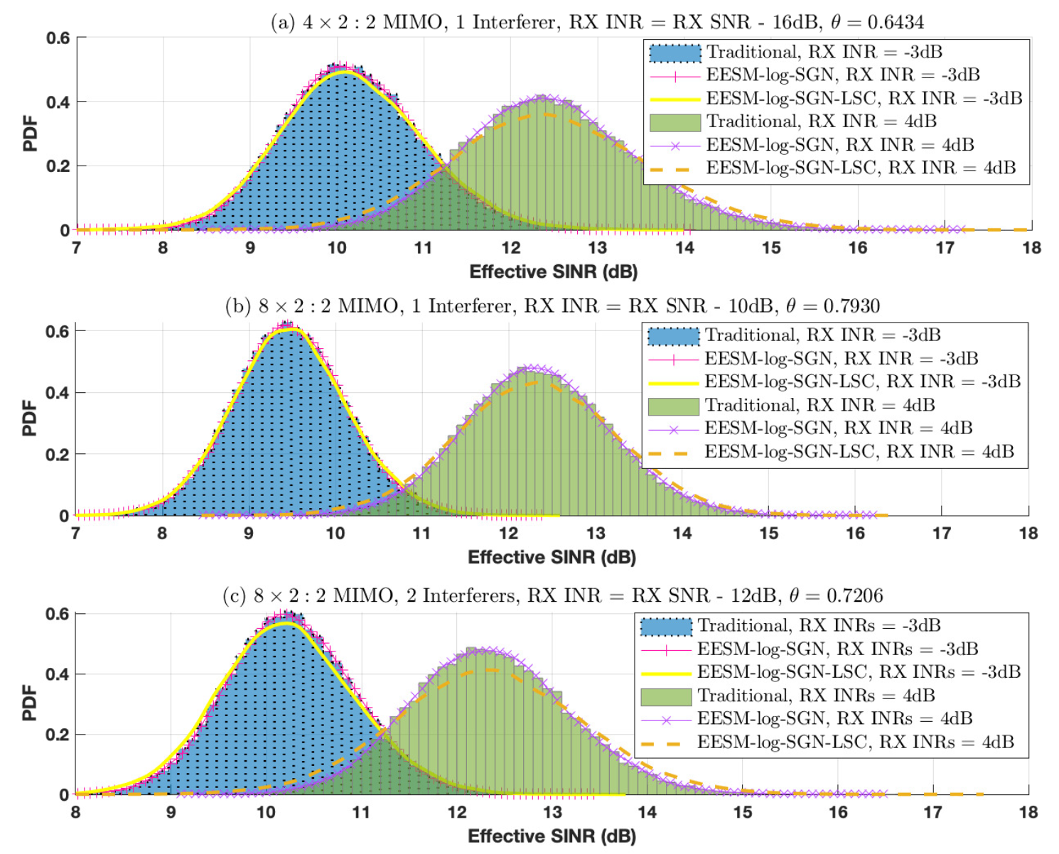
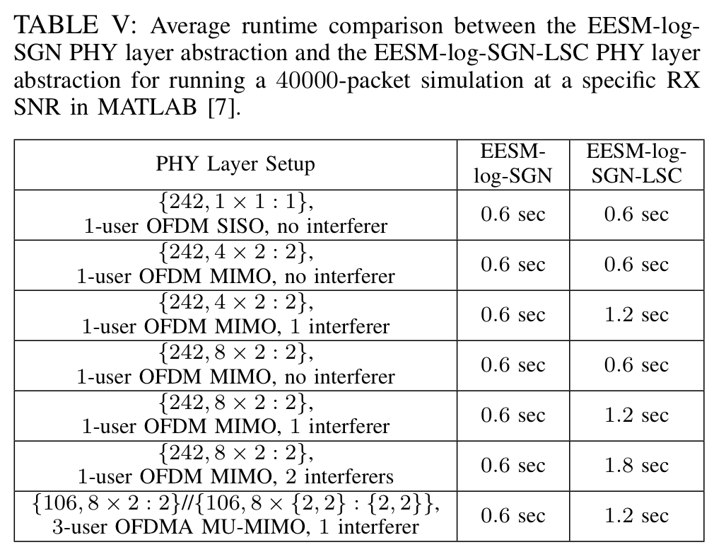
Storage-complexity aspects
Handling numerous interference setups: accuracy and runtime

Slide 91
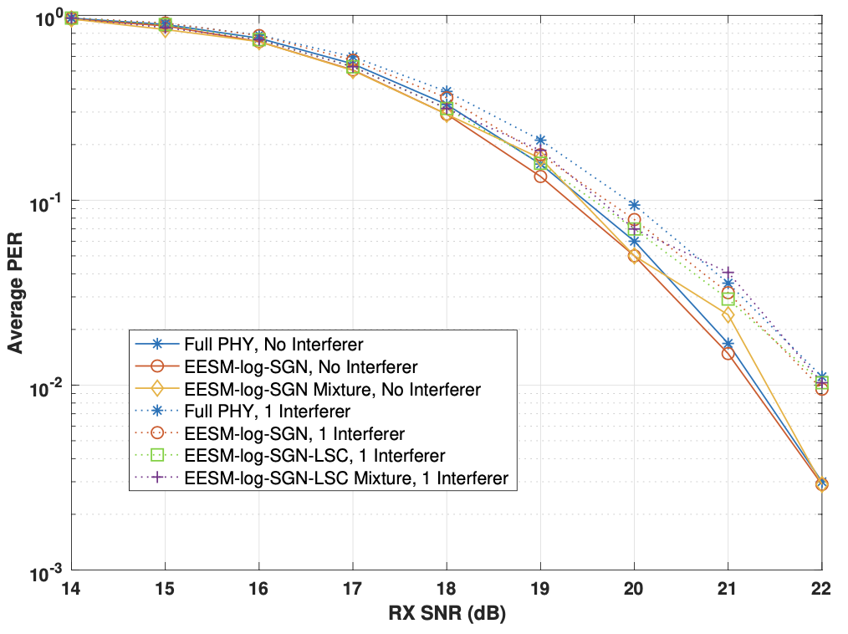
Average PER under of all proposed schemes
106 subcarriers, 8 × {2, 2} MU-MIMO with 2 streams/user, TGax channel model-D, MCS4,
the RX INR is 30dB lower than RX SNR

Slide 92
Conclusion
Under IID slow fading channel model, EESM-log-SGN models effective SINR distribution directly
EESM-log-SGN achieves good accuracy in modeling the PHY performance, while the runtime is insensitive to system dimensionality change and is small
Storage challenges for a wide RX SNR/INR range - effectively solved
Packet
Channel gain/effective SINR
Packet
Packet
Packet
Time

Slide 93
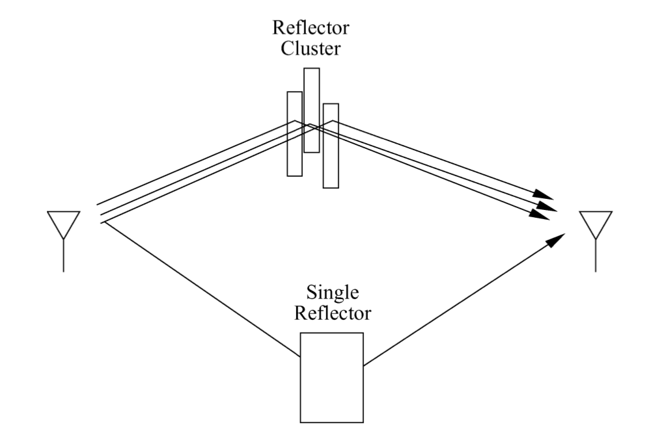
Multi-path Propagation

Slide 94
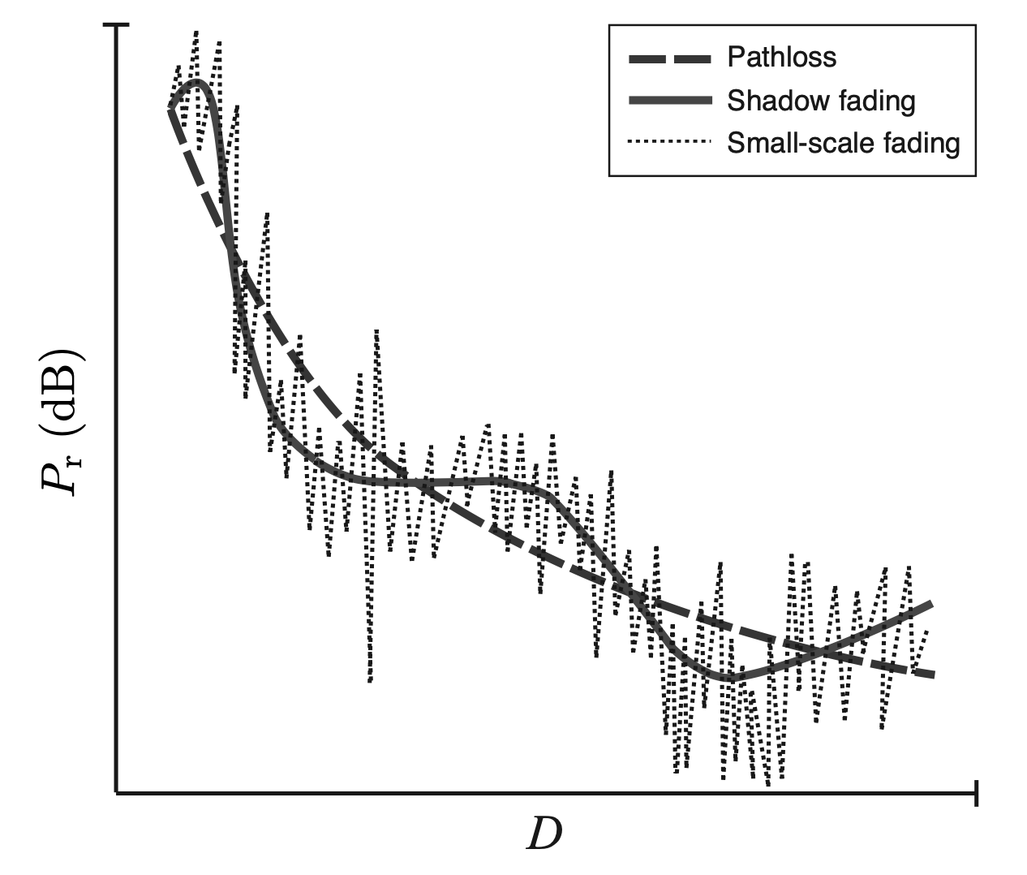
Fading
Received signal power VS. distance

Slide 95
Frequency-selective Channel
LOS
Frequency flat
LOS +
Frequency selective
multi-path NLOS

Slide 96
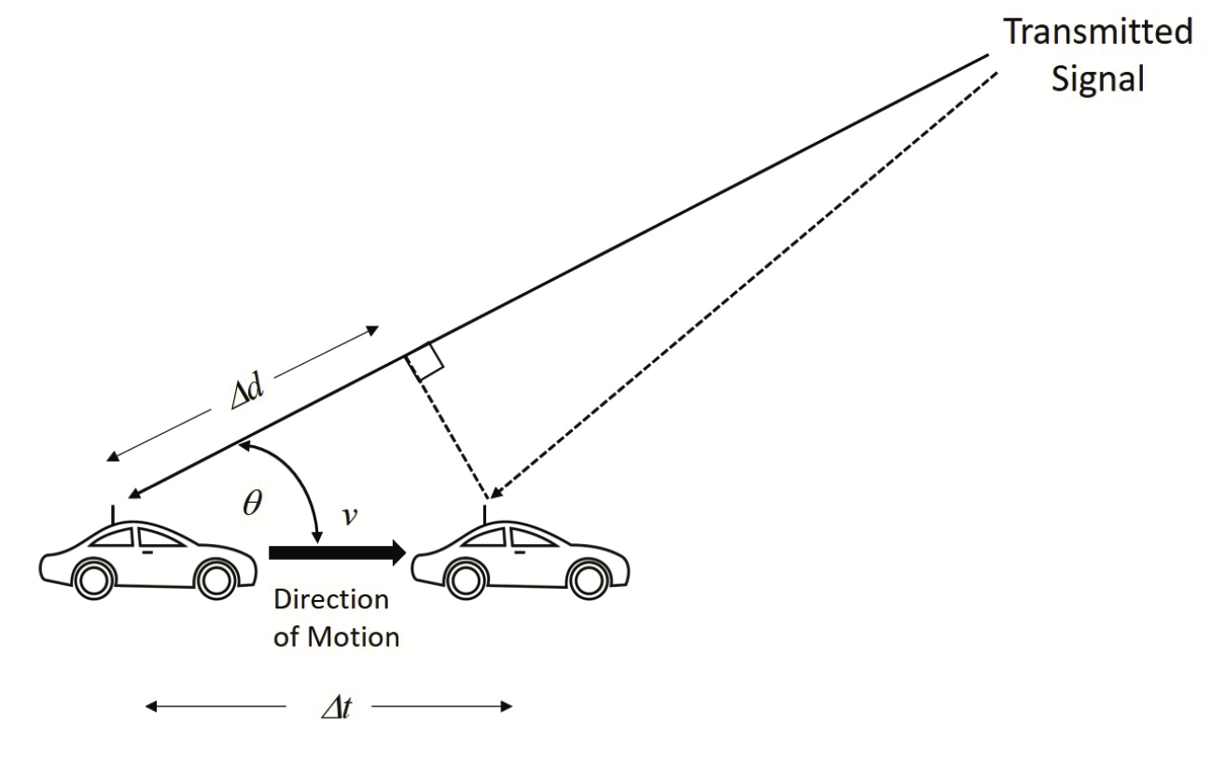
Time-varying Channel

Slide 97
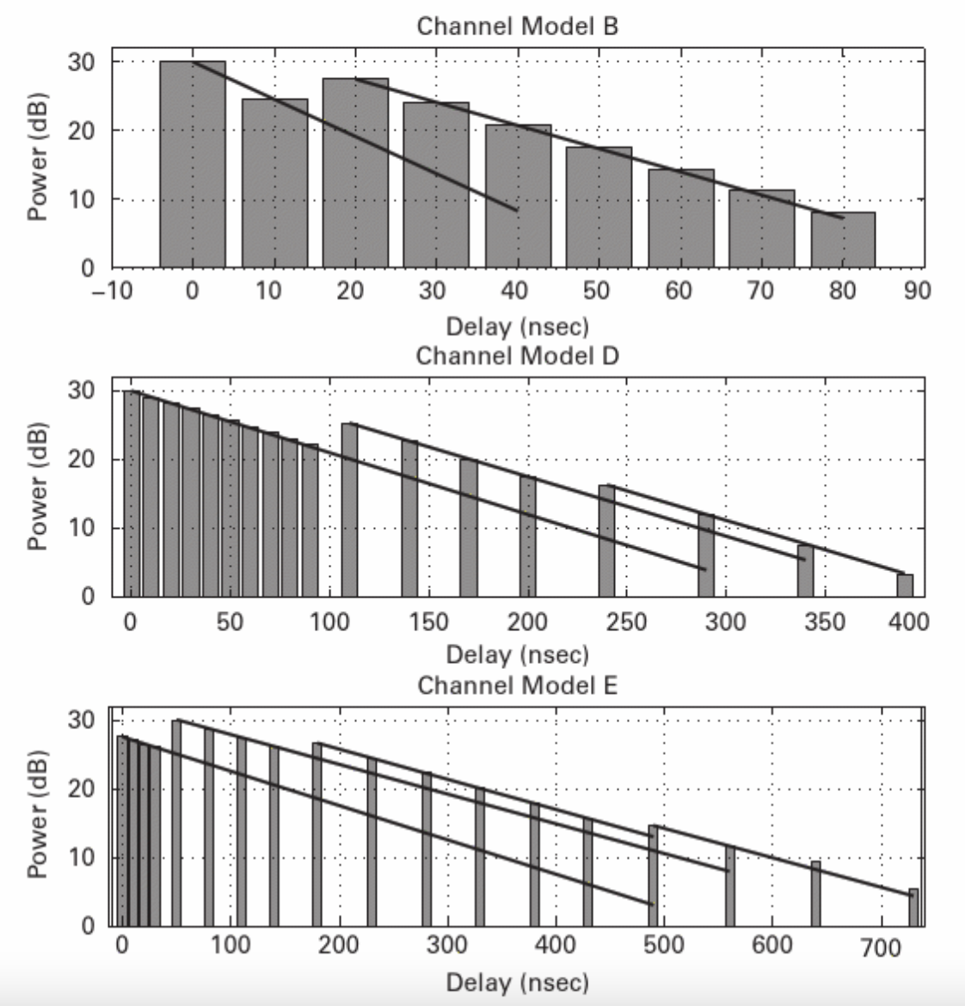
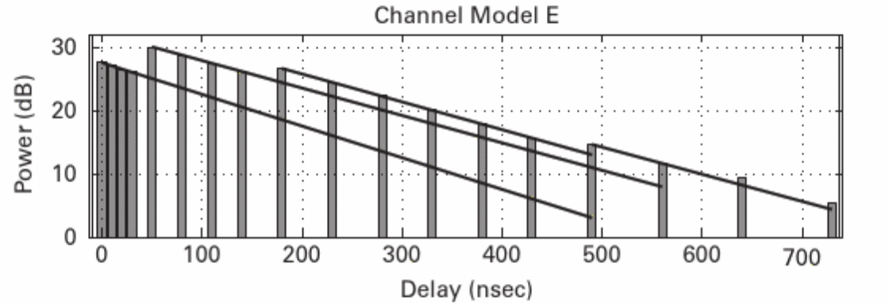
TGax Channel Models
TGax channel Models: A~F
Power Vs received multi-path signal delay

Slide 98
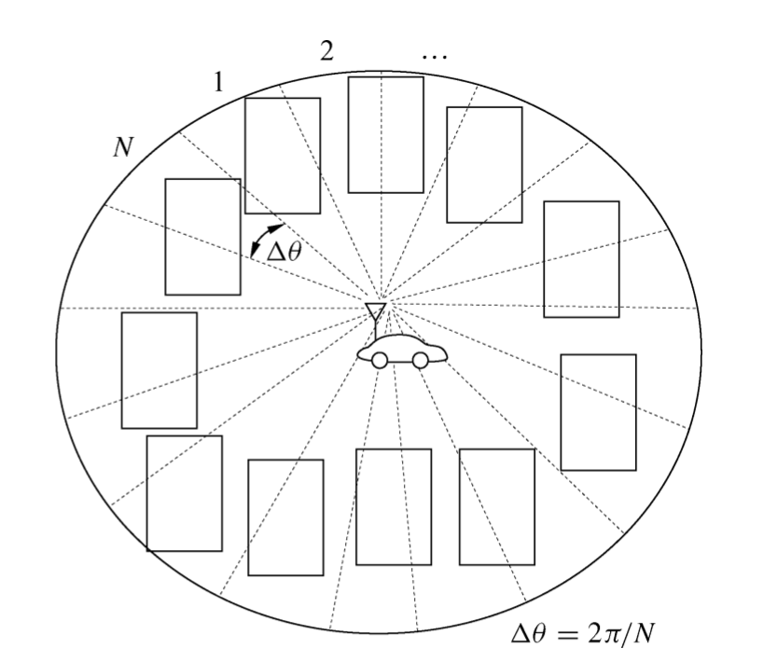
Jakes’ Model
Uniform scattering environment
Doppler spectrum

